Slide 1
Reconstruction

Slide 2
Perspective projection in rectified cameras
For rectified cameras, correspondence problem is easier
Only requires searching along a particular row.

Slide 3
Rectifying cameras
Given two images from two cameras with known relationship, can we rectify them?

Slide 4
Rectifying cameras
Can we rotate / translate cameras?
  Do we need to know the 3D structure of the world to do this?

Slide 5
Rotating cameras
Assume K is identity
Assume coordinate system at camera pinhole

Slide 6
Rotating cameras
Assume K is identity
Assume coordinate system at camera pinhole

Slide 7
Rotating cameras
What happens if the camera is rotated?

Slide 8
Rotating cameras
What happens if the camera is rotated?
No need to know the 3D structure
Rotation matrix
Homogenous coordinates of mapped pixel
Homogenous coordinates of original pixel

Slide 9
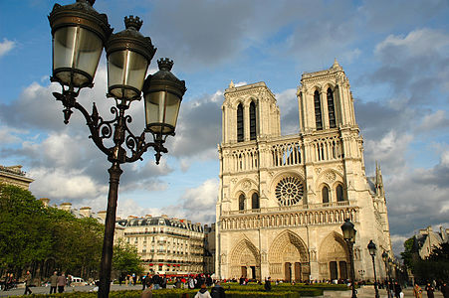
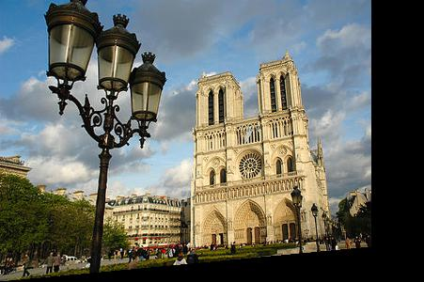
Rotating cameras

Slide 10
Rectifying cameras

Slide 11
Rectifying cameras

Slide 12
Rectifying cameras

Slide 13
Rectifying cameras

Slide 14
Perspective projection in rectified cameras
For rectified cameras, correspondence problem is easier
Only requires searching along a particular row.

Slide 15
Perspective projection in rectified cameras
What about non-rectified cameras?
Is there an equivalent?
For rectified cameras, correspondence problem is easier
Only requires searching along a particular row.

Slide 16
Epipolar constraint
Reduces 2D search problem to search along a particular line: epipolar line

Slide 17
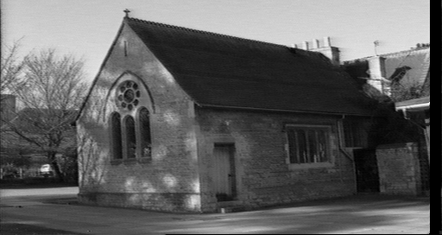
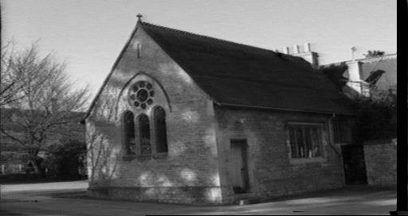
Epipolar constraint
True in general!
Given pixel (x,y) in one image, corresponding pixel in the other image must lie on a line
Line function of (x,y) and parameters of camera
These lines are called epipolar line

Slide 18
Epipolar geometry

Slide 19
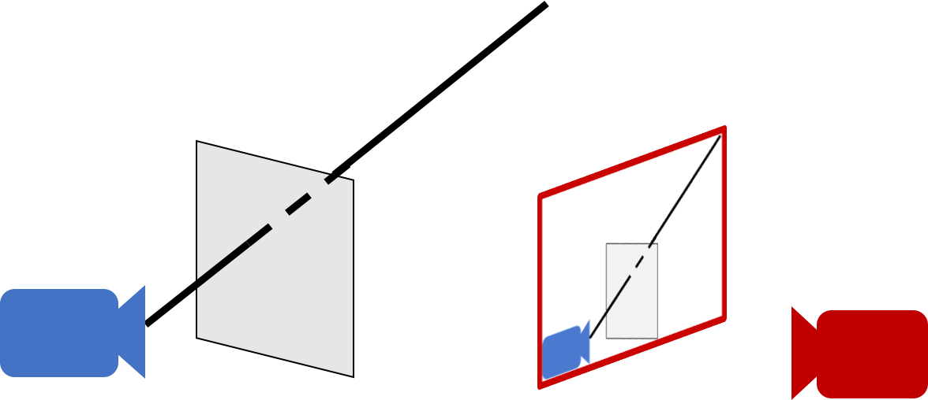
Epipolar geometry - why?
For a single camera, pixel in image plane must correspond to point somewhere along a ray

Slide 20
Epipolar geometry
When viewed in second image, this ray looks like a line: epipolar line
The epipolar line must pass through image of the first camera in the second image - epipole
Epipole
Epipolar line

Slide 21
Epipolar geometry
  Given an image point in one view, where is the corresponding point in the other view?
?
epipolar line
C
C
/
epipole
baseline
  A point in one view “generates” an epipolar line in the other view
  The corresponding point lies on this line

Slide 22
Epipolar line
Epipolar constraint
  Reduces correspondence problem to 1D search along an epipolar line

Slide 23
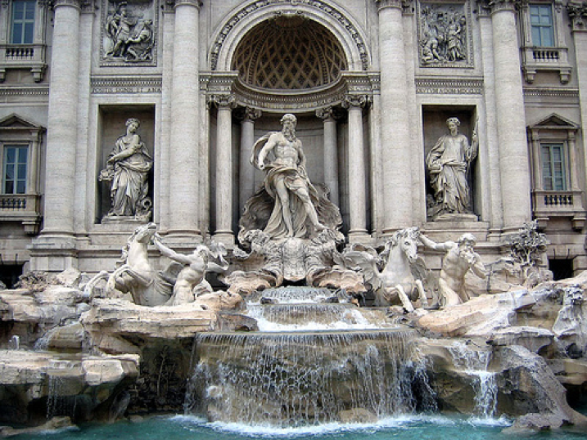
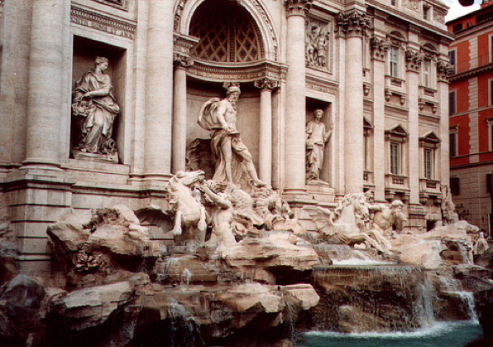
Epipolar lines

Slide 24
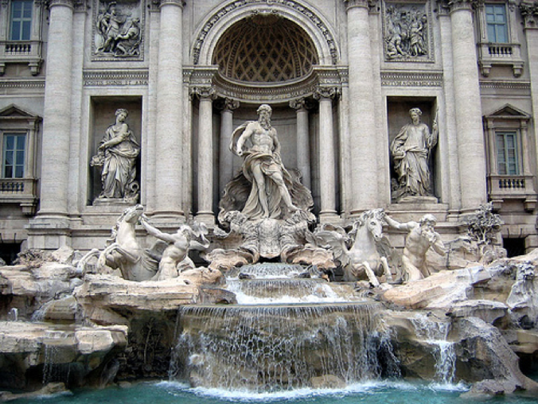
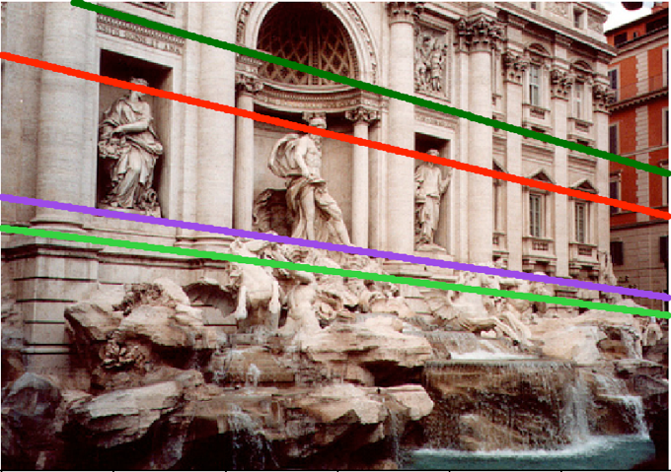
Epipolar lines

Slide 25

Epipolar lines
Epipole

Slide 26
Epipolar geometry continued
Epipolar geometry is a consequence of the coplanarity of the camera centres and scene point
X
x
x
/
C
C
/
The camera centres, corresponding points and scene point lie in a single plane, known as the epipolar plane

Slide 27
Nomenclature
X
l/
right epipolar line
left epipolar line
x
/
x
e
e
/
C
C
/
The epipolar line l/ is the image of the ray through x
The epipole e is the point of intersection of the line joining the camera centres with the image plane
  this line is the baseline for a stereo rig, and
  the translation vector for a moving camera
The epipole is the image of the centre of the other camera: e = PC/ , e/ = P/C

Slide 28
The epipolar pencil
X
e
/
e
baseline
As the position of the 3D point X varies, the epipolar planes “rotate” about the baseline. This family of planes is known as an epipolar pencil (a pencil is a one parameter family).
All epipolar lines intersect at the epipole.

Slide 29
The epipolar pencil
X
e
/
e
baseline
As the position of the 3D point X varies, the epipolar planes “rotate” about the baseline. This family of planes is known as an epipolar pencil (a pencil is a one parameter family).
All epipolar lines intersect at the epipole.

Slide 30
Epipolar geometry - the math
Assume intrinsic parameters K are identity
Assume world coordinate system is centered at 1st camera pinhole with Z along viewing direction

Slide 31
Epipolar geometry - the math
Assume intrinsic parameters K are identity
Assume world coordinate system is centered at 1st camera pinhole with Z along viewing direction

Slide 32
Epipolar geometry - the math
Assume intrinsic parameters K are identity
Assume world coordinate system is centered at 1st camera pinhole with Z along viewing direction

Slide 33
Epipolar geometry - the math
Assume intrinsic parameters K are identity
Assume world coordinate system is centered at 1st camera pinhole with Z along viewing direction

Slide 34
Epipolar geometry - the math
Assume intrinsic parameters K are identity
Assume world coordinate system is centered at 1st camera pinhole with Z along viewing direction

Slide 35
Epipolar geometry - the math
0
0

Slide 36
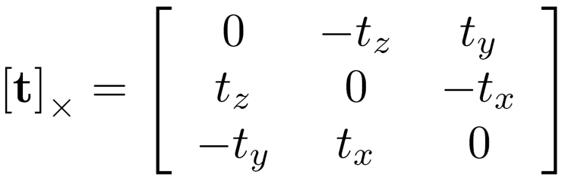
Epipolar geometry - the math
Can we write this as matrix vector operations?
Cross product can be written as a matrix

Slide 37
Epipolar geometry - the math
Can we write this as matrix vector operations?
Dot product can be written as a vector-vector times

Slide 38
Epipolar geometry - the math
Can we write this as matrix vector operations?
Dot product can be written as a vector-vector times

Slide 39
Epipolar geometry - the math

Slide 40
Epipolar geometry - the math
Homogenous coordinates of point in image 2
Homogenous coordinates of point in image 1
Essential matrix

Slide 41
Epipolar constraint and epipolar lines
Consider a known, fixed pixel in the first image
What constraint does this place on the corresponding pixel?
where
What kind of equation is this?

Slide 42
Epipolar constraint and epipolar lines
Consider a known, fixed pixel in the first image
where
Line!

Slide 43
Epipolar constraint: putting it all together
If p is a pixel in first image and q is the corresponding pixel in the second image, then:
q^{T}Ep = 0
E = [t]_{X}R
For fixed p, q must satisfy:
q^{T}l = 0, where l = Ep
For fixed q, p must satisfy:
l^{T}p = 0 where l^{T} = q^{T}E, or l = E^{t}q
These are epipolar lines!
Epipolar line in 2nd image
Epipolar line in 1st image

Slide 44
Essential matrix and epipoles
E = [t]_{X}R
Ep is an epipolar line in 2nd image
All epipolar lines in second image pass through c₂
c₂ is epipole in 2nd image

Slide 45
Essential matrix and epipoles
E = [t]_{X}R
E^{T}q is an epipolar line in 1st image
All epipolar lines in first image pass through c₁
c₁ is the epipole in 1st image

Slide 46
Epipolar geometry - the math
We assumed that intrinsic parameters K are identity
What if they are not?

Slide 47
Fundamental matrix

Slide 48
Fundamental matrix

Slide 49
Fundamental matrix

Slide 50
Fundamental matrix

Slide 51
Fundamental matrix
Fundamental matrix

Slide 52
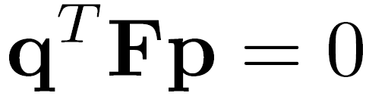

Fundamental matrix result

Slide 53


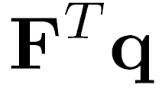



Properties of the Fundamental Matrix
is the epipolar line associated with
is the epipolar line associated with
T
0
Notes:
5 parameters

Slide 54
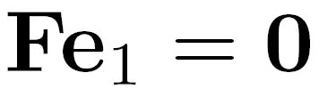
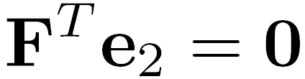
Properties of the Fundamental Matrix
is the epipolar line associated with
is the epipolar line associated with
and
All epipolar lines contain epipole
T
0
Notes:
5 parameters

Slide 55

Properties of the Fundamental Matrix
is the epipolar line associated with
is the epipolar line associated with
and
is rank 2
T
0
Notes:
Prove that F is rank 2. F

Slide 56
Why is F rank 2?
F is a 3 x 3 matrix
But there is a vector c₁ and c₂ such that Fc₁ = 0 and F^{T}c₂ = 0

Slide 57


Estimating F
If we don’t know K₁, K₂, R, or t, can we estimate F for two images?
Yes, given enough correspondences

Slide 58
Estimating F – 8-point algorithm
The fundamental matrix F is defined by
for any pair of matches x and x’ in two images.
Let x=(u,v,1)^{T} and x’=(u’,v’,1)^{T},
each match gives a linear equation

Slide 59
8-point algorithm
In reality, instead of solving , we seek f to minimize , least eigenvector of .

Slide 60
8-point algorithm – Problem?
F should have rank 2
To enforce that F is of rank 2, F is replaced by F’ that minimizes subject to the rank constraint.
This is achieved by SVD. Let , where
, let
then is the solution.
Notes:
The problem is that the resulting often is ill-conditioned. In theory, should have one singular value equal to zero and the rest are non-zero. In practice, however, some of the non-zero singular values can become small relative to the larger ones. If more than eight corresponding points are used to construct , where the coordinates are only approximately correct, there may not be a well-defined singular value which can be identified as approximately zero. Consequently, the solution of the homogeneous linear system of equations may not be sufficiently accurate to be useful.

Slide 61
Recovering camera parameters from F / E
Can we recover R and t between the cameras from F?
No: K₁ and K₂ are in principle arbitrary matrices
What if we knew K₁ and K₂ to be identity?

Slide 62
Recovering camera parameters from E
t is a solution to E^{T}x = 0
Can’t distinguish between t and ct for constant scalar c
How do we recover R?

Slide 63
Recovering camera parameters from E
We know E and t
Consider taking SVD of E and [t]_{X}

Slide 64
Recovering camera parameters from E
t is a solution to E^{T}x = 0
Can’t distinguish between t and ct for constant scalar c

Slide 65
8-point algorithm
Pros: it is linear, easy to implement and fast
Cons: susceptible to noise
Degenerate: if points are on same plane
Normalized 8-point algorithm: Hartley
  Position origin at centroid of image points
  Rescale coordinates so that center to farthest point is sqrt (2)

Slide 66
Discussion

Slide 67
Correspondence-free reconstruction
Stereo algorithms depend on correspondences
What if we don’t have correspondences?
Photometric consistency
  Given a candidate 3D point project it into each camera
  If color matches, photometric consistent
Optimize a candidate shape till it becomes consistent

