Slide 1
Reconstruction

Slide 2
Perspective projection
Y
Y’
Z
O
O’
X’
X
Z’

Slide 3
Final perspective projection
Camera extrinsics: where your camera is relative to the world. Changes if you move the camera
Camera intrinsics: how your camera handles pixel. Changes if you change your camera

Slide 4
Final perspective projection
Camera parameters

Slide 5
Camera calibration
Goal: find the parameters of the camera
Why?
Tells you where the camera is relative to the world/particular objects
Equivalently, tells you where objects are relative to the camera
Can allow you to ”render” new objects into the scene

Slide 6
Camera calibration
Need to estimate P
How many parameters does P have?
Size of P : 3 x 4
But:
P can only be known upto a scale
3*4 - 1 = 11 parameters

Slide 7
Camera calibration
Suppose we know that (X,Y,Z) in the world projects to (x,y) in the image.
How many equations does this provide?
Need to convert equivalence into equality.

Slide 8
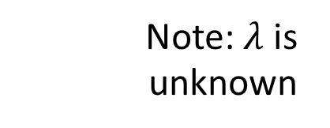
Camera calibration
Suppose we know that (X,Y,Z) in the world projects to (x,y) in the image.
How many equations does this provide?
Note: $λ$ is unknown

Slide 9
Camera calibration
Suppose we know that (X,Y,Z) in the world projects to (x,y) in the image.
How many equations does this provide?

Slide 10
Camera calibration
Suppose we know that (X,Y,Z) in the world projects to (x,y) in the image.
How many equations does this provide?

Slide 11
Camera calibration
Suppose we know that (X,Y,Z) in the world projects to (x,y) in the image.
How many equations does this provide?
2 equations!
Are the equations linear in the parameters?
How many equations do we need?

Slide 12
Camera calibration
In matrix vector form: Ap = 0
6 points give 12 equations, 12 variables to solve for
But can only solve upto scale

Slide 13
Camera calibration
In matrix vector form: Ap = 0
We want non-trivial solutions
If p is a solution, $α$p is a solution too
Let’s just search for a solution with unit norm
How do you solve this?
s.t

Slide 14
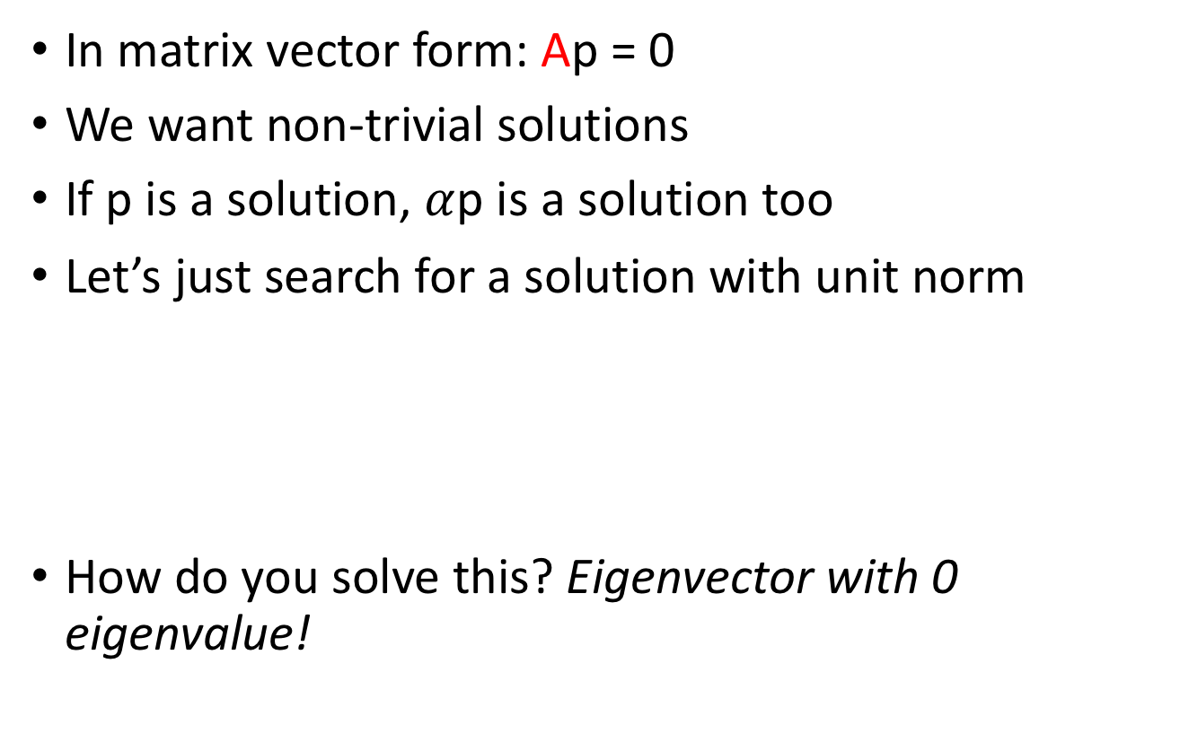
Camera calibration
In matrix vector form: Ap = 0
We want non-trivial solutions
If p is a solution, $α$p is a solution too
Let’s just search for a solution with unit norm
How do you solve this? Eigenvector with 0 eigenvalue!
s.t

Slide 15
Camera calibration
We need 6 world points for which we know image locations
Would any 6 points work?
What if all 6 points are the same?
Need at least 6 non-coplanar points!

Slide 16
Camera calibration
How do we get K, R and t from P?
Need to make some assumptions about K
What if K is upper triangular?
Added skew if image x and y axes are not perpendicular

Slide 17
Camera calibration
How do we get K, R and t from P?
Need to make some assumptions about K
What if K is upper triangular?
P = K [ R t]
First 3 x 3 matrix of P is KR
“RQ” decomposition: decomposes an n x n matrix into product of upper triangular and rotation matrix

Slide 18
Camera calibration
How do we get K, R and t from P?
Need to make some assumptions about K
What if K is upper triangular?
P = K [ R t]
First 3 x 3 matrix of P is KR
“RQ” decomposition: decomposes an n x n matrix into product of upper triangular and rotation matrix
t = K⁻¹P[:,2] ← last column of P

Slide 19
Camera calibration and pose estimation

Slide 20
Final perspective projection
Can we recover this from just a single equation?

Slide 21
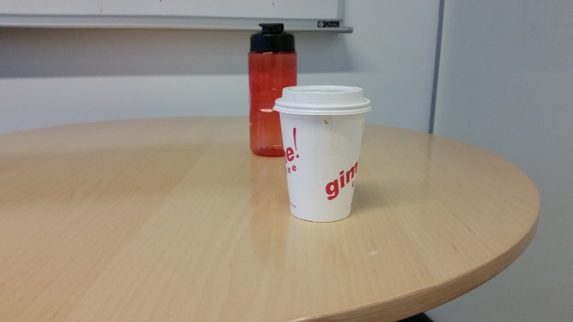
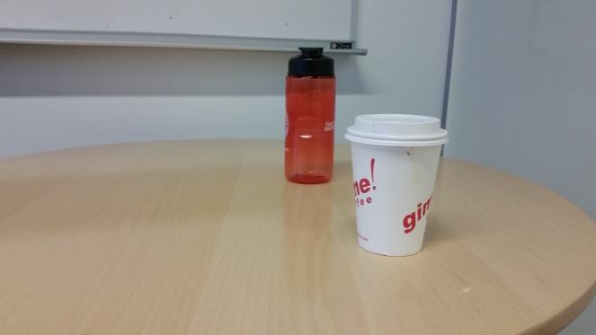
Triangulation
Suppose we have two cameras
Calibrated: parameters known
And a pair of corresponding pixels
Find 3D location of point!

Slide 22
Triangulation
Suppose we have two cameras
Calibrated: parameters known
And a pair of corresponding pixels
Find 3D location of point!
(x₁,y₁)
(x₂,y₂)

Slide 23
Triangulation

Slide 24
Triangulation

Slide 25
Triangulation
1 image gives 2 equations
Need 2 images!
Solve linear equations to get 3D point location

Slide 26
Linear vs non-linear optimization

Slide 27
Linear vs non-linear optimization
Reprojection error

Slide 28
Linear vs non-linear optimization
Reprojection error
Reprojection error is the squared error between the true image coordinates of a point and the projected coordinates of hypothesized 3D point
Actual error we care about
Minimize total sum of reprojection error across all images
Non-linear optimization

Slide 29
Fitting in general
Fitting: find the parameters of a model that best fit the data
Other examples:
least squares linear regression

Slide 30
Least squares: linear regression
(y_{i}, x_{i})
y = mx + b

Slide 31
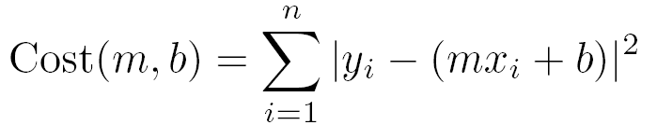
Linear regression
residual error

Slide 32
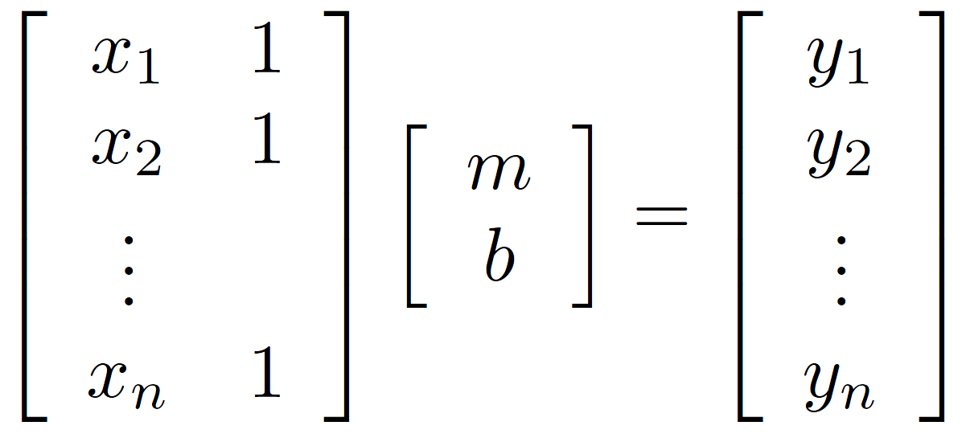
Linear regression

Slide 33
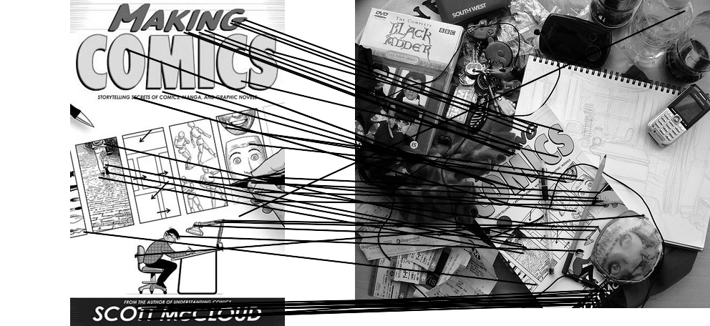
Outliers
outliers
inliers

Slide 34
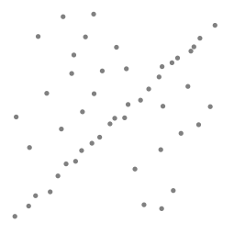
Robustness
Problem: Fit a line to these datapoints
Least squares fit

Slide 35
Idea
Given a hypothesized line
Count the number of points that “agree” with the line
“Agree” = within a small distance of the line
I.e., the inliers to that line
For all possible lines, select the one with the largest number of inliers

Slide 36
Counting inliers

Slide 37
Counting inliers
Inliers: 3

Slide 38
Counting inliers
Inliers: 20

Slide 39
How do we find the best line?
Unlike least-squares, no simple closed-form solution
Hypothesize-and-test
Try out many lines, keep the best one
Which lines?

Slide 40
RANSAC (Random Sample Consensus)
Line fitting example
Algorithm:
Sample (randomly) the number of points required to fit the model (#=2)
Solve for model parameters using samples
Score by the fraction of inliers within a preset threshold of the model
Repeat 1-3 until the best model is found with high confidence
Illustration by Savarese
Notes:
Let me give you an intuition of what is going on. Suppose we have the standard line fitting problem in presence of outliers.
We can formulate this problem as follows: want to find the best partition of points in inlier set and outlier set such that…
The objective consists of adjusting the parameters of a model function so as to best fit a data set.
"best" is defined by a function f that needs to be minimized.
Such that the best parameter of fitting the line give rise to a residual error lower that delta
as when the sum, S, of squared residuals

Slide 41
RANSAC
Line fitting example
Algorithm:
Sample (randomly) the number of points required to fit the model (#=2)
Solve for model parameters using samples
Score by the fraction of inliers within a preset threshold of the model
Repeat 1-3 until the best model is found with high confidence
Notes:
Let me give you an intuition of what is going on. Suppose we have the standard line fitting problem in presence of outliers.
We can formulate this problem as follows: want to find the best partition of points in inlier set and outlier set such that…
The objective consists of adjusting the parameters of a model function so as to best fit a data set.
"best" is defined by a function f that needs to be minimized.
Such that the best parameter of fitting the line give rise to a residual error lower that delta
as when the sum, S, of squared residuals

Slide 42
RANSAC
Line fitting example
Algorithm:
Sample (randomly) the number of points required to fit the model (#=2)
Solve for model parameters using samples
Score by the fraction of inliers within a preset threshold of the model
Repeat 1-3 until the best model is found with high confidence
Notes:
Let me give you an intuition of what is going on. Suppose we have the standard line fitting problem in presence of outliers.
We can formulate this problem as follows: want to find the best partition of points in inlier set and outlier set such that…
The objective consists of adjusting the parameters of a model function so as to best fit a data set.
"best" is defined by a function f that needs to be minimized.
Such that the best parameter of fitting the line give rise to a residual error lower that delta
as when the sum, S, of squared residuals

Slide 43
RANSAC
Algorithm:
Sample (randomly) the number of points required to fit the model (#=2)
Solve for model parameters using samples
Score by the fraction of inliers within a preset threshold of the model
Repeat 1-3 until the best model is found with high confidence
Notes:
Let me give you an intuition of what is going on. Suppose we have the standard line fitting problem in presence of outliers.
We can formulate this problem as follows: want to find the best partition of points in inlier set and outlier set such that…
The objective consists of adjusting the parameters of a model function so as to best fit a data set.
"best" is defined by a function f that needs to be minimized.
Such that the best parameter of fitting the line give rise to a residual error lower that delta
as when the sum, S, of squared residuals

Slide 44
RANSAC
Idea:
All the inliers will agree with each other on the translation vector; the (hopefully small) number of outliers will (hopefully) disagree with each other
RANSAC only has guarantees if there are < 50% outliers
“All good matches are alike; every bad match is bad in its own way.”
– Tolstoy via Alyosha Efros

Slide 45
RANSAC
Inlier threshold related to the amount of noise we expect in inliers
Often model noise as Gaussian with some standard deviation (e.g., 3 pixels)
Number of rounds related to the percentage of outliers we expect, and the probability of success we’d like to guarantee
Suppose there are 20% outliers, and we want to find the correct answer with 99% probability
How many rounds do we need?

Slide 46
How many rounds?
If we have to choose k samples each time
with an inlier ratio p
and we want the right answer with probability P
 | proportion of inliers p
k | 95% | 90% | 80% | 75% | 70% | 60% | 50%
2 | 2 | 3 | 5 | 6 | 7 | 11 | 17
3 | 3 | 4 | 7 | 9 | 11 | 19 | 35
4 | 3 | 5 | 9 | 13 | 17 | 34 | 72
5 | 4 | 6 | 12 | 17 | 26 | 57 | 146
6 | 4 | 7 | 16 | 24 | 37 | 97 | 293
7 | 4 | 8 | 20 | 33 | 54 | 163 | 588
8 | 5 | 9 | 26 | 44 | 78 | 272 | 1177
P = 0.99
Source: M. Pollefeys

Slide 47
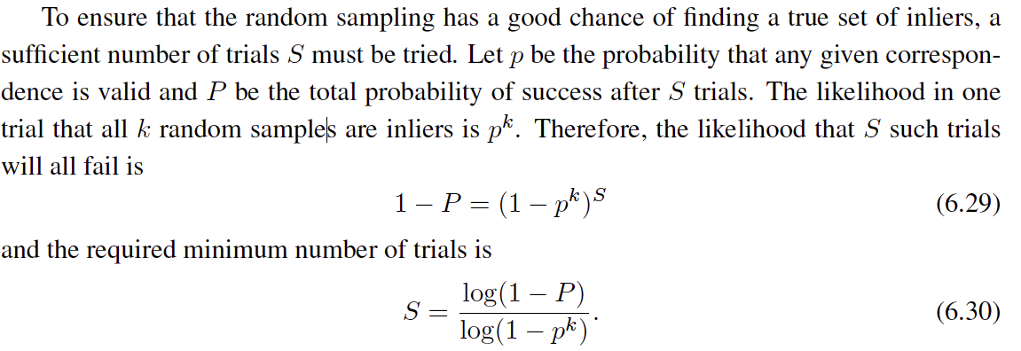
 | proportion of inliers p
k | 95% | 90% | 80% | 75% | 70% | 60% | 50%
2 | 2 | 3 | 5 | 6 | 7 | 11 | 17
3 | 3 | 4 | 7 | 9 | 11 | 19 | 35
4 | 3 | 5 | 9 | 13 | 17 | 34 | 72
5 | 4 | 6 | 12 | 17 | 26 | 57 | 146
6 | 4 | 7 | 16 | 24 | 37 | 97 | 293
7 | 4 | 8 | 20 | 33 | 54 | 163 | 588
8 | 5 | 9 | 26 | 44 | 78 | 272 | 1177
P = 0.99
Notes:
(1-(1-e)^s)^N = 1-p
(1-e)^s = all fail = 1-P

Slide 48
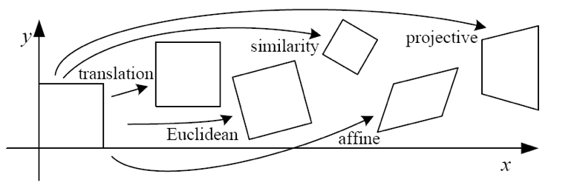
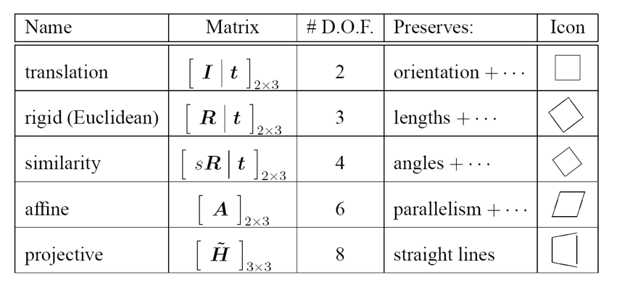
How big is k?
For alignment, depends on the motion model
Here, each sample is a correspondence (pair of matching points)

Slide 49
RANSAC pros and cons
Pros
Simple and general
Applicable to many different problems
Often works well in practice
Cons
Parameters to tune
Sometimes too many iterations are required
Can fail for extremely low inlier ratios

Slide 50
RANSAC
An example of a “voting”-based fitting scheme
Each hypothesis gets voted on by each data point, best hypothesis wins
There are many other types of voting schemes
E.g., Hough transforms…

Slide 51
Triangulation
Suppose we have two cameras
Calibrated: parameters known
And a pair of corresponding pixels
Find 3D location of point!
(x₁,y₁)
(x₂,y₂)

Slide 52
Binocular stereo
Given two calibrated cameras
Find pairs of corresponding pixels
Use corresponding image locations to set up equations on world coordinates
Solve!

Slide 53
Binocular stereo
General case: cameras can be arbitrary locations and orientations

Slide 54
Binocular stereo
Special case: cameras are parallel to each other and translated along X axis
X axis
Z axis

Slide 55
Stereo with rectified cameras
Special case: cameras are parallel to each other and translated along X axis
X axis
Z axis

Slide 56
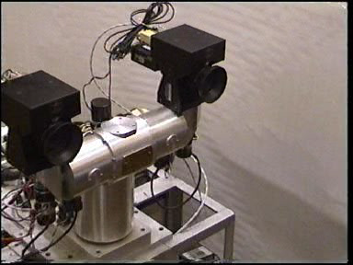
Stereo head
Kinect / depth cameras

Slide 57
Stereo with “rectified cameras”

Slide 58
Perspective projection in rectified cameras
Without loss of generality, assume origin is at pinhole of 1st camera

Slide 59
Perspective projection in rectified cameras
Without loss of generality, assume origin is at pinhole of 1st camera

Slide 60
Perspective projection in rectified cameras
Without loss of generality, assume origin is at pinhole of 1st camera

Slide 61
Perspective projection in rectified cameras
Without loss of generality, assume origin is at pinhole of 1st camera

Slide 62
Perspective projection in rectified cameras
Without loss of generality, assume origin is at pinhole of 1st camera

Slide 63
Perspective projection in rectified cameras
Without loss of generality, assume origin is at pinhole of 1st camera

Slide 64
Perspective projection in rectified cameras
Without loss of generality, assume origin is at pinhole of 1st camera

Slide 65
Perspective projection in rectified cameras
Without loss of generality, assume origin is at pinhole of 1st camera
X coordinate differs by t_{x}/Z
Y coordinate is the same!

Slide 66
Perspective projection in rectified cameras
X coordinate differs by t_{x}/Z
That is, difference in X coordinate is inversely proportional to depth
Difference in X coordinate is called disparity
Translation between cameras (tx) is called baseline
disparity = baseline / depth

Slide 67
The disparity image
For pixel (x,y) in one image, only need to know disparity to get correspondence
Create an image with color at (x,y) = disparity
right image
disparity
left image

Slide 68
Perspective projection in rectified cameras
For rectified cameras, correspondence problem is easier
Only requires searching along a particular row.

Slide 69
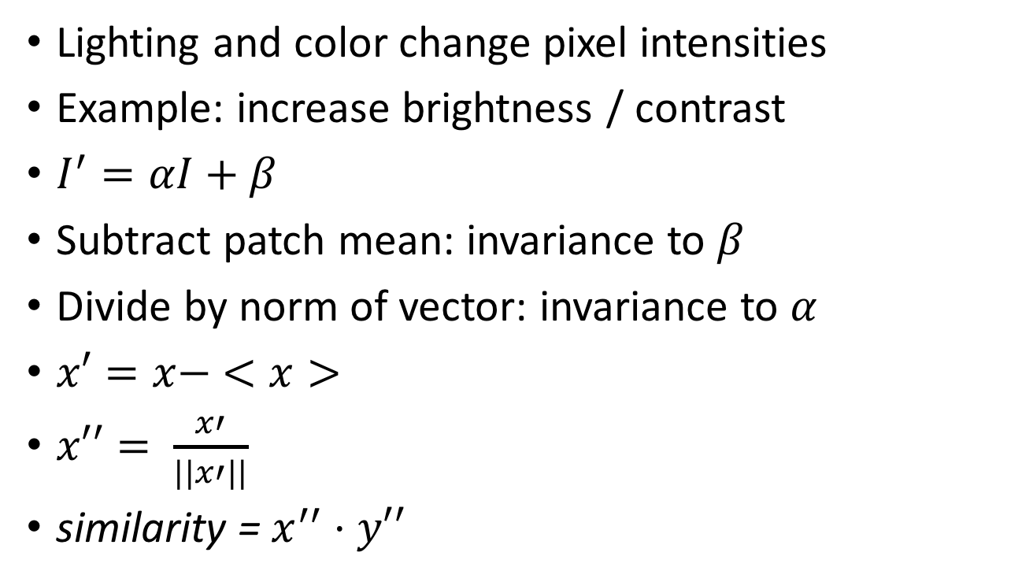
NCC - Normalized Cross Correlation
Lighting and color change pixel intensities
Example: increase brightness / contrast
$I^{′}=αI+β$
Subtract patch mean: invariance to $β$
Divide by norm of vector: invariance to $α$
$x′=x− <x>$
$x′′= \frac{x′}{||x′||}$
similarity = $x^{′′}⋅y′′$

Slide 70
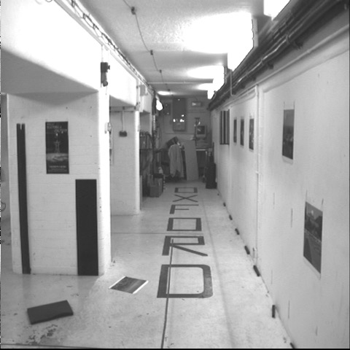
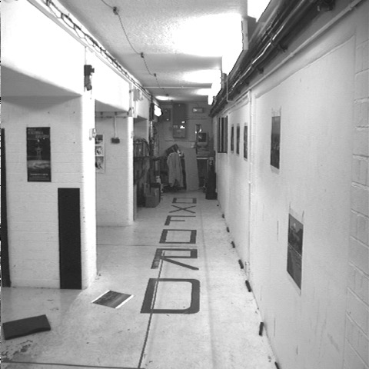


Cross-correlation of neighborhood
translate so that mean is zero

Slide 71

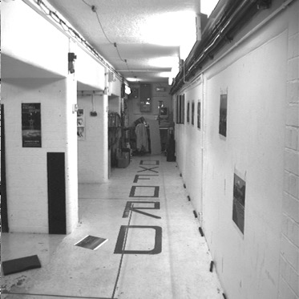
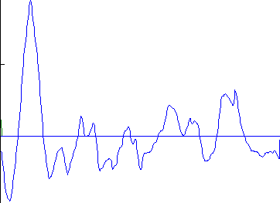
left image band
right image band
1
0.5
cross correlation
0
x

Slide 72
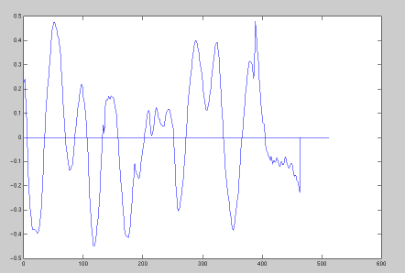
target region
left image band
right image band
1
0.5
cross correlation
0
x

Slide 73
The NCC cost volume
Consider M x N image
Suppose there are D possible disparities.
For every pixel, D possible scores
Can be written as an M x N x D array
To get disparity, take max along 3rd axis

Slide 74
Computing the NCC volume
For every pixel (x, y)
For every disparity d
Get normalized patch from image 1 at (x, y)
Get normalized patch from image 2 at (x + d, y)
Compute NCC

Slide 75
Computing the NCC volume
For every disparity d
For every pixel (x, y)
Get normalized patch from image 1 at (x, y)
Get normalized patch from image 2 at (x + d, y)
Compute NCC
Assume all pixels lie at same disparity d (i.e., lie on same plane) and compute cost for each
Plane sweep stereo

Slide 76
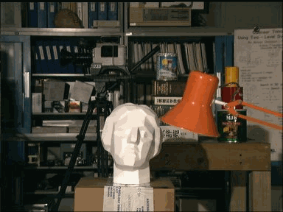
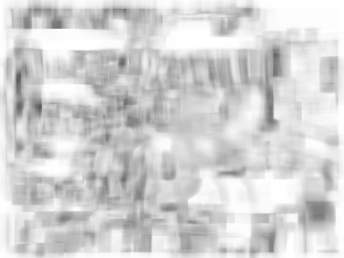
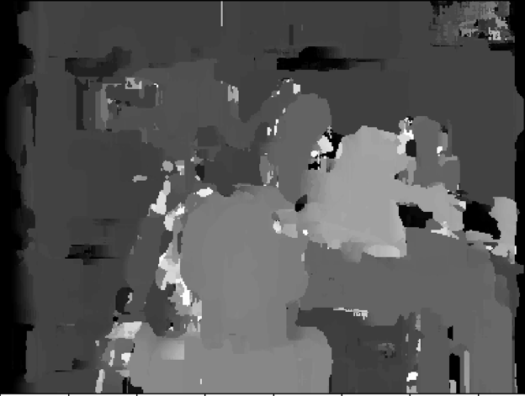

Slide 77
A similar special case
Fixating camera system
Eyes fixate on object
Angle at which they merge proportional to inverse depth
b
Z
a

Slide 78
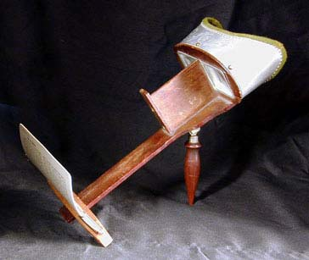
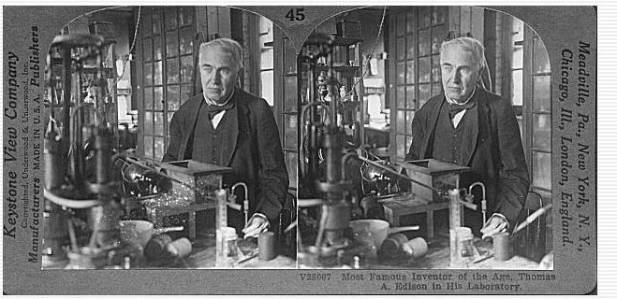
Stereograms
Invented by Sir Charles Wheatstone, 1838

Slide 79
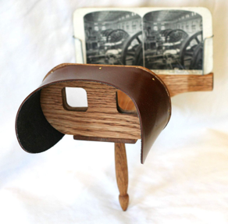
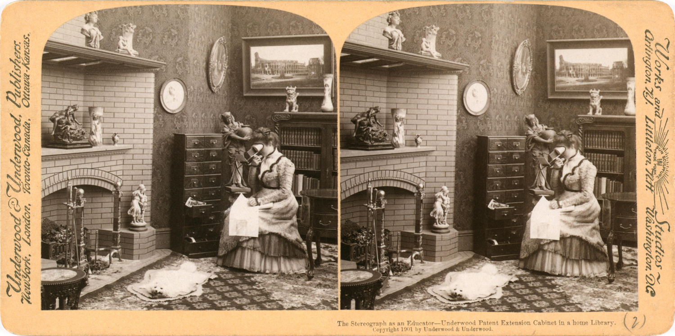

Slide 80
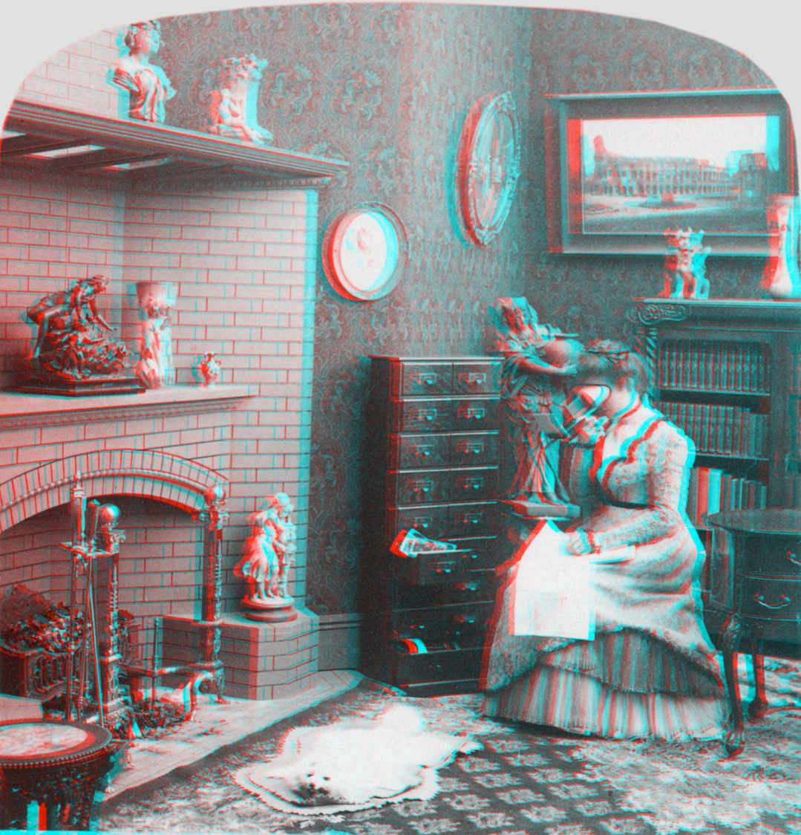
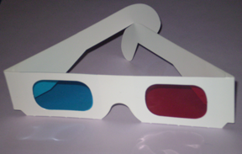
Notes:
Stereo monochrome image anaglyphed for red (left eye) and cyan (right eye) filters. 3D red cyan glasses are recommended to view this image correctly.

Slide 81
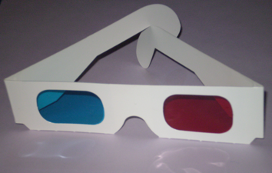
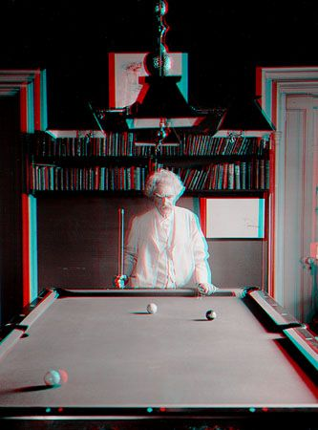
Mark Twain at Pool Table", no date, UCR Museum of Photography
Notes:
Special stereo viewer

Slide 82
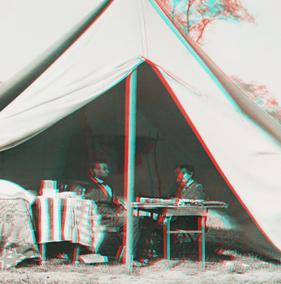
Notes:
Abraham Lincoln and General George McClellan in the generals tent near Antietam battlefield October 3, 1862

