Slide 1
Image resizing

Slide 2
Image resizing

Slide 3
What is a (digital) image?
True image is a function from R² to R
Digital image is a sample from it
1D example:

Slide 4
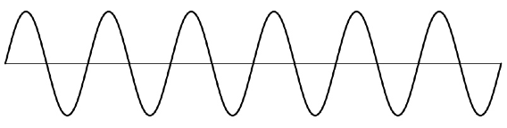
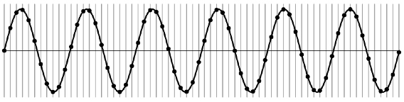
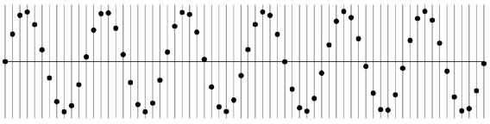
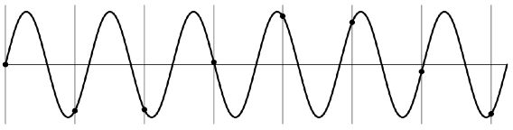
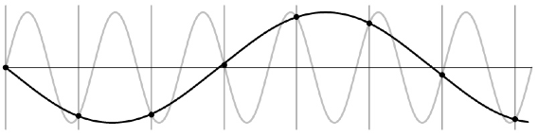
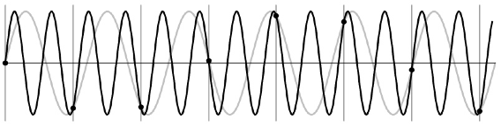
Undersampling
© Kavita Bala, Computer Science, Cornell University

Slide 5
Undersampling
What if we “missed” things between the samples?
Simple example: undersampling a sine wave
  unsurprising result: information is lost
  surprising result: indistinguishable from lower frequency
  also was always indistinguishable from higher frequencies
  aliasing: signals “traveling in disguise” as other frequencies

Slide 6
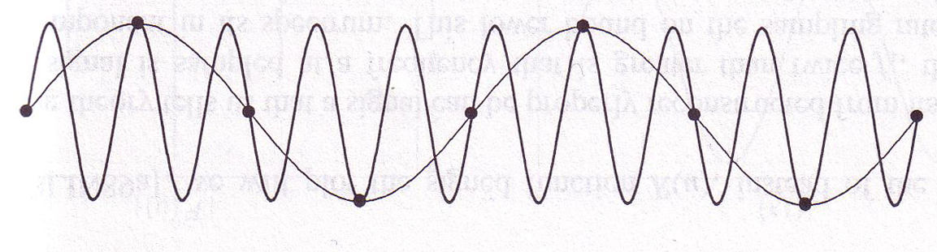
Aliasing
When sampling is not adequate, impossible to distinguish between low and high frequency signal
© Kavita Bala, Computer Science, Cornell University

Slide 7
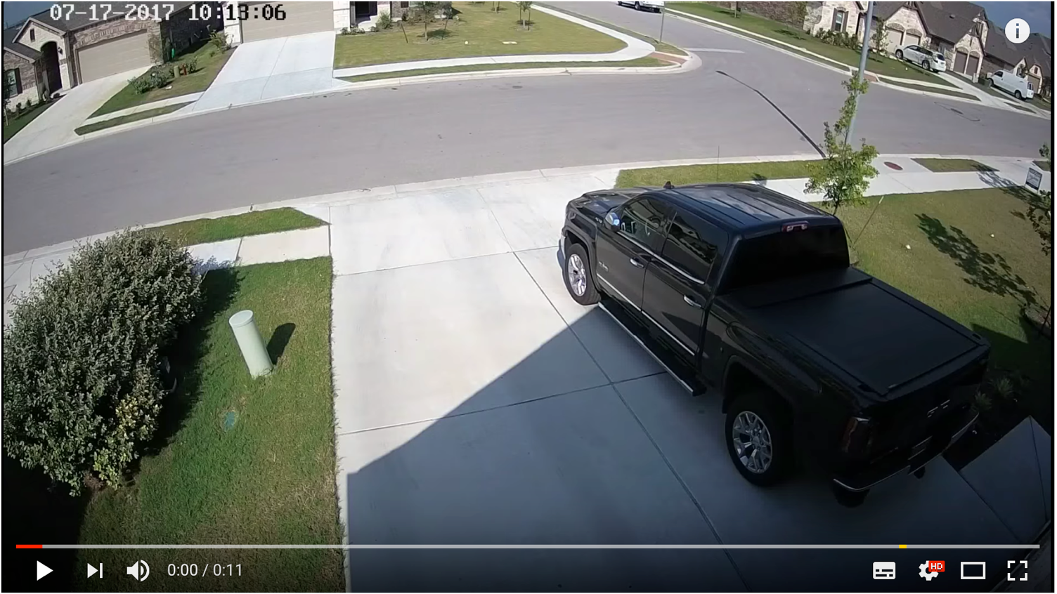
Aliasing in time

Slide 8






Beyond sines and cosines
High frequency components
Images are not sines and cosines
But they can be written as a sum of sines and cosines (Fourier Transform)
= 30*
+ 0.5*
-
+ 100*
+10*

Slide 9
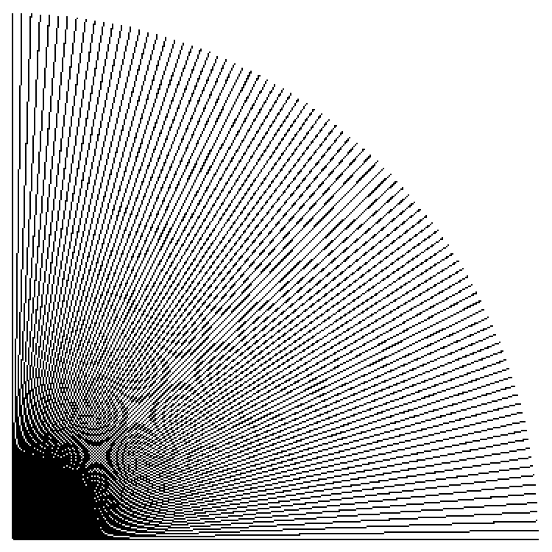
Point sampling
in action
Cornell CS4620 Fall 2015 • Lecture 23

Slide 10
Aliasing
High frequency components when downsampled masquerade as low frequency components
Key step: remove high frequency components. But how?

Slide 11
Smoothing and image frequencies
Smoothing makes a pixel more like its neighbors
Image intensities change more slowly with x and y in smoothed image
➔ Smoothing removes high frequencies

Slide 12


Subsampling images
Step 1: Convolve with Gaussian to eliminate high frequencies
Step 2: Drop unneeded pixels
Subsampling without removing high frequencies
Subsampling after removing high frequencies

Slide 13
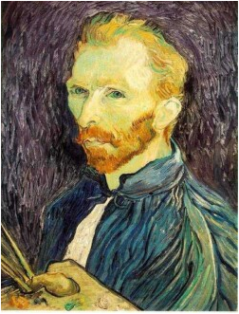
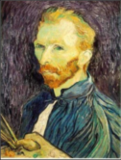






Gaussian pre-filtering
Solution: filter the image, then subsample
F₀
F₁
F₂
…
blur
subsample
blur
subsample
F₀ H
F₁ H
*
*

Slide 14
{
Gaussian pyramid
F₀
F₁
F₂
…
blur
subsample
blur
subsample
F₀ H
F₁ H
*
*

Slide 15
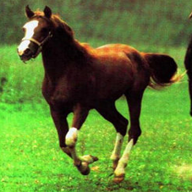
Convolution and subsampling is familiar…
Horse

Slide 16
Key take-away
A versatile tool : convolution
  Any linear shift-invariant operation is a convolution
  In particular edge detection, image smoothing
A versatile structure : pyramids
  Early layers capture low-level detail, higher layers capture global structure.

Slide 17
Grouping

Slide 18
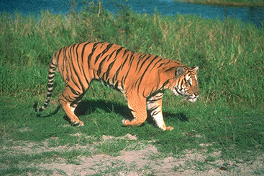
What is grouping?

Slide 19
Why grouping?
Pixels property of sensor, not world
Reasoning at object level (might) make things easy:
  objects at consistent depth
  objects can be recognized
  objects move as one

Slide 20
Regions Boundaries

Slide 21
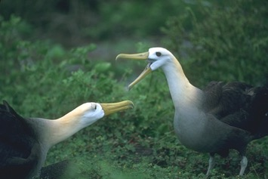
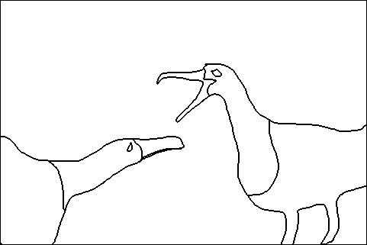
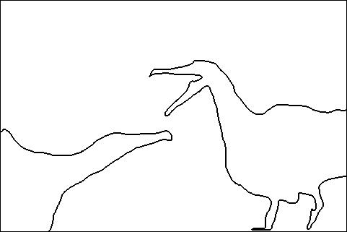
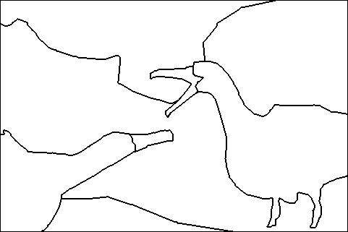
Is grouping well-defined?
Depends on purpose
  Object parts
  Background segmentation
A
B
C

Slide 22
Is grouping well-defined?
A
Perceptual organization forms a tree:
Image
A
B
BG
L-bird
R-bird
B
C
grass
bush
far
beak
body
beak
body
C
eye
head
eye
head
D. Martin, C. Fowlkes, D. Tal, J. Malik. "A Database of Human Segmented Natural Images and its Application to Evaluating Segmentation Algorithms and Measuring Ecological Statistics", ICCV, 2001

Slide 23
How do we group things?
Gestalt principles
Principle of proximity
https://courses.lumenlearning.com/wsu-sandbox/chapter/gestalt-principles-of-perception/

Slide 24
How do we group things?
Gestalt principles
Principle of similarity
https://courses.lumenlearning.com/wsu-sandbox/chapter/gestalt-principles-of-perception/

Slide 25
How do we group things?
Gestalt principles
Principle of continuity and closure
https://courses.lumenlearning.com/wsu-sandbox/chapter/gestalt-principles-of-perception/

Slide 26

How do we group things?
Gestalt principles
Principle of common fate

Slide 27
Gestalt principles in the context of images
Principle of proximity: nearby pixels are part of the same object
Principle of similarity: similar pixels are part of the same object
  Look for differences in color, intensity, or texture across the boundary
Principle of closure and continuity: contours are likely to continue
High-level knowledge?

Slide 28
Regions Boundaries

Slide 29
Discussion: Contour Detection and Hierarchical Image Segmentation

Slide 30
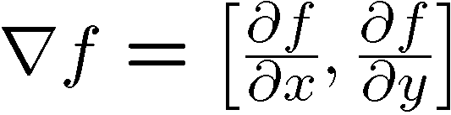
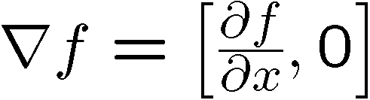
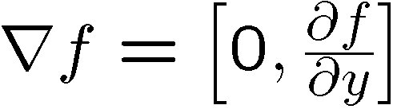
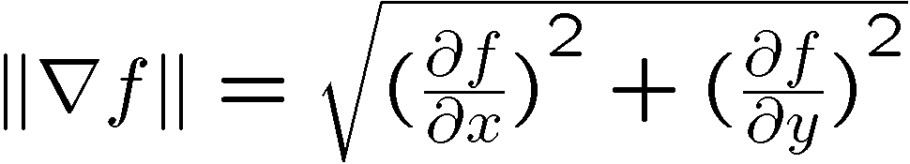
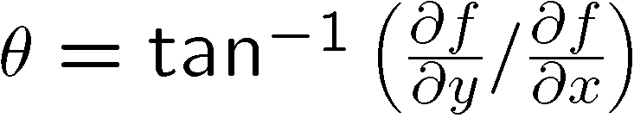
Image gradient
The gradient of an image:
The gradient points in the direction of most rapid increase in intensity
The edge strength is given by the gradient magnitude:
The gradient direction is given by:
  how does this relate to the direction of the edge?
Source: Steve Seitz
Notes:
give definition of partial derivative: lim h->0 [f(x+h,y) – f(x,y)]/h
Gradient direction perpendicular to edge direction

Slide 31
Image gradient
Source: L. Lazebnik
Notes:
Top right: gradient magnitude
x, y

Slide 32
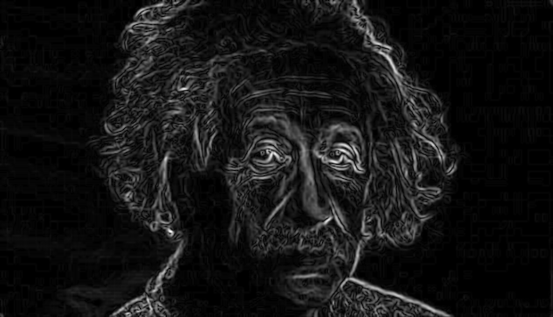
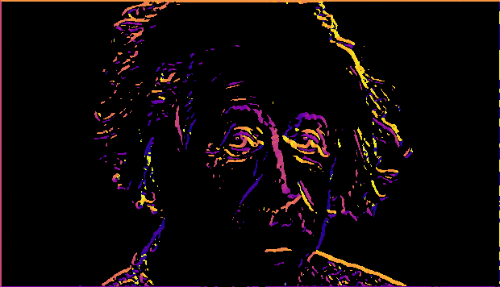
Gradient magnitude and orientation
Orientation is undefined at pixels with 0 gradient
Magnitude
Orientation
theta = numpy.arctan2(gy, gx)

Slide 33


Non-maximum suppression for each orientation
At q, we have a maximum if the value is larger than those at both p and at r. Interpolate to get these values.
Source: D. Forsyth

Slide 34
Before Non-max Suppression

Slide 35
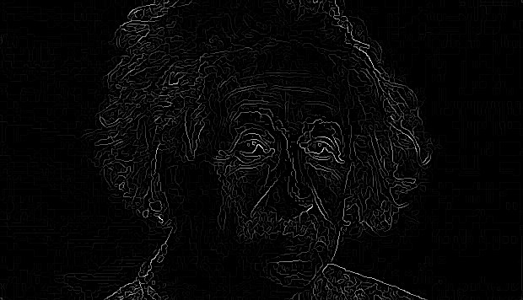
After Non-max Suppression

Slide 36
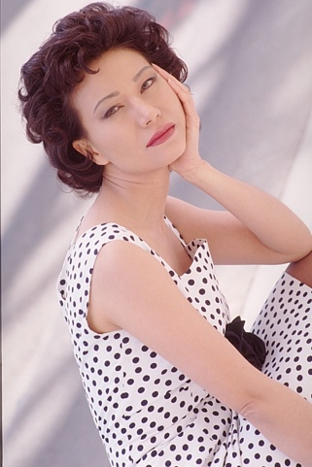

Image gradients are not enough

Slide 37
Image gradients are not enough
Plain
“Texture”
Polka dots

Slide 38
What is texture?
Same thing repeated over and over

Slide 39
What is texture?

Slide 40
Julesz’s texton theory
What is texture?
Distributions of some elements
  Elongated blobs of specific orientations, widths, lengths
  Terminators (ends of line segments)
  Crossings of line segments
Textons

Slide 41
Bringing textons to computer vision
Define a “vocabulary” of textons
Describe texture by a distribution of different textons

Slide 42
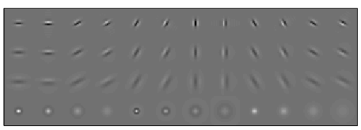
Bringing textons to computer vision
Define a “vocabulary” of textons
Describe texture by a distribution of different textons
Filter responses
Convolve with filter bank

Slide 43
Bringing textons to computer vision
Define a “vocabulary” of textons
Describe texture by a distribution of different textons
Filter responses
Convolve with filter bank
Collection of pixel feature vectors
…
Filter responses
Convolve with filter bank

Slide 44
Bringing textons to computer vision
Define a “vocabulary” of textons
Describe texture by a distribution of different textons
Collection of pixel feature vectors
k-means
Textons

Slide 45
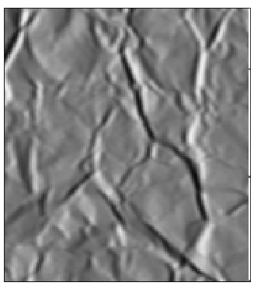
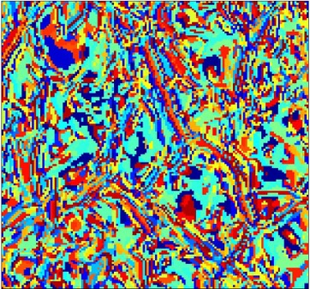
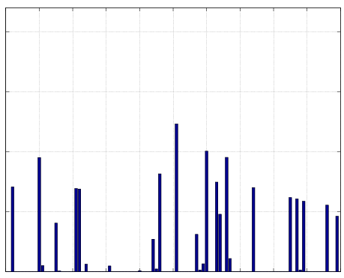
Bringing textons to computer vision
Define a “vocabulary” of textons
Describe texture by a distribution of different textons
Textons
Histogram
Leung, Thomas, and Jitendra Malik. "Representing and recognizing the visual appearance of materials using three-dimensional textons." International journal of computer vision 43.1 (2001): 29-44.

Slide 46
Textons in computer vision
Convolve with filter bank
Assign to k-means centers
Compute histogram
Image
Convolution
Point-wise non-linearity
Avg pooling
Image

Slide 47
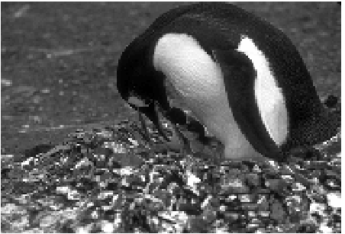
Detecting texture boundaries
Problem: gradient captures change from pixel to pixel
But texture property of region
Martin, David R., Charless C. Fowlkes, and Jitendra Malik. "Learning to detect natural image boundaries using local brightness, color, and texture cues." TPAMI (2004).

Slide 48

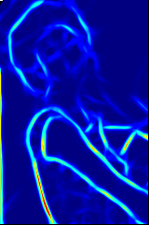
Cue combination
P_{b}
Image
Boundary Cues
Brightness
Color
Average
Texture
Martin, David R., Charless C. Fowlkes, and Jitendra Malik. "Learning to detect natural image boundaries using local brightness, color, and texture cues." TPAMI (2004).

Slide 49
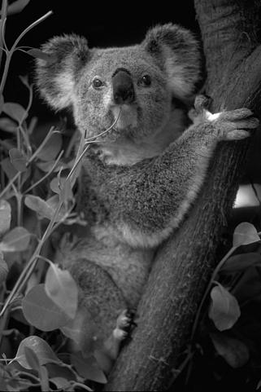
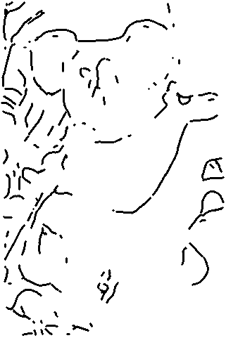
Local computation not enough

Slide 50
“Globalisation”

Slide 51
Segmentation is graph partitioning

Slide 52
Segmentation is graph partitioning
Every partition “cuts” some edges
Idea: minimize total weight of edges cut!

Slide 53
Criterion: Min-cut?
Min-cut carves out small isolated parts of the graph
In image segmentation: individual pixels

Slide 54
Normalized cuts
“Cut” = total weight of cut edges
Small cut means the groups don’t “like” each other
But need to normalize w.r.t how much they like themselves
“Volume” of a subgraph = total weight of edges within the subgraph

Slide 55
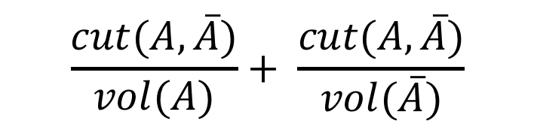
Normalized cut
$$\frac{cut(A, \overline{A})}{vol(A)}+ \frac{cut(A,\overline{A})}{vol(\overline{A})}$$

Slide 56
Min-cut vs normalized cut
Both rely on interpreting images as graphs
By itself, min-cut gives small isolated pixels
  But can work if we add other constraints
min-cut can be solved in polynomial time
  Dual of max-flow
N-cut is NP-hard
  But approximations exist!

Slide 57
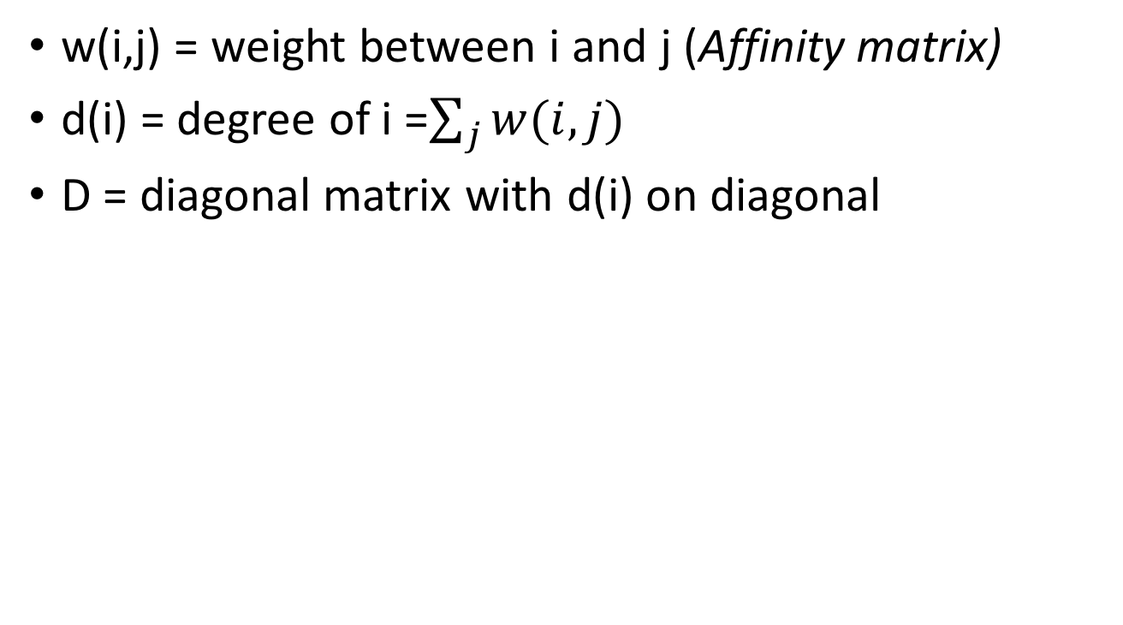
Graphs and matrices
w(i,j) = weight between i and j (Affinity matrix)
d(i) = degree of i =$\sum_{j}{w(i,j)}$
D = diagonal matrix with d(i) on diagonal
W
N
D
N
N
N

Slide 58
Graphs and matrices
1
6
2
7
3
4
8
9
5
0
W

Slide 59
Graphs and matrices
1
6
2
7
3
4
8
9
5
W
0
E = D⁻¹W

Slide 60
Graphs and matrices
How do we represent a clustering?
A label for N nodes
  1 if part of cluster A, 0 otherwise
An N-dimensional vector!
v₁
0:
1:
2:
3:
4:
5:
6:
7:
8:
9:
1
1
1
1
1
0
0
0
0
0
1
6
2
7
3
4
8
9
5
0

Slide 61
Graphs and matrices
How do we represent a clustering?
A label for N nodes
  1 if part of cluster A, 0 otherwise
An N-dimensional vector!
v₁
v₂
0:
1:
2:
3:
4:
5:
6:
7:
8:
9:
1
1
1
1
1
0
0
0
0
0
0
0
0
0
0
1
1
1
1
1
1
6
2
7
3
4
8
9
5
0

Slide 62
Graphs and matrices
How do we represent a clustering?
A label for N nodes
  1 if part of cluster A, 0 otherwise
An N-dimensional vector!
v₁
v₂
v₃
0:
1:
2:
3:
4:
5:
6:
7:
8:
9:
1
1
1
1
1
0
0
0
0
0
0
0
1
1
1
1
1
0
0
0
0
0
1
1
1
1
1
0
0
0
1
6
2
7
3
4
8
9
5
0

Slide 63
Graphs and matrices
v₁
1
6
0:
1:
2:
3:
4:
5:
6:
7:
8:
9:
1
1
1
1
1
0
0
0
0
0
2
7
3
4
8
9
5
0
E = D⁻¹W

Slide 64
Graphs and matrices
v₁
Ev₁
0:
1:
2:
3:
4:
5:
6:
7:
8:
9:
1
1
1
1
1
0
0
0
0
0
1
1
1
1
1
0
0
0
0
0
E = D⁻¹W

Slide 65
Graphs and matrices
v₂
Ev₂
0:
1:
2:
3:
4:
5:
6:
7:
8:
9:
0
0
0
0
0
1
1
1
1
1
0
0
0
0
0
1
1
1
1
1
E = D⁻¹W

Slide 66
Graphs and matrices
v₃
Ev₃
0:
1:
2:
3:
4:
5:
6:
7:
8:
9:
0
0
1
1
1
1
1
0
0
0
0.7
0.8
0.6
0.5
0.6
0.3
0.2
0.5
0.5
0.7
E = D⁻¹W

Slide 67
Graphs and matrices
1
6
2
7
3
4
8
9
5
0
E = D⁻¹W

Slide 68
Graphs and matrices
v₁
Ev₁
0:
1:
2:
3:
4:
5:
6:
7:
8:
9:
1
1
1
1
1
0
0
0
0
0
1
1
1
1
1
0
0
0.2
0
0
E = D⁻¹W

Slide 69
Graphs and matrices
Define z so that

Slide 70
Graphs and matrices
is called the Normalized Graph Laplacian

Slide 71
Graphs and matrices
We want
Trivial solution: all nodes of graph in one cluster, nothing in the other
To avoid trivial solution, look for the eigenvector with the second smallest eigenvalue
Find z s.t.

Slide 72
Normalized cuts
Approximate solution to normalized cuts
Construct matrix W and D
Construct normalized graph laplacian
Look for the second smallest eigenvector
Compute
Threshold y to get clusters
  Ideally, sweep threshold to get lowest N-cut value

Slide 73
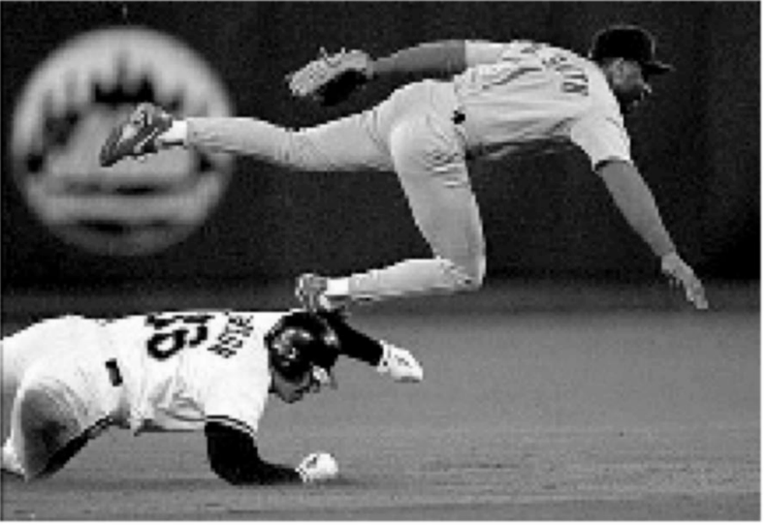
Eigenvectors of images
The eigenvector has as many components as pixels in the image

Slide 74
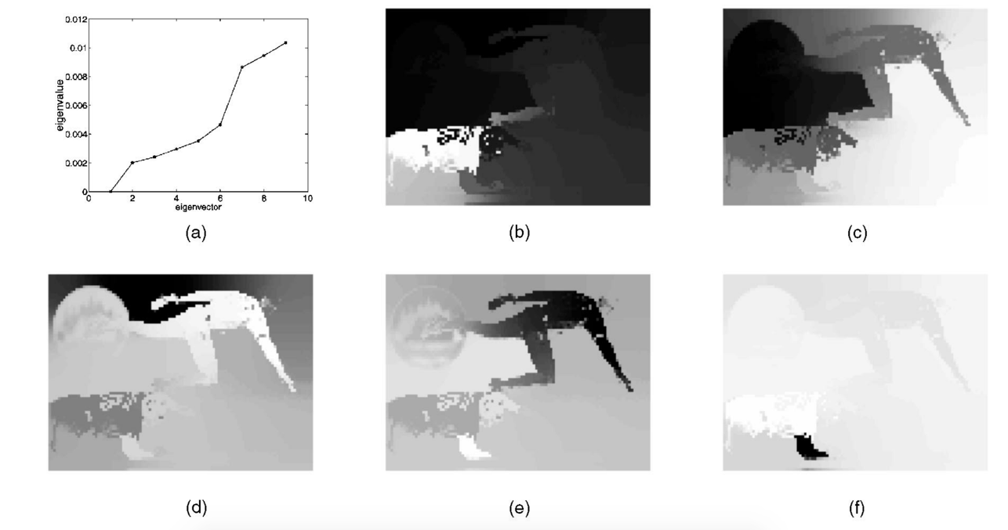
Eigenvectors of images
The eigenvector has as many components as pixels in the image

Slide 75




Another example
2nd eigenvector
3rd eigenvector
4th eigenvector

Slide 76
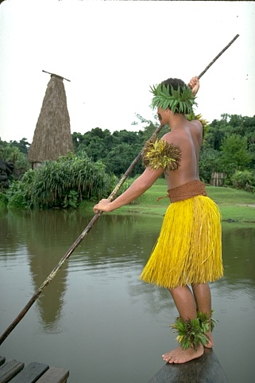
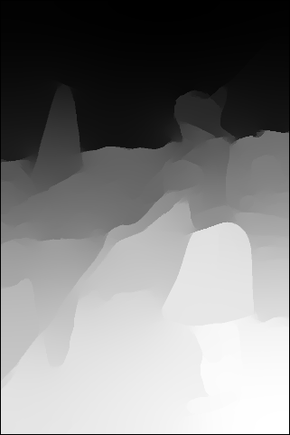
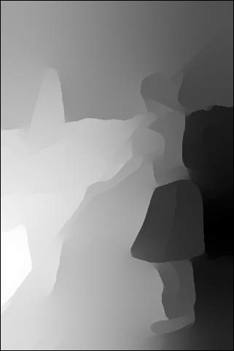
Eigenvectors of images

