Slide 1
Recap: Geometry of image formation

Slide 2
The pinhole camera
Let’s get into the math

Slide 3
Another derivation
P = (X,Y,Z)
Y
1
O
Z
y
p = (x,y,z)

Slide 4
A virtual image plane
A pinhole camera produces an inverted image
Imagine a ”virtual image plane” in the front of the camera
P
P
Y
Y
y
1
Z
O
y
1
O
Z

Slide 5
The projection equation

Slide 6
Consequence 1: Farther away objects are smaller
(X, Y + h, Z)
(X, Y, Z)
Image of foot:
Image of head:

Slide 7
Consequence 2: Parallel lines converge at a point

Slide 8
What about planes?
Normal: (N_{X}, N_{Y}, N_{Z})
What do parallel planes look like?
Vanishing lines
Parallel planes converge!

Slide 9
Changing coordinate systems
Y
Y
P = (X,Y,Z)
Z
O
O’
X
X
Z

Slide 10
Putting everything together
Change coordinate system so that center of the coordinate system is at pinhole and Z axis is along viewing direction
Perspective projection

Slide 11
Can projection be represented as a matrix multiplication?
Matrix multiplication
Perspective projection

Slide 12

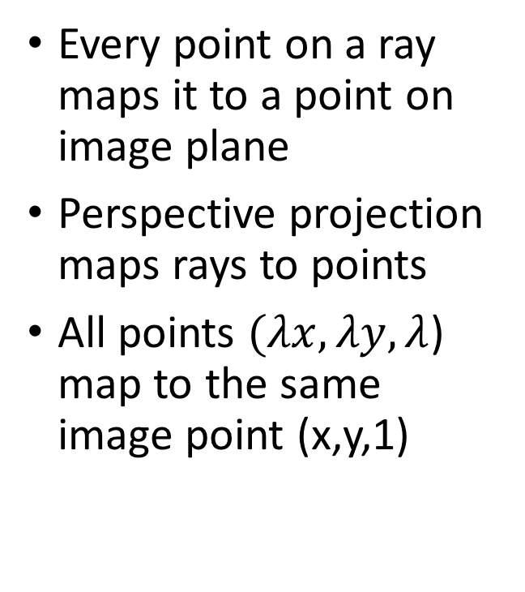
The space of rays
Every point on a ray maps it to a point on image plane
Perspective projection maps rays to points
All points $(λx, λy, λ$) map to the same image point (x,y,1)
($λx, λy, λ$)
(x,y,1)
O

Slide 13
Projective space and homogenous coordinates
Mapping to (points to rays):
Mapping to (rays to points):
A change of coordinates
Also called homogenous coordinates

Slide 14
Homogenous coordinates
In standard Euclidean coordinates
2D points : (x,y)
3D points : (x,y,z)
In homogenous coordinates
2D points : (x,y,1)
3D points : (x,y,z,1)

Slide 15
Why homogenous coordinates?
Homogenous coordinates of world point
Homogenous coordinates of image point

Slide 16
Homogenous coordinates

Slide 17
Perspective projection in homogenous coordinates

Slide 18
Matrix transformations in 2D
Translation
Scaling of Image x and y (conversion from “meters” to “pixels”)
Added skew if image x and y axes are not perpendicular

Slide 19
Final perspective projection
Camera extrinsics: where your camera is relative to the world. Changes if you move the camera
Camera intrinsics: how your camera handles pixel. Changes if you change your camera

Slide 20
Final perspective projection
Camera parameters

Slide 21
Image Formation - Color

Slide 22
The pinhole camera
We know where a pixel comes from.
But what is its color?

Slide 23
The pinhole camera
We know where a pixel comes from.
But what is its color?
A pixel is some kind of sensor that measures incident energy
But what exactly does it measure?

Slide 24
Sensing light
Consider a sensor placed in a single beam of light.
How much energy does it get?
Not enough information

Slide 25
Factor 1: Area
Larger sensors capture more power
Power = LA?
L: measure of beam brightness (radiance)
Radiance is power per unit area?
A larger sensor captures more energy

Slide 26


Factor 2: Orientation
Slanted sensors receive less light
Power = $LA\cos{θ}$
L = Radiance = Power per unit projected area
$$θ$$

Slide 27
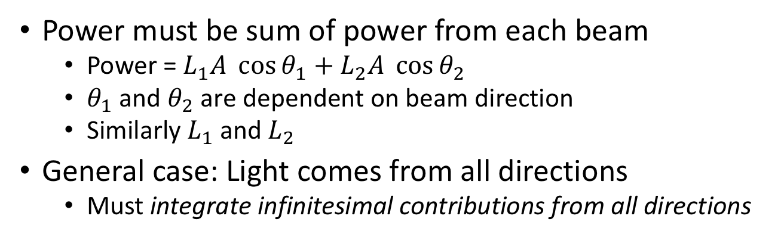
Multiple beams
Power must be sum of power from each beam
Power = $L_{1}A \cos{θ_{1}}+L_{2}A \cos{θ_{2}}$
$θ_{1}$ and $θ_{2}$ are dependent on beam direction
Similarly $L_{1}$ and $L_{2}$
General case: Light comes from all directions
Must integrate infinitesimal contributions from all directions

Slide 28


A hemisphere of directions
In 2D, direction = angle
Infinitesimal set of directions = infinitesimal angle
Integrate over all directions = integrate over angle
3D?
$$dθ$$
$$θ$$

Slide 29
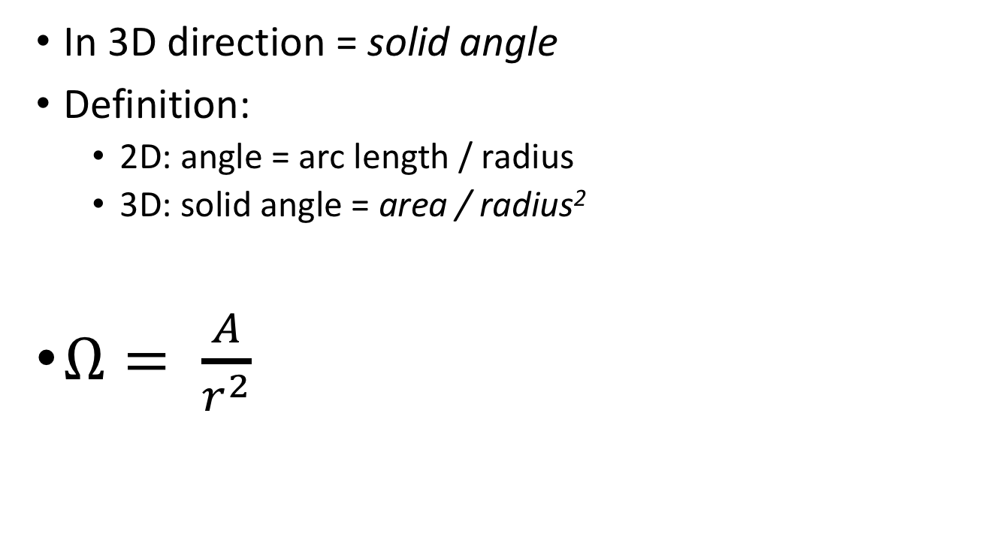
A hemisphere of directions
In 3D direction = solid angle
Definition:
2D: angle = arc length / radius
3D: solid angle = area / radius²
$Ω= \frac{A}{r^{2}}$

Slide 30
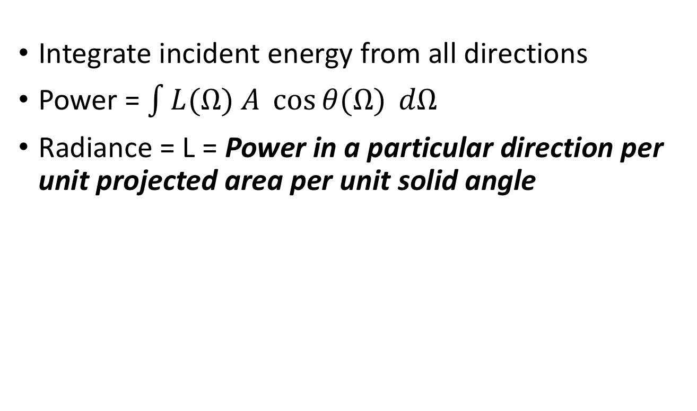
Multiple beams
Integrate incident energy from all directions
Power = $\int{L(Ω) A \cos{θ(Ω)}} dΩ$
Radiance = L = Power in a particular direction per unit projected area per unit solid angle

Slide 31
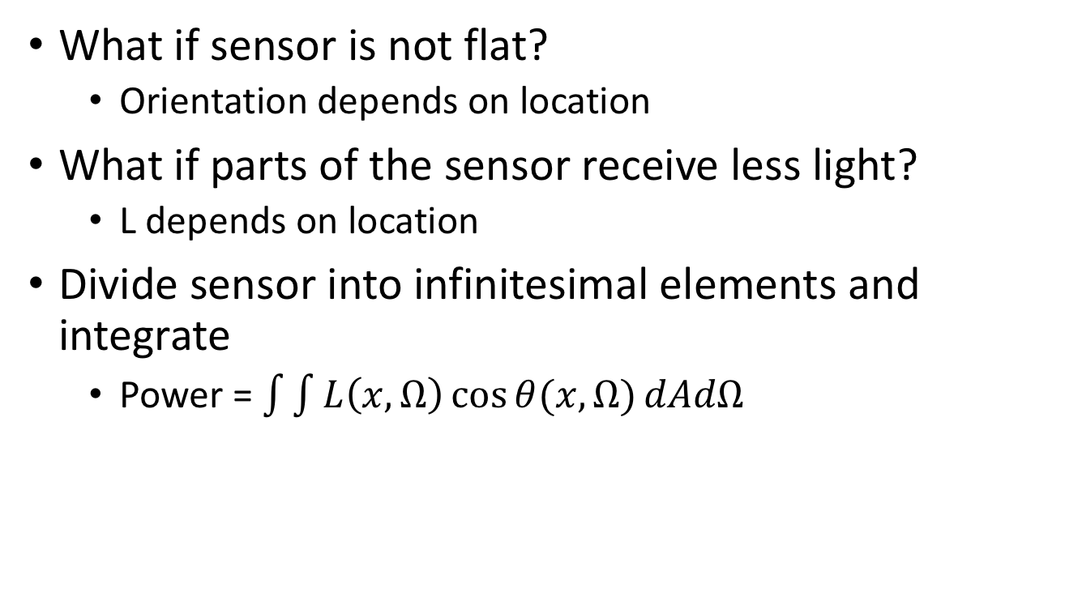
Integrating over area
What if sensor is not flat?
Orientation depends on location
What if parts of the sensor receive less light?
L depends on location
Divide sensor into infinitesimal elements and integrate
Power = $\int{\int{L\left(x,Ω\right)\cos{θ(x,Ω)}dAdΩ}}$

Slide 32
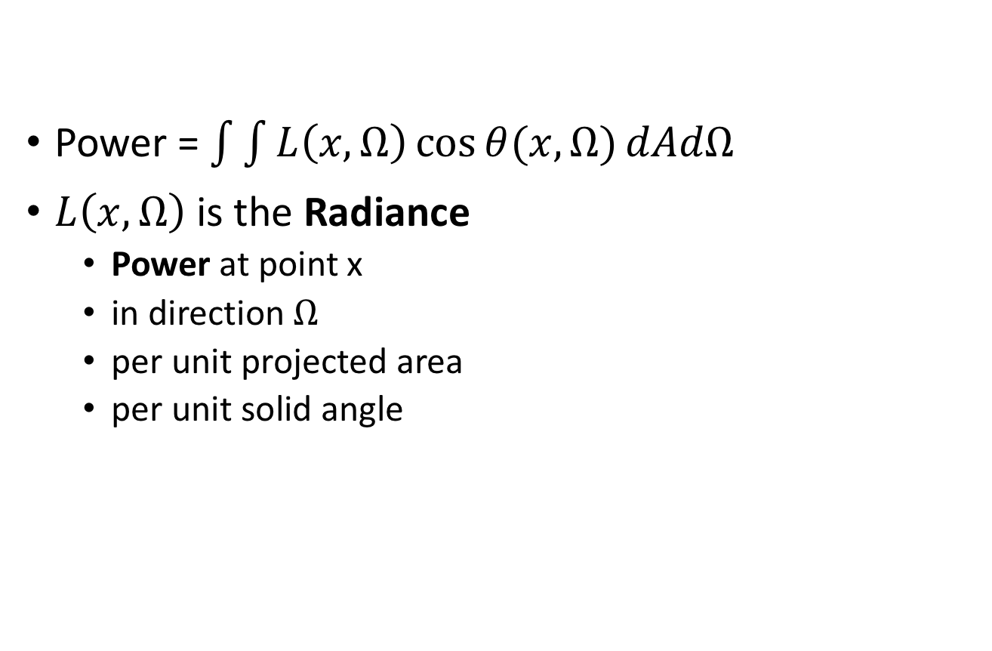
Radiance
Power = $\int{\int{L\left(x,Ω\right)\cos{θ(x,Ω)}dAdΩ}}$
$L\left(x, Ω\right)$ is the Radiance
Power at point x
in direction $Ω$
per unit projected area
per unit solid angle

Slide 33
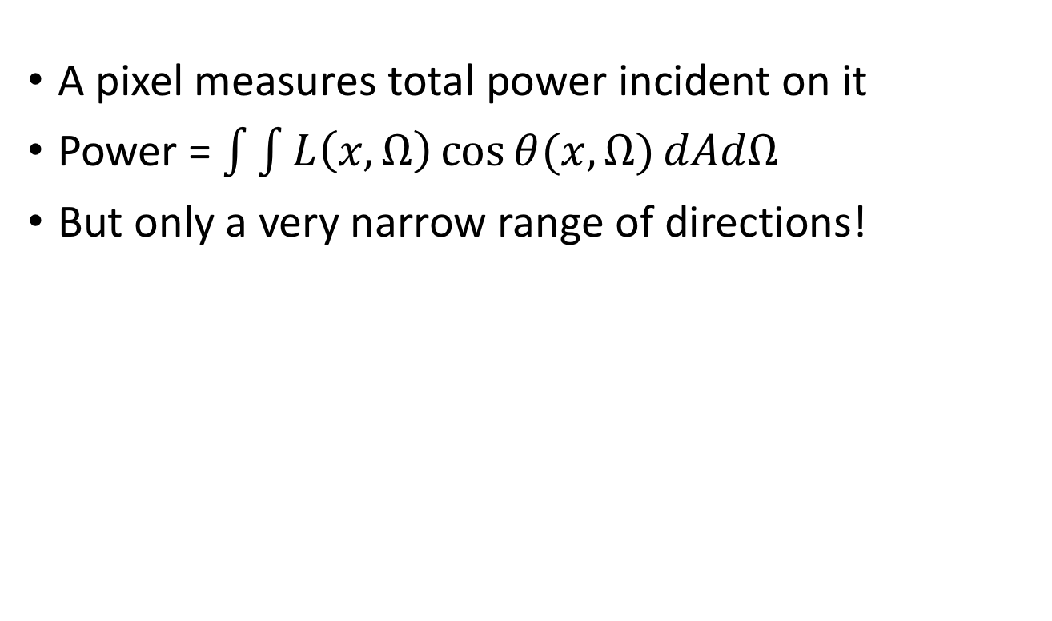
What do pixels measure?
A pixel measures total power incident on it
Power = $\int{\int{L\left(x,Ω\right)\cos{θ(x,Ω)}dAdΩ}}$
But only a very narrow range of directions!

Slide 34

What do pixels measure?
A pixel measures total power incident on it
Power = $LA\cos{θ}$?
Close to the center, Power proportional to L
Radiance of this point in this direction = L

Slide 35
Radiance
Pixels measure radiance
This pixel
Measures radiance in this direction

Slide 36

Where do the rays come from?
Rays from the light source “reflect” off a surface and reach camera
Reflection: Surface absorbs light energy and radiates it back

Slide 37

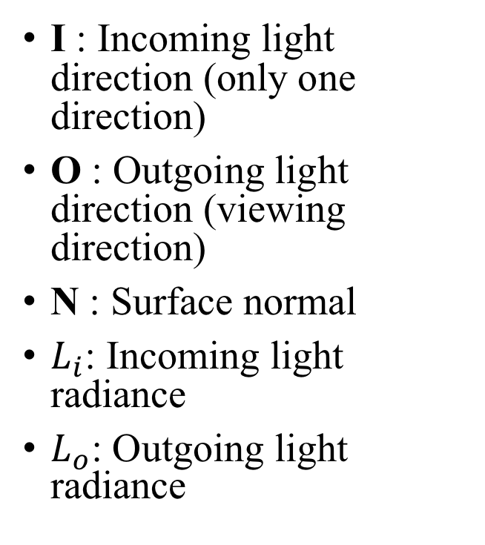

Light rays interacting with a surface
I : Incoming light direction (only one direction)
O : Outgoing light direction (viewing direction)
N : Surface normal
$L_{i}$: Incoming light radiance
$L_{o}$: Outgoing light radiance
I
N
O
$$θ_{i}$$
$$θ_{o}$$

Slide 38
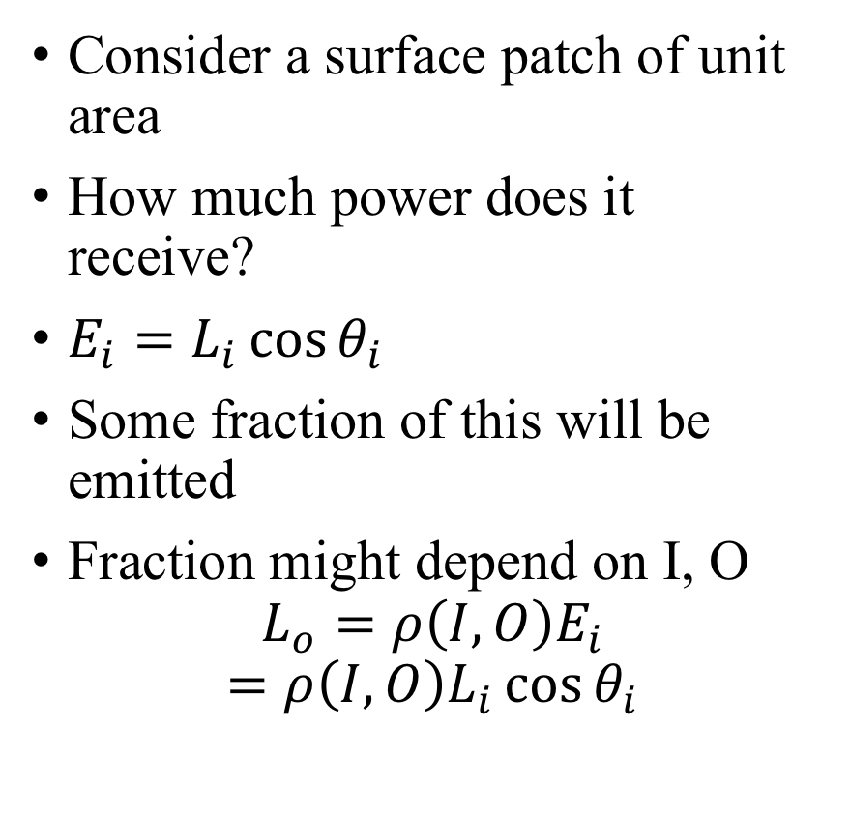
Light rays interacting with a surface
Consider a surface patch of unit area
How much power does it receive?
$E_{i}=L_{i}\cos{θ_{i}}$
Some fraction of this will be emitted
Fraction might depend on I, O
$$L_{o}=ρ\left(I,O\right)E_{i}$$
$$=ρ\left(I,O\right)L_{i}\cos{θ_{i}}$$
I
N
O
$$θ_{i}$$
$$θ_{o}$$

Slide 39

Light rays interacting with a surface
Incoming energy (Irradiance)
I
$$L_{o}=ρ\left(I,O\right)L_{i}\cos{θ_{i}}$$
N
O
BRDF: Bidirectional reflectance function
$$θ_{i}$$
$$θ_{o}$$

Slide 40
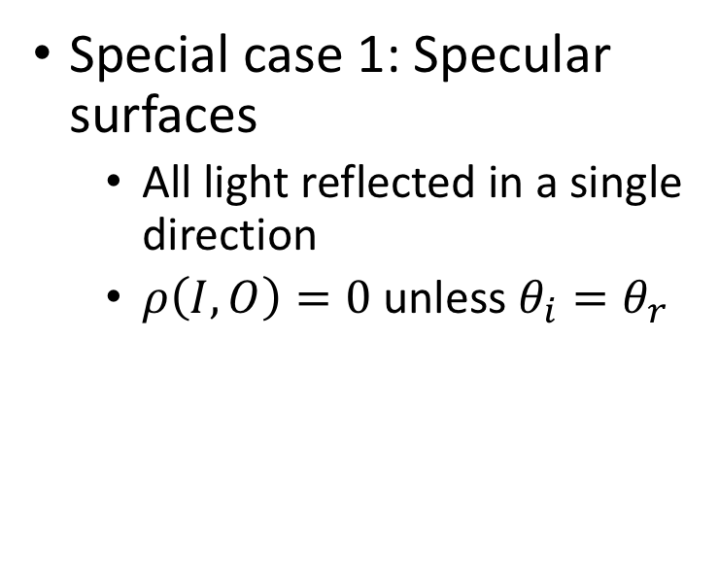

Light rays interacting with a surface
$$L_{o}=ρ\left(I,O\right)L_{i}\cos{θ_{i}}$$
I
N
Special case 1: Specular surfaces
All light reflected in a single direction
$ρ\left(I,O\right)=0$unless $θ_{i}=θ_{r}$
O
$$θ_{i}$$
$$θ_{o}$$

Slide 41
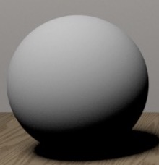
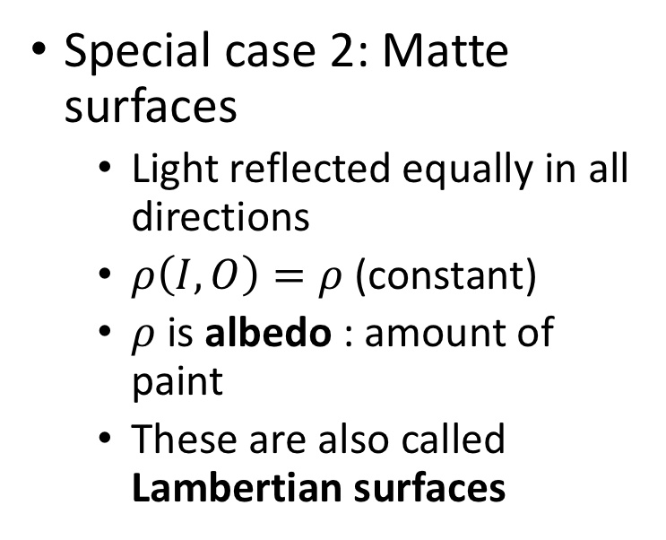
Light rays interacting with a surface
$$L_{o}=ρ\left(I,O\right)L_{i}\cos{θ_{i}}$$
I
N
Special case 2: Matte surfaces
Light reflected equally in all directions
$ρ\left(I,O\right)=ρ$ (constant)
$ρ$ is albedo : amount of paint
These are also called Lambertian surfaces
O
$$θ_{i}$$
$$θ_{o}$$

Slide 42
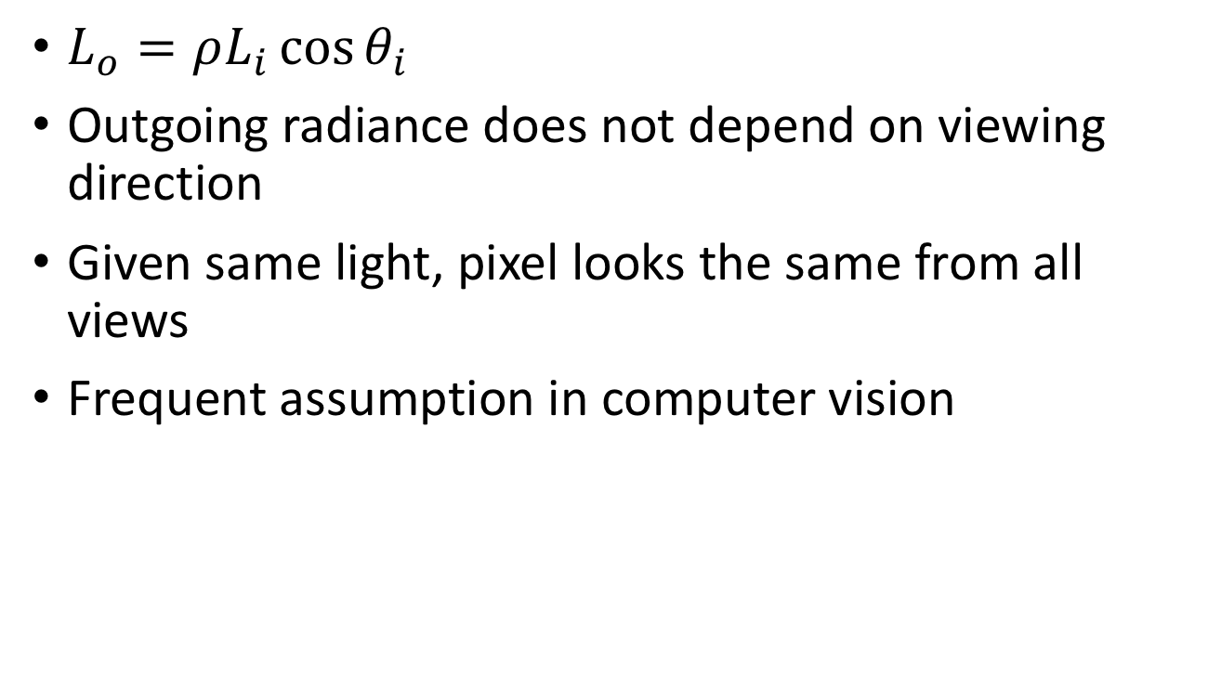
Lambertian surface
$L_{o}=ρL_{i}\cos{θ_{i}}$
Outgoing radiance does not depend on viewing direction
Given same light, pixel looks the same from all views
Frequent assumption in computer vision

Slide 43
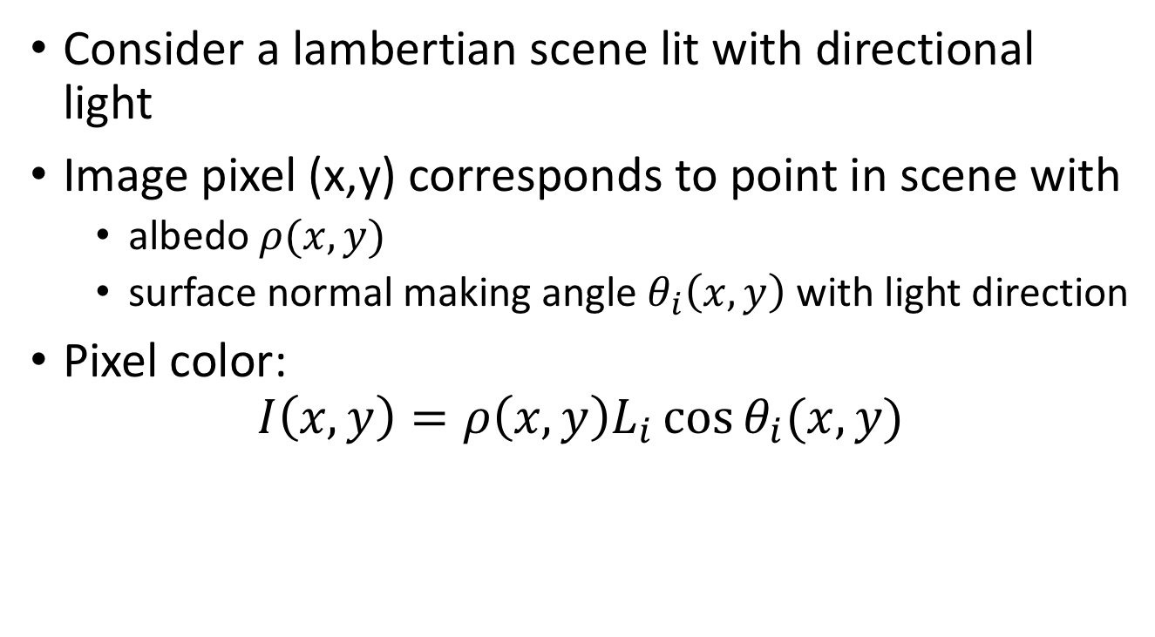
Intrinsic image decomposition
Consider a lambertian scene lit with directional light
Image pixel (x,y) corresponds to point in scene with
albedo $ρ(x,y)$
surface normal making angle $θ_{i}\left(x,y\right)$ with light direction
Pixel color:
$$I\left(x,y\right)=ρ\left(x,y\right)L_{i}\cos{θ_{i}(x,y)}$$
Image
”Reflectance” image
“Shading” Image

Slide 44
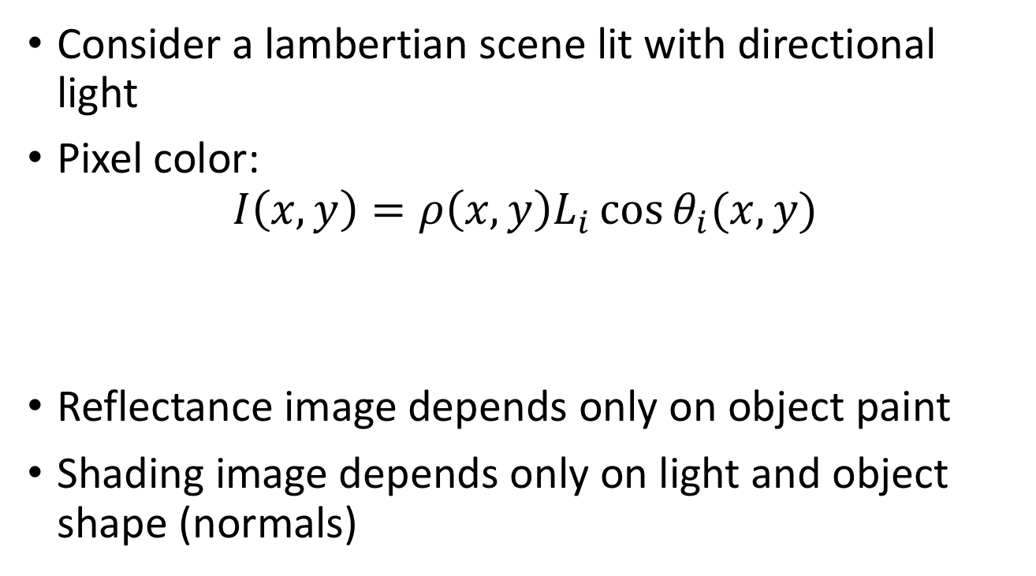
Intrinsic image decomposition
Consider a lambertian scene lit with directional light
Pixel color:
$$I\left(x,y\right)=ρ\left(x,y\right)L_{i}\cos{θ_{i}(x,y)}$$
Reflectance image depends only on object paint
Shading image depends only on light and object shape (normals)
Image
”Reflectance” image
“Shading” Image

Slide 45
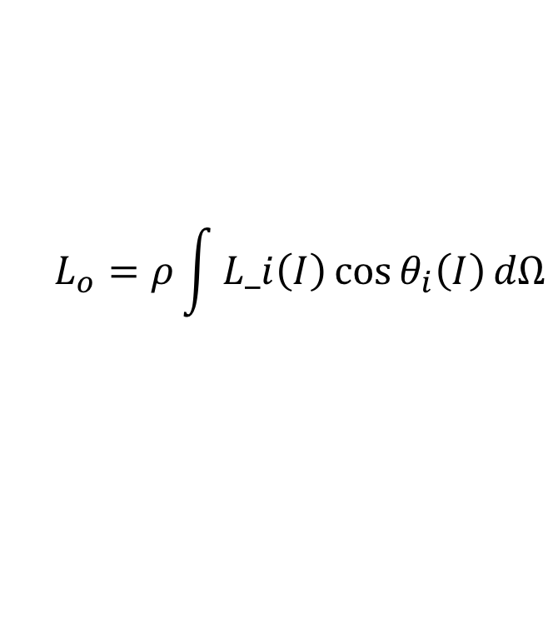
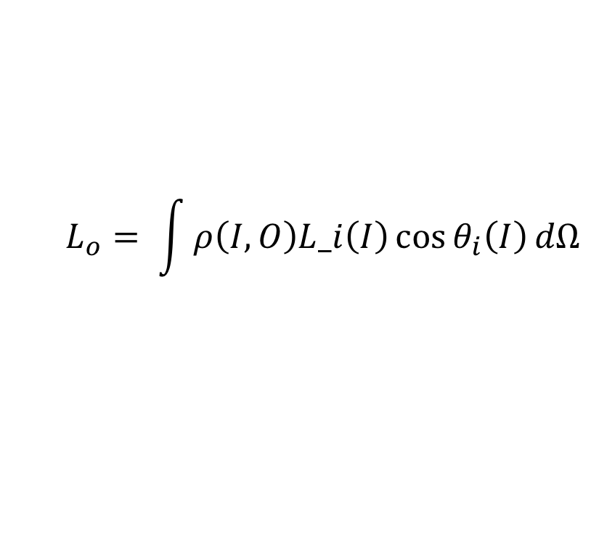
Integrating over incoming light
General case
Lambertian case
$$L_{o}= \int{ρ\left(I,O\right)L_i\left(I\right)\cos{θ_{i}\left(I\right)}dΩ}$$
$$L_{o}=ρ\int{L_i\left(I\right)\cos{θ_{i}\left(I\right)}dΩ}$$

Slide 46
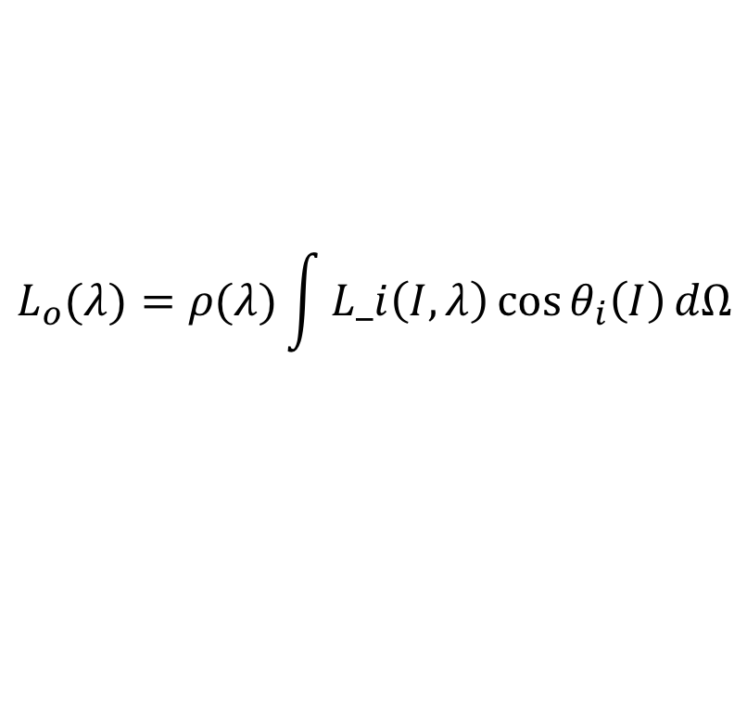
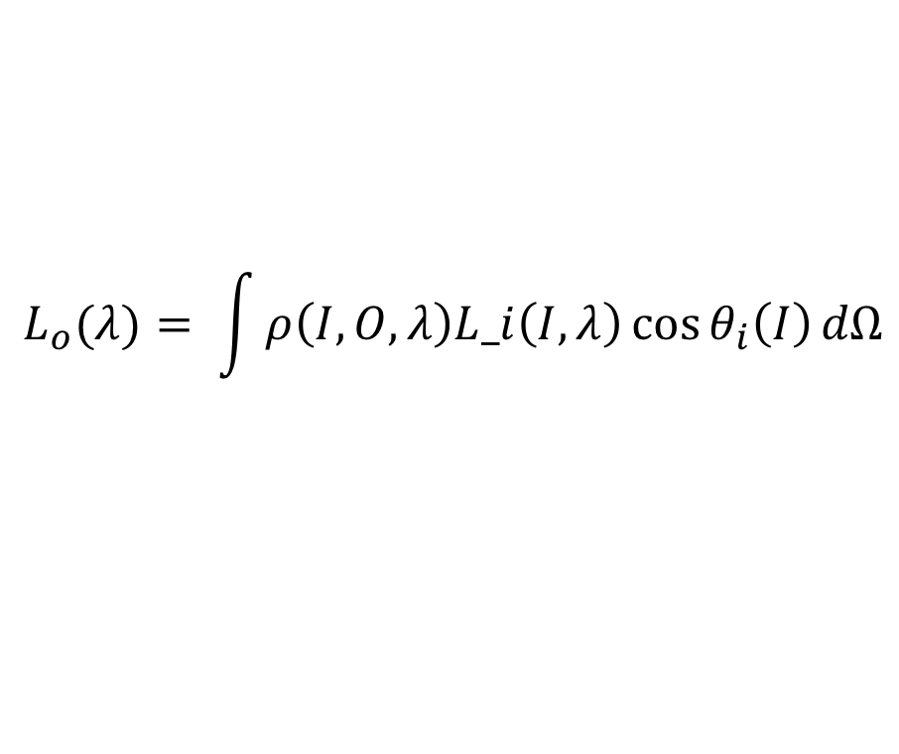
Extension to color
General case
Lambertian case
$$L_{o}(λ)= \int{ρ\left(I,O,λ\right)L_i\left(I, λ\right)\cos{θ_{i}\left(I\right)}dΩ}$$
$$L_{o}(λ)=ρ(λ)\int{L_i\left(I,λ\right)\cos{θ_{i}\left(I\right)}dΩ}$$

Slide 47
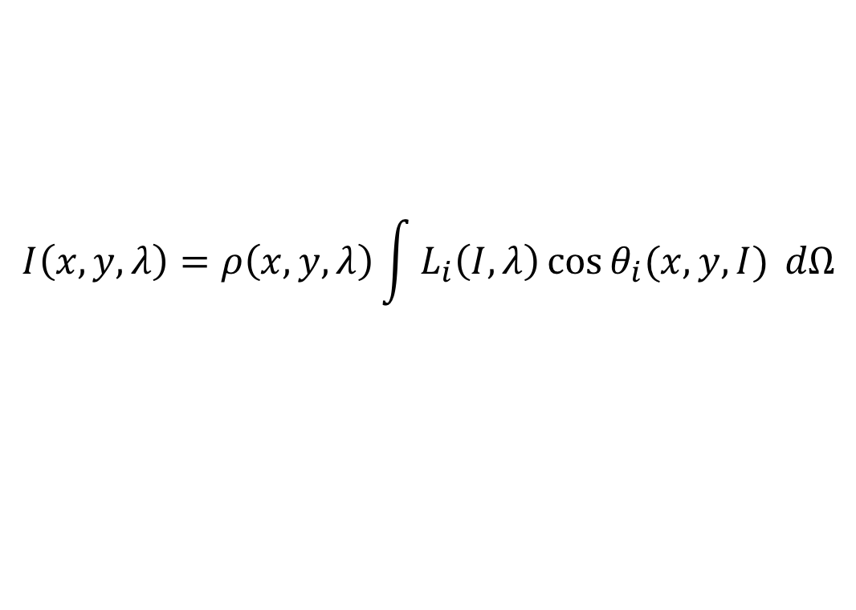
Intrinsic image decomposition
$$I\left(x,y,λ\right)=ρ\left(x,y,λ\right)\int{L_{i}\left(I, λ\right)\cos{θ_{i}(x, y, I)} dΩ}$$
Image
“Reflectance” image, depends on paint only
“Shading” image
depends on shape, lighting

Slide 48

Lambertian surfaces
Notes:
But what can we do with just a single images? Humans have no problem inferring shape, reflectance, and illumination, but we have no algorithms for it.

Slide 49
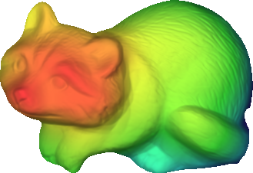

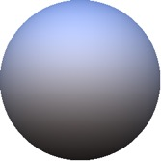


Lambertian surfaces
Far
Near
shape / depth
Shading image of Z and L
illumination
Reflectance
Lambertian reflectance

Slide 50
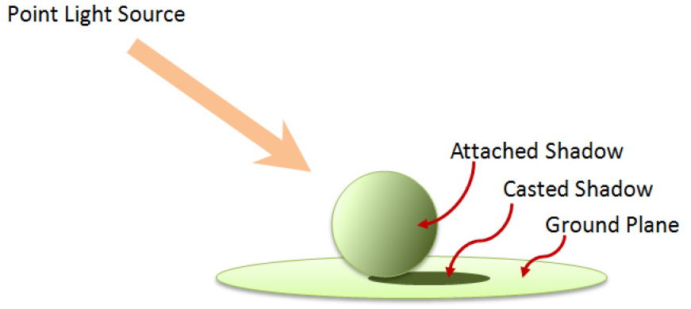
Other lighting effects

Slide 51
How to create an image
Create objects
Pick shape
Pick material
Is it Lambertian?
Pick albedo
Place objects in coordinate system
Place lights
Place camera
Take image

Slide 52
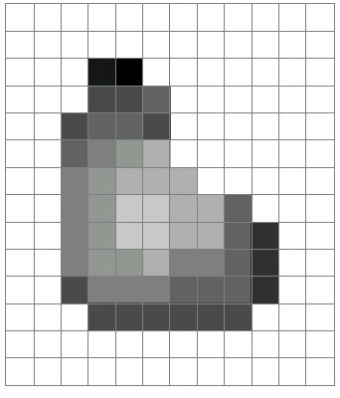
The final output: image
A grid (matrix) of intensity values
(common to use one byte per value: 0 = black, 255 = white)
255 | 255 | 255 | 255 | 255 | 255 | 255 | 255 | 255 | 255 | 255 | 255
255 | 255 | 255 | 255 | 255 | 255 | 255 | 255 | 255 | 255 | 255 | 255
255 | 255 | 255 | 20 | 0 | 255 | 255 | 255 | 255 | 255 | 255 | 255
255 | 255 | 255 | 75 | 75 | 75 | 255 | 255 | 255 | 255 | 255 | 255
255 | 255 | 75 | 95 | 95 | 75 | 255 | 255 | 255 | 255 | 255 | 255
255 | 255 | 96 | 127 | 145 | 175 | 255 | 255 | 255 | 255 | 255 | 255
255 | 255 | 127 | 145 | 175 | 175 | 175 | 255 | 255 | 255 | 255 | 255
255 | 255 | 127 | 145 | 200 | 200 | 175 | 175 | 95 | 255 | 255 | 255
255 | 255 | 127 | 145 | 200 | 200 | 175 | 175 | 95 | 47 | 255 | 255
255 | 255 | 127 | 145 | 145 | 175 | 127 | 127 | 95 | 47 | 255 | 255
255 | 255 | 74 | 127 | 127 | 127 | 95 | 95 | 95 | 47 | 255 | 255
255 | 255 | 255 | 74 | 74 | 74 | 74 | 74 | 74 | 255 | 255 | 255
255 | 255 | 255 | 255 | 255 | 255 | 255 | 255 | 255 | 255 | 255 | 255
255 | 255 | 255 | 255 | 255 | 255 | 255 | 255 | 255 | 255 | 255 | 255
=

Slide 53
Images as functions
Can think of image as a function, f, from R² to R or R^{M}:
Grayscale: f (x,y) gives intensity at position (x,y)
f: [a,b] x [c,d] ➔[0,255]
Color: f (x,y) = [r(x,y), g(x,y), b(x,y)]

Slide 54
The inherent ambiguity in images
Consequence of perspective projection: Loss of depth information
Ames room illusion
Image credit: Ian Stannard

Slide 55
The inherent ambiguity in images
Consequence of perspective projection: Loss of depth information

Slide 56



The inherent ambiguity of images
Lambertian scene:
Appearance only depends on the angle between surface normal and lighting direction
$$L_{o}=ρL_{i}\cos{θ_{i}}$$
I
N
O
$$θ_{i}$$
$$θ_{o}$$

Slide 57
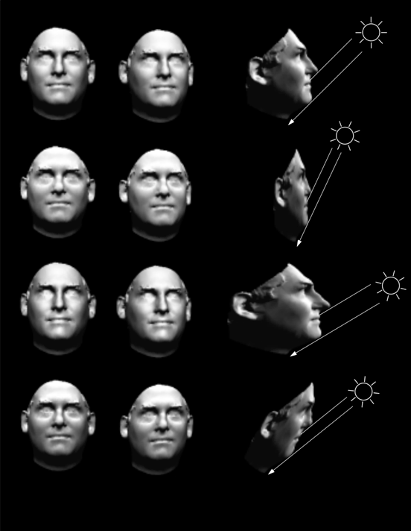
The inherent ambiguity of images
Bas-relief ambiguity: many surface normal and light directions give same image
Belhumeur, Peter N., David J. Kriegman, and Alan L. Yuille. "The bas-relief ambiguity." International journal of computer vision 35.1 (1999): 33-44.

Slide 58
The inherent ambiguity of images
Raised spots, light from right?
Depressed spots, light from left?

Slide 59
The inherent ambiguity of images
What color is the dress?

Slide 60

The inherent ambiguity of images
Key issue: color can be because of albedo or light
$$L_{o}(λ)=ρ(λ)L_{i}(λ)\cos{θ_{i}}$$
https://xkcd.com/1492/

