Slide 1
Computer Vision
CS 6670

Slide 2
Administrivia
Graduate course, designed for PhDs / starting researchers
Prior knowledge expectations:
Linear algebra (“A” in MATH 2210 or equivalent)
Probability (“A” in MATH 4710 or equivalent)
Recommended: CS 4780 / 5780
“Highest common denominator”
Research Project
Note undergrad course next semester

Slide 3
Assignments and projects
2 assignments (40 %)
Readings (10 %)
Project (50%)

Slide 4
Project
Project proposal due 18 September
Projects to be done in groups of 2-4 people
Ask permission for less or more
Mid-semester check-in
Final report due end-of-sem
Final presentation / poster session (depending on number of projects)

Slide 5
Project expectations
Research project
Goal: add to knowledge
Advance computer vision knowledge
Advance knowledge in your field using computer vision
Target: “short paper”

Slide 6
Administrivia
Course website: http://www.cs.cornell.edu/courses/cs6670/2017fa/
TA : Guandao Yang
Office hours 3-4 pm (after class)
Office: 311 Gates Hall

Slide 7
Computer Vision

Slide 8
“This is not a pipe”

Slide 9
The famous pipe. How people reproached me for it! And yet, could you stuff my pipe? No, it's just a representation, is it not? So if I had written on my picture 'This is a pipe', I'd have been lying!
— René Magritte^{[4]}

Slide 10
The goal of computer vision
Extract information from visual data
Notes:
Fairly broadly speaking, the goal of CV is to extract information out of visual data.
But what kind of information?
Ideally information that the system can use to perform some action: for a robot, it might be navigating the world, or picking up and manipulating things etc. For an internet company, it might be blocking the content, or describing it in words to a human purveyor. For an AR system, it might be to render a particular object in a certain way.

Slide 11
The goal of computer vision
Extract enough information from visual data to make good decisions
Notes:
So the goal of CV is to extract enough information from visual data to make good decisions or take good actions.
What enough is, will depend on what decision we want to take.

Slide 12
Example 1: Robotics
Notes:
Need computer vision to perceive the world
Why do we need perception?
Example 1: robots in environments humans can’t go, like Mars Rover.
Navigating requires understanding environment so as to not bump into nasty things, fall into crevasses etc.
Vision useful tool because can ”see” a very large part of the environment, and potentially very far away.

Slide 13
Example 1: Robotics
http://theoatmeal.com/blog/google_self_driving_car
Notes:
For robots in human environments, need to perceive not just obstacles or navigational stuff but also where humans are, what they are doing, and even what they intend to do. For example, self driving cars need to not only find out if there are pedestrians, but also figure out the intent of the pedestrian: is she going to cross? Should we wait? Etc.

Slide 14
Example 2: Internet Vision
Notes:
Example 2: The internet is full of visual data. Need to understand this visual data to: prune out or flag objectionable content, understand what people like or hate or are looking for, and use that for nefarious purposes like selling things, or help visually impaired people consume this visual content. Example: is this livestream video the video of a crime? Should this be reported and the people apprehended? Is this just news coverage?

Slide 15
Example 3: AR
Notes:
Example 3: A big promise nowadays is AR (Augmented Reality), where we can see virtual things interacting with the real world. This can be used for education, for visualizing in engineering and STEM fields, for playing games and so on. But for virtual things to interact correctly with the real world, need to perceive the real world properly. Is this a table? Should things bounce off of it, or sink into it? Where’s the surface of the table?

Slide 16
Example 3: AR
Video from Matt Robinson, as part of AR class taught by Ira Kemelmacher-Schlizerman and Steve Seitz
Notes:
Here is a real-life example of an AR tool that some students built using the hololens.

Slide 17
Analyzing (computer vision) problems
What is the problem?
Why is it hard?
What cues can we use?
How do we use these cues?

Slide 18
What are the problems in computer vision?
What is the image about?
What objects are in the image?
Where are they?
How are they oriented?
What is the layout of the scene in 3D?
What is the shape of each object?
…
Notes:
If we want to check for objectionable content, then we may just want to know what the image is about.
In a self driving car, we may want to know if there are any pedestrians, or other cars, in the visual field, and if so, where are they so that we don’t run into them.
We may also want to know how they are oriented in space and where they are moving.
To navigate the scene successfully, both robots and self driving cars will need to know what the layout of the scene is in 3D.
If we are building a robot that has to pick things up, it probably needs to know the location and orientation fairly precisely, but it will also need to know the shape of the object and where it can be grasped.
And so on.
As humans, we do this fairly easily, and so many of you may not understand why this is so hard. Give example.

Slide 19
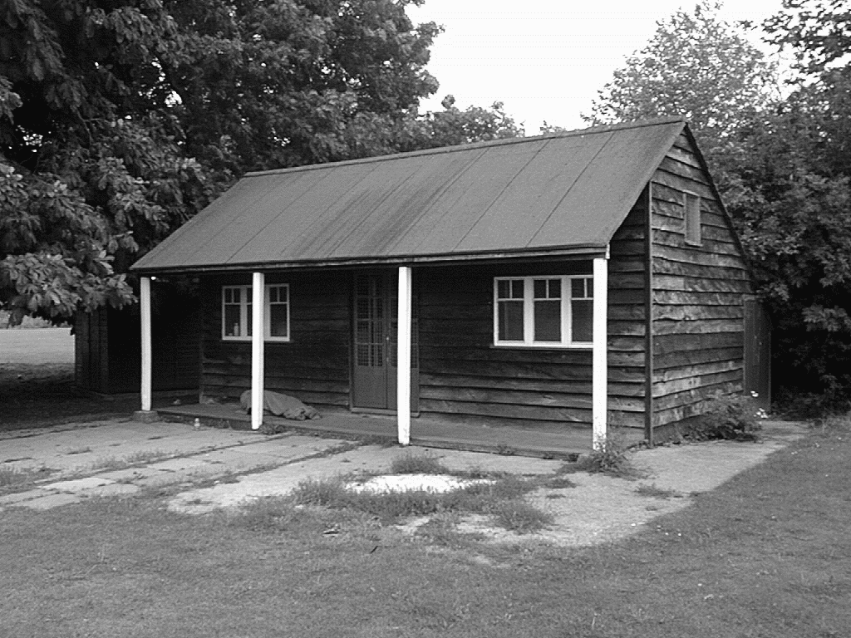
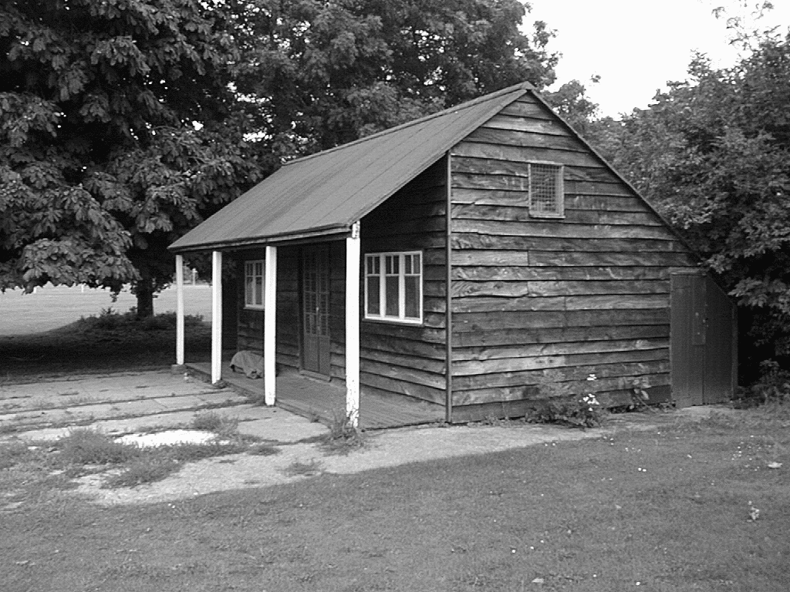
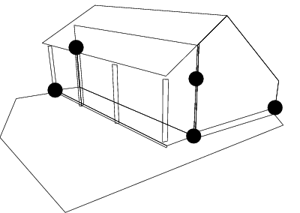
The goal(s) of computer vision
Reconstruction
Understand the 3D layout of the scene and objects
Left View
Right View
[Hartley & Zisserman]

Slide 20
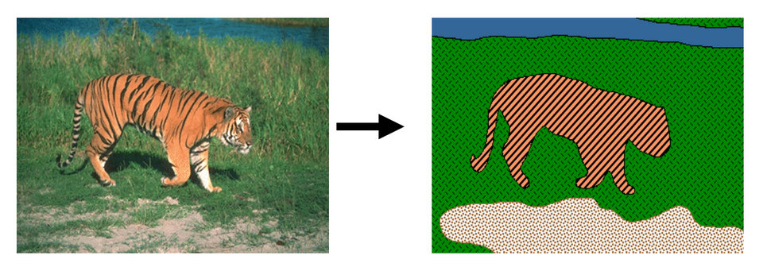
The goal(s) of computer vision
Grouping (“Reorganization”)
Divide the scene into objects
[Blobworld]

Slide 21
The goal(s) of computer vision
Recognition
Understand the semantic properties of the scene and objects
Picture credit: Magritte , Jon Barron

Slide 22
The goal(s) of computer vision
Reconstruction
Recognition
Reorganization

Slide 23
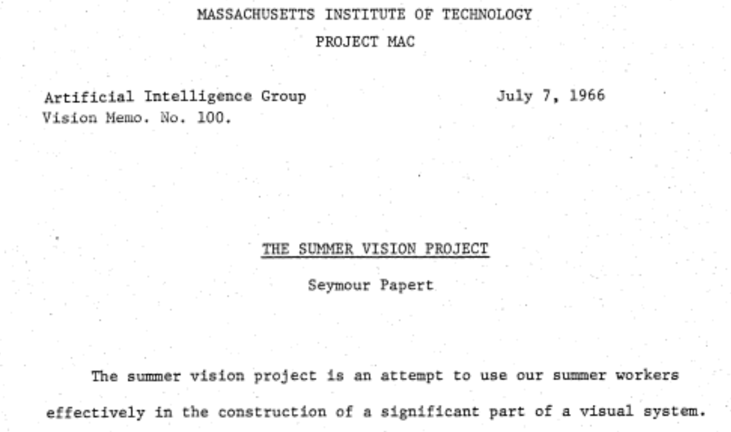
The “summer vision project”

Slide 24
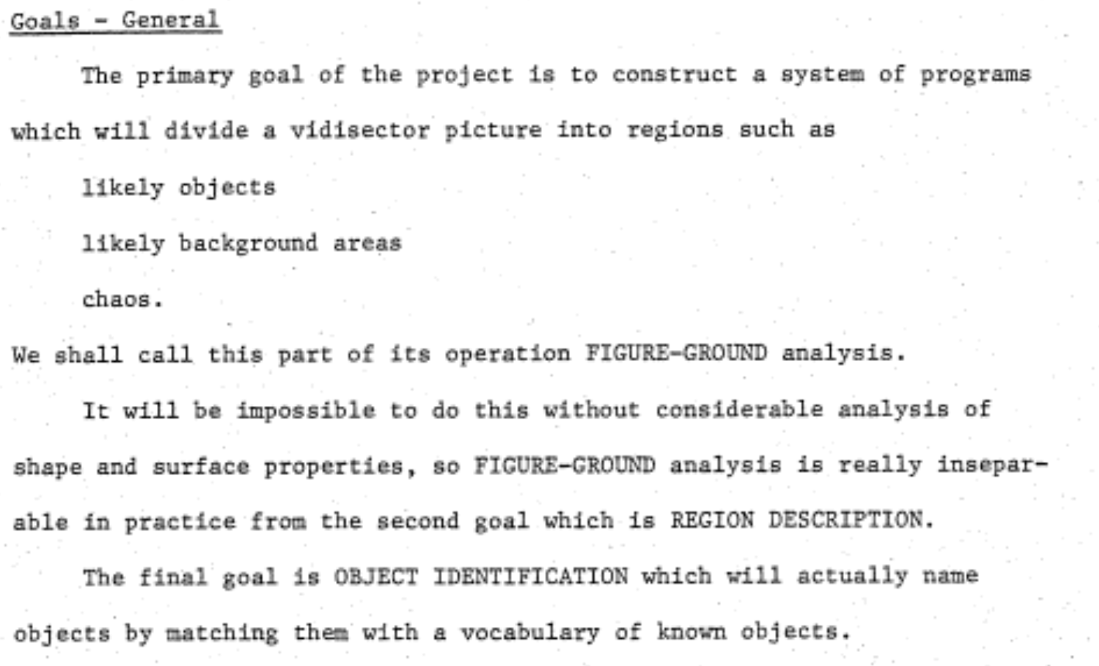
The “summer vision project”

Slide 25
The big reveal
“… in the 1960s almost no one realized that machine vision was difficult… The common and almost despairing feeling of the early investigators like B.K.P. Horn and T.O. Binford was that practically anything could happen in an image and furthermore that practically everything did."
--- Marr, 1982

Slide 26
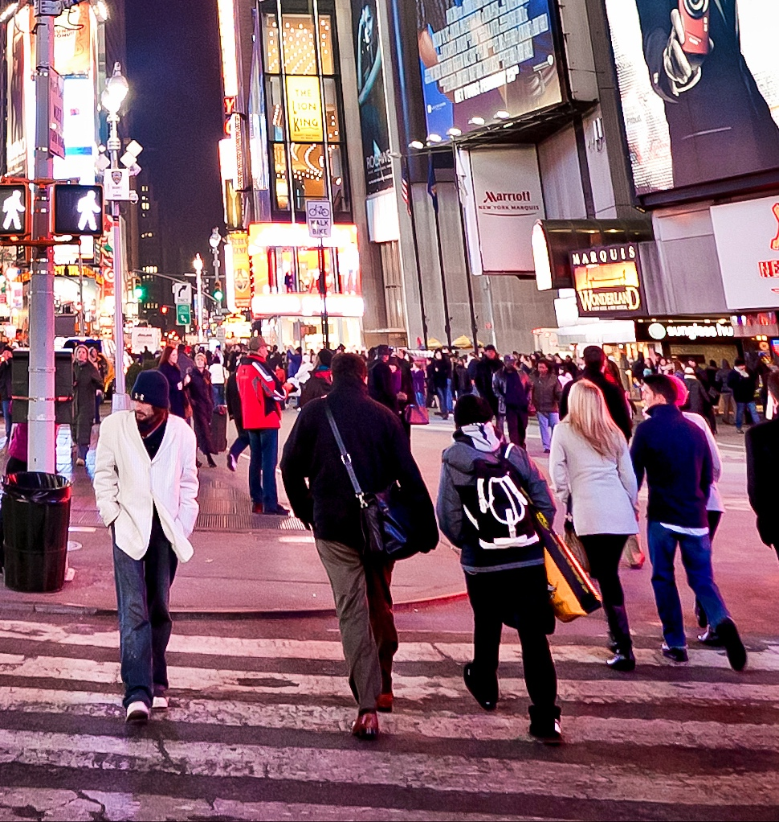
Why is it hard?
71 | 109 | 61 | 71 | 86
66 | 96 | 77 | 76 | 77
63 | 98 | 82 | 79 | 64
65 | 105 | 73 | 92 | 83
90 | 107 | 80 | 96 | 113
"I stand at the window and see a house, trees, sky. Theoretically I might say there were 327 brightnesses and nuances of colour. Do I have "327"? No. I have sky, house, and trees."
-- Max Wertheimer

Slide 27
Why is it hard? Objects blend together
Notes:
For example, do you see something weird in this photograph of a Hollywood actor?
Do you think the actor’s body is this?

Slide 28
Why is it hard? Objects blend together
Notes:
And the thing is, a lot of the animal life on this planet has evolved to take advantage of this ambiguity, through camouflage.
Do you see the spider in here?
If we want a system that can detect spiders and lions and tigers and leopards in their natural environments, well we have to find a way around this ambiguity.

Slide 29
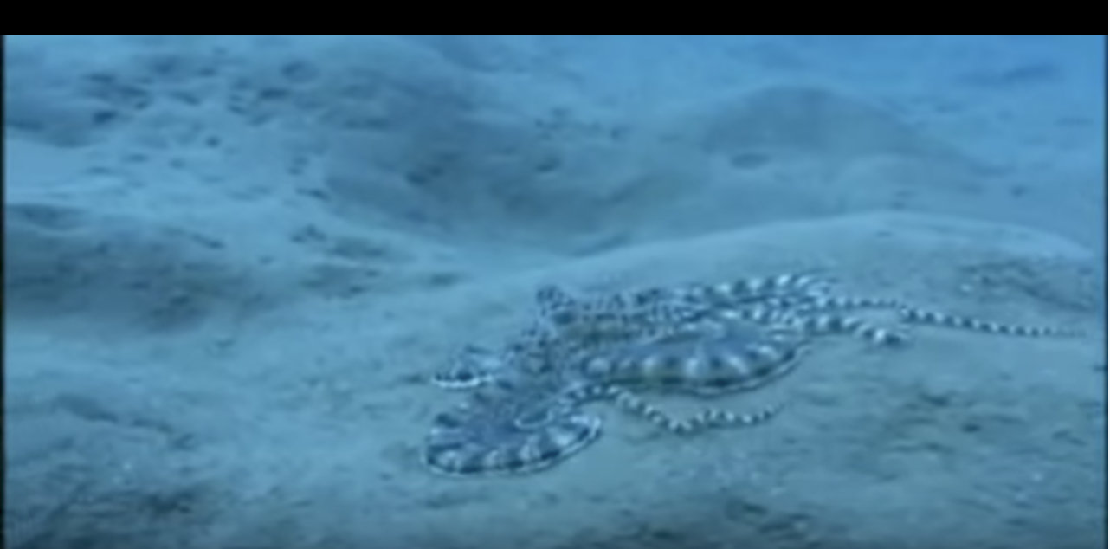
Why is it hard? Concepts have variance
Notes:
As if this ambiguity is not enough, a lot of things in the world can change shape and can look very different when you look at them from different directions. This mimic octopus here is a particularly egregious example, as it intentionally pretends to be something else.

Slide 30
Why is it hard? Concepts have variance
Notes:
In addition, there is also a lot of variation among instances of the same kind of object.
This here, for example, is a very weird kind of chair.
It looks nothing like a chair, but it offers exactly the same functionality as a chair.
Our vision systems need to ignore, or be invariant to, such vast variations, and recognize things for what they really are.

Slide 31
Why is it hard? Concepts are subtle
Tenessee Warbler
Orange Crowned Warbler
https://www.allaboutbirds.org
Notes:
At the same time, two things might look very similar, but be completely different. For example, these are two different species of birds even though they look very similar.

Slide 32
Why is it hard? Intra-class variance and inter-class similarities
Expectation
Reality

Slide 33
What cues can we use? Geometry / Physics

Slide 34
What cues can we use? Geometry / Physics
Farther objects are higher and smaller
Parallel lines converge
Notes:
To handle these problems there are a couple of tools that we vision researchers have.
The first is that of geometry and physics.
We know very well the physics and maths behind image formation, and we understand the impacts this has.
For example, we know that farther objects in an image often tend to be higher and smaller, and parallel lines often converge.
In this course we will understand how these effects come into being.

Slide 35
What cues can we use? Geometry / Physics

Slide 36
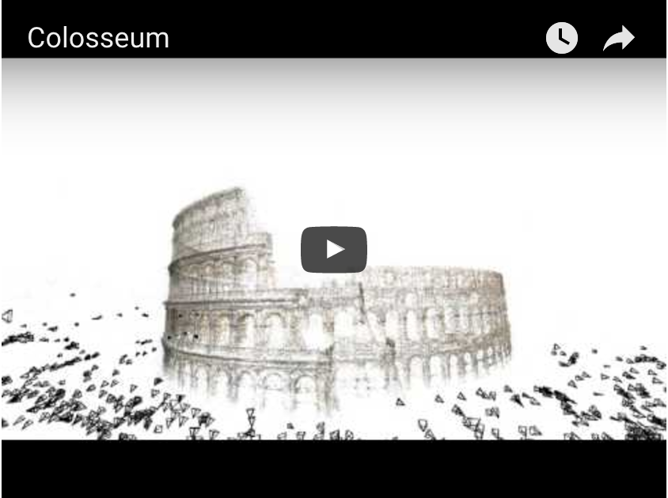
What cues can we use? Geometry / Physics
Building Rome in a Day. Sameer Agarwal, Noah Snavely, Ian Simon, Steven M. Seitz and Richard Szeliski. ICCV, 2009, Kyoto, Japan.
Notes:
We’ve taken such geometric reasoning quite a distance. For example, in this paper from 2009, they used this geometry to reconstruct major tourist destinations from nothing but user uploaded photographs on the internet.

Slide 37
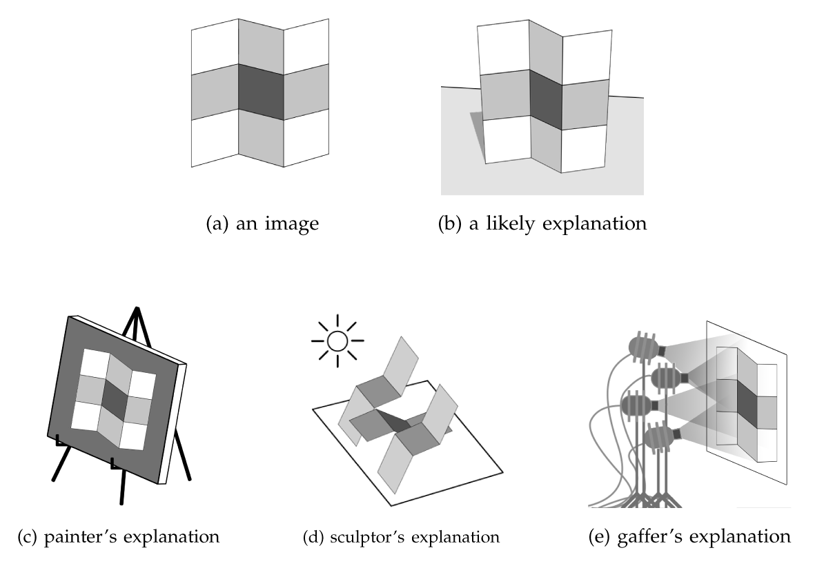
What cues can we use? Geometry / Physics - Priors
Notes:
Beyond the physics of image formation, we also know certain properties about the physical world that can constrain potentially ambiguous solutions.
For example, consider this image.
The geometry of image formation doesn’t tell us much here.
This image could have been created in a bunch of ways.
It could be created by a painter simply painting this pattern on a canvas.
It could be created by a sculptor or sheet metal worker, who cuts and bends metals to reproduce this effect.
Or it could be created by a gaffer, who will move the lights around in a complicated way until this pattern is found.
However, we perceive this image to be of a single piece of metal, with a painted stripe, bent in an S-shape.
Why?
It is because in the real world, complicated pieces of sculpting, painting or lighting are rare.
This hypothesis is the simplest one in a physical sense.
Thus, here we are using a “prior”: an asumption that simpler hypotheses are more likely.

Slide 38
What cues can we use? Geometry / Physics - Priors
Shape, Illumination and Reflectance from Shading. J. T. Barron and J. Malik, TPAMI, 2015.
Notes:
You can use such priors to understand the shape of an object from a single image.
That is what the authors of this paper did.
On the top right is the shape of the object, and on the bottom left is the paint.

Slide 39
What cues can we use? : Geometry / Physics - Priors

Slide 40
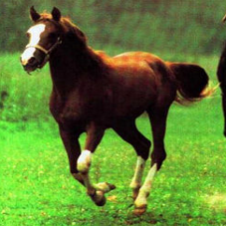
What cues can we use? : Data + Machine Learning
Convolutional Networks
Horse
Yann LeCun, Léon Bottou, Yoshua Bengio, and Patrick Haffner. Gradient-based learning applied to document recognition. Proceedings of the IEEE 86.11 (1998): 2278-2324.
Alex Krizhevsky, Ilya Sutskever, and Geoffrey E. Hinton. Imagenet classification with deep convolutional neural networks. In NIPS 2012.
Notes:
The second major tool we have is machine learning.
A major breakthrough in the past decade has been the re-discovery of black-box machine learning techniques, in particular convolutional networks.
You give these things a dataset of input, output pairs, and they learn to map inputs to outputs.
They seem to be especially effective on images.
Note that I said “Re-discovered”. These were techniques that were invented in the 80’s, or even before that. But it turns out that where they really shine is data. The more data you have, the better they are.

Slide 41
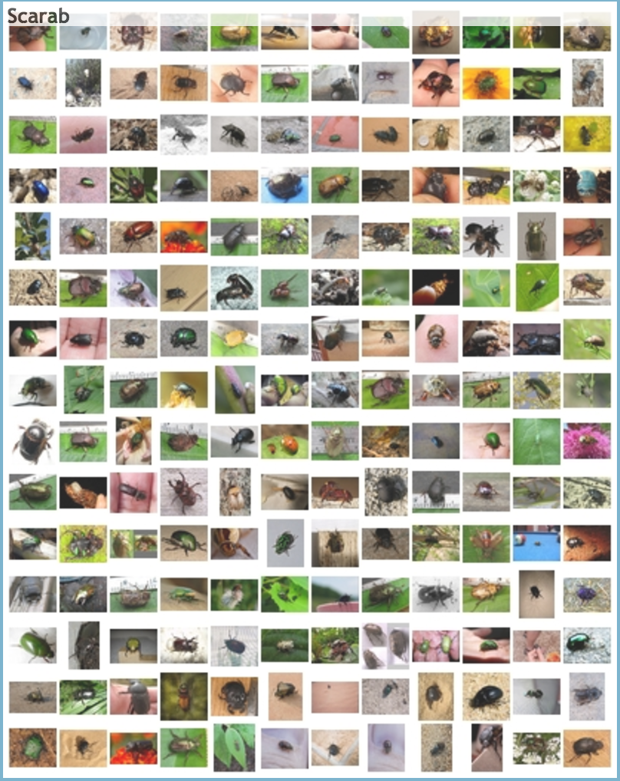
What cues can we use? Data + Machine Learning
ImageNet
ImageNet Large Scale Visual Recognition Challenge.
Olga Russakovsky*, Jia Deng*, Hao Su, Jonathan Krause, Sanjeev Satheesh, Sean Ma, Zhiheng Huang, Andrej Karpathy, Aditya Khosla, Michael Bernstein, Alexander C. Berg and Li Fei-Fei. IJCV, 2015
Notes:
Which means that the key to getting them to work this past decade was the availability of large labeled datasets.
To get these datasets, we had to take the freely available massive collection of images on the web and get them annotated by human beings. This annotation takes a lot of effort: it is tedious effort for the people labeling the image, and it is effort for the people designing the annotation interface, collecting the data, curating it and so on.
ImageNet was one of the datasets collected at this scale, and it is what led to the sudden rediscovery of convolutional networks.
ImageNet contains a million images, and each image is associated with a single label, which is 1 out of 1000 classes.
Using this dataset and with convolutional networks, you can teach machines to label each image with the same set of 1000 classes.

Slide 42
What cues can we use? Data + Machine Learning
mscoco
Microsoft COCO: Common Objects in Context
Tsung-Yi Lin, Michael Maire, Serge Belongie, Lubomir Bourdev, Ross Girshick, James Hays, Pietro Perona, Deva Ramanan, C. Lawrence Zitnick, Piotr Dollár
ECCV, 2014
Notes:
People have taken this farther, and instead of just getting class labels (“is this a cat or not”), they asked humans to mark the precise boundaries of objects. And now from this massive amount of data, you can teach machines how to do the same task.

Slide 43
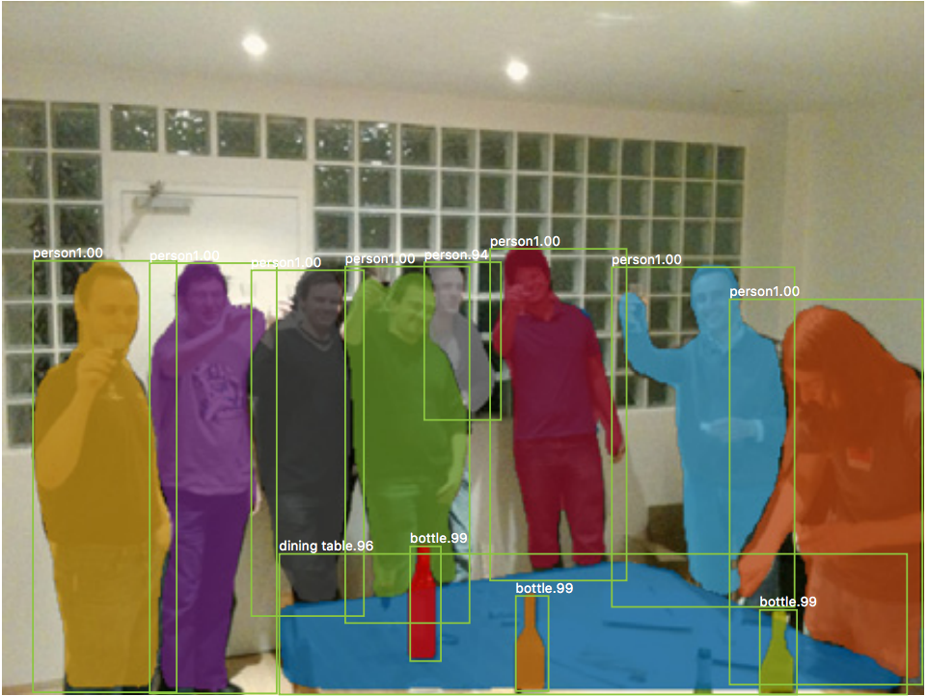
What cues can we use? Data + Machine Learning
Mask R-CNN. Kaiming He, Georgia Gkioxari, Piotr Dollar, Ross Girshick. ICCV 2017
Notes:
Here’s the top performing modern system that marks the boundaries of a bunch of objects, trained on the same kind of data.
In this course, we will go into some of these machine learning models and their key ideas.

Slide 44
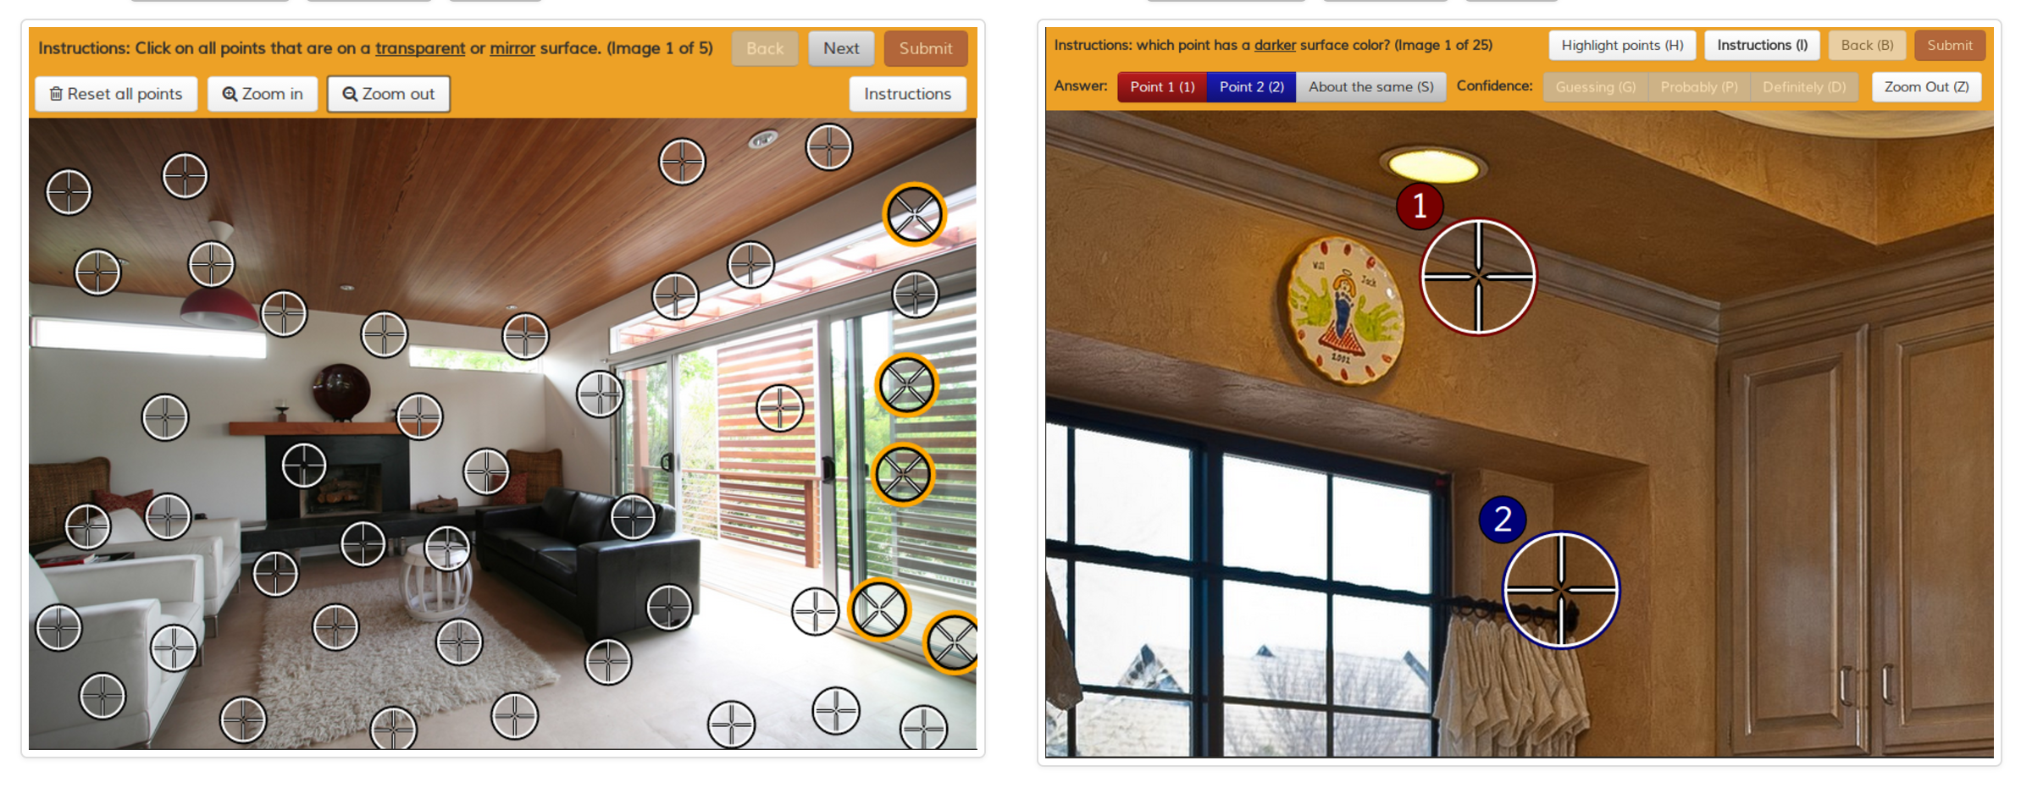
What cues can we use? Data + Machine Learning
Intrinsic Images in the Wild
Sean Bell, Kavita Bala, Noah Snavely Cornell University
ACM Transactions on Graphics (SIGGRAPH 2014)
Notes:
This approach of collecting data, getting humans to label them, and then teaching machines to do the same thing using this data, jas proven to be surprisingly general. You can also get people to label which image patch is in shadow or which is in light, and then use it to teach computers to do the same thing.

Slide 45
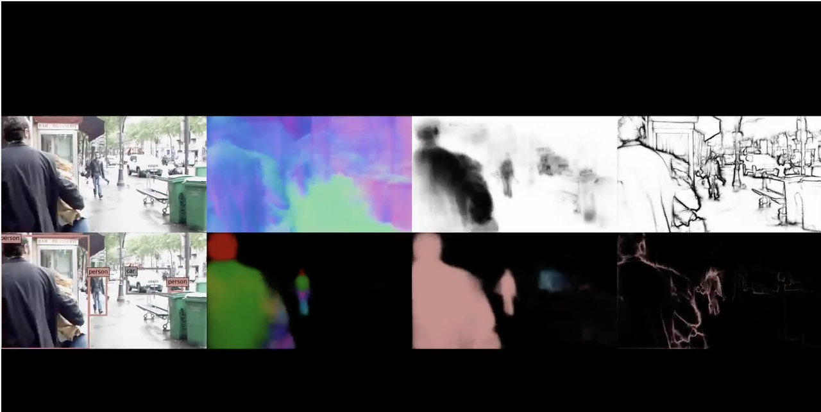
Tool 2: Data + Machine Learning
UberNet: Training a ‘Universal’ CNN for Low-, Mid-, and High- Level Vision using Diverse Datasets and Limited Memory. I. Kokkinos, CVPR 2017
Notes:
Here’s the output of a fairly middle-of-the-rung system that has been trained to mark boundaries of objects, divide them into parts, estimate the orientation of the surface and so on. As you can see, it actually works fairly well.

Slide 46
The problems of tomorrow: Better, Faster, Stronger
Deep Residual Learning for Image Recognition Kaiming He, Xiangyu Zhang, Shaoqing Ren, and Jian Sun. CVPR 2016.
Notes:
So what next? What’s driving the field in the coming years?
The first obvious thing is to just make the existing systems better and better.
For instance, a line of work has been developing stronger and stronger convolutional networks that extract more and more signal out of the data.

Slide 47
The problems of tomorrow: Answering free-form questions
VQA: Visual Question Answering
S. Antol, A. Agarwal, J. Lu, M. Mitchell, D. Batra, C. L. Zitnick, D. Parikh.
ICCV 2015
Notes:
A different direction is to get computer vision systems to do more.
For example, a recent line of work asks: can we get computers to answer really arbitrary questions about images?
In this case, perhaps the computer needs to not only identify objects in the scene, but reason about the relationships between the objects and perhaps even understand what is actually going on.

Slide 48
The problems of tomorrow: Geometric Reasoning + Learning
Use geometry to impose constraints on learning.
Unsupervised Learning of Depth and Ego-motion from Video Tinghui Zhou, Matthew Brown, Noah Snavely, David Lowe In CVPR 2017
Notes:
Second, I described these two tools, one geometry and the other data, and techniques based on these have often inhabited two parallel universes till now. This is changing. For example, in this work, the authors tried to use geometry to constrain what our black box machine learning models were learning.
I won’t go into details here, but the basic idea is to make sure the outputs produced by the machine learning model are consistent geometrically.

Slide 49
The problems of tomorrow: Machine Learning without Annotations
Philippine Tarsier
Notes:
Third, I mentioned that our current machine learning models require tons and tons of labeled data.
This massive amount of labeling is really expensive.
It is also completely unlike how humans learn.
We can understand new objects and new categories from very little data.
For example…

Slide 50
Philippine Tarsier
Philippine Tarsier

Slide 51
Beaver
Philippine Tarsier

Slide 52
Mouse Lemur
Philippine Tarsier

Slide 53
Lessons from infant development
Infants spend a long time observing and randomly playing with the world…
…then take a long time to learn first few visual concepts…
…but then learn novel concepts with very little data

Slide 54
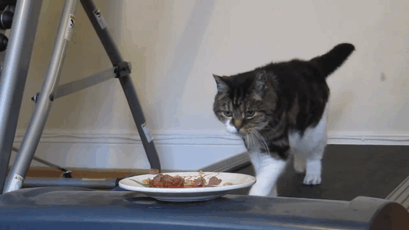
Machine Learning without Annotations
Learning Features by Watching Objects Move Deepak Pathak, Ross Girshick, Piotr Dollár, Trevor Darrell, Bharath Hariharan CVPR, 2017
Notes:
Another aspect of human vision is that a lot of the development of the visual senses happens before infants learn anything about cats or dogs or cars. In fact, one could argue that a majority of the visual learning happens without any “class labels” at all. Indeed, you have likely never seen a parent show a kid a thousand different cars before she understands what a car is. What are humans doing, and again, can we replicate that in machines. This general question is the subject of much research. In this paper that I was involved in, we tried to use the idea that human infants see videos, not images, and in videos, interesting objects seem to pop out.

Slide 55
Machine Learning without Annotations
:
:
B. Hariharan, R. Girshick. Low-shot Visual Recognition by Shrinking and Hallucinating Features. In ICCV, 2017.
Notes:
The main reason why learning from a few examples is hard is that real-world objects have many modes of variation. For instance, if your category of interest is a particular kind of bird, then that bird can be flying in the sky, perching on a branch, close to the camera, far away, occluded and so on. One or two examples are not enough to cover all these modes of variation. Our key insight is that many of these modes of variation are actually shared across categories. For instance, the same modes of variation will be found in other birds that you may have seen before. So if we can identify recurring modes of variation in categories we have seen, we can try to transfer these to the nopvel class examples we have, and so generate additional training examples.

Slide 56
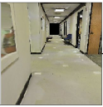
Integrating Vision and Action
Plan
Turn left
Map
Cognitive Mapping and Planning for Visual Navigation
Saurabh Gupta, James Davidson, Sergey Levine, Rahul Sukthankar, Jitendra Malik
CVPR 2017
Notes:
Finally, recall that I mentioned that a goal of computer vision is to extract enough information from the visual world so that it is useful to some downstream action you want to perform. For example, if you are building a robot that needs to move about in corridors, then you might be using the visual input to build a map, and then planning in that map. Instead of building vision systems to extract the right information, can we instead directly use machine learning to train the system to do the task we are interested in?
This has the advantage that we do not need to figure out exactly what it is that the vision system should extract, and also, by doing so maybe the mapping and planning modules can learn to be resistant to the errors in the vision.

Slide 57
This course: Learning outcomes
Explain intuitively and mathematically the following basic ideas in computer vision and implement relevant modules in code: The geometry and physics of image formation
Statistical properties of images
Basic image processing techniques: Edge detection, corner detection, convolution

Slide 58
This course: Learning outcomes
For any computer vision problem, including reconstruction, reorganization or recognition problems, answer the following questions:
What are the inputs and required outputs?
Why should we care about this problem?
What are the constraints / challenges?
What are the cues that we can use?
How do we design an algorithm using these cues?
What are the limitations of the algorithm used?

Slide 59
This course: Learning outcomes
Do good research, including the following skills:Critiquing research papers
Choosing a research problem to work on
Performing careful experiments: designing and testing hypothesis
Writing and presenting technical work
Understanding the impact of and effect on bias and inequalities; ethical implications of AI research

Slide 60
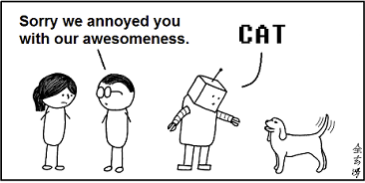
Welcome!
pic credit: abstruse goose

