Slide 1
Optical flow

Slide 2
Estimating optical flow
Yet another correspondence problem!
But:
  Bad: scene can move
  Good: changes are usually small (classic optical flow problem: <1 pixel)

Slide 3
Optical flow constraint equation
Image intensity continuous function of x, y, t
In time dt, pixel (x,y,t) moves to (x + dx, y + dy, t + dt)
Want: I(x+dx, y + dy, t+dt) = I(x,y,t)

Slide 4
Horn-Schunk
Data
Smoothness

Slide 5
MPI-Sintel
Open-source animated movie “Sintel”
“Naturalistic” video
Ground truth optical flow
Large motions
Complex scenes

Slide 6

MPI-Sintel results

Slide 7
Optical flow with large displacements
Optical flow constraint equation assumes differential optical flow
“Large displacement”?
Key idea: reducing resolution reduces displacement
Reduce resolution, then upsample?
3
6
13
24
27

Slide 8

Optical flow with large displacements
Optical flow constraint equation assumes differential optical flow
“Large displacement”?
Key idea: reducing resolution reduces displacement
Reduce resolution, then upsample?
  will lose fine details

Slide 9
Optical flow with large displacements
Key idea 2: Use upsampled flow as initialization
Changes to initialization will be infinitesimal
compute flow
use as init
compute flow
…
Brox, Thomas, et al. "High accuracy optical flow estimation based on a theory for warping." Computer Vision-ECCV 2004 (2004)

Slide 10
Coarse-to-fine processing
A specific instance of a general idea
Coarse scales:
  Global / large structures
  Long-range relationships
  But: imprecise localization
Fine scales:
  Precise localization
  But: aperture problem
Idea: start from coarse scales, add fine scale detail

Slide 11
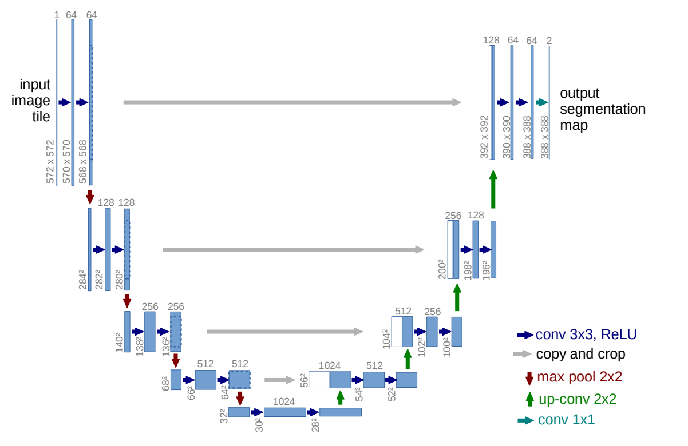
Coarse-to-fine processing
U-Net: Convolutional Networks for Biomedical Image Segmentation. Olaf Ronneberger, Philipp Fischer, and Thomas Brox. In MICCAI, 2015.

Slide 12
Optical flow for large displacements
Horn-schunk variants match using color - Bad!
Use descriptor matching (e.g. SIFT) on sparse points
Use smoothness to propagate
Brox, Thomas, Christoph Bregler, and Jitendra Malik. "Large displacement optical flow." CVPR, 2009.

Slide 13
Large displacement optical flow (LDOF)

Slide 14
Grouping

Slide 15
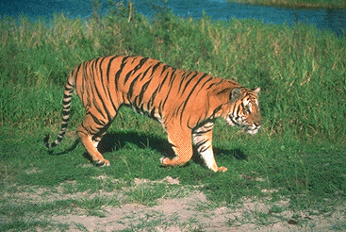
What is grouping?

Slide 16
Why grouping?
Pixels property of sensor, not world
Reasoning at object level (might) make things easy:
  objects at consistent depth
  objects can be recognized
  objects move as one
"I stand at the window and see a house, trees, sky. Theoretically I might say there were 327 brightnesses and nuances of colour. Do I have "327"? No. I have sky, house, and trees."
Max Wertheimer

Slide 17
Regions Boundaries

Slide 18
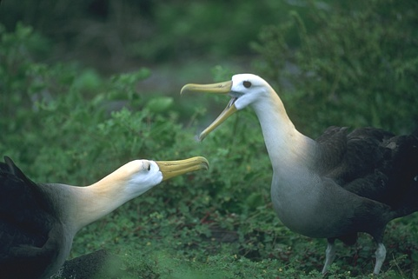
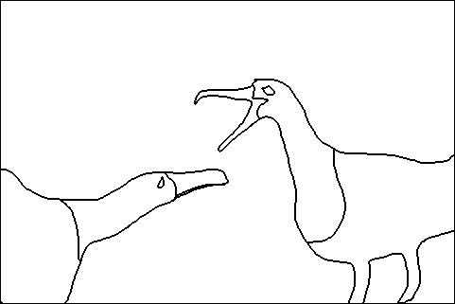
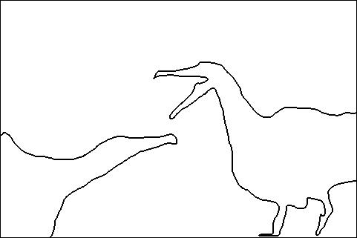
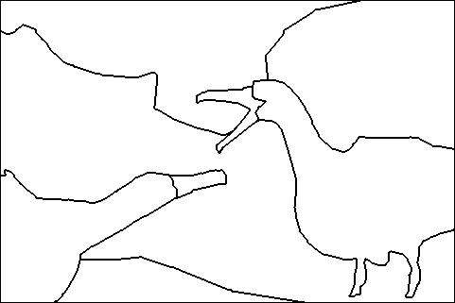
Is grouping well-defined?
Depends on purpose
  Object parts
  Background segmentation
A
B
C

Slide 19
Is grouping well-defined?
A
Perceptual organization forms a tree:
Image
A
B
BG
L-bird
R-bird
B
C
grass
bush
far
beak
body
beak
body
C
eye
head
eye
head
D. Martin, C. Fowlkes, D. Tal, J. Malik. "A Database of Human Segmented Natural Images and its Application to Evaluating Segmentation Algorithms and Measuring Ecological Statistics", ICCV, 2001

Slide 20
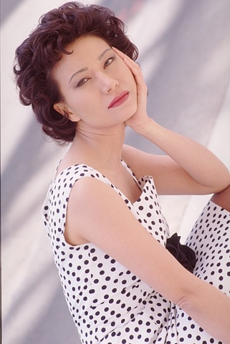

Image gradients are not enough

Slide 21
Image gradients are not enough
Plain
“Texture”
Polka dots

Slide 22
What is texture?
Same thing repeated over and over

Slide 23
What is texture?

Slide 24
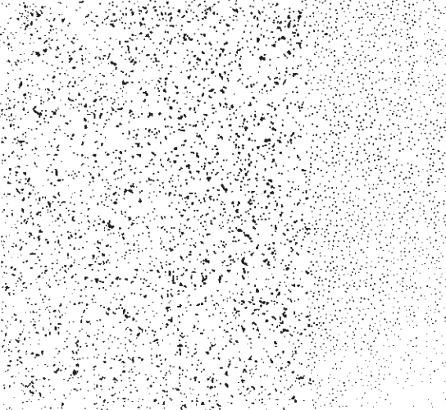
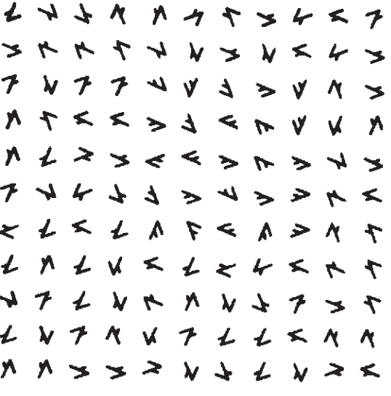
Julesz’s texton theory
Two modes of human vision
  Attentive vision - serial search by focal attention in 50 ms steps limited to a small aperture as in form recognition
  Pre-attentive vision - parallel, instantaneous, without scrutiny, independent of the number of patterns
Julesz, Bela. "Textons, the elements of texture perception, and their interactions." Nature 290.5802 (1981): 91-97.

Slide 25
Julesz’s texton theory
What texture properties are detected in pre-attentive vision?
Distributions of some elements
  Elongated blobs of specific orientations, widths, lengths
  Terminators (ends of line segments)
  Crossings of line segments
Textons

Slide 26
Bringing textons to computer vision
Define a “vocabulary” of textons
Describe texture by a distribution of different textons

Slide 27
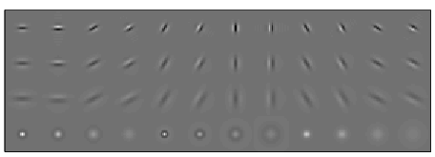
Bringing textons to computer vision
Define a “vocabulary” of textons
Describe texture by a distribution of different textons
Filter responses
Convolve with filter bank

Slide 28
Bringing textons to computer vision
Define a “vocabulary” of textons
Describe texture by a distribution of different textons
Filter responses
Convolve with filter bank
Collection of pixel feature vectors
…
Filter responses
Convolve with filter bank

Slide 29
Bringing textons to computer vision
Define a “vocabulary” of textons
Describe texture by a distribution of different textons
Collection of pixel feature vectors
k-means
Textons

Slide 30
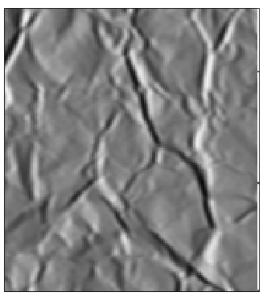
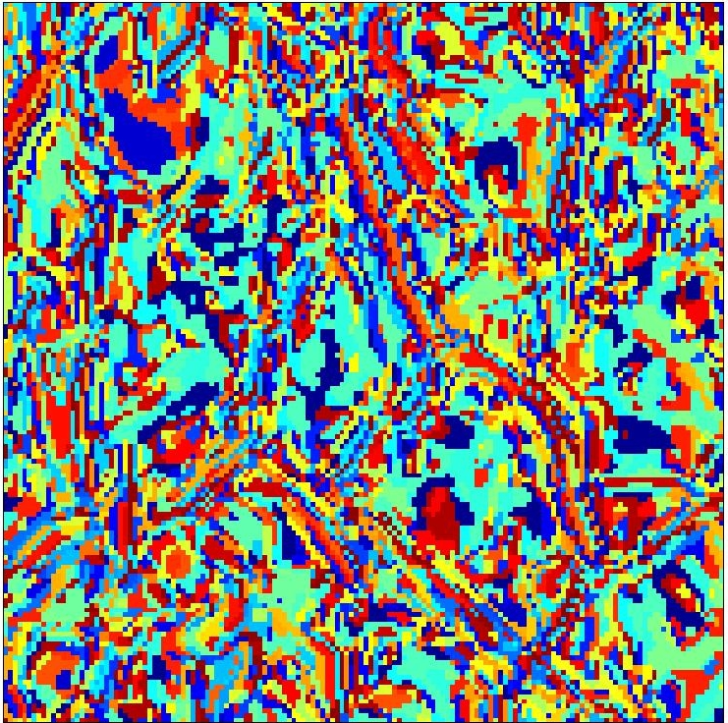
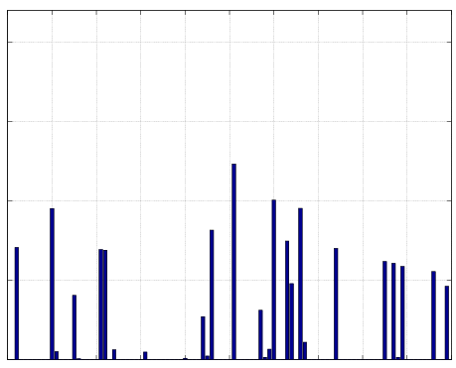
Bringing textons to computer vision
Define a “vocabulary” of textons
Describe texture by a distribution of different textons
Textons
Histogram
Leung, Thomas, and Jitendra Malik. "Representing and recognizing the visual appearance of materials using three-dimensional textons." International journal of computer vision 43.1 (2001): 29-44.

Slide 31
Textons in computer vision
Convolve with filter bank
Assign to k-means centers
Compute histogram
Image
Convolution
Point-wise non-linearity
Avg pooling
Image

Slide 32
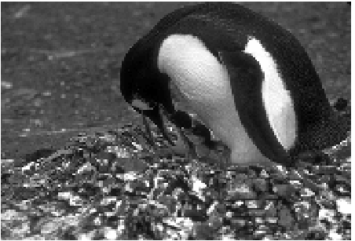
Detecting texture boundaries
Problem: gradient captures change from pixel to pixel
But texture property of region
Martin, David R., Charless C. Fowlkes, and Jitendra Malik. "Learning to detect natural image boundaries using local brightness, color, and texture cues." TPAMI (2004).

Slide 33
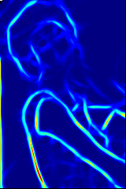
Cue combination
P_{b}
Image
Boundary Cues
Brightness
Color
Average
Texture
Martin, David R., Charless C. Fowlkes, and Jitendra Malik. "Learning to detect natural image boundaries using local brightness, color, and texture cues." TPAMI (2004).

Slide 34
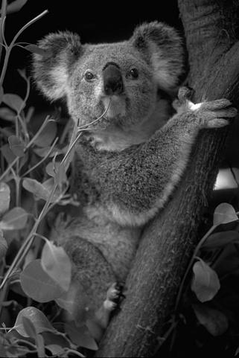

Local computation not enough

Slide 35
“Globalisation”

Slide 36
Images as graphs
Each pixel is node
Edge between neighboring pixel
Weight of edge = 1 - magnitude of gradient (say)

Slide 37
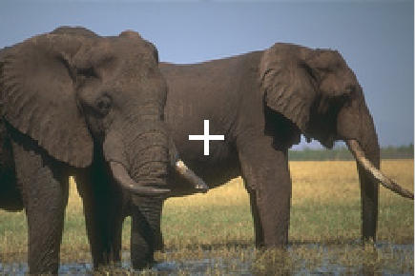
Images as graphs
Enhancement: edge between far away pixel, weight = 1 – magnitude of intervening contour

Slide 38
Segmentation is graph partitioning

Slide 39
Criterion: Min-cut?

Slide 40
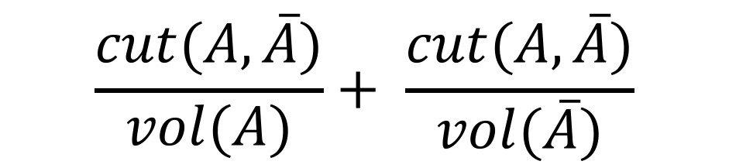
Normalized cut
$$\frac{cut(A, \overline{A})}{vol(A)}+ \frac{cut(A,\overline{A})}{vol(\overline{A})}$$

Slide 41
Random walk

Slide 42
Random walk

Slide 43
Random walk

Slide 44
Random walk

Slide 45
Random walk

Slide 46
Random walk

Slide 47
Random walk

Slide 48
Random walk
Key idea: Partition should be such that ghost should be likely to stay in one partition

Slide 49

Graphs and matrices
w(i,j) = weight between i and j
d(i) = degree of i =$\sum_{j}{w(i,j)}$
D = diagonal matrix with d(i) on diagonal

Slide 50
Graphs and matrices
x(0) : one-hot encoding of position of ghosts (or one-hot encoding of partition)
x(1) = WD⁻¹x(0)
Want x(1) = x(0)
Want y s.t y = WD⁻¹y
  Or z = D^{-0.5}WD^{-0.5}z
  Or (I-D^{-0.5}WD^{-0.5})z = 0
Avoid trivial solution
second smallest eigenvector of I - D^{-0.5}WD^{-0.5}
Normalized graph laplacian

Slide 51
Graphs and matrices

Slide 52
Normalized cuts
NP Hard
But approximation using eigenvector of normalized graph laplacian
  Smallest eigenvector : all 1s
  Second smallest eigenvector: good partition

Slide 53
Spectral clustering
Given graph, compute eigenvectors of normalized Laplacian
Use first few eigenvectors as embedding for each node
Cluster using k-means
Eigenvectors summarize connectivity of the graph

Slide 54
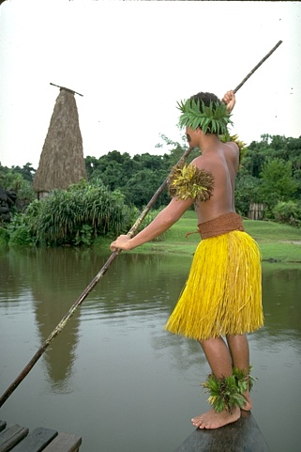


Eigenvectors of images

Slide 55
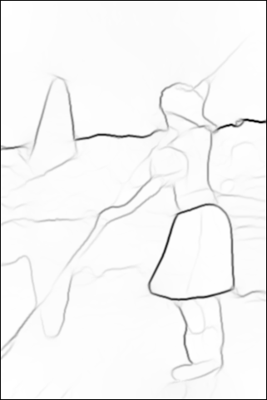
Eigenvectors of images

Slide 56
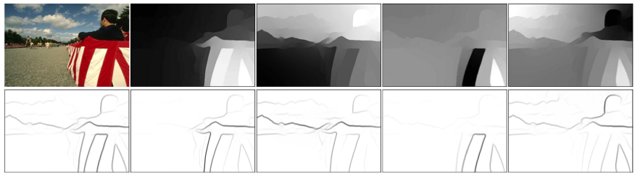
Eigenvectors of images

Slide 57
Segmentation is not good enough
No segmentation good enough
Possibly require recognition?

Slide 58
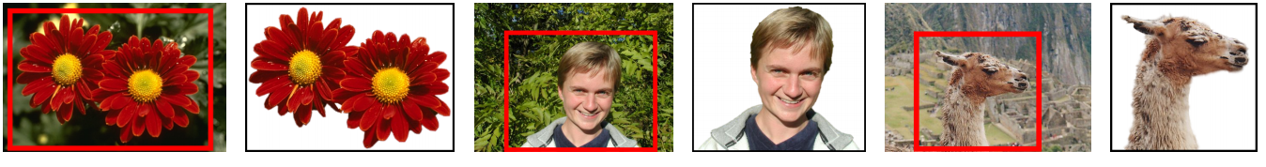
Guided segmentation

Slide 59
Guided segmentation
Use-case: recognition machinery gives coarse signal
Use coarse signal to separate foreground and background
Initial foreground score for each pixel
Use smoothness to propagate score, except at image edges
y = 1 for foreground and 0 for background

Slide 60
Markov Random Fields (MRFs)
Hammersley-clifford theorem
Unary potential
Binary potential

Slide 61
MRF Inference and graph cuts
Fun fact: for binary MRFs with associative binary potentials, MAP inference = min-cut!
  Binary MRF : label space 0/1
  Associative binary potential: potential that encourages smoothness
  MAP inference: finding most likely labeling

Slide 62
Segmentation as object proposals
Core idea: try several different segmentations
Construct pool of plausible segmentations
Let recognition machinery choose the best one

Slide 63
Segmentation as object proposals
Key idea: diversification
Aim for recall
Possible ideas:
  Run segmentation on multiple color spaces using multiple algorithms
  Consider pairs and triplets of segmentations
  Consider guided segmentation with various foreground seeds

Slide 64
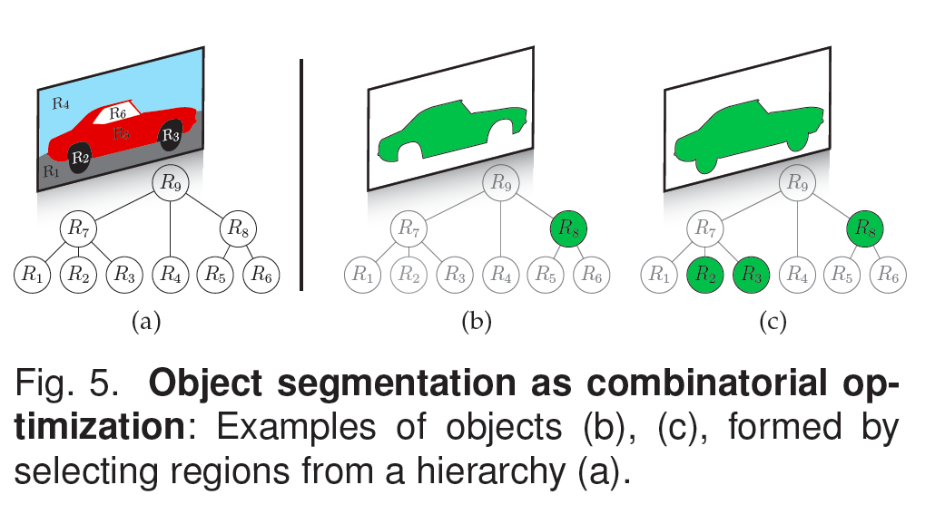

Slide 65
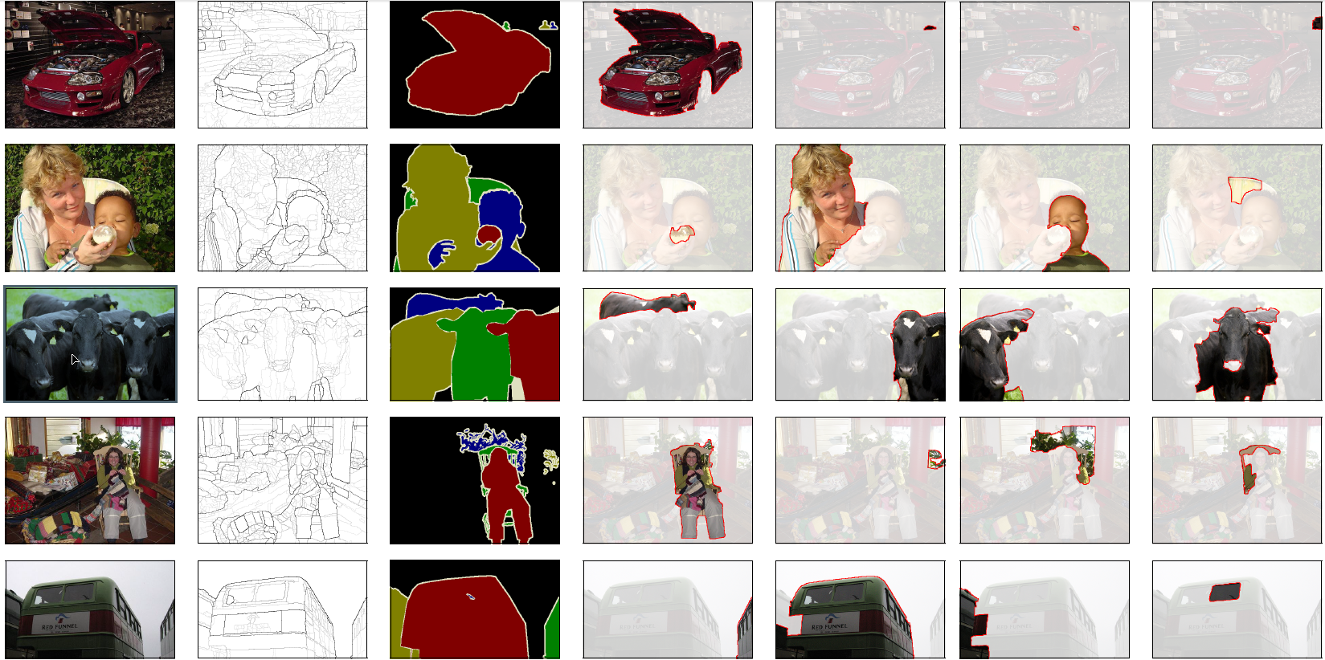
Examples

