Slide 1
Announcements
Partner finding social : Today 7 pm, Phillips 203
Vote on piazza for GPUs

Slide 2
Dense correspondence (continued)

Slide 3
An example binocular stereo algorithm
Get images
Extract interest points / keypoints
Match keypoints using SIFT
Use RANSAC to fit E and get set of inlier matches
Use inliers to triangulate

Slide 4
Dense correspondence
Only correspondence at interest points?
Setup: assume rectified images
  Correspondence only along scan-lines
  Can be represented using disparity

Slide 5
Dense correspondence

Slide 6
Dense correspondence

Slide 7
Dense correspondence
Goal: Assign disparity value to each pixel
Problem: most pixels will be ambiguous
Solution: propagate from unambiguous to ambiguous pixels
Basic idea: nearby pixels likely to have same disparity (smoothness)

Slide 8
Dense correspondence
Obtain disparity through optimization
Based on e.g NCC distance
(d(i,j) – d(k,l))²

Slide 9
Detour: Graphical models
Probabilistic models with graphs
Nodes are variables
Edges determine dependency structure
It is 8 am
Alarm rings
I wake up
Naughty roommate
Roommate sets up prank

Slide 10
Markov Random Fields (MRFs)
Probabilistic model
Represented by graph
Each node is random variable
Edges represent dependence structure
  independent of given all

Slide 11
Markov Random Fields (MRFs)
Hammersley-clifford theorem
Unary potential
Binary potential

Slide 12
Dense correspondence as MRFs
Obtain disparity through optimization
Random variable: disparity
Find most likely disparity
Based on e.g NCC distance
(d(i,j) – d(k,l))²

Slide 13
Aligning depth boundaries to image boundaries
Some pairs more likely to have same disparity
w(i,j) (d(i,j) – d(k,l))²
w(i,j) = 0 for edges
Conditional Random Field (CRF)

Slide 14
Other applications of MRFs / CRFs
Semantic Image Segmentation with Deep Convolutional Nets and Fully Connected CRFs.
Liang-Chieh Chen*, George Papandreou*, Iasonas Kokkinos, Kevin Murphy, and Alan L. Yuille. In ICLR, 2015

Slide 15
Optimizing MRFs
NP-Hard
Approximate solutions
  Message passing
  Mean field-based inference
  Graph cut-based solutions
A comparative study of energy minimization methods for markov random fields with smoothness-based priors. Szeliski, R., Zabih, R., Scharstein, D., Veksler, O., Kolmogorov, V., Agarwala, A., Tappen, M. and Rother, C. In TPAMI, 2008.

Slide 16
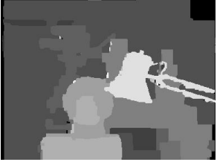
Dense correspondence with MRFs

Slide 17
Optical flow

Slide 18
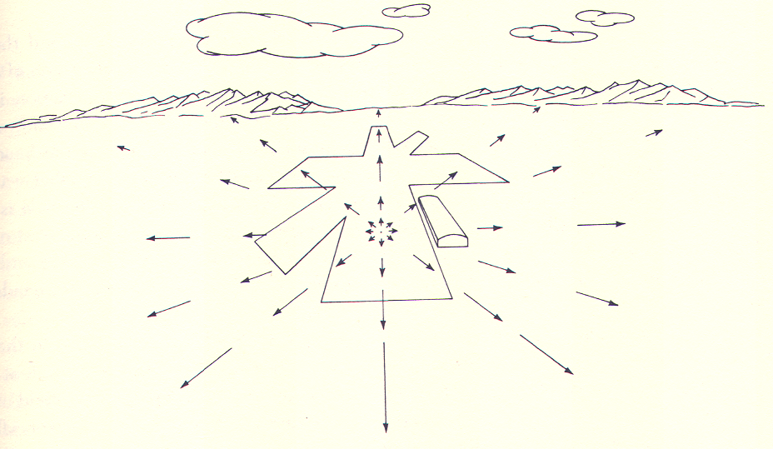
J. J. Gibson

Slide 19
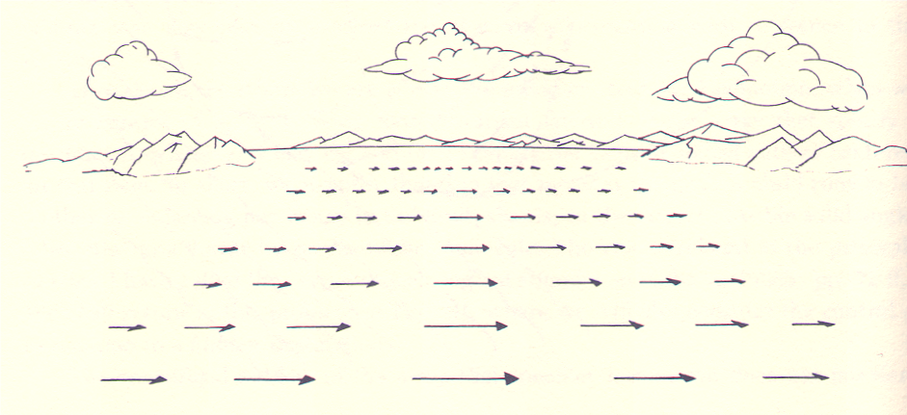

Slide 20
Optical flow due to camera motion
Consider camera translating and rotating

Slide 21
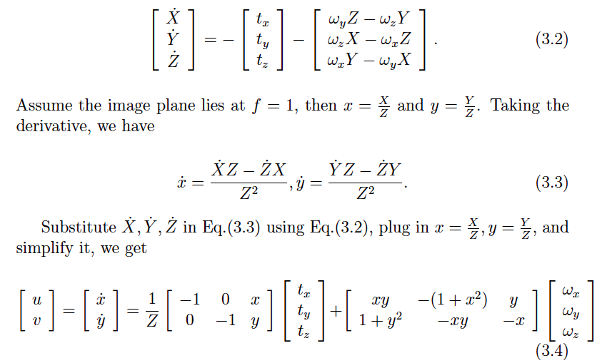
Optical flow due to camera motion

Slide 22
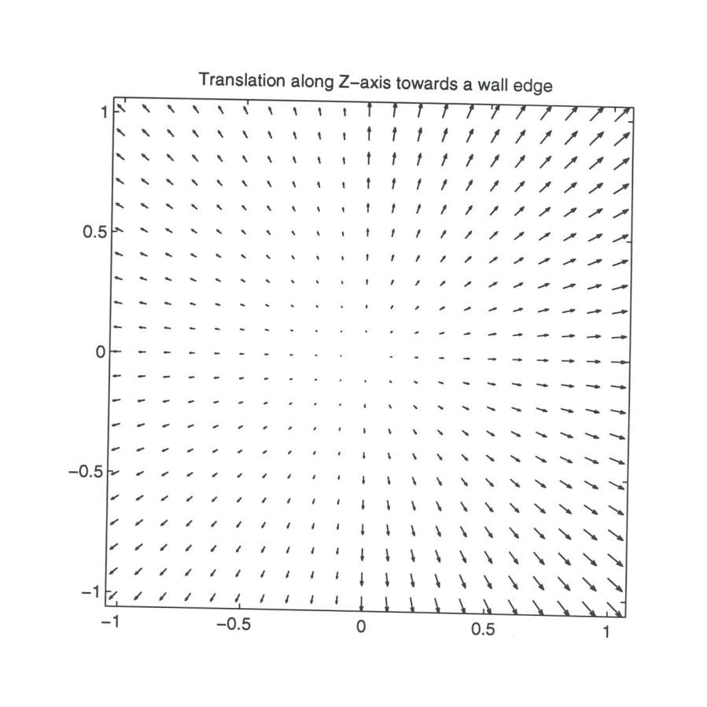
Focus of expansion

Slide 23
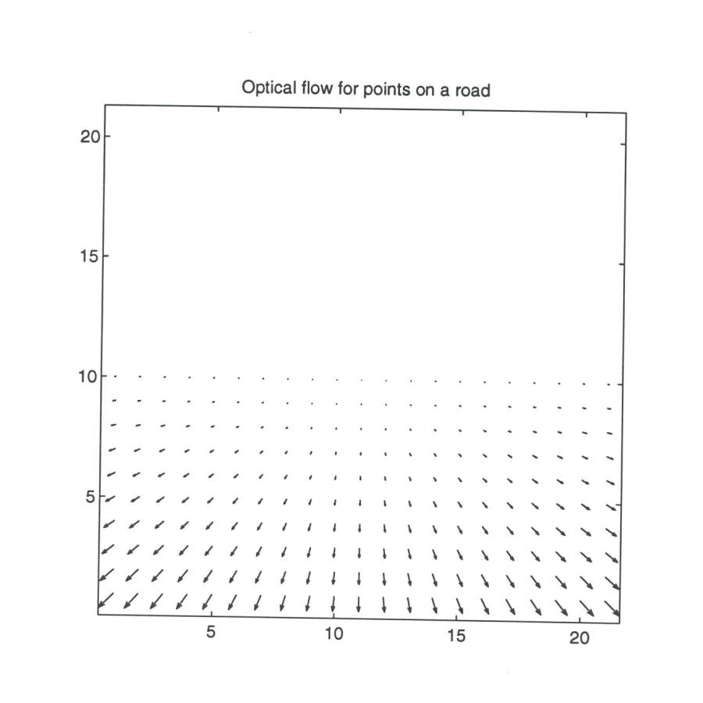

Slide 24
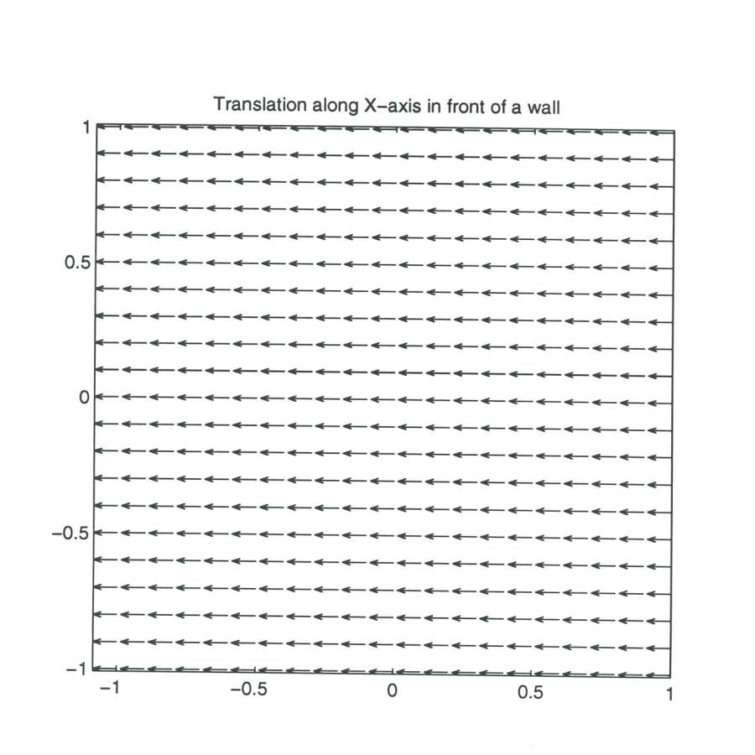

Slide 25
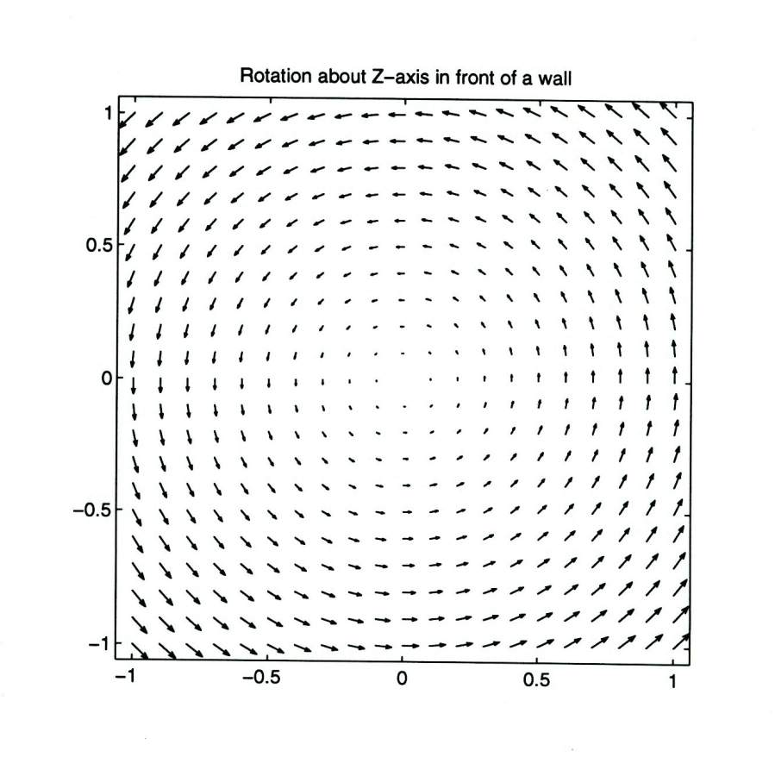

Slide 26
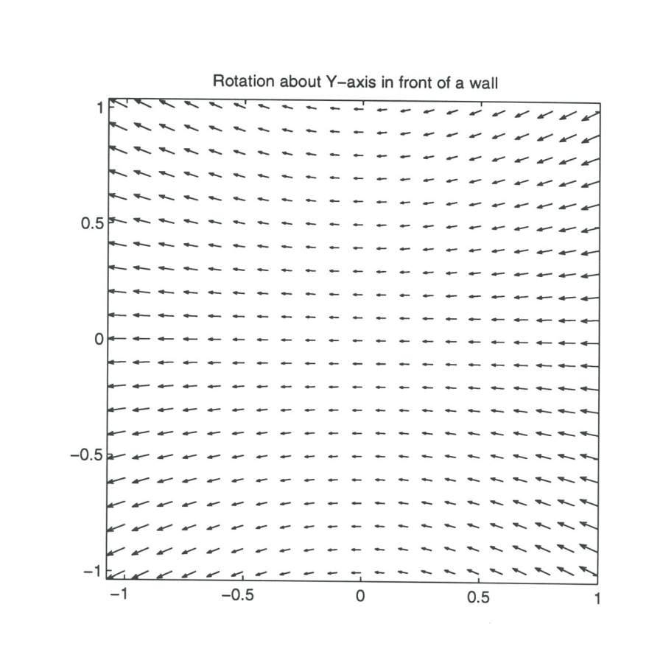

Slide 27
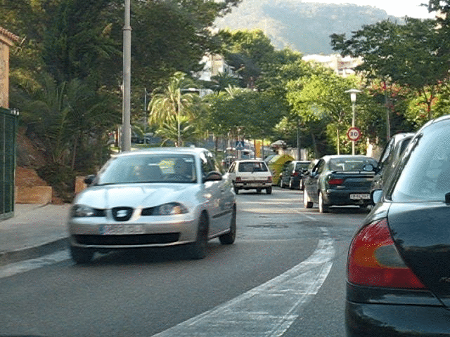
Optical flow for moving scenes

Slide 28
Optical flow for moving scenes

Slide 29
Optical flow for moving scenes
Optical flow helps grouping
Gestalt principle of common fate
  Things that move together belong together

Slide 30
Motion segmentation in humans
Elizabeth Spielke. Principles of Object Perception. In Cognitive Science, 1990.
Notes:
There is evidence from human psychology that this is a really important cue. For example, if you show really young infants this static display on the left, then they cannot distinguish between the two options on the right. In other words, they are unable to decide if the two halves of the rod form a single unified object, or whether they are indeed two rods.

Slide 31
Motion segmentation in humans
Elizabeth Spielke. Principles of Object Perception. In Cognitive Science, 1990.
Notes:
However, if you show infants this moving display

Slide 32
Motion segmentation in humans
Elizabeth Spielke. Principles of Object Perception. In Cognitive Science, 1990.
Notes:
Then they do perceive the rod as connected. This suggests that very young infants are unable to perceive any sort of depth ordering in the static image, but when objects move, they actually use the fact that things that move together form part of a single object.

Slide 33
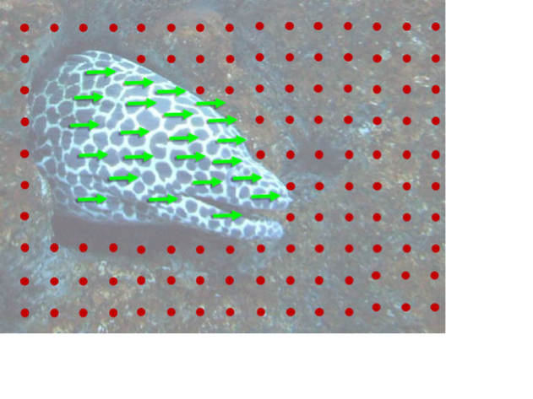
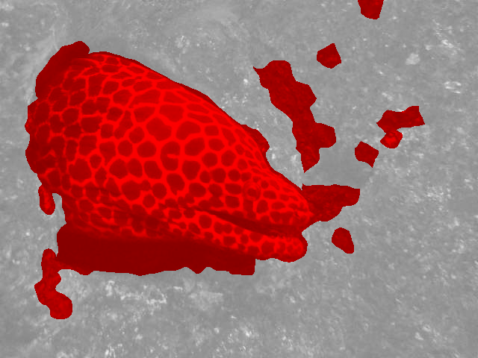
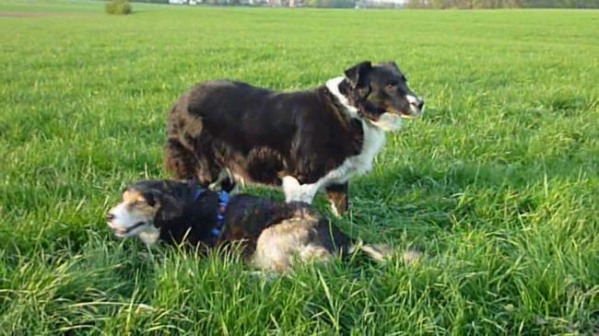
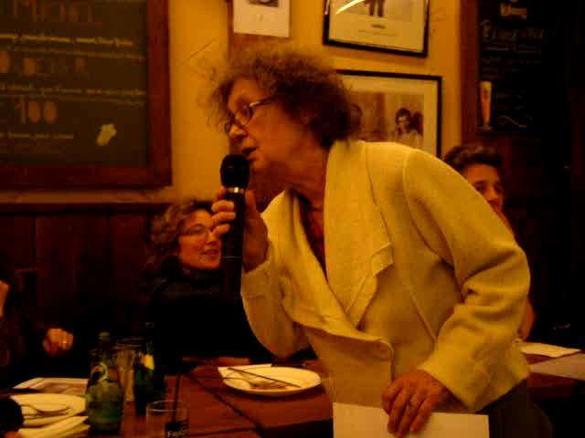
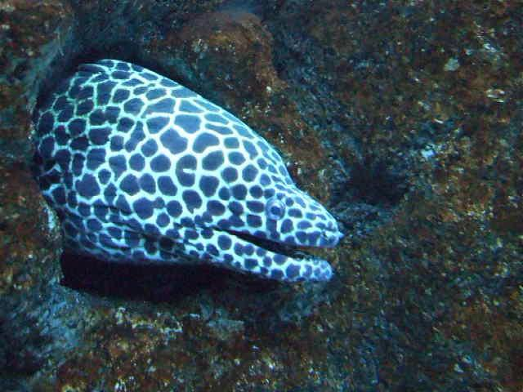
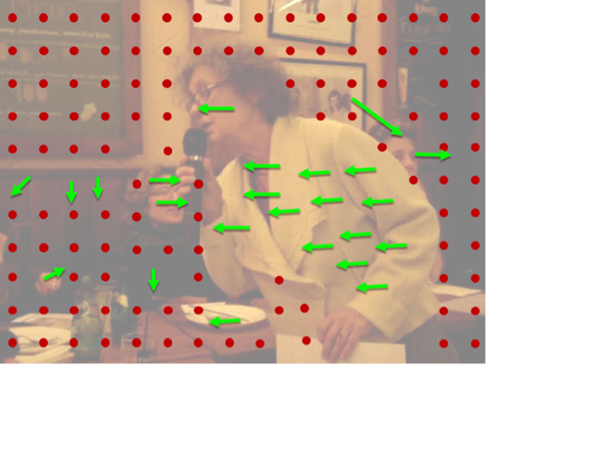
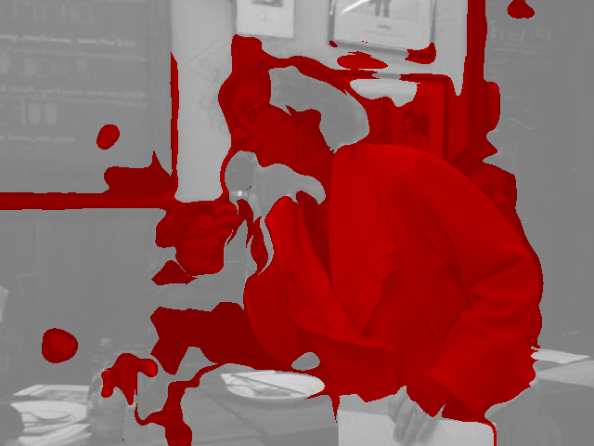
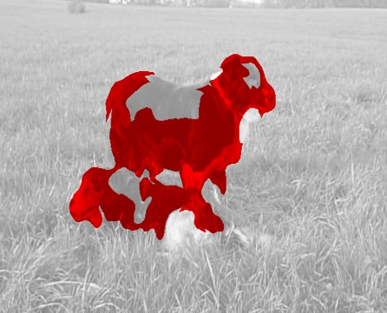
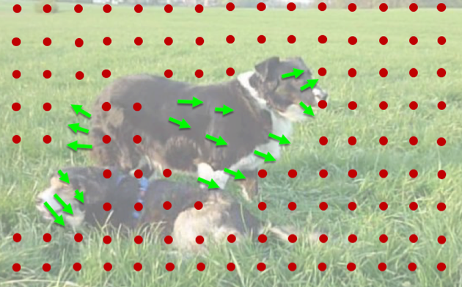
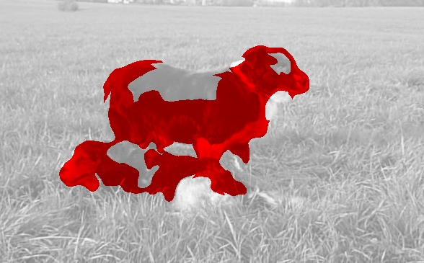


1. Collect videos
2. Segment using motion
3. Train ConvNet
Learning Features by Watching Objects Move. D. Pathak, R. Girshick, P. Dollar, T. Darrell, B. Hariharan. CVPR, 2017.
Notes:
This led to a fairly straightforward approach to learning representations in an unsupervised manner: we collected a large number of uncurated videos, we used motion grouping to segment out the foreground in each frame, and then we trained a ConvNet to predict this foreground segmentation

Slide 34
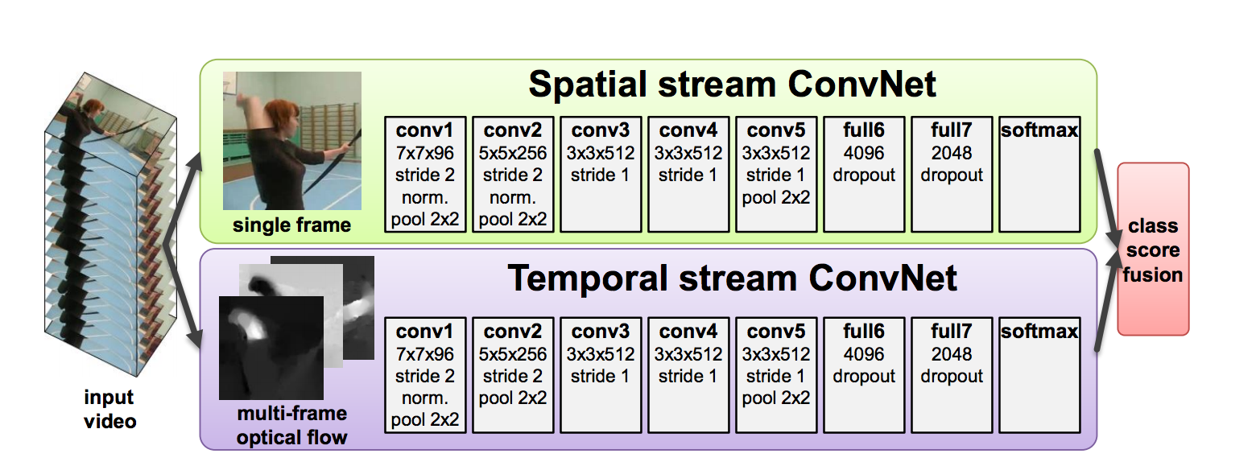
Optical flow for moving scenes
Motion is cue for recognition
  Gestures, actions, …
Two-Stream Convolutional Networks for Action Recognition in Videos. Simonyan and Zisserman. In NIPS 2014.

Slide 35
Optical flow for moving scenes
Motion is cue for recognition
  Gestures, actions, …
Model | Accuracy
Without optical flow | 73.0%
With optical flow | 88.0%
Two-Stream Convolutional Networks for Action Recognition in Videos. Simonyan and Zisserman. In NIPS 2014.

Slide 36
Estimating optical flow
Yet another correspondence problem!
But:
  Bad: scene can move
  Good: changes are usually small (classic optical flow problem: <1 pixel)

Slide 37
Optical flow constraint equation
Image intensity continuous function of x, y, t
In time dt, pixel (x,y,t) moves to (x + dx, y + dy, t + dt)
Want: I(x+dx, y + dy, t+dt) = I(x,y,t)

Slide 38
Lucas-Kanade
Assume all pixels in patch have the same flow
Corners again!

Slide 39
Horn-Schunk
Data
Smoothness

Slide 40
Horn-Schunk
Data
Smoothness

Slide 41
Variational minimization
u and v are functions
Euler-lagrange equations
  Similar to “gradient=0”

Slide 42
Variational minimization

Slide 43
MPI-Sintel
Open-source animated movie “Sintel”
“Naturalistic” video
Ground truth optical flow
Large motions
Complex scenes

Slide 44

MPI-Sintel results

Slide 45
Optical flow with large displacements
Optical flow constraint equation assumes differential optical flow
“Large displacement”?
Key idea: reducing resolution reduces displacement
Reduce resolution, then upsample?
  will lose fine details
3
6
13
24
27

Slide 46
Optical flow with large displacements
Key idea 2: Use upsampled flow as initialization
Changes to initialization will be infinitesimal
compute flow
use as init
compute flow
…
Brox, Thomas, et al. "High accuracy optical flow estimation based on a theory for warping." Computer Vision-ECCV 2004 (2004)

Slide 47
Coarse-to-fine processing
A specific instance of a general idea
Coarse scales:
  Global / large structures
  Long-range relationships
  But: imprecise localization
Fine scales:
  Precise localization
  But: aperture problem
Idea: start from coarse scales, add fine scale detail

Slide 48
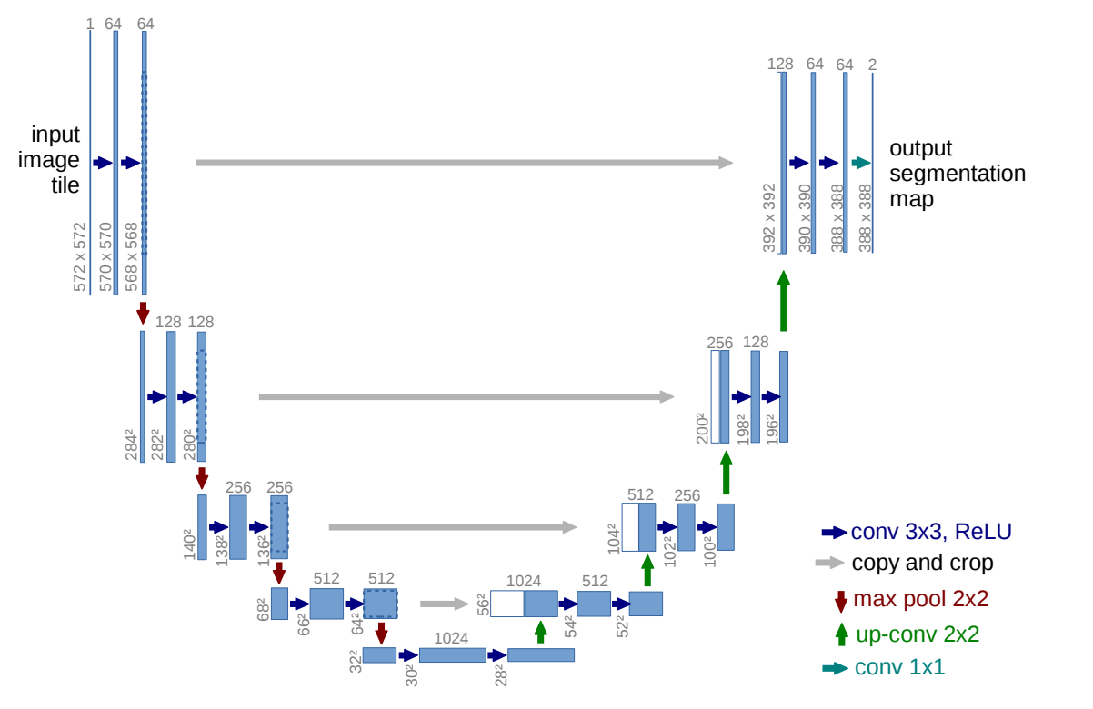
Coarse-to-fine processing
U-Net: Convolutional Networks for Biomedical Image Segmentation. Olaf Ronneberger, Philipp Fischer, and Thomas Brox. In MICCAI, 2015.

Slide 49
Optical flow for large displacements
Horn-schunk variants match using color - Bad!
Use descriptor matching (e.g. SIFT) on sparse points
Use smoothness to propagate
Brox, Thomas, Christoph Bregler, and Jitendra Malik. "Large displacement optical flow." CVPR, 2009.

Slide 50
Large displacement optical flow (LDOF)

