Slide 1
The correspondence problem

Slide 2
Till now
Geometry of image formation
Stereo reconstruction
Given 3D → 2D correspondence, find K, R, t
Given 2 images, correspondence, K, R, t, find 3D points
Given 2 images, correspondence, find F, E, R, t, 3D points

Slide 3
Till now
Geometry of image formation
Stereo reconstruction
Given 3D → 2D correspondence, find K, R, t
Given 2 images, correspondence, K, R, t, find 3D points
Given 2 images, correspondence, find F, E, R, t, 3D points

Slide 4
The correspondence problem

Slide 5
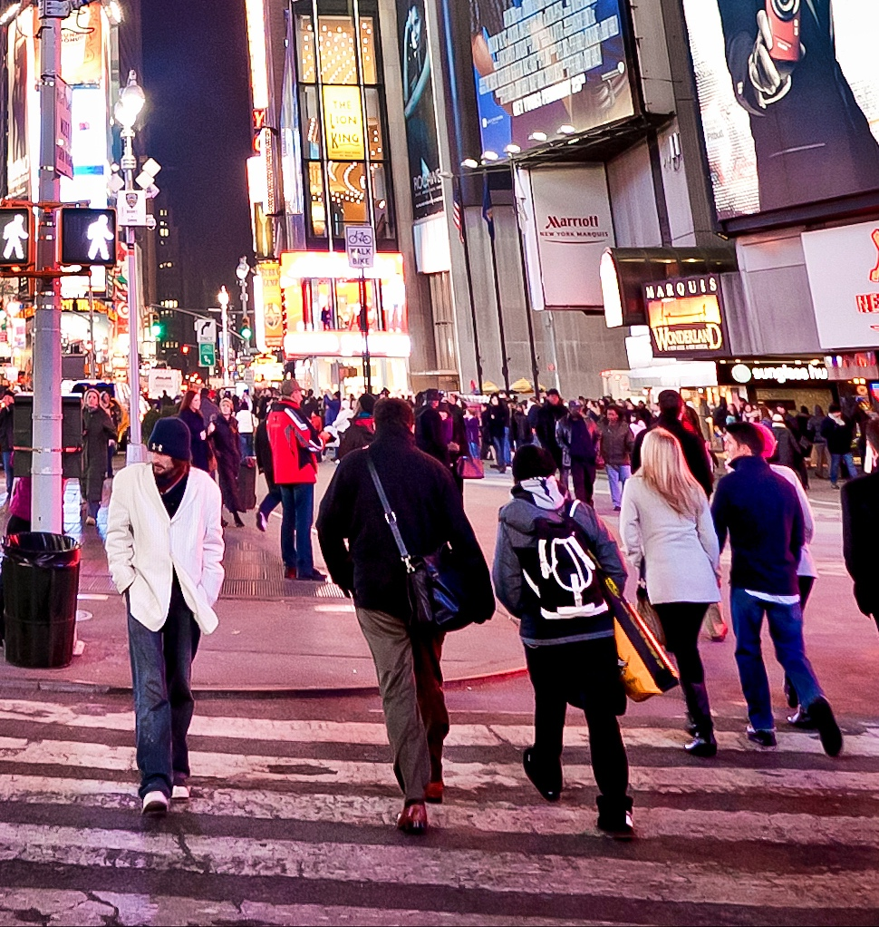
What does an image look like?
71 | 109 | 61 | 71 | 86
66 | 96 | 77 | 76 | 77
63 | 98 | 82 | 79 | 64
65 | 105 | 73 | 92 | 83
90 | 107 | 80 | 96 | 113

Slide 6
The aperture problem

Slide 7
The aperture problem
Individual pixels are ambiguous
Idea: look at whole patch!
71 | 109 | 61 | 71 | 86
66 | 96 | 77 | 76 | 77
63 | 98 | 82 | 79 | 64
65 | 105 | 73 | 92 | 83
90 | 107 | 80 | 96 | 113

Slide 8
The aperture problem
Individual pixels are ambiguous
Idea: Look at whole patches!

Slide 9
The aperture problem
Individual pixels are ambiguous
Idea: Look at whole patches!

Slide 10
The aperture problem
Some local neighborhoods are ambiguous

Slide 11
The aperture problem

Slide 12
Sparse correspondences
For many applications, a few good correspondences suffice
Camera calibration
Estimating essential matrix
Reconstructing a sparse cloud of 3D points
Detect points that will produce good correspondences
Match detected points from both images

Slide 13
Interest point detectors
Informative: Must be able to reliably match from two views
Reproducible: Must be detected in both views

Slide 14
Harris corner detector
Main idea: Translating patch should cause large differences
An example of an interest point detector

Slide 15
Detour: Basic edge detection

Slide 16
Images as functions
I : R²→R
Smooth
Can talk of derivatives, second derivatives etc.

Slide 17
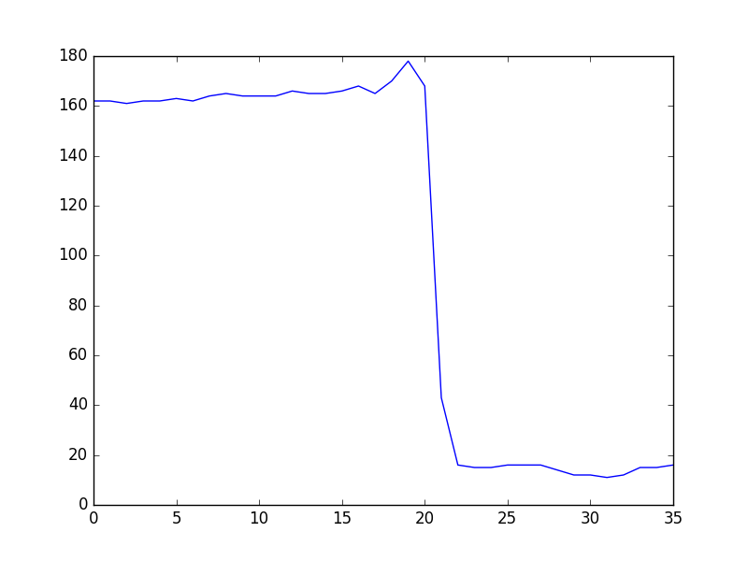

What are edges? 1D analog
Edge = where $|\frac{dI}{dt}|$is maximum

Slide 18
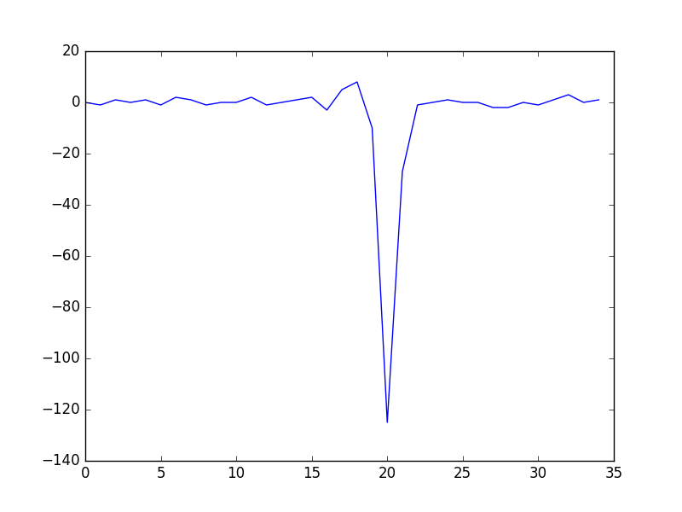
1D analog

Slide 19
Images as signals
Signals over spatial domain

Slide 20
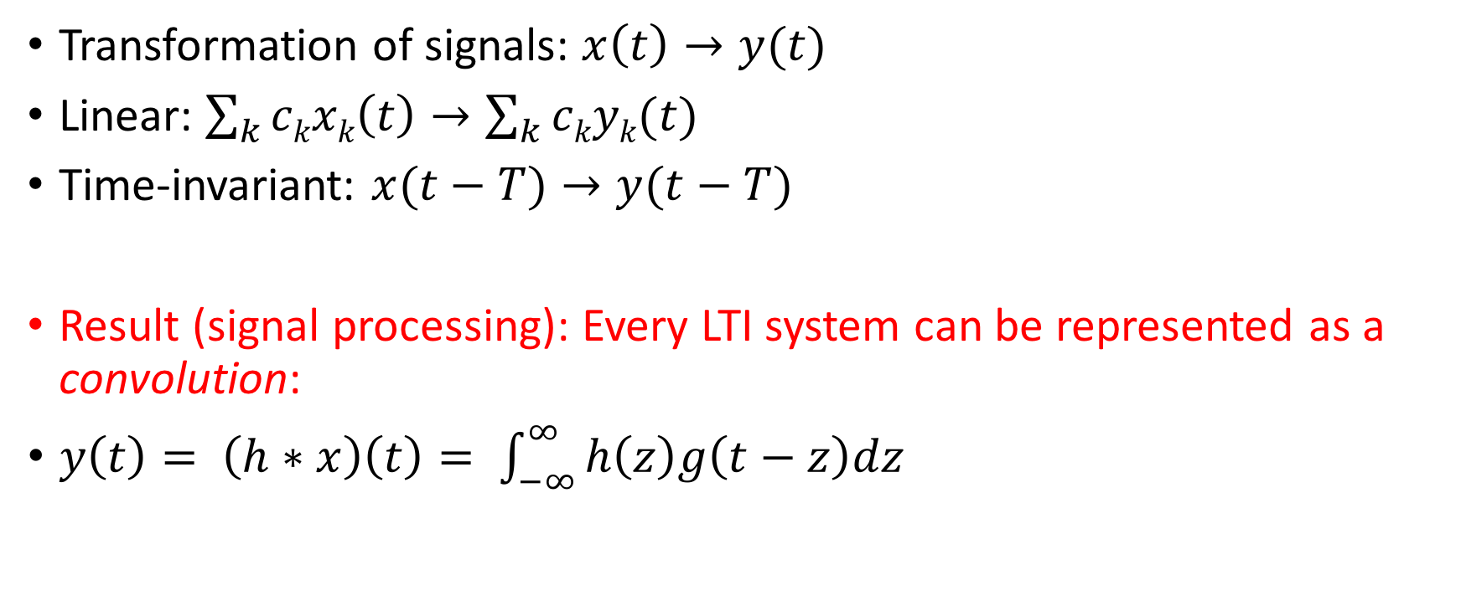
Linear Time-Invariant Systems
Transformation of signals: $x\left(t\right)→y(t)$
Linear: $\sum_{k}{ckxk\left(t\right)→\sum_{k}{ckyk(t)}}$
Time-invariant: $x(t−T)→y(t−T)$
Result (signal processing): Every LTI system can be represented as a convolution:
$y\left(t\right)= \left(h∗x\right)\left(t\right)= \int_{−∞}^{∞}{h\left(z\right)g\left(t−z\right)dz}$

Slide 21
Convolution

Slide 22
Convolution

Slide 23
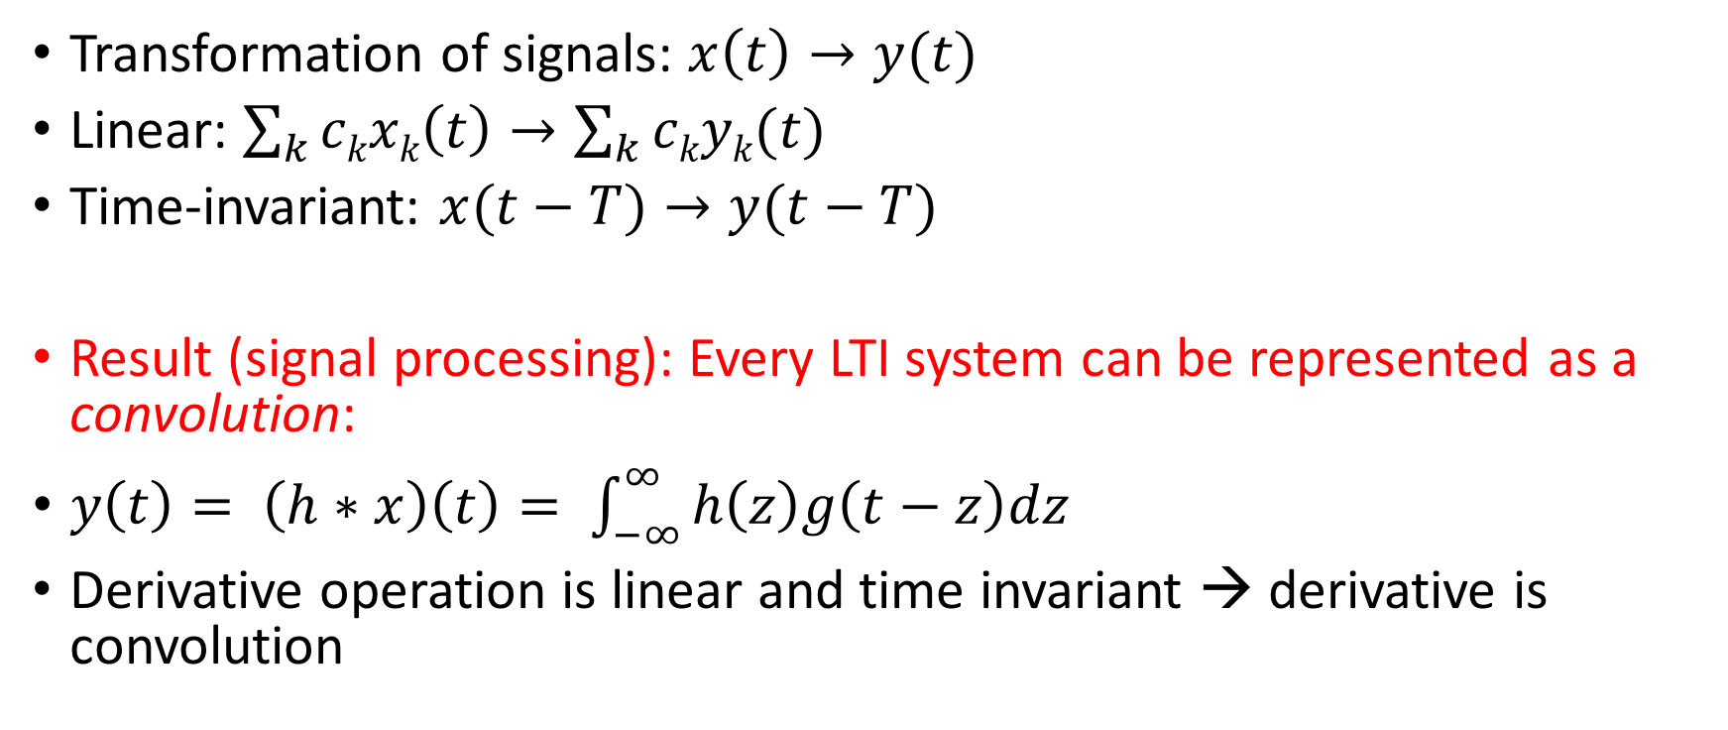
Linear Time-Invariant Systems
Transformation of signals: $x\left(t\right)→y(t)$
Linear: $\sum_{k}{ckxk\left(t\right)→\sum_{k}{ckyk(t)}}$
Time-invariant: $x(t−T)→y(t−T)$
Result (signal processing): Every LTI system can be represented as a convolution:
$y\left(t\right)= \left(h∗x\right)\left(t\right)= \int_{−∞}^{∞}{h\left(z\right)g\left(t−z\right)dz}$
Derivative operation is linear and time invariant → derivative is convolution

Slide 24
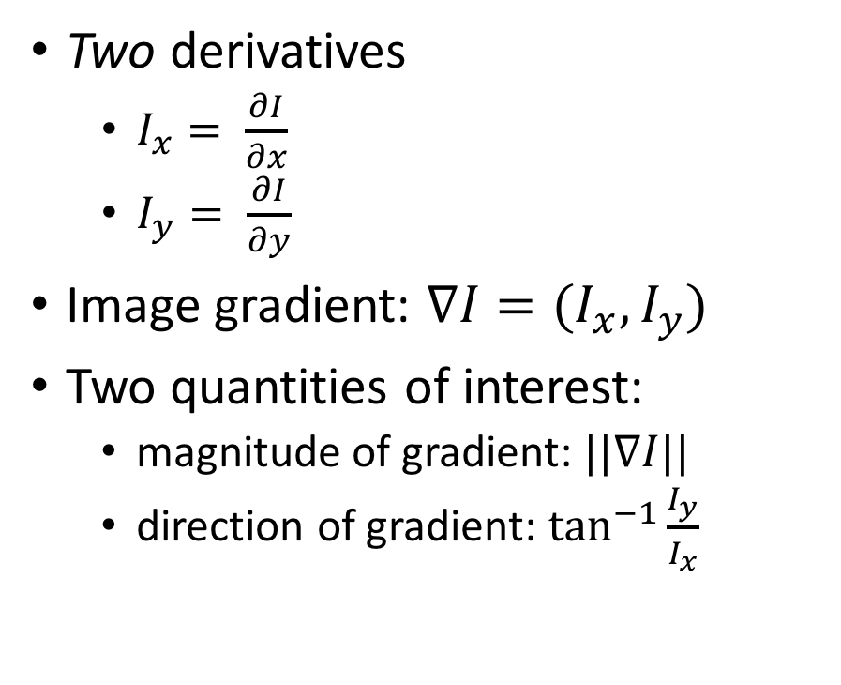
From 1D to 2D
Two derivatives
$I_{x}= \frac{∂I}{∂x}$
$I_{y}= \frac{∂I}{∂y}$
Image gradient: $∇I=(I_{x}, I_{y})$
Two quantities of interest:
magnitude of gradient: $||∇I||$
direction of gradient: $\tan^{−1}{\frac{I_{y}}{I_{x}}}$

Slide 25
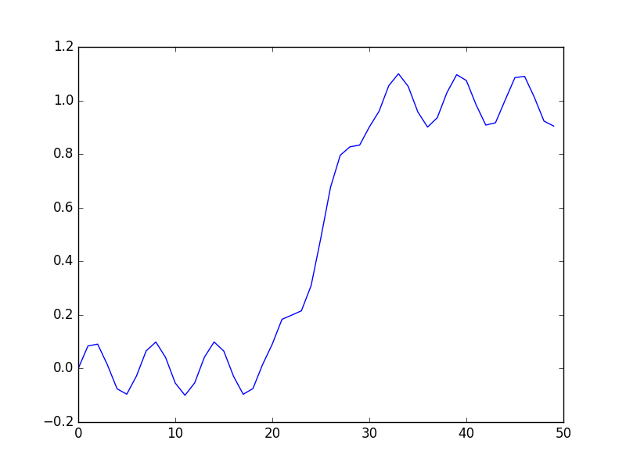
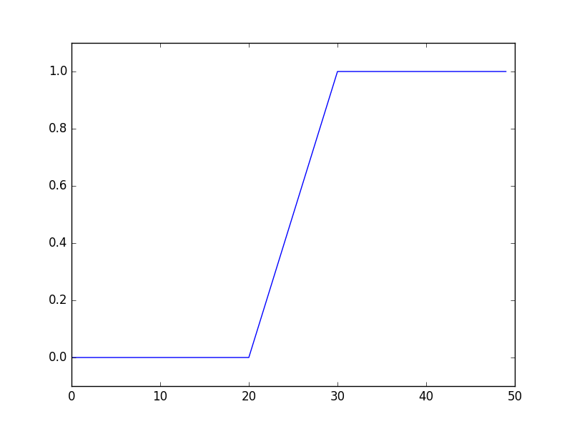
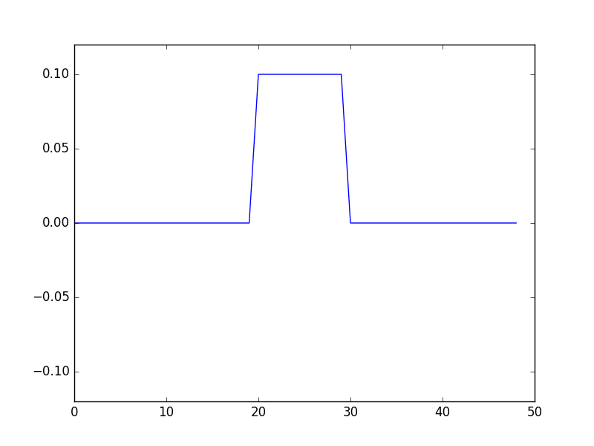
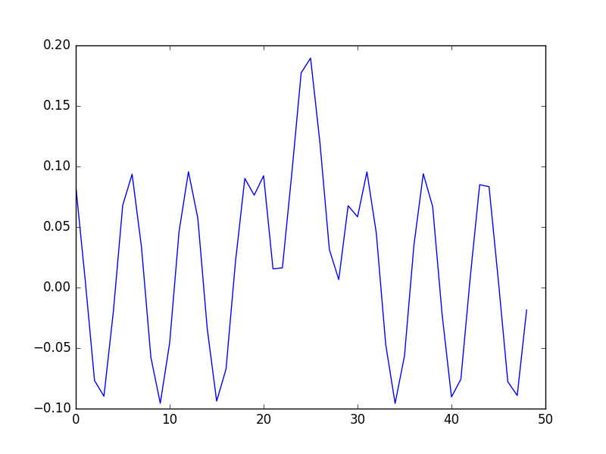
Derivatives amplify high frequency noise
d(sin wx) / dx = w sin wx

Slide 26
Solution: kill high frequency noise
Low-pass filter
Simple solution: Filter with Gaussian
Another convolution!
https://software.intel.com/en-us/articles/iir-gaussian-blur-filter-implementation-using-intel-advanced-vector-extensions

Slide 27
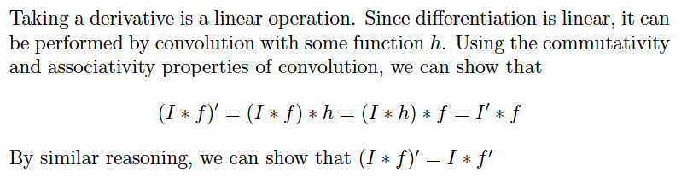
An important observation
slide credit: Jitendra Malik

Slide 28
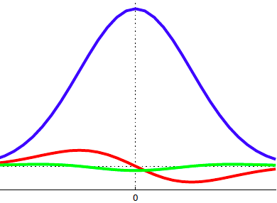
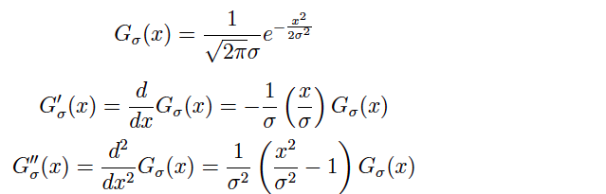
The 1D Gaussian and its derivatives
slide credit: Jitendra Malik

Slide 29
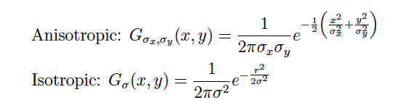
Two Dimensional Gaussian
slide credit: Jitendra Malik

Slide 30
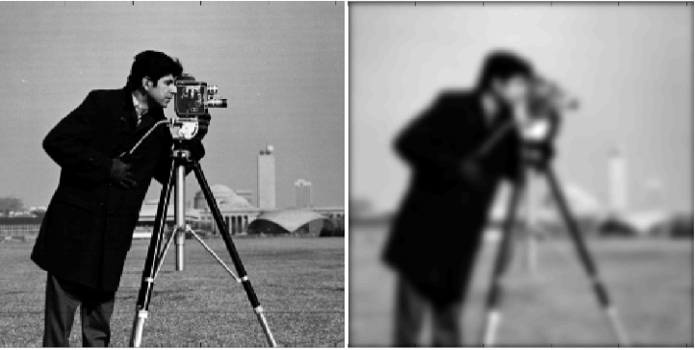
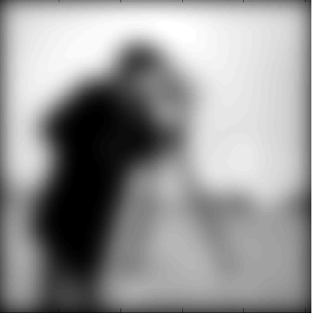
Image convolved with 2D Gaussian
slide credit: Jitendra Malik

Slide 31

Discrete convolution
Images are discrete
Use discrete convolution instead!
1D: $\left(f∗g\right)\left[n\right]=\sum_{k}{f\left[k\right]g[n−k]}$
2D: $\left(f ∗g\right)\left[m,n\right]= \sum_{k}{\sum_{l}{f\left[k,l\right]g[m−k,n−l]}}$

Slide 32
Back to correspondence

Slide 33
Detecting corners
Main idea: Translating patch should cause large differences
An example of an interest point detector

Slide 34
The second moment matrix
eigenvector with small eigenvalue
both eigenvalues away from 0
both eigenvalues close to 0
one eigenvalue close to 0

Slide 35

Harris corner detector
Look at det(G) – a trace(G)²
Equal to $λ_{1}λ_{2}−a{\left(λ_{1}+λ_{2}\right)}^{2}$
In general, want both $λ_{1}$ and $λ_{2}$ to be high

Slide 36
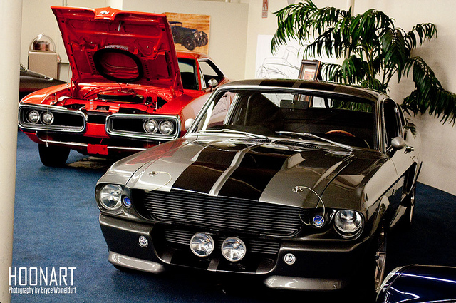
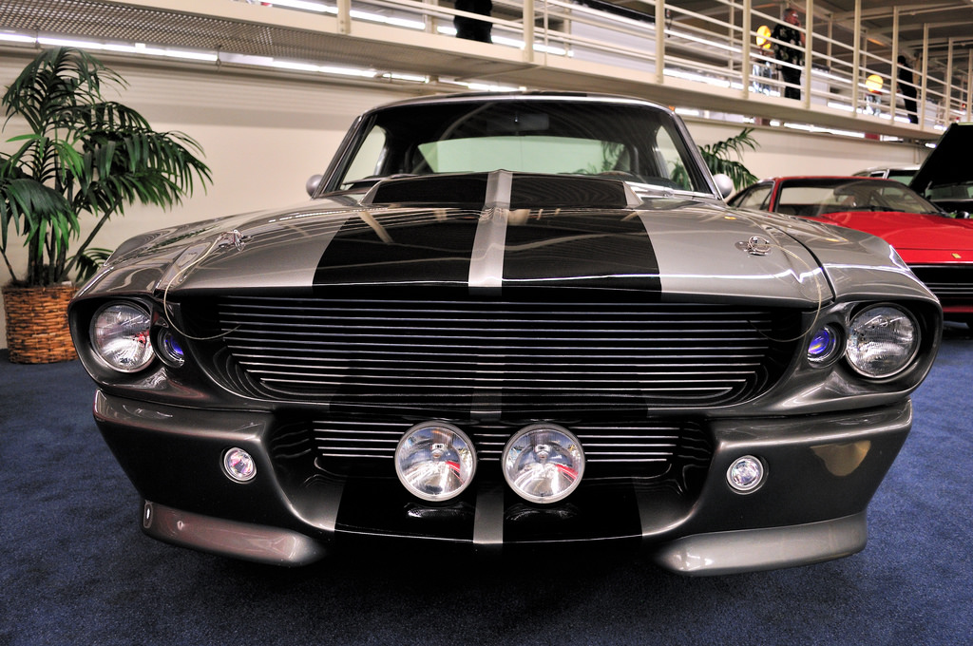
Measuring patch similarity
Idea 1: SSD
Sum of squared distances between pixel values

Slide 37
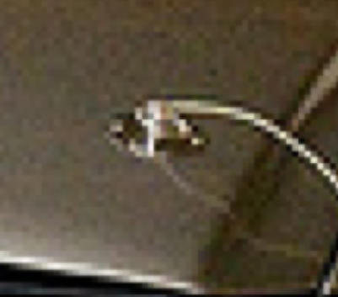
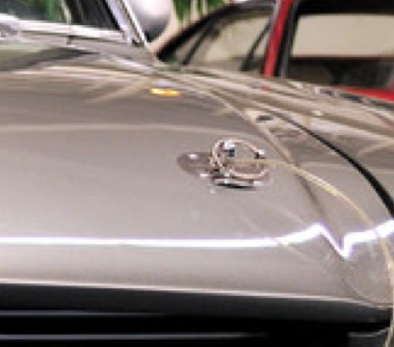
Measuring patch similarity is hard

Slide 38
Measuring patch similarity is hard

Slide 39
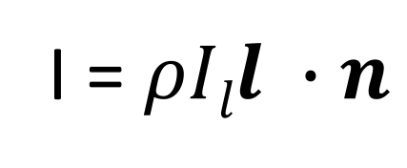
Color can be misleading
Albedo
Light color
I = $ρIll ∙n$
Lighting direction
Surface normal

Slide 40
A good distance metric
Two qualities
Invariance: resilient to light, viewpoint etc
Specificity: should not give false positive matches

Slide 41
Idea 2: NCC
NCC : Normalized cross correlation
Matches the pattern of intensities in each patch

Slide 42
Better representation than color: Edges
Normal discontinuity
Depth Discontinuity
Albedo Edge
Shadow

Slide 43
Measuring patch similarity is hard

Slide 44
Towards a feature descriptor
Match pattern of edges
Edge orientation – clue to shape
Be resilient to small deformations
Deformations might move pixels around, but slightly
Deformations might change edge orientations, but slightly

Slide 45
Rotational invariance by quantization
37
42
Between 30 and 45

Slide 46
Spatial invariance by histogramming
2 blue balls, one red box

Slide 47
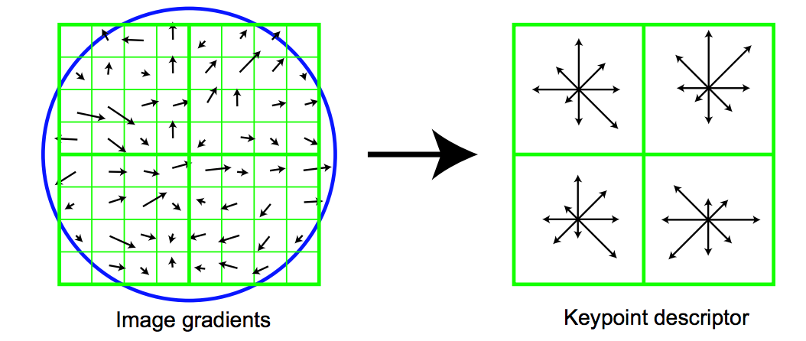
The SIFT descriptor
Compute edge magnitudes + orientations
Quantize orientations (rotational invariance)
Divide into spatial cells
Compute orientation histogram in each cell (spatial invariance)

Slide 48
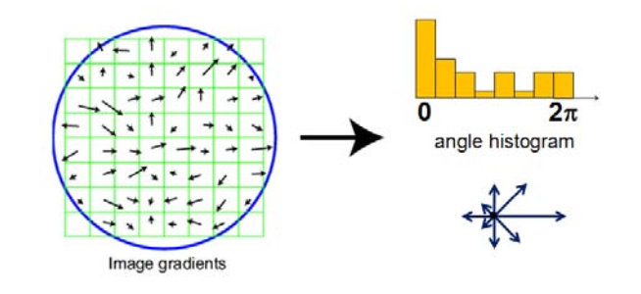
The SIFT descriptor – rotation invariance
Identify peak in rotation histogram
Specify orientation bins relative to the peak

Slide 49
The SIFT descriptor - Foreshadowing modernity
Convolve w/ derivative of Gaussian
Quantize orientation
Add into histogram
Convolution
Pointwise Non-linearity
Average pooling

Slide 50
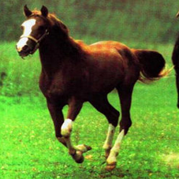
Foreshadowing modernity
Convolutional Networks
Horse
Yann LeCun, Léon Bottou, Yoshua Bengio, and Patrick Haffner. Gradient-based learning applied to document recognition. Proceedings of the IEEE 86.11 (1998): 2278-2324.
Alex Krizhevsky, Ilya Sutskever, and Geoffrey E. Hinton. Imagenet classification with deep convolutional neural networks. In NIPS 2012.
Notes:
The second major tool we have is machine learning.
A major breakthrough in the past decade has been the re-discovery of black-box machine learning techniques, in particular convolutional networks.
You give these things a dataset of input, output pairs, and they learn to map inputs to outputs.
They seem to be especially effective on images.
Note that I said “Re-discovered”. These were techniques that were invented in the 80’s, or even before that. But it turns out that where they really shine is data. The more data you have, the better they are.

Slide 51
Using correspondence for stereo
Given two images:
Detect keypoints in each image
Use descriptor to compute similarities and match
Use matched correspondences to estimate eg., F, E, R, t, 3D points etc…

Slide 52
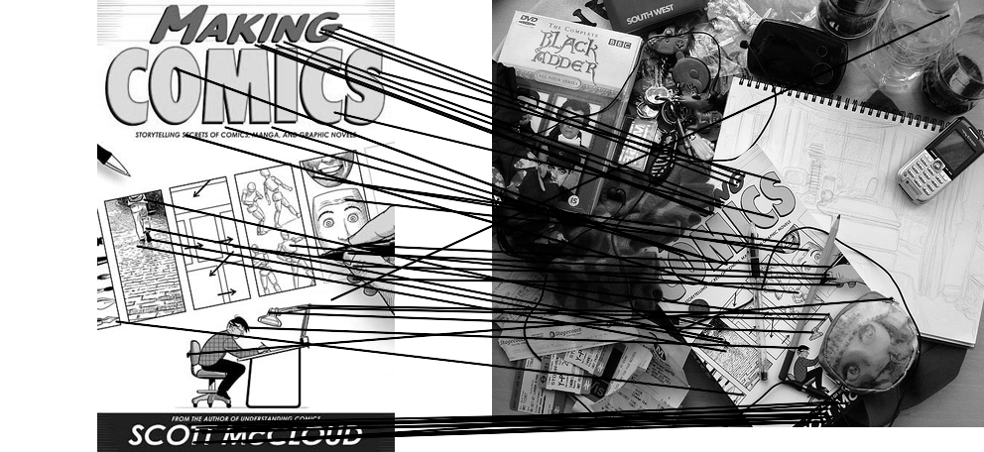
Outliers
outliers
inliers
slide credit: Noah Snavely

Slide 53
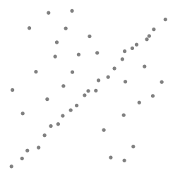
Robustness
Let’s consider a simpler example… linear regression
How can we fix this?
Problem: Fit a line to these datapoints
Least squares fit
slide credit: Noah Snavely

Slide 54
Idea
Given a hypothesized line
Count the number of points that “agree” with the line
“Agree” = within a small distance of the line
I.e., the inliers to that line
For all possible lines, select the one with the largest number of inliers
slide credit: Noah Snavely

Slide 55
Counting inliers
slide credit: Noah Snavely

Slide 56
Counting inliers
Inliers: 3
slide credit: Noah Snavely

Slide 57
Counting inliers
Inliers: 20
slide credit: Noah Snavely

Slide 58
How do we find the best line?
Hypothesize-and-test
Try out many lines, keep the best one
Which lines?
slide credit: Noah Snavely

Slide 59
RANSAC
Idea:
All the inliers will agree with each other on the translation vector; the (hopefully small) number of outliers will (hopefully) disagree with each other
RANSAC only has guarantees if there are < 50% outliers
“Happy families are all alike; every unhappy family is unhappy in its own way.”
– Tolstoy
slide credit: Noah Snavely

Slide 60
RANSAC
General version:
Randomly choose s samples
Typically s = minimum sample size that lets you fit a model
Fit a model (e.g., line) to those samples
Count the number of inliers that approximately fit the model
Repeat N times
Choose the model that has the largest set of inliers
RANSAC gives two things:
model that fits largest set of inliers
set of inliers corresponding to model
slide credit: Noah Snavely

Slide 61
An example binocular stereo algorithm
Get images
Extract interest points / keypoints
Match keypoints using SIFT
Use RANSAC to fit E and get set of inlier matches
Use inliers to triangulate

Slide 62
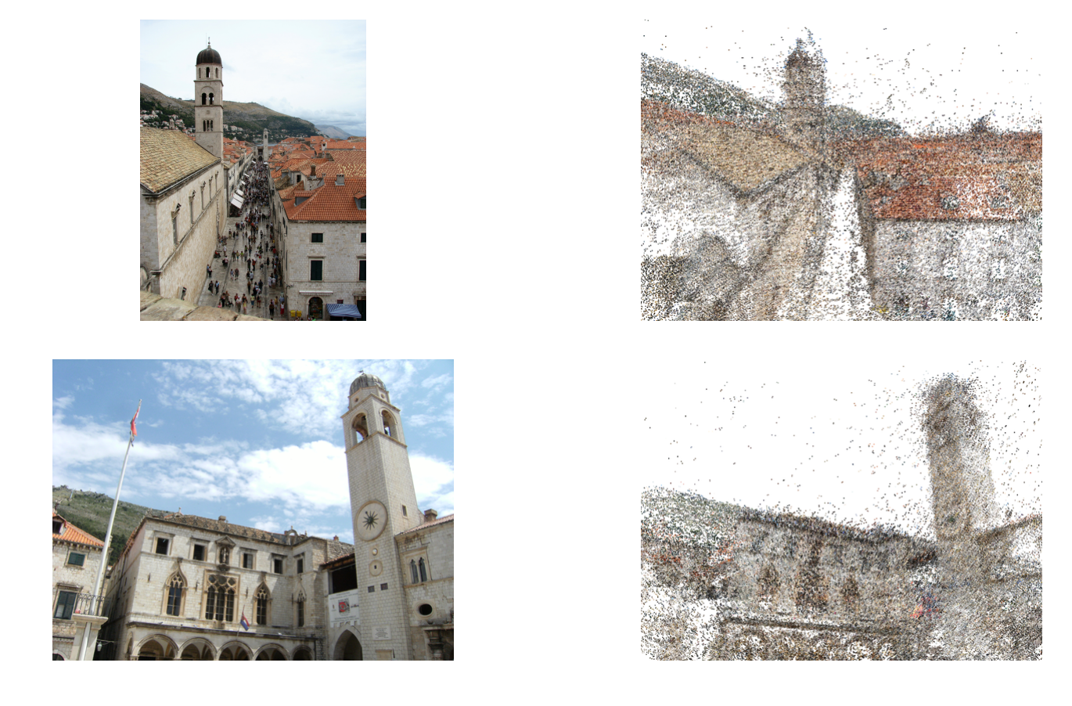
Building Rome in a day. Agarwal et al., ICCV 2009.

Slide 63
Dense correspondence
Only correspondence at interest points?
Setup: assume rectified images
Correspondence only along scan-lines
Can be represented using disparity

Slide 64
Dense correspondence

Slide 65
Dense correspondence

Slide 66
Dense correspondence
Goal:
Assign disparity value to each pixel
Basic idea:
Disparity image should be smooth
Energy minimization
min E(d), where d is disparity image
E(d) = E_{data}(d) + E_{smoothness}(d)
E_{data}(d) : scores based on NCC (for example)
E_{smoothness}(d) =

Slide 67
Markov Random Fields
Probabilistic model
Undirected graphical model
Undirected graph with nodes and edges
Unary potential on nodes = data term
Binary potential on edges = smoothness term

Slide 68
Optimizing MRFs
NP-Hard
Approximate solutions
Message passing
Graph cut-based solutions

Slide 69
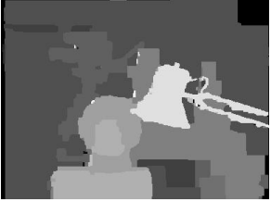
Dense correspondence with MRFs

Slide 70
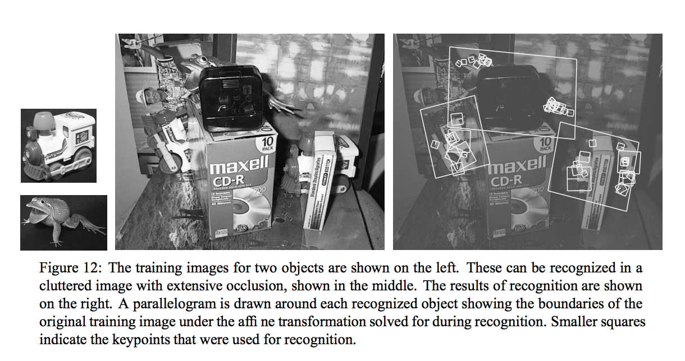
Side note: Correspondence as a general problem
Instance recognition

Slide 71
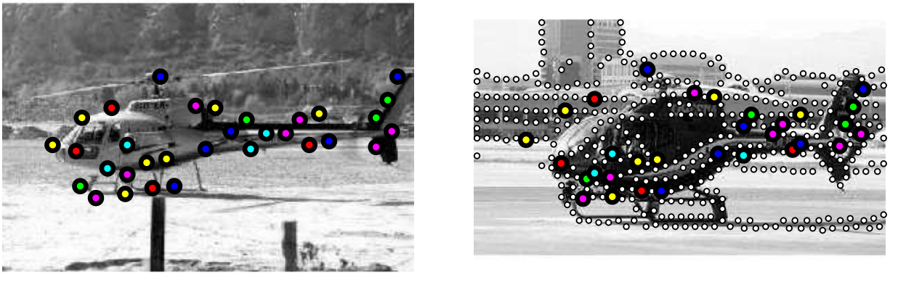
Side note: Correspondence as a general problem
Object recognition

Slide 72
Side note: Correspondence as a general problem

