Slide 1
Taking inspiration from biology

Slide 2
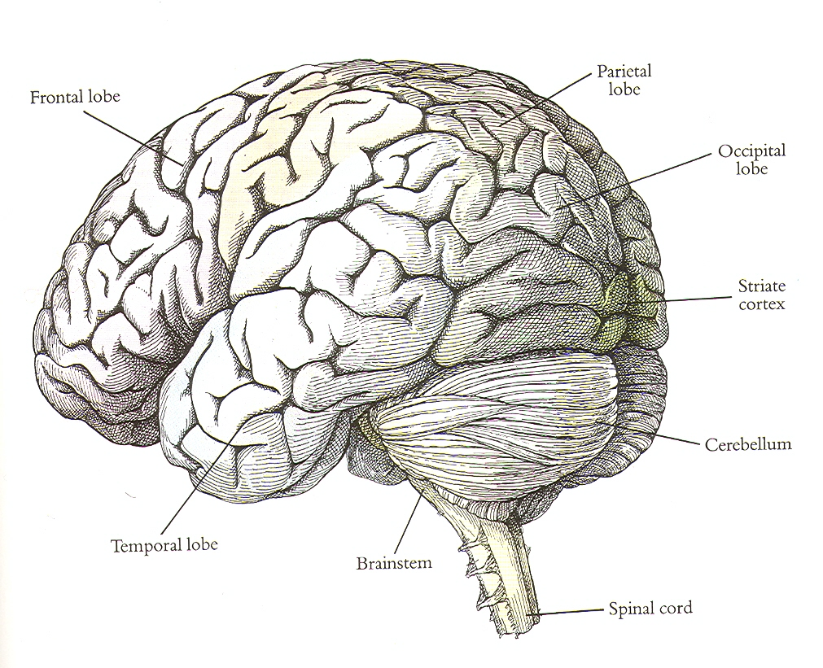
Slide credit: Jitendra Malik

Slide 3
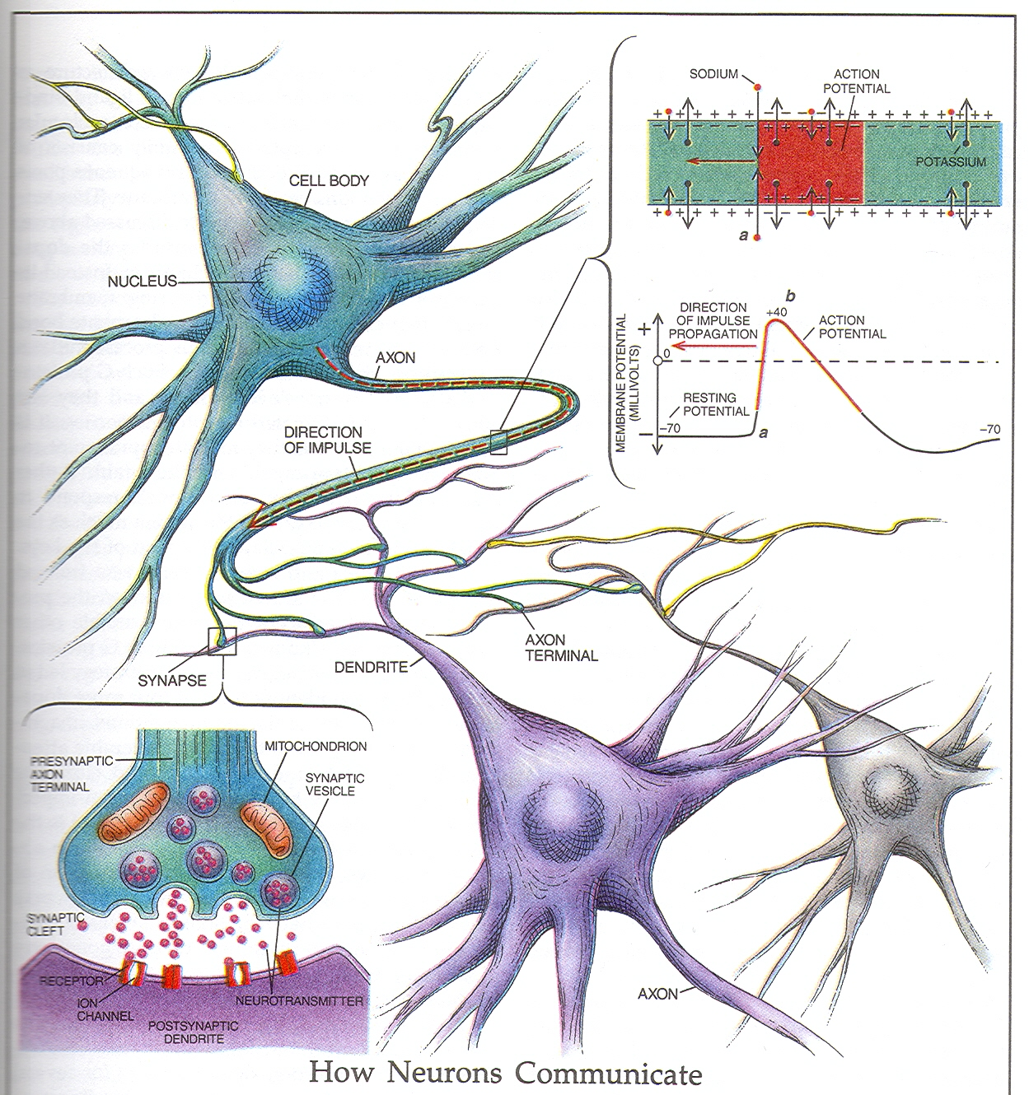
Slide credit: Jitendra Malik

Slide 4

McCullough - Pitts model of the neuron
x₁
w₁
w₂
x₂
$$Σ$$
w₃
x₃

Slide 5
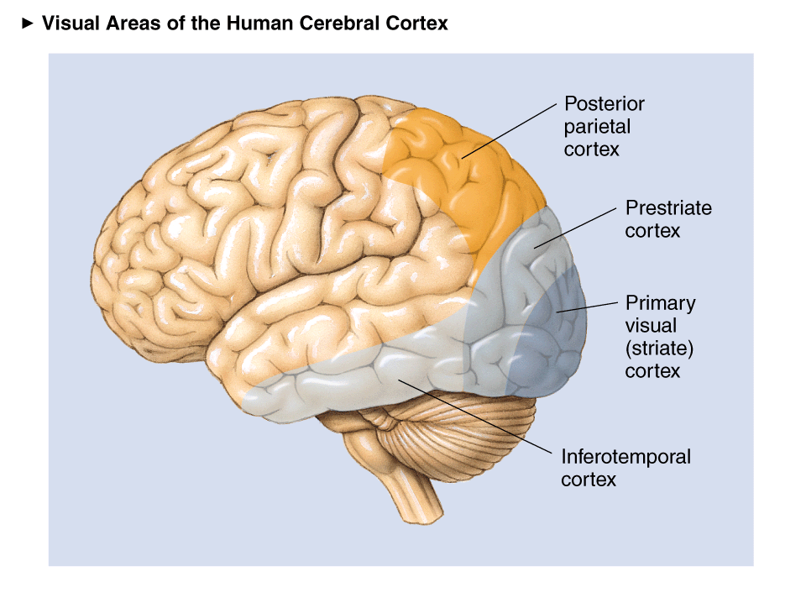
Visual Areas
Slide credit: Jitendra malik

Slide 6
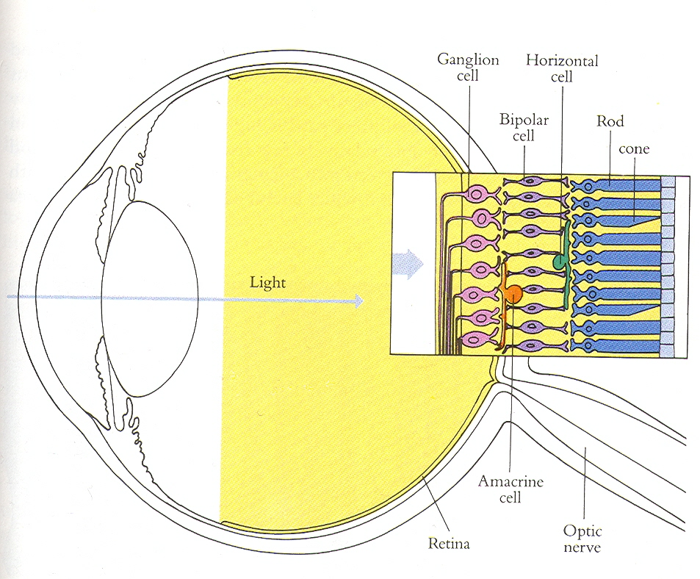
Slide credit: Jitendra Malik

Slide 7
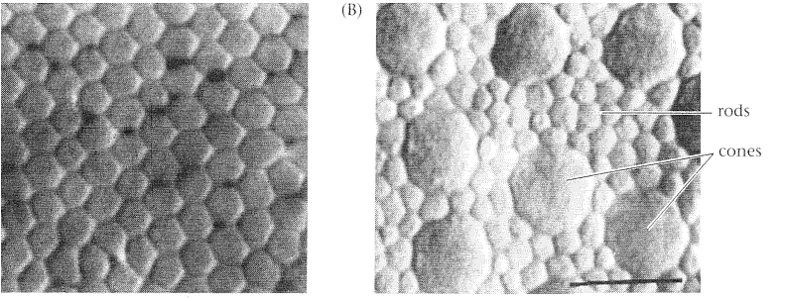
The photoreceptor mosaic: rods and cones are the eye’s pixels
Slide credit: Jitendra Malik

Slide 8
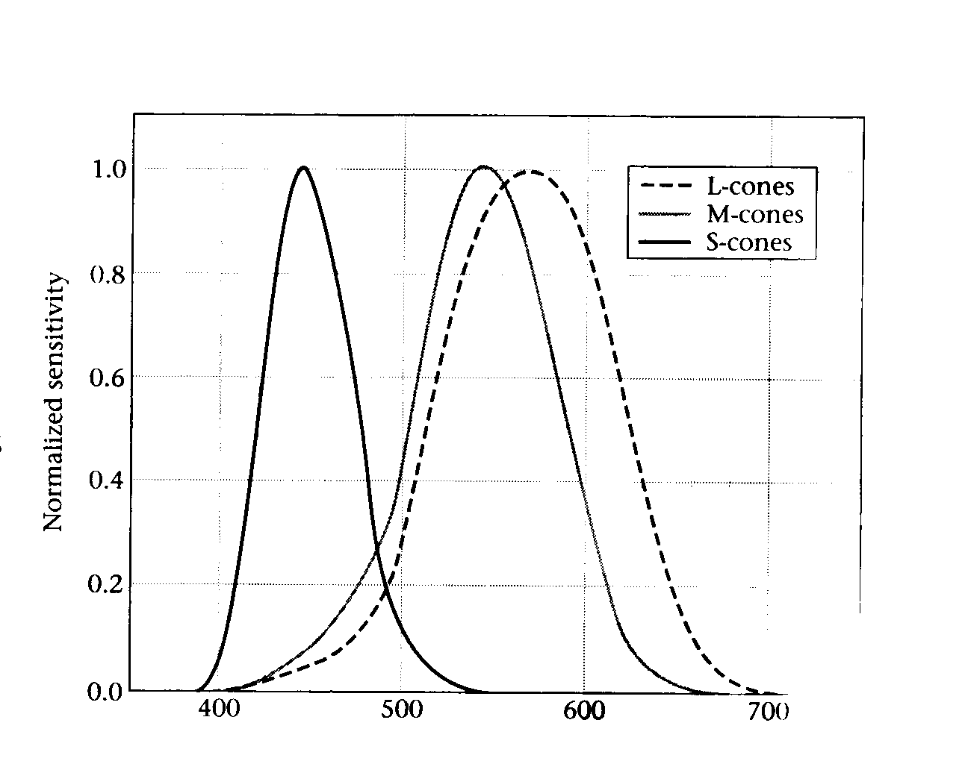
The three cone types have different spectral sensitivity functions

Slide 9
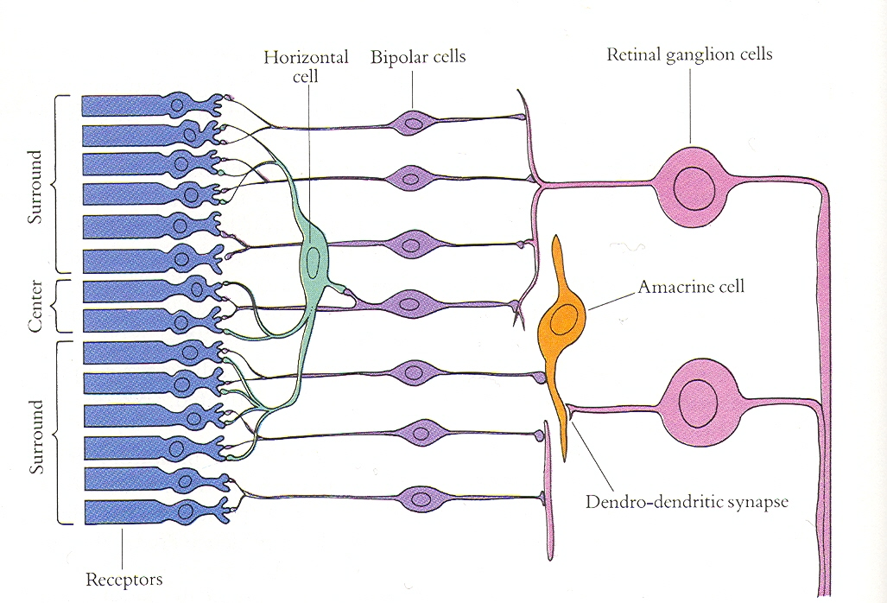
Slide credit: Jitendra Malik

Slide 10
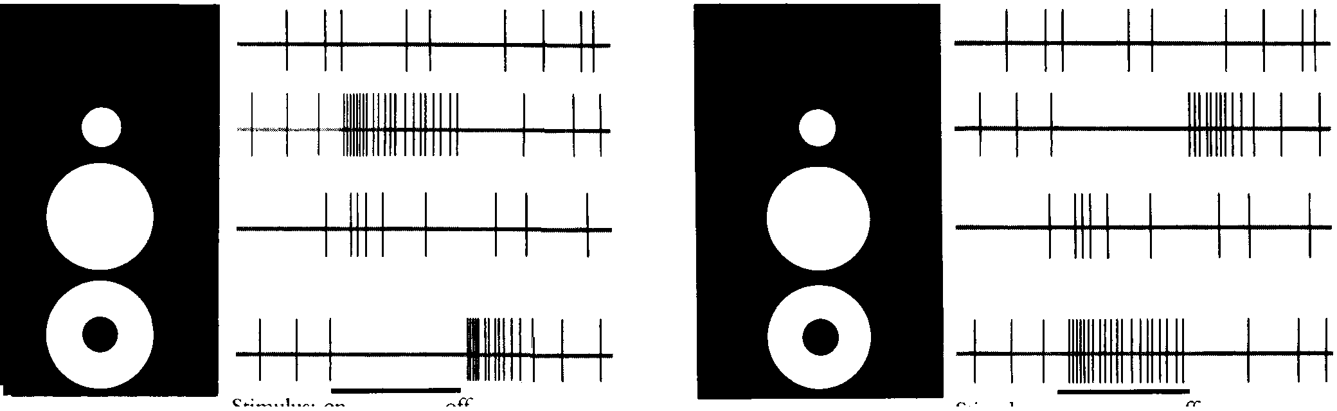
ON and OFF cells in retinal ganglia
Slide credit: Jitendra Malik

Slide 11
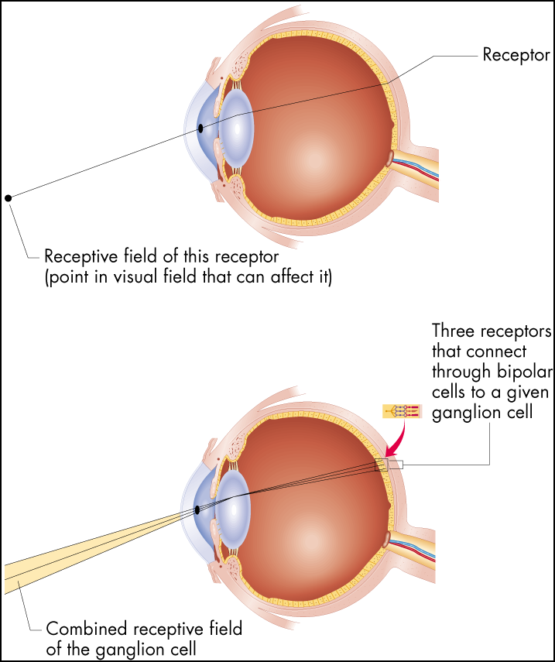
Receptive Fields
Figure 6.16 Receptive fields
The receptive field of a receptor is simply the area of the visual field from which light strikes that receptor. For any other cell in the visual system, the receptive
field is determined by which receptors connect to the cell in question.
Slide credit: Jitendra Malik

Slide 12
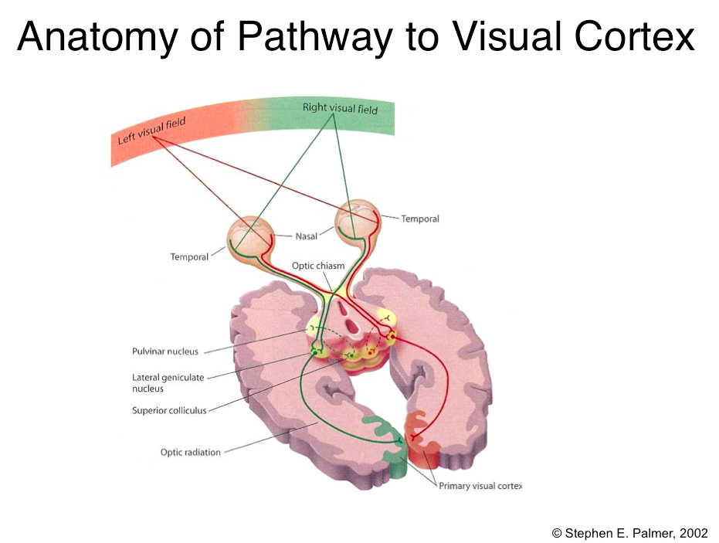
Slide credit: Jitendra Malik

Slide 13
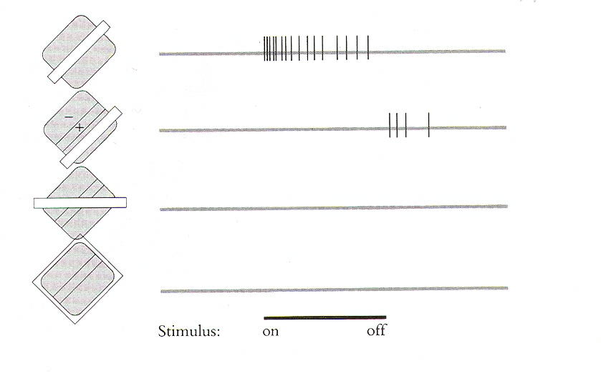
Orientation Selectivity in V1
Slide credit: Jitendra Malik

Slide 14
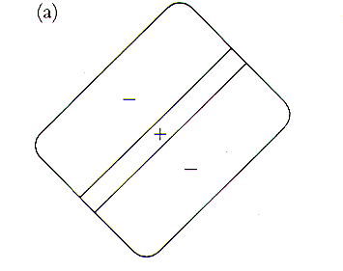
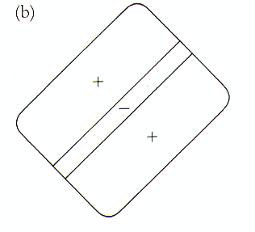
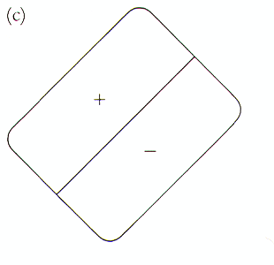
Receptive fields of simple cells
(discovered by Hubel & Wiesel)
Slide credit: Jitendra Malik

Slide 15


Oriented Gaussian First and Second Derivatives
Slide credit: Jitendra Malik

Slide 16
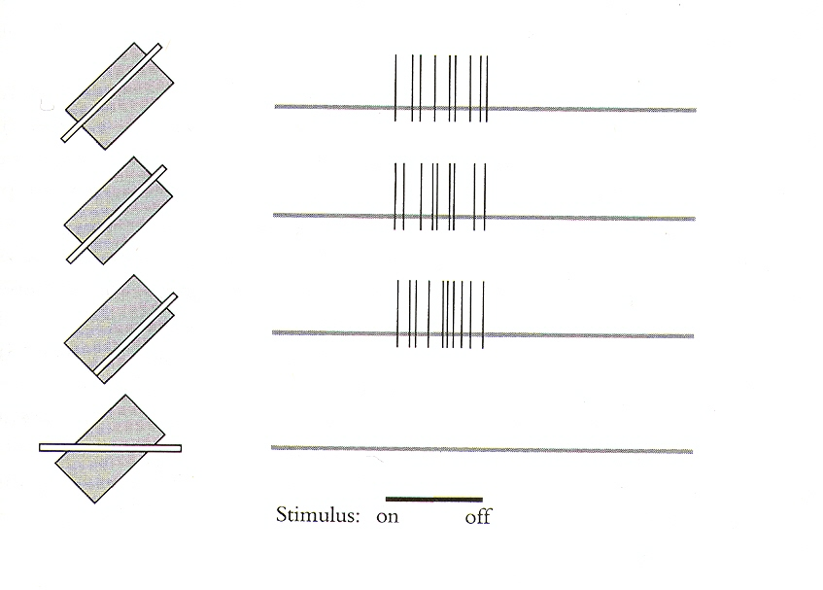
Receptive fields of complex cells
Slide credit: Jitendra Malik

Slide 17
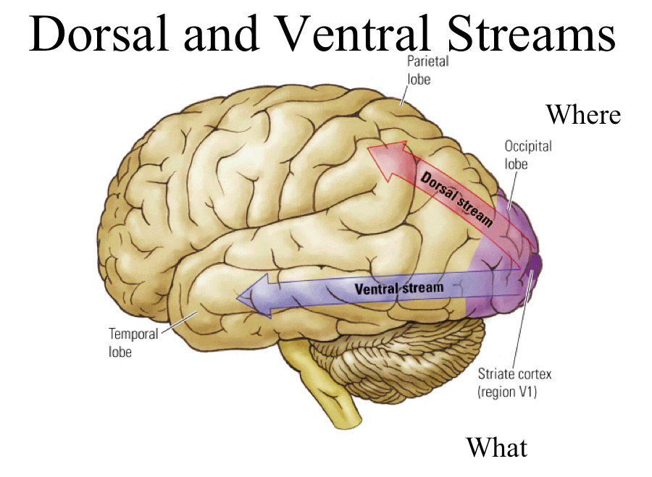
Slide credit: Jitendra Malik

Slide 18
By NIH - http://www.nlm.nih.gov/hmd/emotions/frontiers.html (archive.org), Public Domain, https://commons.wikimedia.org/w/index.php?curid=8274336

Slide 19
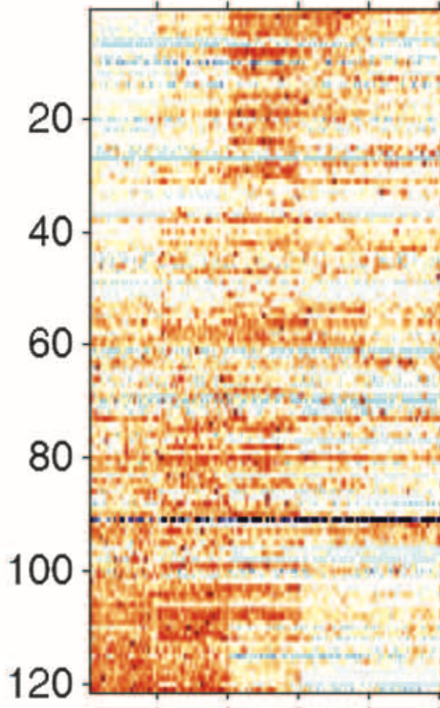
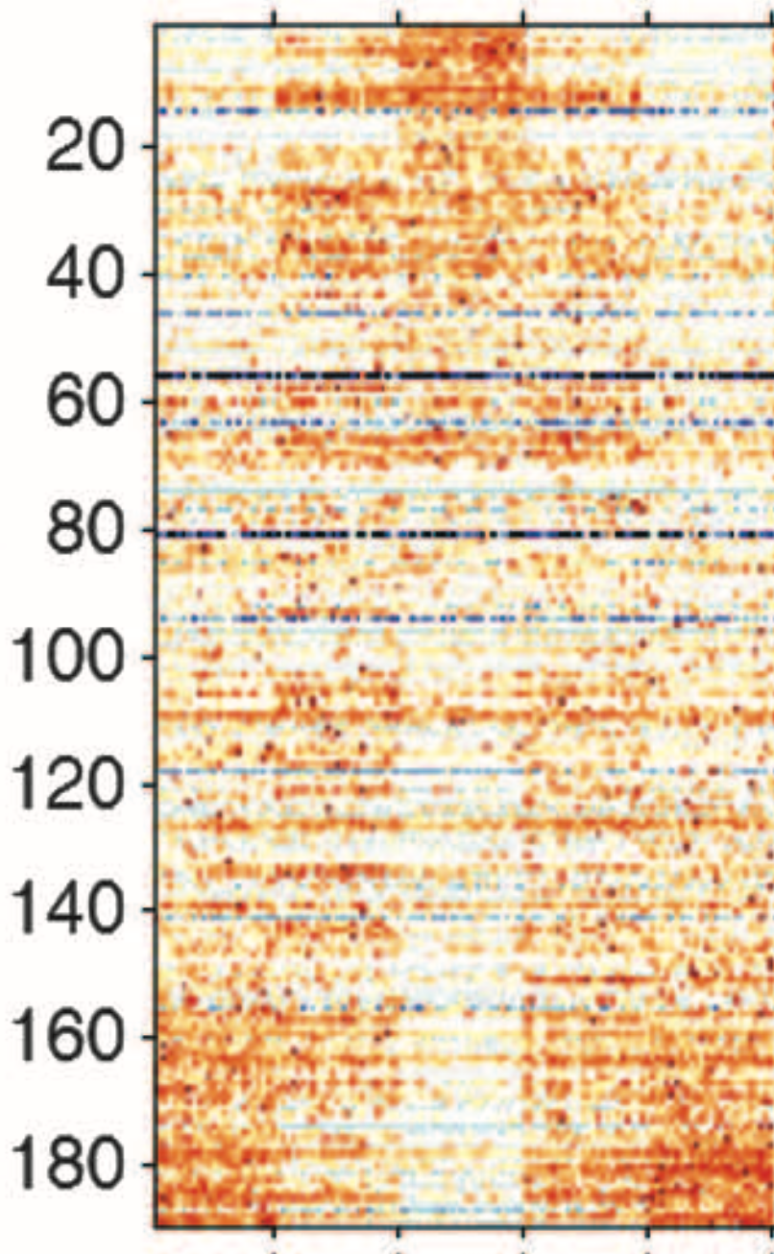
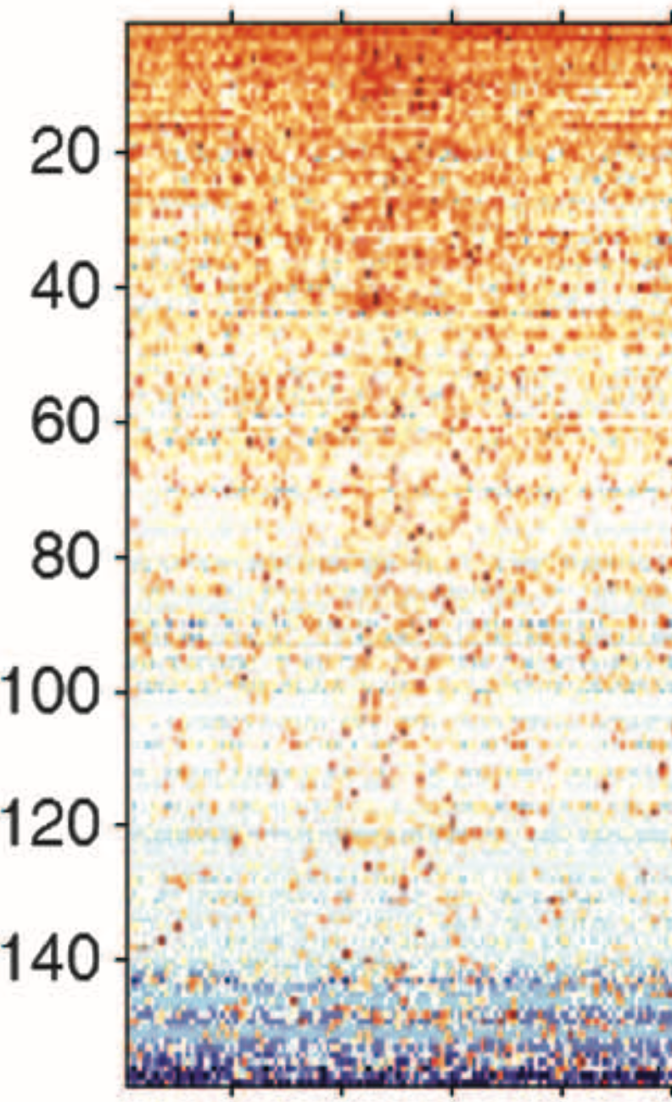
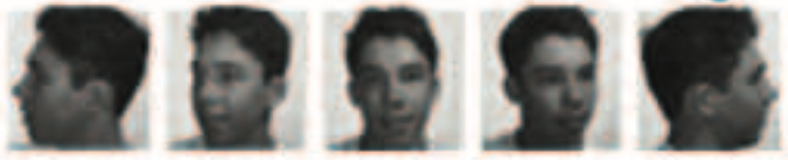
Increasing invariance
Winrich A. Freiwald, Doris Tsao. In Science, 2015.

Slide 20
Increasing invariance
Images from CVL Face dataset
Winrich A. Freiwald, Doris Tsao. In Science, 2010.

Slide 21
Increasing invariance
Images from CVL Face dataset
Winrich A. Freiwald, Doris Tsao. In Science, 2010.

Slide 22
Increasing invariance
Images from CVL Face dataset
Winrich A. Freiwald, Doris Tsao. In Science, 2010.

Slide 23
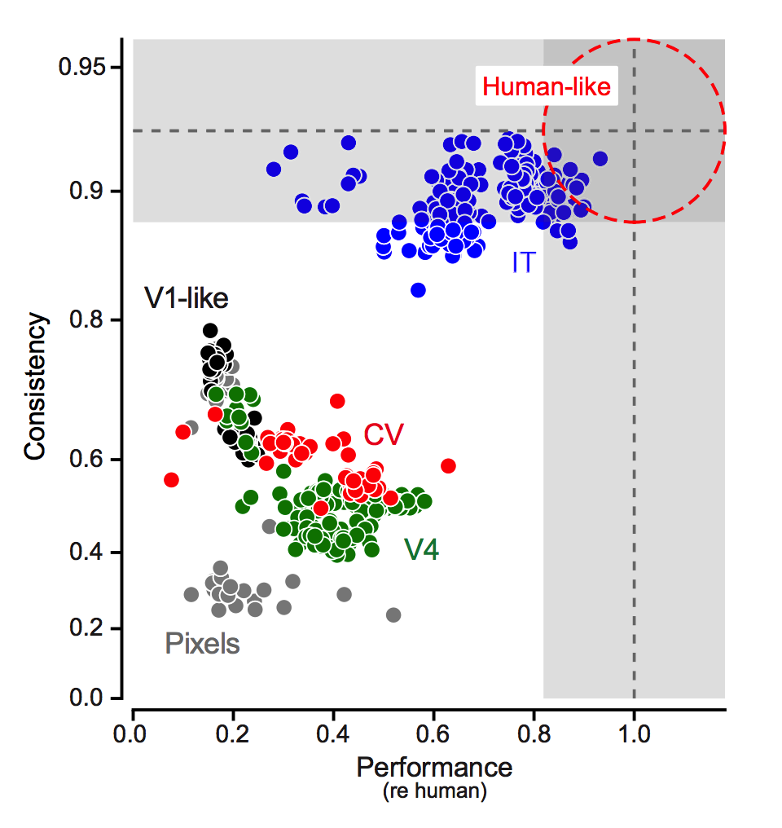
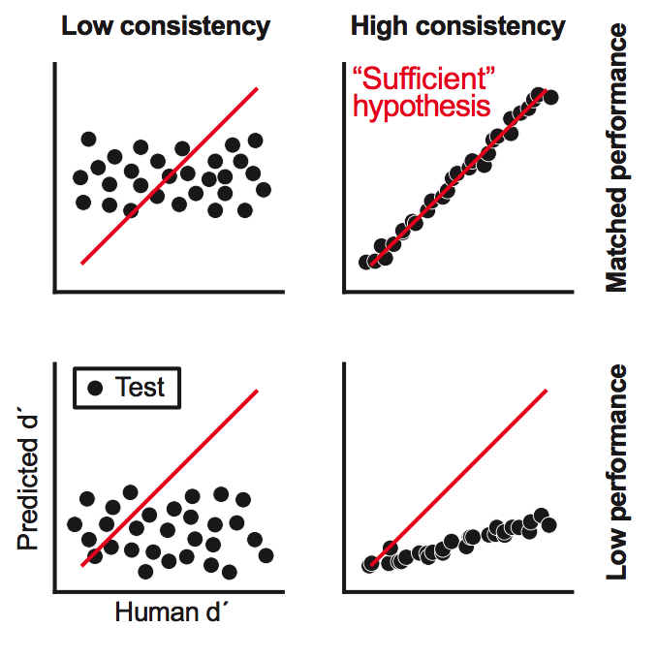
Brains vs machines
Majaj et al. Journal of Neuroscience

Slide 24
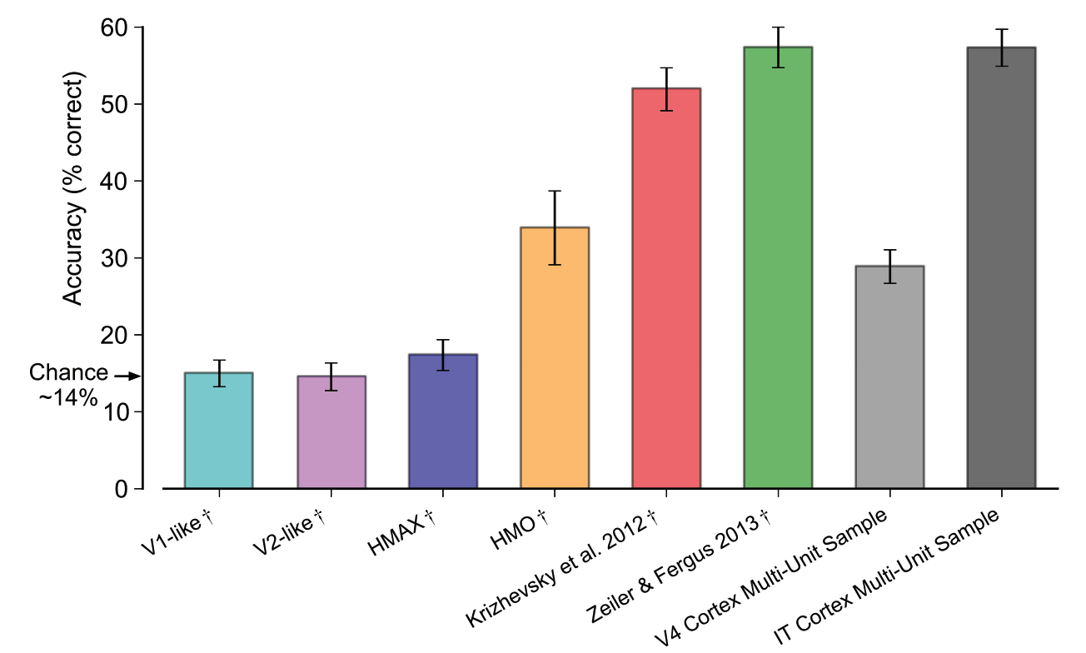
Brains vs machines
Cadieu et al. PLOS Computational biology

Slide 25
Feedforward vs feedback
On a task of judging animal vs no animal, humans can make mostly correct saccades in 150 ms (Kirchner & Thorpe, 2006)
  Comparable to synaptic delay in the retina, LGN, V1, V2, V4, IT pathway.
  Doesn’t rule out feed back but shows feed forward only is very powerful
But tons and tons of feedback connections!
Hard images require feedback?

Slide 26
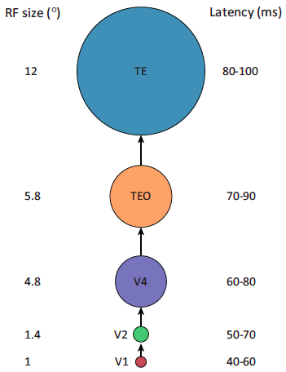
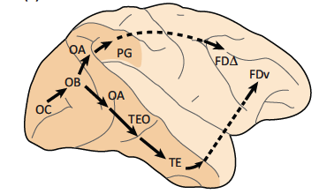
Feed-forward model of the ventral stream

Slide 28
Development of vision in babies
Multi-modal
Incremental development
Physical world
Exploration and play
Social world
Symbolic language
Smith, Linda, and Michael Gasser. "The development of embodied cognition: Six lessons from babies." Artificial life11.1-2 (2005): 13-29.

Slide 29
Animal eyes

Slide 30
The end

