Slide 1
Adversaries

Slide 2
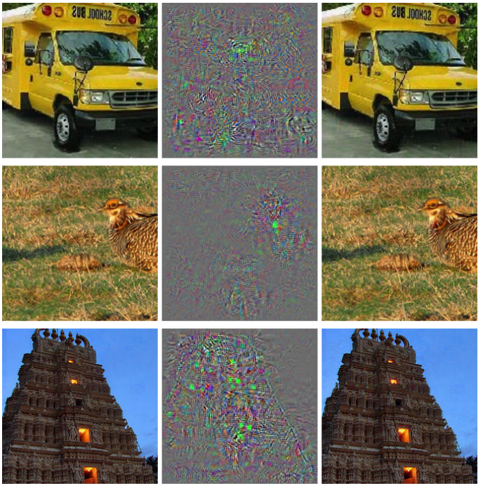
Adversarial examples

Slide 3
Adversarial examples
Ostrich!

Slide 4
Adversarial examples
Ostrich!
Intriguing properties of neural networks. Christian Szegedy, Wojciech Zaremba, Ilya Sutskever, Joan Bruna, Dumitru Erhan, Ian Goodfellow, Rob Fergus. In ICLR, 2014

Slide 5
Why do we care?
Security
Safety
Hint to malfunction?

Slide 6
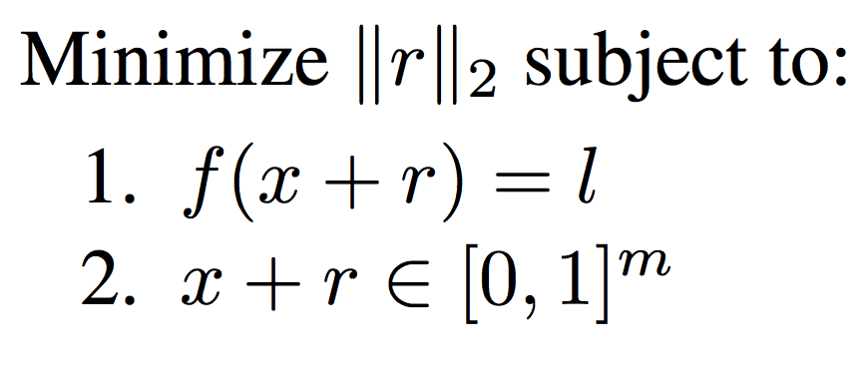
Adversarial examples

Slide 7
Adversarial examples for linear classifiers

Slide 8
Adversarial examples for convolutional networks

Slide 9
Adversarial examples for convolutional networks
Convolutional networks w/ RELUare differentiable almost everywhere
Are linear almost everywhere
Slope for a given x = gradient at x
Can use gradient to generate an adversarial example
Explaining and Harnessing Adversarial Examples. Ian Goodfellow, Jonathon Shlens, Christian Szegedy. In ICLR 2015.

Slide 10
Adversarial examples for convolutional networks

Slide 11
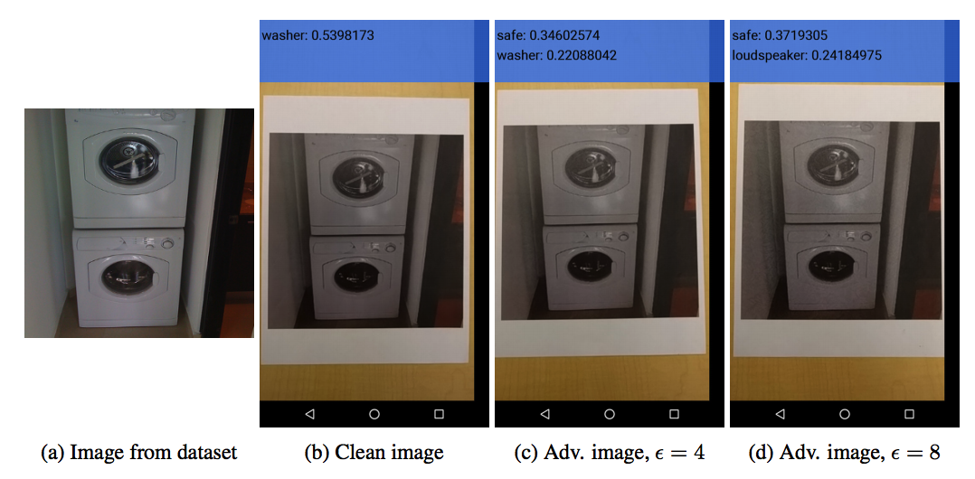
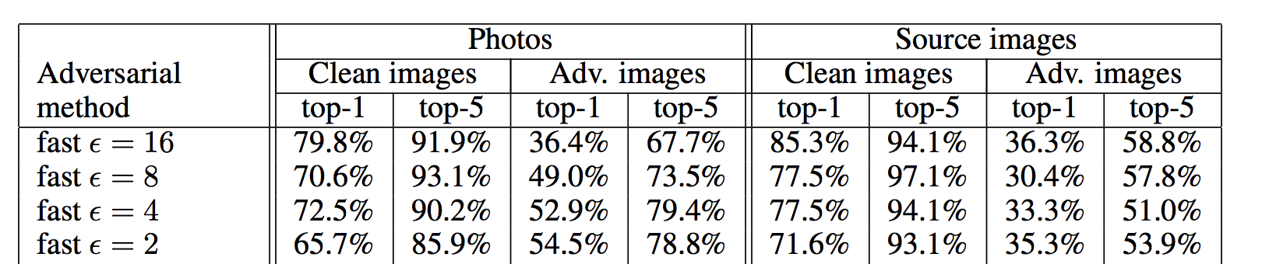
Moar fun with adversarial examples
Transferable across models
Resilient to printing and photographing
Adversarial examples in the physical world. Alexey Kurakin, Ian Goodfellow, Samy Bengio. ICLR Workshop (2017)

Slide 12
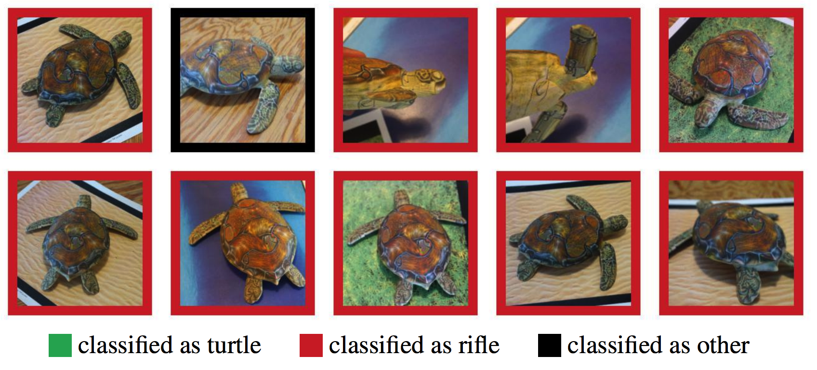
Adversarial turtle
Synthesizing robust adversarial examples. Anish Athalye, Logan Engstrom , Andrew Ilyas , Kevin Kwok.

Slide 13
Adversarial turtle

Slide 14
Kinds of adversarial perturbations
“White-box” vs “black-box”
  Does adversary have access to the model?
“Untargeted” vs “Targeted”
  Should the new output be incorrect in a particular way?

Slide 15
Resilience to adversaries
89.4% → 17.9%

Slide 16
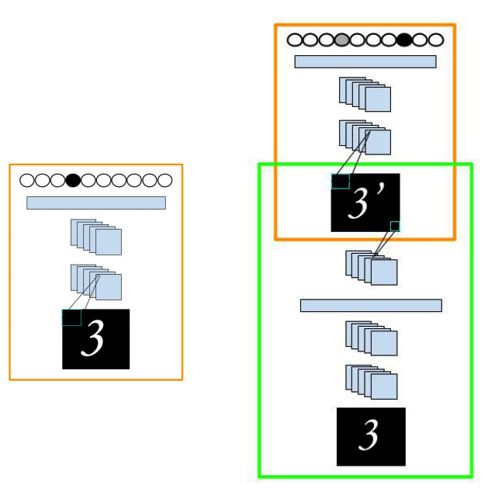
Learnt adversaries

Slide 17
Visualizing and understanding neural networks

Slide 18
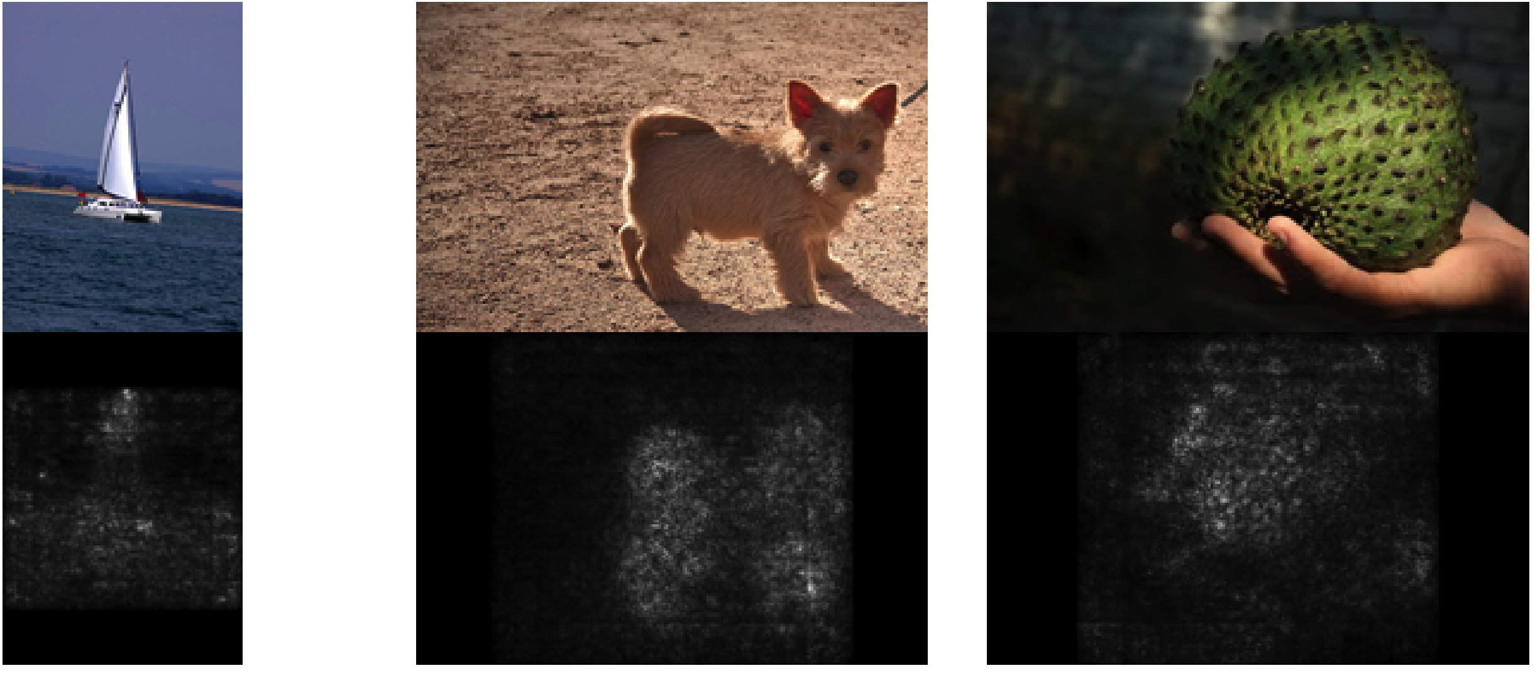
The gradient of the score
Deep Inside Convolutional Networks: Visualising Image Classification Models and Saliency Maps.K. Simonyan, A. Vedaldi, A. Zisserman. ICLR Workshop 2014

Slide 19
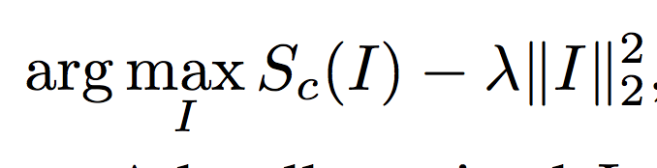
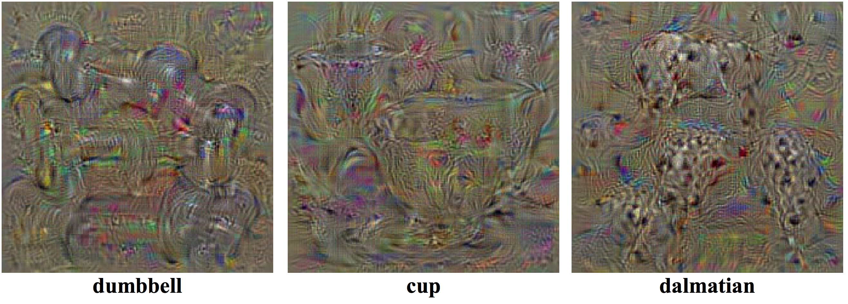
The image for a class

Slide 20
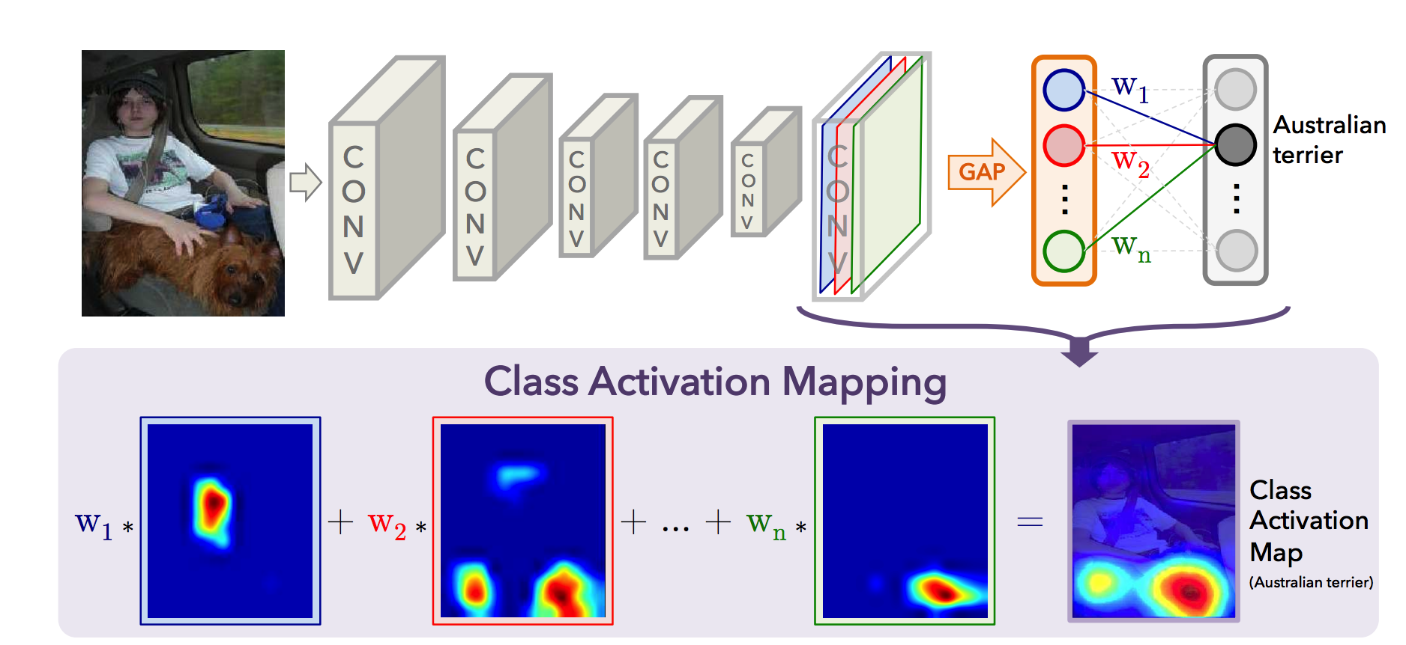
Class activation maps
global average pooling + score = scoring + global average pooling
Learning Deep Features for Discriminative Localization. Bolei Zhou, Aditya Khosla, Agata Lapedriza, Aude Oliva, and Antonio Torralba. In CVPR, 2016

Slide 21
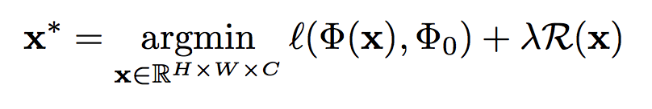
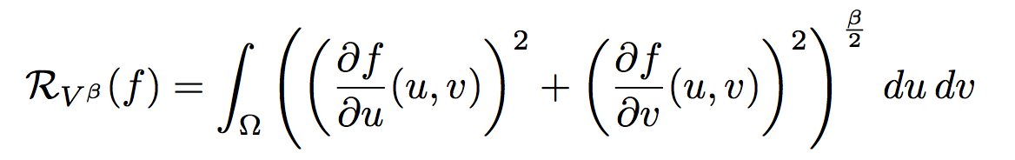
Inverting convolutional networks

Slide 22
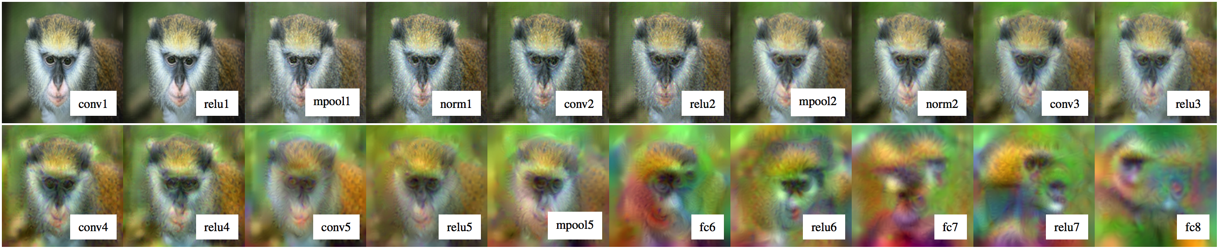
Inverting convolutional networks
Mahendran, Aravindh, and Andrea Vedaldi. "Understanding deep image representations by inverting them." Proceedings of the IEEE conference on computer vision and pattern recognition. 2015.

Slide 23
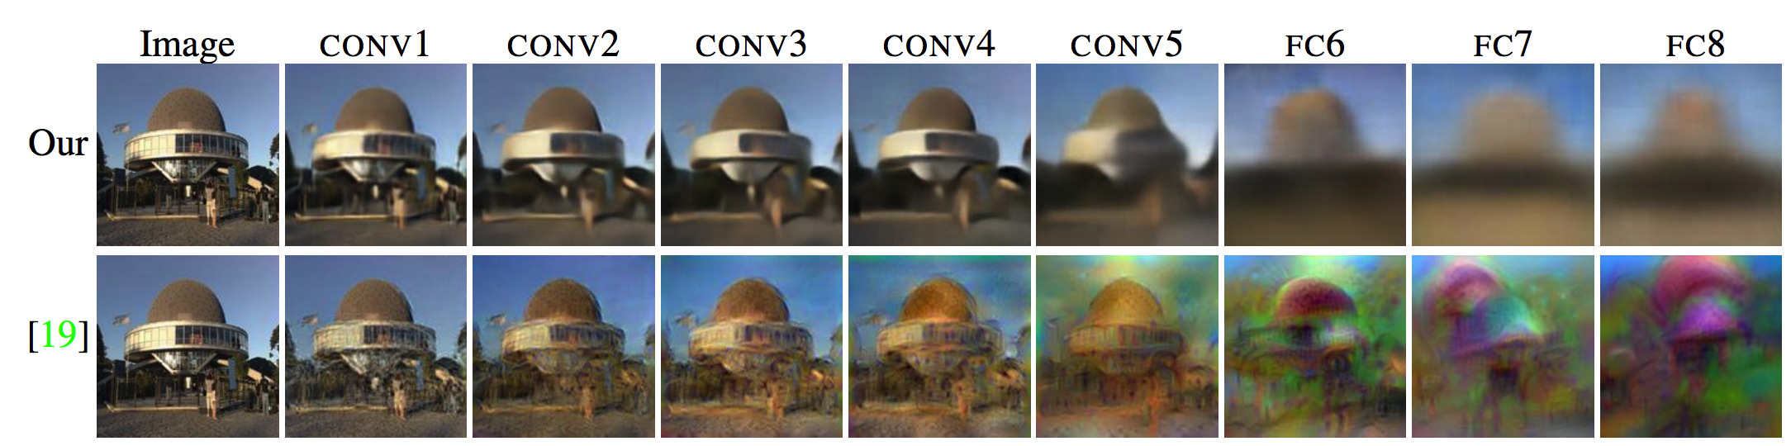
Learning to invert convolutional networks
Dosovitskiy, Alexey, and Thomas Brox. "Inverting visual representations with convolutional networks." Proceedings of the IEEE Conference on Computer Vision and Pattern Recognition. 2016.

Slide 24
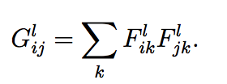
Side-effect - style transfer
Content representation: feature map at each layer
Style representation: Covariance matrix at each layer
  Spatially invariant
  Average second-order statistics
Idea: Optimize x to match content of one image and style of another
Gatys, Leon A., Alexander S. Ecker, and Matthias Bethge. "A neural algorithm of artistic style." arXiv preprint arXiv:1508.06576 (2015).

Slide 25
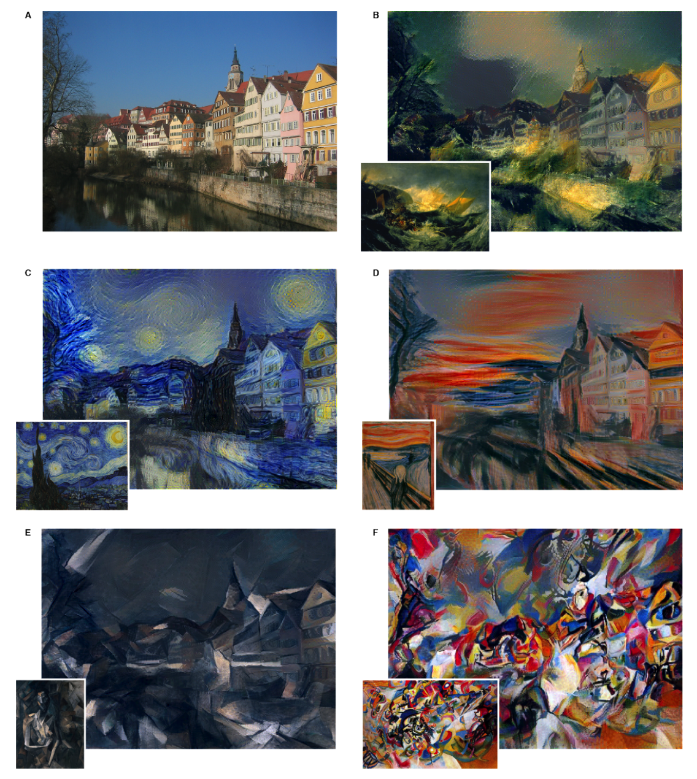
Style transfer

Slide 26
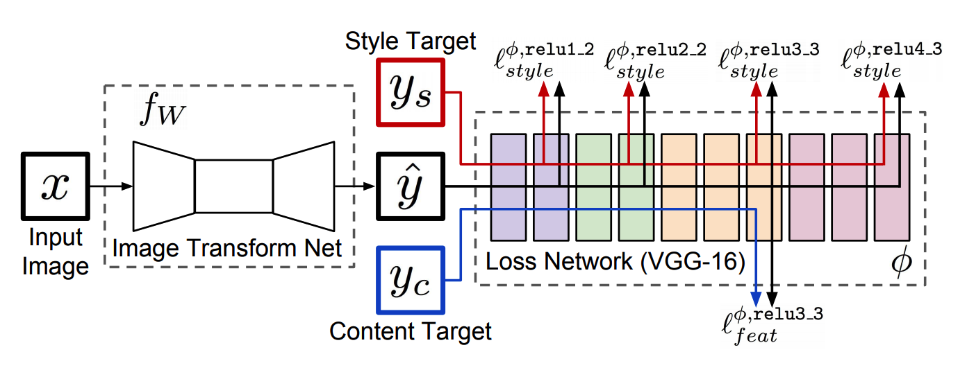
Learning to transfer style
Perceptual Losses for Real-Time Style Transfer and Super-Resolution
Justin Johnson, Alexandre Alahi, Li Fei-Fei
ECCV 2016

Slide 27
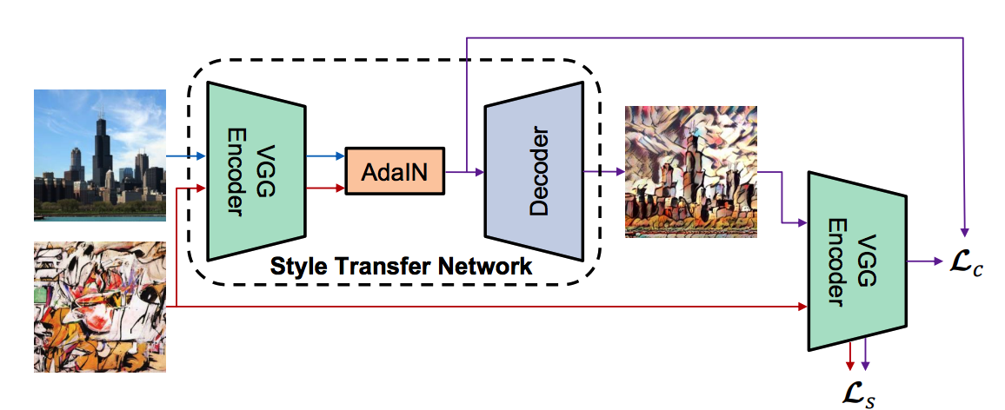
Learning to transfer style
Huang, Xun; Belongie, Serge
Arbitrary Style Transfer in Real-time with Adaptive Instance Normalization
International Conference on Computer Vision (ICCV), Venice, Italy, 2017, (Oral).

