Slide 1
Embodied cognition

Slide 2
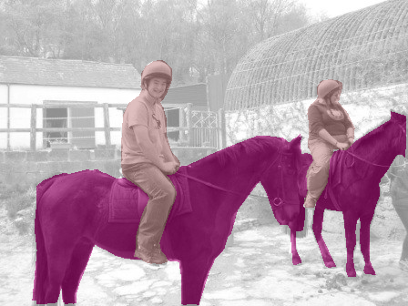
Two phases of supervision
Base task (ImageNet)
New task
Representation learning
Finetuning
New
Model
Evaluation
Model
Notes:
So here’s the problem setup. We’ll first get to train our model on a large labeled dataset containing a set of “base” classes. Then we’ll get to see some “novel classes”, which have only a few training examples. Our task is to update our model so that it can now distinguish among all the classes in the combined set.

Slide 3
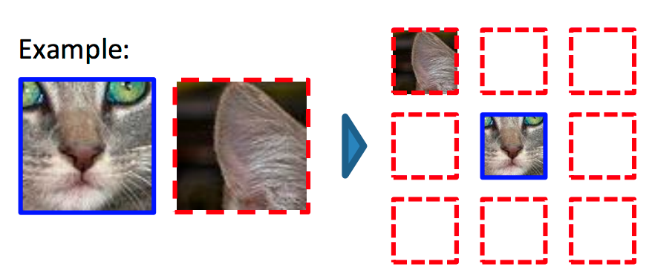
Self supervision by reconstructing hidden data
Doersch et al, ICCV 2015
Zhang et al, ECCV 2016
Pathak et al, CVPR 2016

Slide 4
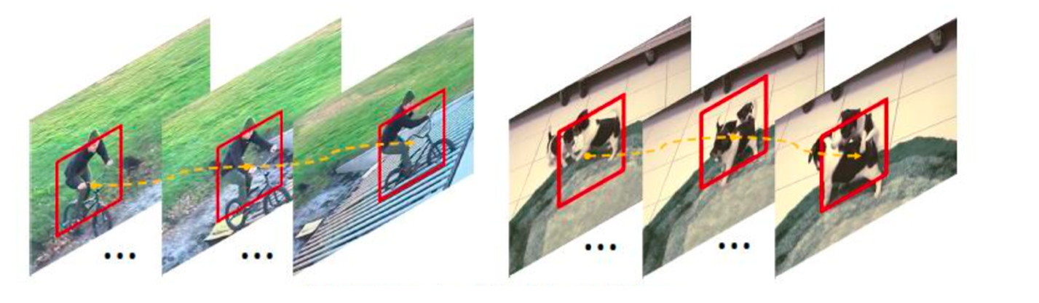
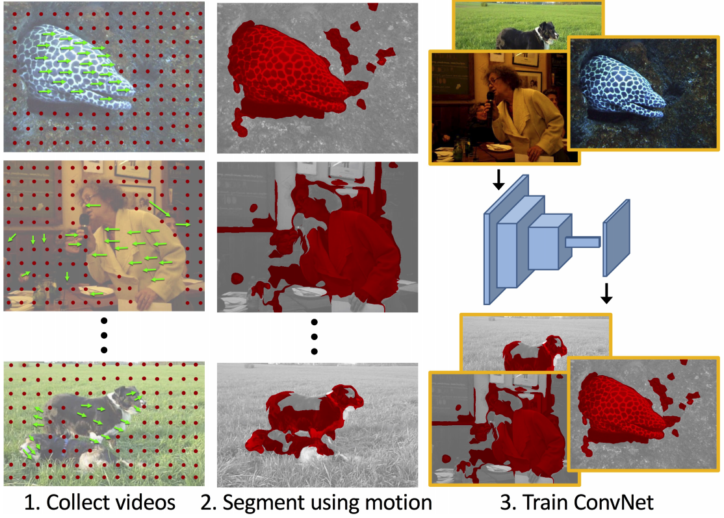
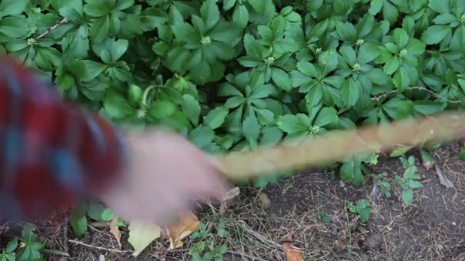
Self supervision by using external information
Wang et al, ICCV 2015
Pathak et al, CVPR 2017
Agrawal et al, ICCV 2015.
Jayaraman and Grauman, ICCV 2015.
Owens et al, CVPR 2016

Slide 5
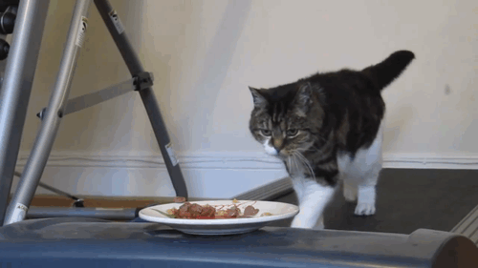
What do humans do?
Notes:
We decided to look at the human visual system more closely to figure out how it is able to learn good representations. One of the first things we realized was that humans don’t see static images, they see a moving scene, kind of like this constant video stream.
In such a video stream, more often than not, objects tend to pop out. This is because they move differently from the background. In this video here, even though the cat is made up of a bunch of different colors, we still see it as a single object because all the cat pixels move together and differently from the rest of the background.

Slide 6
What do humans do?
Elizabeth Spielke. Principles of Object Perception. In Cognitive Science, 1990.
Notes:
There is evidence from human psychology that this is a really important cue. For example, if you show really young infants this static display on the left, then they cannot distinguish between the two options on the right. In other words, they are unable to decide if the two halves of the rod form a single unified object, or whether they are indeed two rods.

Slide 7
What do humans do?
Elizabeth Spielke. Principles of Object Perception. In Cognitive Science, 1990.
Notes:
However, if you show infants this moving display

Slide 8
What do humans do?
Elizabeth Spielke. Principles of Object Perception. In Cognitive Science, 1990.
Notes:
Then they do perceive the rod as connected. This suggests that very young infants are unable to perceive any sort of depth ordering in the static image, but when objects move, they actually use the fact that things that move together form part of a single object.

Slide 9
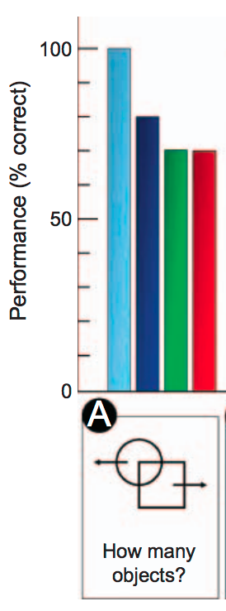
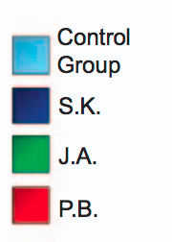

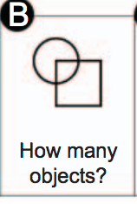
What do humans do?
Patients recovering from blindness
Ostrovsky et al. Visual Parsing After Recovery From Blindness. In Psychological Science, 2009.
Notes:
A similar effect was found in adults and older children who had recently recovered from blindness. In particular, they had trouble grouping correctly overlapping, static shapes, but they had no trouble when the objects moved.
What’s more, their ability to recognize objects was also correlated with if the object moved, that is, if it was a motile object. All of this suggests that motion-based grouping appears early on, and basically bootstraps the other forms of grouping, and even recognition.

Slide 10
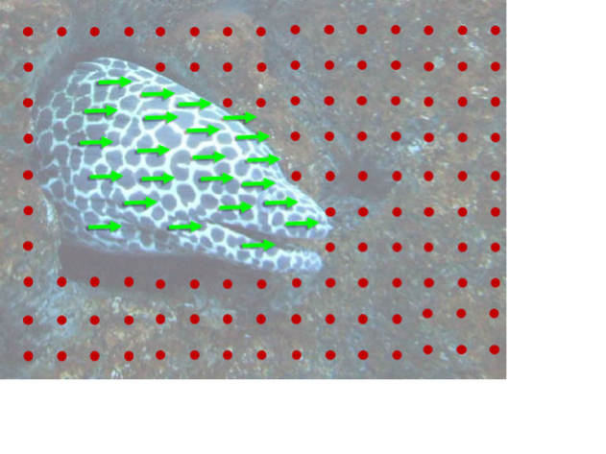
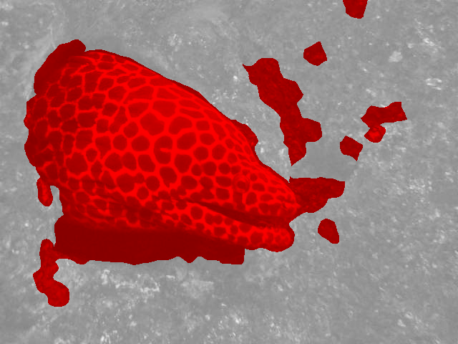
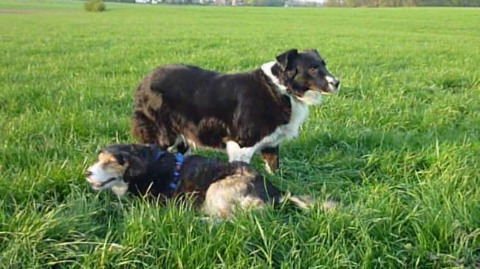
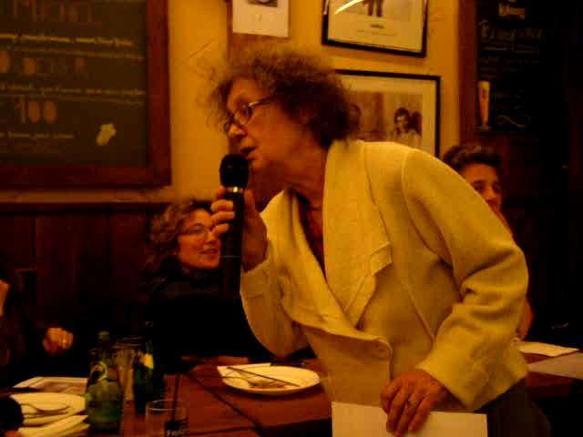
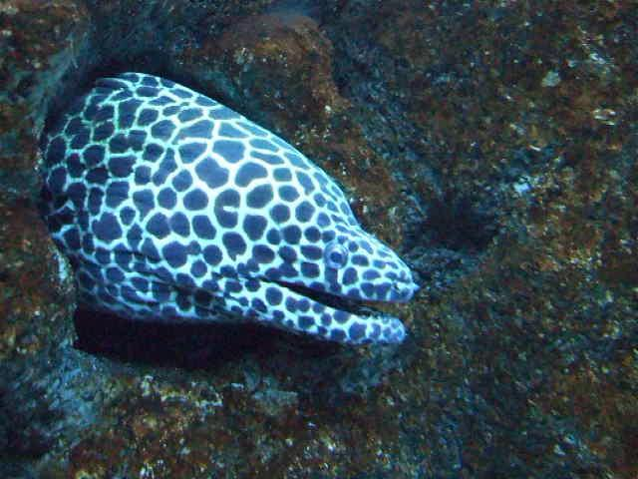
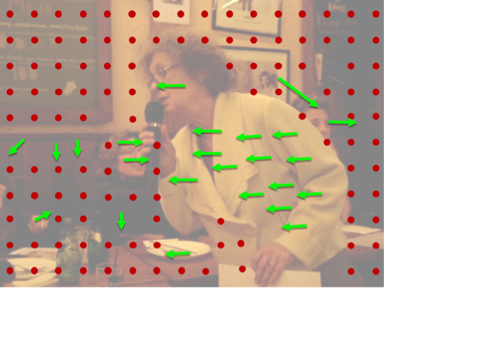
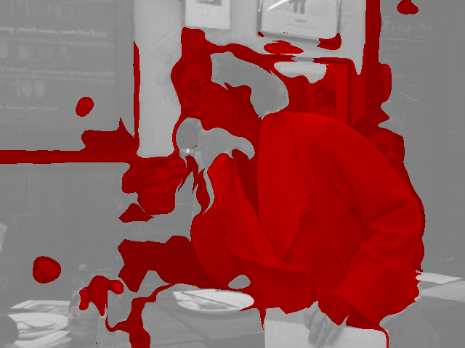
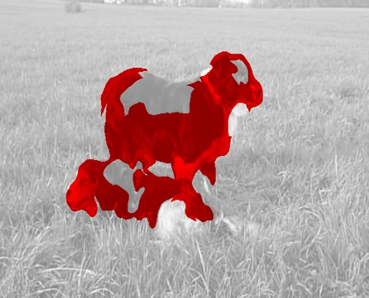
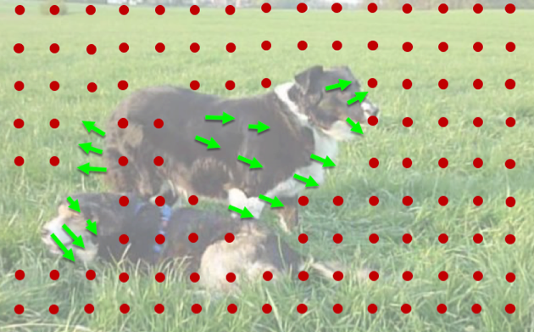
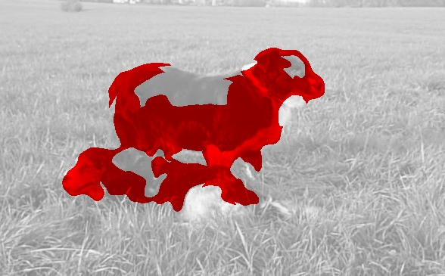


1. Collect videos
2. Segment using motion
3. Train ConvNet
Notes:
This led to a fairly straightforward approach to learning representations in an unsupervised manner: we collected a large number of uncurated videos, we used motion grouping to segment out the foreground in each frame, and then we trained a ConvNet to predict this foreground segmentation

Slide 11
What do humans do?

Slide 12
Visually indicated sounds
Owens et al, CVPR 2016

Slide 13
Learning from egomotion
Agrawal et al, ICCV 2015.

Slide 14
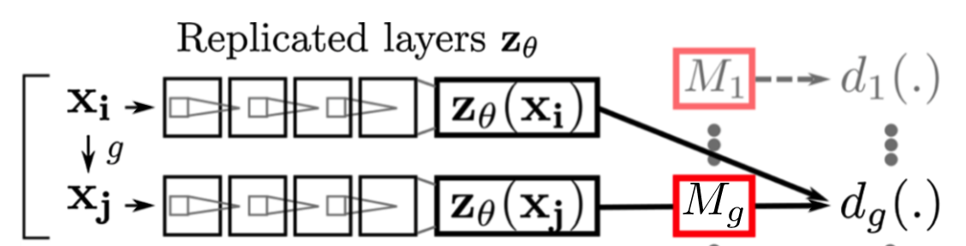
Learning from egomotion
Invariance: features don’t change if image changes
Equivariance: features change the same way as visual input
Jayaraman and Grauman, ICCV 2015.

Slide 15
Vision for action
Perception
Action
Owens et al, CVPR 2016

Slide 16
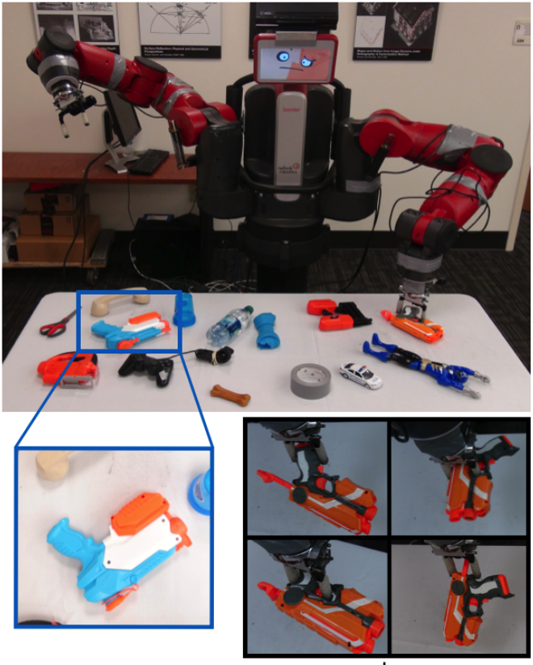
Learning to use vision for acting

Slide 17
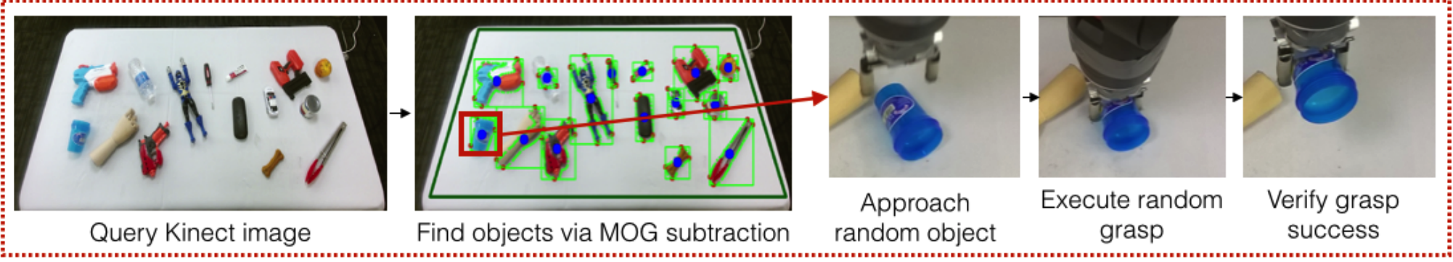
Learning to use vision for acting
Supersizing Self-supervision: Learning to Grasp from 50K Tries and 700 Robot Hours. Lerrel Pinto and Abhinav Gupta. In ICRA, 2016

Slide 18
Learning policies
Markov decision process
State at time t+1 depends only on state at time t + action
Transitions and rewards unknown
Policy: mapping from states to actions

Slide 19
Value functions
V*(s): expected return if following optimal policy starting from s
Q*(s,a): expected return if following optimal policy starting from s and taking action a
Bellman equation

Slide 20
Challenges of reinforcement learning
Sparse rewards
Far-reaching consequences: previous actions affect future rewards
Partial feedback: only see the consequences of the actions taken

Slide 21
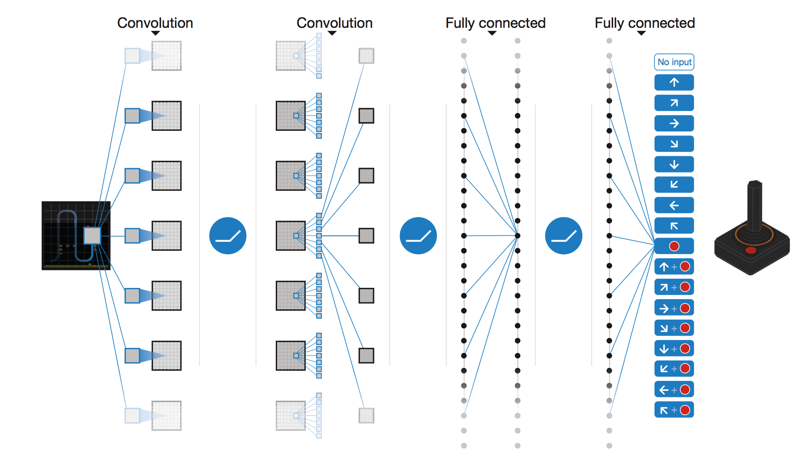
Learning to play Atari games
Mnih, Volodymyr, et al. "Human-level control through deep reinforcement learning." Nature518.7540 (2015): 529-533.

Slide 22
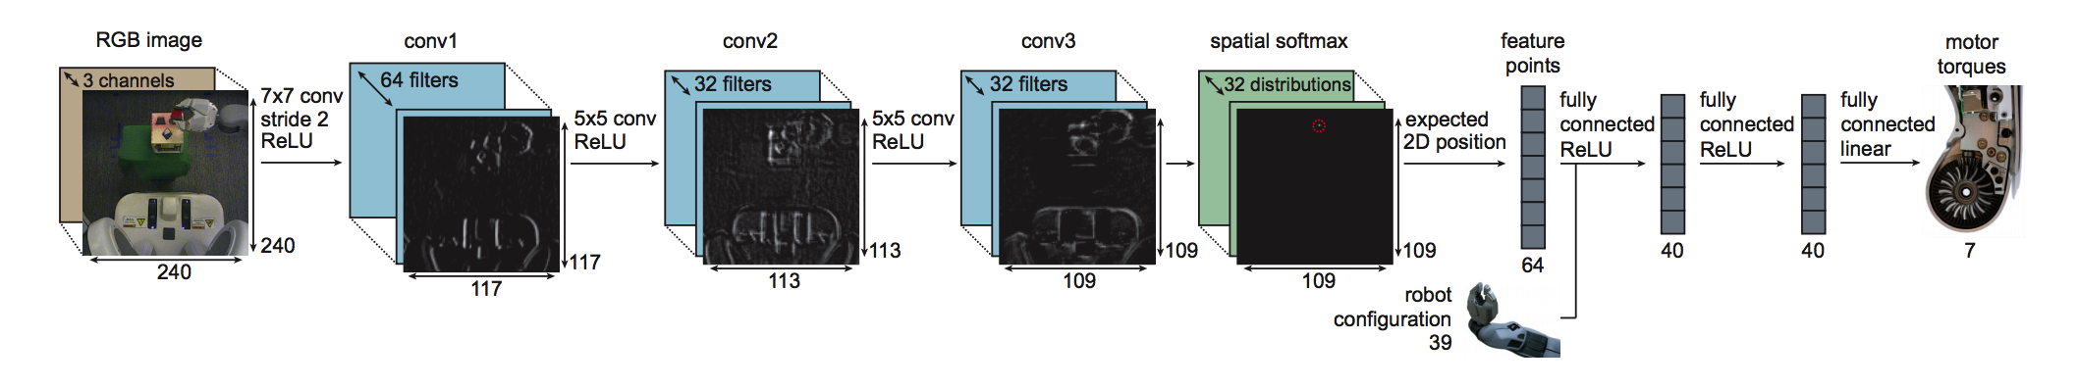
Learning to do robotic tasks
End-to-End Training of Deep Visuomotor Policies. S. Levine, C. Finn, T. Darrell, P. Abbeel. In JMLR, 2016

Slide 23
Reinforcement learning and generalization
RL learns a policy
Policies are specific to goals
Reinforcement learning = learning to play a particular game
Separate model for each game
  “Close this bottle”
  “Peel this banana”
General model?

Slide 24
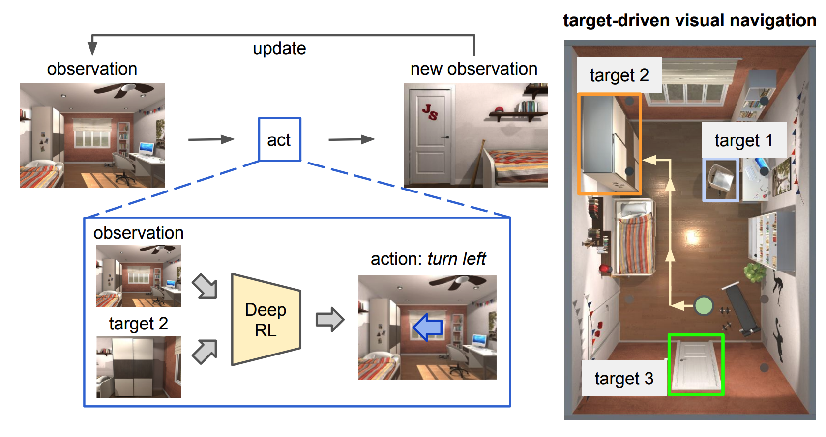
Target-driven Visual Navigation in Indoor Scenes using Deep Reinforcement Learning. Y. Zhu, R. Mottaghi, E. Kolve, J. J. Lim, A. Gupta, L. Fei-fei, A. Farhadi. In ICRA, 2017

Slide 25
Reflex agents
Reflex agents
  Map observations to actions
  Are feedforward
  Cannot explore / back-track
  Have to be trained on each environment

Slide 26
Planning
If we can predict consequences of actions, we can plan

Slide 27
Intuitive physics

Slide 28
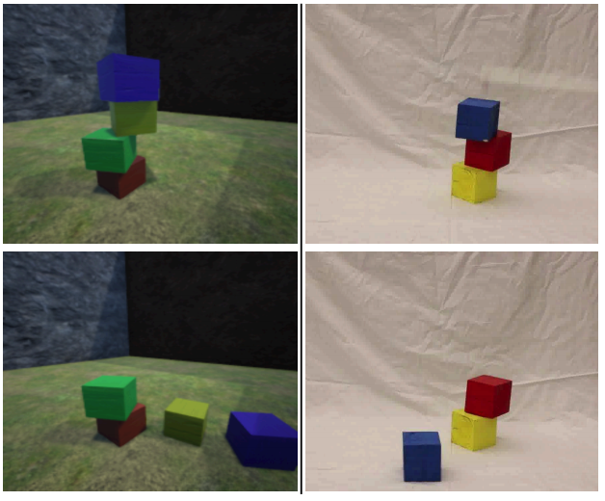
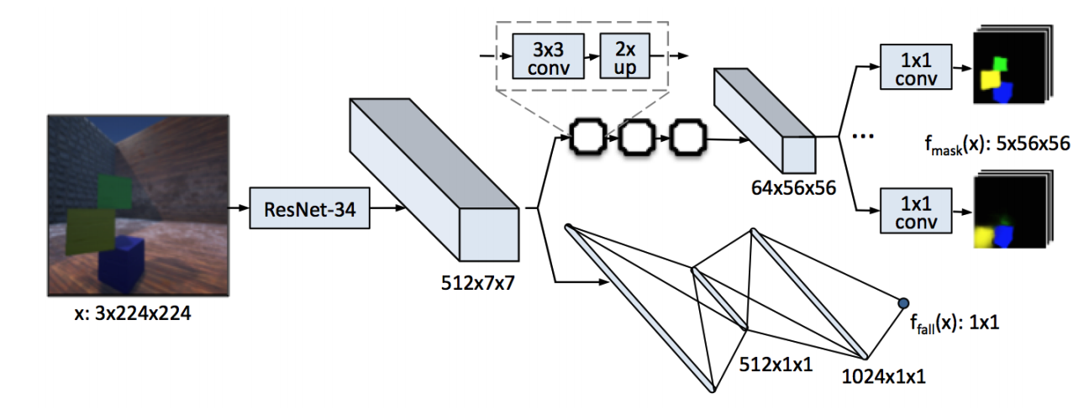
Learning intuitive physics
Learning Physical Intuition of Block Towers by Example. Adam Lerer, Sam Gross, Rob Fergus. In ICML 2016

Slide 29
Learning intuitive physics
Forward model: given current state and action, predict next state
Inverse model: given previous state and current state, predict action taken
Learning To Poke by Poking: Experiential Learning of Intuitive Physics. Pulkit Agrawal, Ashwin Nair, Pieter Abbeel, Jitendra Malik, Sergey Levine. In NIPS, 2016

Slide 30
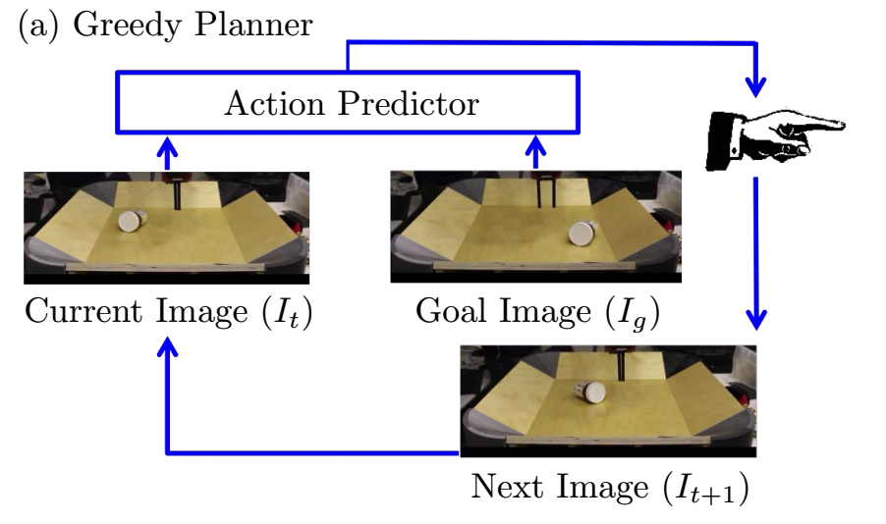
Learning intuitive physics
Learning To Poke by Poking: Experiential Learning of Intuitive Physics. Pulkit Agrawal, Ashwin Nair, Pieter Abbeel, Jitendra Malik, Sergey Levine. In NIPS, 2016

Slide 31
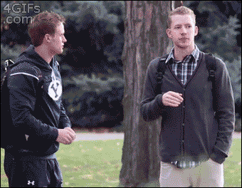
Learning to predict the future

Slide 32
Learning to predict the future
“It is difficult to make predictions, especially about the future” - Danish proverb
Multimodal distribution
High-dimensional space (images)
Only single sample seen at any given time

Slide 33
Detour : Generative models

Slide 34
Generative models of images
Can we compute probability of a given image?
Can we sample from the distribution?

Slide 35
Learning generative models of images
Standard probabilistic models (e.g. Gaussian)
  Can be sampled from
  Cannot capture arbitrary distributions
Neural networks
  Can learn to model arbitrary functions
  Are deterministic
Key idea 1: neural networks with noise input!

Slide 36
Learning generative models of images

Slide 37
Learning generative models of images
Two distributions: p_{real} and p_{model}
Both highly multimodal, high-dimensional
Only have samples from each distribution
Want to minimize the difference between the two distributions

Slide 38
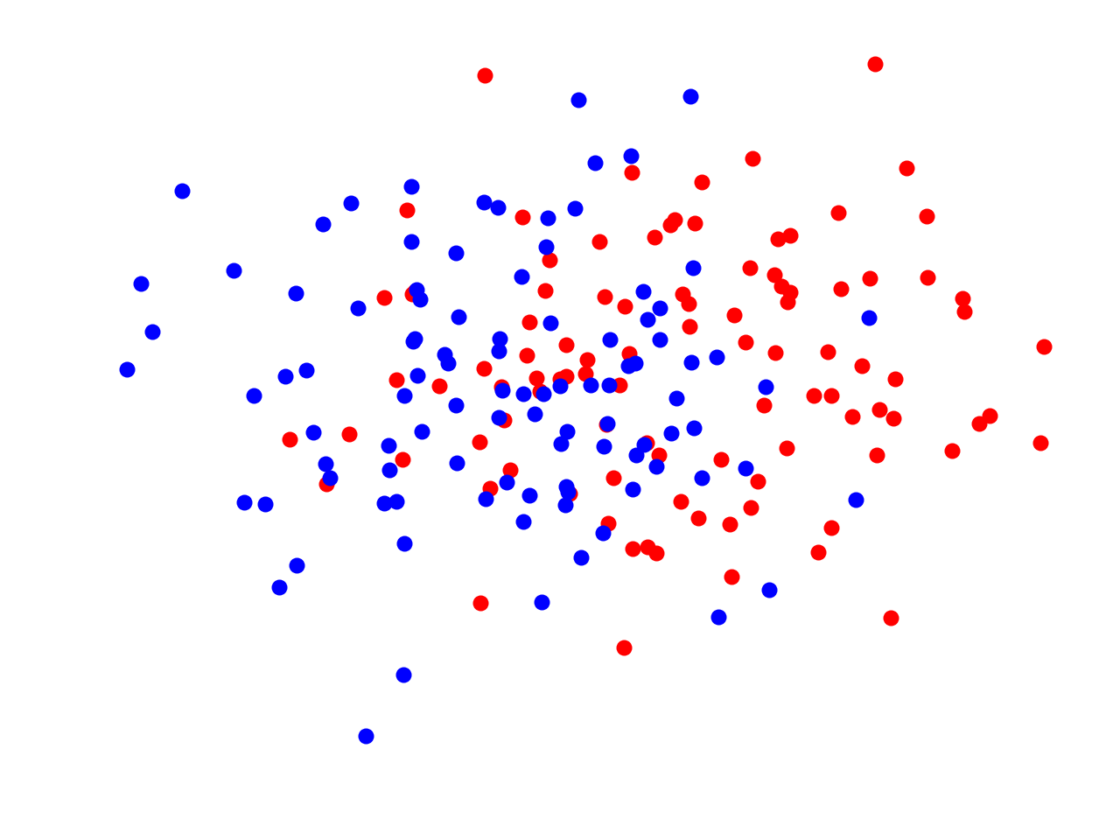
The adversary

Slide 39
Generative Adversarial Networks (GANs)
Two player game:
  Adversary or discriminator tries to distinguish between real and generated images
  Generator tries to fool adversary
Goodfellow, Ian, et al. "Generative adversarial nets." Advances in neural information processing systems. 2014.

Slide 40
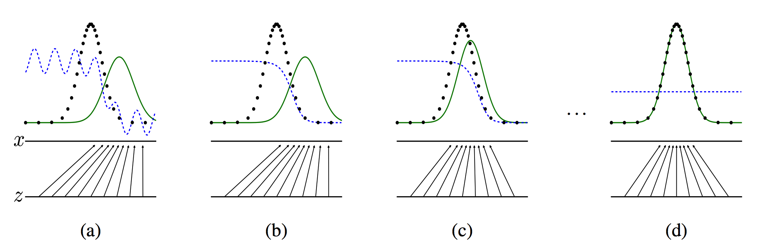
Generative Adversarial Networks (GANs)

Slide 41
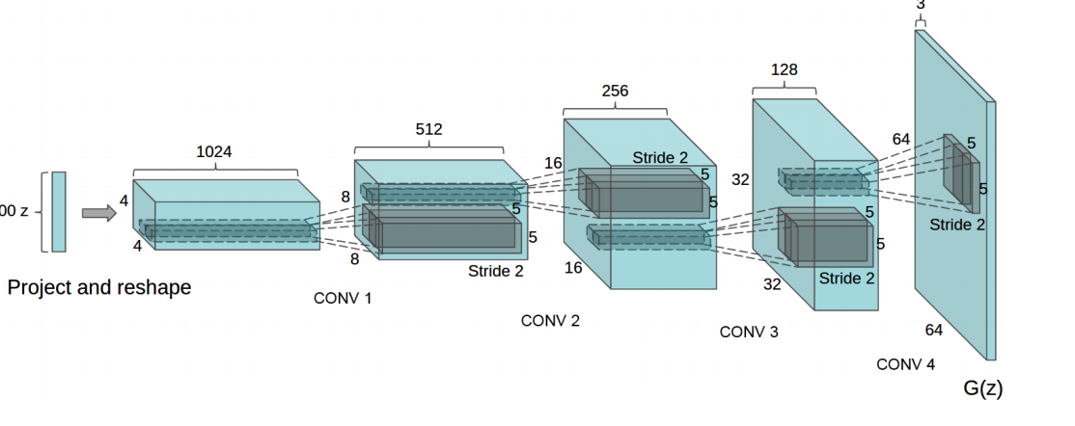
GANs
Radford, Alec, Luke Metz, and Soumith Chintala. "Unsupervised representation learning with deep convolutional generative adversarial networks." In ICLR, 2016.

Slide 42
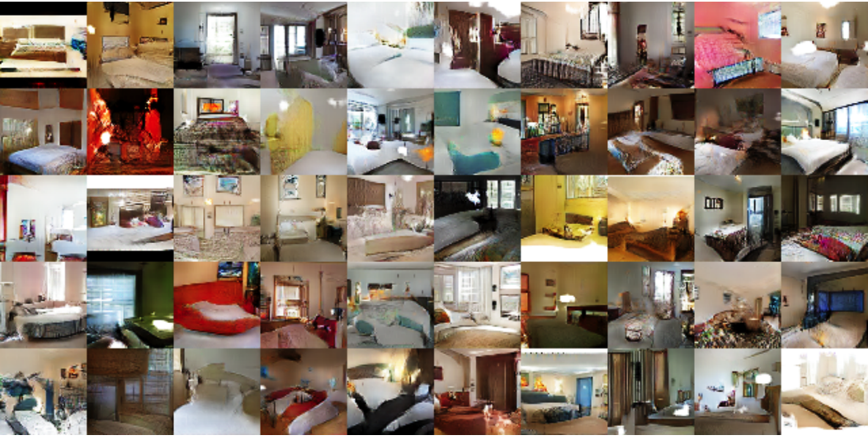
GANs
Radford, Alec, Luke Metz, and Soumith Chintala. "Unsupervised representation learning with deep convolutional generative adversarial networks." In ICLR, 2016.

Slide 43
GANs

Slide 44
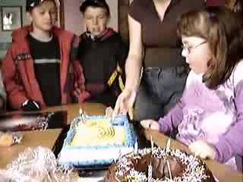
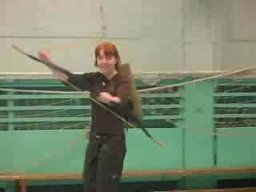
Back to the future
Michael Mathieu, Camille Couprie, Yann LeCun
"Deep multi-scale video prediction beyond mean square error"
International Conference on Learning Representation (2016).

Slide 45
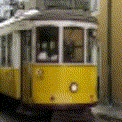
Predicting the future
J. Walker, K. Marino, A. Gupta, and M. Hebert
The Pose Knows: Video Forecasting by Generating Pose Futures
ICCV 2017
Generating the Future with Adversarial Transformers
Carl Vondrick, Antonio Torralba
CVPR 2017

