Slide 1
Visual Question Answering
Direct motivation: assistive technology
Indirect motivation: sandbox for reasoning
VQA: Visual Question Answering. Aishwarya Agrawal, Jiasen Lu, Stanislaw Antol, Margaret Mitchell, C. Lawrence Zitnick, Dhruv Batra, Devi Parikh. In ICCV, 2015.

Slide 2
The problem with VQA
Dataset biases allow cheating
  Only-question Bag-of-Words: 53.7% (vs ~65% for state-of-the-art)
Require common sense to answer
  “What is the moustache made of?”
Hard to diagnose error
  Is the problem understanding the question?
  Or understanding the image?

Slide 3
Clever Hans

Slide 4
Disiderata for a diagnostic dataset
Minimal bias
Minimal reliance on hard-to-access common sense
Ability to experiment with “perfect vision” and “perfect NLP”
  Need “ground truth reasoning”
Ability to control dataset properties
Sufficient complexity of reasoning required

Slide 5
CLEVR - Images
Synthetic universe: spheres, cylinders, cubes
Each image comes with ground truth location
CLEVR: A Diagnostic Dataset for Compositional Language and Elementary Visual Reasoning
Justin Johnson, Bharath Hariharan, Laurens van der Maaten, Li Fei-Fei, C. Lawrence Zitnick, Ross Girshick
CVPR, 2017

Slide 6
CLEVR – Questions
Need ground truth reasoning for every question
Idea: create questions by sampling functional programs
  Take scene as input, output answer
Filter color
Filter shape
Unique
Relate
Filter shape
Unique
Query
color
yellow
sphere
right
cube

Slide 7
CLEVR – Questions
Need to convert functional programs into natural(-istic) language
Idea: templates
Filter color
Filter shape
Unique
Relate
Filter shape
Unique
Query
color
yellow
sphere
right
cube
What is the color of the <S> <R> of the <C><S>?
What is the color of the cube right of the yellow sphere?

Slide 8
Results – Overall performance

Slide 9
Results – Query color

Slide 10
Results – Equal Shape

Slide 11
Chains vs trees
Chain: How many cubes are to the right of the sphere that is to the left of the red thing?
Tree: How many cubes are both to the right of the sphere and left of the red thing?

Slide 12
Compositional Generalization
Two conditions
  Cubes and cylinders only seen in specific colors
  Color palettes swapped in two conditions

Slide 13
Compositional reasoning
What is the color of the kitten to the left of the blue kitten?

Slide 14
Compositional reasoning
What is the color of the kitten to the left of the blue kitten?
Detect kittens
And
Look left
Detect blueness
Get color

Slide 15
Compositional reasoning
Triangle detector
Look left
Look left
Blue detector
Triangle detector
And
Get color
Get color
Red

Slide 16
Compositional reasoning
What is the color of the kitten to the left of the blue kitten?
Kitten detector
Look left
Blue detector
And
Get color

Slide 17
Compositional reasoning
What is the color of the kitten to the left of the blue kitten?
Kitten detector
Look left
Kitten detector
Blue detector
And
Look left
Get color
And
Blue detector
Get color

Slide 18
Compositional reasoning
How do we learn a mapping from language to trees?
  Problem: semantic parsing
  Option 1: Syntactic parsing
  Option 2: Use supervision
Neural module networks.Jacob Andreas, Marcus Rohrbach, Trevor Darrell and Dan Klein.CVPR 2016
Learning to compose neural networks for question answering.Jacob Andreas, Marcus Rohrbach, Trevor Darrell and Dan Klein.NAACL 2016
Learning to reason: End-to-end module networks for visual question answering.Ronghang Hu, Jacob Andreas, Marcus Rohrbach, Trevor Darrell and Kate Saenko.ICCV 2017
Inferring and Executing Programs for Visual Reasoning
Justin Johnson, Bharath Hariharan, Laurens van der Maaten, Judy Hoffman, Li Fei-Fei, C. Lawrence Zitnick, Ross Girshick. ICCV, 2017

Slide 19
Compositional reasoning

Slide 20
Reducing supervision

Slide 21
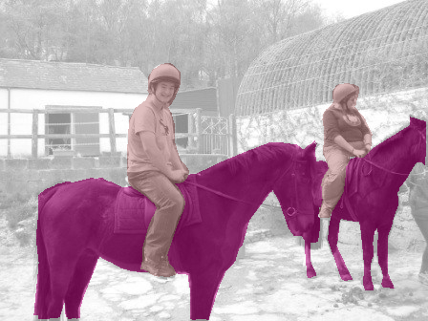
Two phases of supervision
Base task (ImageNet)
New task
Representation learning
Finetuning
New
Model
Evaluation
Model
Notes:
So here’s the problem setup. We’ll first get to train our model on a large labeled dataset containing a set of “base” classes. Then we’ll get to see some “novel classes”, which have only a few training examples. Our task is to update our model so that it can now distinguish among all the classes in the combined set.

Slide 22
VQA
Instance Segmentation
Cost of Annotation
Image Classification more classes
Object Detection
Image Classification
Richness of output

Slide 23
Notes:
But we humans can do so much more.
We can not only recognize objects but also understand the scene more deepy.
We can see, of course, that there’s a tiger here,
but in spite of the jumble of lines and shadows and stripes in the scene, but can still figure out the boundaries of the tiger
And yet in this case we’ve not even seen a single tiger with its boundaries highlighted,
or the boundaries for anything else for that matter
How are humans able to understand images so richly with so little supervision
and, the question that I am interested in: can computers do the same?

Slide 24
Two phases of supervision
Base task (ImageNet)
New task
Representation learning
Finetuning
New
Model
Evaluation
Model
Notes:
So here’s the problem setup. We’ll first get to train our model on a large labeled dataset containing a set of “base” classes. Then we’ll get to see some “novel classes”, which have only a few training examples. Our task is to update our model so that it can now distinguish among all the classes in the combined set.

Slide 25
Unsupervised representation learning
k-means
Assign to nearest centers

Slide 26
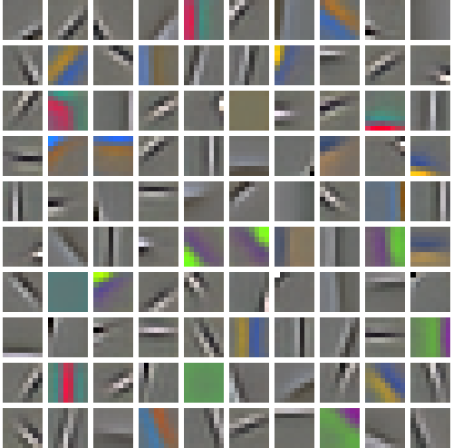
Unsupervised representation learning
Deeper?

Slide 27
Evaluating representations
Feature representations | Frozen representations | Finetuned representations
ImageNet | 52.5 | 56.5
k-means | 26.0 | 42.8
DPM | 32.2
Data-dependent Initializations of Convolutional Neural Networks
Philipp Krähenbühl, Carl Doersch, Jeff Donahue, and Trevor Darrell.
ICLR, 2016

Slide 28
What makes for a good feature representation?
Not just model densities, capture semantics
Objects
Object parts
Scene properties

Slide 29
Self-supervised learning
Idea: force convnet to learn semantics
Frame proxy task that requires using semantics

Slide 30
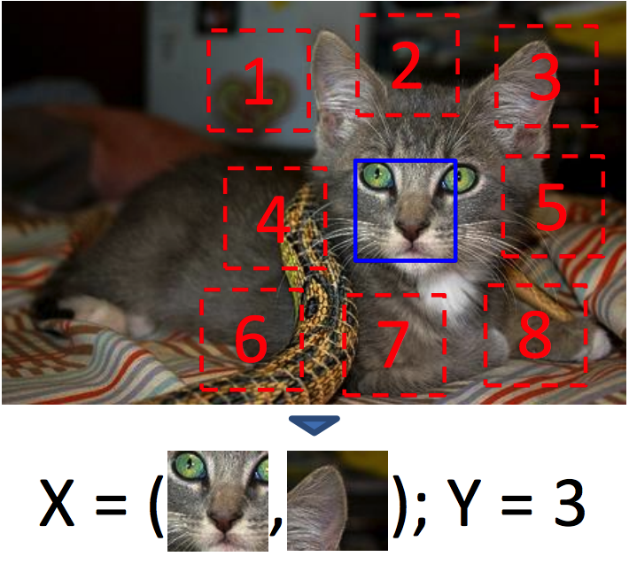
Self-supervised learning
Unsupervised Visual Representation Learning by Context Prediction
Carl Doersch, Abhinav Gupta, and Alexei A. Efros.
in ICCV 2015

Slide 31
Self-supervised learning
Feature representations | Frozen representations | Finetuned representations
ImageNet | 52.5 | 56.5
k-means | 26.0 | 42.8
DPM | 32.2
Unsupervised learning by context | 33.2 | 49.9

Slide 32
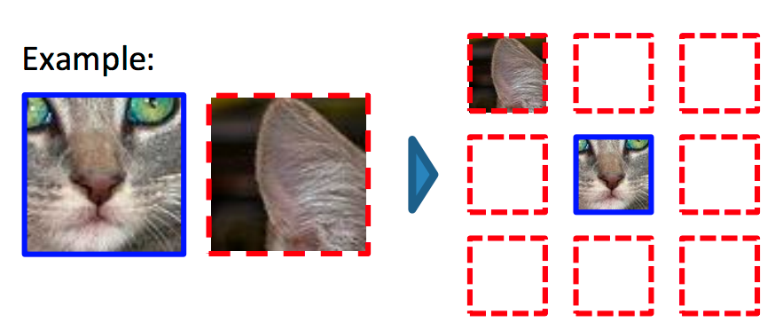
Self supervision by reconstructing hidden data
Doersch et al, ICCV 2015
Zhang et al, ECCV 2016
Pathak et al, CVPR 2016

Slide 33
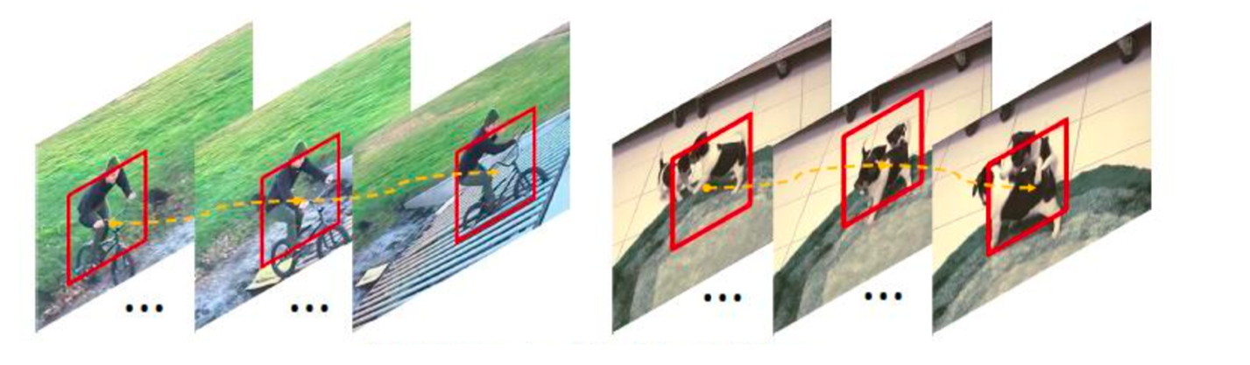
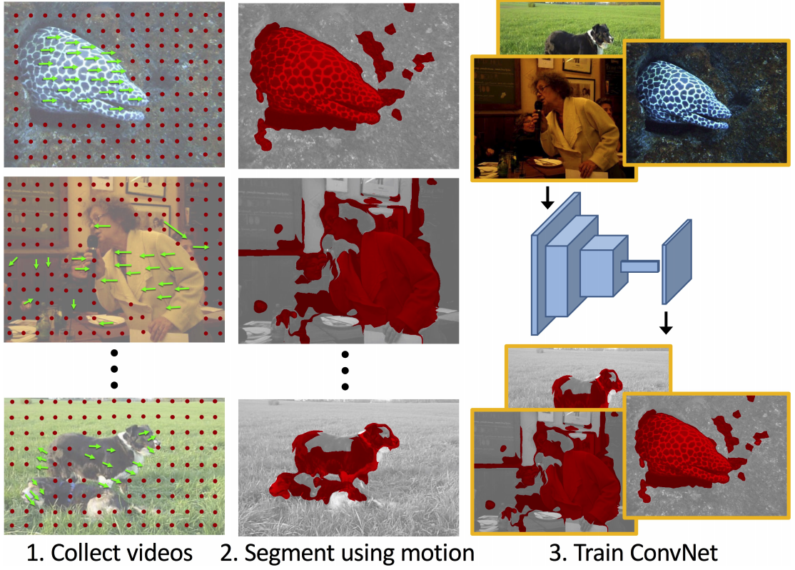
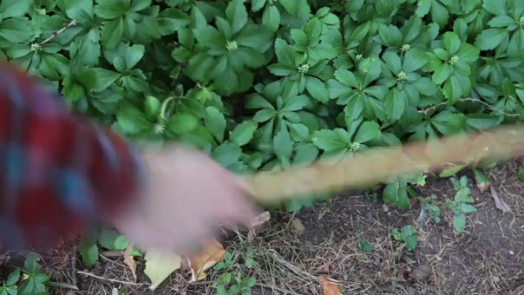
Self supervision by using external information
Wang et al, ICCV 2015
Pathak et al, CVPR 2017
Agrawal et al, ICCV 2015.
Jayaraman and Grauman, ICCV 2015.
Owens et al, CVPR 2016

Slide 34
Self-supervised learning
Feature representations | Frozen representations | Finetuned representations
ImageNet | 52.5 | 56.5
k-means | 26.0 | 42.8
DPM | 32.2
Unsupervised learning by context | 33.2 | 49.9
Motion | 40.3 | 48.6

Slide 35
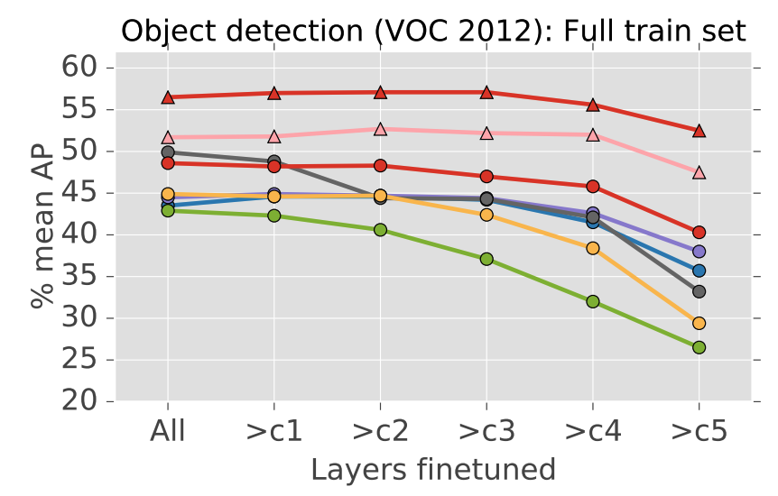
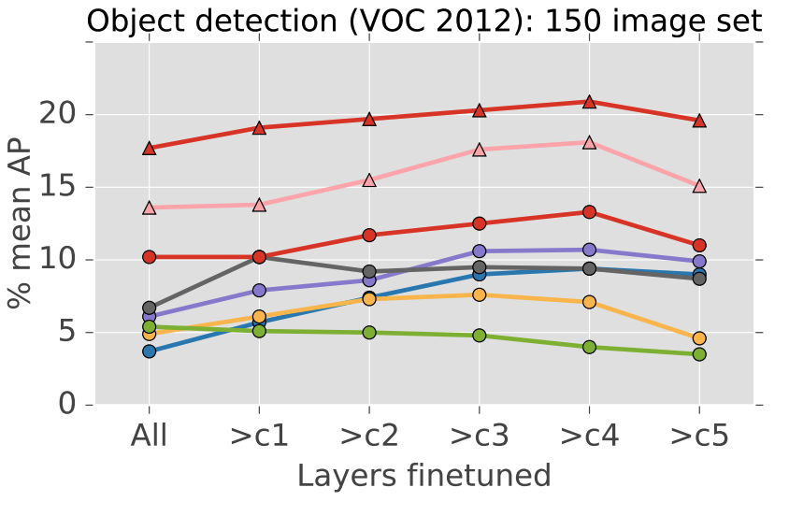
The unreasonable effectiveness of ImageNet

Slide 36
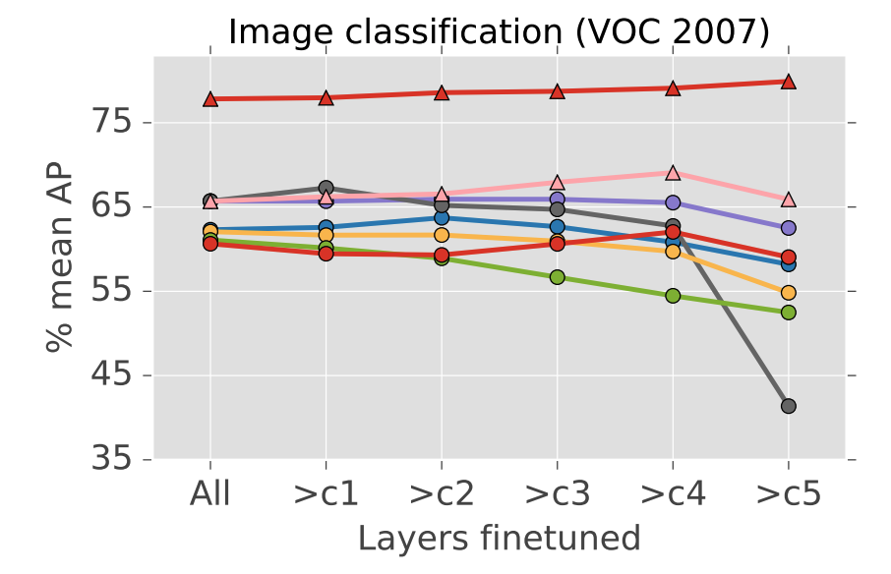
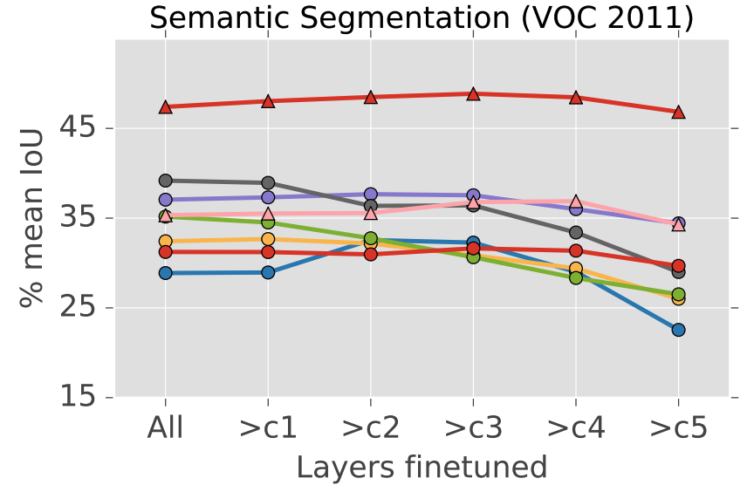
The unreasonable effectiveness of ImageNet

Slide 37
Why is ImageNet so good?
Classification?
Curated images?
Many diverse classes?
Related to target tasks?

Slide 38
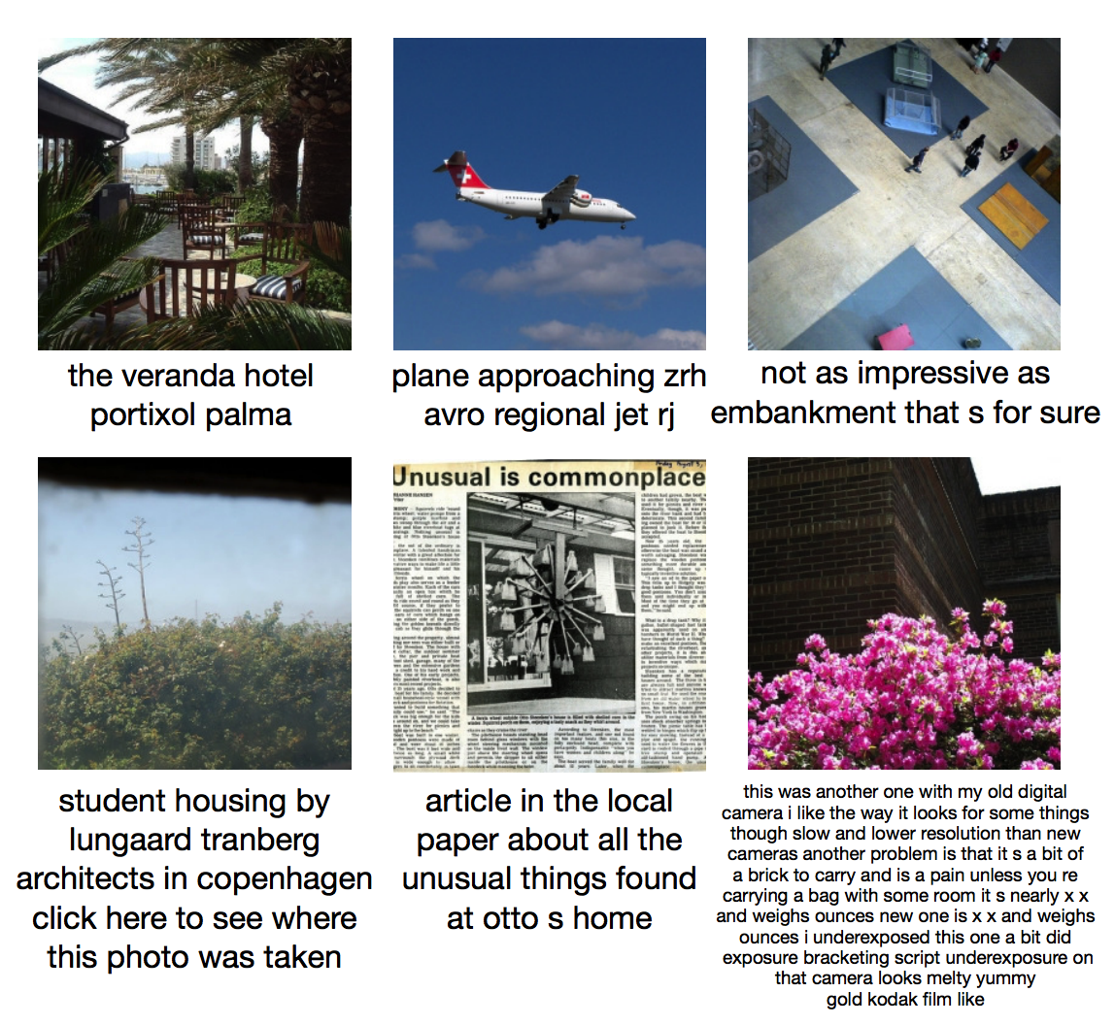
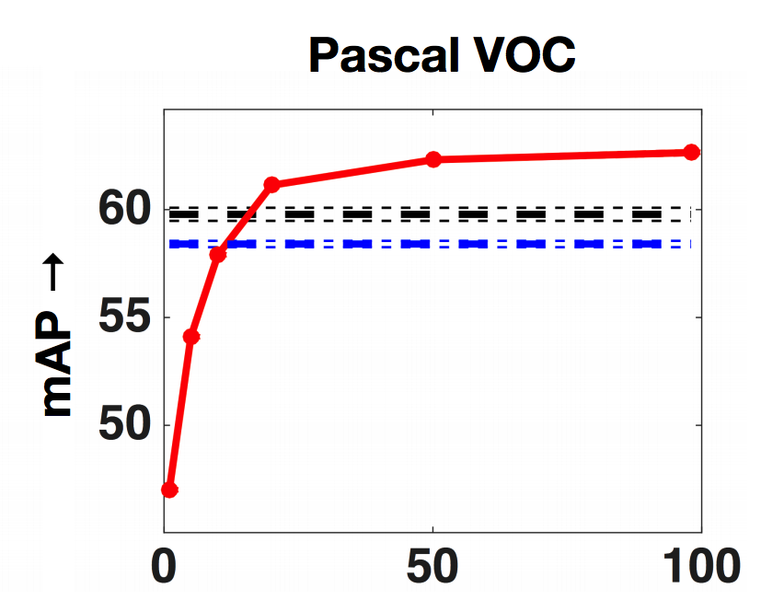
Weak supervision
A. Joulin*, L.J.P. van der Maaten*, A. Jabri, and N. Vasilache (*both authors contributed equally). Learning Visual Features from Large Weakly Supervised Data. In ECCV, 2016.

Slide 39
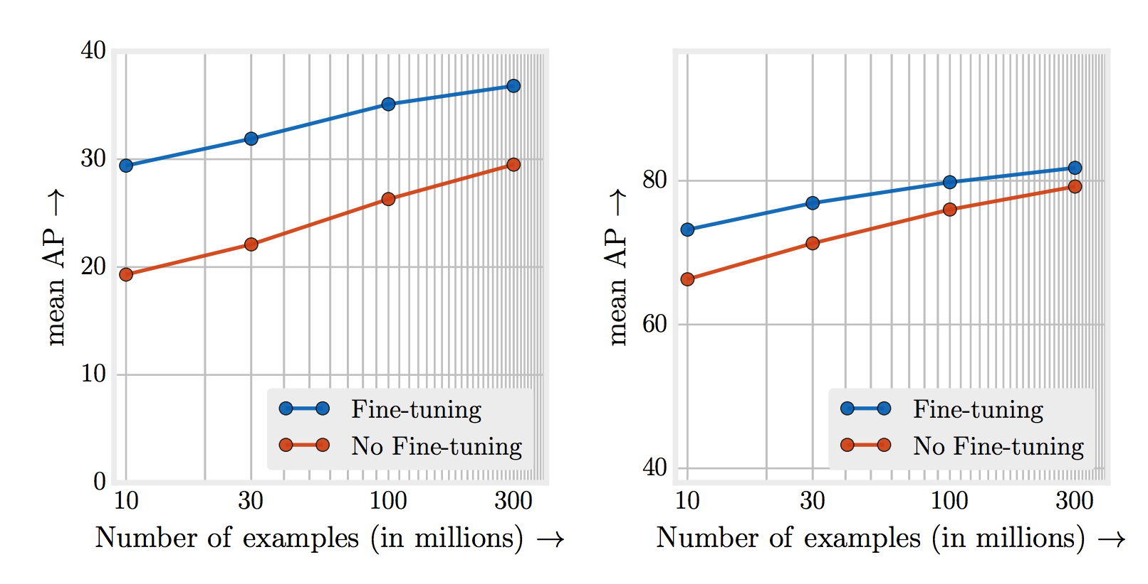
Beating supervised learning with tons and tons of data
Revisiting Unreasonable Effectiveness of Data in Deep Learning Era. Chen Sun, Abhinav Srivastava, Saurabh Singh, Abhinav Gupta. In ICCV, 2017.

Slide 40
Two phases of supervision
Base task (ImageNet)
New task
Representation learning
Finetuning
New
Model
Evaluation
Model
Notes:
So here’s the problem setup. We’ll first get to train our model on a large labeled dataset containing a set of “base” classes. Then we’ll get to see some “novel classes”, which have only a few training examples. Our task is to update our model so that it can now distinguish among all the classes in the combined set.

Slide 41
Different forms of reduced supervision
Weakly supervised
  Use less rich annotation / noisy annotation
Semi supervised
  Use a few labeled images and a bank of unlabeled images
Few-shot
  Use a few labeled images
  Mainly used for classification

Slide 42
Weak supervision for detection
Can we learn object detection / semantic segmentation with only image level labels?
Idea: image label = “cat” => somewhere in the image there is a cat

Slide 43
Multiple instance learning

Slide 44
Multiple instance learning
Bag is negative if all instances are negative
Bag is positive if one or more instances are positive

Slide 45
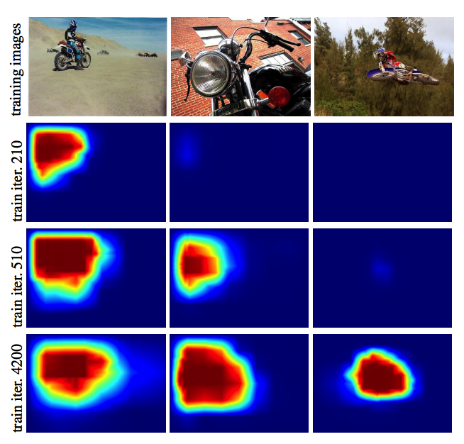
Fully-convolutional multiple instance learning
Each instance in bag is location in feature map
Computing instance scores = fully convolutional network
Is object localization for free?-weakly-supervised learning with convolutional neural networks. M Oquab, L Bottou, I Laptev, J Sivic. In CVPR, 2015.

Slide 46
Zero-shot learning
Learning from no examples
Y. Xian, C. H. Lampert, B. Schiele, Z. Akata. "Zero-Shot Learning - A Comprehensive Evaluation of the Good, the Bad and the Ugly" arXiv:1707.00600 [cs.CV]

Slide 47
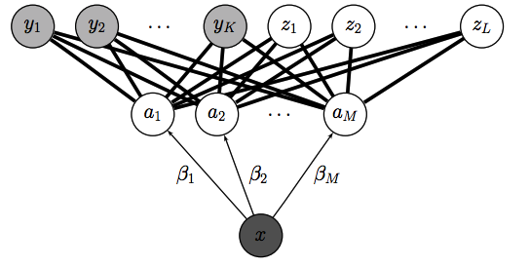
Zero-shot learning

Slide 48
Zero-shot learning
attributes
tiger
polar bear
whale
zebra
cheetah

Slide 49
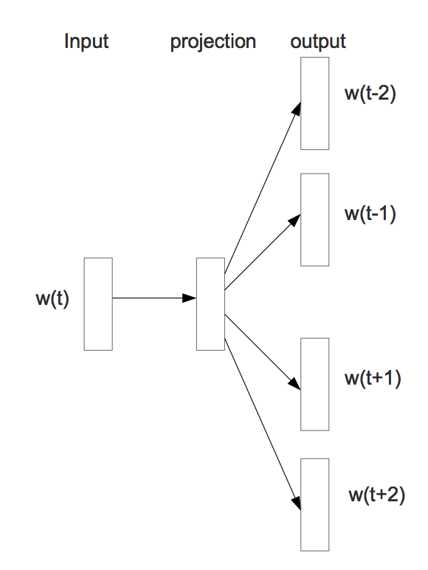
Word embeddings
Define vector representations for each word
Mikolov, Tomas, et al. "Distributed representations of words and phrases and their compositionality." Advances in neural information processing systems. 2013.

