Slide 1
Video classification

Slide 2
Video recognition with convolutional networks

Slide 3
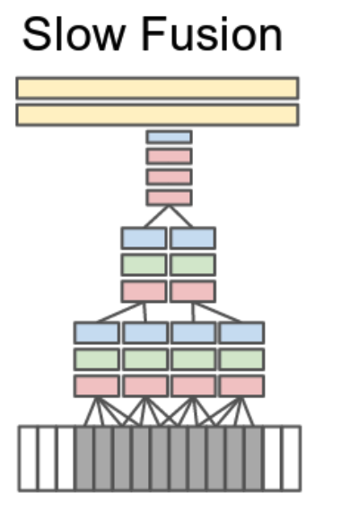
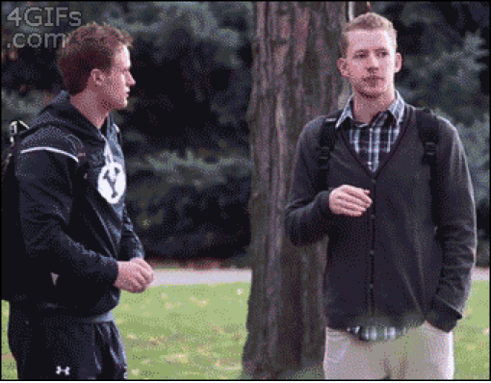
Extending convolutional networks to 3D

Slide 4
Extending convolutional networks to 3D
Method | Accuracy (UCF 101)
Best dense trajectories + bag-of-words | 85.9%
Temporal convolution | 65.4%

Slide 5
Convnets and Videos
Can’t use pretraining
Can’t train with long videos
3D convolution too expensive

Slide 6
A step back: frame-based convnets
Idea: train single-frame classifier
  Can use pretraining
  Can sample frames from videos
  Cheap
Average scores over frames
Method | Accuracy (UCF 101)
Best dense trajectories + bag-of-words | 85.9%
Temporal convolution | 65.4%
Avg-of-frame-scores | 72.8%

Slide 7
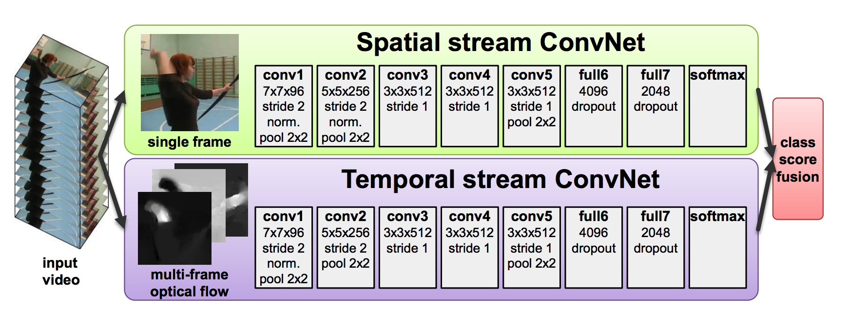
Bringing back motion
How do we take motion into account?
Key idea: use optical flow
Add flow as additional channel?
  Can’t use pretraining!
Idea: Use two-stream architecture

Slide 8
Bringing back motion
Method | Accuracy (UCF 101)
Best dense trajectories + bag-of-words | 85.9%
Temporal convolution | 65.4%
Avg-of-frame-scores (color) | 72.8%
Avg-of-frame-scores (flow) | 81.2%
Avg-of-frame-scores (both) | 86.2%
Two-Stream Convolutional Networks for Action Recognition in Videos. Karen Simonyan and Andrew Zisserman. In NIPS, 2014.

Slide 9
Beyond frame averaging
Do better than averaging frames?
  without increasing cost!
Idea: video is sequence of frames
Convnet converts each frame into feature vector
Sequence of feature vectors → class scores?

Slide 10
Detour: Sequence modeling

Slide 11
Sequence modeling
Internal state h
Observations x
See observations over time
Update state
h₁
h₂
h₃
f
f
f
x₁
x₂
x₃
Recurrent Neural Networks (RNNs)

Slide 12
Problem: vanishing/exploding gradients

Slide 13
“Long Short-term Memory”
Instead of repeated applications of arbitrary function f
Have repeated application of something that does not decay or scale up
  Addition!

Slide 14
(Not) LSTM - 1

Slide 15
(Not) LSTM - 2

Slide 16
(Not) LSTM - 3

Slide 17
(Not) LSTM - 3
Long Short-Term Memory. Sepp Hochreiter and Jurgen Schmidhuber. In Neural Computation

Slide 18
Using LSTMs for frame accumulation
Method | Accuracy (UCF 101)
Simple average | 78.9%
LSTM | 82.3%
Long-term Recurrent Convolutional Networks. J. Donahue, L. A. Hendricks, S. Guadarrama, M. Rohrbach, S. Venugopalan, K. Saenko, T. Darrell. In CVPR, 2015.

Slide 19
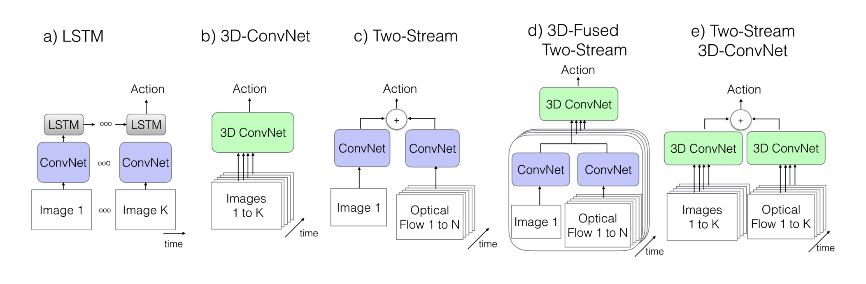
Revisiting video classification architectures
Quo Vadis, Action Recognition? A New Model and the Kinetics Dataset. J. Carreira and A. Zisserman. In CVPR, 2017.

Slide 20
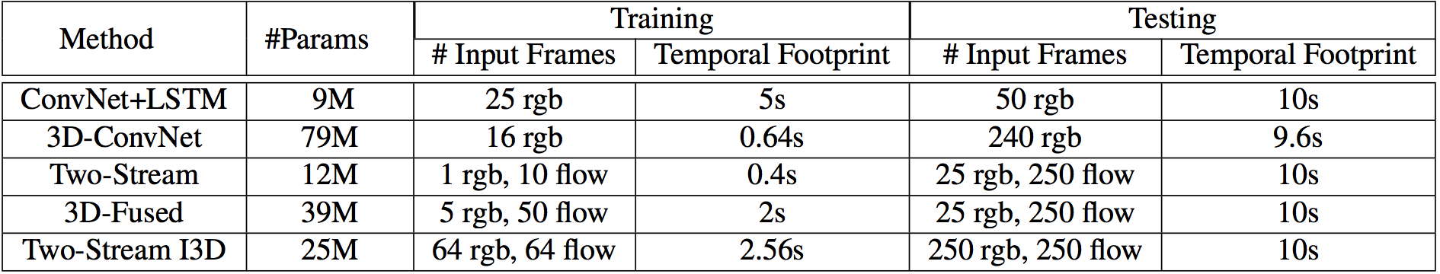
Revisiting video classification architectures

Slide 21
Pre-training 3D convolutional networks

Slide 22
Pre-training 3D convolutional networks

Slide 23
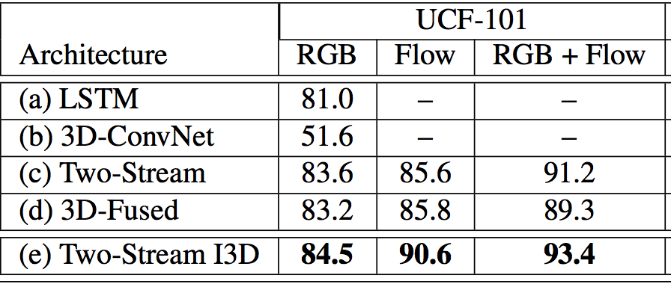
Revisiting video classification architectures

Slide 24
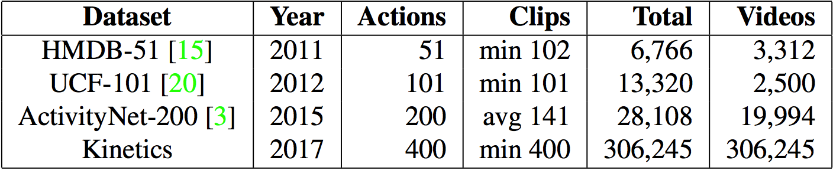
Towards better video datasets
The Kinetics Human Action Video Dataset. Kay, Will et al. Arxiv 2017.

Slide 25
Other video problems
Action “detection / localization” in time
Temporally consistent object detection / semantic segmentation
Tracking

Slide 26
Vision and Language

Slide 27
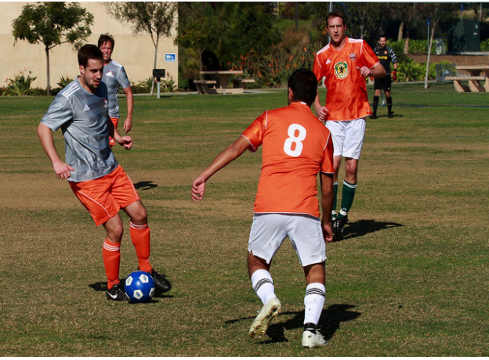
Image captioning - The task
A group of young men playing soccer.

Slide 28
Image captioning - why?
Alt-text for visually impaired
Test for true understanding?

Slide 29
Image captioning - evaluation
Given computer-generated caption and human caption, compute match
BLEU from machine translation community
Computes (modified) n-gram precision
Reference: A group of people playing soccer
Candidate: People playing baseball.
BLEU: 1/3

Slide 30
Image captioning
Long-term Recurrent Convolutional Networks. J. Donahue, L. A. Hendricks, S. Guadarrama, M. Rohrbach, S. Venugopalan, K. Saenko, T. Darrell. In CVPR, 2015.
Deep Visual-Semantic Alignments for Generating Image Descriptions. Andrej Karpathy and Li Fei-Fei. In CVPR, 2015
Show and tell: A neural image caption generator
Oriol Vinyals, Alexander Toshev, Samy Bengio, Dumitru Erhan. In CVPR, 2015.

Slide 31
Generating sequences with LSTMs
…
x₁
x₂
x₃

Slide 32
Generating sequences with LSTMs
y₁
y₂
y₃
…
x₁
x₂
x₃

Slide 33
Generating sequences with LSTMs
A
group
of
p₁
p₂
p₃
…
x
x
x

Slide 34
Image captioning with attention

Slide 35
Image captioning with attention
Query
LSTM
Attended vector

Slide 36
LSTMs with attention

Slide 37
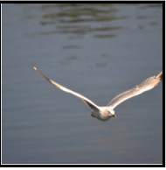
LSTMs with attention
Show, Attend and Tell: Neural Image Caption Generation with Visual Attention. K. Xu, J. L. Ba, R. Kiros, K. Cho, A. Courville, R. Salakhudtinov, R. S. Zemel, Y. Bengio. In ICML, 2015

Slide 38
Method | BLEU (4-grams)
Convnet + LSTM | 0.224
Attention | 0.277
Humans | 0.217
Nearest neighbors | 0.280

Slide 39
Evaluation Metrics
Slide credit: Larry Zitnick

Slide 40
Evaluation Metrics
Human captions
Slide credit: Larry Zitnick

Slide 41
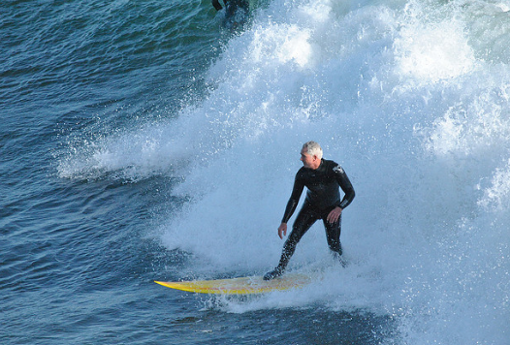
A man riding a wave on a surfboard in the water.
Slide credit: Larry Zitnick

Slide 42
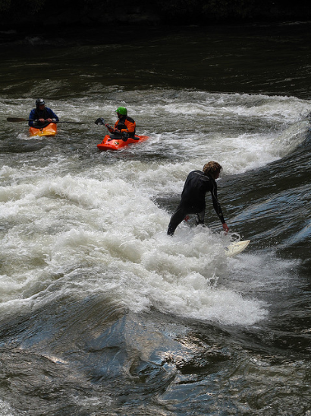
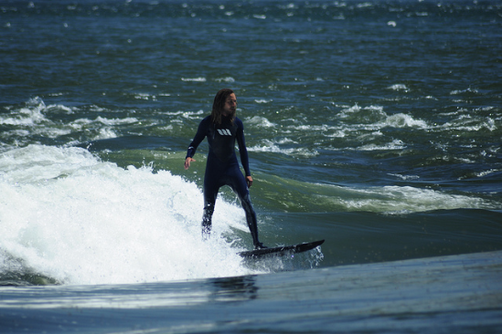
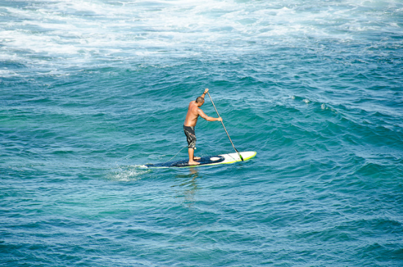
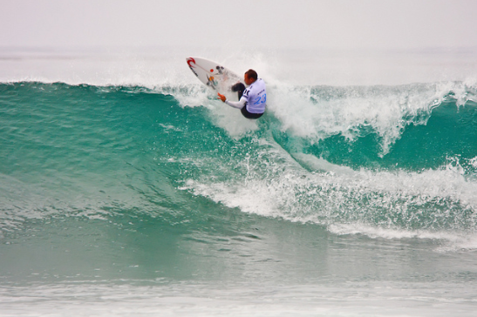
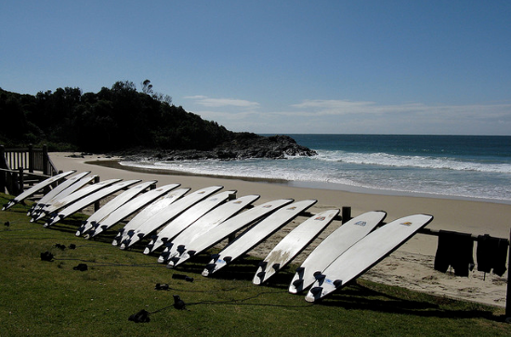
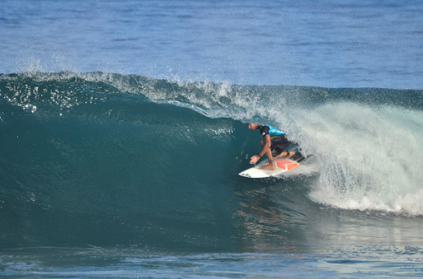
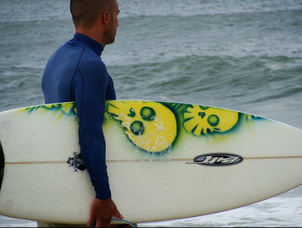
A man riding a wave on a surfboard in the water.
“surfboard”
Slide credit: Larry Zitnick

Slide 43
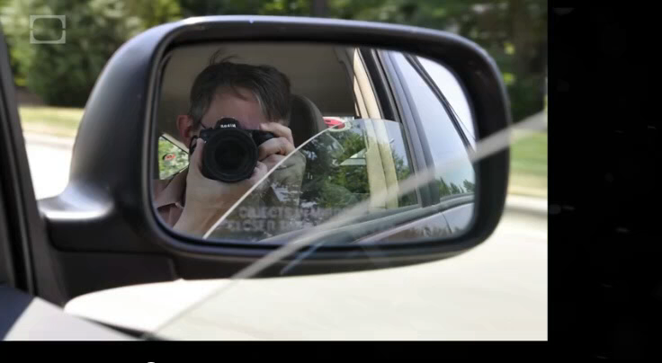
vemödalen - n. the fear that our datasets will never have the diversity we desire
vemödalen - n. the frustration of photographing something amazing when thousands of identical photos already exist
Vemödalen: The Fear That Everything Has Already Been Done
https://www.youtube.com/watch?v=8ftDjebw8aA
Slide credit: Larry Zitnick

Slide 44
The post-captioning world
Captioning is hard to evaluate!
  Frame task so that it is easy to evaluate objectively
Datasets are biased!
  Control dataset bias

Slide 45
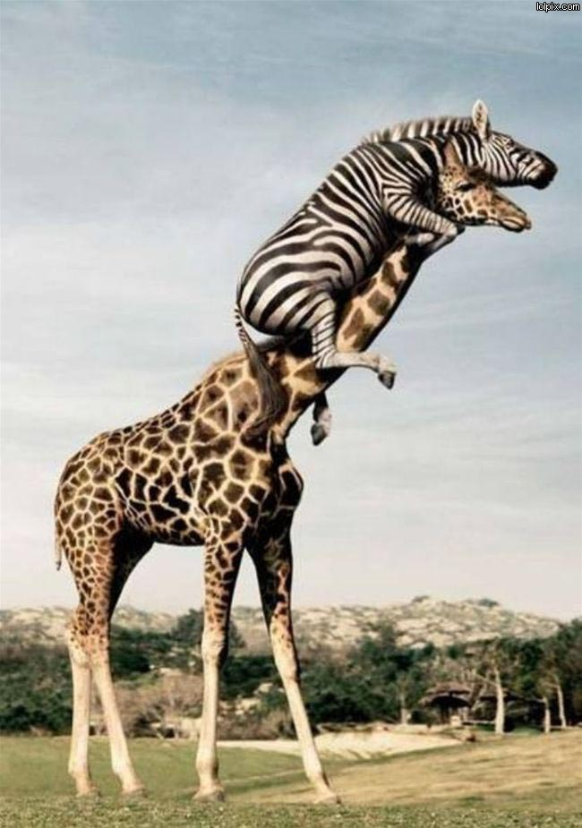
A crazy zebra climbing a giraffe to get a better view.
Slide credit: Larry Zitnick

Slide 46
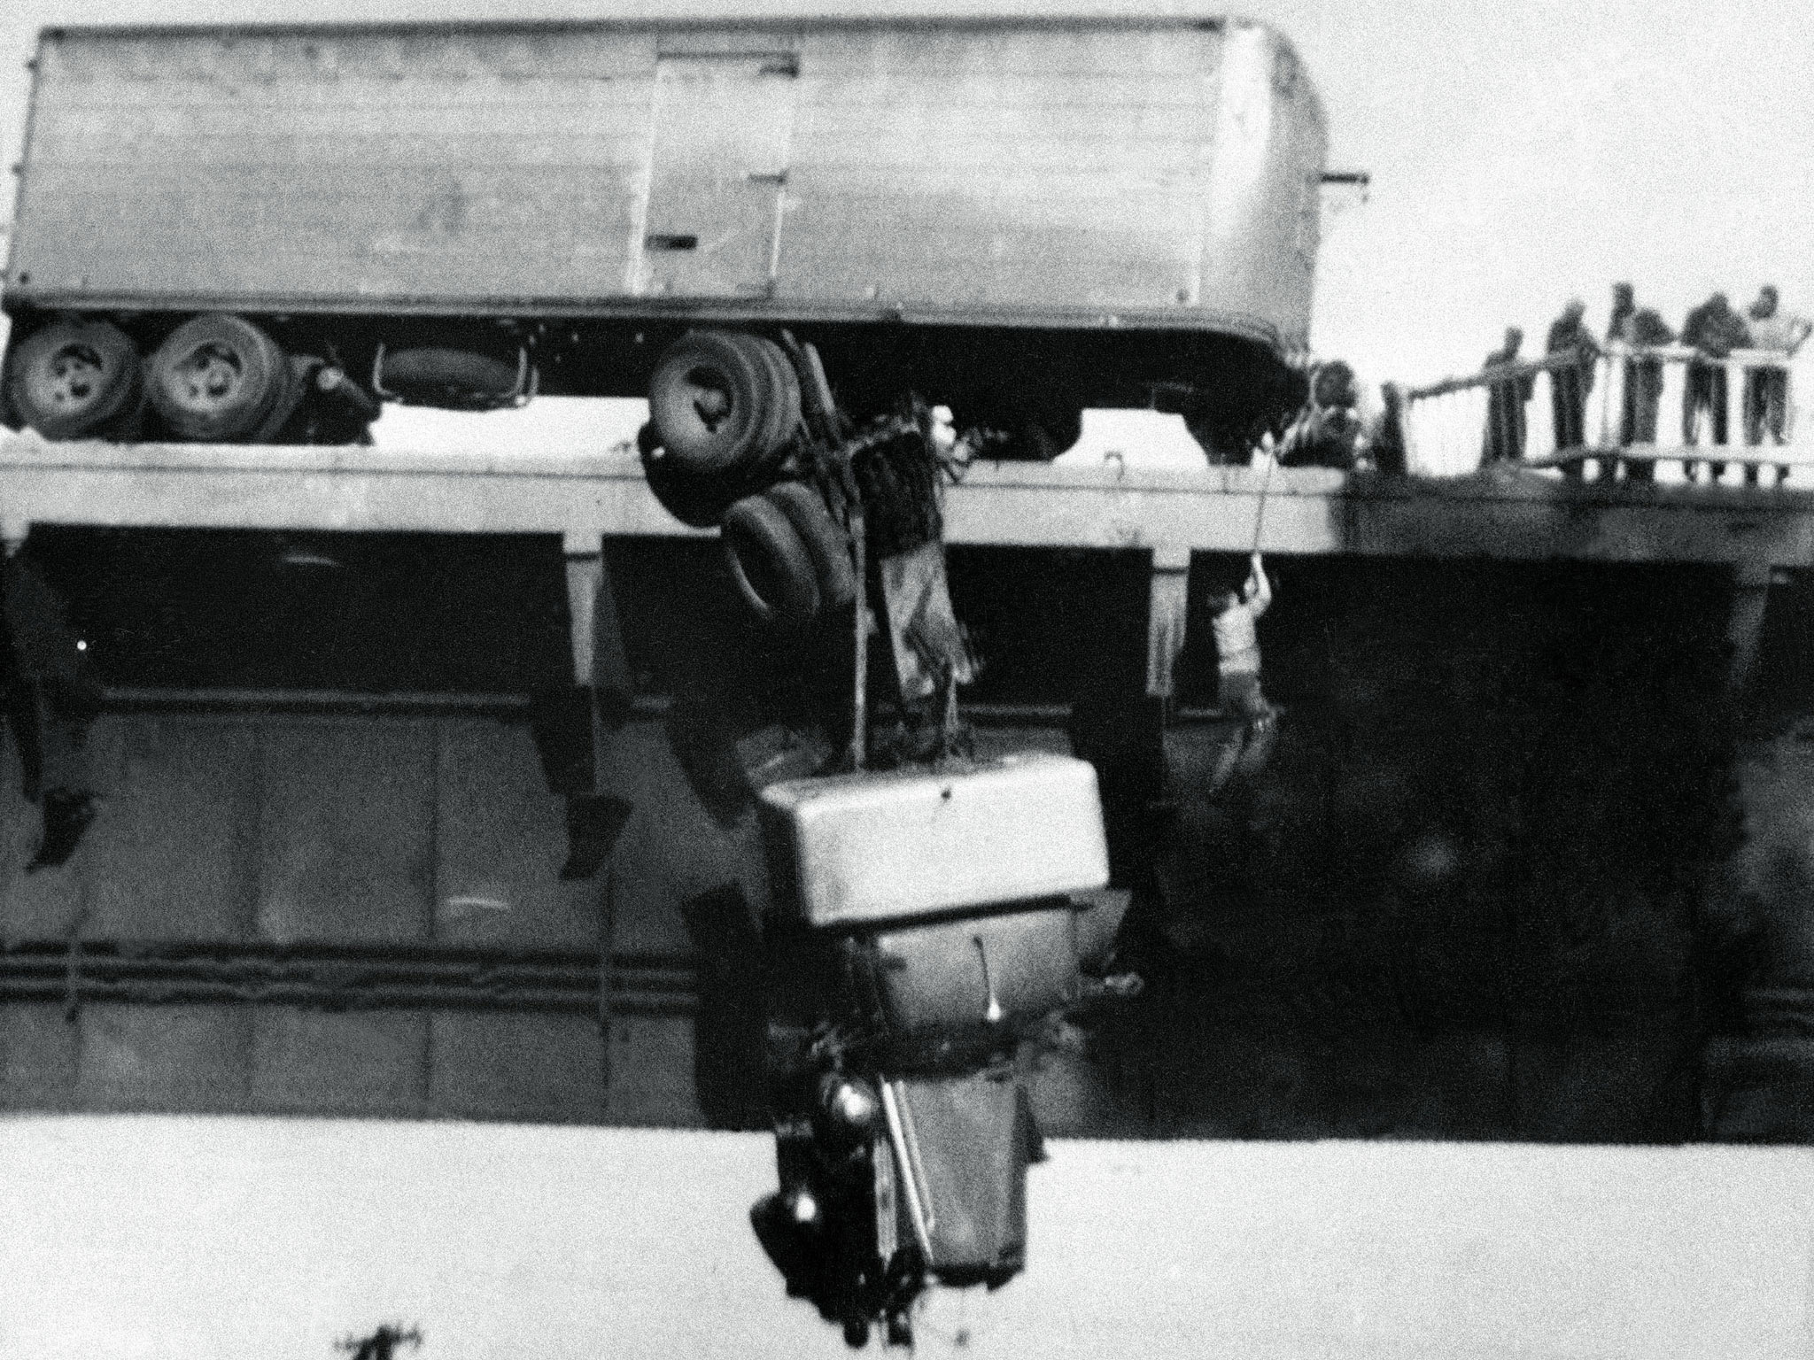
A man is rescued from his truck that is hanging dangerously from a bridge.
Virginia M. Schau
Slide credit: Larry Zitnick

Slide 47
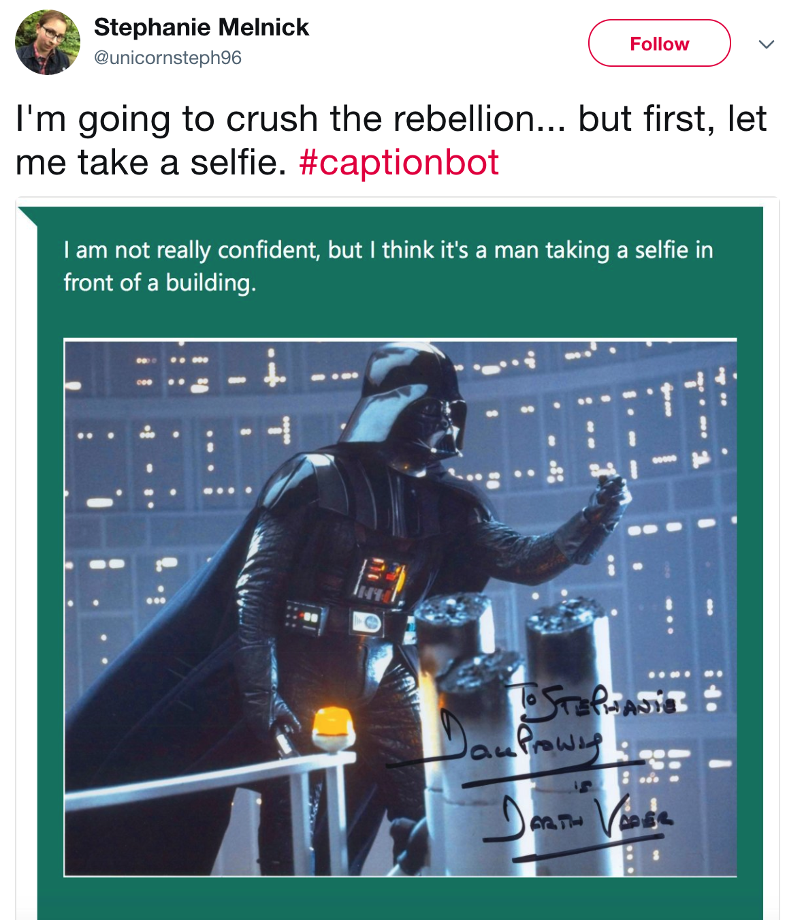

Slide 48
Reasoning
Want vision systems to reason about what is going on
  Identify objects and scenes
  Identify relationships between objects
  Understand physics of the world
  Understand social interactions, intent etc.
  Incorporate knowledge: common sense, pop culture, …

Slide 49
Recognition → Reasoning
http://theoatmeal.com/blog/google_self_driving_car

Slide 50
Visual Question Answering
Direct motivation: assistive technology
Indirect motivation: sandbox for reasoning
VQA: Visual Question Answering. Aishwarya Agrawal, Jiasen Lu, Stanislaw Antol, Margaret Mitchell, C. Lawrence Zitnick, Dhruv Batra, Devi Parikh. In ICCV, 2015.

Slide 51
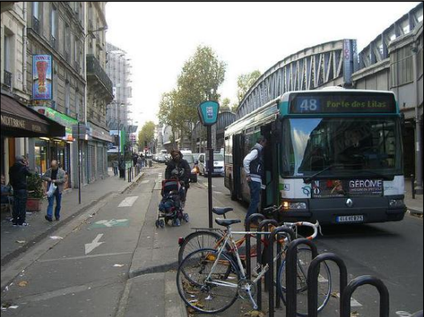
Visual Question Answering
“We have built a smart robot. It understands a lot about images. It can recognize and name all the objects, it knows where the objects are, it can recognize the scene (e.g., kitchen, beach), people’s expressions and poses, and properties of objects (e.g., color of objects, their texture). Your task is to stump this smart robot! Ask a question about this scene that this smart robot probably can not answer, but any human can easily answer while looking at the scene in the image.”

Slide 52
Methods for VQA
Answer
Standard recognition CNN
How
many
bikes
are
there
?

Slide 53
Methods for VQA
Answer
Standard recognition CNN
…
How
many
bikes
are
there
?
Z. Yang, X. He, J. Gao, L. Deng, and A. Smola. Stacked attention networks for image question answering. In CVPR, 2016

Slide 54
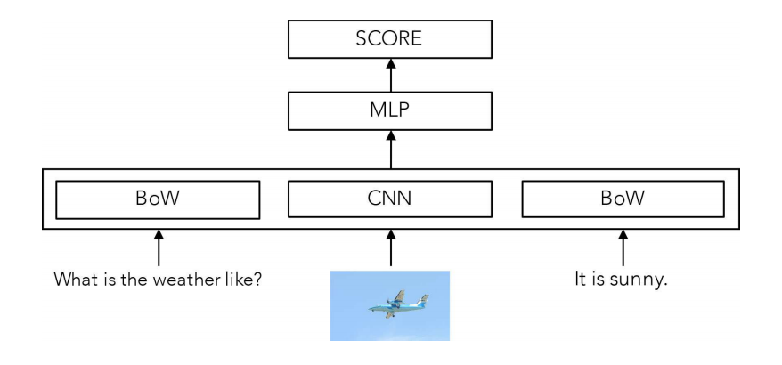
The Unreasonable Effectiveness of Baselines
A. Jabri, A. Joulin, L. van der Maaten. Revisiting visual question answering baselines. In ECCV, 2016.

Slide 55
The problem with VQA
Dataset biases allow cheating
  Only-question Bag-of-Words: 53.7% (vs ~65% for state-of-the-art)
Require common sense to answer
  “What is the moustache made of?”
Hard to diagnose error
  Is the problem understanding the question?
  Or understanding the image?

Slide 56
Clever Hans

