Slide 1
Recognition on videos

Slide 2
Video classification
Significantly harder to collect data
1 video = hundreds of frames
UCF 101 : 13k videos from 101 actions
HMDB: 7k videos from 51 actions

Slide 3
UCF 101
Recognition of 101 human actions from videos in the wild, Khurram Soomro, Amir Roshan Zamir and Mubarak Shah, In arXiv preprint arXiv:1212.0402, November, 2012

Slide 4
HMDB 51
H. Kuehne, H. Jhuang, E. Garrote, T. Poggio, and T. Serre. HMDB: A Large Video Database for Human Motion Recognition. ICCV, 2011.

Slide 5
Is a video just a collection of images?

Slide 6
Is a video just a collection of images?

Slide 7
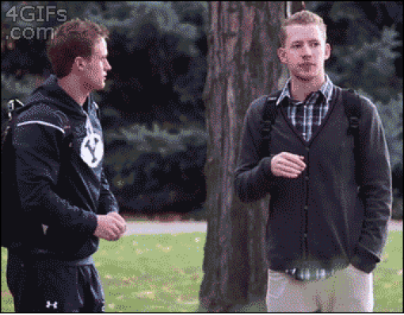
Is a video just a collection of images?

Slide 8
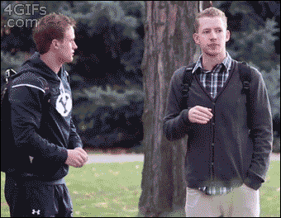
Is a video just a collection of images?

Slide 9
Is a video just a collection of images?
Mostly a question of classes involved
Actions involving object interactions can be identified from single image
e.g., riding horse, playing tennis, pitching ball
Actions that occur in particular scenes can be identified from single images
e.g., diving, swimming, rock-climbing

Slide 10
Classical Video Classification

Slide 11
Classical Image Classification - Bag of words
SIFT or HOG
Dictionary

Slide 12
Video as a 3D image
t
h
w

Slide 13
Bag of spatiotemporal words

Slide 14
Bag of spatiotemporal words
3D HOG
Dictionary

Slide 15
Bag of spatiotemporal words
Method | mean AP
BOW with HOG 3D | 25.2

Slide 16
The importance of motion
How things move as important as appearance
Idea: compute histogram of orientations for flow instead of image gradients.
Histogram of optical flow (HOF)

Slide 17
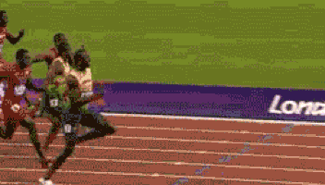
The importance of motion
Optical flow = motion of object + camera motion
Only motion of object important
Capture difference in motion?
Motion boundary histograms: Histogram of orientations for motion gradients

Slide 18
Bag of spatiotemporal words
Method | mean AP
BOW with HOG 3D | 25.2
BOW with HOF | 29.4
BOW with MBH | 40.9
BOW with combined | 43.1

Slide 20
Euler vs Lagrange
Euler
Lagrange

Slide 21
Using trajectories

Slide 22
Using trajectories

Slide 23
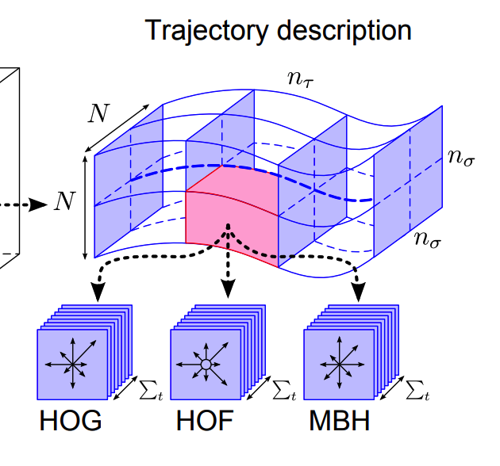
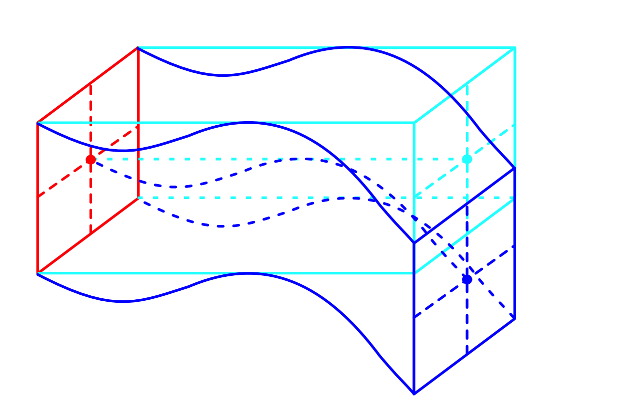
Using trajectories

Slide 24
Using trajectories
Method | mean AP (cuboids) | mean AP (trajectories)
BOW with HOG 3D | 25.2 | 27.9
BOW with HOF | 29.4 | 31.5
BOW with MBH | 40.9 | 43.2
BOW with combined | 43.1 | 46.6

Slide 25
Video recognition with convolutional networks

Slide 26
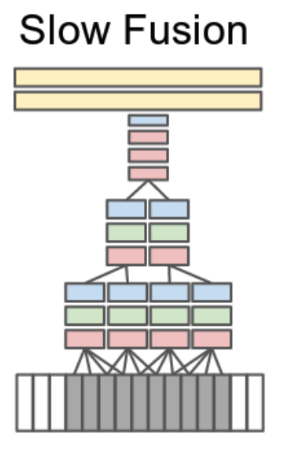
Extending convolutional networks to 3D

Slide 27
Extending convolutional networks to 3D
Method | Accuracy
Best dense trajectories + bag-of-words | 85.9%
Temporal convolution | 65.4%

Slide 28
The challenge of applying convnets to videos
Each video = multiple images: memory constraints
Cost of convolution increases with dimension: time constraints

