Slide 1
Recognition summary
Image classification → convolutional networks
Object detection → convnets + object proposals
Semantic segmentation → convnets + dilation / skip connections / multi-scale prediction
Instance segmentation → detection + convnets + dilation / skip / multi-scale
Pose estimation → (detection +) convnets + dilation / skip / multiscale + iterated inference / learnt MRFs

Slide 2
Recognition and 3D reasoning

Slide 3
Recognition and 3D reasoning
Statistical properties of visual world
Recognition
Reconstruction
Physics of image formation

Slide 4
Recognition and 3D reasoning
Statistical properties of visual world
Recognition
Reconstruction
Physics of image formation

Slide 5
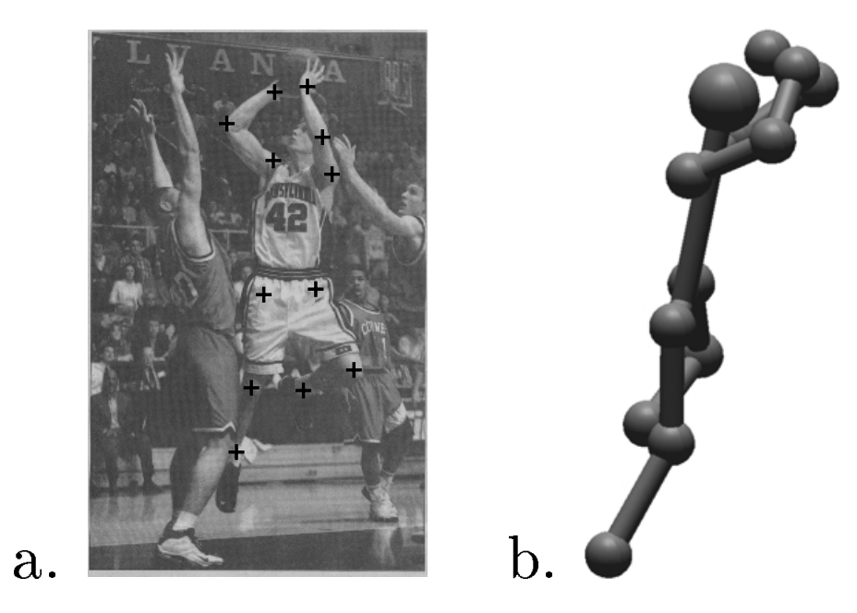
Pose estimation in 3D
Reconstruction of Articulated Objects from Point Correspondences in a Single Uncalibrated Image. C. J. Taylor. In CVPR, 2000

Slide 6
Pose estimation in 3D
Key idea: know relative lengths of each limb4
Assume scaled orthographic projection
  Valid when variation in depth much smaller than depth
constant
Reconstruction of Articulated Objects from Point Correspondences in a Single Uncalibrated Image. C. J. Taylor. In CVPR, 2000

Slide 7
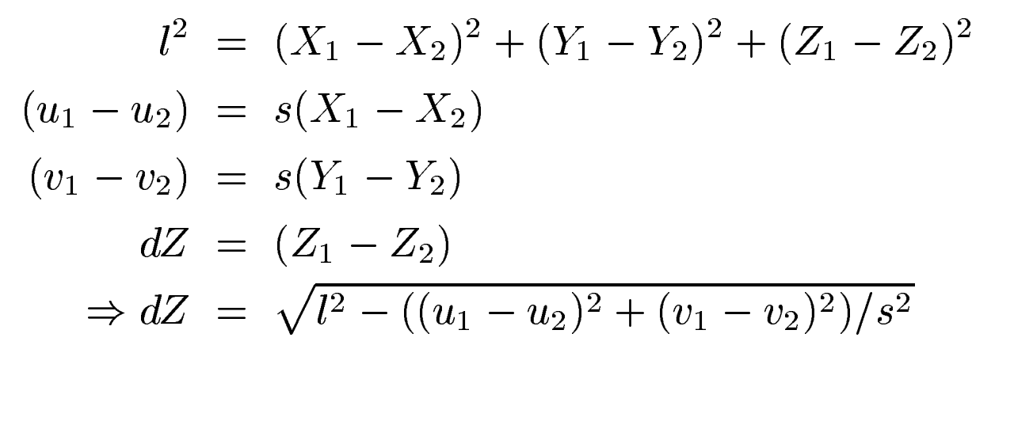
Pose estimation in 3D
Reconstruction of Articulated Objects from Point Correspondences in a Single Uncalibrated Image. C. J. Taylor. In CVPR, 2000

Slide 8
Pose estimation for rigid objects

Slide 9
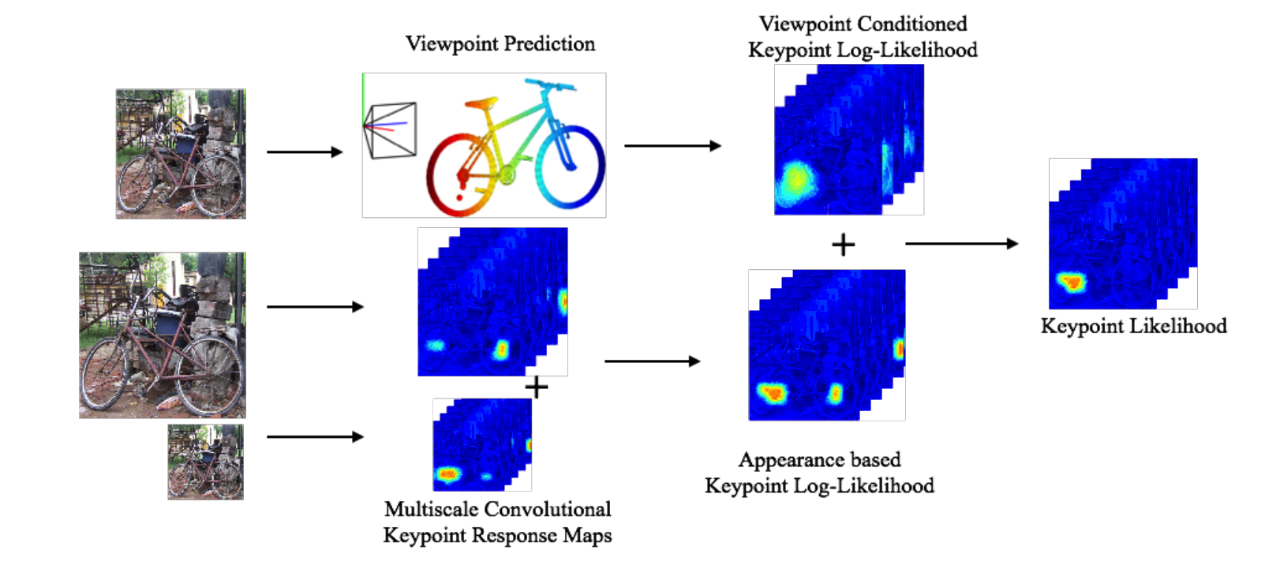
Pose estimation for rigid objects
Viewpoints and keypoints. S. Tulsiani and J. Malik. In CVPR, 2015

Slide 10
Pose estimation for rigid objects
Cyclo-rotation / roll
Azimuth / yaw
Elevation / pitch

Slide 11
Viewpoint-conditioned pose
Viewpoint prediction
Viewpoints and keypoints. S. Tulsiani and J. Malik. In CVPR, 2015

Slide 12
Viewpoint-conditioned pose
Viewpoint prediction
Viewpoints and keypoints. S. Tulsiani and J. Malik. In CVPR, 2015

Slide 13
Fitting viewpoint to keypoints
Idea: minimize reprojection error

Slide 14
Shape models

Slide 15
Shape models

Slide 16
Shape models
3p
c
3p
X
A
B
c
N
N

Slide 17
Shape models

Slide 18
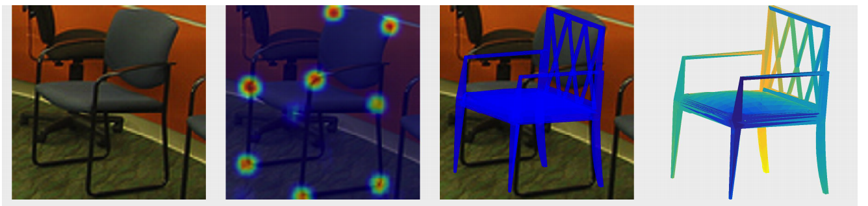
Fitting viewpoints to keypoints
6-DoF Object Pose from Semantic Keypoints. Georgios Pavlakos , Xiaowei Zhou , Aaron Chan , Konstantinos G. Derpanis , and Kostas Daniilidis. In ICRA, 2017.

Slide 19
Recognition and 3D reasoning
Statistical properties of visual world
Recognition
Reconstruction
Physics of image formation

Slide 20
Disparity estimation

Slide 21
Disparity estimation

Slide 22
Disparity estimation
Goal:
  Assign disparity value to each pixel
Basic idea:
  Disparity image should be smooth
Energy minimization
  min E(d), where d is disparity image
  E(d) = E_{data}(d) + E_{smoothness}(d)
E_{data}(d) : scores based on NCC (for example)
E_{smoothness}(d) =

Slide 23

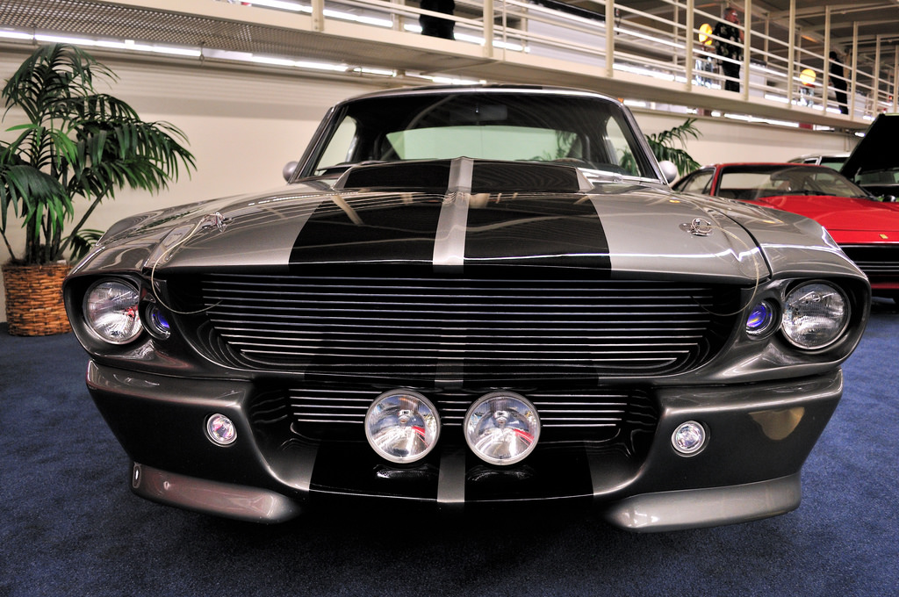
Measuring patch similarity is hard

Slide 24
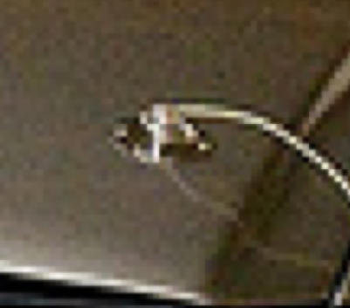
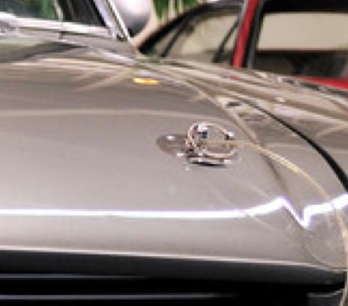
Measuring patch similarity is hard
Idea: learn to compute patch similarity?

Slide 25
The KITTI Dataset and Benchmark
Depth from here
Stereo pair from here

Slide 26
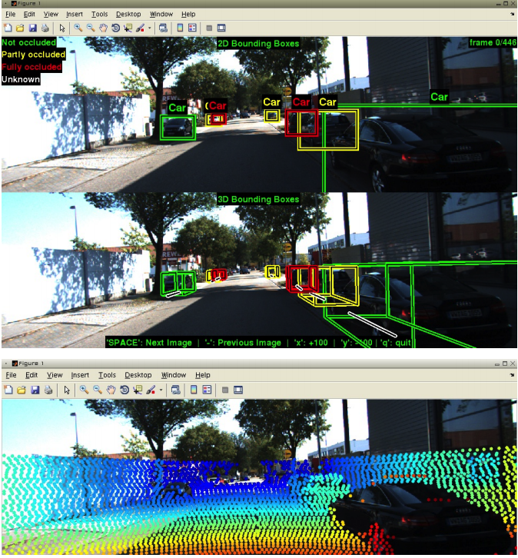
The KITTI Dataset and Benchmark
Vision meets Robotics: The KITTI Dataset. Andreas Geiger, Philip Lenz, Christoph Stiller and Raquel Urtasun. In IJRR, 2013.

Slide 27
Learning patch similarity for disparity estimation

Slide 28
Learning patch similarity for disparity estimation

Slide 29
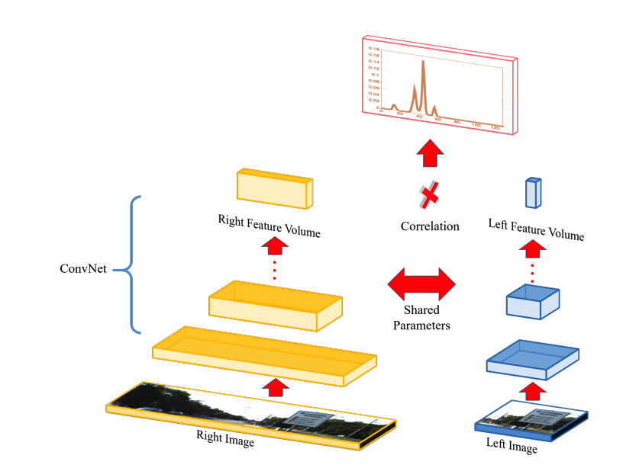
Learning patch similarity for disparity estimation
Efficient Deep Learning for Stereo Matching. Wenjie Luo, Alexander G. Schwing, Raquel Urtasun. In CVPR, 2016

Slide 30
Learning stereo without depth supervision
Given scenes with >=3 rectified views
Use 2 views to produce depth
  Compute scores for each disparity
  Match pixel to pixel with best disparity
  Disparity = 1/depth
Use depth to produce 3rd view
Use reconstruction error

Slide 31
Plane-sweep stereo
Stereo till now:
  Go pixel by pixel
  For each pixel, compute score for each disparity
Plane-sweep:
  Go disparity-by-disparity (or depth-by-depth)
  For each disparity, compute scores for all pixels

Slide 32
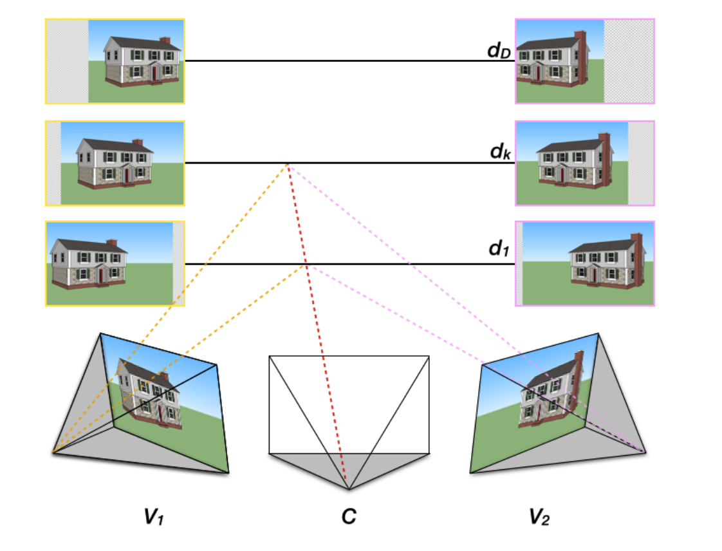
Plane-sweep stereo
For every possible depth value d:
  Assume every pixel in middle image has the same depth d
  Use d to compute disparity to left and right image
  Reproject left and right images to center coordinate system using disparity
  Compute score for all pixels

Slide 33
Plane-sweep stereo
If depth is correct, appearance should match!

Slide 34
Plane-sweep stereo
Score for pixel only depends on the two patches at that pixel
Can be computed using convolutions

Slide 35
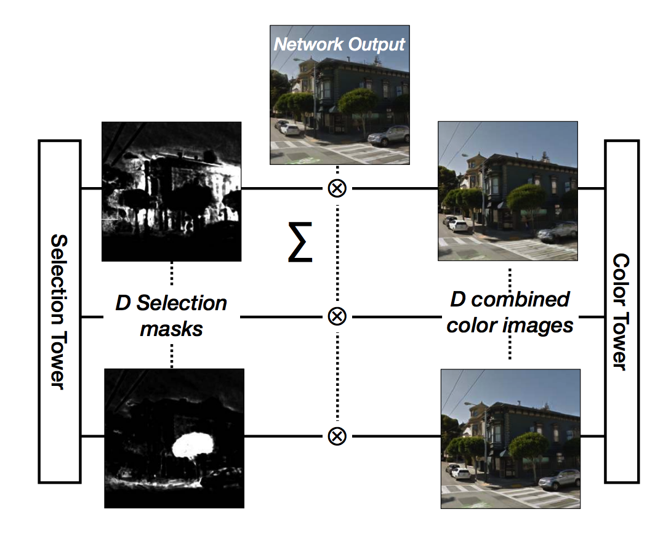
Deep Stereo
DeepStereo: Learning to Predict New Views from the World’s Imagery. John Flynn, Ivan Neulander, James Philbin, Noah Snavely. CVPR, 2016

Slide 36
Estimating depth from a single image
Why is this even possible?

Slide 37
Estimating depth from a single image
Why is this even possible?

Slide 38
Estimating depth from a single image
Why is this even possible?

Slide 39
Estimating depth from a single image
Why is this even possible?

Slide 40
Estimating depth from a single image

Slide 41
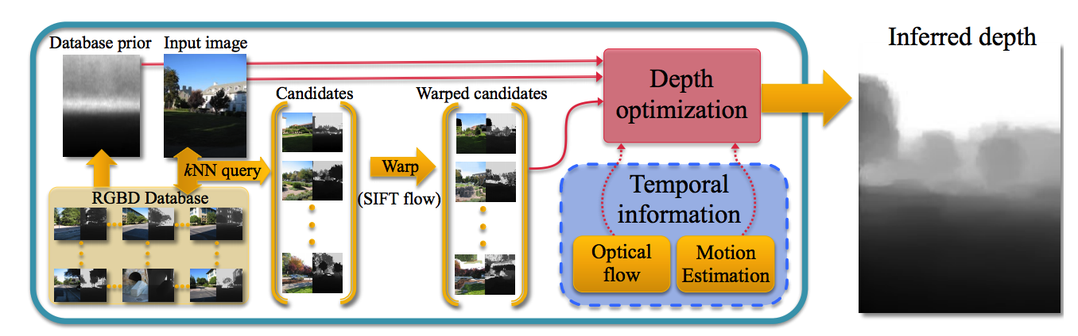
Estimating depth from a single image
DepthTransfer: Depth Extraction from Video Using Non-parametric Sampling. Kevin Karsch, Ce Liu, Sing Bing Kang. TPAMI 2013.

Slide 42
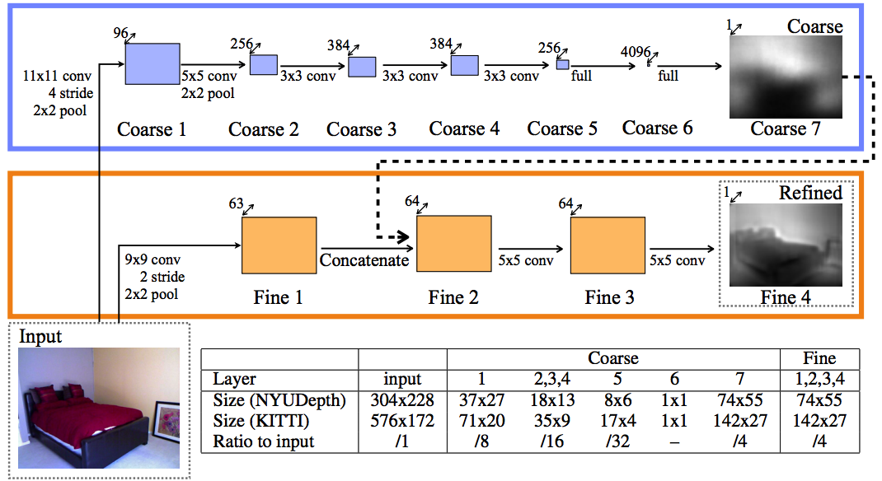
Estimating depth from a single image
Yet another image-to-image translation
Again, resolution issues
Depth Map Prediction from a Single Image using a Multi-Scale Deep Network. David Eigen, Christian Puhrsch, Rob Fergus. In NIPS, 2014

Slide 43
Metric depth is a bad target

Slide 44
Metric depth is a bad target
Only relative depths matter
Only logarithmic scales matter
Depth Map Prediction from a Single Image using a Multi-Scale Deep Network. David Eigen, Christian Puhrsch, Rob Fergus. In NIPS, 2014

Slide 45
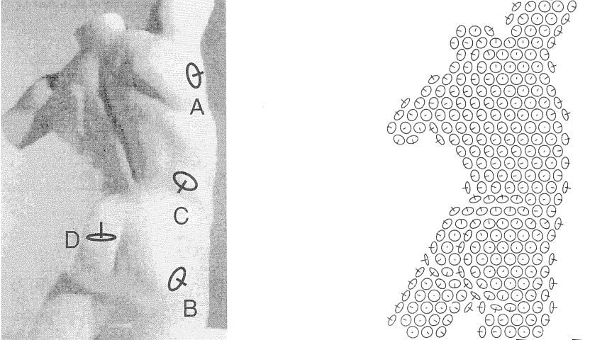
Humans perceive surface normals, not just depth, through a combination of various pictorial cues
Surface perception in pictures. Koenderink, van Doorn and Kappers, 1992
Slide credit: Jitendra Malik

Slide 46
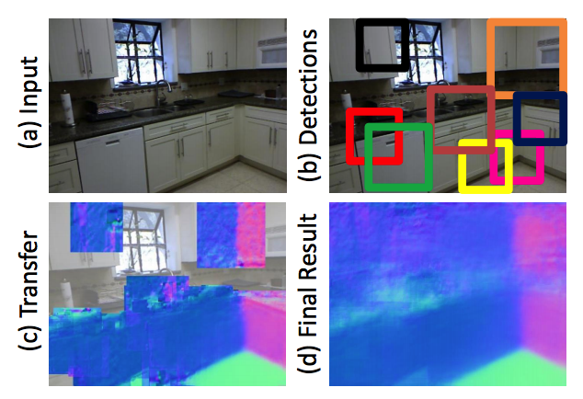
Estimating normals from a single image
Data-Driven 3D Primitives for Single Image Understanding. David F. Fouhey, Abhinav Gupta, Martial Hebert. In ICCV 2013.

Slide 47
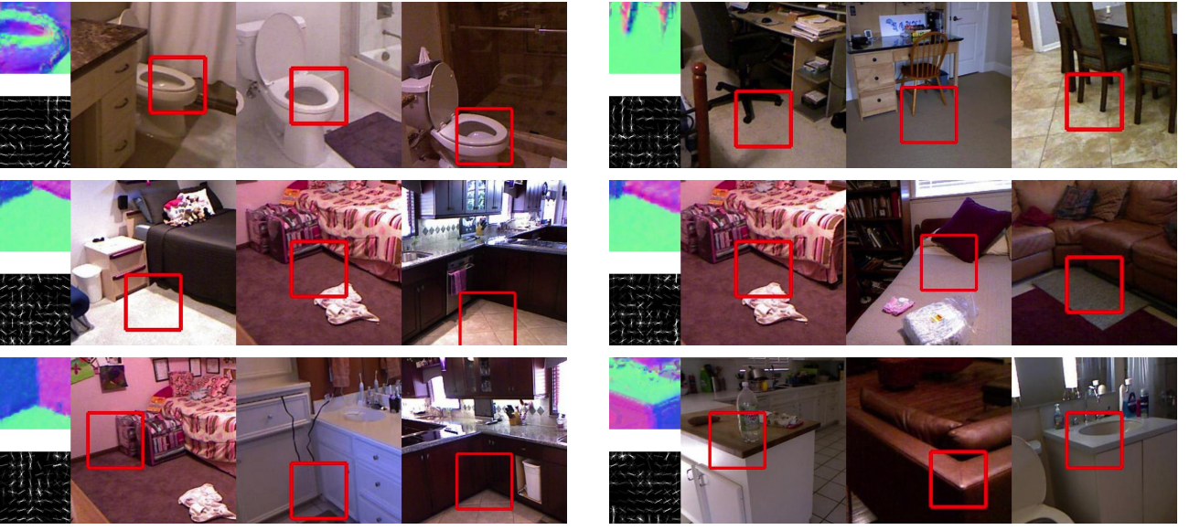
Estimating normals from a single image

Slide 48
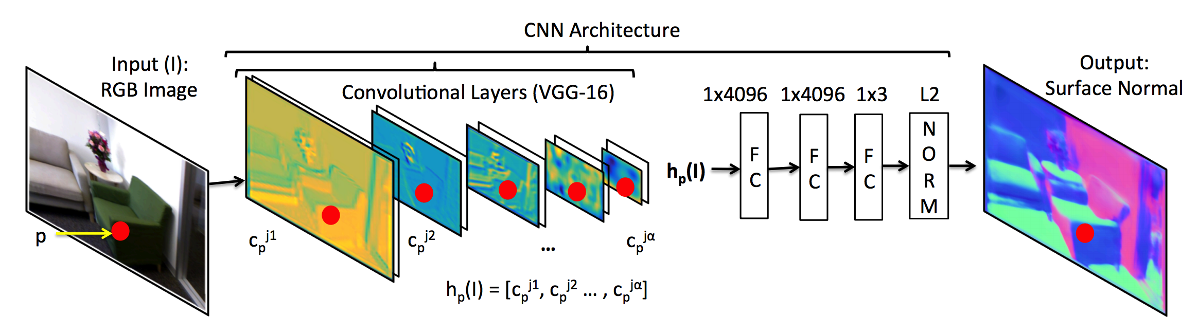
Estimating normals from a single image
Marr Revisited: 2D-3D Alignment via Surface Normal Prediction. Aayush Bansal, Bryan Russell, Abhinav Gupta. In CVPR, 2016

Slide 49
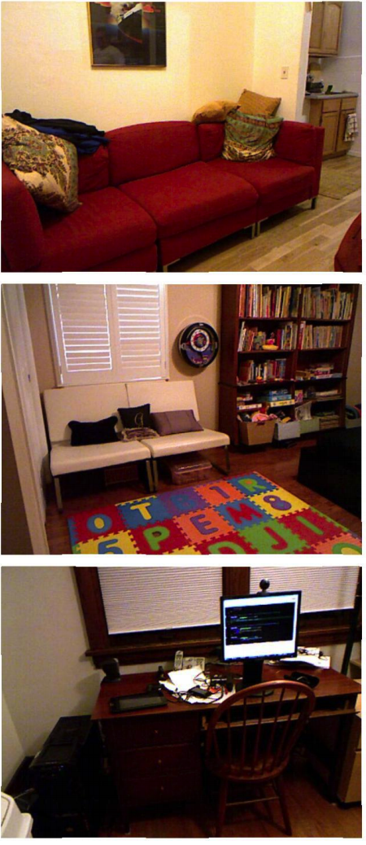
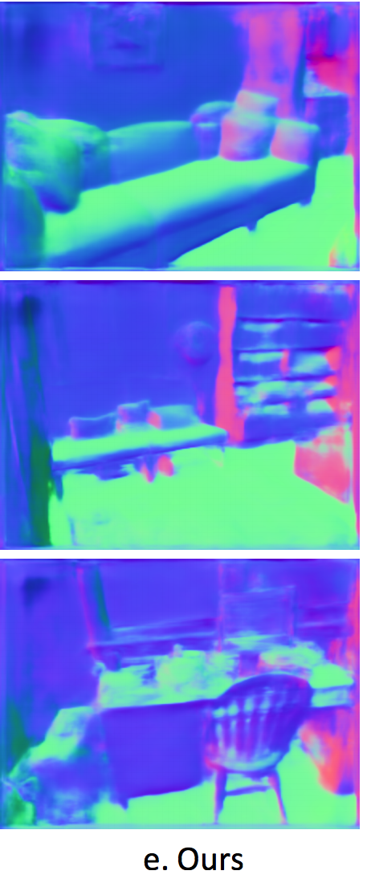
Estimating normals from a single image

Slide 50
Estimating other physical properties
Shading image: captures interaction of shape and light
Reflectance image: captures the albedi at every pixel

Slide 51
Estimating other physical properties
Intrinsic Images in the Wild. Sean Bell, Kavita Bala, Noah Snavely. In SIGGRAPH 2014.

Slide 52
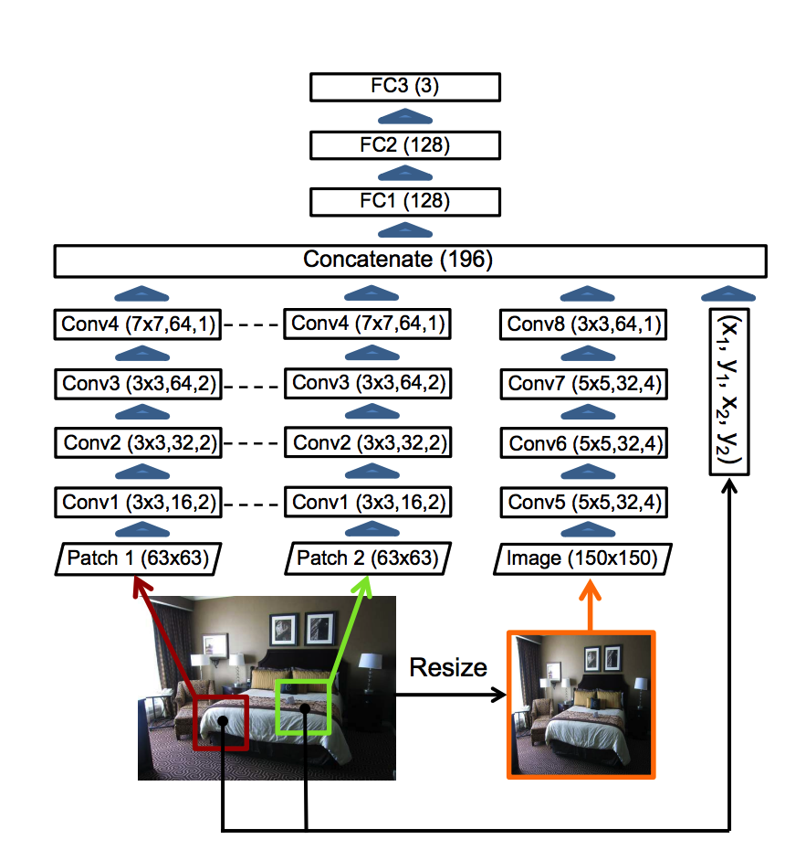
Estimating other physical properties
Learning Data-driven Reflectance Priors for Intrinsic Image Decomposition. Tinghui Zhou, Philipp Krahenbuhl, Alexei Efros. In ICCV, 2015

Slide 53
Vision as inverse graphics
Lighting parameters
Category
Object instance
Object deformation
Image
Camera parameters

