Slide 1
Instance segmentation

Slide 2
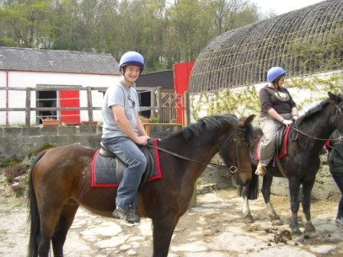
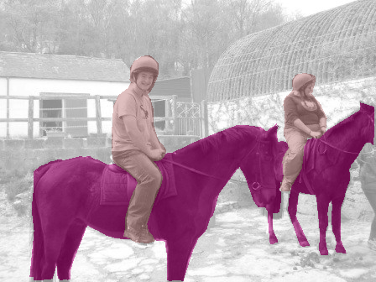
Till now
person 1
person 2
horse 1
horse, person
horse 2
Object Detection
horse
person
Image Classification
Semantic Segmentation
Notes:
Traditionally, “recognition” has been subdivided into a few different buckets. The first bucket is obviously image classification, where you want to assign labels to each image.
But we’ve also seen work on object detection. Given an image, an object detection system will detect each instance of a particular kind of object, and roughly localize it with a bounding box.
A bounding box is a very coarse output if you want to interact with a world. If you are trying to grasp an object you will need the precise boundaries of the object.
Alternatively a semantic segmentation system assigns category labels to pixels. This gives precise boundaries, but fails to resolve individual instances. This is again problematic because usually you want to interact with individual object instances, and a mass of “horseness” doesn’t help.

Slide 3
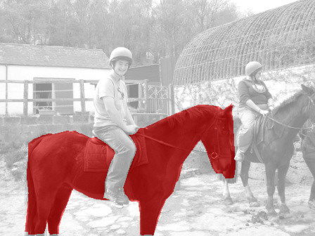
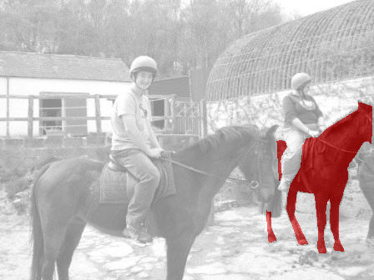
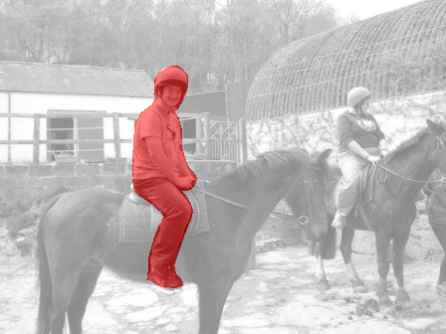
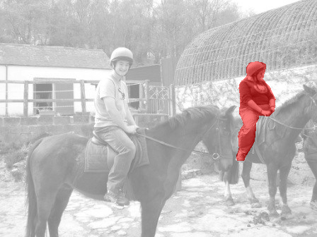
Fine-grained Localization
horse 1
horse 2
person 1
person 2
Instance Segmentation
Notes:
This motivation led us to propose the task of instance segmentation. An instance segmentation system detects every instance of a given object category and also segments them out. For instance, it will tell you that these are the boundaries of horse 1, these are the boundaries of horse 2, and so on.

Slide 4
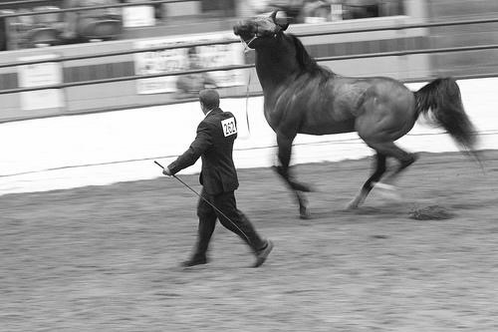

Evaluation Protocol
Sort predicted instances by confidence
Match prediction to closest annotation based on segment overlap
  If segment overlap > threshold, correct
segment = overlap
U
Notes:
We will also assume that we have a held out test set annotated by humans with individual segmented instances and corresponding category labels. We will take each instance predicted by the model, and match it to the closest human annotation of that category based on the overlap of the two segments. The formula for this overlap is given here. If the overlap is greater than a threshold, we will consider the prediction a correct one, with the caveat that if a higher scoring prediction has already been matched to this annotation, we will consider the prediction a duplicate and thus incorrect.

Slide 5
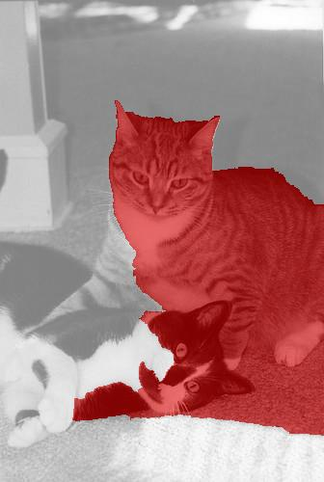
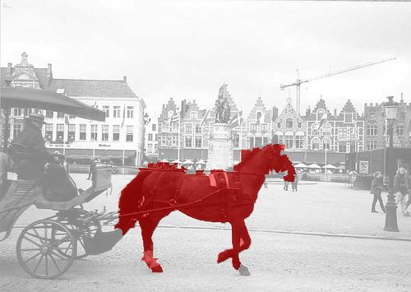
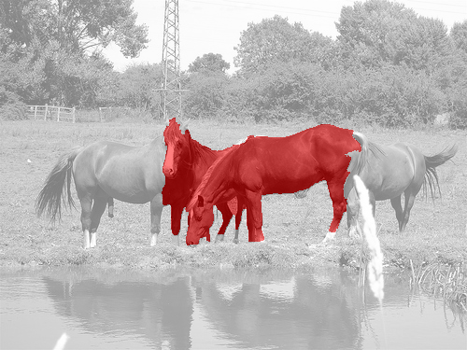
Evaluation Protocol
Labels = [ …. ]
Scores = [ 0.90 0.87 0.82 0.78 0.70 0.69 0.60 …. ]
Notes:
We therefore get a label for each prediction of the model.

Slide 6
Evaluation protocol
Average Precision (AP)

Slide 7
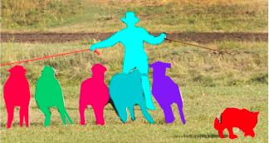
The COCO Challenge
mscoco.org
T. Y. Lin et al. Microsoft COCO: Common Objects in Context. In ECCV, 2014
Notes:
The task of instance segmentation gained a lot of traction in the community, and many people agreed that we need systems that can do this task. The COCO benchmark, which is not the definitive benchmark for all things object recognition, made this task front and center, and used our proposed evaluation protocol as part of their benchmark.
Instance segmentation is now an active area of research.

Slide 8
Two strategies
Segment then classify
  Use bottom-up techniques to come up with segment proposals
  Classify segment proposals with convnets
  Segmentation is category agnostic
  Modification: use convnets to produce segmentation proposals
Detect then segment
  Use standard object detection to produce boxes
  Segment boxes
  Segmentation is category specific

Slide 9
Box proposals
Use segmentation to produce ~5K candidates
Selective Search for Object Recognition
J. R. R. Uijlings, K. E. A. van de Sande, T. Gevers, A. W. M. Smeulders
In International Journal of Computer Vision 2013.

Slide 10
Segment proposals
Multi-scale combinatorial grouping. Pablo Arbelaez, Jordi Pont-Tuset, Jonathan Barron, Ferran Marques, Jitendra Malik. In CVPR, 2014.

Slide 11
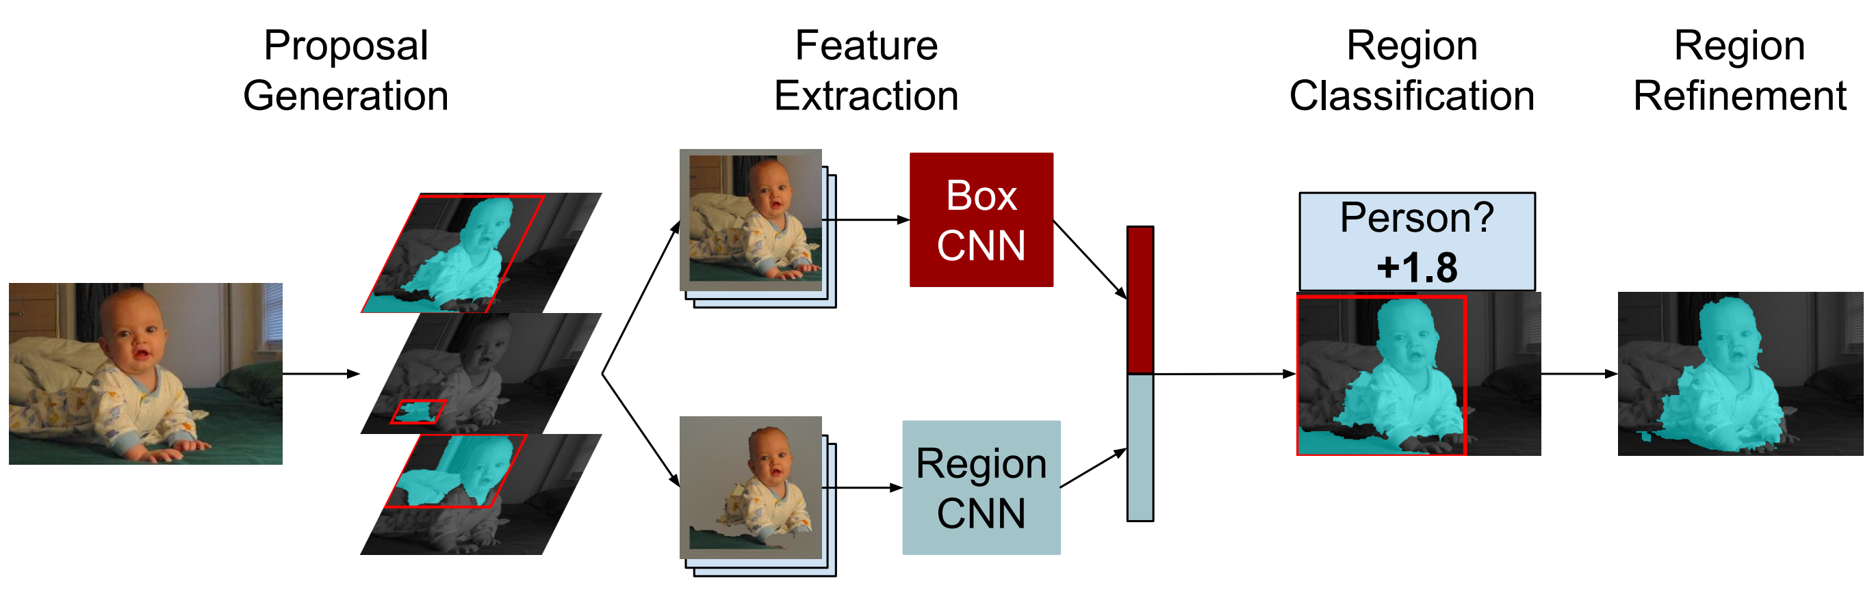
R-CNN for instance segmentation
Simultaneous Detection and Segmentation Bharath Hariharan , Pablo Arbelaez , Ross Girshick, Jitendra Malik. In ECCV 2014

Slide 12
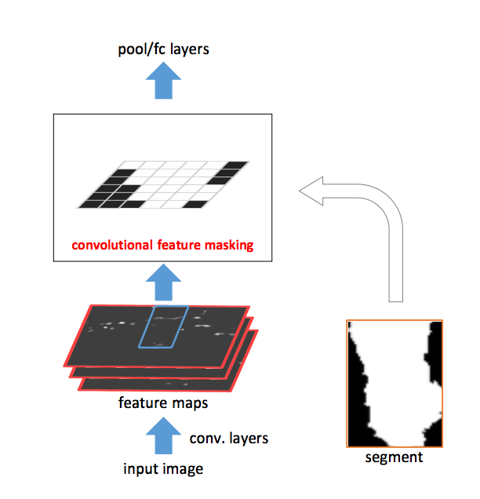
Fast R-CNN for instance segmentation
Convolutional Feature Masking for Joint Object and Stuff Segmentation. Jifeng Dai, Kaiming He, Jian Sun. In CVPR 2015

Slide 13
Fast R-CNN for instance segmentation
CFM
ROI Pool
Convolutional Feature Masking for Joint Object and Stuff Segmentation. Jifeng Dai, Kaiming He, Jian Sun. In CVPR 2015

Slide 14
Two strategies
Segment then classify
  Use bottom-up techniques to come up with segment proposals
  Classify segment proposals with convnets
  Segmentation is category agnostic
  Modification: use convnets to produce segmentation proposals
Detect then segment
  Use standard object detection to produce boxes
  Segment boxes
  Segmentation is category specific

Slide 15
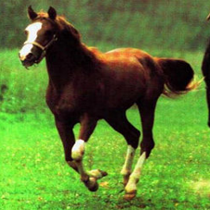
Predicting segmentation for bounding boxes
Given a detection, predict segmentation

Slide 16
Predicting segmentation for bounding boxes
x`

Slide 17
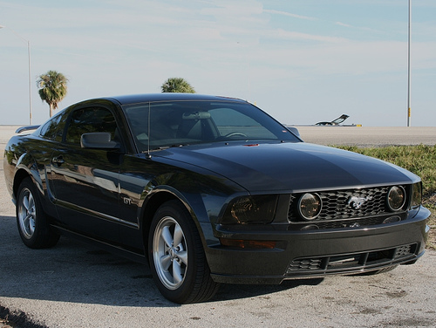
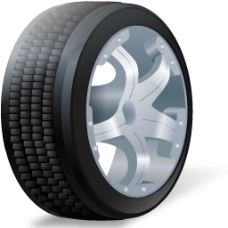
Fully convolutional or not?
Convolution is location invariant
Semantic segmentation is location invariant
Figure-ground segmentation of a detected bounding box is not location invariant

Slide 18
Fully convolutional or not?
Convolution is cheaper
Local connections without parameter sharing?
  Too many parameters?
  Predicting 50x50 segmentation: 2500 times more parameters
Predict lower resolution, then upsample
Fully convolutional:
Mask R-CNN. Kaiming He, Georgia Gkioxari, Piotr Dollar, Ross Girshick. In ICCV, 2017.
Non-fully convolutional:
Learning to Segment Object Candidates. Pedro O. Pinheiro, Ronan Collobert, Piotr Dollar. In ICCV, 2015.

Slide 19
The resolution issue: Skip connections

Slide 20
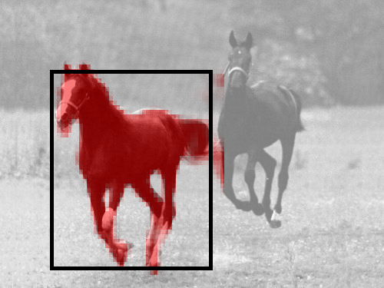
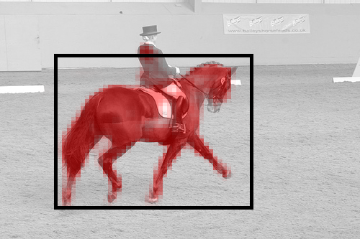
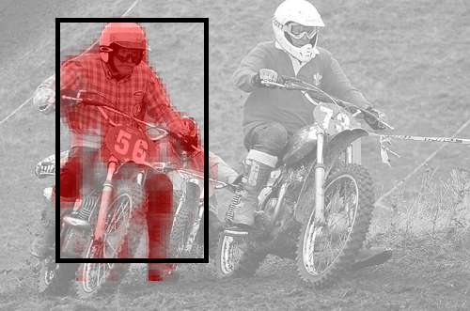
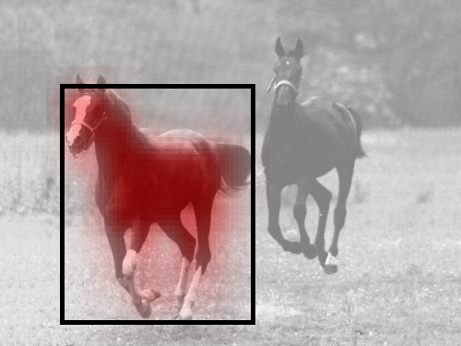
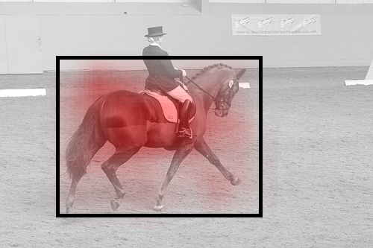
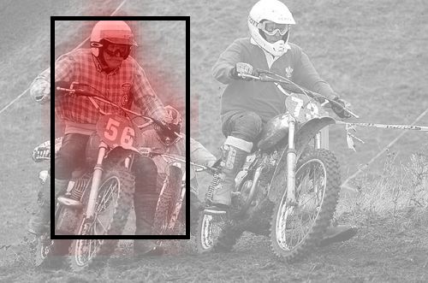
The resolution issue: Skip connections
Hypercolumns for Object Segmentation and Fine-grained Localization. Bharath Hariharan, Pablo Arbeláez, Ross Girshick, Jitendra Malik. CVPR, 2015

Slide 21
Human pose estimation

Slide 22
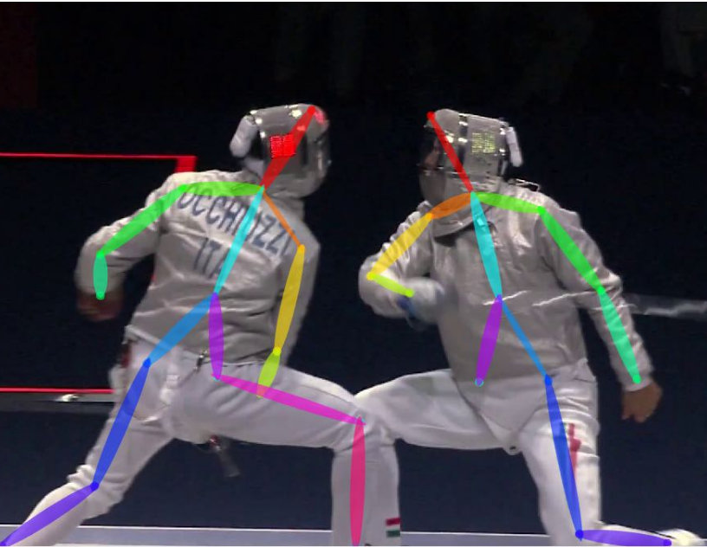
The task
Mark joint locations for person
Nose
Right/left shoulder
Right/left elbow
Right/left hip
…

Slide 23
Two versions of task
Assume people have been detected
Rough bounding box given
Key info available:
  scale
  only 1 location per joint
Pros: disentangles detection and pose estimation
Cons: unrealistic
Tabula rasa without detections
Challenge: no idea of scale or number
Possible opportunity: use keypoint estimates to improve detections
Pros: realistic
Cons: conflates detection and pose estimation

Slide 24
Pose estimation given detection

Slide 25
Evaluation metric - given detection
Evaluate every keypoint separately
For each person, check if keypoint is correct
Compure fraction of people for which keypoint is correct: PCK (Probability of Correct Keypoint)

Slide 26
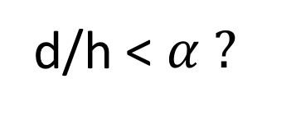
Evaluation metric - given detection
d
d/h < $α ?$
h

Slide 27
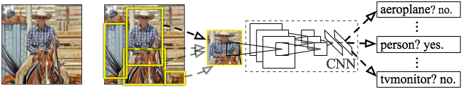
R-CNN: Regions with CNN features
Input
image
Extract region
proposals (~2k / image)
Compute CNN
features
Classify regions
(linear SVM)
Rich Feature Hierarchies for Accurate Object Detection and Semantic Segmentation
R. Girshick, J. Donahue, T. Darrell, J. Malik
IEEE Conference on Computer Vision and Pattern Recognition (CVPR), 2014
Slide credit : Ross Girshick
Notes:
Here’s a schematic of the system that we came up with.
Compared to previous state-of-the-art methods, R-CNN is relatively simple and does not rely on an ensemble of classifiers.
Let’s see how it works at test time.

Slide 28
Bounding-box regression
w
Δw × w + w
(x, y)
h
(Δx × w + x,
Δy × h + h)
Δh × h + h
original
predicted
Slide credit : Ross Girshick

Slide 29
Strategy 1: Regression
Regression targets relative to bounding box
Right elbow x: 0.45
Right elbow y: 0.12
Left elbow x: 0.98
…
DeepPose: Human Pose Estimation via Deep Neural Networks. Alexander Toshev and Christian Szegedy. In CVPR, 2014.

Slide 30
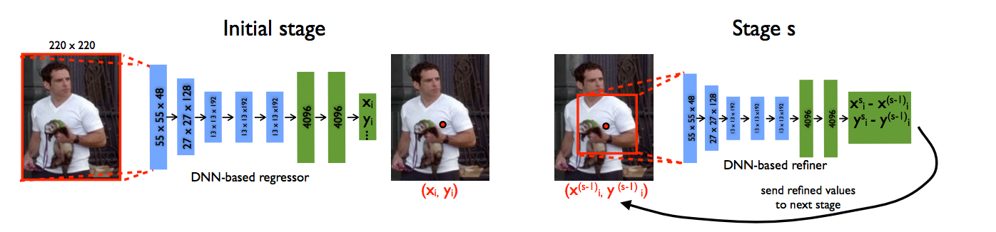
Strategy 1: Regression
Assumes global object features has enough information for accurate localization
  Localization info missing due to subsampling?
Solution: Refinement!
DeepPose: Human Pose Estimation via Deep Neural Networks. Alexander Toshev and Christian Szegedy. In CVPR, 2014.

Slide 31
Strategy 1: Regression
Minimizer of
Multimodal distributions?
p(x)
x

Slide 32
Strategy 2: Heatmaps

Slide 33
Strategy 2: Heatmaps
Still have the resolution issue
Same solutions
  Dilation?
  Multiple layers?
  Multiple image scales?

Slide 34
Are all keypoints independent?

Slide 35
Are all keypoints independent?
l is a candidate location for each keypoint
Consistency between joints
Score from heatmap

Slide 36
Are all keypoints independent?
l is a candidate location for each keypoint
Consistency between joints
Score from heatmap

Slide 37

Joint prediction of keypoints
Conditional Random Field
But not just smoothness: $φ$ is unknown!
Needs to be learnt

Slide 38
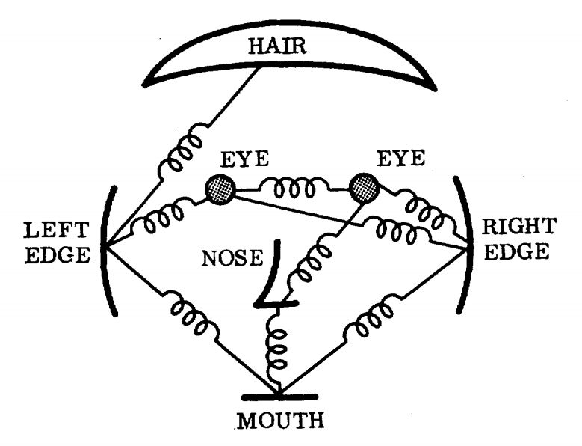
Pictorial structures

Slide 39
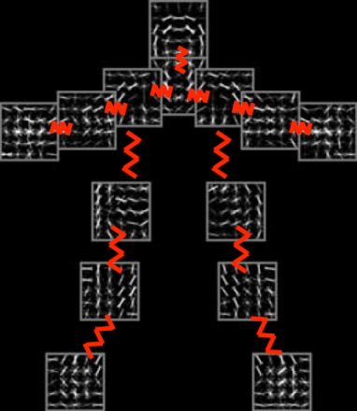
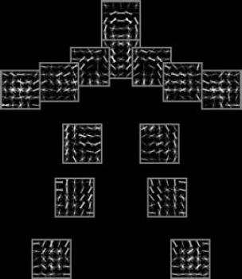
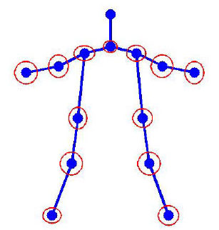




Flexible Mixture of Parts
$ψ(l_{i},l_{j})$: Spatial features between $l_{i}$ and $l_{j}$
$β_{ij}$: Pairwise springs between part $i$ and part $j$
Articulated Human Pose Estimation with Flexible Mixtures of Parts. Yi Yang and Deva Ramanan. TPAMI 2013.
Slide credit: Yang et al

Slide 40
Flexible Mixture of Parts
Learning?
Structured SVMs
  Very large output spaces
  A scoring function that scores input-output pairs
  Predicted output is arg max of scoring function
  Loss is
Support vector machine learning for interdependent and structured output spaces. Tsochantaridis I, Hofmann T, Joachims T, Altun Y. In ICML, 2004

Slide 41
Inference?

Slide 42
Combining learning and inference
Inference in MRFs and CRFs usually iterative and approximate
  Except trees: FMP
Instead of learning scoring function, then approximately minimizing it
Learn iterative inference procedure?

Slide 43
Combining learning and inference
In each iteration, beliefs of one variable are updated using current beliefs of the others
Frame each iteration of inference as a differentiable function
Write inference as a convolutional network
Joint Training of a Convolutional Network and a Graphical Model for Human Pose Estimation. Jonathan Tompson, Arjun Jain, Yann LeCun, Christoph Bregler. In NIPS, 2014.

Slide 44
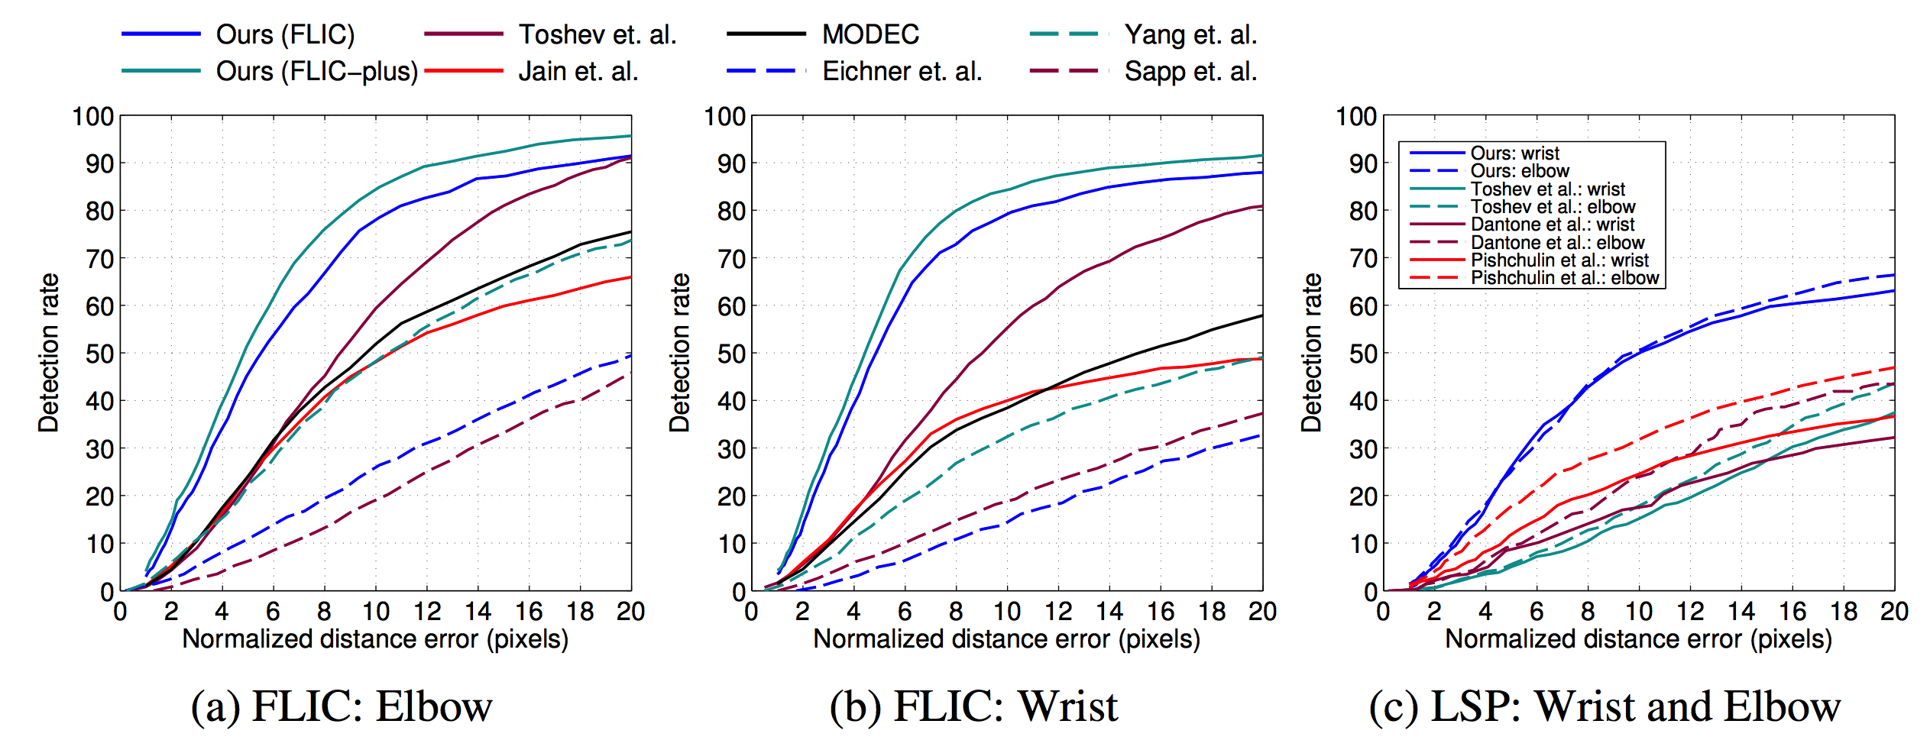
Combining learning and inference
Mixture of parts
Regression
Joint Training of a Convolutional Network and a Graphical Model for Human Pose Estimation. Jonathan Tompson, Arjun Jain, Yann LeCun, Christoph Bregler. In NIPS, 2014.

Slide 45
Autocontext and Inference Machines
Instead of learning model that does iterative improvement
Learn model that does refinement
Image
New
Pose estimate
Image
Pose
Current
Pose estimate

Slide 46
Autocontext and Inference Machines
Image
Image
Pose estimate(t)
Pose estimate(t+1)
Pose estimate(t+2)
Shared parameters: Inference Machines
Unshared parameters: Autocontext
Auto-context and Its Application to High-level Vision Tasks. Zhuowen Tu. In CVPR 2008.
Learning Message-Passing Inference Machines for Structured Prediction. Stephane Ross, Daniel Munoz, Martial Hebert, J. Andrew Bagnell. In CVPR 2011.

Slide 47
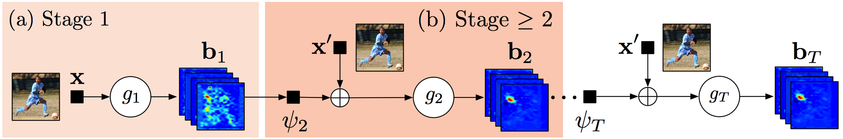
Inference machines
Convolutional Pose Machines. Shih-En Wei, Varun Ramakrishna, Takeo Kanade, Yaser Sheikh. In CVPR, 2016

Slide 48
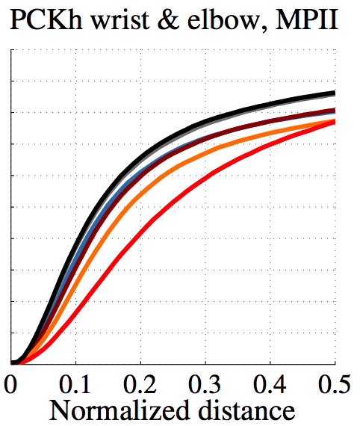

Slide 49
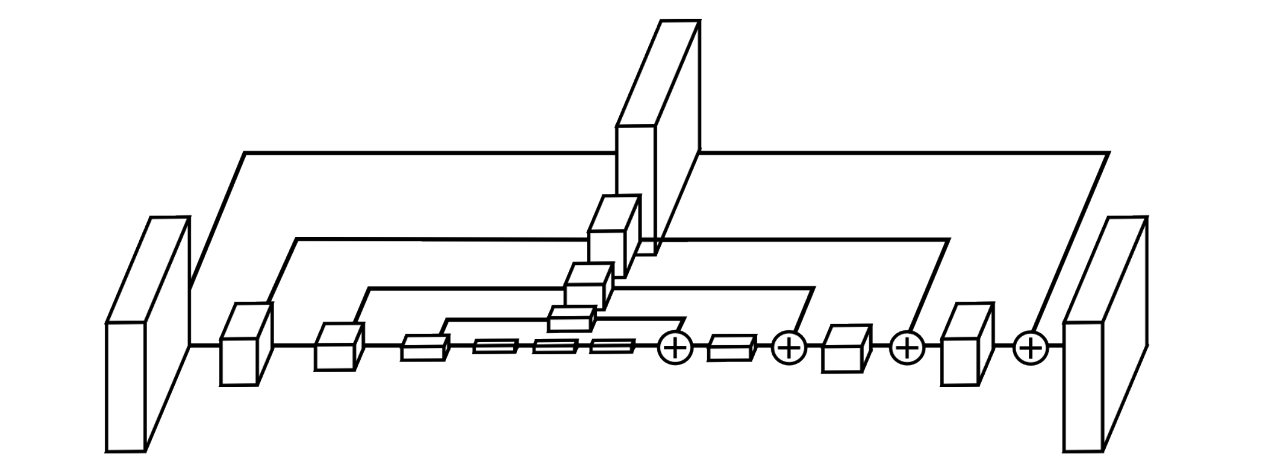
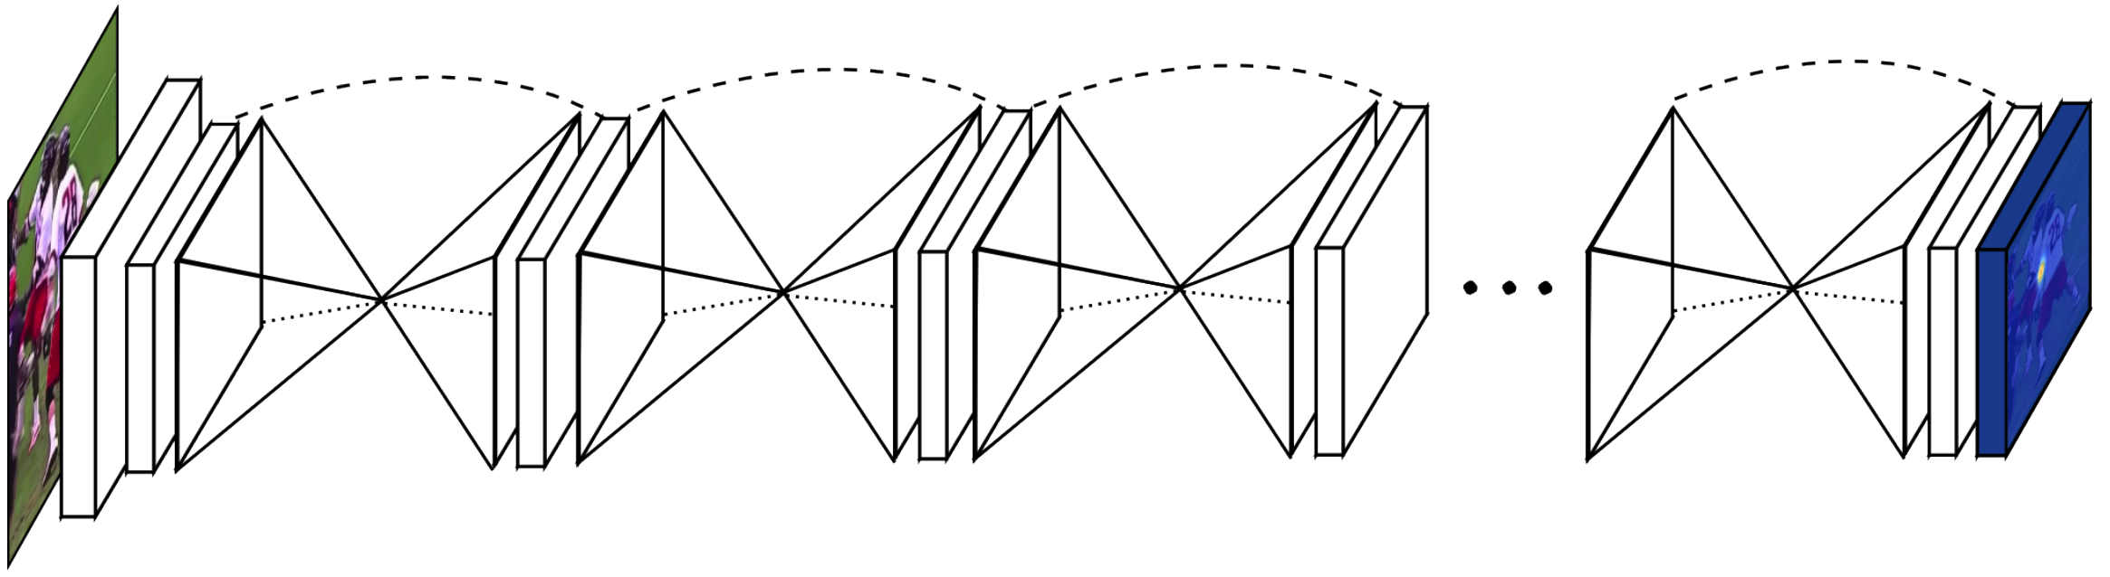
Stacked Hourglass Networks
Each refinement round has to
  Combine global information about pose
  Use global pose information to produce new precise pose estimate
”Hourglass structure”
Stacked Hourglass Networks for Human Pose Estimation. Alejandro Newell, Kaiyu Yang, and Jia Deng. In ECCV, 2016.

Slide 50
Pose estimation without detection

Slide 51
Evaluation metric - tabula rasa
Algorithm detects keypoints + scores
Match keypoint to a ground truth keypoint if d/h is less than threshold
Compute precision-recall curve
Compute AP (called APK : AP Keypoint)

Slide 52
Two strategies
First detect, then estimate keypoints
  Can use any of previous techniques
  Similar to instance segmentation
  Easy to get object level information
  Hard to recover from bad detections
  e.g. Mask R-CNN
Detect keypoints, then group into people
  Need a way to group keypoints: hard problem, requires heuristics
  No simple way to have object level information

Slide 53
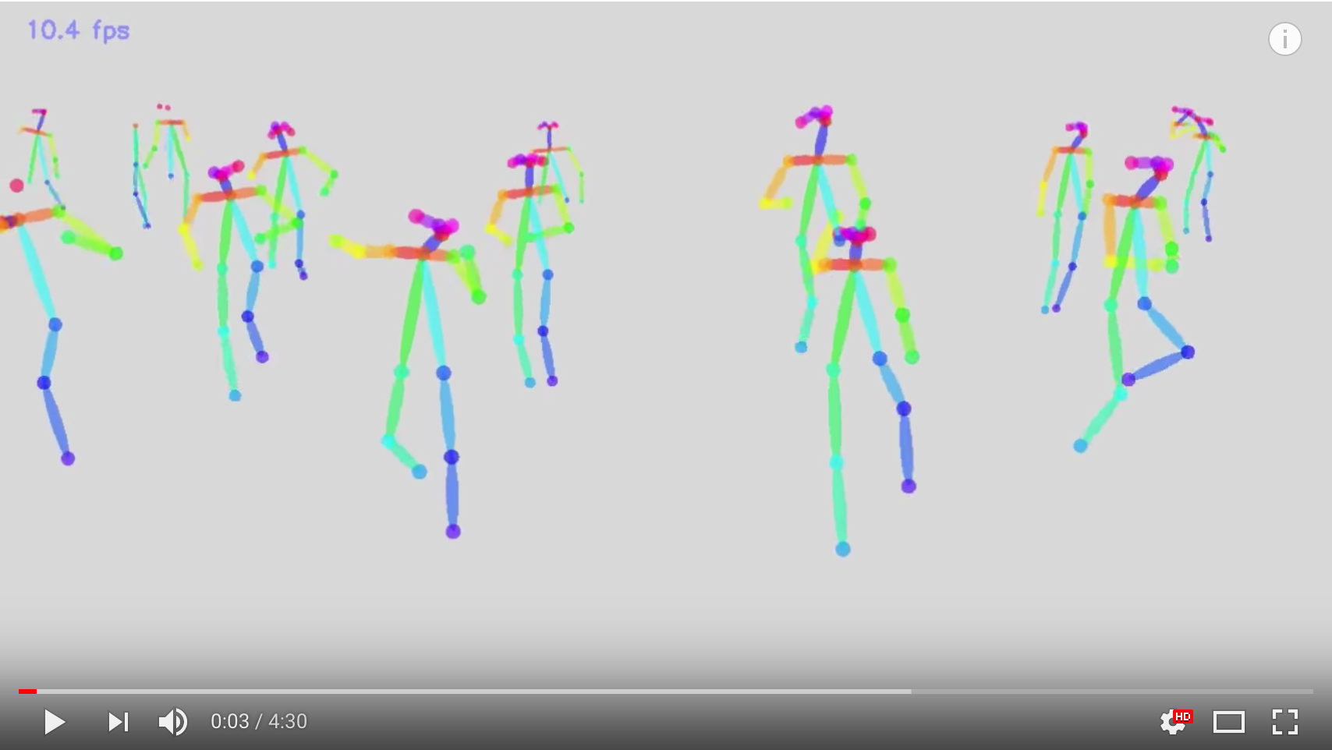
Realtime Multi-Person 2D Pose Estimation using Part Affinity Fields. Zhe Cao, Tomas Simon, Shih-En Wei, Yaser Sheikh. In CVPR, 2017.

