Slide 1
Announcements
Project proposal due tomorrow
Altered time for OH tomorrow: 9:00-10:00 am.
Please complete mid-semester feedback

Slide 2
Semantic Segmentation

Slide 3
The Task
person
grass
trees
motorbike
road

Slide 4
Evaluation metric
Pixel classification!
Accuracy?
  Heavily unbalanced
Intersection over Union
  Average across classes and images
Per-class accuracy
  Average across classes and images

Slide 5
Things vs Stuff
THINGS
Person, cat, horse, etc
Constrained shape
Individual instances with separate identity
May need to look at objects
STUFF
Road, grass, sky etc
Amorphous, no shape
No notion of instances
Can be done at pixel level
“texture”

Slide 6
Challenges in data collection
Precise localization is hard to annotate
Annotating every pixel leads to heavy tails
Common solution: annotate few classes (often things), mark rest as “Other”
Common datasets: PASCAL VOC 2012 (~1500 images, 20 categories), COCO (~100k images, 20 categories)

Slide 7
Pre-convnet semantic segmentation
Things
  Do object detection, then segment out detected objects
Stuff
  ”Texture classification”
  Compute histograms of filter responses
  Classify local image patches

Slide 8
Semantic segmentation using convolutional networks
w
3
h

Slide 9
Semantic segmentation using convolutional networks
c
w/4
h/4

Slide 10
Semantic segmentation using convolutional networks
c
w/4
h/4

Slide 11
Semantic segmentation using convolutional networks
c
w/4
h/4

Slide 12
Semantic segmentation using convolutional networks
c
#classes
Convolve with #classes 1x1 filters
w/4
h/4

Slide 13
Semantic segmentation using convolutional networks
Pass image through convolution and subsampling layers
Final convolution with #classes outputs
Get scores for subsampled image
Upsample back to original size

Slide 14
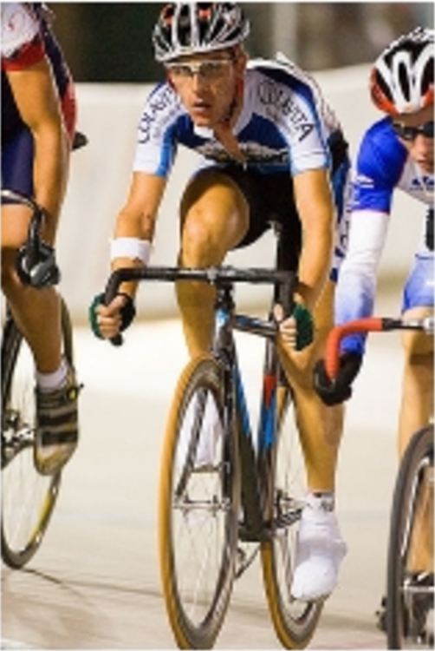
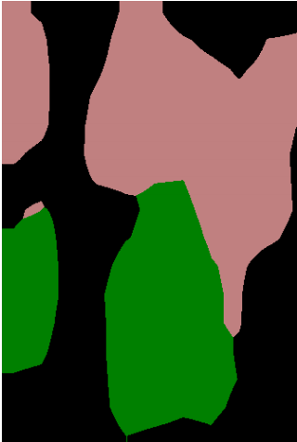
Semantic segmentation using convolutional networks
person
bicycle

Slide 15
The resolution issue
Problem: Need fine details!
Shallower network / earlier layers?
  Not very semantic!
Remove subsampling?
  Looks at only a small window!

Slide 16
Solution 1: Image pyramids
Higher resolution
Less context
Learning Hierarchical Features for Scene Labeling. Clement Farabet, Camille Couprie, Laurent Najman, Yann LeCun. In TPAMI, 2013.

Slide 17
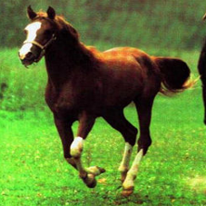
Solution 2: Skip connections
upsample

Slide 18
Solution 2: Skip connections

Slide 19

Skip connections
Fully convolutional networks for semantic segmentation. Evan Shelhamer, Jon Long, Trevor Darrell. In CVPR 2015

Slide 20
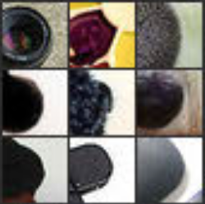
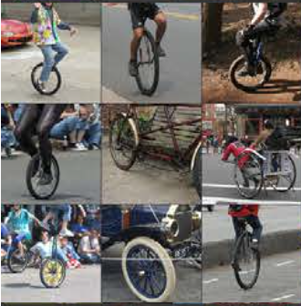
Skip connections
Problem: early layers not semantic
Horse
Visualizations from : M. Zeiler and R. Fergus. Visualizing and Understanding Convolutional Networks. In ECCV 2014.
Notes:
If you look at what one of these higher layers is detecting, here I am showing the input image patches that are highly scored by one of the units. This particular layer really likes bicycle wheels, so if this unit fires, you know that there is a bicycle wheel in the image. Unfortunately, you don’t know where the bicycle wheel is, because this unit doesn’t care where the bicycle wheel appears, or at what orientation or what scale.

Slide 21
Solution 3: Dilation
Need subsampling to allow convolutional layers to capture large regions with small filters
  Can we do this without subsampling?

Slide 22
Solution 3: Dilation
Need subsampling to allow convolutional layers to capture large regions with small filters
  Can we do this without subsampling?

Slide 23
Solution 3: Dilation
Need subsampling to allow convolutional layers to capture large regions with small filters
  Can we do this without subsampling?

Slide 24
Solution 3: Dilation
Instead of subsampling by factor of 2: dilate by factor of 2
Dilation can be seen as:
  Using a much larger filter, but with most entries set to 0
  Taking a small filter and “exploding”/ “dilating” it
Not panacea: without subsampling, feature maps are much larger: memory issues

Slide 25
Solution 4: Conditional Random Fields
Idea: take convolutional network prediction and sharpen using classic techniques
Conditional Random Field

Slide 26
Fully Connected CRFs
Typically, only adjacent pixels connected
  Fewer connections => Easier to optimize
Dense connectivity: every pixel connected to everything else
Intractable to optimize except if pairwise potential takes specific form
Efficient Inference in Fully Connected CRFs with Gaussian Edge Potentials. Philipp Krahenbuhl, Vladlen Koltun. In NIPS, 2011.

Slide 27
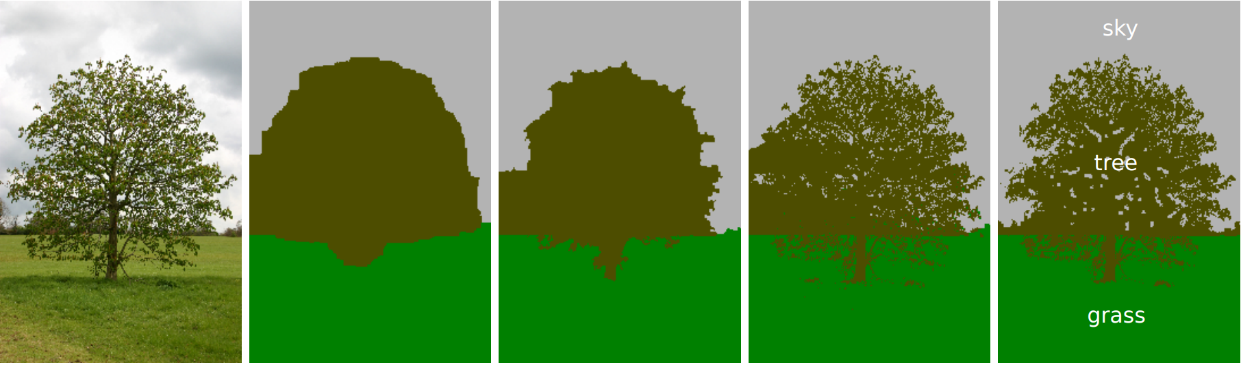
Fully Connected CRFs
Grid CRF
Fully connected CRF
Ground truth

Slide 28
Putting it all together
Best Non-CNN approach: ~46.4%
Semantic Image Segmentation with Deep Convolutional Nets and Fully Connected CRFs. Liang-Chieh Chen, George Papandreou, Iasonas Kokkinos, Kevin Murphy, Alan Yuille. In ICLR, 2015.

Slide 29
Other additions
Method | mean IoU (%)
VGG16 + Skip + Dilation | 65.8
ResNet101 | 68.7
ResNet101 + Pyramid | 71.3
ResNet101 + Pyramid + COCO | 74.9
DeepLab: Semantic Image Segmentation with Deep Convolutional Nets, Atrous Convolution, and Fully Connected CRFs. Liang-Chieh Chen, George Papandreou, Iasonas Kokkinos, Kevin Murphy, Alan Yuille. Arxiv 2016.

Slide 30
Image-to-image translation problems

Slide 31
Image-to-image translation problems
Segmentation
Optical flow estimation
Depth estimation
Normal estimation
Boundary detection
…

Slide 32
Learning to segment images

Slide 33
The 3 core problems
Reconstruction
Machine Learning
Reorganization (Grouping)
Recognition
Convolutional Networks

Slide 34
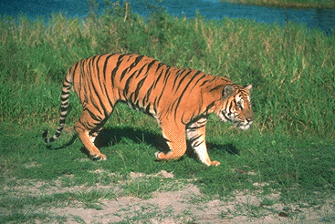
Revisiting contour detection

Slide 35
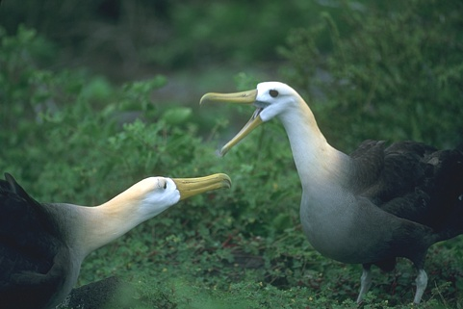
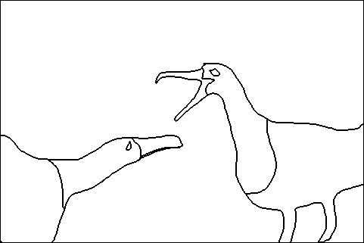
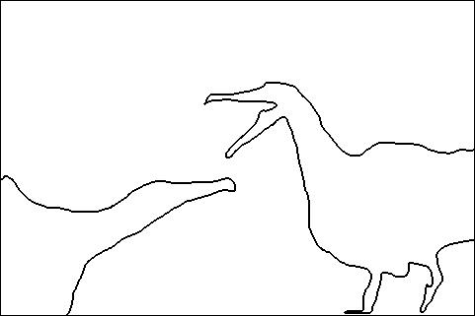
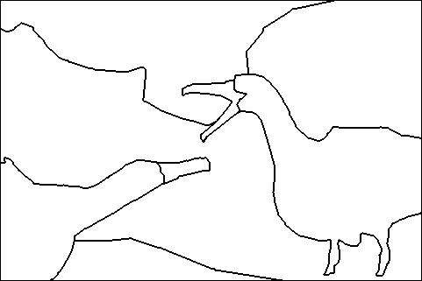
The BSDS Benchmark
5 humans annotate boundaries, take union
Algorithm assigns “probability of boundary” to each pixel
Threshold gives a binary map
A
B
C

Slide 36
The BSDS Benchmark
For particular threshold, get predicted boundary map
Match predicted boundaries to ground truth
  Construct bipartite graph
  Construct optimal matching

Slide 37
The BSDS Benchmark
For particular threshold, get predicted boundary map
Match predicted boundaries to ground truth
  Construct bipartite graph
  Construct optimal matching
  Matched predicted boundaries = correct
  Precision =
  #matched predictions / #predictions
  Recall =
  #matched GT / #GT

Slide 38
The BSDS Benchmark
Compute precision recall curve
F-measure = harmonic mean of precision and recall
Pick point with maximum F measure

Slide 39
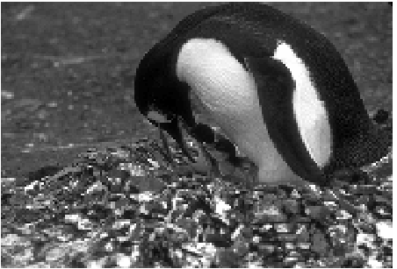
Learning to detect boundaries
Two steps in boundary detection:
  Compute local gradients: brightness, color, texture
  Combine information over entire image using normalized cuts
Local gradients (e.g., texture gradients) involve complex pipelines
Can we replace local gradients by something better?

Slide 40

Learning to detect boundaries
Learn to identify local boundary pattern

Slide 41
Decision Trees and Random Forests
Non-linear classifiers
Has four legs?
Has fur?
Lives in water?
cat
zebra
snake
fish

Slide 42
Decision trees for classification
Leaf nodes store distribution of labels
For each test data point, find correct leaf node

Slide 43
Decision trees for classification
Grow node by node
At each node, try candidate splits based on sampled features
Pick split that minimizes entropy of daughters

Slide 44
Shape?
Color?
Size?
,+
,-
,+
,-
,-
,+
Shape?
square
not square

Slide 45
Decision trees for classification
End of training: entropy below threshold / maximum depth
Each leaf node contains subset of training data points
  compute distribution of labels at leaves

Slide 46
Random forests
Looking for best decision at every node bad: overfitting
Sample a few candidates
Construct an ensemble of trees: random forests

Slide 47
Random forests for boundary detection
Not classification : label is boundary map
Two key questions:
  How do we split nodes during training?
  How do we make predictions during testing?

Slide 48
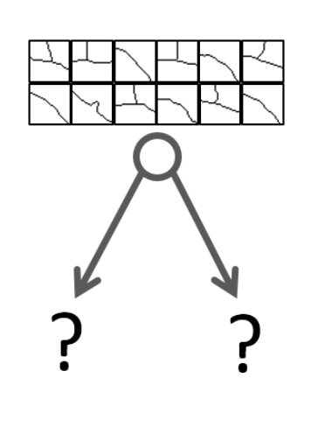
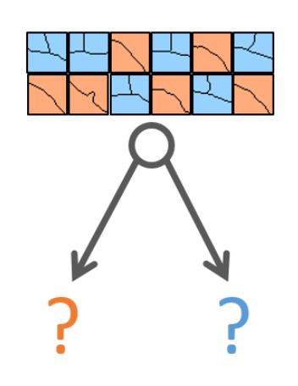
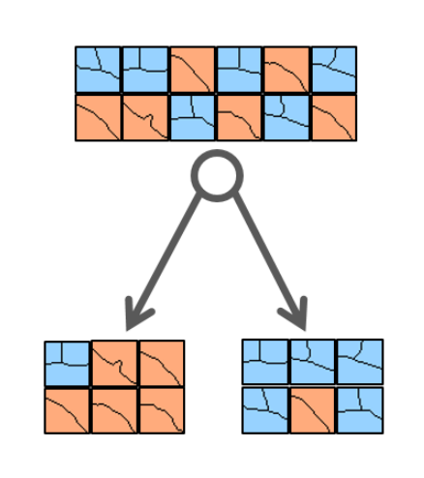
Random forests for boundary detection
Idea: cluster boundary maps into classes at each node
Fast Edge Detection Using Structured Forests. P. Dollar, C. Lawrence Zitnick. In TPAMI 2015

Slide 49
Random forests for boundary detection
Not classification : label is boundary map
Two key questions:
  How do we split nodes during training?
  How do we make predictions during testing?

Slide 50
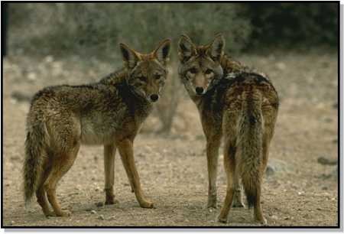
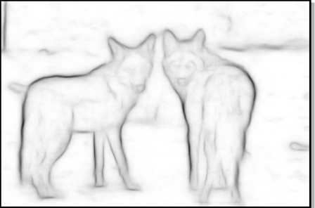
Random forests for boundary detection
Each leaf node has set of boundary patches
Simply output average of boundary patches at leaf

Slide 51
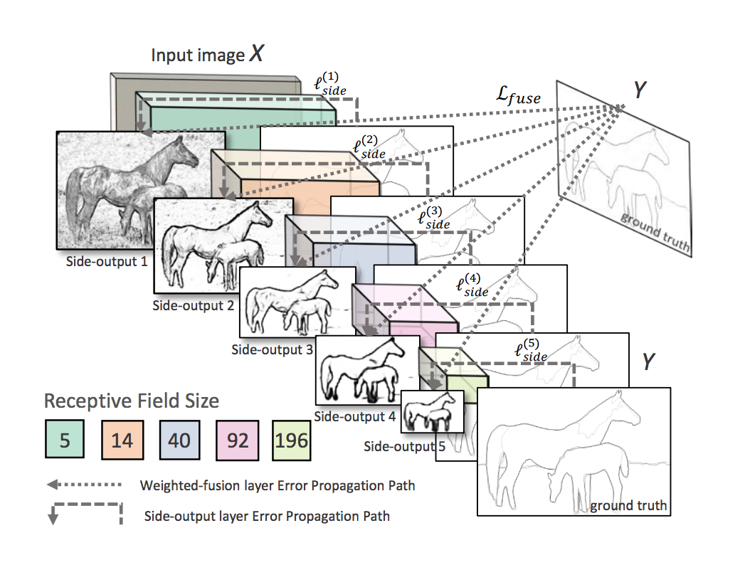
Convolutional network based edge detection
Deep supervision: Skip connections, but additional loss at each layer
Method | Max F measure
Structured Edges | 74.6
HED without deep supervision | 77.1
HED with deep supervision | 78.2
Humans | 80
Holistically-Nested Edge Detection. Saining Xie, Zhuowen Tu. In ICCV, 2015.

Slide 52
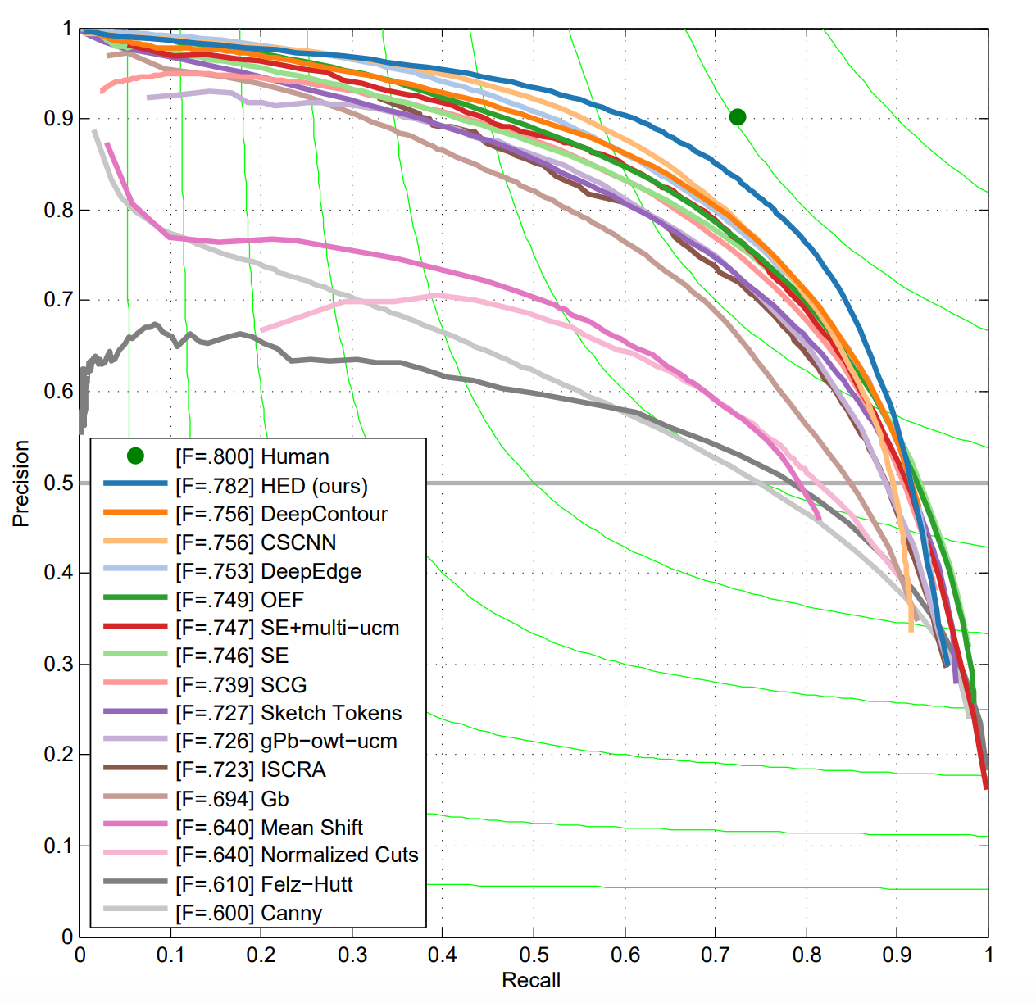
Convolutional network based edge detection

Slide 53
Why do convolutional networks work for edges?
Structured forests look at patches, convnet receptive fields are much larger
Convnets are pretrained on ImageNet : can implicitly recognize objects?

