Slide 1
Announcements
Project proposal due end of the week (Oct 6)
AWS Instructions to be posted soon

Slide 2
Object detection

Slide 3
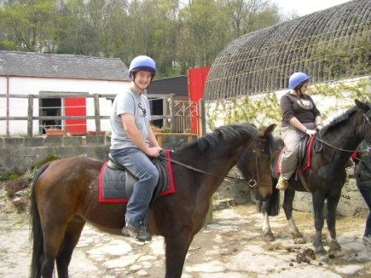
The Task
person 1
person 2
horse 1
horse 2

Slide 4
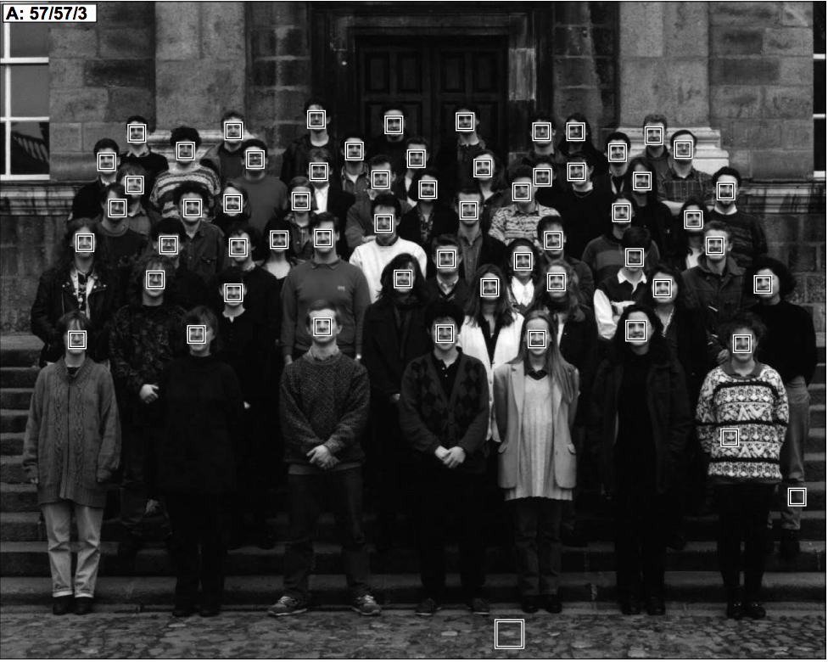
Datasets
Face detection
One category: face
Frontal faces
Fairly rigid, unoccluded
1990’s
Human Face Detection in Visual Scenes. H. Rowley, S. Baluja, T. Kanade. 1995.

Slide 5
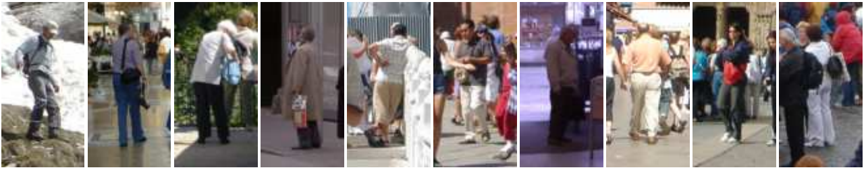
Pedestrians
One category: pedestrians
Slight pose variations and small distortions
Partial occlusions
Faces
1990’s
2000’s
Histograms of Oriented Gradients for Human Detection. N. Dalal and B. Triggs. CVPR 2005

Slide 6
PASCAL VOC
20 categories
10K images
Large pose variations, heavy occlusions
Generic scenes
Cleaned up performance metric
Faces
1990’s
2000’s
2007 - 2012

Slide 7
Coco
80 diverse categories
100K images
Heavy occlusions, many objects per image, large scale variations
Faces
1990’s
2000’s
2007 - 2012
2014 -

Slide 8
Evaluation metric

Slide 9
Matching detections to ground truth

Slide 10
Matching detections to ground truth
Match detection to most similar ground truth
  highest IoU
If IoU > 50%, mark as correct
If multiple detections map to same ground truth, mark only one as correct
Precision = #correct detections / total detections
Recall = #ground truth with matched detections / total ground truth

Slide 11
Tradeoff between precision and recall
ML usually gives scores or probabilities, so threshold
Too low threshold → too many detections → low precision, high recall
Too high threshold → too few detections → high precision, low recall
Right tradeoff depends on application
  Detecting cancer cells in tissue: need high recall
  Detecting edible mushrooms in forest: need high precision

Slide 12
Average precision
1
Precision
Recall

Slide 13
Average precision
1
Precision
Recall
1

Slide 14
Average average precision
AP marks detections with overlap > 50% as correct
But may need better localization
Average AP across multiple overlap thresholds
Confusingly, still called average precision
Introduced in COCO

Slide 15
Mean and category-wise AP
Every category evaluated independently
Typically report mean AP averaged over all categories
Confusingly called “mean Average Precision”, or “mAP”

Slide 16
Why is detection hard(er)?
Precise localization

Slide 17
Why is detection hard(er)?
Much larger impact of pose

Slide 18
Why is detection hard(er)?
Occlusion makes localization difficult

Slide 19
Why is detection hard(er)?
Counting

Slide 20
Why is detection hard(er)?
Small objects

Slide 21
Detection as classification
Run through every possible box and classify
How many boxes?
  Every pair of pixels = 1 box
  = O(N²)
  For 300 x 500 image, N = 150K
  2.25 x 10¹⁰ boxes!

Slide 22
Idea 1: scanning window
Fix size
  Can take a few different sizes
Fixed stride
Convolution with a filter
  Classic: compute HOG features over entire image

Slide 23
Dealing with scale

Slide 24
Dealing with scale

Slide 25
Idea 2: Object proposals
Use segmentation to produce ~5K candidates
Selective Search for Object Recognition
J. R. R. Uijlings, K. E. A. van de Sande, T. Gevers, A. W. M. Smeulders
In International Journal of Computer Vision 2013.

Slide 26
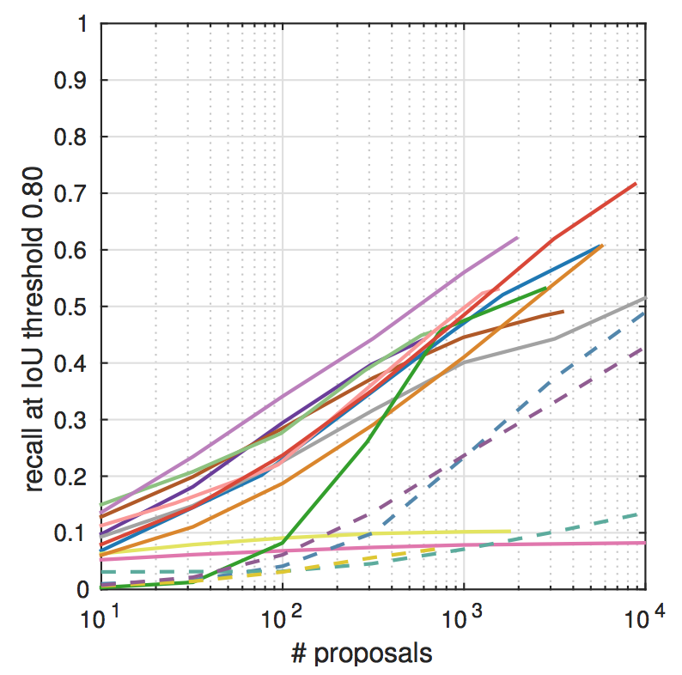
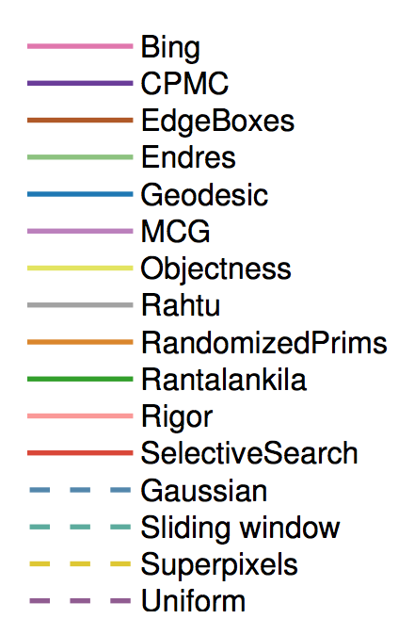
Idea 2: Object proposals
What makes for effective detection proposals? J. Hosang, R. Benenson, P. Dollar, B. Schiele. In TPAMI

Slide 27
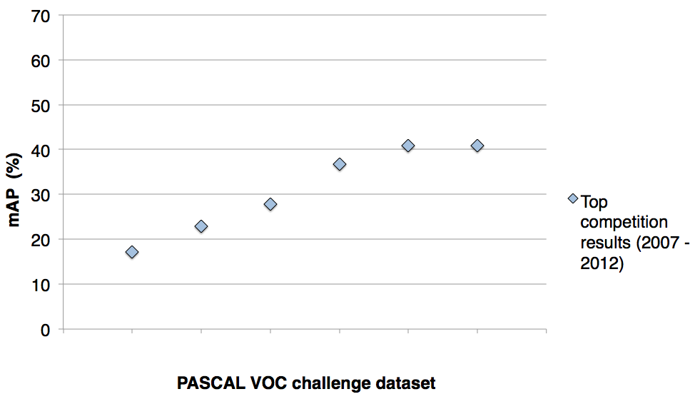
A rapid rise in performance
41%
41%
37%
DPM++,
MKL,
Selective
Search
Selective
Search,
DPM++,
MKL
28%
DPM++
23%
17%
DPM,
MKL
DPM,
HOG+BOW
DPM
DPM
VOC’07
VOC’08
VOC’09
VOC’10
VOC’11
VOC’12
PASCAL VOC challenge dataset
Slide credit : Ross Girshick
[Source: http://pascallin.ecs.soton.ac.uk/challenges/VOC/voc20{07,08,09,10,11,12}/results/index.html]
Notes:
As you can see, performance increased rapidly from 2007 through 2011.

Slide 28
Complexity and the plateau
plateau & increasing complexity
41%
41%
37%
DPM++,
MKL,
Selective
Search
Selective
Search,
DPM++,
MKL
28%
DPM++
23%
17%
DPM,
MKL
DPM,
HOG+BOW
DPM
DPM
VOC’07
VOC’08
VOC’09
VOC’10
VOC’11
VOC’12
PASCAL VOC challenge dataset
Slide credit : Ross Girshick
[Source: http://pascallin.ecs.soton.ac.uk/challenges/VOC/voc20{07,08,09,10,11,12}/results/index.html]
Notes:
However, it reached a plateau and there was no improvement from 2011 to 2012.
Meanwhile, the winning systems were becoming complex ensembles.

Slide 29
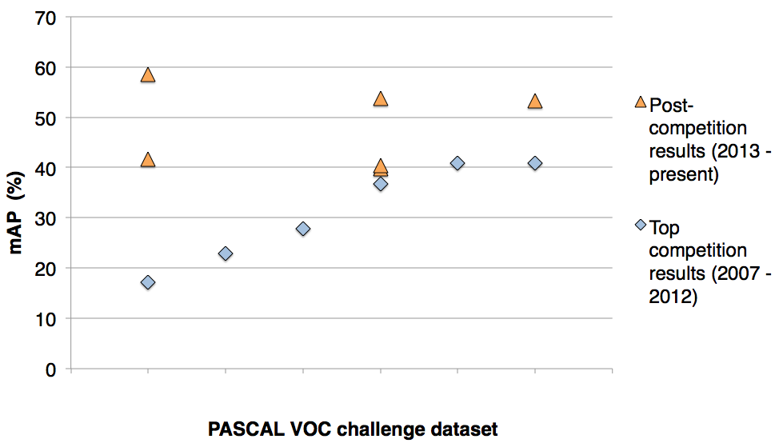
SIFT, HOG, LBP, ...
SegDPM (2013)
Regionlets
(2013)
Regionlets (2013)
DPM++,
MKL,
Selective
Search
Selective
Search,
DPM++,
MKL
DPM++
DPM,
MKL
DPM,
HOG+BOW
DPM
VOC’07
VOC’08
VOC’09
VOC’10
VOC’11
VOC’12
PASCAL VOC challenge dataset
Slide credit : Ross Girshick
[Regionlets. Wang et al. ICCV’13]
[SegDPM. Fidler et al. CVPR’13]
Notes:
In the year following the final challenge, the best methods still remained at the plateau.
One notable commonality between these approaches is that they all use low-level image features like SIFT, HOG, and LBP.

Slide 30
R-CNN: Regions with CNN features
R-CNN
58.5%
R-CNN
R-CNN
53.7%
53.3%
VOC’07
VOC’08
VOC’09
VOC’10
VOC’11
VOC’12
PASCAL VOC challenge dataset
Slide credit : Ross Girshick
Notes:
In this talk, I will present R-CNN: Regions with Convolutional Neural Network features.
R-CNN uses features learned by a large convolutional network together with bottom-up region proposals.
It dramatically outperforms all previous approaches on PASCAL VOC and ImageNet detection.

Slide 31
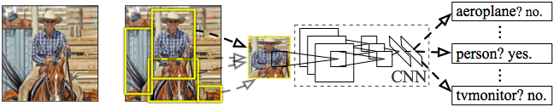
R-CNN: Regions with CNN features
Input
image
Extract region
proposals (~2k / image)
Compute CNN
features
Classify regions
(linear SVM)
Rich Feature Hierarchies for Accurate Object Detection and Semantic Segmentation
R. Girshick, J. Donahue, T. Darrell, J. Malik
IEEE Conference on Computer Vision and Pattern Recognition (CVPR), 2014
Slide credit : Ross Girshick
Notes:
Here’s a schematic of the system that we came up with.
Compared to previous state-of-the-art methods, R-CNN is relatively simple and does not rely on an ensemble of classifiers.
Let’s see how it works at test time.

Slide 32
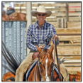
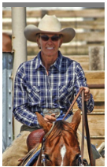
R-CNN at test time: Step 2
Input
image
Extract region
proposals (~2k / image)
Compute CNN
features
a. Crop
Slide credit : Ross Girshick
Notes:
Then, we crop out the region of interest...

Slide 33
R-CNN at test time: Step 2
Input
image
Extract region
proposals (~2k / image)
Compute CNN
features
227 x 227
a. Crop
b. Scale (anisotropic)
Slide credit : Ross Girshick
Notes:
...and scale it to a fixed size square so that it can be input into the CNN.

Slide 34

R-CNN at test time: Step 2
Input
image
Extract region
proposals (~2k / image)
Compute CNN
features
c. Forward propagate
Output: “fc7” features
1. Crop
b. Scale (anisotropic)
Slide credit : Ross Girshick
Notes:
We then forward propagate it through the network to produce a feature vector from the 7th layer, which we call fc7.

Slide 35
R-CNN at test time: Step 3
Input
image
Extract region
proposals (~2k / image)
Compute CNN
features
Classify
regions
person? 1.6
...
horse? -0.3
...
4096-dimensional
fc7 feature vector
linear classifiers
(SVM or softmax)
Warped proposal
Slide credit : Ross Girshick
Notes:
In step 3, we classify the region using a linear classifier on the four-thousand dimensional fc7 feature vectors.
We have one classifier per class that was trained to discriminate between well-localized instances of that class and poorly-localized instances.

Slide 36
Step 4: Object proposal refinement
Linear regression
on CNN features
Original
proposal
Predicted
object bounding box
Bounding-box regression
Slide credit : Ross Girshick
Notes:
Finally, we refine the original object proposals with a simple regression step.
We use a linear regressor on the CNN features to predict a new bounding box relative to the proposal.
This regression step improves localization and allows non-maximum suppression to be more effective.

Slide 37
Bounding-box regression
w
Δw × w + w
(x, y)
h
(Δx × w + x,
Δy × h + h)
Δh × h + h
original
predicted
Slide credit : Ross Girshick

Slide 38
R-CNN results on PASCAL
 | VOC 2007 | VOC 2010
DPM v5 (Girshick et al. 2011) | 33.7% | 29.6%
UVA sel. search (Uijlings et al. 2013) |  | 35.1%
Regionlets (Wang et al. 2013) | 41.7% | 39.7%
SegDPM (Fidler et al. 2013) |  | 40.4%
R-CNN | 54.2% | 50.2%
R-CNN + bbox regression | 58.5% | 53.7%
Reference systems
metric: mean average precision (higher is better)
Slide credit : Ross Girshick
Notes:
Now, let’s look at results on PASCAL in more detail.
First, here are reference systems including the most recently published top-performing methods.

Slide 39
R-CNN results on PASCAL
 | VOC 2007 | VOC 2010
DPM v5 (Girshick et al. 2011) | 33.7% | 29.6%
UVA sel. search (Uijlings et al. 2013) |  | 35.1%
Regionlets (Wang et al. 2013) | 41.7% | 39.7%
SegDPM (Fidler et al. 2013) |  | 40.4%
R-CNN | 54.2% | 50.2%
R-CNN + bbox regression | 58.5% | 53.7%
metric: mean average precision (higher is better)
Slide credit : Ross Girshick
Notes:
Here are our results using R-CNN.
R-CNN improves over the previous state-of-the-art by more than 30% relative and is the most dramatic improvement in object detection performance since the early years of the PASCAL challenge.

Slide 40
Training R-CNN
Train convolutional network on ImageNet classification
Finetune on detection
  Classification problem!
  Proposals with IoU > 50% are positives
  Sample fixed proportion of positives in each batch because of imbalance
Notes:
Now let’s talk about how R-CNN is trained.
Unlike image classification, detection training data is relatively scarce.
One key insight in this work is that when the target task has too little training data, we can use supervised pre-training on a data-rich auxiliary task and transfer the learned representation to detection.

Slide 41
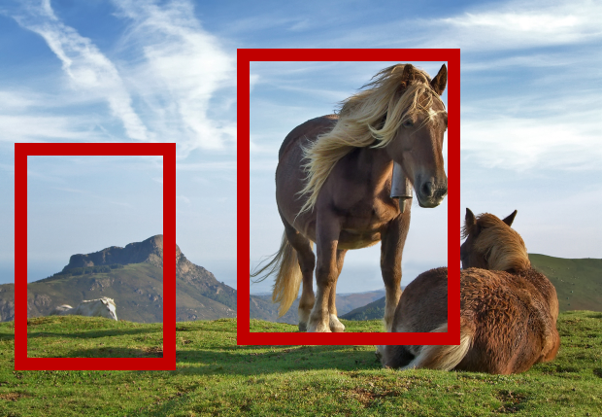
Speeding up R-CNN
CNN
CNN

Slide 42
Speeding up R-CNN
CNN

Slide 43
ROI Pooling
How do we crop from a feature map?
Step 1: Resize boxes to account for subsampling
Fast R-CNN. Ross Girshick. In ICCV 2015

Slide 44
ROI Pooling
How do we crop from a feature map?
Step 2: Snap to feature map grid

Slide 45
ROI Pooling
How do we crop from a feature map?
Step 3: Place a grid of fixed size

Slide 46
ROI Pooling
How do we crop from a feature map?
Step 4: Take max in each cell

Slide 47
Fast R-CNN
 | Fast R-CNN | R-CNN
Train time (h) | 9.5 | 84
Speedup | 8.8x | 1x
Test time / image | 0.32s | 47.0s
Speedup | 146x | 1x
mean AP | 66.9 | 66.0

Slide 48
Fast R-CNN
Bottleneck remaining (not included in time):
  Object proposal generation
Slow
  Requires segmentation
  O(1s) per image

Slide 49
Faster R-CNN
Can we produce object proposals from convolutional networks?
A change in intuition
  Instead of using grouping
  Recognize likely objects?
For every possible box, score if it is likely to correspond to an object
Faster R-CNN: Towards Real-Time Object Detection with Region Proposal Networks. S. Ren, K. He, R. Girshick, J. Sun. In NIPS 2015.

Slide 50
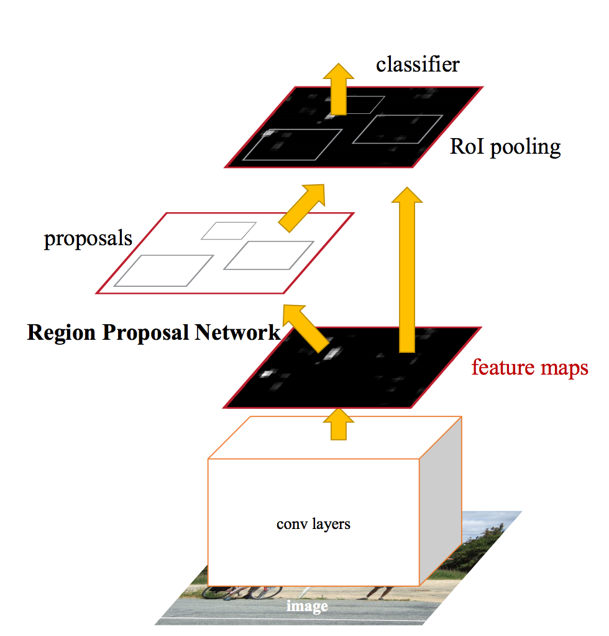
Faster R-CNN

Slide 51
Faster R-CNN
At each location, consider boxes of many different sizes and aspect ratios

Slide 52
Faster R-CNN
At each location, consider boxes of many different sizes and aspect ratios

Slide 53
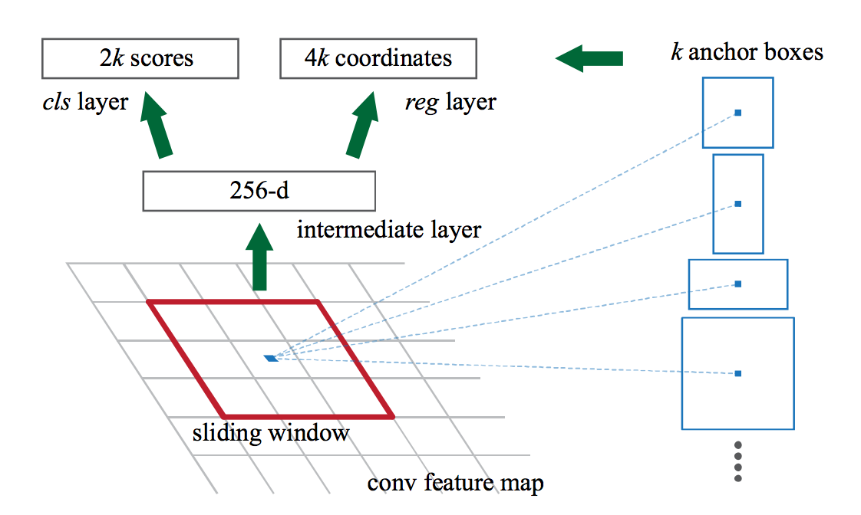
Faster R-CNN
At each location, consider boxes of many different sizes and aspect ratios

Slide 54
Faster R-CNN
s scales * a aspect ratios = sa anchor boxes
Use convolutional layer on top of filter map to produce sa scores
Pick top few boxes as proposals

Slide 55
Faster R-CNN
Method | mean AP (PASCAL VOC)
Fast R-CNN | 65.7
Faster R-CNN | 67.0

Slide 56
Impact of Feature Extractors
ConvNet | mean AP (PASCAL VOC)
VGG | 70.4
ResNet 101 | 73.8

Slide 57
Impact of Additional Data
Method | Training data | mean AP (PASCAL VOC 2012 Test)
Fast R-CNN | VOC 12 Train (10K) | 65.7
Fast R-CNN | VOC07 Trainval + VOC 12 Train | 68.4
Faster R-CNN | VOC 12 Train (10K) | 67.0
Faster R-CNN | VOC07 Trainval + VOC 12 Train | 70.4

Slide 58
The R-CNN family of detectors

Slide 59
SSD (Single Shot Detector)
Why go through separate proposals?
Directly produce class-specific scores at each location for every scale and aspect ratio
  s scales * a aspects * c classes = sac scores per location
SSD: Single Shot MultiBox Detector. Wei Liu , Dragomir Anguelov , Dumitru Erhan , Christian Szegedy , Scott Reed , Cheng-Yang Fu , Alexander C. Berg. In ECCV, 2016

Slide 60
SSD
Method | mean AP (PASCAL VOC)
Faster R-CNN | 70.4
SSD | 74.9

Slide 61
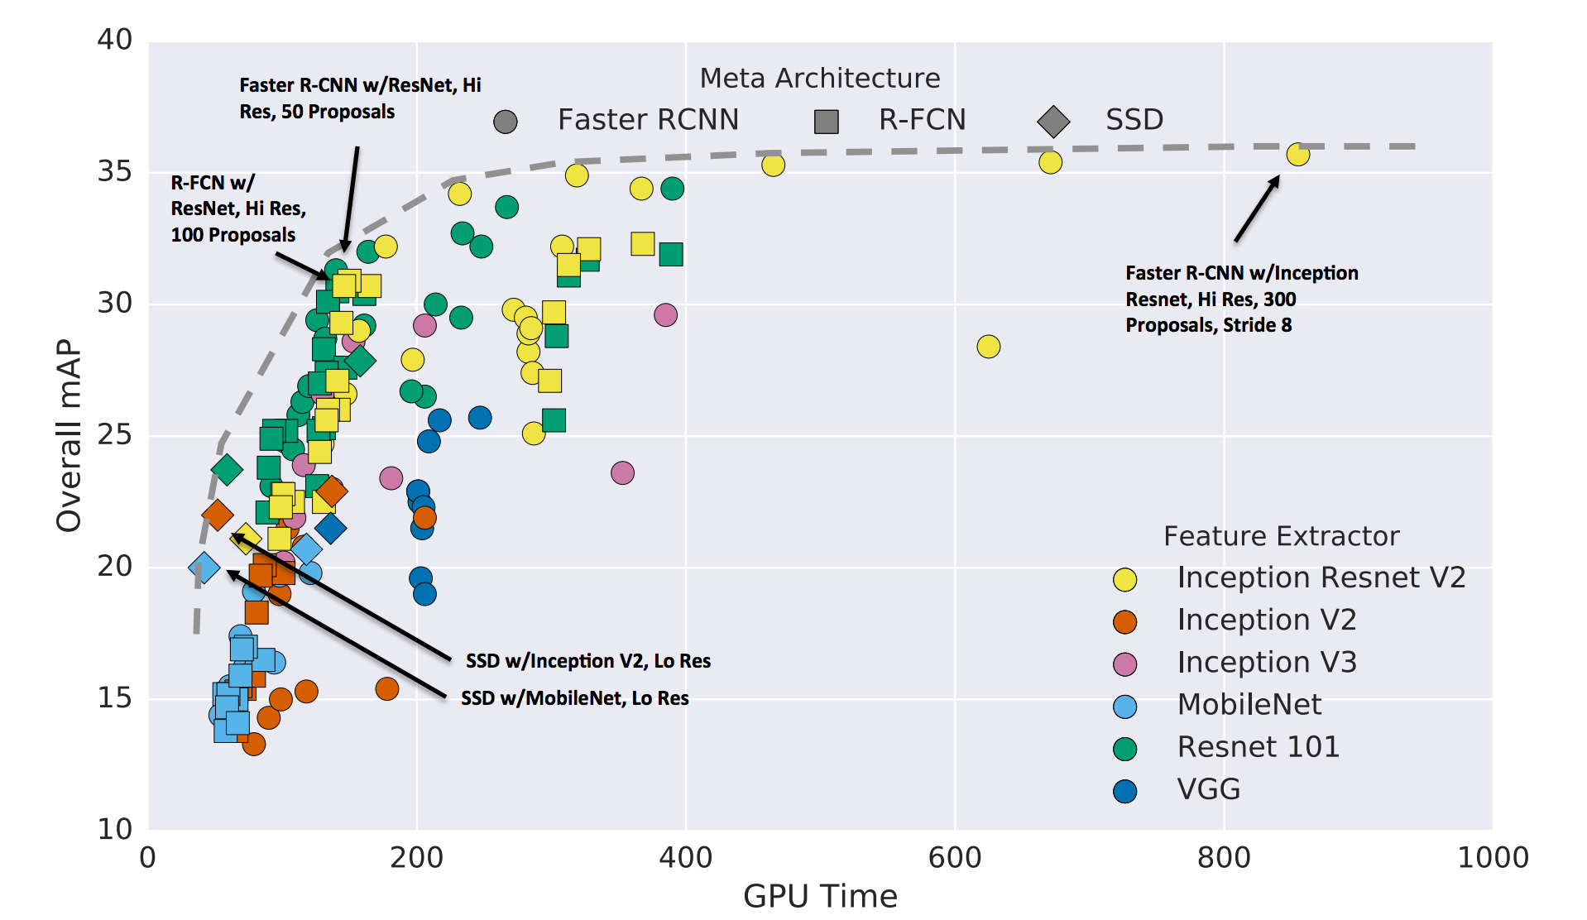
A comprehensive evaluation
Speed and accuracy trade-offs for modern convolutional object detectors
Alireza Fathi, Anoop Korattikara, Chen Sun, Ian Fischer, Jonathan Huang, Kevin Murphy, Menglong Zhu, Sergio Guadarrama, Vivek Rathod, Yang Song, Zbigniew Wojna
CVPR 2017

Slide 62
Other details - Non-max suppression
0.9
0.8

Slide 63
Other details - Non-max suppression
Go down the list of detections starting from highest scoring
Eliminate any detection that overlaps highly with a higher scoring detection
Separate, heuristic step

Slide 64
Other details - ROI Align
Snapping box to grid introduces quantization artifacts
Instead, use bilinear interpolation
Mask R-CNN. K. He, G. Gkioxari, P. Dollar, R. Girshick. In ICCV 2017.

