Slide 1
Transfer learning

Slide 2
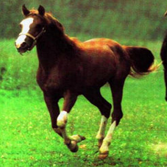
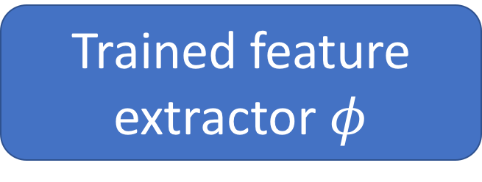
Transfer learning with convolutional networks
Horse
Trained feature extractor $φ$

Slide 3
Transfer learning with convolutional networks
Dataset | Non-Convnet Method | Non-Convnet perf | Pretrained convnet + classifier | Improvement
Caltech 101 | MKL | 84.3 | 87.7 | +3.4
VOC 2007 | SIFT+FK | 61.7 | 79.7 | +18
CUB 200 | SIFT+FK | 18.8 | 61.0 | +42.2
Aircraft | SIFT+FK | 61.0 | 45.0 | -16
Cars | SIFT+FK | 59.2 | 36.5 | -22.7

Slide 4
Why transfer learning?
Availability of training data
Computational cost
Ability to pre-compute feature vectors and use for multiple tasks
Con: NO end-to-end learning

Slide 5
Finetuning
Horse

Slide 6
Finetuning
Bakery
Initialize with pre-trained, then train with low learning rate

Slide 7
Finetuning
Dataset | Non-Convnet Method | Non-Convnet perf | Pretrained convnet + classifier | Finetuned convnet | Improvement
Caltech 101 | MKL | 84.3 | 87.7 | 88.4 | +4.1
VOC 2007 | SIFT+FK | 61.7 | 79.7 | 82.4 | +20.7
CUB 200 | SIFT+FK | 18.8 | 61.0 | 70.4 | +51.6
Aircraft | SIFT+FK | 61.0 | 45.0 | 74.1 | +13.1
Cars | SIFT+FK | 59.2 | 36.5 | 79.8 | +20.6

Slide 8
Exploring convnet architectures

Slide 9
Deeper is better
7 layers
16 layers

Slide 10
Deeper is better
Alexnet
VGG16

Slide 11
The VGG pattern
Every convolution is 3x3, padded by 1
Every convolution followed by ReLU
ConvNet is divided into “stages”
Layers within a stage: no subsampling
Subsampling by 2 at the end of each stage
Layers within stage have same number of channels
Every subsampling → double the number of channels

Slide 12
Challenges in training: exploding / vanishing gradients
Vanishing / exploding gradients
If each term is (much) greater than 1 → explosion of gradients
If each term is (much) less than 1 → vanishing gradients

Slide 13
Challenges in training: dependence on init

Slide 14
Solutions
Careful init
Batch normalization
Residual connections

Slide 15
Careful initialization
Key idea: want variance to remain approx. constant
Variance increases in backward pass => exploding gradient
Variance decreases in backward pass => vanishing gradient
“MSRA initialization”
weights = Gaussian with 0 mean and variance = 2/(k*k*d)
Delving Deep into Rectifiers: Surpassing Human-Level Performance on ImageNet Classification. K. He, X. Zhang, S. Ren, J. Sun

Slide 16
Batch normalization
Key idea: normalize so that each layer output has zero mean and unit variance
Compute mean and variance for each channel
Aggregate over batch
Subtract mean, divide by std
Need to reconcile train and test
No ”batches” during test
After training, compute means and variances on train set and store
Batch Normalization: Accelerating Deep Network Training by Reducing Internal Covariate Shift. S. Ioffe, C. Szegedy. In ICML, 2015.

Slide 17
Residual connections
In general, gradients tend to vanish
Key idea: allow gradients to flow unimpeded

Slide 18
Residual connections
In general, gradients tend to vanish
Key idea: allow gradients to flow unimpeded

Slide 19
Residual connections
Assumes all z_{i} have the same size
True within a stage
Across stages?
Doubling of feature channels
Subsampling
Increase channels by 1x1 convolution
Decrease spatial resolution by subsampling

Slide 20
A residual block
Instead of single layers, have residual connections over block
Conv
BN
ReLU
Conv
BN

Slide 21
Bottleneck blocks
Problem: When channels increases, 3x3 convolutions introduce many parameters
3x3xc²
Key idea: use 1x1 to project to lower dimensionality, do convolution, then come back
cxd + 3x3xd² + dxc

Slide 22
The ResNet pattern
Decrease resolution substantially in first layer
Reduces memory consumption due to intermediate outputs
Divide into stages
maintain resolution, channels in each stage
halve resolution, double channels between stages
Divide each stage into residual blocks
At the end, compute average value of each channel to feed linear classifier

Slide 23
Putting it all together - Residual networks

Slide 24
Object detection

Slide 25
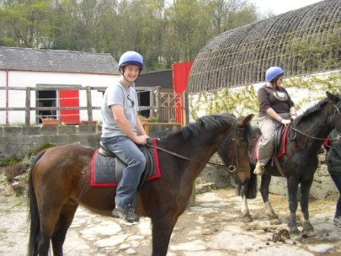
The Task
person 1
person 2
horse 1
horse 2

Slide 26
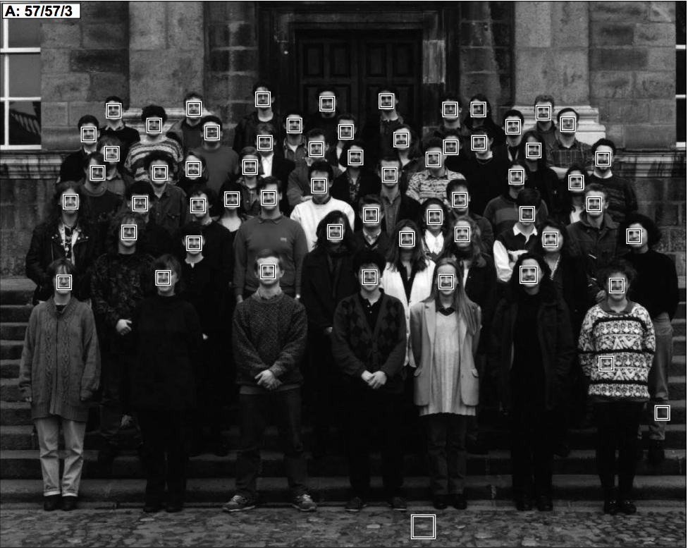
Datasets
Face detection
One category: face
Frontal faces
Fairly rigid, unoccluded
1990’s
Human Face Detection in Visual Scenes. H. Rowley, S. Baluja, T. Kanade. 1995.

Slide 27
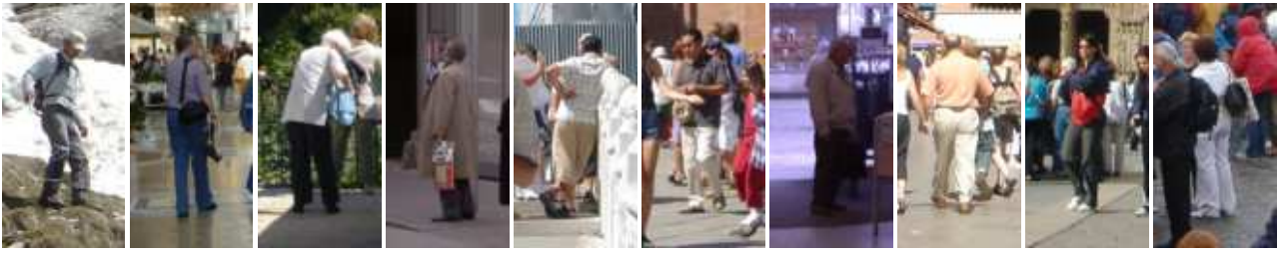
Pedestrians
One category: pedestrians
Slight pose variations and small distortions
Partial occlusions
Faces
1990’s
2000’s
Histograms of Oriented Gradients for Human Detection. N. Dalal and B. Triggs. CVPR 2005

Slide 28
PASCAL VOC
20 categories
10K images
Large pose variations, heavy occlusions
Generic scenes
Cleaned up performance metric
Faces
1990’s
2000’s
2007 - 2012

Slide 29
Coco
80 diverse categories
100K images
Heavy occlusions, many objects per image, large scale variations
Faces
1990’s
2000’s
2007 - 2012
2014 -

Slide 30
Evaluation metric

Slide 31
Matching detections to ground truth

Slide 32
Matching detections to ground truth
Match detection to most similar ground truth
highest IoU
If IoU > 50%, mark as correct
If multiple detections map to same ground truth, mark only one as correct
Precision = #correct detections / total detections
Recall = #ground truth with matched detections / total ground truth

Slide 33
Tradeoff between precision and recall
ML usually gives scores or probabilities, so threshold
Too low threshold → too many detections → low precision, high recall
Too high threshold → too few detections → high precision, low recall
Right tradeoff depends on application
Detecting cancer cells in tissue: need high recall
Detecting edible mushrooms in forest: need high precision

Slide 34
Average precision
1
Precision
Recall

Slide 35
Average precision
1
Precision
Recall
1

Slide 36
Detection as classification
Run through every possible box and classify
How many boxes?
Every pair of pixels = 1 box
= O(N²)
For 300 x 500 image, N = 150K
2.25 x 10¹⁰ boxes!

Slide 37
Idea 1: scanning window
Fix size
Can take a few different sizes
Fixed stride
Convolution with a filter
Classic: compute HOG features over entire image

Slide 38
Dealing with scale

Slide 39
Dealing with scale

Slide 40
Idea 2: Object proposals
Use segmentation to produce ~5K candidates
Selective Search for Object Recognition J. R. R. Uijlings, K. E. A. van de Sande, T. Gevers, A. W. M. Smeulders In International Journal of Computer Vision 2013.

Slide 41
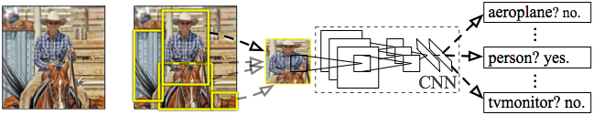
R-CNN: Regions with CNN features
Input
image
Extract region
proposals (~2k / image)
Compute CNN
features
Classify regions
(linear SVM)
Rich Feature Hierarchies for Accurate Object Detection and Semantic Segmentation R. Girshick, J. Donahue, T. Darrell, J. Malik IEEE Conference on Computer Vision and Pattern Recognition (CVPR), 2014
Notes:
Here’s a schematic of the system that we came up with.
Compared to previous state-of-the-art methods, R-CNN is relatively simple and does not rely on an ensemble of classifiers.
Let’s see how it works at test time.

Slide 42
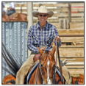
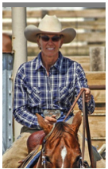
R-CNN at test time: Step 2
Input
image
Extract region
proposals (~2k / image)
Compute CNN
features
a. Crop
Notes:
Then, we crop out the region of interest...

Slide 43
R-CNN at test time: Step 2
Input
image
Extract region
proposals (~2k / image)
Compute CNN
features
227 x 227
a. Crop
b. Scale (anisotropic)
Notes:
...and scale it to a fixed size square so that it can be input into the CNN.

Slide 44

R-CNN at test time: Step 2
Input
image
Extract region
proposals (~2k / image)
Compute CNN
features
c. Forward propagate
Output: “fc7” features
1. Crop
b. Scale (anisotropic)
Notes:
We then forward propagate it through the network to produce a feature vector from the 7th layer, which we call fc7.

Slide 45
R-CNN at test time: Step 3
Input
image
Extract region
proposals (~2k / image)
Compute CNN
features
Classify
regions
person? 1.6
...
horse? -0.3
...
4096-dimensional
fc7 feature vector
linear classifiers
(SVM or softmax)
Warped proposal
Notes:
In step 3, we classify the region using a linear classifier on the four-thousand dimensional fc7 feature vectors.
We have one classifier per class that was trained to discriminate between well-localized instances of that class and poorly-localized instances.

Slide 46
Step 4: Object proposal refinement
Linear regression
on CNN features
Original
proposal
Predicted
object bounding box
Bounding-box regression
Notes:
Finally, we refine the original object proposals with a simple regression step.
We use a linear regressor on the CNN features to predict a new bounding box relative to the proposal.
This regression step improves localization and allows non-maximum suppression to be more effective.

Slide 47
Bounding-box regression
w
Δw × w + w
(x, y)
h
(Δx × w + x,
Δy × h + h)
Δh × h + h
original
predicted

Slide 48
R-CNN results on PASCAL
 | VOC 2007 | VOC 2010
DPM v5 (Girshick et al. 2011) | 33.7% | 29.6%
UVA sel. search (Uijlings et al. 2013) |  | 35.1%
Regionlets (Wang et al. 2013) | 41.7% | 39.7%
SegDPM (Fidler et al. 2013) |  | 40.4%
R-CNN | 54.2% | 50.2%
R-CNN + bbox regression | 58.5% | 53.7%
Reference systems
metric: mean average precision (higher is better)
Notes:
Now, let’s look at results on PASCAL in more detail.
First, here are reference systems including the most recently published top-performing methods.

Slide 49
R-CNN results on PASCAL
 | VOC 2007 | VOC 2010
DPM v5 (Girshick et al. 2011) | 33.7% | 29.6%
UVA sel. search (Uijlings et al. 2013) |  | 35.1%
Regionlets (Wang et al. 2013) | 41.7% | 39.7%
SegDPM (Fidler et al. 2013) |  | 40.4%
R-CNN | 54.2% | 50.2%
R-CNN + bbox regression | 58.5% | 53.7%
metric: mean average precision (higher is better)
Notes:
Here are our results using R-CNN.
R-CNN improves over the previous state-of-the-art by more than 30% relative and is the most dramatic improvement in object detection performance since the early years of the PASCAL challenge.

Slide 50
Training R-CNN
Train convolutional network on ImageNet classification
Finetune on detection
Classification problem!
Proposals with IoU > 50% are positives
Sample fixed proportion of positives in each batch because of imbalance
Notes:
Now let’s talk about how R-CNN is trained.
Unlike image classification, detection training data is relatively scarce.
One key insight in this work is that when the target task has too little training data, we can use supervised pre-training on a data-rich auxiliary task and transfer the learned representation to detection.

Slide 51
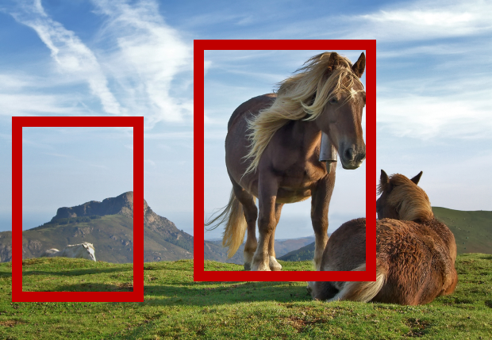
Speeding up R-CNN
CNN
CNN

Slide 52
Speeding up R-CNN
CNN

Slide 53
ROI Pooling
How do we crop from a feature map?
Step 1: Resize boxes to account for subsampling
Fast R-CNN. Ross Girshick. In ICCV 2015

Slide 54
ROI Pooling
How do we crop from a feature map?
Step 2: Place a grid of fixed size

Slide 55
ROI Pooling
How do we crop from a feature map?
Step 3: Take max in each cell

Slide 56
Fast R-CNN
 | Fast R-CNN | R-CNN
Train time (h) | 9.5 | 84
Speedup | 8.8x | 1x
Test time / image | 0.32s | 47.0s
Speedup | 146x | 1x
mean AP | 66.9 | 66.0

Slide 57
Fast R-CNN
Bottleneck remaining (not included in time):
Object proposal generation
Slow
Requires segmentation
O(1s) per image

Slide 58
Faster R-CNN
Can we produce object proposals from convolutional networks?
A change in intuition
Instead of using grouping
Recognize likely objects?
For every possible box, score if it is likely to correspond to an object
Faster R-CNN: Towards Real-Time Object Detection with Region Proposal Networks. S. Ren, K. He, R. Girshick, J. Sun. In NIPS 2015.

Slide 59
Faster R-CNN
At each location, consider boxes of many different sizes and aspect ratios

Slide 60
Faster R-CNN
At each location, consider boxes of many different sizes and aspect ratios

Slide 61
Faster R-CNN
s scales * a aspect ratios = sa scores at each location
Use convolutional layer on top of filter map to produce sa scores
Pick top few boxes as proposals

Slide 62
SSD (Single Shot Detector)
Why go through separate proposals?
Directly produce class-specific scores at each location for every scale and aspect ratio
s scales * a aspects * c classes = sac scores per location
SSD: Single Shot MultiBox Detector. Wei Liu , Dragomir Anguelov , Dumitru Erhan , Christian Szegedy , Scott Reed , Cheng-Yang Fu , Alexander C. Berg. In ECCV, 2016

Slide 63
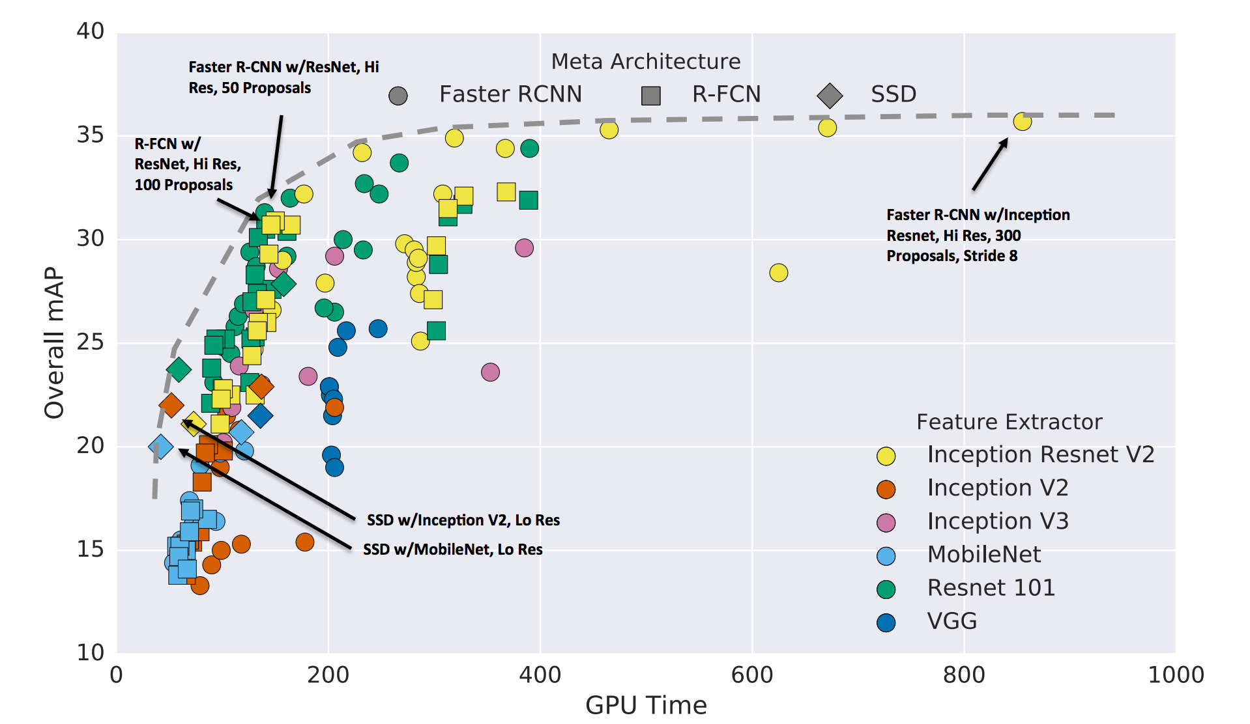
A comprehensive evaluation
Speed and accuracy trade-offs for modern convolutional object detectors
Alireza Fathi, Anoop Korattikara, Chen Sun, Ian Fischer, Jonathan Huang, Kevin Murphy, Menglong Zhu, Sergio Guadarrama, Vivek Rathod, Yang Song, Zbigniew Wojna
CVPR 2017

