Slide 1
Training convolutional networks

Slide 2
Last time
Linear classifiers on pixels bad, need non-linear classifiers
Multi-layer perceptrons overparametrized
Reduce parameters by local connections and shift invariance => Convolution
Intersperse subsampling to capture ever larger deformations
Stick a final classifier

Slide 3
Convolutional networks
conv
subsample
conv
subsample
linear
filters
filters
weights

Slide 4
Empirical Risk Minimization
Convolutional network

Slide 5
Computing the gradient of the loss

Slide 6
Convolutional networks
conv
subsample
conv
subsample
linear
filters
filters
weights

Slide 7
The gradient of convnets
z₁
z₂
z₃
z₄
z₅ = z
f₁
f₂
f₃
f₄
f₅
x
w₁
w₂
w₃
w₄
w₅

Slide 8
The gradient of convnets
z₁
z₂
z₃
z₄
z₅ = z
f₁
f₂
f₃
f₄
f₅
x
w₁
w₂
w₃
w₄
w₅

Slide 9
The gradient of convnets
z₁
z₂
z₃
z₄
z₅ = z
f₁
f₂
f₃
f₄
f₅
x
w₁
w₂
w₃
w₄
w₅

Slide 10
The gradient of convnets
z₁
z₂
z₃
z₄
z₅ = z
f₁
f₂
f₃
f₄
f₅
x
w₁
w₂
w₃
w₄
w₅

Slide 11
The gradient of convnets
z₁
z₂
z₃
z₄
z₅ = z
f₁
f₂
f₃
f₄
f₅
x
w₁
w₂
w₃
w₄
w₅

Slide 12
The gradient of convnets
z₁
z₂
z₃
z₄
z₅ = z
f₁
f₂
f₃
f₄
f₅
x
w₁
w₂
w₃
w₄
w₅

Slide 13
The gradient of convnets
z₁
z₂
z₃
z₄
z₅ = z
f₁
f₂
f₃
f₄
f₅
x
w₁
w₂
w₃
w₄
w₅

Slide 14
The gradient of convnets
z₁
z₂
z₃
z₄
z₅ = z
f₁
f₂
f₃
f₄
f₅
x
w₁
w₂
w₃
w₄
w₅

Slide 15
The gradient of convnets
z₁
z₂
z₃
z₄
z₅ = z
f₁
f₂
f₃
f₄
f₅
x
w₁
w₂
w₃
w₄
w₅

Slide 16
The gradient of convnets
z₁
z₂
z₃
z₄
z₅ = z
f₁
f₂
f₃
f₄
f₅
x
w₁
w₂
w₃
w₄
w₅

Slide 17
The gradient of convnets
z₁
z₂
z₃
z₄
z₅ = z
f₁
f₂
f₃
f₄
f₅
x
w₁
w₂
w₃
w₄
w₅

Slide 18
The gradient of convnets
z₁
z₂
z₃
z₄
z₅ = z
f₁
f₂
f₃
f₄
f₅
x
w₁
w₂
w₃
w₄
w₅

Slide 19
The gradient of convnets
z₁
z₂
z₃
z₄
z₅ = z
f₁
f₂
f₃
f₄
f₅
x
w₁
w₂
w₃
w₄
w₅

Slide 20
The gradient of convnets
z₁
z₂
z₃
z₄
z₅ = z
f₁
f₂
f₃
f₄
f₅
x
w₁
w₂
w₃
w₄
w₅
Recurrence going backward!!

Slide 21
The gradient of convnets
z₁
z₂
z₃
z₄
z₅ = z
f₁
f₂
f₃
f₄
f₅
x
w₁
w₂
w₃
w₄
w₅
Backpropagation

Slide 22
Backpropagation for a sequence of functions
Previous term
Function derivative

Slide 23
Backpropagation for a sequence of functions
Assume we can compute partial derivatives of each function
Use g(z_{i}) to store gradient of z w.r.t z_{i}, g(w_{i}) for w_{i}
Calculate g_{i} by iterating backwards
Use gi to compute gradient of parameters

Slide 24
Backpropagation for a sequence of functions
Each “function” has a “forward” and “backward” module
Forward module for f_{i}
  takes z_{i-1} and weight w_{i} as input
  produces z_{i} as output
Backward module for f_{i}
  takes g(z_{i} ) as input
  produces g(z_{i-1} ) and g(w_{i}) as output

Slide 25
Backpropagation for a sequence of functions
z_{i-1}
f_{i}
z_{i}
w_{i}

Slide 26
Backpropagation for a sequence of functions
g(z_{i-1})
f_{i}
g(z_{i})
g(w_{i})

Slide 27
Chain rule for vectors
Jacobian

Slide 28
Loss as a function
label
conv
subsample
conv
subsample
linear
loss
filters
filters
weights

Slide 29
Neural network frameworks
Caffe

Slide 30
Beyond sequences: computation graphs
Arbitrary graphs of functions
No distinction between intermediate outputs and parameters
u
g
k
x
f
l
z
y
h
w

Slide 31
Why computation graphs
Allows multiple functions to reuse same intermediate output
Allows one function to combine multiple intermediate output
Allows trivial parameter sharing
Allows crazy ideas, eg., one function predicting parameters for another

Slide 32
Computation graphs
a
f_{i}
b
d
c

Slide 33
Computation graphs
f_{i}

Slide 34
Computation graphs
a
f_{i}
b
d
c

Slide 35
Computation graphs
f_{i}

Slide 36


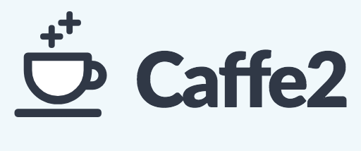

Neural network frameworks

Slide 37
Stochastic gradient descent
Gradient on single example = unbiased sample of true gradient
Idea: at each iteration sample single example x^{(t)}
Con: variance in estimate of gradient → slow convergence, jumping near optimum
step size

Slide 38
Minibatch stochastic gradient descent
Compute gradient on a small batch of examples
Same mean (=true gradient), but variance inversely proportional to minibatch size

Slide 39
Momentum
Average multiple gradient steps
Use exponential averaging

Slide 40
Weight decay
Add -aw^{(t)} to the gradient
Prevents w^{(t)} from growing to infinity
Equivalent to L2 regularization of weights

Slide 41
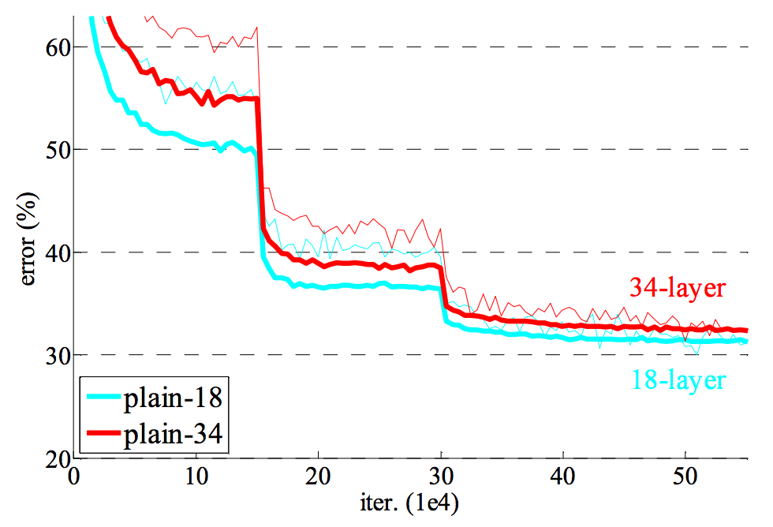
Learning rate decay
Large step size / learning rate
  Faster convergence initially
  Bouncing around at the end because of noisy gradients
Learning rate must be decreased over time
Usually done in steps

Slide 42
Convolutional network training
Initialize network
Sample minibatch of images
Forward pass to compute loss
Backpropagate loss to compute gradient
Combine gradient with momentum and weight decay
Take step according to current learning rate

Slide 43
Vagaries of optimization
Non-convex
  Local optima
  Sensitivity to initialization
Vanishing / exploding gradients
  If each term is (much) greater than 1 → explosion of gradients
  If each term is (much) less than 1 → vanishing gradients

Slide 44
Vanishing and exploding gradients

Slide 45
Sigmoids cause vanishing gradients
Gradient close to 0

Slide 46
Rectified Linear Unit (ReLU)
max (x,0)
Also called half-wave rectification (signal processing)

Slide 47
Image Classification

Slide 48
How to do machine learning
Create training / validation sets
Identify loss functions
Choose hypothesis class
Find best hypothesis by minimizing training loss

Slide 49
How to do machine learning
Multiclass classification!!
Create training / validation sets
Identify loss functions
Choose hypothesis class
Find best hypothesis by minimizing training loss

Slide 50
MNIST Classification
Method | Error rate (%)
Linear classifier over pixels | 12
Kernel SVM over HOG | 0.56
Convolutional Network | 0.8

Slide 51
ImageNet
1000 categories
~1000 instances per category
Olga Russakovsky*, Jia Deng*, Hao Su, Jonathan Krause, Sanjeev Satheesh, Sean Ma, Zhiheng Huang, Andrej Karpathy, Aditya Khosla, Michael Bernstein, Alexander C. Berg and Li Fei-Fei. (* = equal contribution) ImageNet Large Scale Visual Recognition Challenge. International Journal of Computer Vision, 2015.

Slide 52
ImageNet
Top-5 error: algorithm makes 5 predictions, true label must be in top 5
Useful for incomplete labelings

Slide 53
Convolutional Networks

Slide 54
Why ConvNets?
Why now?

Slide 55
Why do convnets work?
Claim: ConvNets have way more parameters than traditional models
  Wrong: contemporary models had same or more parameters
Claim: Deep models are more expressive than shallow models
  Wrong: 3 layer neural networks are universal function approximators
What does depth provide?
  More non-linearities: many ways of expressing non-linear functions
  More module reuse: really long switch-case vs functions
  More parameter sharing: most computation is shared amongst categories

Slide 56
Why do convnets work?
We’ve had really long pipelines before. What’s new?
End-to-end learning: all functions tuned for final loss
Follows prior trend: more learning is better.

Slide 57
Visualizing convolutional networks I

Slide 58
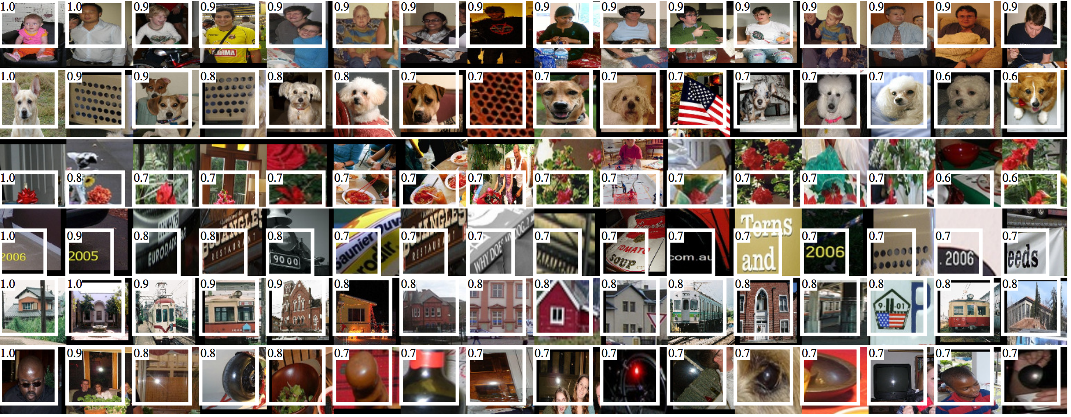
Visualizing convolutional networks I
Rich feature hierarchies for accurate object detection and semantic segmentation. R. Girshick, J. Donahue, T. Darrell, J. Malik. In CVPR, 2014.

Slide 59
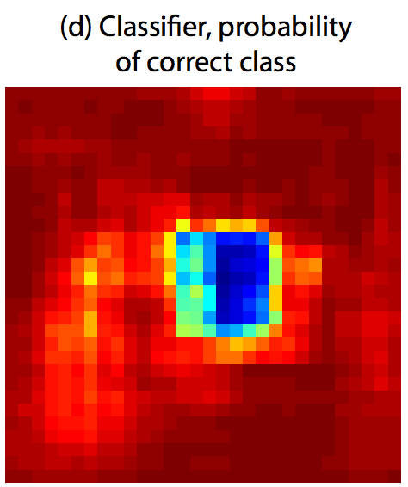
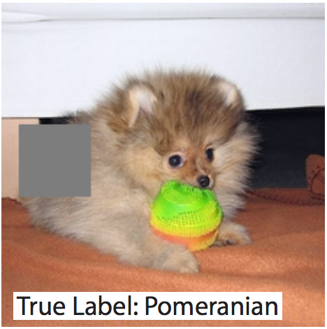
Visualizing convolutional networks II
Image pixels important for classification = pixels when blocked cause misclassification
Visualizing and Understanding Convolutional Networks. M. Zeiler and R. Fergus. In ECCV 2014.

Slide 60
Myths of convolutional networks
They have too many parameters!
  So does everything else
They are hard to understand!
  So is everything else
They are non-convex!
  So what?

Slide 61
Why did we take so long?
Convolutional networks have been around since 80’s. Why now?
Early vision problems were too simple
  Fewer categories
  Less intra-class variation
  Large differences between categories
Early vision datasets were too small
  Easy to overfit on small datasets
  Small datasets encourage less learning

Slide 62
Data, data, data! I cannot make bricks without clay!
- Sherlock Holmes

Slide 63
Transfer learning

Slide 64
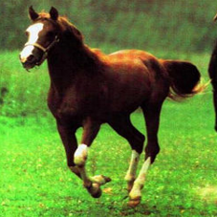
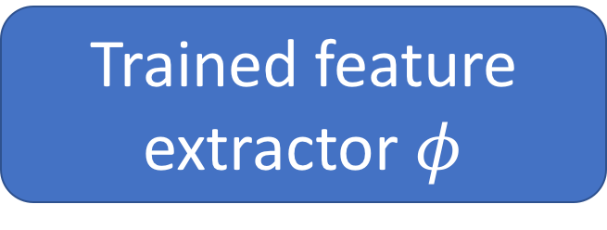
Transfer learning with convolutional networks
Horse
Trained feature extractor $φ$

Slide 65
Transfer learning with convolutional networks
Dataset | Non-Convnet Method | Non-Convnet perf | Pretrained convnet + classifier | Improvement
Caltech 101 | MKL | 84.3 | 87.7 | +3.4
VOC 2007 | SIFT+FK | 61.7 | 79.7 | +18
CUB 200 | SIFT+FK | 18.8 | 61.0 | +42.2
Aircraft | SIFT+FK | 61.0 | 45.0 | -16
Cars | SIFT+FK | 59.2 | 36.5 | -22.7

Slide 66
Why transfer learning?
Availability of training data
Computational cost
Ability to pre-compute feature vectors and use for multiple tasks
Con: NO end-to-end learning

Slide 67
Finetuning
Horse

Slide 68
Finetuning
Bakery
Initialize with pre-trained, then train with low learning rate

Slide 69
Finetuning
Dataset | Non-Convnet Method | Non-Convnet perf | Pretrained convnet + classifier | Finetuned convnet | Improvement
Caltech 101 | MKL | 84.3 | 87.7 | 88.4 | +4.1
VOC 2007 | SIFT+FK | 61.7 | 79.7 | 82.4 | +20.7
CUB 200 | SIFT+FK | 18.8 | 61.0 | 70.4 | +51.6
Aircraft | SIFT+FK | 61.0 | 45.0 | 74.1 | +13.1
Cars | SIFT+FK | 59.2 | 36.5 | 79.8 | +20.6

Slide 70
Exploring convnet architectures

Slide 71
Deeper is better
7 layers
16 layers

Slide 72
Deeper is better
Alexnet
VGG16

Slide 73
The VGG pattern
Every convolution is 3x3, padded by 1
Every convolution followed by ReLU
ConvNet is divided into “stages”
  Layers within a stage: no subsampling
  Subsampling by 2 at the end of each stage
Layers within stage have same number of channels
Every subsampling → double the number of channels

Slide 74
Challenges in training: exploding / vanishing gradients
Vanishing / exploding gradients
  If each term is (much) greater than 1 → explosion of gradients
  If each term is (much) less than 1 → vanishing gradients

Slide 75
Challenges in training: dependence on init

Slide 76
Solutions
Careful init
Batch normalization
Residual connections

Slide 77
Careful initialization
Key idea: want variance to remain approx. constant
  Variance increases in backward pass => exploding gradient
  Variance decreases in backward pass => vanishing gradient
“MSRA initialization”
  weights = Gaussian with 0 mean and variance = 2/(k*k*d)
Delving Deep into Rectifiers: Surpassing Human-Level Performance on ImageNet Classification. K. He, X. Zhang, S. Ren, J. Sun

Slide 78
Batch normalization
Key idea: normalize so that each layer output has zero mean and unit variance
  Compute mean and variance for each channel
  Aggregate over batch
  Subtract mean, divide by std
Need to reconcile train and test
  No ”batches” during test
  After training, compute means and variances on train set and store
Batch Normalization: Accelerating Deep Network Training by Reducing Internal Covariate Shift. S. Ioffe, C. Szegedy. In ICML, 2015.

Slide 79
Residual connections
In general, gradients tend to vanish
Key idea: allow gradients to flow unimpeded

Slide 80
Residual connections
In general, gradients tend to vanish
Key idea: allow gradients to flow unimpeded

Slide 81
Residual connections
Assumes all z_{i} have the same size
True within a stage
Across stages?
  Doubling of feature channels
  Subsampling
Increase channels by 1x1 convolution
Decrease spatial resolution by subsampling

Slide 82
A residual block
Instead of single layers, have residual connections over block
Conv
BN
ReLU
Conv
BN

Slide 83
Bottleneck blocks
Problem: When channels increases, 3x3 convolutions introduce many parameters
  3x3xc²
Key idea: use 1x1 to project to lower dimensionality, do convolution, then come back
  cxd + 3x3xd² + dxc

Slide 84
The ResNet pattern
Decrease resolution substantially in first layer
  Reduces memory consumption due to intermediate outputs
Divide into stages
  maintain resolution, channels in each stage
  halve resolution, double channels between stages
Divide each stage into residual blocks
At the end, compute average value of each channel to feed linear classifier

Slide 85
Putting it all together - Residual networks

