Slide 1
Non-linear classifiers and neural networks

Slide 2
How to do machine learning
Create training / validation sets
Identify loss functions
Choose hypothesis class
Find best hypothesis by minimizing training loss

Slide 3
Linear classifiers on pixels are bad

Slide 4
How to choose a hypothesis class
Training error
Generalization error
Large enough to allow low training error
  Otherwise underfitting
Small enough to avoid high generalization error
  Otherwise overfitting
Easy to optimize / learn

Slide 5
How to choose a hypothesis class
Choose more expressive functions

Slide 6
How to choose a hypothesis class
Choose more expressive functions

Slide 7
How to choose a hypothesis class
Choose more expressive functions
Put in more domain knowledge

Slide 8
Linear classifiers on pixels are bad
Better feature vectors
Non-linear classifiers

Slide 9
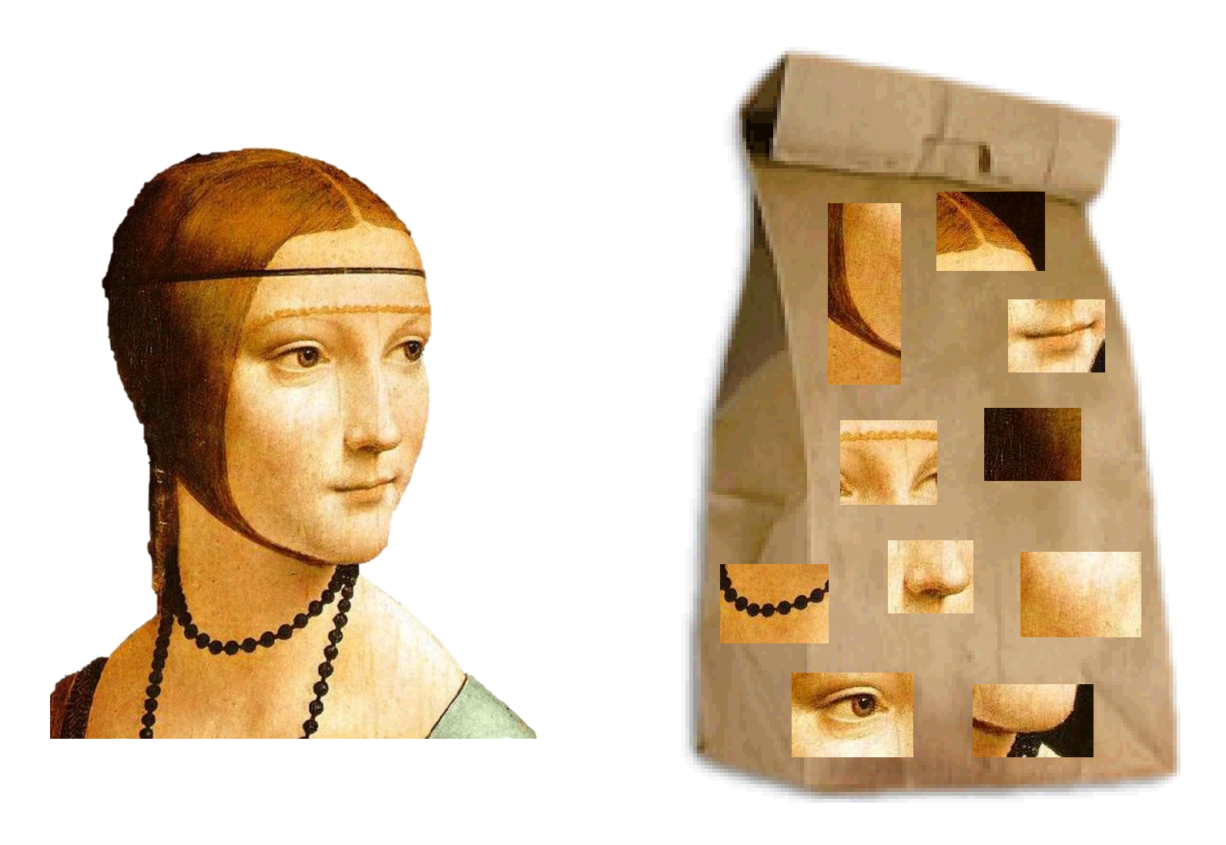
SIFT + Bag of Visual Words
Slide credit: Rob Fergus

Slide 10
Non-linear classifiers: part-based models

Slide 11
Non-linear classifiers: part-based models
sum over
parts
HOG descriptor
of patch at l_{i}
max over locations
Linear
classifier
for part i
Deformation cost
for part i

Slide 12
Non-linear classifiers: Kernel machines
Representer theorem:
Key idea: replace standard dot product by sophisticated dot product k(x_{i}, x)

Slide 13
Example kernels
RBF kernel
A. Vedaldi

Slide 14
Multilayer perceptrons
Key idea: build complex functions by composing simple functions
f(x) = Wx
g(x) = max(x,0)
f(x) = Wx
g(x) = max(x,0)
f(x) = Wx

Slide 15
Multilayer perceptrons
Key idea: build complex functions by composing simple functions
Caveat: simple functions must include non-linearities
W(U(Vx)) = (WUV)x

Slide 16
Multilayer perceptrons

Slide 17
Reducing capacity
256
65K
256

Slide 18
Reducing capacity
W
65K
65K
65K

Slide 19
Reducing capacity
W

Slide 20
Reducing capacity

Slide 21
Idea 1: local connectivity
Pixels only related to nearby pixels

Slide 22
Idea 2: Translation invariance
Pixels only related to nearby pixels

Slide 23
Local connectivity + translation invariance = convolution
5.4 | 0.1 | 3.6
1.8 | 2.3 | 4.5
1.1 | 3.4 | 7.2

Slide 24
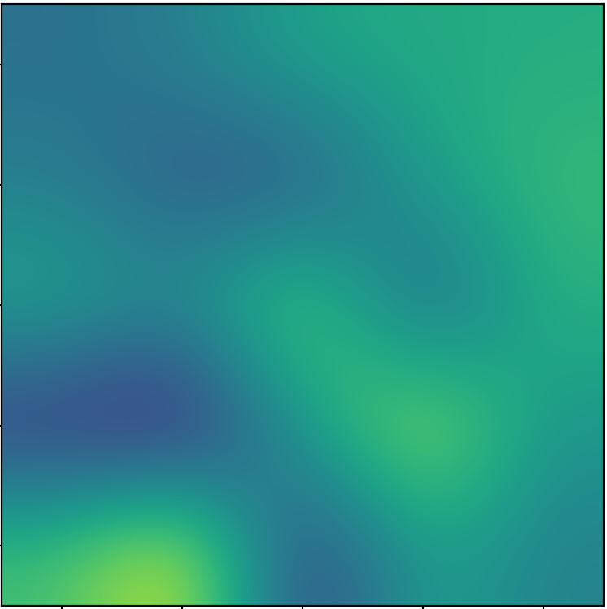
Local connectivity + translation invariance = convolution
5.4 | 0.1 | 3.6
1.8 | 2.3 | 4.5
1.1 | 3.4 | 7.2

Slide 25
Local connectivity + translation invariance = convolution
Feature map
5.4 | 0.1 | 3.6
1.8 | 2.3 | 4.5
1.1 | 3.4 | 7.2

Slide 26
Convolution as a primitive
c
c
c’
c’
Convolution
h
h
w
w

Slide 27
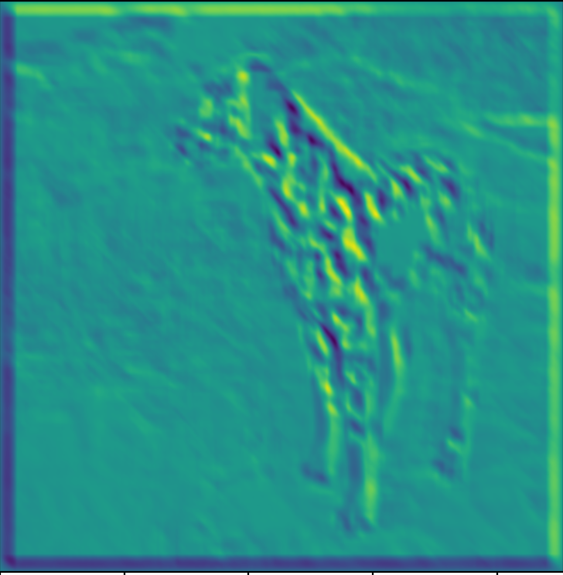

Convolution as a feature detector
score at (x,y) = dot product (filter, image patch at (x,y))
Response represents similarity between filter and image patch

Slide 28
Kernel sizes and padding
k
k

Slide 29
Kernel sizes and padding
k
k

Slide 30
Invariance to distortions

Slide 31
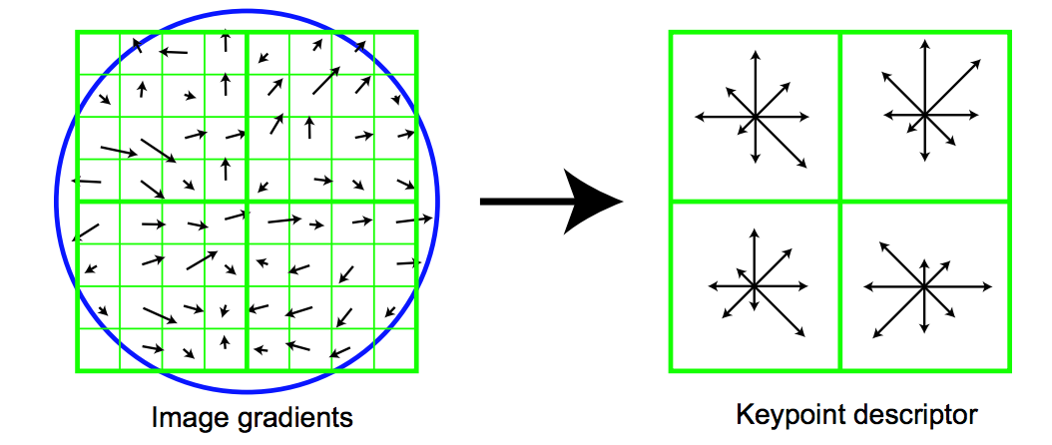
Invariance to distortions

Slide 32
Invariance to distortions

Slide 33
Invariance to distortions: Pooling
…

Slide 34
Invariance to distortions: Subsampling

Slide 35
Convolution subsampling convolution

Slide 36
Convolution subsampling convolution
Convolution in earlier steps detects more local patterns less resilient to distortion
Convolution in later steps detects more global patterns more resilient to distortion
Subsampling allows capture of larger, more invariant patterns

Slide 37
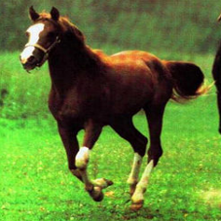
Convolutional networks
Horse

Slide 38
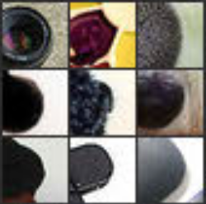
From Classifiers to Segmenters
Horse
Visualizations from : M. Zeiler and R. Fergus. Visualizing and Understanding Convolutional Networks. In ECCV 2014.
Notes:
In contrast, if you look at the earlier layers, this particular unit here really likes a dark blob at a very precise location and scale in its field of view. If this unit fired, you will know exactly where the dark blob was. Unfortunately, this unit doesn’t care about the actual semantics of the dark blob: you will have no idea what the dark blob actually is.

Slide 39
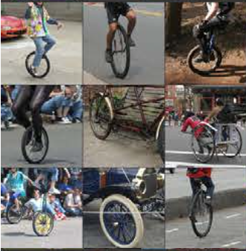
From Classifiers to Segmenters
Horse
Visualizations from : M. Zeiler and R. Fergus. Visualizing and Understanding Convolutional Networks. In ECCV 2014.
Notes:
If you look at what one of these higher layers is detecting, here I am showing the input image patches that are highly scored by one of the units. This particular layer really likes bicycle wheels, so if this unit fires, you know that there is a bicycle wheel in the image. Unfortunately, you don’t know where the bicycle wheel is, because this unit doesn’t care where the bicycle wheel appears, or at what orientation or what scale.

Slide 40
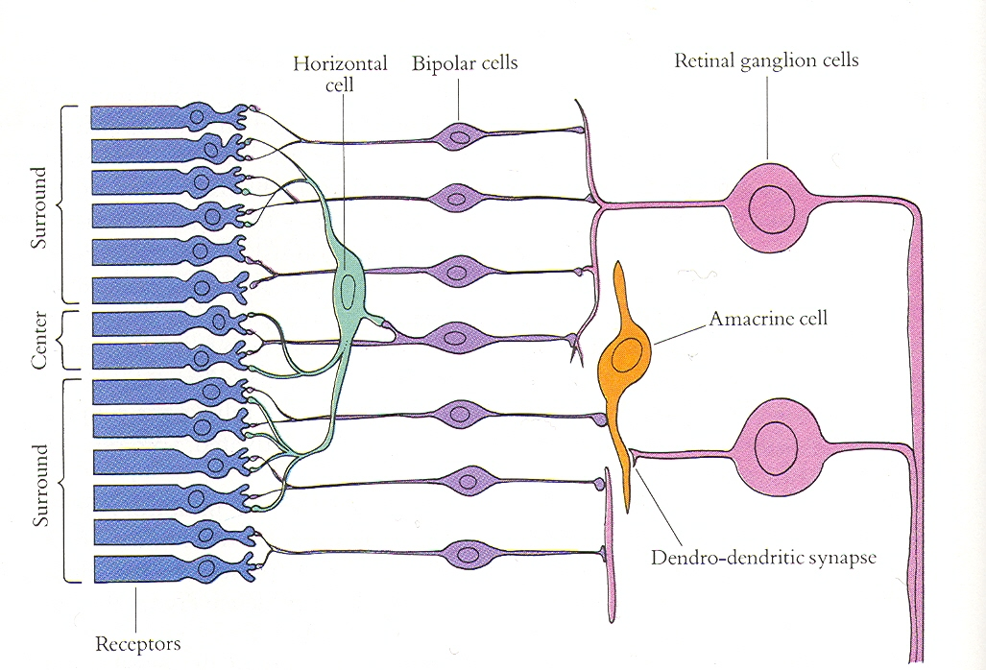
Convolutional Networks and the Brain
Slide credit: Jitendra Malik

Slide 41
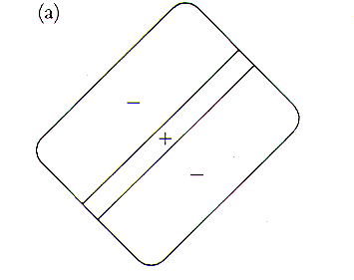
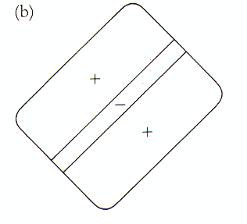
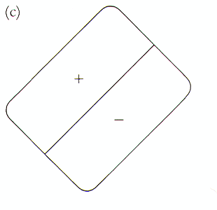
Receptive fields of simple cells
(discovered by Hubel & Wiesel)

Slide 42
Convolutional networks
Yann LeCun, Léon Bottou, Yoshua Bengio, and Patrick Haffner. Gradient-based learning applied to document recognition. Proceedings of the IEEE 86.11 (1998): 2278-2324.

Slide 43
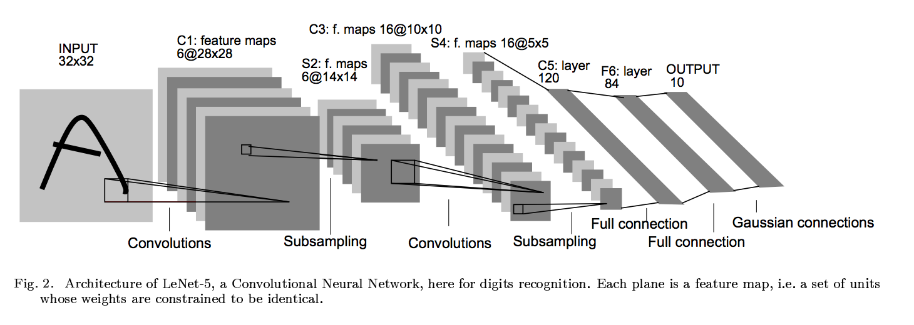
Convolutional networks

Slide 44
Convolutional networks
conv
subsample
conv
subsample
linear
filters
filters
weights

Slide 45
Training

Slide 46
Empirical Risk Minimization
Convolutional network

Slide 47
Computing the gradient of the loss

Slide 48
Convolutional networks
conv
subsample
conv
subsample
linear
filters
filters
weights

Slide 49
The gradient of convnets
z₁
z₂
z₃
z₄
z₅ = z
f₁
f₂
f₃
f₄
f₅
x
w₁
w₂
w₃
w₄
w₅

Slide 50
The gradient of convnets
z₁
z₂
z₃
z₄
z₅ = z
f₁
f₂
f₃
f₄
f₅
x
w₁
w₂
w₃
w₄
w₅

Slide 51
The gradient of convnets
z₁
z₂
z₃
z₄
z₅ = z
f₁
f₂
f₃
f₄
f₅
x
w₁
w₂
w₃
w₄
w₅

Slide 52
The gradient of convnets
z₁
z₂
z₃
z₄
z₅ = z
f₁
f₂
f₃
f₄
f₅
x
w₁
w₂
w₃
w₄
w₅

Slide 53
The gradient of convnets
z₁
z₂
z₃
z₄
z₅ = z
f₁
f₂
f₃
f₄
f₅
x
w₁
w₂
w₃
w₄
w₅

Slide 54
The gradient of convnets
z₁
z₂
z₃
z₄
z₅ = z
f₁
f₂
f₃
f₄
f₅
x
w₁
w₂
w₃
w₄
w₅

Slide 55
The gradient of convnets
z₁
z₂
z₃
z₄
z₅ = z
f₁
f₂
f₃
f₄
f₅
x
w₁
w₂
w₃
w₄
w₅

Slide 56
The gradient of convnets
z₁
z₂
z₃
z₄
z₅ = z
f₁
f₂
f₃
f₄
f₅
x
w₁
w₂
w₃
w₄
w₅

Slide 57
The gradient of convnets
z₁
z₂
z₃
z₄
z₅ = z
f₁
f₂
f₃
f₄
f₅
x
w₁
w₂
w₃
w₄
w₅

Slide 58
The gradient of convnets
z₁
z₂
z₃
z₄
z₅ = z
f₁
f₂
f₃
f₄
f₅
x
w₁
w₂
w₃
w₄
w₅

Slide 59
The gradient of convnets
z₁
z₂
z₃
z₄
z₅ = z
f₁
f₂
f₃
f₄
f₅
x
w₁
w₂
w₃
w₄
w₅

Slide 60
The gradient of convnets
z₁
z₂
z₃
z₄
z₅ = z
f₁
f₂
f₃
f₄
f₅
x
w₁
w₂
w₃
w₄
w₅

Slide 61
The gradient of convnets
z₁
z₂
z₃
z₄
z₅ = z
f₁
f₂
f₃
f₄
f₅
x
w₁
w₂
w₃
w₄
w₅
Recurrence going backward!!

Slide 62
Chain rule for vectors
Jacobian

Slide 63
Backpropagation for a sequence of functions

Slide 64
Backpropagation for a sequence of functions
Assume we can compute partial derivatives of each function
Use g_{i} to store gradient of z w.r.t z_{i}
Calculate g_{i} by iterating backwards
Use gi to compute gradient of parameters

Slide 65
Backpropagation for a sequence of functions
Each “function” has a “forward” and “backward” module
Forward module for f_{i}
  takes z_{i-1} and weight w_{i} as input
  produces z_{i} as output
Backward module for f_{i}
  takes g_{i} as input
  produces g_{i-1} and as output

Slide 66
Backpropagation for a sequence of functions
z_{i-1}
f_{i}
z_{i}
w_{i}

Slide 67
Backpropagation for a sequence of functions
g_{i-1}
f_{i}
g_{i}

Slide 68
Beyond sequences
a
f_{i}
b
d
c

Slide 69
Beyond sequences
f_{i}

Slide 70
Beyond sequences
a
f_{i}
b
d
c

Slide 71
Beyond sequences
f_{i}

Slide 72
Computation graphs
u
g
k
x
f
l
z
y
h
w

Slide 73




Neural network frameworks

