Slide 1
ZooKeeper
Wait-free coordination for Internet-scale systems

Slide 2
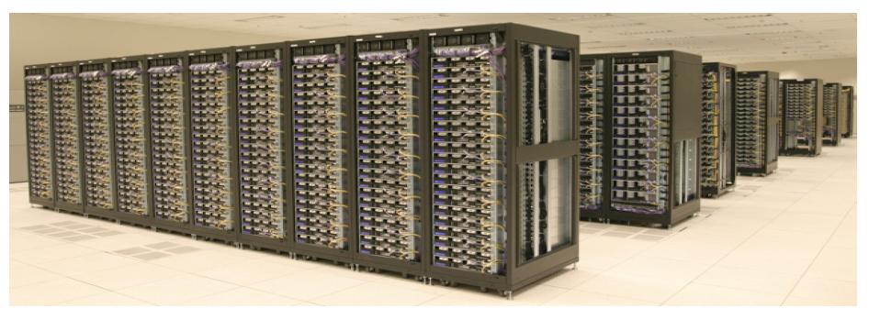
ZooKeeper
Aims to provide a simple and high performance kernel for building more complex client
Wait free
FIFO
No lock
Pipeline architecture

Slide 3
What is coordination?
Group membership
Leader election
Dynamic Configuration
Status monitoring
Queuing
Critical sections

Slide 4
Contributions
Coordination kernel
Wait-free coordination
Coordination recipes
Build higher primitives
Experience with Coordination
Some application use ZooKeeper

Slide 5
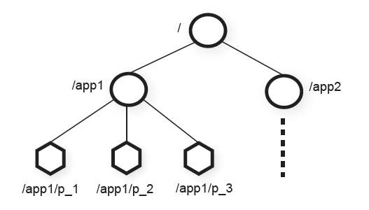
Zookeeper Service
Znode
In-memory data node in the Zookeeper data
Have a hierarchical namespace
UNIX like notation for path
Types of Znode
Regular
Ephemeral
Flags of Znode
Sequential flag

Slide 6
Zookeeper Service
Watch Mechanism
Get notification
One time triggers
Other properties of Znode
Znode doesn’t not design for data storage, instead it store meta-data or configuration
Can store information like timestamp version
Session
A connection to server from client is a session
Timeout mechanism

Slide 7
Client API
Create(path, data, flags)
Delete(path, version)
Exist(path, watch)
getData(path, watch)
setData(path, data, version)
getChildren(path, watch)
Sync(path)
Two version synchronous and asynchronous

Slide 8
Guarantees
Linearizable writes
All requests that update the state of ZooKeeper are serializable and respect precedence
FIFO client order
All requests are in order that they were sent by client.

Slide 9
Examples of primitives
Configuration Management
For dynamic configuration propose
Simplest way is to make up a znode c for saving configuration.
Other processes set the watch flag on c
The notification just indicate there is a update without telling how many time updates occurs

Slide 10
Examples of primitives
Rendezvous
Configuration of the system may not be sure at the begining
Create a znode r for this problem
When master start he fill the configuration in r
Workers watch node r
Set to ephemeral node

Slide 11
Examples of primitives
Group Membership
Create a znode g
Each process create a znode under g in ephemeral mode
Watch g for group information

Slide 12
Examples of primitives
Simple Lock
Create a znode l for locking
If one gets to create l he gets the lock
Others who fail to create watch l
Problems: herd effect

Slide 13
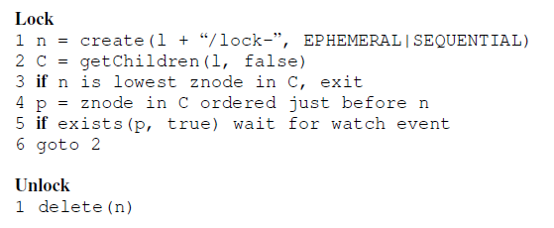
Examples of primitives
Simple Lock without herd effect

Slide 14
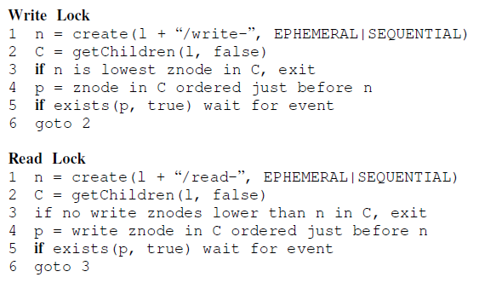
Examples of primitives
Read/Write Lock

Slide 15
Examples of primitives
Double Barrier
To synchronize the beginning and the end of compuation
Create a znode b, and every process needs to register on it, by adding a znode under b
Set a threshold that start the process

Slide 16
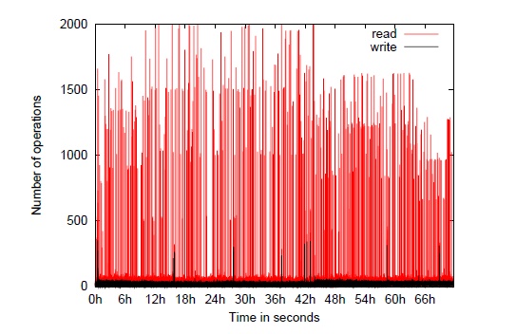
Application
Fetching Service
Using ZooKeeper for recovering from failure of masters
Configuration metadata and leader election

Slide 17
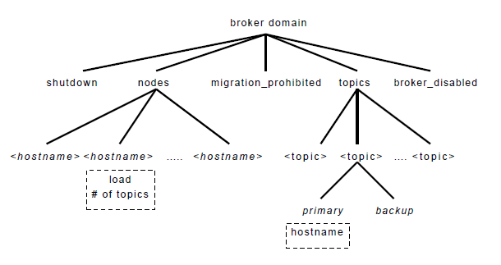
Application
Yahoo Message Broker
A distributed publish-subscribe system

