Slide 1
Data Centers, Disks &
Power Consumption
Guy Hugot-Derville

Slide 2
Motivation
Annual Data Center Electricity Costs worldwide = $7.2B (2005)
25M tons CO2 /yr in US
Data growth rate 50.6% /yr⁴

Slide 3
Solution?
Mode⁶ | Disk Rotation | Head Movement | R/W interface | Power (W)
Active | On | On | On | 12.8
Idle | On | Off | On | 7.5
Standby | Off | Off | On | 1.5
Sleep | Off | Off | Off | < 1
Whenever disks are idle, spin them down?
5-10s

Slide 4
Other Solutions?
Use multiple rotational speed disks
  IBM Ultrastar 36Z15
  At 3,000RPM: 6.1W
  At 15,000RPM: 13.5W
Do we save power?
  Remember: Energy = Power X Time
  We want to minimize Energy
  Works for a 20% workload
  We need to predict the workload!

Slide 5
Plan
Introduction
Predicting the writes
  Hibernator
Directing the writes
  LFS-based solution
  Write Off-Loading
Evaluation
Conclusion

Slide 6
Hibernator
Formalization
  Constraints
  Poisson Distribution
  How do we get E_{ij}?
  How do we get R_{ij}?
Adaptative Layout
  Small Scale Reorganization
  Large Scale Reorganization

Slide 7
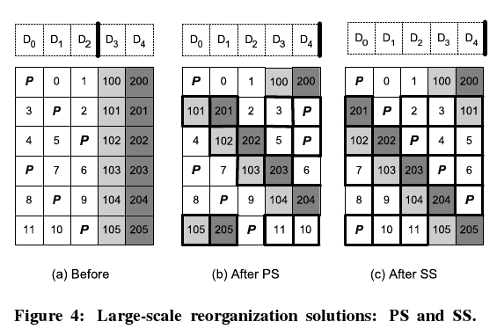
Large Scale Reorganization 1
Lighter = smaller = hotter
Permutational Shuffing
  Newly added disks to old ones
  Few relocated blocks
  Load uneven
Sorting Shuffing
  Blocks first sorted
  Rotational shuffing
  Big overhead
  Load even

Slide 8
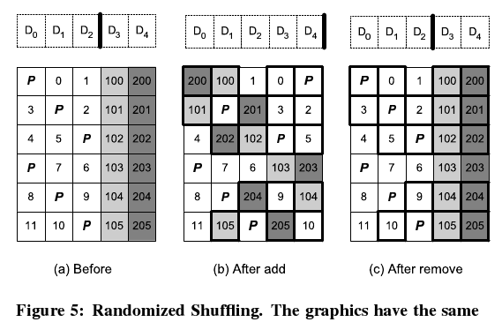
Large Scale Reorganization 1
Randomized Shuffing
  Fixes both problem
  2m migrated blocks for m stripes as in PS
  Load even because random

Slide 9
Small Scale Reorganization
Avoiding Hot Spots
Data into fixed-size relocation blocks (RB)
Temperature of each RB is maintained
RB are moved down or up a tier depending on their relative temperature

Slide 10
Setting the speed of disks
Disk speed is adapted
  We know the previous disk utilization
  We predict the future disk utilization
Coarse-grain Response (CR)
  Avoid frequent spin up and down
  T_{epoch}: fixed time during which speed is constant
Trade-off
  Responsive
  MTTL and power cost amortization of changing speed

Slide 11

Constraints
Energy
  The less energy we spend, the better
  Total energy is the sum of all the disk energy
Response time
  Mean response time inferior to a given limit: R_{limit}
  Average weighted by the number of request number on each disks

Slide 12
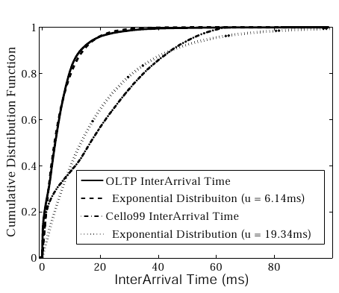
Notations
Poisson distribution
t_{ij} service time
Exp(t_{ij}): average
Var(t_{ij}): variance
α_{i}: request arrival rate
ρ_{ij} = α_{i}Exp(t_{ij}): disk utilization

Slide 13
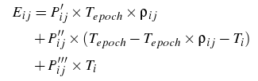
How do we get E_{ij}?
Three terms
  Remember: Energy = Power * Time
  Active: servicing requests
  Idle: no requests
  Transition between two speeds

Slide 14



How do we get R_{ij}?
Two terms:
  Disks are spinning up:
  long delays
  Normal usage:
  short delays
We do the weighted average of both terms

Slide 15
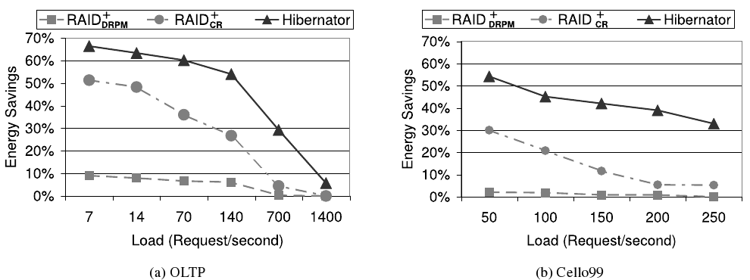
Power Consumption – Hibernator 1

Slide 16
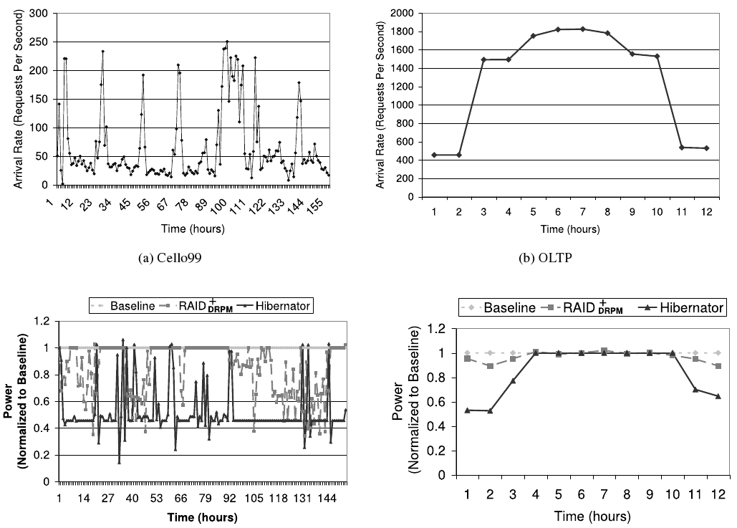
Power Consumption – Hibernator 2

Slide 17

Log-structured File System
  We don’t predict write accesses, we know
$$ CACHE
Log Head
Log Head
Log Head
Log Head
Log Head

Slide 18
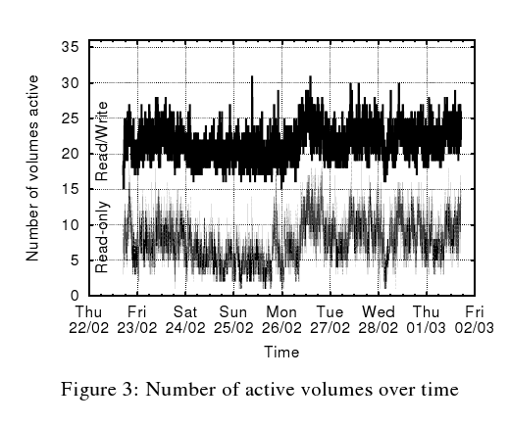
We predict writes but not reads
Writes:
  Heavy load
  BUT one disk
Reads:
  ALL disks
  BUT cache => soft load
10% of disks need to be up

Slide 19
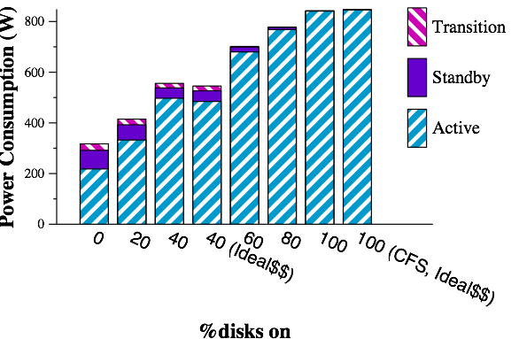
Power Consumption

Slide 20
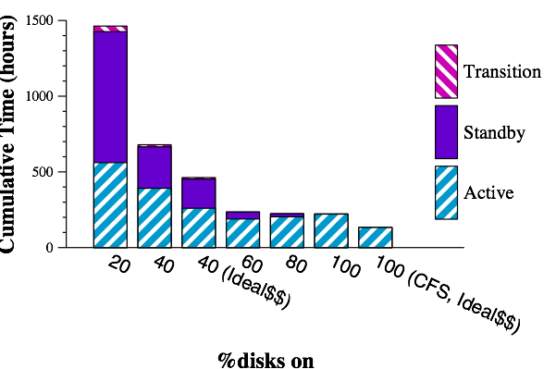
Time of run

Slide 21
Write Off-Loading
Idea:
  Split the log across all the disks
  Better write performances
Design
  Loggers
    Temporarily stores blocks on behalf of other disks
    On each disks
  Managers
    Intercept all Read/Write requests
    Control Off-loading of blocks
    Consistency & Failure recovery
Consistency & Failures

Slide 22
Design - Loggers
Four operations
  Write: data + meta-data (LogicalBlockNr + version)
  Read: latest stored version
  Invalidate: mark a version as invalid, garbage collected
  Reclaim: like read, for any block
Invalidate and Reclaim: background process
  Not latency critical
Write and Read : latency critical
  Reads are rare
  Optimized for writes: log

Slide 23
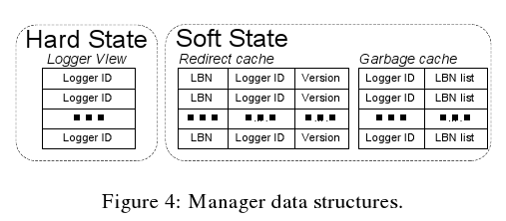
Managers
Hard/Soft State
Reads
  Check Red Cache for latest version
  Fallback: home
Write
  Choose best logger
  When write acknowledged: invalidate older versions
  Writes are reclaimed in idle mode

Slide 24
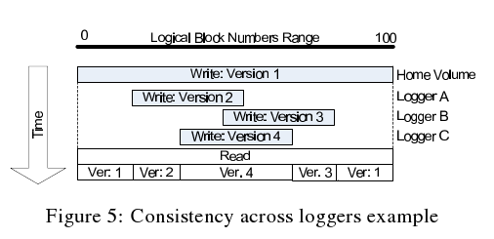
Consistency & Failures
Consistency
  Always knows where the last block is
Failures
  Loggers: reconstruct soft state from the log
  Managers: reconstruct soft state from Logger View and Loggers

Slide 25
Evaluation

Slide 26
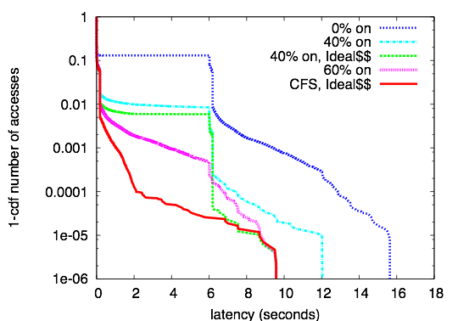
Performance - LFS-based Solution
y: log-scale
Long-tail distribution
Cache miss => disks spin up
99.9% accesses take <= 3.7s

Slide 27
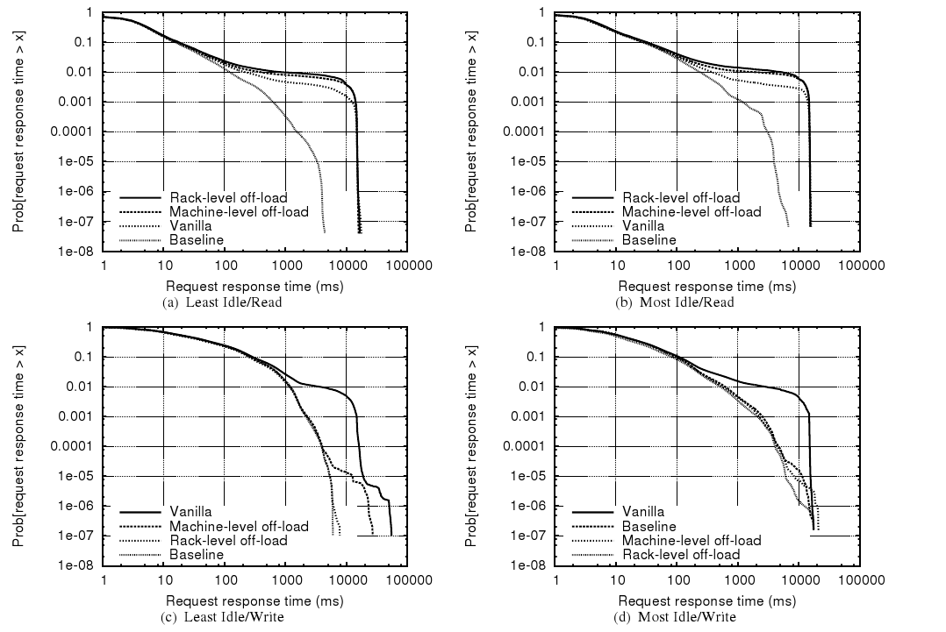
Performance – Write Off-Loading 1
Same graph
Left/right = Least/most idle
Top/Bot = Read/Write
Read:Cache Miss
Write:Cache Overflow

Slide 28
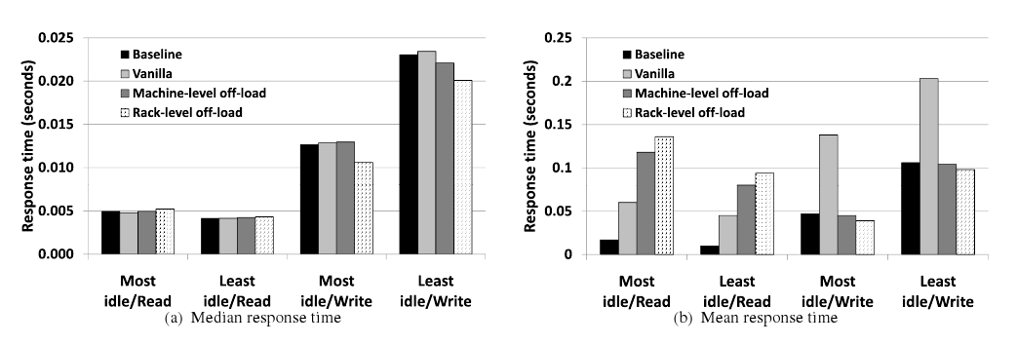
Performance – Write Off-Loading 2
Median Response Time
Mean Response Time

Slide 29
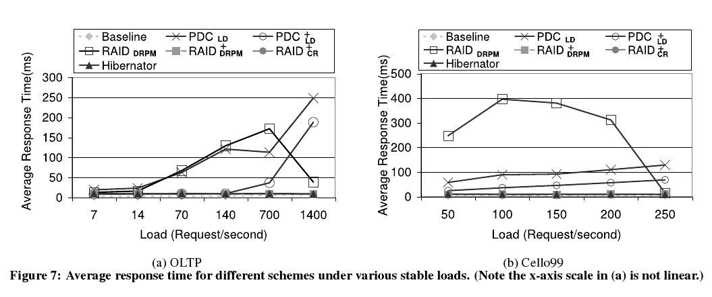
Performance – Hibernator 1
Focus set on MEAN response time

Slide 30
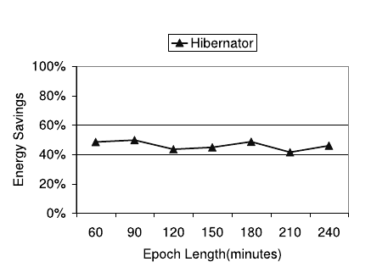
Performance – Hibernator 2
Do we still have a long tail distribution?
Yes: speed transitions need to restart disks
It can be good: 15s/(240*60s) = 10^-3
It can be catastrophic

Slide 31
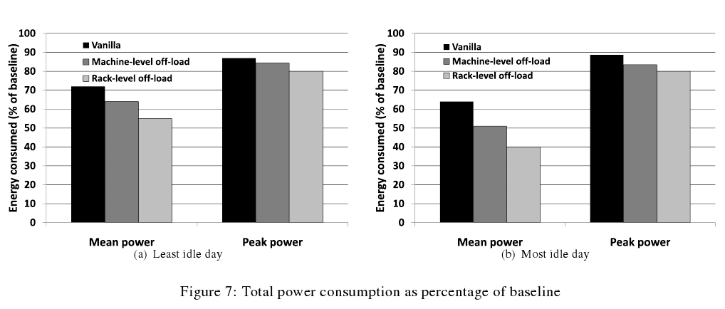
Power Consumption –
Write Off-Loading

Slide 32
Conclusion
Substantial power saving can be achieved
Two solutions
  Predict the writes
  Direct the writes
A trade-off has to be considered:
  What performance impact can I accept,
  For what power gain?

