Slide 1
Cimbiosys: A platform for content-based partial replication
Venugopalan
Thomas L, Douglas,Meg Walraed-Sullivan, Ted Wobber, Catherine C. Marshall, Amin Vahdat
Presented by Darshan N

Slide 2
Requirement
People use more than one device to store data
Portable devices have limit on storage and bandwidth.
Should be able to define its own content-based filtering criteria.
Automatically share updates with any new other device encountered.

Slide 3
Typical situations
Alice iPhones gets synchronize with Bob phone only on selected contents (daughters photos).
Bob watch movies on his i-pod
  Syncs his player wit Youtube, The Daily show
  Electronic bill board, advertising new TV show
  Grab commercial content from trusted sources.
  Bob subscribes to new show.
  deleting eventually propagated to home media center
Notes:
Alice photo sharing
Tags photos * 1-5
Master collection home PC
update 5* ones in photo frame, photojournal, facebook etc.
extra effort to are store with other photos on her laptop,
BOB video on ipod
Night sync YouTube, The Daily Show, Colbert Report
electronic billboard advertising a new TV show, copied a trailer
shared with other fellow commuters.
Deleted it later and at home got sync media center
Typical Requirements for a modern storage platform:
Inter-device communication may be ad hoc, device proximity, availability of particular content.
changing set of people and devices
Not all device-based stores have complete collections
Updates may originate from multiple sites and be
contributed by different people.

Slide 4
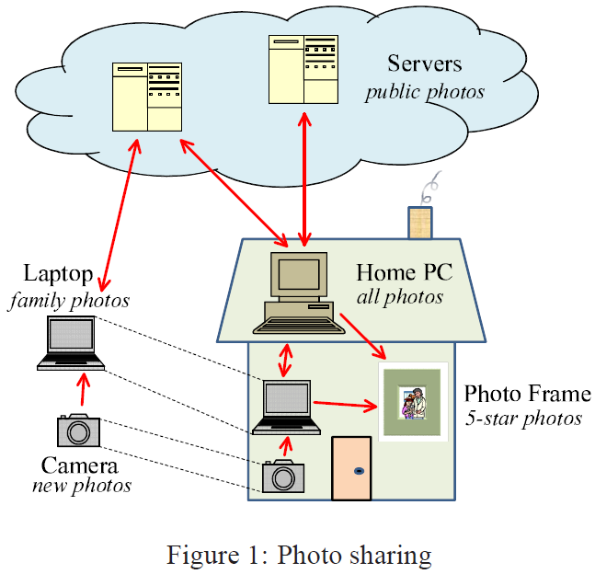

Slide 5
Challenges for such a activity
Manage data across their own devices.
Delivering relevant information to changing set of people and devices
Requires synchronization through personalized content filtering.
Updates originate from multiple sites and contributed by different people.
Inter-device communication may be ad hoc, device proximity, availability of particular content.
Not all device stores have complete collections

Slide 6
Goals
It is essential to take advantage of proximity and selected replication of content.
Device represents its metadata in a compact form
State proportional to the number of devices and not total number of items.
Frequent and low BW sync.
Items latest version meets arbitrary filter criteria are stored.
independent of any hierarchical namespace.

Slide 7
Outline of the topics
Cimbiosys Platform and its feature
Software components
Implementation
CIM Sync protocol
  Knowledge
  Move-out notifications
  Out-of-filter updates
  Changing filter
  Compaction
Tree Topologies to guarantee synchronization
Evaluation: Simulation and Experiment results
Limitations of the paper

Slide 8
Cimbiosys Platform
Def: Cimbiosys, an application platform that supports content-based partial replication and synchronization with arbitrary peers, to manage home media and shared data (Replication system), such as calendars, videos etc.
  Eventual knowledge singularity:
  replicas exchange compact metadata , efficient use of BW and resources,
  Synchronizing , detect overlapping interests, identify missing versions.
  Knowledge converges to a size,
  Eventual filter consistency :
  over time
  all items meeting “content-based filtering”

Slide 9
Problems with exisiting solutions
such as,
  Ficus, per-item version vectors
  PRACTI and Bayou, has lesser overhead but, Exchange of operation logs, storage use grow proportion to update rate.
They are, non optimized BW utilization since, proportional to the collection size or dependent on the update rate, as collection size grows (frequent update)
Notes:
Ad hoc
each node is willing to send data to other nodes
forwarding data is made dynamically based on the network connectivity.
Individual items match different filtering criteria as the items are updated, device may vary its criteria over time, causing items with stable contents to enter and leave the device’s interest set.
brief intervals of connectivity with peer devices effectively.

Slide 10
Features and components
Provides distributed, peer-to-peer architecture each node is called Device.
Device Stores full or partial copies of one or more data collections.
Items = XML object + associated file (optional)
XML object, eg: photo, created, resolution, quality rating , keyword.
Replica, copy of some or all items in a given collection
Filter, set of item is specified by…
The default “*” filter indicates, device interested in all items, and hence stores a full replica of the collection.
Notes:
Collections are : Eg photo album, compilation of videos from different people, companies CR database
Each collection is managed separately and consists of a set of items that are not shared with other collections.
Replica: copy of some or all of the items in a given collection
Filter: Specifies the set of items included in device’s replica, for Eg : files tagged, photos starred.

Slide 11
Cont…
Device-to-device Synchronization protocol, used to send updated items to other replicas.
Devices generally have regular partners or any replica they encounter.
Device join system by creating empty replica.
Sync protocol to ensure eventual filter consistency.

Slide 12
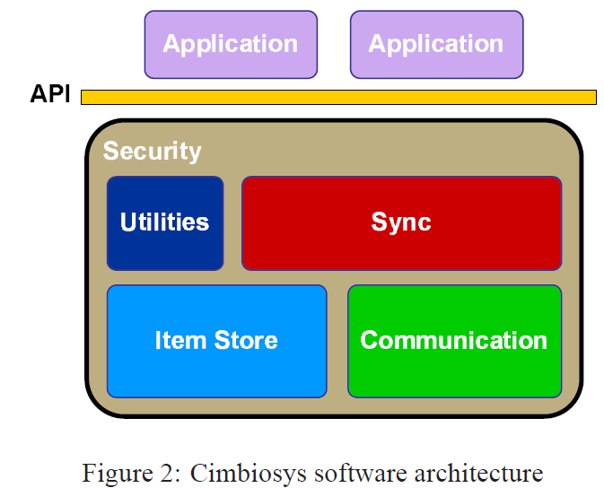
Software components

Slide 13
Cont..
Item Store manages items for local replicas of one or more collections & per item (id, ver-id,xml+file content and information)
Communication: Both devices agree on network and protocol
  Network Ethernet, WiFi, cellular, or Bluetooth.
  Transport protocols such as SOAP-based RPC, HTTP etc,
Sync: implements synchronization protocol
Utilities: recording synchronization partners, naming collections and devices, managing access controls
Security: items are digitally signed by the originating device and collection-specific Policies dictate as in which devices can create/update/delete items in a collection
API’s are mean by which application talk to Cimbiosys platform for operation on items/ collections/ local replica , initiate sync etc ..

Slide 14
Implementation
Two different environments
C# using Microsoft’s .NET and Mace which is a C++ language extension that supports distributed systems development.
Applications
  Cimetric, collaborative authoring tool writing a paper and
  CimBib is designed as a bibliographic database and personal digital library for people to share references local and remote copies of published papers,

Slide 15
CIM Sync protocol
Metadata
sync protocol relies on a variety of per-item and per-replica metadata.
unique identifier for collection and every item
Each version of an item has unique identifier called version-id
When item is created, updated, or deleted a new version-id <replica’s id, counter of updates>
Deleted items marked & referred as tombstones.

Slide 16
The Knowledge is just set of version-ids and consists of identifiers for any versions that
(a) match the replica’s filter and are stored in its item store,
(b) are known to be obsolete, or
(c) are known to not match the replica’s filter
Knowledge has one or more fragments ( version vector and an associated explicit set of item ids)
if a replica holds a " knowledge fragment S:V " then the replica knows all versions of items in the set S whose version-ids included version vector V .

Slide 17
CIM Sync: Protocol
one-way, pull-style synchronization protocol.
target replica → source replica, through SyncRequest message, includes target’s knowledge & its filter
source replica checks - item store for items, whose version-ids unknown to target replica & whose XML contents match the target’s filter
Source responds XML contents, file contents & metadata for each of these items and SyncComplete message.
All messages received by target result in updates is applied to item store.

Slide 18
Example
Synchronization of photo frame ‘B’ and laptop ‘C’
State of devices, metadata and item store before synchronization.
more recent version of r and a new item s
updated k to reduce its rating

Slide 19
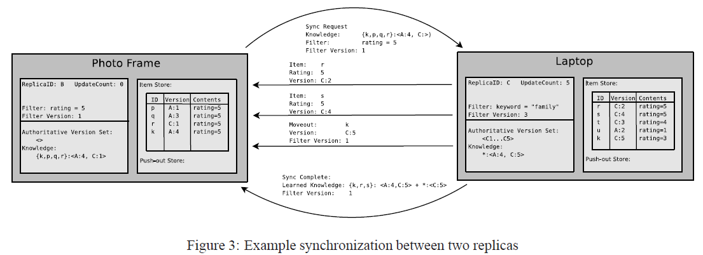
Knowledge of B
No updates since version , C:1
More recent version
New item to be added
Reduce rating of k (Moveout)

Slide 20
Knowledge
If source replica’s filter no more restrictive than target’s filter, i.e item that matches target’s filter also matches source’s filter, SyncComplete message.
target has broader /incomparable filter
  Example family and 5*, send only partial knowledge

Slide 21
Move-out notifications
Source replica tells, causing the target to remove specified items from its item store(later version available).
Move-out notifications during sync.. Will move it out of its item store Eg: for k
C1: partial replica currently stored items have later versions that no longer match its filter
C2: Source has item what target does not have hence move out. To avoid this target tells set of items it stores initially.

Slide 22
Cont…
Pro: Move-out notifications based on previous filter that no longer applies,(Since target can change its filter anytime)
Sol: Target Replica increments counter when ever it updates filter & ignore that move-out from source .

Slide 23
Out-of-filter updates
Operations that produce new versions of items that do not match the local replica’s filter are called out-of-filter updates.
Eg: Filter is unread Email and should delete after reading.
Cannot be discarded immediately
Items are moved to Special portion, push-out store, in visible to applications
Hot potato problem !! Send to target (whose filter matches) and delete, but target send it back and delete.

Slide 24
Changing filter
Case1:Cannot directly remove items of the old filter if it does not match its new filter. Because it may be the only replica making the latest version of such a item.
Hence push-out store and then eventually deleted.
Case2: During sync as a source replica. maintain soft-state mapping their partners filter versions to the actual filter queries.
If soft-state discarded, then special error, causing target to resend its full filter as a new sync request.

Slide 25
Knowledge and compaction **
Replicas items version-ids to their knowledge but not obsolete or deleted items.
As data exchanged, Knowledge fragments keeps growing, hence compaction.
  S1 is a subset of set S2 and the version vector V2 dominates V1 (any V1 is also present inV2)
  S1 and S2 can be combined into a single knowledge fragment
Cannot be done always
  keyword k, s , t and C:1 become C :2, C:3,C:4
  which are all C filter different and will not be updated
Notes:
A replica is authoritative for a version of an item if it either stores the item or knows the item to be obsolete.
Solution is having at least one replica that is authoritative for every version ever generated.

Slide 26
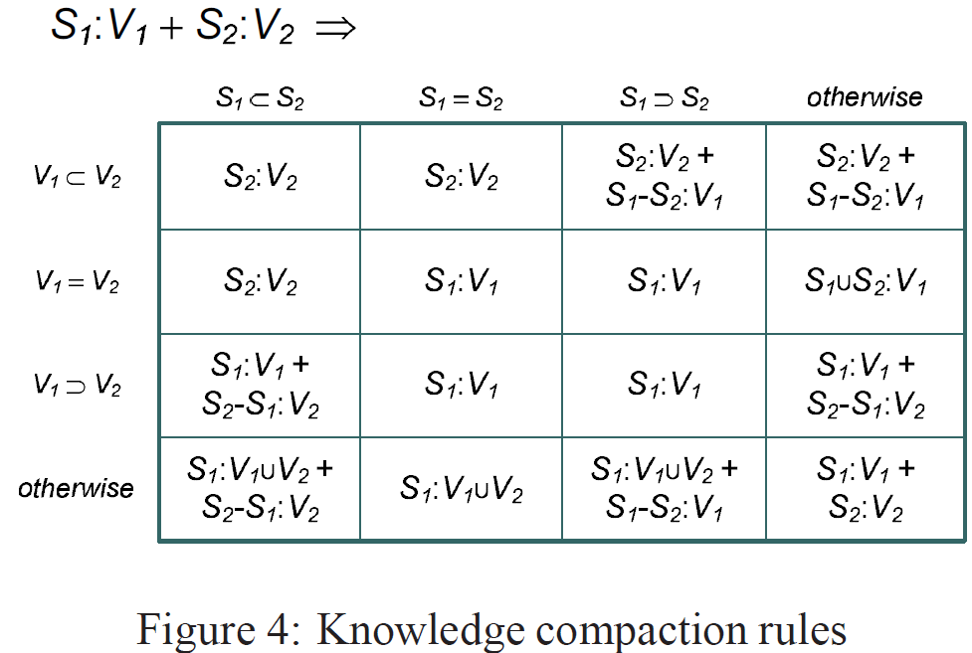
Compaction rules for any pair of knowledge fragments

Slide 27
Tree Topologies to guarantee synchronization
Forces replica, replicas of a given collection to configure themselves into a hierarchically filtered tree topology.
Synchronization topology, is to achieve desired system properties, eventual knowledge singularity.
Root /Reference replica * filter
Creating New replica at least root will be because its * least restrictive.
Retire graceful from a collection, should notify its children so they can select a new parent
Immediate parent or one of the child become parents for other siblings
Replica can changing the parent: but suitable filter

Slide 28
Benefits of TST
Well-connected and groups of replicas for the same collection cannot be disconnected indefinitely, hence eventual convergence.
Each version of an item has a guaranteed path, Eg: new version created flows up the tree from child to parent replicas until it reaches common ancestors.
Move-out notifications can be delivered by a parent to any of its children, source replica no more restrictive than the target.
Push-out store flow up tree, until they reach replicas interested with the item.
  The tree topology prevents replicas from playing “hot potato” with out-of-filter versions.
Ensures eventual knowledge singularity: As authoritative versions are passed up the tree, a parent replica assumes authority for any versions generated by any of its children or descendants.
  all authoritative versions arrive at the reference replica, which then produces a single star-knowledge
Notes:
******
In Cimbiosys, a replica can choose arbitrary synchronization partners (in addition to its parent and children). The only restriction is that the overall synchronization topology must include an embedded tree with a reference replica.
The digital camera, which only synchronizes with the laptop, uses the laptop as its parent replica.

Slide 29
Simulation
Three serial phases: with 10 replicas (3 level hierarchy)
1000 inserts of new items at randomly chosen replicas,
400 syncs between randomly chosen sync partners
Another 400 random syncs interleaved with 1000 updates to random items.
PIVV : maintains individual version vector for each item that matches replicas filter and sends entire knowledge during syncs and receives only those VV pertaining to items in its filter
CIM-PIVV modified CIM, discards whenever the star knowledge subsumes them.

Slide 30
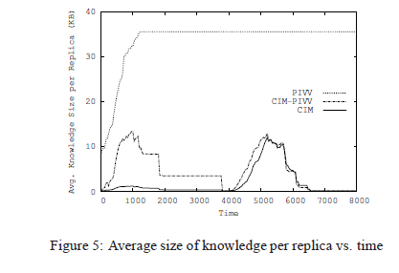
CIM and CIM-PIVV, knowledge is fragmented in initial stages
Significant savings initially whereas savings is marginal synchronizing the updates in the third phase.
The key reason for this behavior is initial inserts were performed in batches, providing opportunities for CIM to compact knowledge into item sets.
Notes:
PIVV, maintains individual version vectors per item that matches a replica’s filter, sends this entire knowledge during syncs, and receives in return version vectors pertaining only to items in its filter.
CIM-PIVV maintains per/item version vectors but uses the notion of star knowledge accumulated through the hierarchy to converge to a single knowledge fragment.

Slide 31
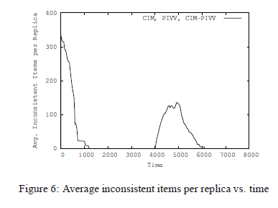
All three simulated solutions for partial replication eventually converge (at the same rate)
Figures 5 and 6 indicates that the system could achieve filter consistency much earlier than knowledge singularity. (as it is across the whole system till ‘*’)

Slide 32
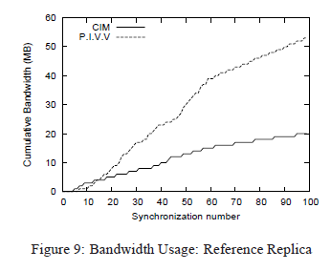
Experimental Evaluation of Mace implementation
Bandwidth is measured as the sum of all data as it is queued into the transport layer.
String of 6 character as data content shouldn't contribute significantly to bandwidth used.
Notes:
• Are the knowledge storage requirements for CIM Sync significantly smaller than those for per-item version vector protocols?
• Does the bandwidth usage of CIM Sync leverage the reduction in knowledge size?
• What are the benefits of requiring a filter hierarchy?
• How does the incorporation of non-hierarchical synchronizations affect the knowledge size, bandwidth usage, and time to convergence?

Slide 33
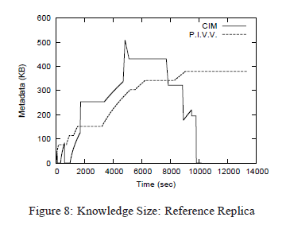
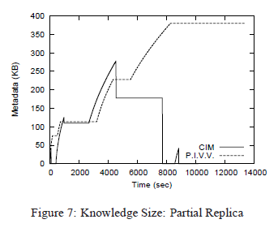
CIM: Spikes demonstrate the significance of the knowledge compaction process. at the completion of the synchronization, the target compacts its knowledge
PIVV: requires version vector be stored per item, knowledge stored for this representation remains on the order of the number of items in the system.

Slide 34
Limitations
These systems support peer-to-peer sharing of data and can be highly available, but are unable to guarantee correctness in the presence of malfunctioning or malicious nodes.
Simultaneous updates from more than one replica.
The restriction that, overall synchronization topology must include an embedded tree with a reference replica.(* knowledge or root of the tree)

Slide 35
Thank you!
QUESTIONS?

