Slide 1
Cooperative File System

Slide 2
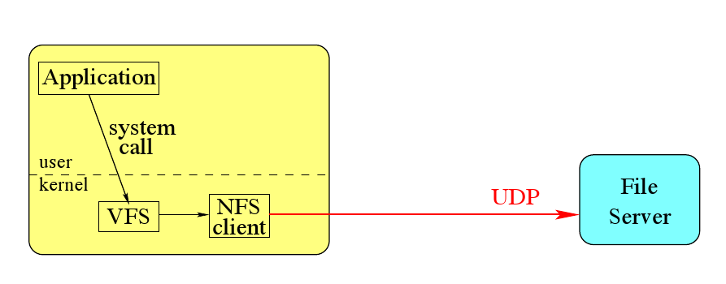
So far we had…
- Consistency BUT…
- Availability
- Partition tolerance ?

Slide 3
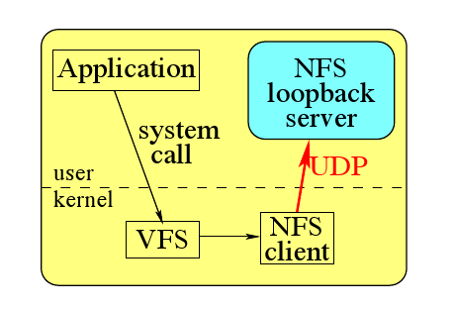
Let’s be cooperative
CFS
CFS

Slide 4
We need a NFS Server…
…let’s use the SFS toolkit
CFS
CFS
dispatch()
SFS Tk
CFS
reply()
UDP

Slide 5
Small is beautiful
Need to emulate a real FS
Small entities to spread the load
Let’s implement a real FS,
where blocks are spread over multiple peers,
and identified by keys
CFS
put()
SFS
FS
get()
UDP

Slide 6
Replication is everything
Servers fails
Servers may be overloaded
Let’s replicate
We need a layer to locate them
CFS
DHash
CFS
lookup(k)
SFS
FS
DHash
IPs
UDP

Slide 7
Who has the key?
We need to associate each key to an IP,
in a distributed manner,
with efficient lookup
Let’s use Chord
CFS
DHash
Chord
CFS
SFS
FS
DHash
Chord
UDP

Slide 8
Outline
Overview
Objectives
FS
DHash
Chord
Discussion

Slide 9
Objectives
Decentralized control
Scalability
Availability
Load Balance
Persistence
Quotas
Efficiency
Consistency ?

Slide 10
The File System
Convert NFS calls into put and get primitives
Integrity
Consistency
CFS
dispatch()
put()
SFS
FS
reply()
get()
UDP

Slide 11
Let’s store a block
How do we enforce integrity?
Server can be malicious…
Everyone can write a block at any given key…
We can either:
Sign the block
Store at its hash value
We want load balancing => K=H(B)
Is it enough?
Billion users X Billion block per user => 10⁻²⁸
Notes:
Pq pas pubkey ici ? Load balencing & quota: has the block the right to be here ?

Slide 12
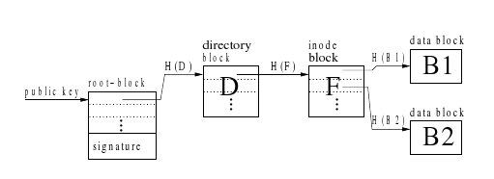
Let’s store a File and a Directory
Remember the blocks’ keys
Use an inode block
=> File Key = H(inode)
Remember the files’ keys
Use a directory block
=> Direcotry Key = H(D)

Slide 13
Root Block & Consistency
Where to store the root key?
Hash => update external references
Append a signature and store at H(pubkey)
Consistency?
Only if everyone see the same version of the block

Slide 14
put/get API
put_h(block)
put_s(block, pubkey)
get(key)
Amazon API:
put(object,key)
get(key)
Amazon
CFS
put()
SFS
FS
get()
UDP

Slide 15
DHash
Replication
Caching
Load balancing
Quotas
CFS
DHash
CFS
put()
lookup(k)
SFS
FS
DHash
get()
IPs
UDP

Slide 16
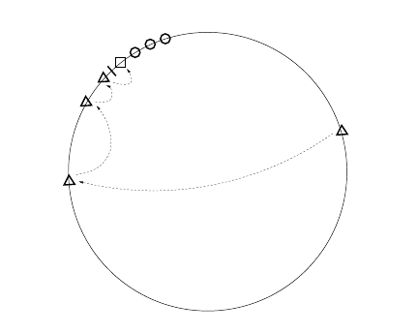
Replication
Block (square) stored at the first successor of ID (thick mark)
DHash maintains replicas on r successors given by Chord (circles)
Each replicas are independent due to consistent hashing
DHash do get() on one of the replicas depending on latency => load balancing

Slide 17
Replication
Consistency ?
put_h?
put_s?

Slide 18
Transient & Permanent Failures
Transient failures =>unnecessary uploads and deletes of replicas
Lost of bandwidth
Must remember the work done
=> have scope > r
Decreases replication delay

Slide 19
Caching
Caches blocks along the lookup path
Least-recently-used replacement policy
Keeps replicas close to the block ID
Consistency?

Slide 20
Load balancing
Consistent hashing => spread blocks across the ID space
But variance would be log(N)
And server capacities vary
Introduce virtual servers: IDKey = Hash(IP||id)
Security?
Gives the freedom to chose id => dictionary attack => limit range of id => limit load-balancing

Slide 21
Quotas
Per-IP Quotas
Does it work?
Storage available is O(N) but storage provided is O(1) => Naturally overloaded
Let’s use O(1/N) quota
But we need N*block size >> minimum storage space at a server

Slide 22
Updates and Deletions
Only signed blocks can be updated
Difficult to find a collision => prevents attack
No delete but refresh
Recover from large amount of data inserted
But consume bandwidth and loss-prone

Slide 23
Chord
Key space is a ring, ie m = 0
Associate each key to a list of r IPs
Fault-tolerant
Efficient: O(log(N))
CFS
lookup(k)
DHash
Chord
IPs
CFS
lookup(k)
SFS
FS
DHash
Chord
IPs
UDP

Slide 24
Linear Routing
Key and nodeID belongs to the same space
Each key belongs to its successor node
Always able to lookup a key if the list of successors is large enough
Inefficient: O(N)

Slide 25
Recursive Routing
Finger[k] = ﬁrst node on circle that succeeds (n+2^{k−1} ) mod 2m , 1 ≤ k ≤ m
O(log(N)) in space
O(log(N)) in hops
Fingers tables aren’t vital, just an accelerator

Slide 26
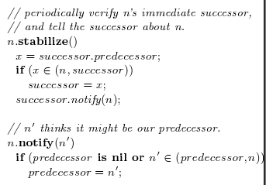
Joins

Slide 27
Server Selection
log(N): number of significant bits
ones(): number of bit set to 1
H(n_{i}): estimation of the number of hops
D: latencies

Slide 28
Discussion
Efficiency
Load Balance
Persistence
Decentralized control
Scalability
Availability
Quotas
Consistency ?

Slide 29
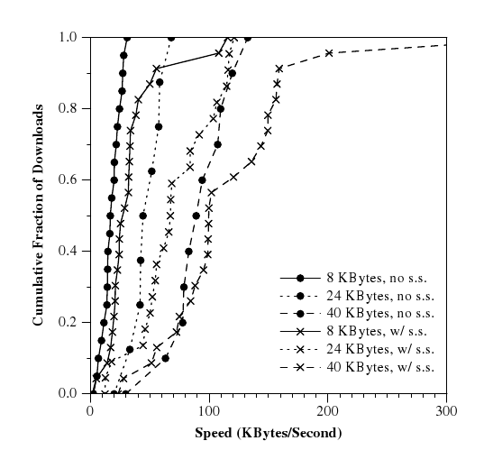
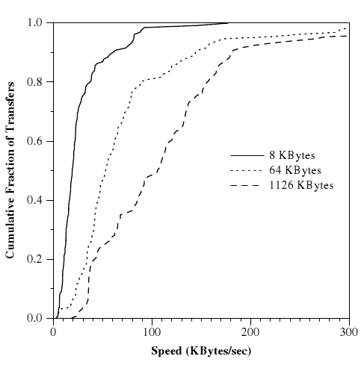
Efficiency
FTP – different file sizes
CFS – w/ and w/o server selection

Slide 30
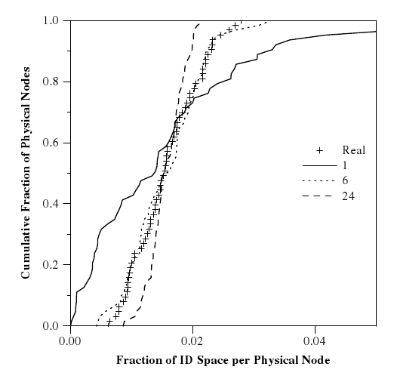
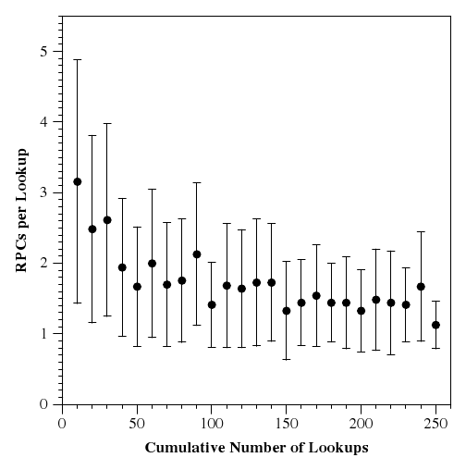
Load Balancing
Storage – 64 servers
Banwidth – 1000 servers

Slide 31
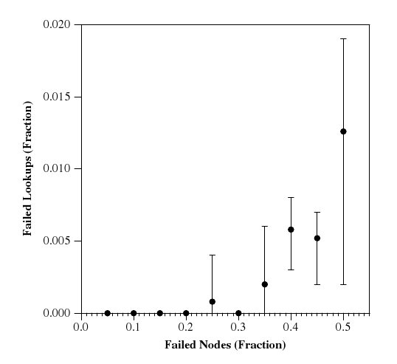
Persistence

Slide 32
Discussion
Decentralized control ?
Scalability ?
Availability ?
Quotas ?
Consistency ?

