Slide 1
Notes:
Why aren’t banks mirroring at a distance

Slide 2
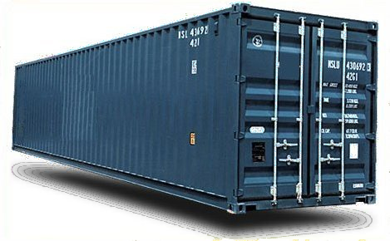


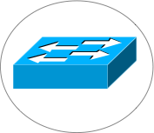
Critical Infrastructure Protection and Compliance
U.S. Department of Treasury Study
  Financial Sector vulnerable to significant data loss in disaster
  Need new technical options
Risks are real, technology available, Why is problem not solved?
Notes:
A Research and Development Agenda to Improve the Resiliency
of the Financial and Banking Sector
U.S. Department of Treasury - Office of Critical Infrastructure Protection and
Compliance Policy
Financial and Banking Information Infrastructure Committee
Financial Services Sector Coordinating Council
Design eloquent in its simplicity
Secure log promotes integrity
A hash asserts the data and order integrity of log
Byzantine quorums maintain consistency despite failure
Self-organizing via DHT technology
Narrow interface made it possible to implement and deploy system
Need to somehow summarize “Antiquity Design Summary” and “My Contributions” slides and somehow transition to SMFS and KyotoFS!
What one point should the audience take away from here?
This is also where we may discuss our research approach, or we can do it at the end

Slide 3
Bold New (Distributed Systems) World…
High performance applications coordinate over vast distances
  Systems coordinate to cache, mirror, tolerate disaster, etc.
  Enabled by cheap storage and cpus, commodity datacenters, and plentiful bandwidth
Scale is amazing, but tradeoffs are old ones
Notes:
A Research and Development Agenda to Improve the Resiliency
of the Financial and Banking Sector
U.S. Department of Treasury - Office of Critical Infrastructure Protection and
Compliance Policy
Financial and Banking Information Infrastructure Committee
Financial Services Sector Coordinating Council
Design eloquent in its simplicity
Secure log promotes integrity
A hash asserts the data and order integrity of log
Byzantine quorums maintain consistency despite failure
Self-organizing via DHT technology
Narrow interface made it possible to implement and deploy system
Need to somehow summarize “Antiquity Design Summary” and “My Contributions” slides and somehow transition to SMFS and KyotoFS!
What one point should the audience take away from here?
This is also where we may discuss our research approach, or we can do it at the end

Slide 4
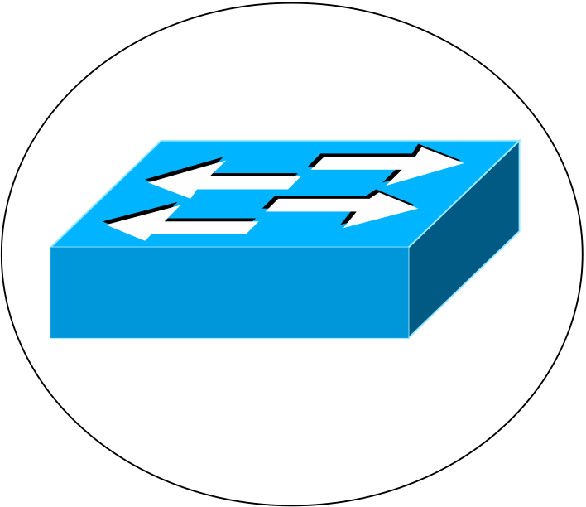

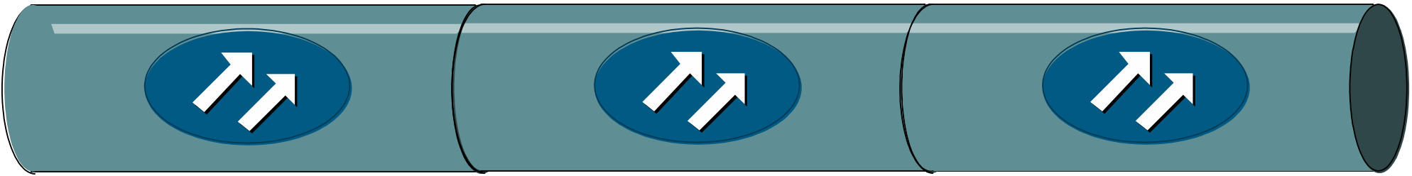
Mirroring and speed of light dilemma…
async
Conundrum:
there is no middle ground
sync
Primary site
Remote mirror
Want asynchronous performance to local data center
And want synchronous guarantee
Notes:
most enterprise use asynchronous mirroring even though a single transaction may be valued at millions of dollars
Want asynchronous performance to local data center
But if failure occurs, data may be lost
70% small firms go out of business after major data loss
And want synchronous guarantee
But many businesses cannot afford reducing client performance

Slide 5
Mirroring and speed of light dilemma…
Conundrum:
there is no middle ground
sync
Local-sync
Remote-sync
Primary site
Remote mirror
Want asynchronous performance to local data center
And want synchronous guarantee
Notes:
most enterprise use asynchronous mirroring even though a single transaction may be valued at millions of dollars
Want asynchronous performance to local data center
But if failure occurs, data may be lost
70% small firms go out of business after major data loss
And want synchronous guarantee
But many businesses cannot afford reducing client performance

Slide 6
Challenge
How can we increase reliability of local-sync protocols?
  Given many enterprises use local-sync mirroring anyways
Different levels of local-sync reliability
  Send update to mirror immediately
  Delay sending update to mirror – deduplication reduces BW

Slide 7
Talk Outline
Introduction
Enterprise Continuity
  How data loss occurs
  How we prevent it
  A possible solution
Evaluation
Message Logging: Pessimisitic, Optimistic, Causal, and Optimal
Cornell National Lambda Rail (NLR) Testbed
Conclusion

Slide 8
How does loss occur?
Rather, where do failures occur?
Rolling disasters
Packet
loss
Partition
Site
Failure
Power
Outage
Primary site
Remote mirror
Notes:
Want asynchronous performance to local data center
But if failure occurs, data may be lost
70% small firms go out of business after major data loss
And want synchronous guarantee
But many businesses cannot afford reducing client performance

Slide 9
Enterprise Continuity: Network-sync
Local-sync
Network-sync
Remote-sync
Primary site
Wide-area network
Remote mirror

Slide 10
Enterprise Continuity Middle Ground
Primary site
Data Packet
Repair Packet
Network-level Ack
Storage-level Ack
Remote mirror
Use network level redundancy and exposure
  reduces probability data lost due to network failure
Notes:
Optical links connect datacenters
In particular, loss rate is low
Use redundancy to reduce loss and expose redundancy to reason about reliability

Slide 11
Enterprise Continuity Middle Ground
Network-sync increases data reliability
  reduces data loss failure modes, can prevent data loss if
  At the same time primary site fail network drops packet
  And ensure data not lost in send buffers and local queues
Data loss can still occur
  Split second(s) before/after primary site fails…
  Network partitions
  Disk controller fails at mirror
  Power outage at mirror
Existing mirroring solutions can use network-sync
Notes:
Optical links connect datacenters
In particular, loss rate is low
Use redundancy to reduce loss and expose redundancy to reason about reliability

Slide 12
Smoke and Mirrors File System
A file system constructed over network-sync
  Transparently mirrors files over wide-area
  Embraces concept:
  file is in transit (in the WAN link) but with enough recovery data to ensure that loss rates are as low as for the remote disk case!
  Group mirroring consistency

Slide 13

Mirroring consistency and
Log-Structured File System
V1
R1
I1
I2
B1
B2
B3
B4
append(B1,B2)
V1
R1
I2
B4
B3
I1
B2
B1
append(V1..)
Notes:
Transition to next slide: A secure log does not solve problems/challenges, still need to replicate log
And maintain consistency amongst replicas

Slide 14
Talk Outline
Introduction
Enterprise Continuity
Evaluation
Message Logging
Conclusion

Slide 15
Evaluation
Demonstrate SMFS performance over Maelstrom
  In the event of disaster, how much data is lost?
  What is system and app throughput as link loss increases?
  How much are the primary and mirror sites allowed to diverge?
Emulab setup
  1 Gbps, 25ms to 100ms link connects two data centers
  Eight primary and eight mirror storage nodes
  64 testers submit 512kB appends to separate logs
    Each tester submits only one append at a time
Notes:
4 points:
Minimize loss in disaster
Tput independent of latency and loss on link
App Performance same as local-sync
There is a tradeoff: FEC reduces goodput

Slide 16
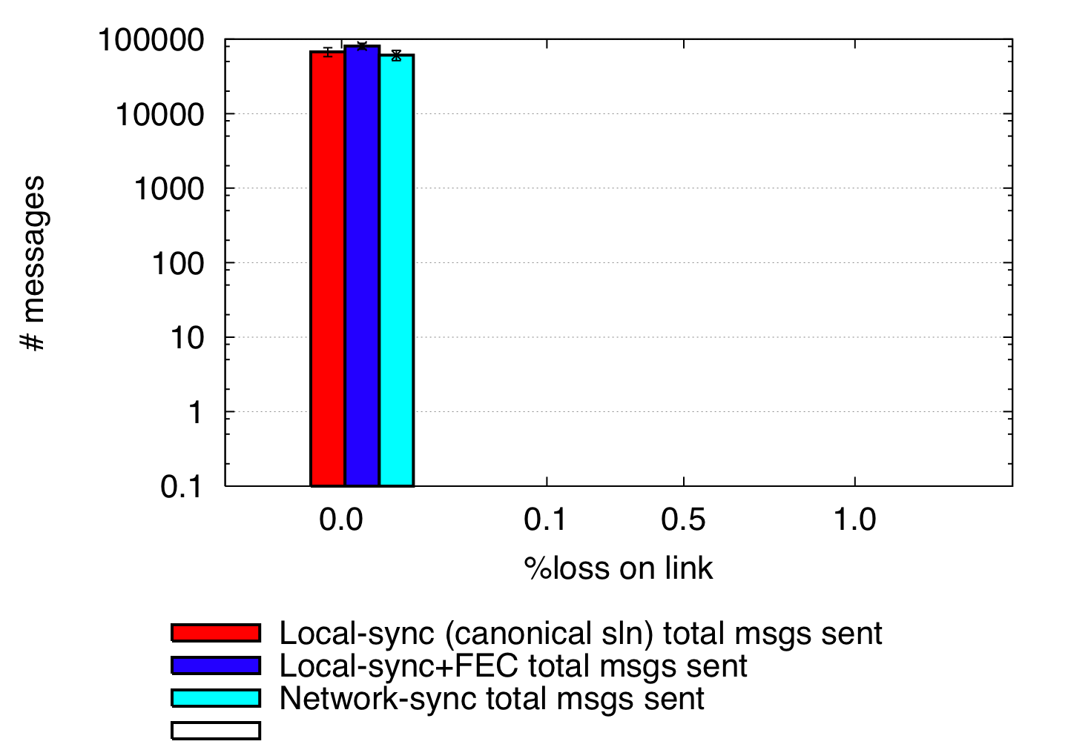
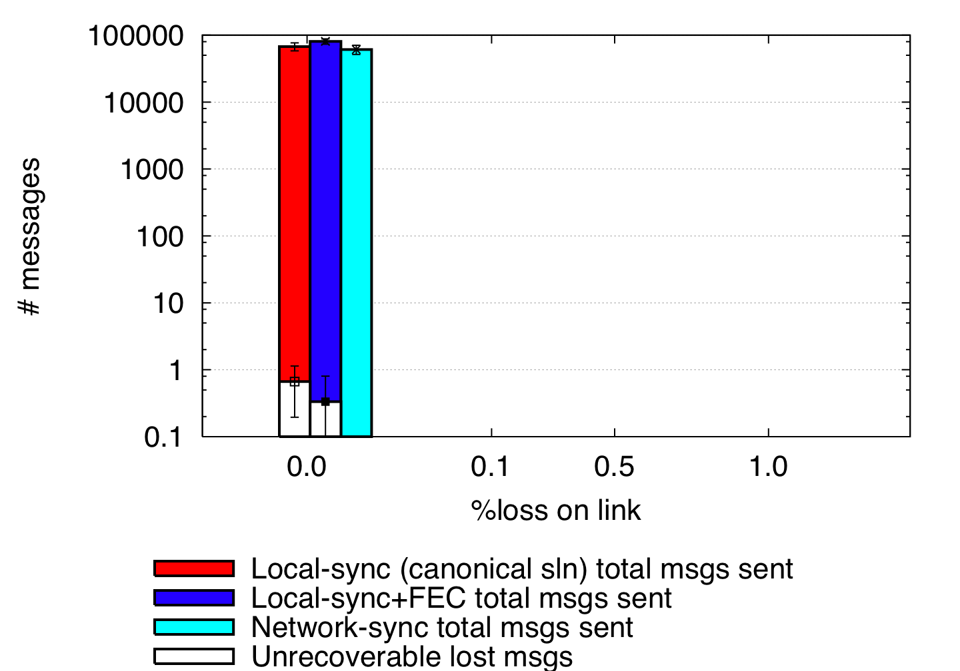
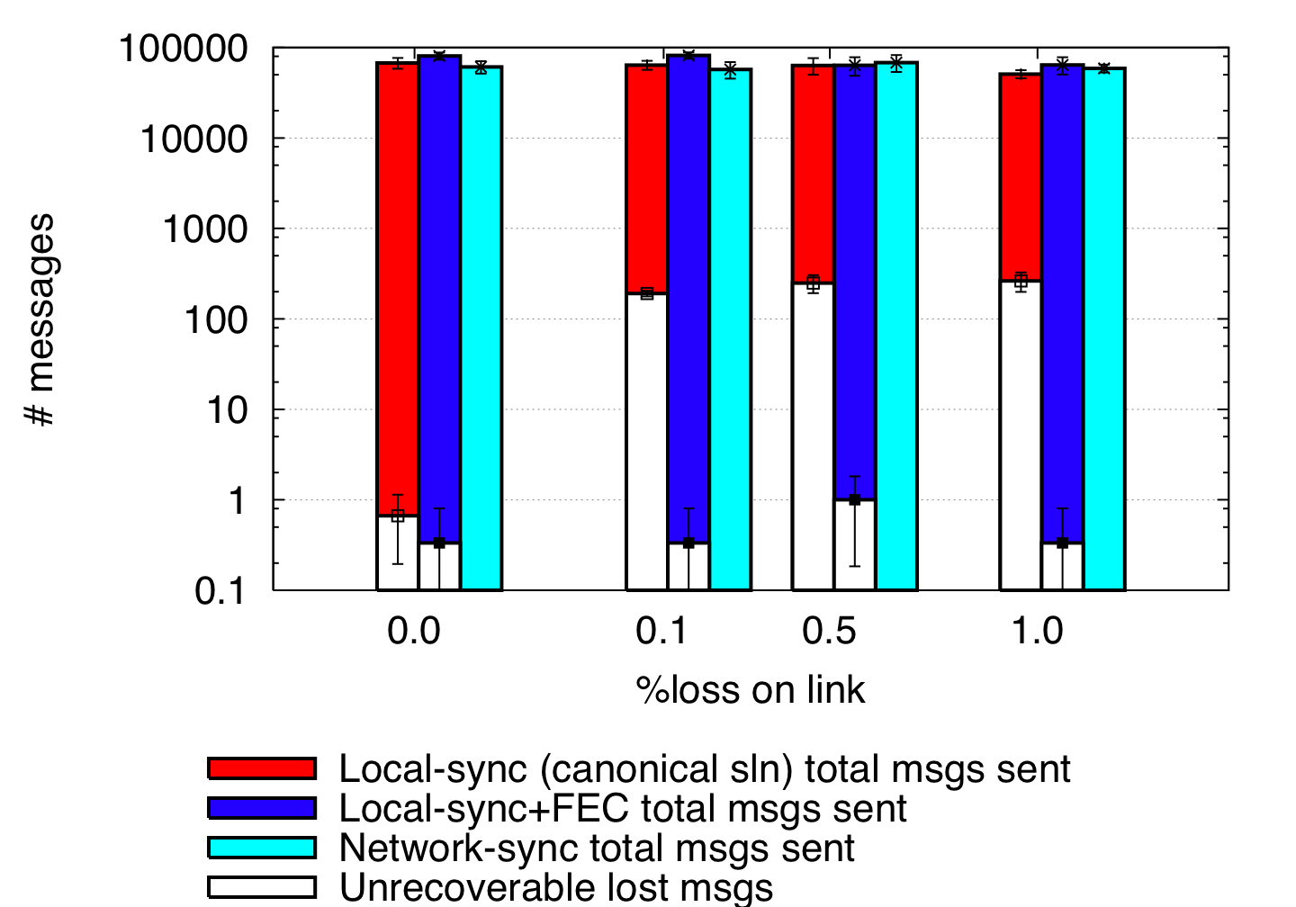
Data loss as a result of disaster
Local-
sync
Network-
sync
Remote-
sync
Primary site
Remote mirror
50 ms one-way latency
FEC(r,c) = (8,3)
Local-sync unable to recover data dropped by network
Local-sync+FEC lost data not in transit
Network-sync did not lose any data
  Represents a new tradeoff in design space

Slide 17
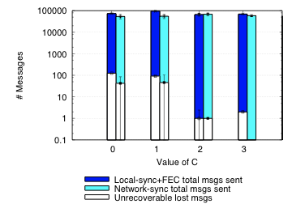
Data loss as a result of disaster
Local-
sync
Network-
sync
Remote-
sync
Primary site
Remote mirror
50 ms one-way latency
FEC(r,c) = (8,varies)
1% link loss
c = 0, No recovery packets: data loss due to packet loss
c = 1, not sufficient to mask packet loss either
c > 2, can mask most packet loss
Network-sync can prevent loss in local buffers

Slide 18
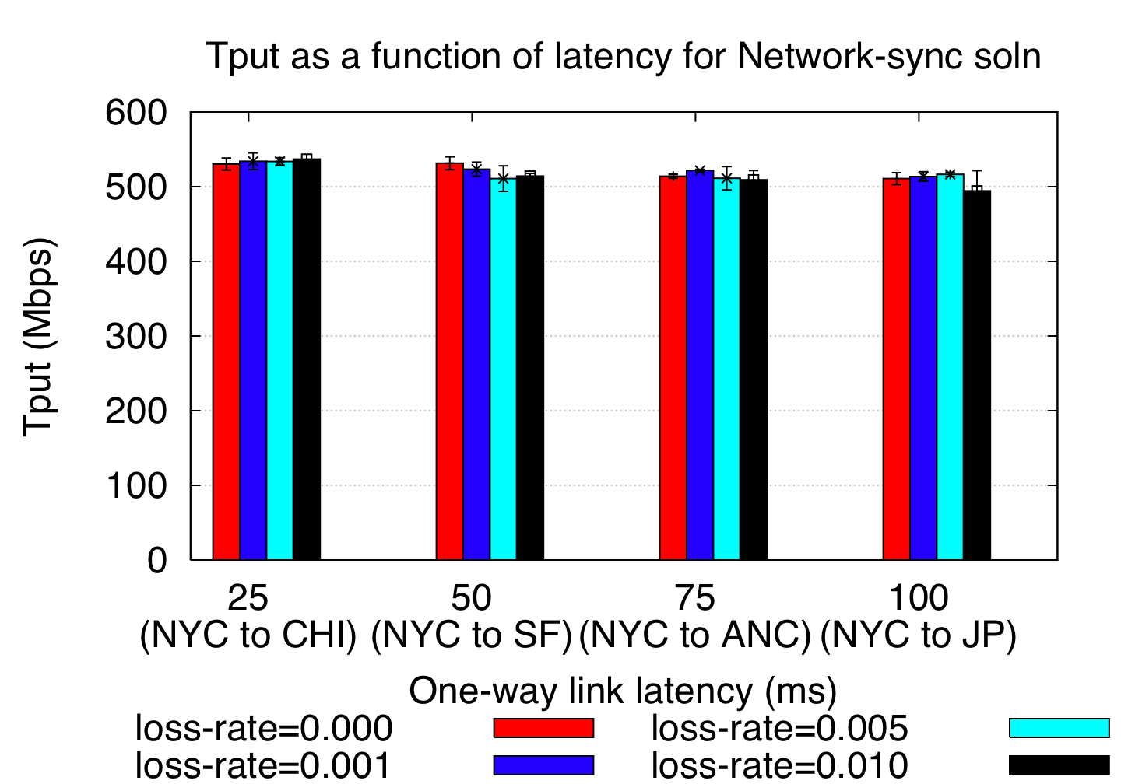
High throughput at high latencies
Notes:
Performance independent of link latency and loss

Slide 19
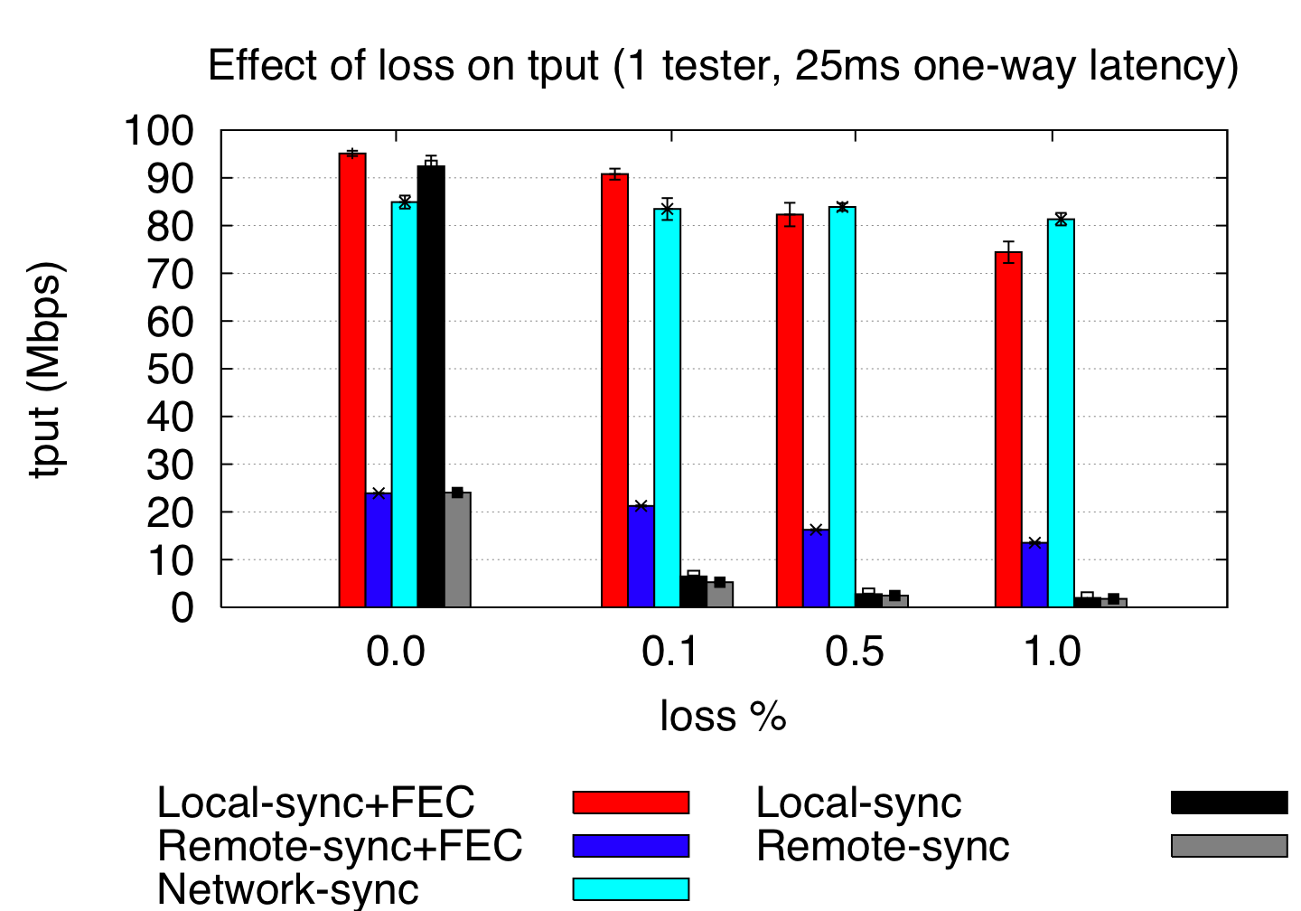
Application Throughput
App throughput measures application perceived performance
Network and Local-sync+FEC tput significantly greater than Remote-sync(+FEC)
Notes:
Network-sync performance similar to local-sync

Slide 20
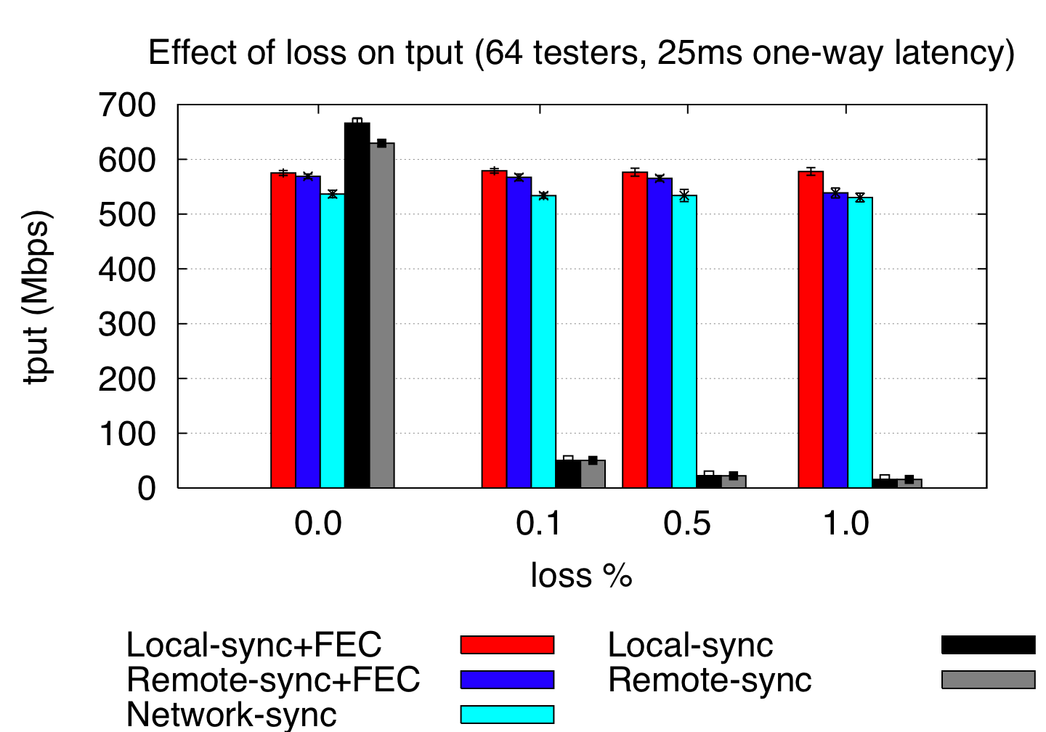
…There is a tradeoff
Notes:
Network-sync reduces goodput to protect against future loss

Slide 21
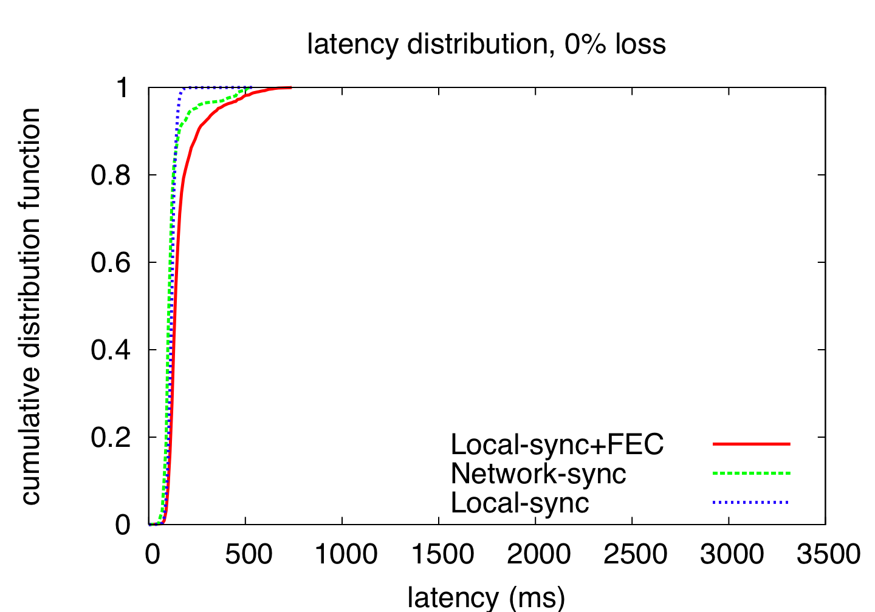
Latency Distributions
Notes:
Time between msg sent by primary server and received by remote mirror

Slide 22
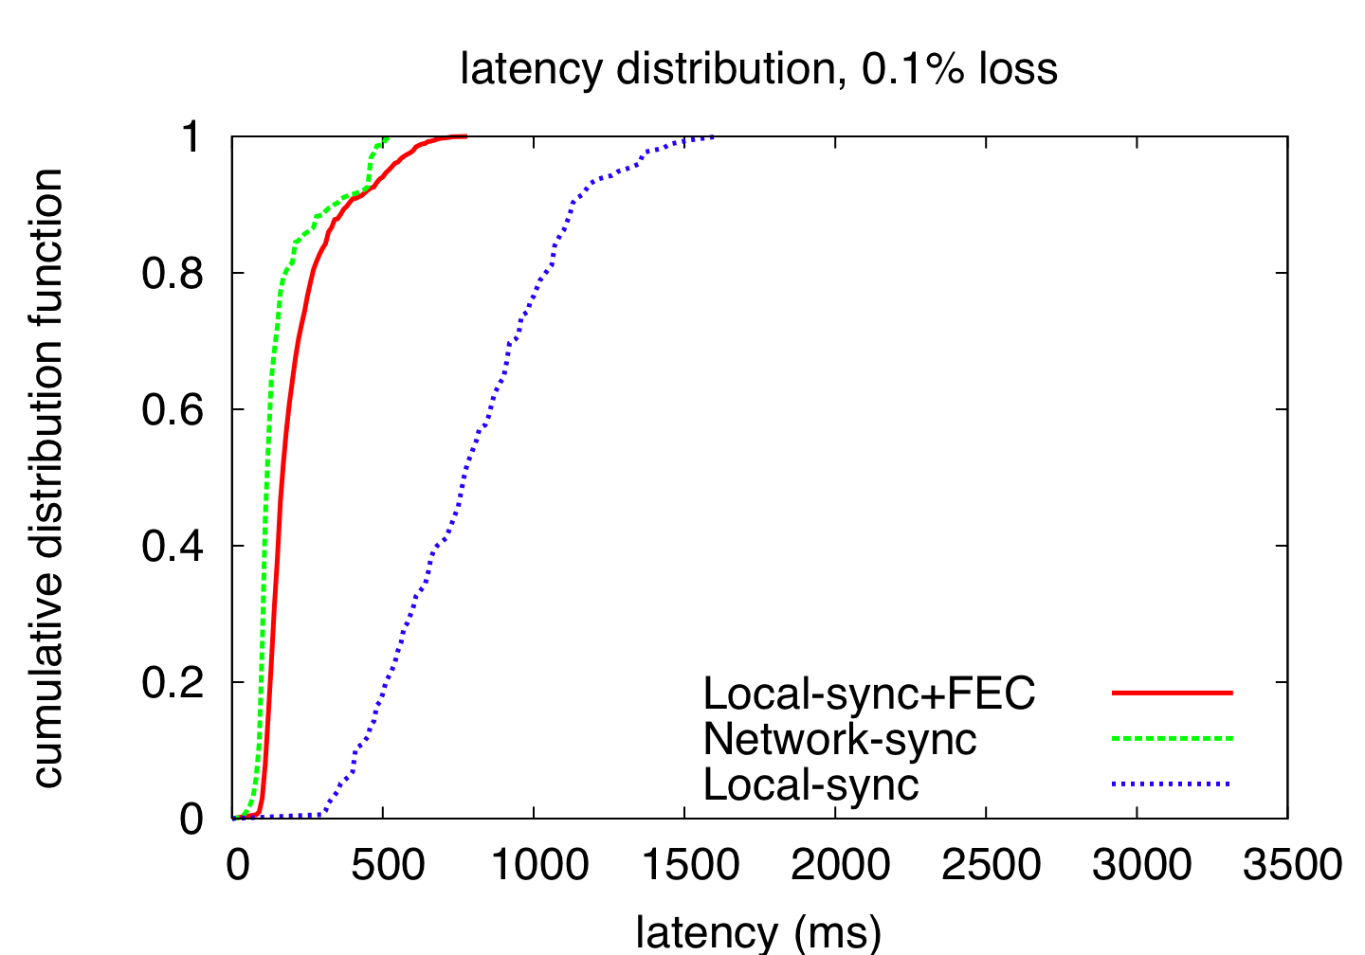
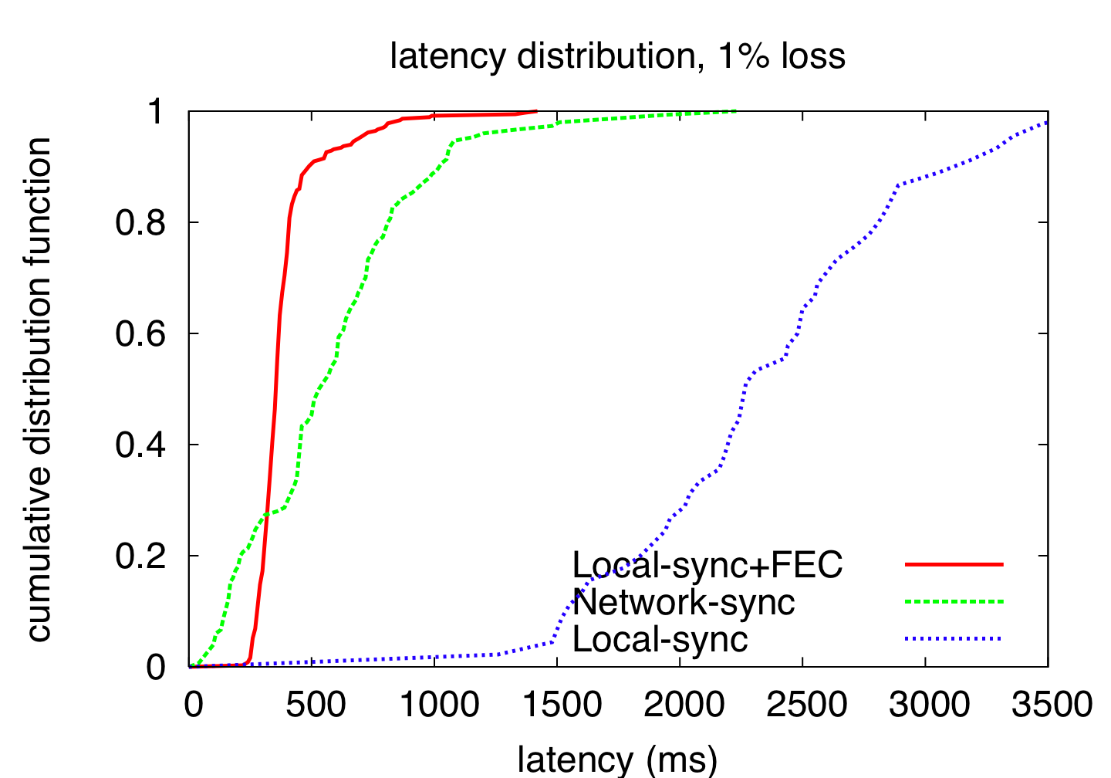
Latency Distributions
Notes:
Time between msg sent by primary server and received by remote mirror

Slide 23
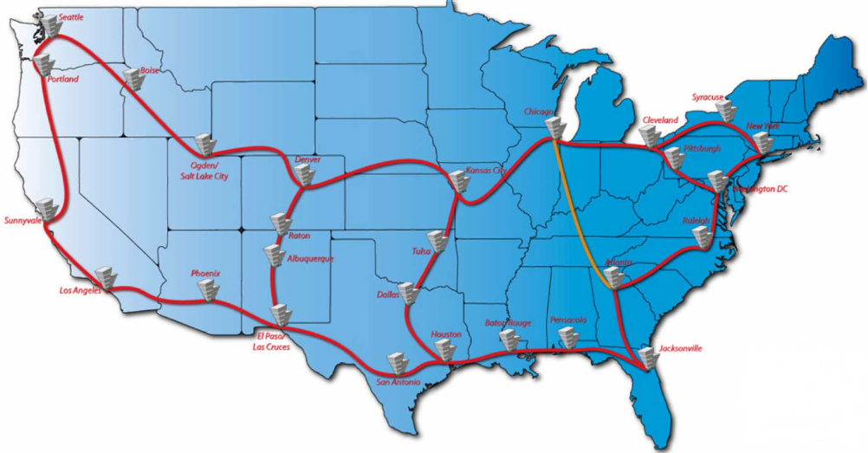
Cornell National Lambda Rail (NLR) Rings

Slide 24
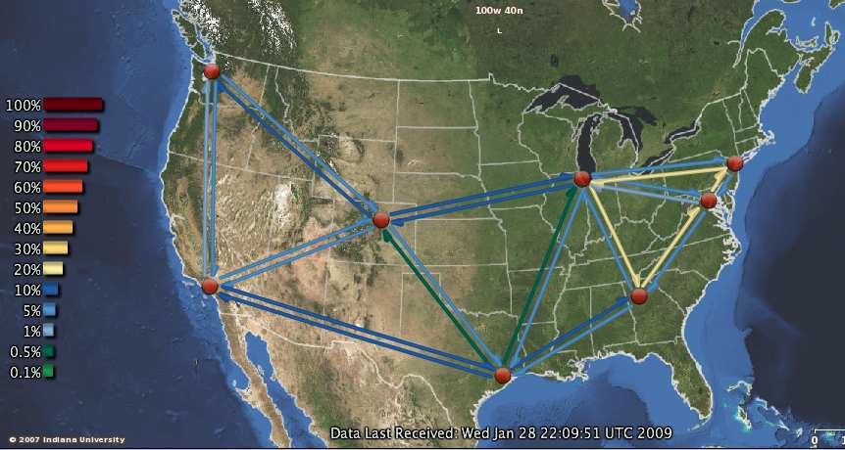
Cornell National Lambda Rail (NLR) Rings

Slide 25
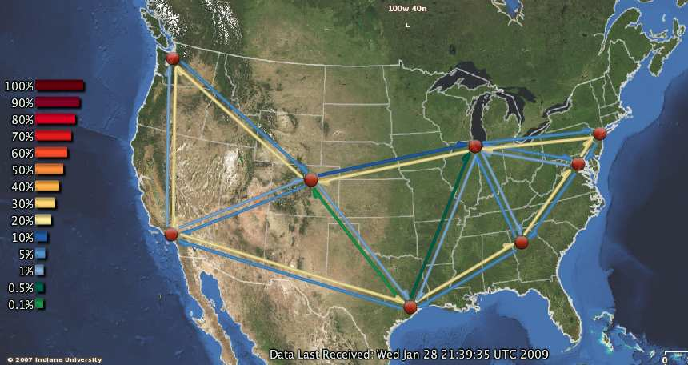
Cornell National Lambda Rail (NLR) Rings

Slide 26
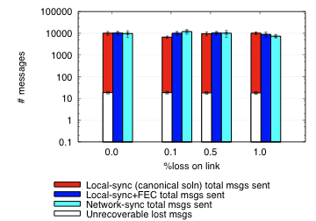
Cornell NLR Rings Testbed:
Data loss as a result of disaster
Local-
sync
Network-
sync
Remote-
sync
Primary site
Remote mirror
37 ms one-way latency
FEC(r,c) = (8,3)
Local-sync unable to recover data dropped by network
Both Local-sync+FEC and Network-sync did not lost data

Slide 27
Talk Outline
Introduction
Enterprise Continuity
Evaluation
Message Logging
Conclusion

Slide 28
Message Logging
Optimistic
  Return result to client before recording to stable storage
Pessimistic
  Record result to stable storage first, then return result
Question, how to prevent orphaned processes?
  After crash, How does a crash-recovery node recover state of system before crash?
  Pessimistic case is easy, just use log
  Optimistic case?....
    Either data lost
    Possibly can scrape state from clients – (possible project idea)

Slide 29
Message Logging
e.g. “Lehmen Brothers Network Survives”
  http://www.networkworld.com/research/2001/1126feat.html
Pharmacy prescriptions after hurricane Katrina

Slide 30
Talk Outline
Introduction
Enterprise Continuity
Evaluation
Message Logging
Conclusion

Slide 31
Conclusion
Technology response to critical infrastructure needs
When does the filesystem return to the application?
  Fast — return after sending to mirror
  Safe — return after ACK from mirror
SMFS — return to user after sending enough FEC
Network-sync:
Lossy Network➔Lossless Network➔Disk!
Result: Fast, Safe Mirroring independent of link length!

Slide 32
Next Time
Read NFS and write review. Turn into CMS before class:
  Wide-area cooperative storage with CFS, Frank Dabek, M. Frans Kaashoek, David Karger, Robert Morris, and Ion Stoica. Appears in Proceedings of 18th ACM SIGOPS Symposium on Operating Principles (SOSP), October, 2001.
  Chord: A Peer-to-Peer Lookup Service for Internet Applications, Ion Stoica, Robert Morris, David Karger, Frans Kaashoek, Hari Balakrishnan. Appears in Proceedings of the ACM SIGCOMM Conference, September, 2001.
Do Lab 1---Due next Tuesday, February 10th

Slide 33
Questions?

Slide 34
Future Work
Apply Network-sync technologies to large “DataNets”
High-speed online processing of massive quantities of real-time data:
  Performance enhancement proxies (PEP)
  Deep packet inspection (DPI)
  Sensor network monitoring
  Malware / worm signature detection
  Software switch, IPv4 – IPv6 gateway
Current state of the art – solution in the kernel
User process cannot keep up with kernel/NIC

Slide 35
Backup slides

Slide 36
Future Work
Apply Network-sync technologies to large “DataNets”
  NSF focus on global-scale scientific computing
  DARPA interested in unification of globally distributed military data management subsystems and centers
  AFRL interested in high speed eventing (e.g. Distributed Missions Operations – DMO)

Slide 37
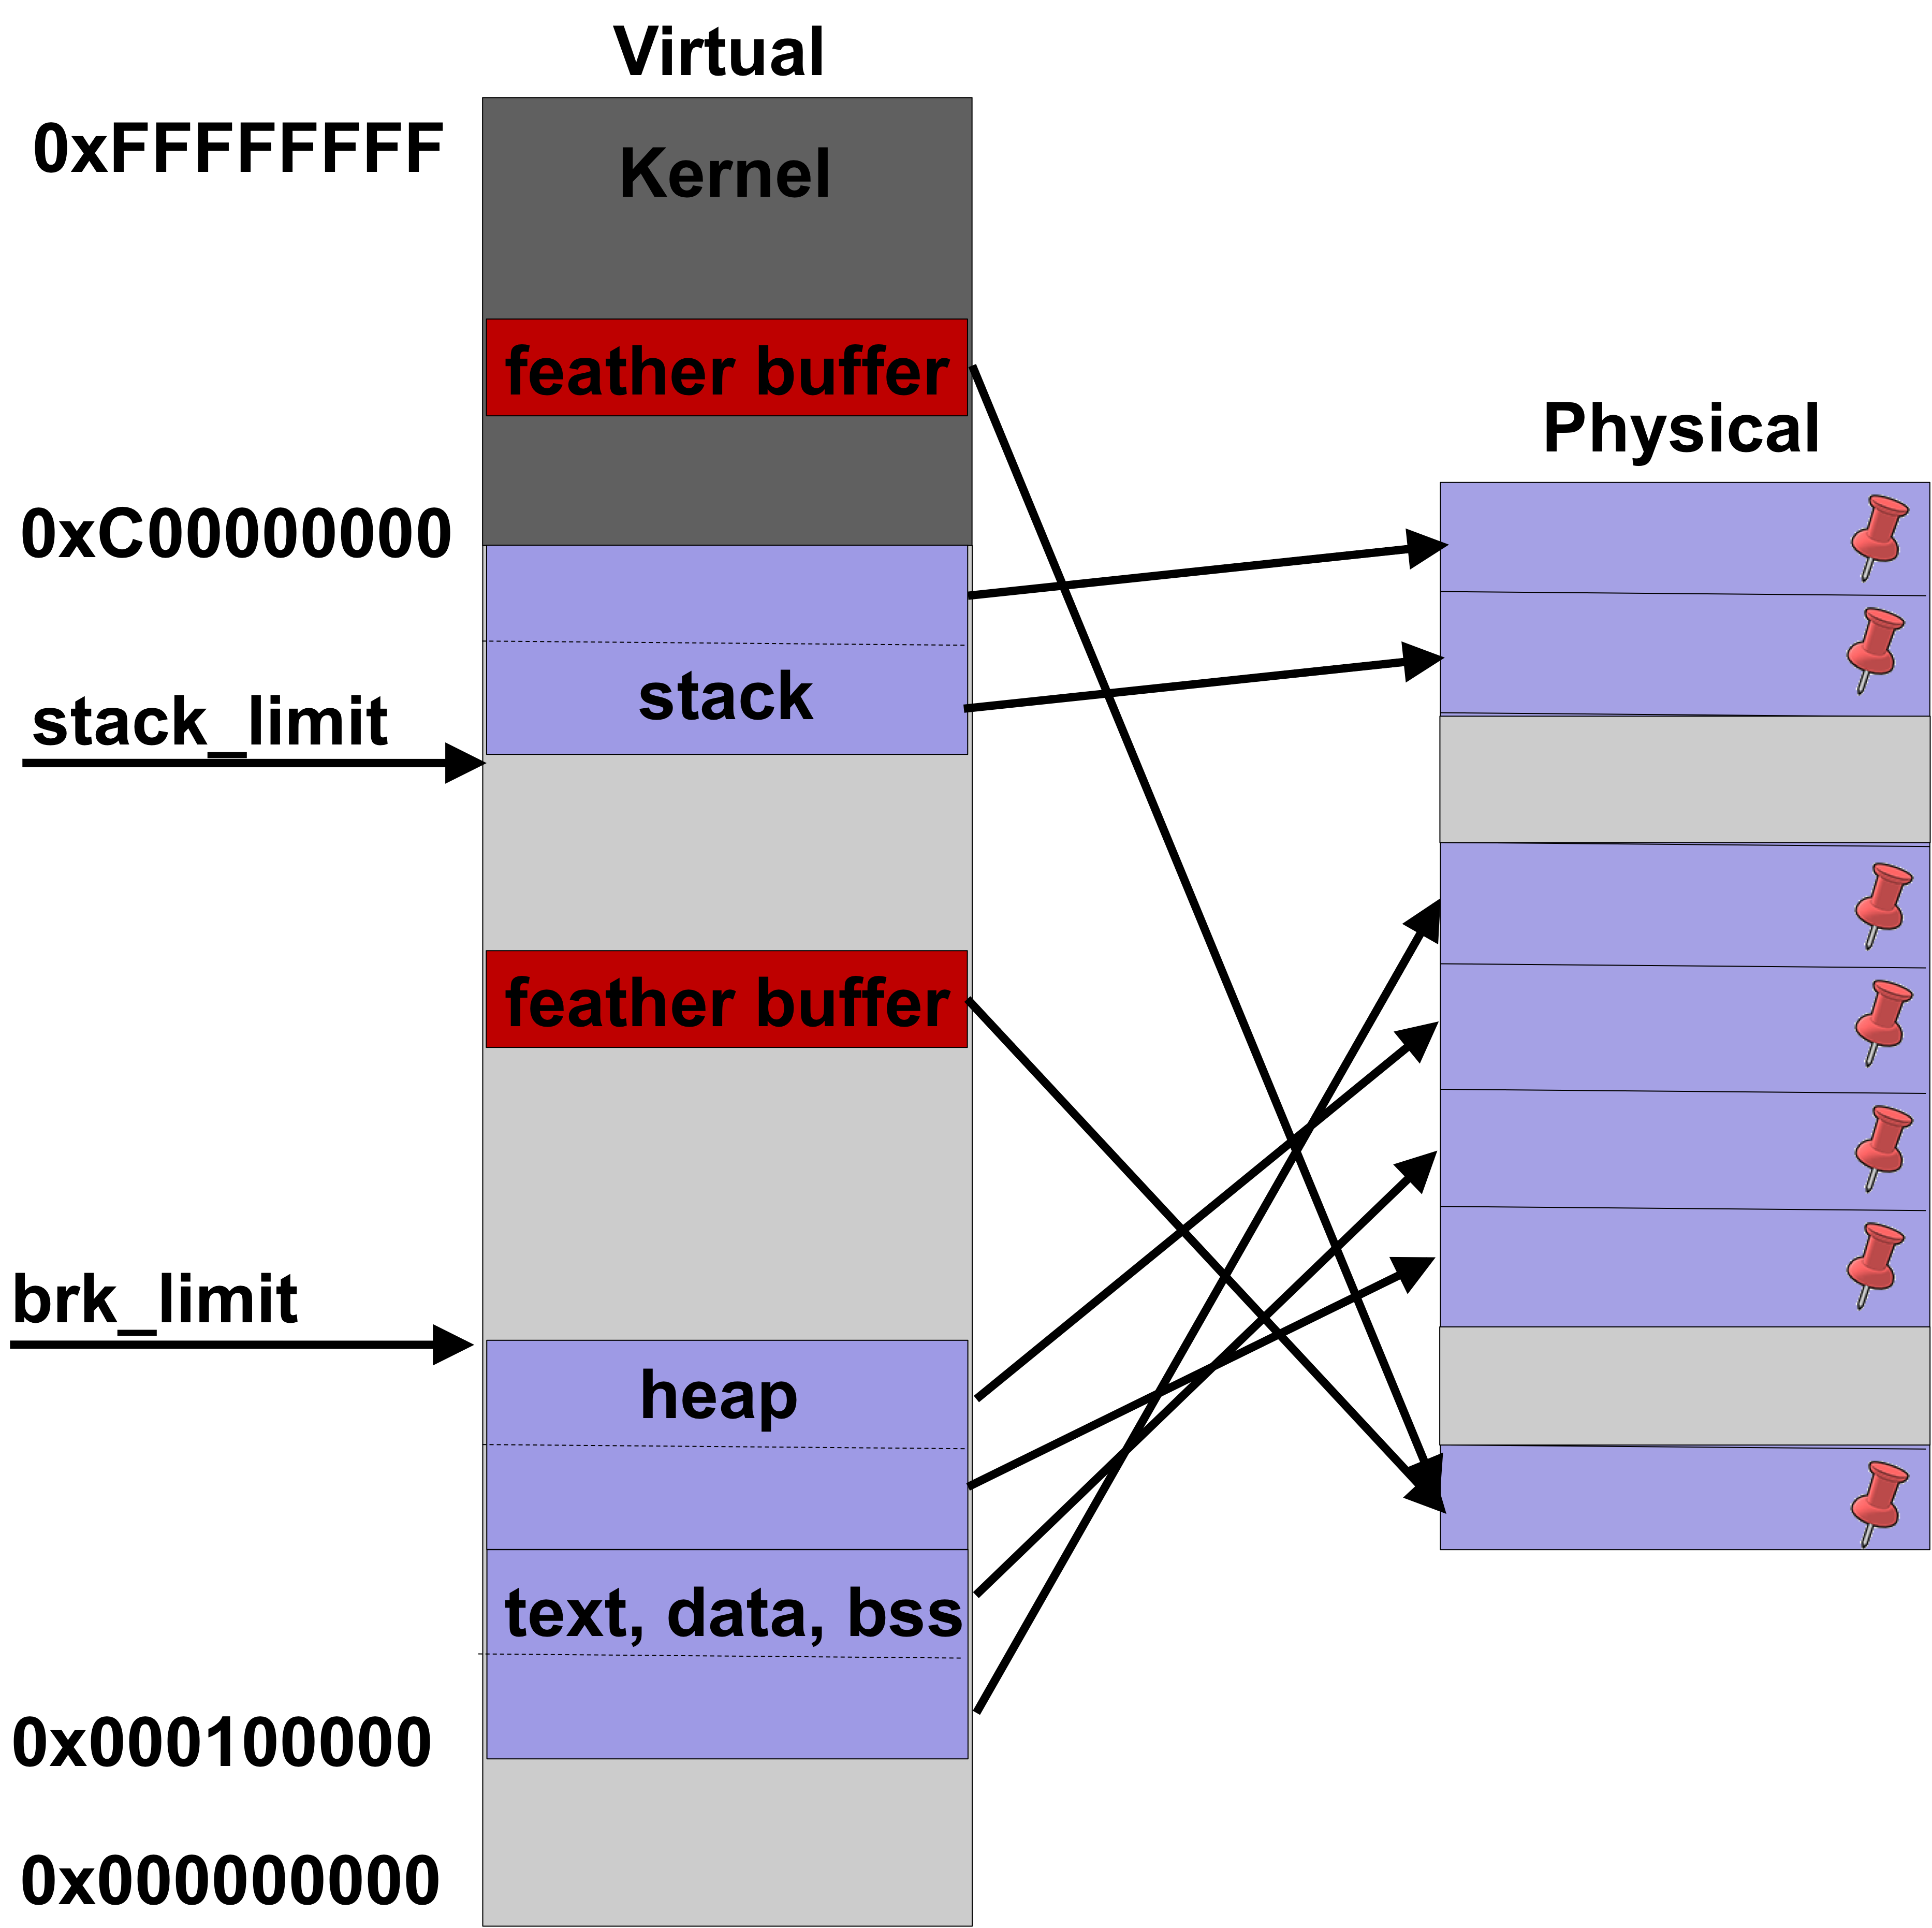
Featherweight Processes
User-Mode Processes with Fast Reflexes
User-mode process abstraction
Reduce copies between protection domains
Thin syscall interface
  Restrict blocking calls
Proactive resource request
  Enforce limits
Pin down memory
Kernel IPC – feather buffer

Slide 38
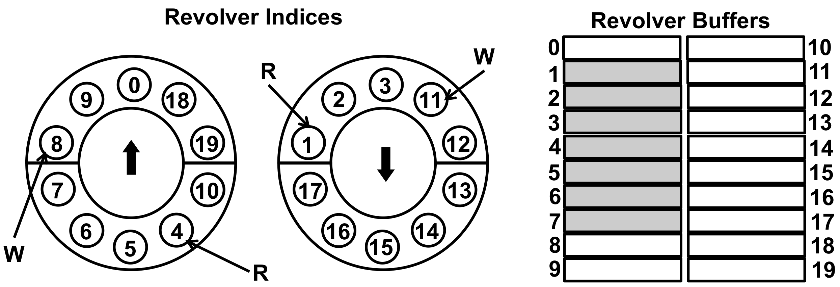
Revolver Buffers
Feather buffer IPC (kernel-feather process communication)
Pair of unidirectional revolving doors in each direction
Lock free, hold packet slots
Writing to the buffer
  From the kernel – while in softirq
Reading from the buffer
  While in the kernel – on a workqueue
Turn buffer around – in place processing

Slide 39
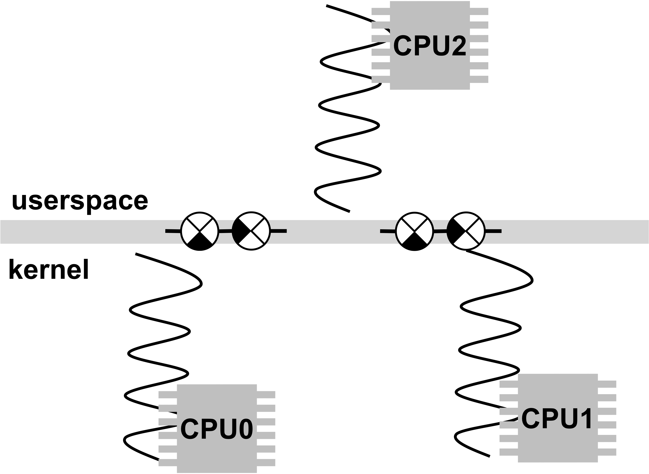
Technical Details
Thin syscall interface: ffork, mmap, await
  FFORK(feather buffer size, heap limit)
  MMAP – maps the feather buffer
  AWAIT – blocks feather process
Feather buffer interface
  put / get / peek / turnaround / available
Peg kernel and feather process threads

