Slide 1
CS 6464:
Advanced Distributed Storage Systems
Spring 2009
Instructor: Hakim Weatherspoon

Slide 2

Who am I?
Prof. Hakim Weatherspoon
  (Hakim means Doctor, wise, or prof. in Arabic)
  Background in Education
    Undergraduate University of Washington
      Played Varsity Football
        Some teammates collectively make $100’s of millions
        I teach!!!
    Graduate University of California, Berkeley
      Some class mates collectively make $100’s of millions
      I teach!!!
  Background in Operating Systems
    Peer-to-Peer Storage
      Antiquity project - Secure wide-area distributed system
      OceanStore project – Store your data for 1000 years
    Network overlays
      Bamboo and Tapestry – Find your data around globe
    Tiny OS
      Early adopter in 1999, but ultimately chose P2P direction

Slide 3
Goals for Today
Be brief!
Why take this course?
Goals of distributed storage systems
Intro to cloud computing
How does this class operate?

Slide 4
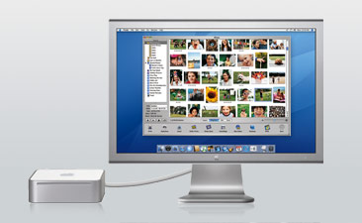
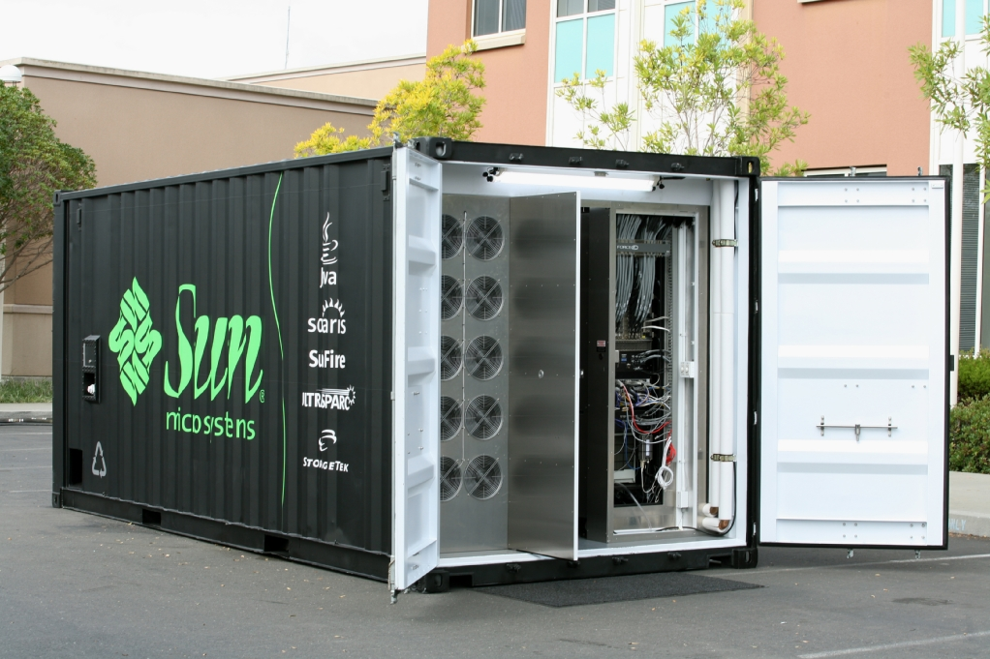
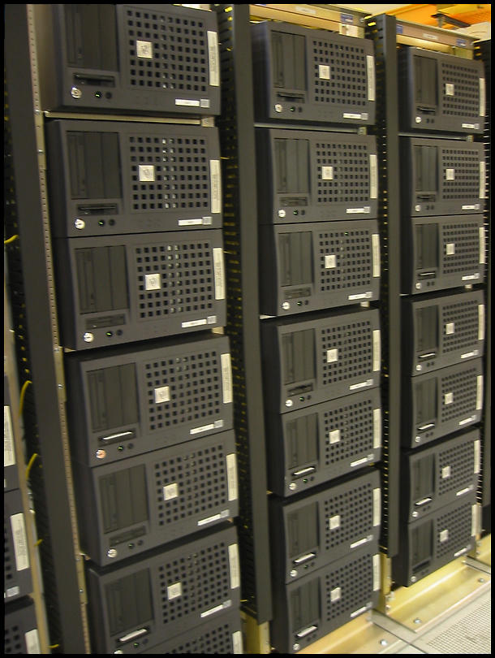
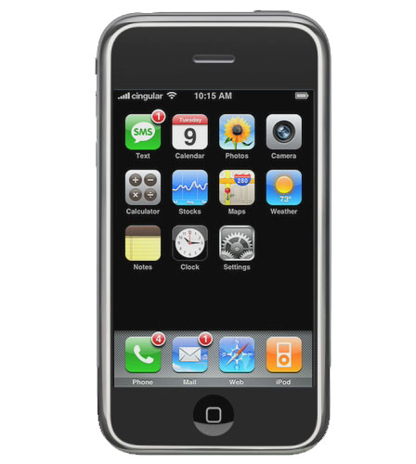
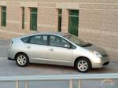

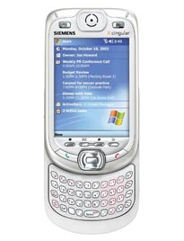
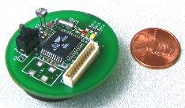
Why take this course?
Notes:
Computer Systems Everywhere!
What’s the largest single use of microprocessors? Not computers – Embedded computers (10 billion versus 400 million)
Example: Nintendo game machine. Second largest? Automobiles. Both require concurrency, but no need for protection

Slide 5




Why take this course?
Notes:
Yahoo mail 250 million users 1GB per user quota
YouTube tens of millions of videos each > 10MB long
Flickr
Google

Slide 6
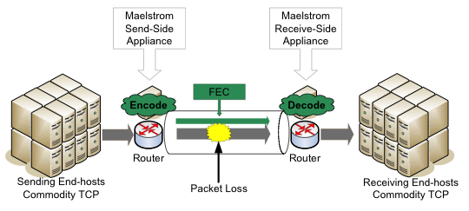
Why take this course?
We have access to state-of-the-art equipment
  Cornell National Lambda Rail (NLR) Rings

Slide 7

Why take this course?
We have access to state-of-the-art infrastructure

Slide 8
Distributed Storage Systems

Slide 9
Distributed Storage System Goals
Problem: No single server is capable of
  Holding hundreds of terabytes of data
  Serving millions of requests per second
Goals
  Stable performance – load balance
  Scalable performance
  High availability
  Durability
  security

Slide 10
Cloud Computing

Slide 11

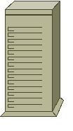
Cloud Computing Intro
Web service expensive to deploy
  Provision for peak load

Slide 12




Cloud Provider Leases Resources
Datacenter
Low server utilization

Slide 13
A Service Running in the Cloud
Under client web service control
App
Guest OS
VMM

Slide 14
Server Consolidation Through Virtualization
Datacenter

Slide 15
Oversubscription
Datacenter
Memory
CPU
Disk
Network
...

Slide 16
Observations
Memory is the local bottleneck resource
  Swap solves this problem using disk
  Disk I/O is slow
Large datacenter environment
  Managed
  Guests run standard VMs
  Very fast network
Few guests overloaded at one time
  Memory is not a global bottleneck resource

Slide 17
How class operates

Slide 18
How this class operates
Instructor: Hakim Weatherspoon
  hweather@cs.cornell.edu
  Office Location: 4105C Upson
TA: Tudor Marian
  tudorm@cs.cornell.edu
Lectures:
  CS 6464: Tu, Th: 10:10 – 11:25 PM, Hollister 362

Slide 19
Course Help
Course staff, office hours, etc:
  http://www.cs.cornell.edu/courses/cs6464/2009sp

Slide 20
CS 6464: Overview
Prerequisite:
  Mastery of CS 4410 material
    Fundamentals of OS design
    How parts of the OS are structured
    What algorithms are commonly used
    What are the mechanisms and policies used
Class Structure
  Papers Readings (whole semester)
  Paper Presentations (whole semester)
  Labs (first 1/3)
  Research Project (second 2/3)

Slide 21
CS 6464: Class Structure
Paper readings
  Read paper before each class
  Write a review and turn in at beginning of class
  Review has three components
    Summary, 2 – 3 strengths, and 2 – 3 weaknesses
Paper presentations
  Each person will present a paper 1-3 times, depending on class size
  Have presentation prepared a week ahead of time and show slides or “chalk talk” to professor

Slide 22
CS 6464: Class Structure
Labs (first 1/3 of semester)
  2 – 3 labs
  Using Amazons EC2/S3 infrastructure
  Building your own distributed file system
Research Project
  Initial project proposal – due beginning of March
  Midterm survey paper – due beginning of April
  Final demo/presentation – due beginning of May
  Final project report – due sbeginning of May

Slide 23
Grading
CS 6464: Operating Systems
  Midterm ~ 30%
  Final ~ 50%
  Assignments ~ 10%
  Subjective ~ 10%
  Regrade policy
    Submit written request to lead TA. TA will pick a different grader
    Submit another written request, lead TA will regrade directly.
    Submit another written request for professor to regrade.
CS 4411: Systems Programming
  Six projects ~ 100%
This is a rough guide

Slide 24
Academic Integrity
Submitted work should be your own
Acceptable collaboration:
  Clarify problem, C syntax doubts, debugging strategy
Dishonesty has no place in any community
  May NOT be in possession of someone else’s homework/project
  May NOT copy code from another group
  May NOT copy, collaborate or share homework/assignments
  University Academic Integrity rules are the general guidelines
Penalty can be as severe as an ‘F’ in CS 6464

Slide 25
Next time
Read Cumulus and write review
  Cumulus: Filesystem Backup to the Cloud, Michael Vrable, Stefan Savage and Geoffrey M. Voelker
  http://www-cse.ucsd.edu/Dienst/UI/2.0/Describe/ncstrl.ucsd_cse/CS2008-0927
Lab 0
  Using Amazon’s EC2/S3 infrastructure
Check website for updated schedule

