Slide 1
Networked Systems: TCP
Yu-Ju Huang
Dec. 3, 2019
Some slides from CS6410 on 2009 and 2013, and CS144 Stadford University.

Slide 2
Outline
Network history
Network basics
  Layering
  End-to-end principle
Congestion Avoidance and Control
TCP Congestion Control with a Misbehaving Receiver

Slide 3
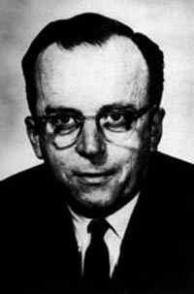
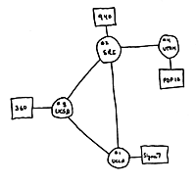
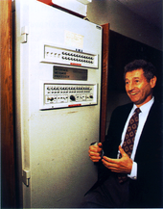
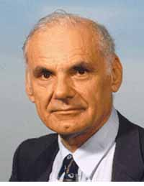
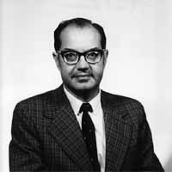
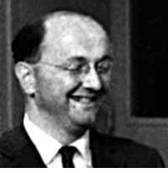
Parallel beginnings
Brief History of the Internet paper:
“It happened that the work at MIT (1961-1967), at RAND (1962-1965), and at NPL (1964-1967) had all proceeded in parallel without any of the researchers knowing about the other work.”
J.C.R. Licklider describes an Intergalactic Network connecting everyone on the globe. (1962)
Four nodes interconnected (UCLA, SRI, UCSB, Utah)
MIT (Leonard Kleinrock) First paper on packet switching theory. (1964)
DARPA (Larry Roberts) plans for “ARPANET”.
RAND (Paul Baran) Packet switching for survivable networks.
WAN connects two time-sharing computers - btw Mass. and Cal.
(circuit switching)
NPL, UK (Donald Davies)
Packet network.
1960
1965
1966
1968
1969
Notes:
In 1962, J.C.R. Licklider at MIT started to write memos and give talks about his concepts of an Intergalactic Network, in which everyone on the globe is interconnected and can access programs and data at any site from anywhere. This is widely thought to be the first recorded description of the social interactions that could be enabled by a large communication network.

Slide 4
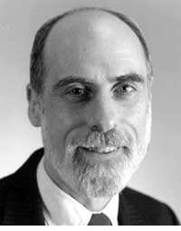
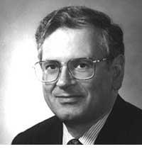
TCP/IP deployed (1983)
New networks appear:
ALOHAnet, Cyclades, IBM SNA.
First public demonstration of this network technology. Also, electronic mail was introduced. (1972)
World Wide Web, by Tim Berners-Lee, became publicly available (1991)
“Internetting” and TCP born (DARPA), led by Vint Cerf and Bob Kahn. (1974)
1st Web browser, Mosaic, by Marc Andreessen (1993)
1970
1980
1990
From CS144, Stanford University
with modification, source from Wikipedia
Notes:
ALOHAnet: first public demonstration of a wireless packet data network

Slide 5
Useful References
The Early History of Data Networks
G. J. Holzmann, B. Pehrson, IEEE Press 1994.
The Design Philosophy of the DARPA Internet Protocols.
D. Clark, ACM Sigcomm 1988
Brief History of the Internet
B. M. Leiner, V. Cerf, D. D. Clark et al.
http://www.internetsociety.org/internet/internet-51/history-internet/brief-history-internet
Notes:
If you would like to learn more about the early days of networking and the Internet, here are three excellent references that I really enjoy.
I’d highly recommend you read them to learn more about what led to an amazing transformation of modern society.

Slide 6
Design Philosophy of DARPA Internet Protocols
Top level goal: effective technique for multiplexed utilization of existing interconnected networks
The Internet must… (sorted based on importance)
  continue despite loss of networks or gateways
  support multiple types of communications service
  accommodate a variety of networks
  permit distributed management of its resources
  be cost effective
  permit host attachment with a low level of effort
  resources used in the internet architecture must be accountable
Notes:
state information which describes the on-going conversation must be protected.

Slide 7
Design Philosophy of DARPA Internet Protocols
Top level goal: effective technique for multiplexed utilization of existing interconnected networks
The Internet must… (sorted based on importance)
  continue despite loss of networks or gateways
    state information which describes the on-going conversation must be protected
  support multiple types of communications service
    TCP, UDP
  accommodate a variety of networks
    including military and commercial facilities
Notes:
state information which describes the on-going conversation must be protected.

Slide 8
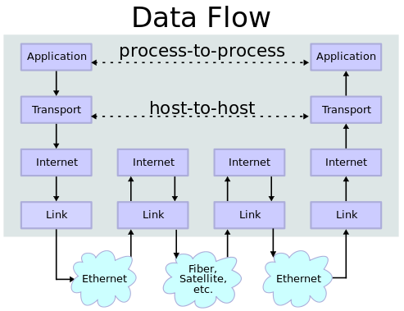
Network Layers
Layering principle
End-to-end principle
  IP layer: best-effort delivery
TCP
  Guaranteed in-order delivery
From Wikipedia
Notes:
https://comitserver.com/2018/03/14/%D9%BE%D8%B1%D9%88%D8%AA%DA%A9%D9%84-%D9%87%D8%A7%DB%8C-%D9%85%D8%AA%D8%AF%D8%A7%D9%88%D9%84-%D9%87%D8%A7%D8%B3%D8%AA-%D9%88-%D8%B3%D8%B1%D9%88%D8%B1-%D9%88-%D9%BE%D9%88%D8%B1%D8%AA-%D9%87%D8%A7%DB%8C/

Slide 9
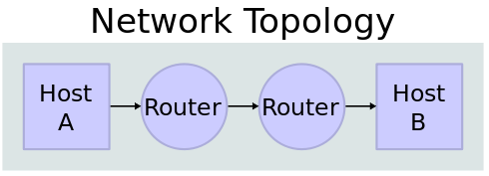
Router - Lookup and Forward
From Wikipedia
Data
H
Lookup
Address
Queue
Packet
Destination
Address
Egress link
Forwarding
Table
Buffer
Memory
From CS144, Stanford University

Slide 10
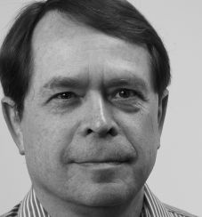
Congestion Avoidance and Control (SIGCOMM’88)
Van Jacobson
Adjunct professor at UCLA
One of the primary contributors to the TCP/IP protocol stack

Slide 11
Problems
A series of congestion collapses in Oct. 1986
  Data throughput from LBL to UC Berkeley dropped from 32 Kbps to 40 bps

Slide 12
Analysis
Conservation principle break
  A new packet isn’t put into the network until an old packet leaves
Possible failure reasons
  The connection doesn’t get to equilibrium
    Equilibrium: running stably with a full window of data in transit
  A sender injects a new packet before an old packet has exited
  The equilibrium can’t be reached because of resource limits along the path

Slide 13
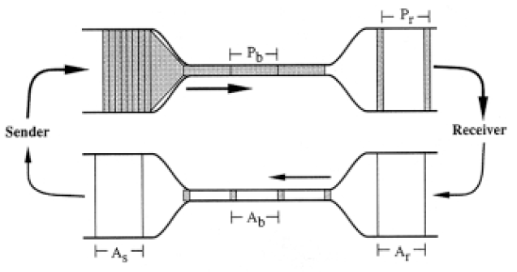
Getting to Equilibrium: Slow-start
Self-clocking
  Use ACK as the clock
So, how to start?

Slide 14
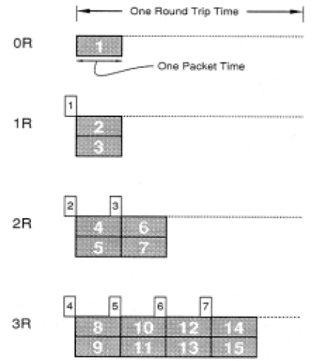
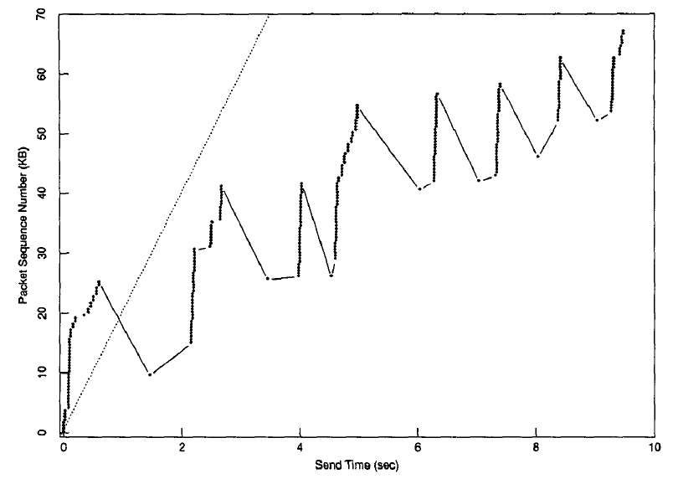
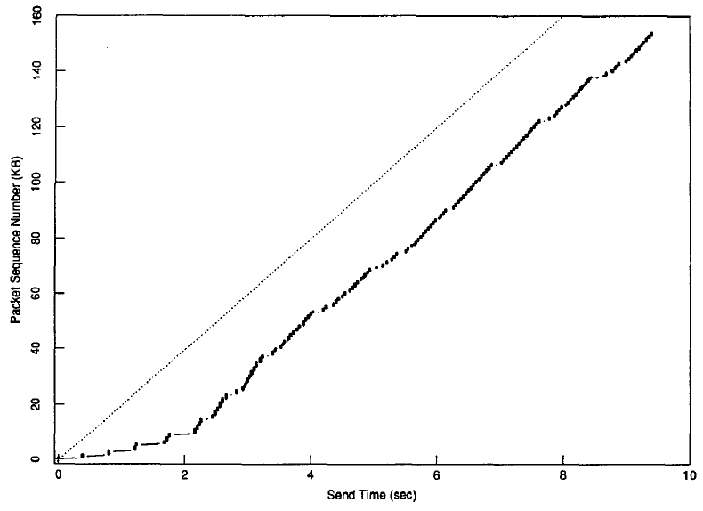
Getting to Equilibrium: Slow-start (2)
Slow start
  Start from cwnd=1
  Increase cwnd by 1 for each ACK
  Slow start but grow fast!
Before
After

Slide 15
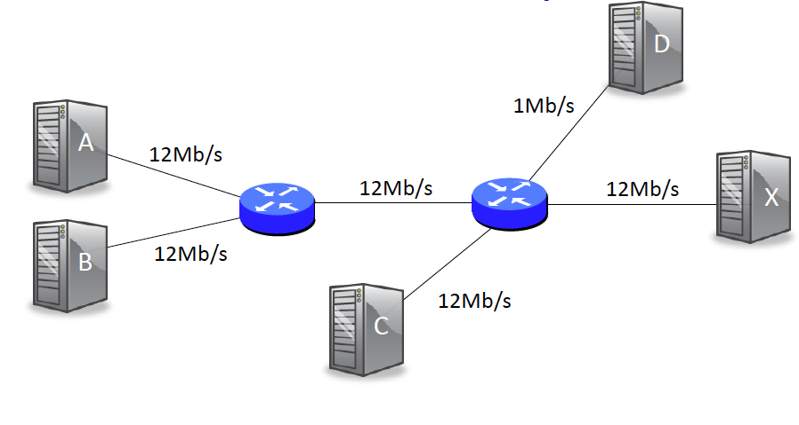
After Slow-start
How to converge to equlibrium?
Key insight: when congestion happens, packets drop
  Packet drop reason: insufficient buffer
Question
  How to know when packets drop?
  How to adjust cwnd gracefully?

Slide 16
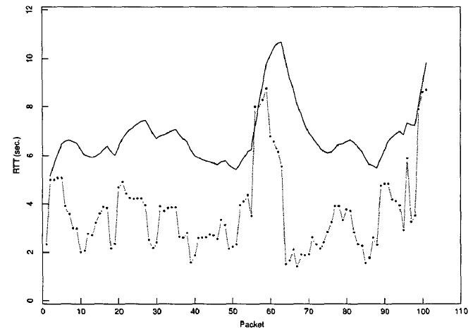
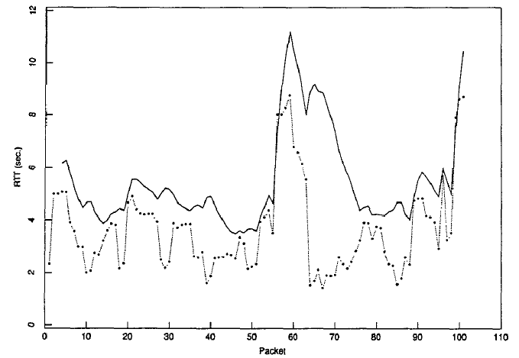
How to know when packets drop?
Use timeout!
  Timeout causes retransmission
  If timeout is not well estimated, a sender will injects a new packet before an old packet has exited
Timeout value is related to round-trip time (RTT)
  RTT changes dynamically
  EstimatedRTT = α * EstimatedRTT + (1−α) * MeasuredRTT
  Timeout value = β * EstimatedRTT
Mistake: not considering RTT variation
  Propose a cheap method for estimating variation
Before
After

Slide 17
How to Adjust cwnd Gracefully?
Congestion Avoidance
  Cannot grow like slow-start, it’s too fast
  Need a way to backoff
Additive increase / Multiplicative decrease (AIMD)
  On no congestion
    cwnd = cwnd + u (u > 0)
  On congestion
    cwnd = d * cwnd (d < 1)

Slide 18
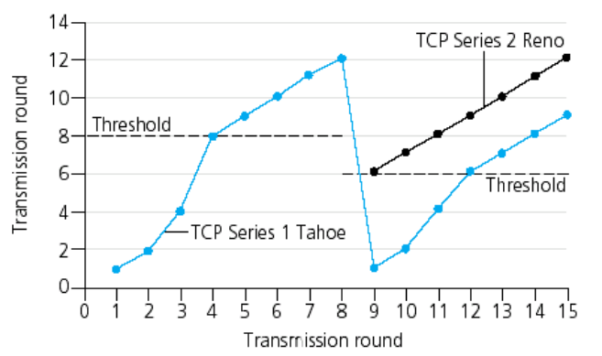
Put It All Together
Start with cwnd = 1
Slow start: Increase cwnd by 1 for each ack
On a timeout
  ssthresh = cwnd / 2
  cwnd= 1
  cwnd < ssthresh: cwnd += 1 for each ack (slow start)
  cwnd > ssthresh: cwnd += 1 / cwnd for each ack (additive increase)

Slide 19
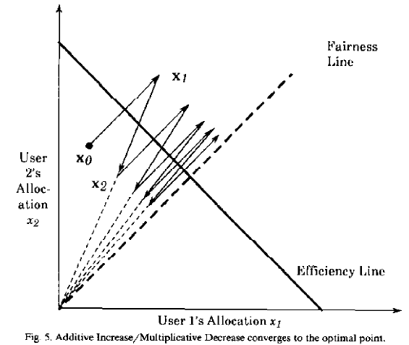

AIMD Analysis
“Analysis of the Increase and Decrease Algorithms for Congestion Avoidance in Computer Network“, Dah-Ming Chiu and Raj Jain (1989)
Criteria
  Quick convergence
  Efficiency: high utilization
  Fairness: each end-host gets fair-share
Equi-fairness line
Optimal point

Slide 20
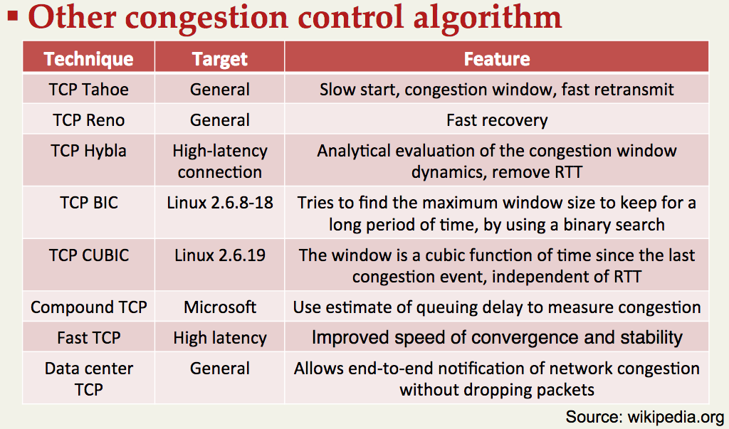
https://en.wikipedia.org/wiki/TCP_congestion_control#Algorithms
From CS6410 on 2013.

Slide 21
Other Congestion Control Mechanism
Timeout or duplicate ACK are actually implicit notification
Explicit congestion notification (ECN)
  Rate Control Protocol (RCP)
    Router divides outgoing link bandwidth equally among all the flows
    Encode the rate in packet header
  XCP
    Router encode hints in packet and let sender know how to adjust cwnd
  Datacenter TCP (DCTCP)

Slide 22
DCTCP algorithm
Sender side
Receiver side
Maintain the fraction of ECN marked seg. for each RTT
and update average fraction
of marked seg. ( )
Adopt alpha to cwnd decrease
Mark ECE only when CE packet is received
send immediate ACK when CE state is changed (regardless of delayed ACK)
wo Delayed ACK
w Delayed ACK
S
R
S
R
Immediate
ACK
CE (Congestion Experience)
ECE (ECN Echo)
Slide from https://slideplayer.com/slide/4764537/
Notes:
F = \frac{\mathrm{\#\ of\ marked\ ACKs}}{\mathrm{\#\ of\ ACKs}}
\alpha \leftarrow (1 - g)\ \alpha + g F
\mathrm{cwnd} \leftarrow (1 - \frac{\alpha}{2} )\mathrm{\ cwnd}

Slide 23


TCP Congestion Control with a Misbehaving Receiver (SIGCOMM’99)
Stefan Savage, PhD at UW, now Professor at UCSD
Neal Cardwell, MS at UW, now at Google
David Wetherall, Professor at UW, now at Google AI
Tom Anderson, Professor at UW
Images from Amazon

Slide 24
Misbehavior on TCP’s congestion control
TCP mechanisms implicitly rely on both endpoints to cooperate in determining the proper rate at which to send data
TCP's vulnerabilities arise from
  Unstated assumptions
  Casual specification
  Congestion control that are backward compatible with previous TCP
Proposal: designing robust protocols
  Principle 1: Every message should say what it means
  Principle 2: The conditions for a message to be acted upon should be clearly set out
  Principle 3. If the identity of a principal is essential to the meaning of a message, it is prudent to mention the principal's name explicitly in the message.

Slide 25
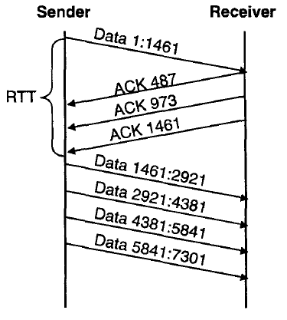
ACK division
TCP spec
  During slow start, TCP increments cwnd by at most SMSS bytes for each ACK received.
  During congestion avoidance, cwnd is incremented by 1 full-sized segment per round-trip time (RTT).
Attack
  Upon receiving a data segment containing N bytes, the receiver divides the resulting ACK into M separate acknowledgments
Misbehavior: cwnd=4 instead of 2!

Slide 26
ACK division - Solution
This vulnerability arises from an ambiguity about how ACKs should be interpreted
Two solutions
  modify the congestion control mechanisms to operate at byte granularity
    virtually identical to the "byte counting" modifications to TCP discussed in [Al198, A1199]
  guarantee that segment-level granularity is always respected
    only increment cwnd by one SMSS when a valid ACK arrives that covers the entire data segment sent
    In Linux 2.2.x

Slide 27
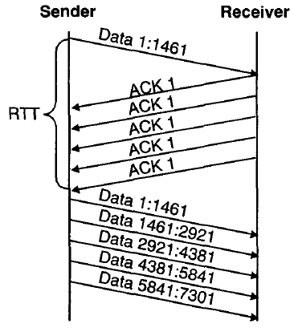
DupACK spoofing
TCP fast recovery
  Set cwnd to ssthresh plus 3*SMSS
  For each additional duplicate ACK received, increment cwnd by SMSS
Attack
  Upon receiving a data segment, the receiver sends a long stream of acknowledgments for the last sequence number received

Slide 28
DupACK spoofing - Solution
This vulnerability arises from the meaning of a duplicate ACK is implicit, dependent on previous context, and consequently difficult to verify.
Solution
  Two new fields into the TCP packet format: Nonce and Nonce reply
  Sender: fills the Nonce field with a unique random number
  Receiver: echoes the nonce value by writing it into the Nonce Reply

Slide 29
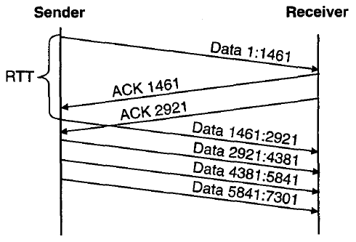
Optimistic ACKing
TCP spec
  assumption that the time between a data segment being sent and an ACK is at least one round-trip time. Since TCP's congestion
  However, there is no mechanism to enforce this assumption
Attack
  Upon receiving a data segment, the receiver sends a stream of ACKs anticipating data that will be sent by the sender

Slide 30
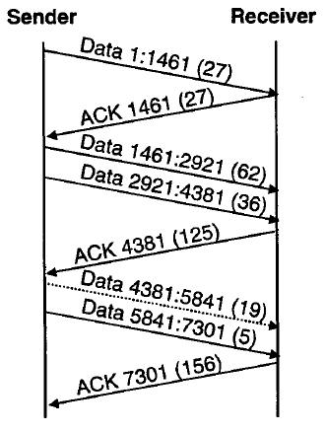
Optimistic ACKing - Solution
The optimistic ACK attack is possible because ACKs do not contain any proof regarding the identity of the data segment(s) that caused them to be sent
Solution
  Cumulative Nonce
Last ACK’s cumulative nonce value is incorrect (156 instead
of the expected value of 149)

Slide 31
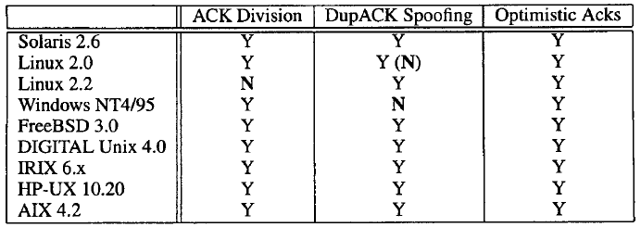
Different Implementation

Slide 32
Recap
Congestion control
  Slow-start
  RTT estimation using variation
  AIMD
TCP attack
  ACK division
  DupACK spoofing
  Optimistic ACKing

Slide 33
Perspective
There are 4.1 billion Internet users in the world as of December 2018
  compared to 3.9 billion Internet users in mid-2018 and about 3.7 billion Internet users in late 2017
Mobile traffic is responsible for 52.2 percent of Internet traffic in 2018
  compared to 50.3 percent from 2017
Numbers from https://hostingfacts.com/internet-facts-stats/

Slide 34
Thanks!

