Slide 1
Distributed systems: PAxos
Hakim Weatherspoon
CS6410
Slides borrowed liberally from past presentations from Robert Surton, Cecchetti, Burcu Canakci and Matt Burke

Slide 2
Timeline
Time, Clocks and Ordering
State Machine Replication
Paxos Published
1978
1984
1989

Slide 3
Timeline
Time, Clocks and Ordering
State Machine Replication
Paxos Published
Paxos Published In Journal
1978
1984
1989
1998

Slide 4
Timeline
Time, Clocks and Ordering
State Machine Replication
Paxos Published
Paxos Published In Journal
Paxos Made Simple
1978
1984
1989
1998
2001

Slide 5
Timeline
Time, Clocks and Ordering
State Machine Replication
Paxos Published
Paxos Published In Journal
Paxos Made Simple
1978
1984
1989
1998
2001
Paxos Made Moderately Complex
2015

Slide 6
What is consensus?
Assume a collection of processes that can propose values. A consensus algorithm ensures that a single one among the proposed values is chosen . . . We won’t try to specify precise liveness requirements.
The consensus problem involves an asynchronous system of processes, some of which may be unreliable. The problem is for the reliable processes to agree on a binary value . . . every protocol for this problem has the possibility of nontermination . . .

Slide 7
What is consensus?
Only a proposed value may be chosen.
Only one, unique value may be chosen.
All correct processes must eventually choose that value.

Slide 8
Paxos
Leslie Lamport

Slide 9
Paxos
The Part-Time Parliament (1998)
Recent archaeological discoveries on the island of Paxos reveal that the parliament functioned despite the peripatetic propensity of its part-time legislators. The legislators maintained consistent copies of the parliamentary record, despite their frequent forays from the chamber and the forgetfulness of their messengers. The Paxon parliament’s protocol provides a new way of implementing the state machine approach to the design of distributed systems.

Slide 10
The Part-Time Parliament

Slide 11
Paxos: The Lost Manuscript
Finally published in 1998 after it was put into use
Published as a “lost manuscript” with notes from Keith Marzullo
“This submission was recently discovered behind a filing cabinet in the TOCS editorial office. Despite its age, the editor-in-chief felt that it was worth publishing. Because the author is currently doing field work in the Greek isles and cannot be reached, I was asked to prepare it for publication.”
“Paxos Made Simple” simplified the explanation…a bit too much
Abstract: The Paxos algorithm, when presented in plain English, is very simple.

Slide 12
Assumptions about our model
Processes can fail by crashing
No indication of failure; simply stops responding to messages
Failed processes cannot arbitrarily transition or send arbitrary messages
Asynchronous, but reliable, network
Messages can be
lost
duplicated
reordered
held arbitrarily long
If a msg is sent infinitely many time, it will be delivered infinitely many times.

Slide 13
Processes

Slide 14
Processes
Proposers
Learners
Acceptors

Slide 15
Processes
Proposers
Learners
Acceptors

Slide 16
Any process might fail
There must be multiple acceptors.

Slide 17
Only choose a single value
A majority of acceptors must agree on the choice.

Slide 18
Property 1
An acceptor must accept the first proposal it receives.

Slide 19
Wait—what?
Majority-must-agree + Must-accept-first =
Acceptors must be able to accept multiple proposals

Slide 20
Wait—what?
Majority-must-agree + Must-accept-first =
Acceptors must be able to accept multiple proposals
Number all proposals uniquely to distinguish them

Slide 21
Property 2
If a proposal with value v is chosen, then every higher-numbered proposal that is chosen
has value v.

Slide 22
Property 2a
If a proposal with value v is chosen, then every higher-numbered proposal accepted by any acceptor
has value v.

Slide 23
Property 2b
If a proposal with value v is chosen, then every higher-numbered proposal issued by any proposer
has value v.

Slide 24
Property 2c
For any v and n, if a proposal with value v and number n is issued, then there is a set S consisting of a majority of acceptors such that either
no acceptor in S has accepted any proposal numbered less than n, or
v is the value of the highest-numbered proposal among all proposals numbered less than n accepted by the acceptors in S.

Slide 25
Proposers

Slide 26
Proposers
Proposers

Slide 27
Prepare requests
Instead of predicting the future
Proposer sends prepare n to acceptors
Each acceptor replies with
A promise to reject lower proposals in future
If any, the highest accepted lower proposal

Slide 28
Accept request
If a majority promise
Proposer sends propose n, v
If there were accepted proposals
v must match the highest one
(Otherwise, v can be arbitrary.)

Slide 29
Acceptors
Acceptors

Slide 30
Property 1a
An acceptor can accept a proposal numbered n iff it has not responded to a prepare request having a number greater than n.

Slide 31
Responding to prepare requests
An acceptors may respond to any prepare request
To optimize, ignore requests lower than promised

Slide 32
Learners
Choose majority
Broadcast choices
Learners

Slide 33
Distinguished learner (optimization)

Slide 34
Progress
P₁ receives promises for n₁
P₂ receives promises for n₂ > n₁
P₁ sends proposal numbered n₁, rejected
P₁ receives promises for n₁’ > n₂
P₂ sends proposal numbered n₂, rejected
P₁ receives promises for n₂’ > n₁’
P₁ sends proposal numbered n₁’, rejected
ad infinitum…

Slide 35
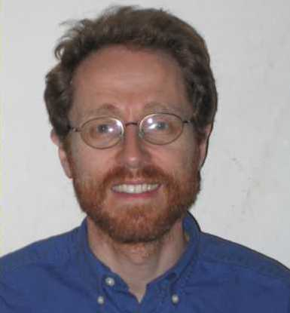
Paxos Made Moderately Complex
Robbert van Renesse and Deniz Altinbuken (Cornell University) ACM Computing Surveys, 2015
“The Part-Time Parliament” was too confusing
“Paxos Made Simple” was overly simplified
Better to make it moderately complex! Much easier to understand

Slide 36
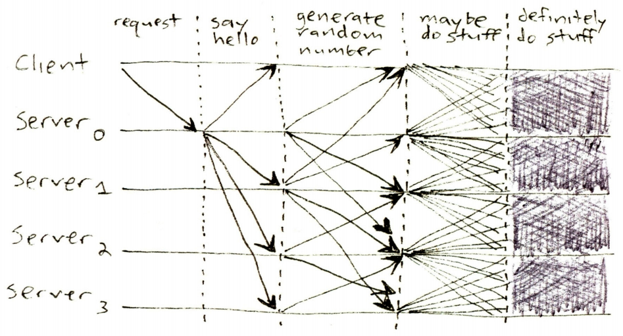
Paxos Structure
Figure from James Mickens. ;login: logout. The Saddest Moment. May 2013

Slide 37
Paxos Structure
Proposers
Acceptors
Learners

Slide 38
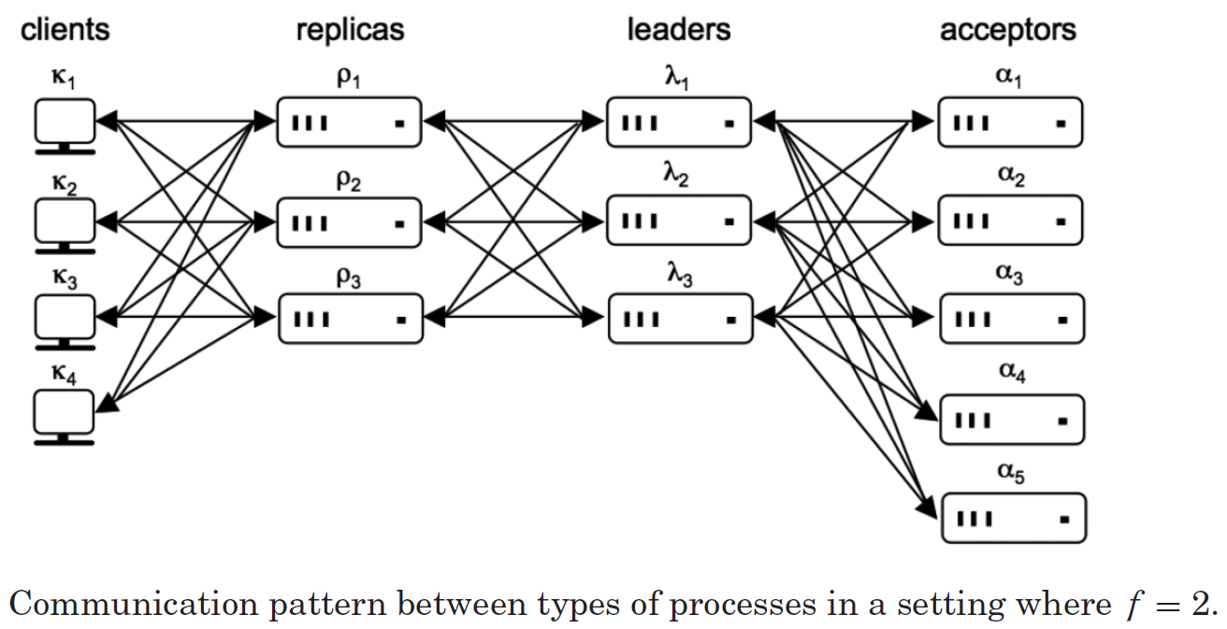
Moderate Complexity: Notation
Function as proposers and learners without persistent storage
Store data and propose to proposers
Figure from van Renesse and Altinbuken 2015

Slide 39
Single-Decree Synod
Proposer
b = 0
Acceptor_{i}
b' = 0
Decides on one command
System is divided into proposers and acceptors
The protocol executes in phases:
b = b + 1
Send (p1a,b)
if (b' < b)
b' = b
Send (p1b,b',c_{i})
Proposer proposes a ballot b
if (b' > b)
b = b'
abort
if majority
c = b-max(c_{i})
Send (p2a,b,c)
Acceptor_{i} responds with (b', c_{i})
If b' > b, update b and abort Else wait for majority of acceptors Request received c_{i} with highest ballot number
if (b' == b)
accept (b',c)
Send (p2b,b',c)
If b' has not changed, accept
A learner learns c if it receives the same (p2b, b',c) from a majority of acceptors

Slide 40
Optimizations: Distinguished Learner
Proposers
Acceptors
Distinguished Learner
Other Learners

Slide 41
Optimizations: Distinguished Proposer
Other Proposers
Distinguished Proposer
Acceptors
Learners

Slide 42
What can go wrong?
A bunch of preemption
If two proposers keep preempting each other, no decision will be made
Too many faults
Liveness requirements
majority of acceptors
one proposer
one learner
Correctness requires one learner

Slide 43
Deciding on Multiple Commands
Run Synod protocol for multiple slots
Slot 1
Sequential separate runs
Slow
Parallel separate runs
Broken (no ordering)
One run with multiple slots Multi-decree Synod!
Synod
c₁
Slot 2
Multi-decree Synod
Synod
c₂
Slot 3
Syond
c₃

Slide 44
Paxos with Multi-Decree Synod
Like single-decree Synod with one key difference: Every proposal contains a both a ballot and slot number
Each slot is decided independently
On preemption (if (b' > b) {b = b'; abort;}), proposer aborts active proposals for all slots

Slide 45
Moderate Complexity: Leaders
Leader functionality is split into pieces
Scouts – perform proposal function for a ballot number
While a scout is outstanding, do nothing
Commanders – perform commit requests
If a majority of acceptors accept, the commander reports a decision
Both can be preempted by a higher ballot number
Causes all commanders and scouts to shut down and spawn a new scout

Slide 46
Moderate Complexity: Optimizations
Distinguished Leader
Provides both distinguished proposer and distinguished learner
Garbage Collection
Each acceptor has to store every previous decision
Once f + 1 have all decisions up to slot s, no need to store s or earlier

Slide 47
Paxos Questions?

Slide 48
Backup

Slide 49
What is consensus?
Consensus is the problem of getting a set of processors to agree on some value.

Slide 50
What is consensus?
More formally, consensus is the problem of satisfying the following properties:
Validity
Agreement
Integrity
Termination
Notes:
Not to be confused with previous properties that we’ve seen with the same names (such as Agreement from SMR)

Slide 51
What is consensus?
More formally, consensus is the problem of satisfying the following properties:
Validity
If all processes that propose a value propose v, then all correct deciding processes eventually decide v
Agreement
Integrity
Termination
Notes:
Discussion question: in the lunch example, what is the meaning of validity?
Answer: If all of the proposals for where to eat are the same place, then all people eventually agree to eat at the proposed place.

Slide 52
What is consensus?
More formally, consensus is the problem of satisfying the following properties:
Validity
If all processes that propose a value propose v, then all correct deciding processes eventually decide v
Agreement
If a correct deciding process decides v, then all correct deciding processes eventually decide v
Integrity
Termination
Notes:
Discussion question: in the lunch example, what is the meaning of agreement?
Answer: If a person in the groups makes a final decision to go to a place to eat, then all people in the group eventually agree to eat there as well.

Slide 53
What is consensus?
More formally, consensus is the problem of satisfying the following properties:
Validity
If all processes that propose a value propose v, then all correct deciding processes eventually decide v
Agreement
If a correct deciding process decides v, then all correct deciding processes eventually decide v
Integrity
Every correct deciding process decides at most one value, and if it decides v, then some process must have proposed v
Termination
Notes:
Discussion question: in the lunch example, what is the meaning of integrity?
Answer: There is no pre-determined place at which everyone will agree to eat. It must be possible (for sake of variety!) that a proposal can be made.

Slide 54
What is consensus?
More formally, consensus is the problem of satisfying the following properties:
Validity
If all processes that propose a value propose v, then all correct deciding processes eventually decide v
Agreement
If a correct deciding process decides v, then all correct deciding processes eventually decide v
Integrity
Every correct deciding process decides at most one value, and if it decides v, then some process must have proposed v
Termination
Every correct learning process eventually learns some decided value
Notes:
Discussion question: in the lunch example, what is the meaning of termination?
Answer: They eventually get eat lunch!

