Slide 1
MapReduce
Kate Donahue
[Some slides taken from Yiqing Hua and Mengqi Xia’s presentation]

Slide 2
Overview
MapReduce
  Timeline
  Core idea
  Examples
  Other design choices
  Demonstrated Results
Comparison
  RDD paper
  Friends or Foes? paper

Slide 3
Timeline
1998: Google founded
2004: Google IPO
2004: MapReduce paper
2006: Hadoop released
2010: “MapReduce and Parallel DBMSs: Friends or Foes?” paper
2012: “Resilient Distributed Datasets” paper

Slide 4
Authors
Jeff Dean
  Now head of Google AI
Sanjay Ghemawat
  Now senior fellow in Google Systems group
  Went to Cornell but doesn’t donate enough
Both joined Google early and were responsible for many core contributions, even by the time this paper was written.

Slide 5
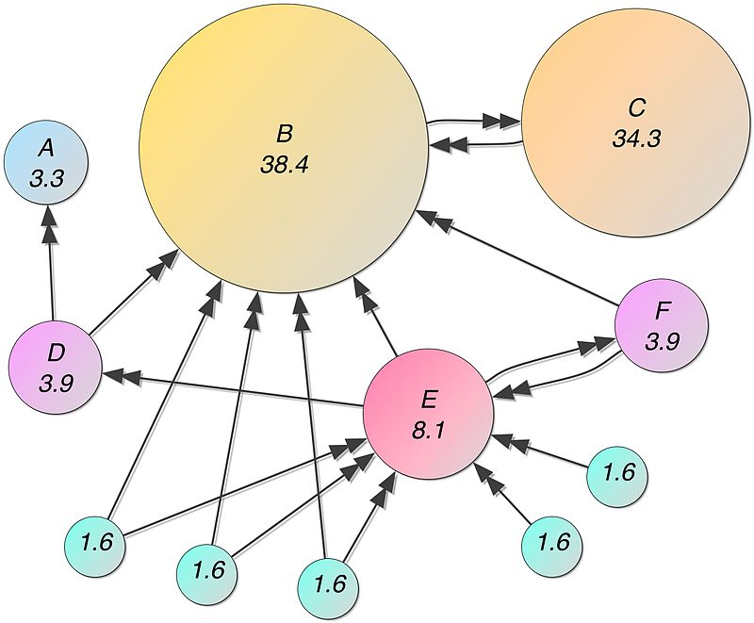
Engineering need
Google’s core business: search
Core search tool: PageRank
PageRank calculates importance of webpages based off of links to other pages.
“Join”: matrix with non-zero entries if there is a link from one webpage to another

Slide 6
Research needs (Discussion questions)
Engineering need:
  Key question: How do we compute PageRank on the entire web downloaded onto Google machines?
Developer need:
  Parallelization: thinking about it is tricky
  Key question: How can we make it very easy for engineers to use many worker machines to solve core Google problems?

Slide 7
MapReduce
A very simple framework with multiple implementations
Map
  Simple function taking in instances, calculating output associated with key
  Write intermediate data
(Shuffle)
  Optimal step: rewrite instances so identical keys are located closer together
Reduce
  Combine results associated with same key
Example: Word counts across documents

Slide 8
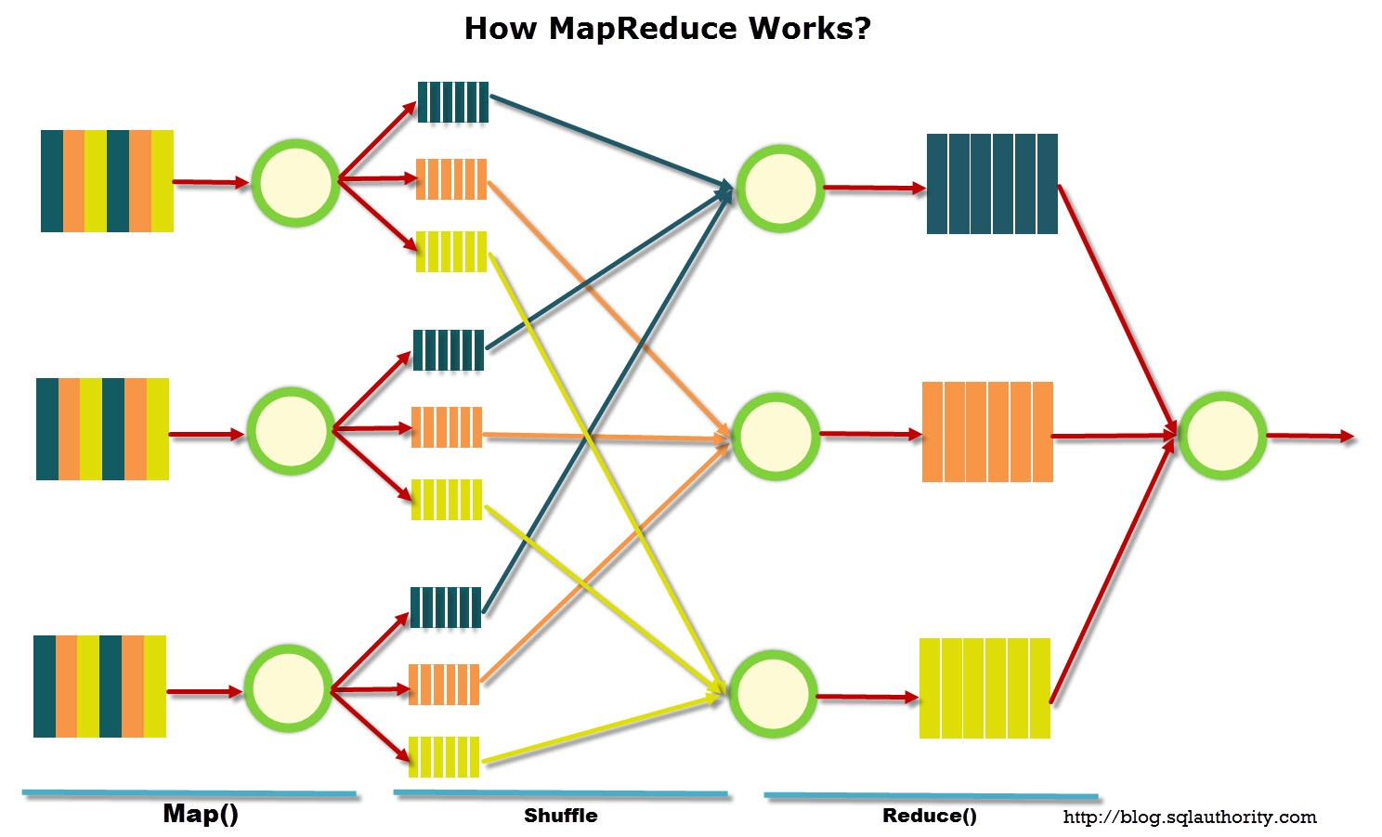
Step 1: define the “mapper”
map(String key, String value):
// key: document name
// value: document contents
for each word w in document:
EmitIntermediate (w, “1”);
map(“Hamlet”, “Tis now strook twelve…”)
{“tis”: “1”}
{“now”: “1”}
{“strook”: “1”}
…

Slide 9
Step 2: Shuffling
The shuffling step aggregates all results with the same key together into a single list. (Provided by the framework)
{“tis”: [“1”,“1”,“1”...]}
{“now”: [“1”,“1”,“1”]}
{“strook”: [“1”,“1”]}
{“the”: [“1”,“1”,“1”...]}
{“twelve”: [“1”,“1”]}
{“romeo”: [“1”,“1”,“1”...]}
{“juliet”: [“1”,“1”,“1”...]}
…
{“tis”: “1”}
{“now”: “1”}
{“strook”: “1”}
{“the”: “1”}
{“twelve”: “1”}
{“romeo”: “1”}
{“the”: “1”}
…

Slide 10
Step 3: Define the Reducer
Aggregates all the results together.
reduce(String key, Iterator values):
// key: a word
// values: a list of counts
sum = 0
for each v in values:
result += ParseInt(v)
Emit (AsString(result))
reduce(“tis”, [“1”,“1”,“1”,“1”,“1”])
{“tis”: “5”}
reduce(“the”, [“1”,“1”,“1”,“1”,“1”,“1”,“1”...])
{“the”: “23590”}
reduce(“strook”, [“1”,“1”])
{“strook”: “2”}
...

Slide 11
MapReduce
A very simple framework with multiple implementations
Map
  Simple function taking in instances, calculating output associated with key
  Write intermediate data
(Shuffle)
  Optimal step: rewrite instances so identical keys are located closer together
Reduce
  Combine results associated with same key
Example: Word counts across documents

Slide 12
Other examples
Reverse Web-link graph: <target, list of sources>
  Map: Ingests a source and produces <target, source> pairs for each target
  Shuffle: Sort by targets
  Reduce: Concatenate to produce <target, list(source)> output.

Slide 13
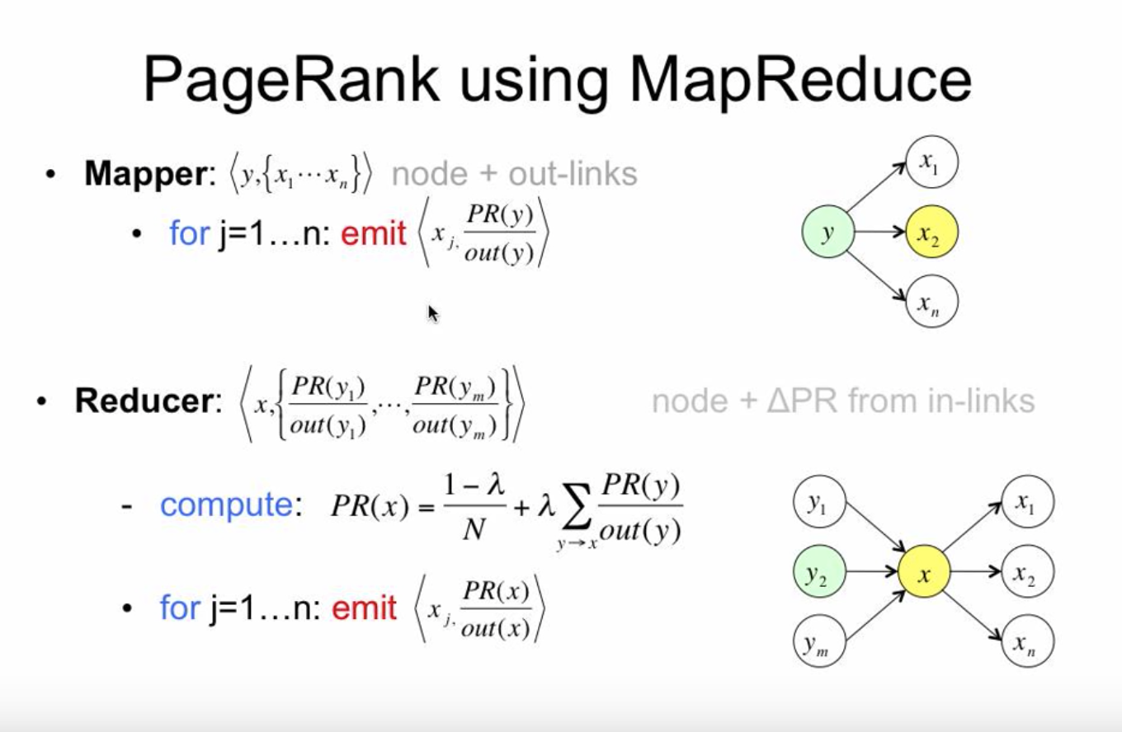
Other examples
Calculate PageRank algorithm:
  Iterative process – repeated.
  Map: Ingests a source and produce <target, calculated PR> for each target.
  Shuffle: sort by targets
  Reduce: Combine PR from all sources for a given target

Slide 14
Other examples
Distributed sort:
  Map: Ingests record, produces <key, record> pair.
  Shuffle: Sort by key.
  Reduce: Identity function.
Calculate mean by key:
  Map: Ingests <key, value> pair and produces same pair: is identity map.
  Shuffle: Sort by key.
  Reduce: Calculate mean for each key.

Slide 15
Implementation Environment
Machines: dual-processor running Linux, 2-4 GB memory
Commodity Networking Hardware: 100 MB/s or 1 GB/s, averaging less
Cluster: hundreds or thousands of machines → Common Machine Failure
Storage: disks attached to machines
File System: GFS
Users submit jobs (consists of tasks) to scheduler, scheduler schedules to machines within a cluster.

Slide 16
Design choices in paper implementation
M: number of map tasks (should be much larger than the total number of machines – heterogenous machines and tasks)
R: number of reduce tasks (should be a small multiple of number of machines – GFS restrictions)
“Combiner” function does local reduction for commutative reduction tasks (like addition).
If a worker fails to respond, re-assign its task to another worker.

Slide 17
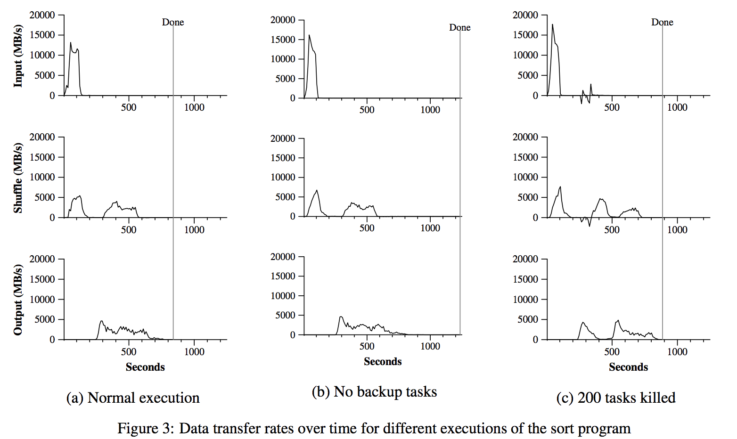
Stragglers experiment
If a worker fails to respond, re-assign its task to another worker.
Sort example:
Two humps for shuffle around the mapping and reduction steps.
Without backup steps, takes 44% longer to run.

Slide 18
Killing workers experiment
Kill 200 workers while process has begun.
Tasks re-assigned, only 5% longer to complete.

Slide 19
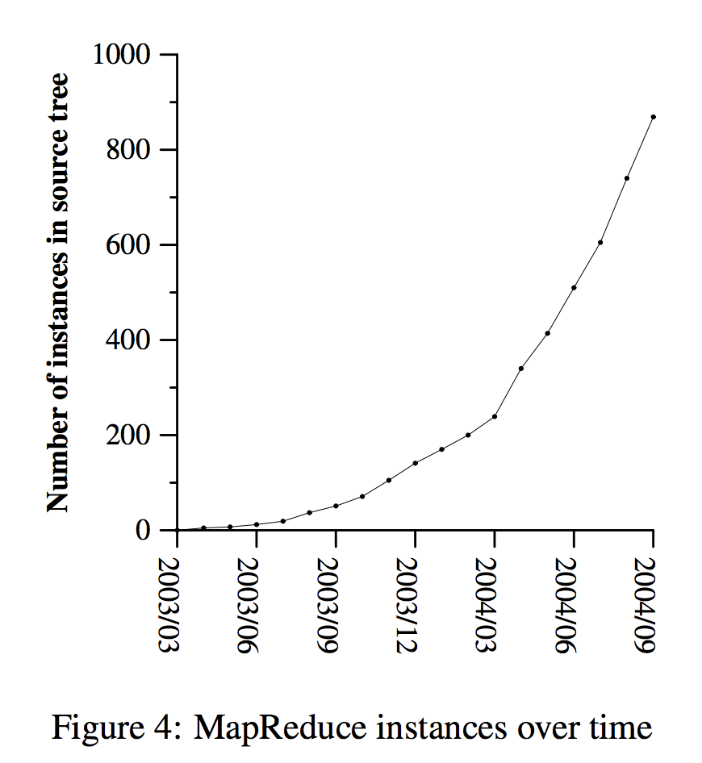
Usage at Google
Increasing usage at Google up to publication of this paper
Use cases:
  Machine learning
  Clustering for Google News
  Graph computations
  Extracting properties from web pages
Ease of use cited as helping widespread utilization

Slide 20
MapReduce Falling Behind User Desires
MapReduce greatly simplified “big data” analysis on large, unreliable clusters
But as soon as it got popular, users wanted more:
More complex, multi-stage applications (for example, iterative machine learning)
More interactive ad-hoc queries
Iterative algorithms and interactive data queries both require one thing that MapReduce lacks:
Efficient data sharing primitives

Slide 21
Limitations
MapReduce shares data across jobs by writing to stable storage.
This is SLOW because of replication and disk I/O, but necessary for fault tolerance in MapReduce’s framework
However, this isn’t necessary for fault tolerance in all frameworks – foreshadowing to Spark later!

Slide 22
Research question
Why did Google invent MapReduce rather than just using databases and database processing algorithms?

Slide 23
“MapReduce and Parallel DBMSs: Friends or Foes?”
“It was not until we received expert support from one of the vendors that we were able to get one particular DBMS to run queries that completed in minutes, rather than hours or days.”
MapReduce (Hadoop implementation)
  Extract-Transform-Load functionality
  Easier to get started with, free.
  Allows unstructured data, more flexible code structure than SQL.
  Potentially better for “quick and dirty” one-off runs of data.
Parallel database management systems
  Database systems
  Much trickier to get up and running.
  Structured data and SQL queries.
  Better when repeated queries are likely or results need to be stored.

Slide 24
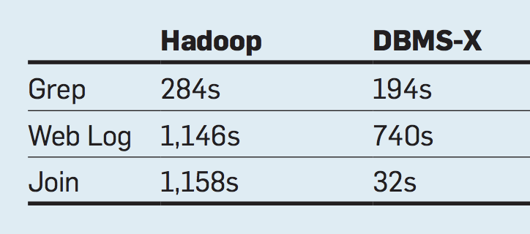
MapReduce vs. Parallel DBMS
Replicated tasks from original MapReduce paper, specifically chosen so indexing or other database techniques wouldn’t be helpful
Despite this, DBMS had much higher performance!

Slide 25
Potential Explanations
Mainly architectural decisions, not inherent limitations of MapReduce.
Repetitive record parsing: data stored in same form it was originally stored in (requires repeatedly converting from text).
Compression appears to help DBMS much more than MR.
Scheduling: DBMS has pre-build query plan, so easier to optimize.
In DBMS, data is sent directly from one worker to another, rather than being written to disk.
“The two technologies are complementary, and we expect MR-style systems performing ETL to live directly upstream from DBMSs”

Slide 26
Is there a better way to do MapReduce?
Research goal: Can we get the advantages of MapReduce over databases without the slowdown?

Slide 27
Resilient Distributed Datasets (Spark)
Keep intermediate results in memory. For fault-tolerance, keep “lineage” of steps required to produce data. In case of a fault, it is easier to reproduce data from versions still in memory: look at the specific input lines needed to produce the output lines that were lost.
Only coarse-grained operations (join, map, filter) rather than cell-level manipulation. Easier to maintain a log of transformations, but restricts actions you can take.
No checkpointing (writing of intermediate steps) necessary.
Users can ask for certain outputs to persist.

Slide 28
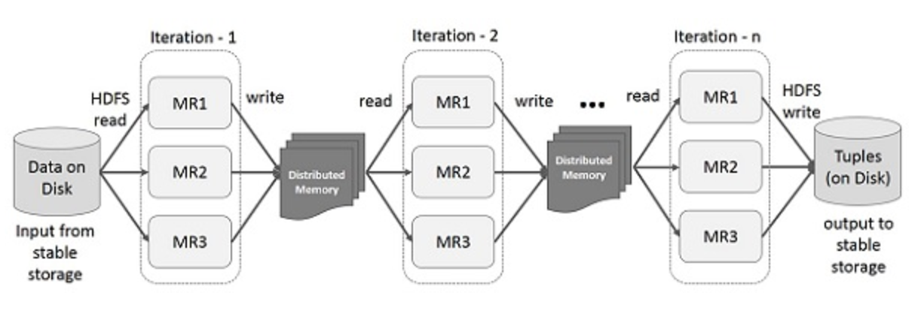
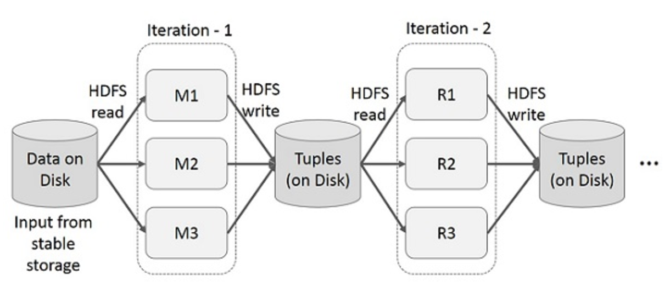
Iterative Operations
MapReduce
Spark RDD
Notes:
Hadoop file system, go to disk, read from disk , replicated

Slide 29
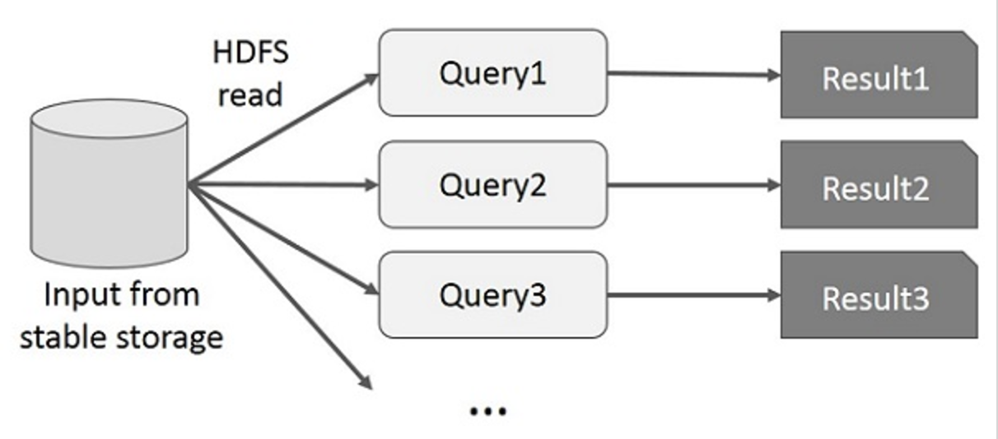
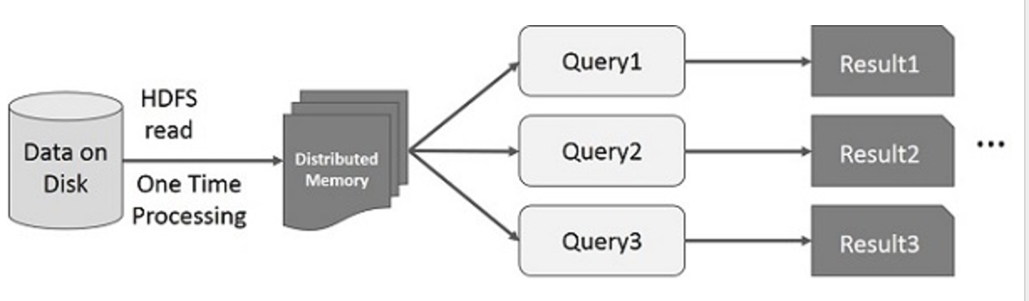
Interactive Operations
MapReduce
Spark RDD
Notes:
Each query needs disk I/O which also suffers from overhead

Slide 30
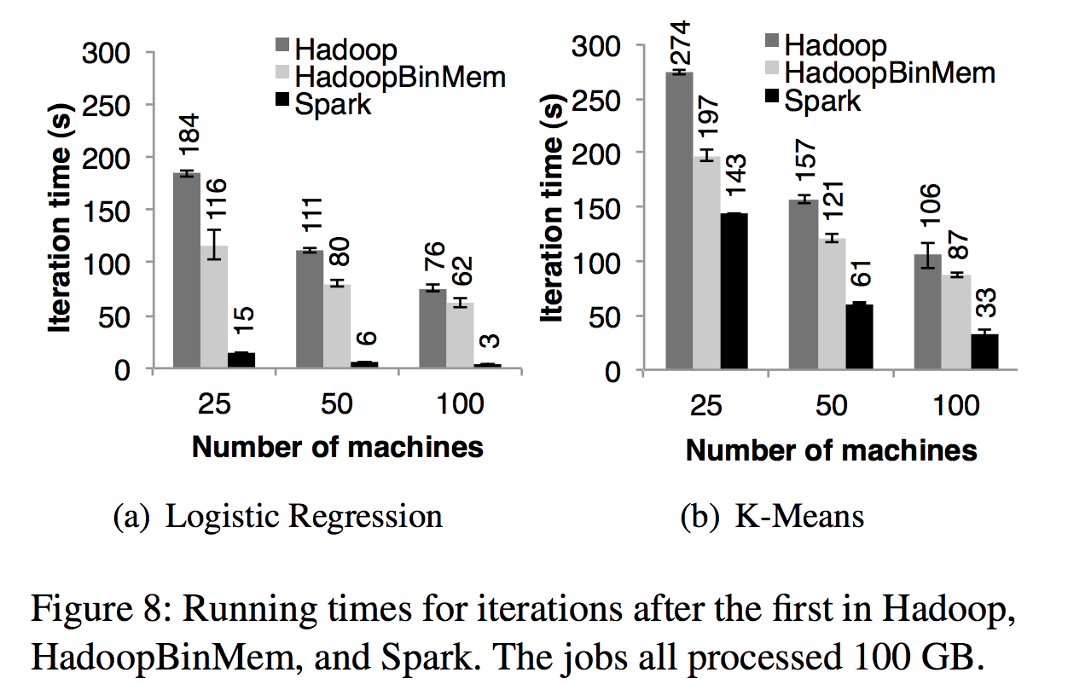
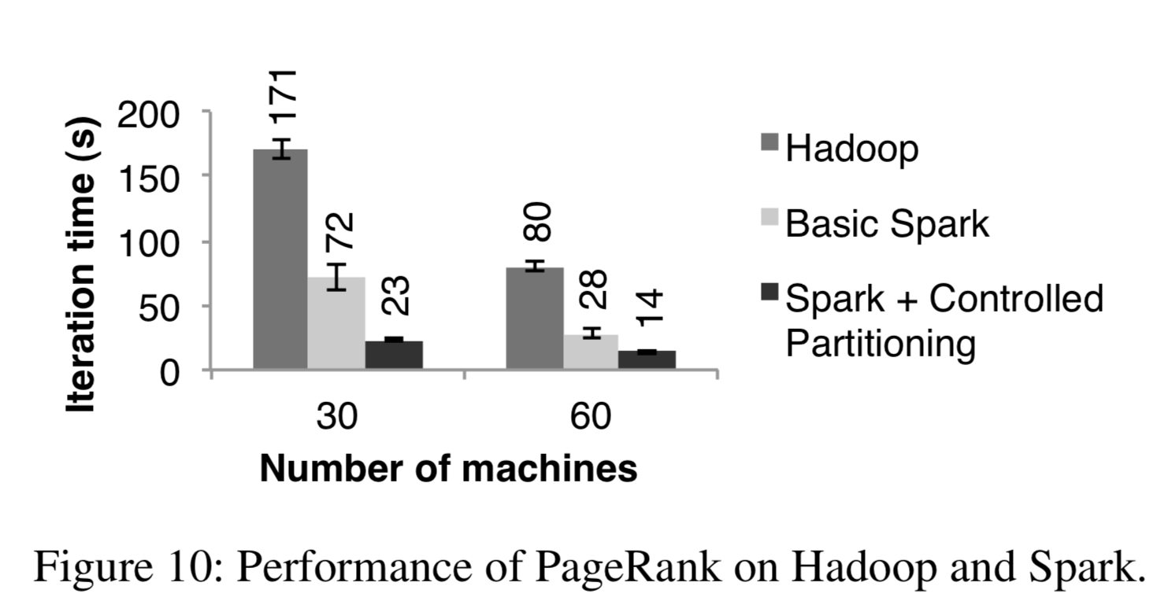
Performance: Time

Slide 31
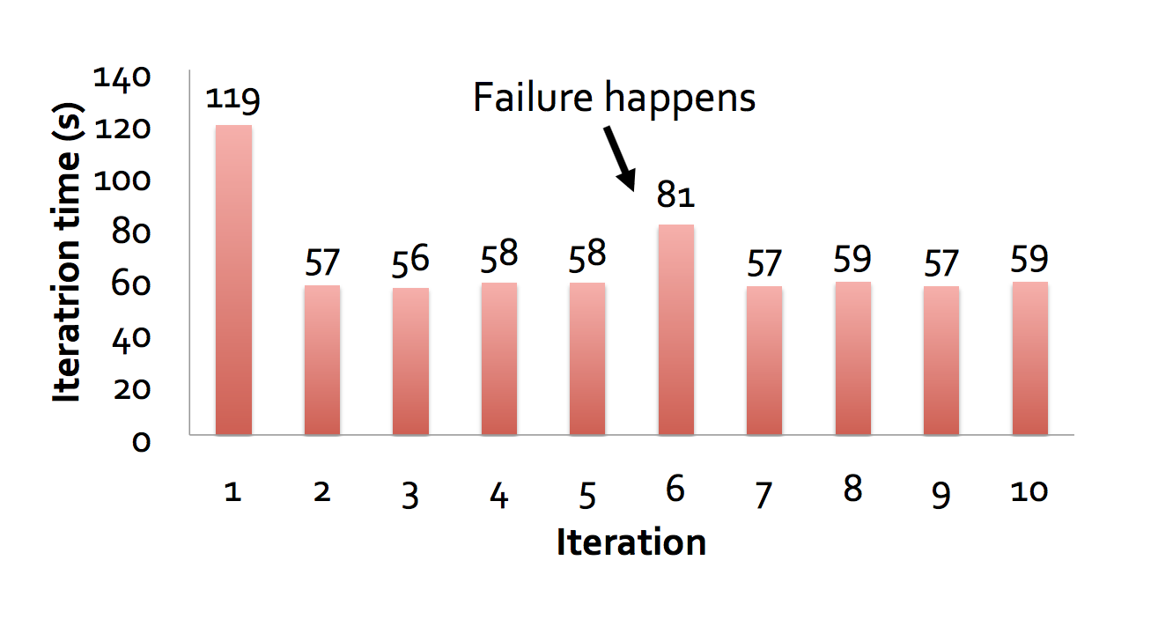
Performance: Fault-resilience
When nodes fail, Spark can recover quickly by rebuilding only the lost RDD partitions.
Notes:
Evaluated the cost of reconstructing RDD partitions using lineage after a node failure in the k-means application. Running times for 10 iterations of k-means on a 75-node cluster in normal operating scenario, with one where a node fails at the start of the 6th iteration.

Slide 32
Limitations
RDDs are best suited for batch applications that apply the same operation to all elements of a dataset. RDDs are not suitable for applications that make asynchronous fine-grained updates to shared state.
Spark loads a process into memory and keeps it for the sake of caching. If the data is too big to fit entirely into the memory, then there could be major performance degradations.

Slide 33
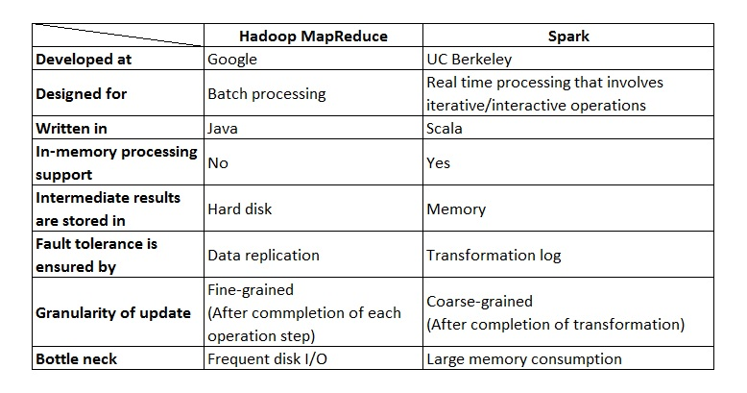
MapReduce vs Spark

Slide 34
Perspectives
MapReduce, databases, Spark, all differ:
  In engineering needs for a particular application
  In human needs in a particular situation
Selecting between them is likely a process of balancing these objectives.

