Slide 1
Cloud Storage Systems
CS 6410 - Fall 2019
Midhul Vuppalapati
(mvv25@cornell.edu)

Slide 2
History of Distributed Storage Systems

Slide 3
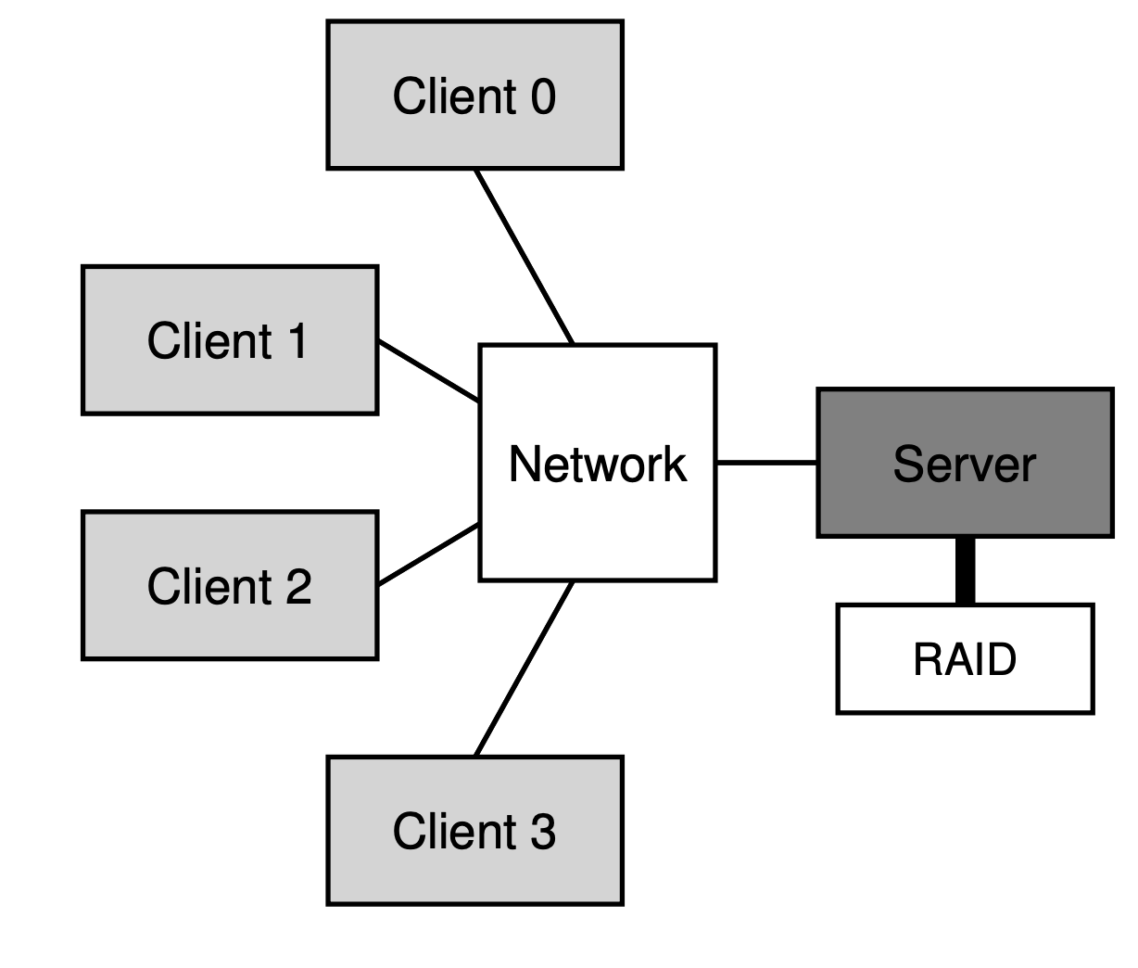
Networked File Systems
Network File System (NFS), Sun, 1986
Andrew File System (AFS), CMU, 1988
Goal: Make files accessible over network
Client/Server architecture
Q: How to reduce network transfers?
A: Client-side caching
Consistency Model
Figure taken from “Operating Systems: Three Easy Pieces”

Slide 4
“Distributed” File Systems
NFS/AFS - Given sub-tree of namespace managed by single server
Can’t store files larger than the capacity of single server
Server down => all files owned by it unavailable
Capacity under-utilization
Ideally: File should not be bound to single machine
“Serverless” Distributed File Systems
xFS [SOSP ’95], Petal [ASPLOS ’96] + Frangipani [SOSP ’97]
File data + metadata split across multiple machines
Redundancy across machines
Recovery + load balancing transparently handled

Slide 5
P2P Storage Systems
Designed for peers over WAN
Napster [1999]
Distributed Hash Tables (DHTs)
CAN, Chord, Pastry, Tapestry [2001]
Distributed Storage based on DHTs
Cooperative File System (CFS) [SOSP’01]
Pond [FAST’03]
Untrusted peers (possibly malicious)
Join/Leave (churn)
Figures taken from the public Internet

Slide 6
Google File System (GFS)
SOSP 2003

Slide 7
About the Authors
Sanjay Ghemawat
Undergrad at Cornell!
Howard Gobioff
Shun-Tak Leung

Slide 8
Why build GFS?
Built by Google, for Google
Google’s use-case: Large-scale data processing workloads
Data: crawled documents, search logs etc..
Clusters: 100s-1000s of machines w/ commodity hardware
MapReduce jobs (distributed computing framework)
Why not use existing systems?
Older DFS (xFS/Petal) don’t scale
P2P Storage systems designed for un-trusted scenario

Slide 9
Assumptions
Failures are common case
Large (Multi-GB) files are the common case
Read Characteristics
Large contiguous sequential reads (1MB+)
Small random reads (few KBs) at arbitrary offsets
Write Characteristics
Large sequential appends (possibly concurrent) are common case
Random writes are rare
Bandwidth more important than latency

Slide 10
Interface
Familiar file system interface
create, delete
open, close
read, write
Additional operations
Snapshot
Record Append
Not POSIX compliant

Slide 11
Architecture
GFS Master
Single Master!!!
Chunk
File
/
/foo/a.csv
CS1 | CS3 | CS5
bar
Application
foo
GFS Client
a.csv
b.csv
c.csv
Chunk
Replica
Namespace
File
Instructions
Heartbeats
GFS Chunk Server
Chunk size
Linux FS
CS1
CS2
CS3
CS4
CS5
CS6
Chunk Servers

Slide 12
Chunk size
Chunk-size = 64MB
Significantly larger than other file systems
Linux FS block size: 4KB
xFS / Petal: 64KB
Based on assumption that large files are common case
Reduces metadata footprint at Master
Internal fragmentation ?
Lazy space allocation for files on chunkservers.

Slide 13
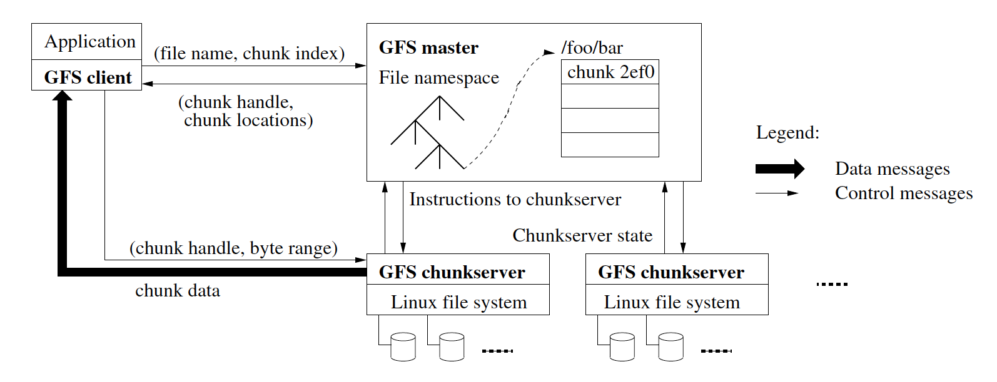
Read Path
Figure taken from GFS paper [SOSP’03]
Clients cache chunk locations
No client-side data caching!

Slide 14
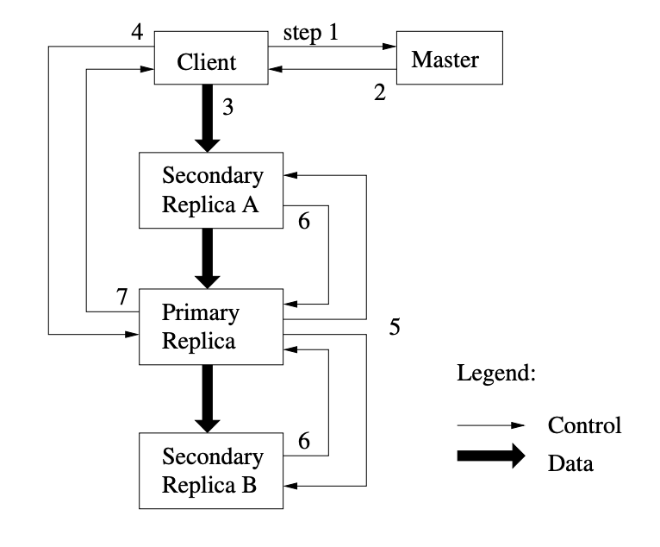
Write Path
Client contacts Master
Master replies w/ location of primary and other replicas
Client pushes data to all replicas; replicas buffer received data
Client sends write request to primary; primary serializes requests
Primary applies request, forwards to secondaries in serial order
Secondaries send Ack to primary
Primary sends Ack to client
Figure taken from GFS paper [SOSP’03]

Slide 15
What can go wrong?
Failures
Secondary B fails during write (transient failure)
Write operation fails
Primary & Secondary A have applied the write
Region is inconsistent
Write Failed
Figure taken from GFS paper [SOSP’03]

Slide 16
What can go wrong?
Concurrent writes
write(63999997, “hello”)
write(63999997, “world”)
GFS Client
GFS Client
Data from concurrent writes can get intermingled
Consistent but undefined
S
P
S
S
P
S
……………..hel
ld..…………….
0
64M
64M+1
128M

Slide 17
Writes - Consistency Model
Failed write - region is inconsistent
Successful write - region is consistent
Serial - region is defined
Concurrent - region is undefined
Messy consistency model!
File

Slide 18
Record Append
Atomic concurrent appends
Offset is decided by GFS
Primary checks if append can fit in chunk
No => pad and move to next chunk
Yes => write at current offset and tell secondaries to write at same offset
Failures can lead to duplicate records
Figure taken from GFS paper [SOSP’03]

Slide 19
Master: Fault-tolerance
Operation log + checkpoints replicated on multiple machines
Failure => New Master reads checkpoint and replays operation log
“shadow” masters provide read-only access
May lag behind Master

Slide 20
Master: Chunk Placement
Place chunk replicas on different racks
Better fault-tolerance
Use aggregate b/w of multiple racks
Figure taken from “Datacenter Network Topologies” by Costing Raiciu

Slide 21
Master: Other operations
Re-replication
Whenever # of available replicas < replication goal (3)
Rebalancing
Periodically moves replicas for better load balance
Garbage collection
Files & chunks are deleted asynchronously

Slide 22
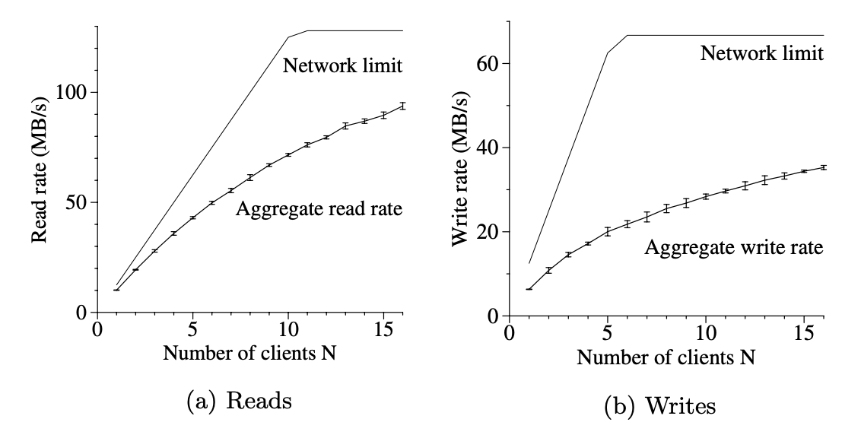
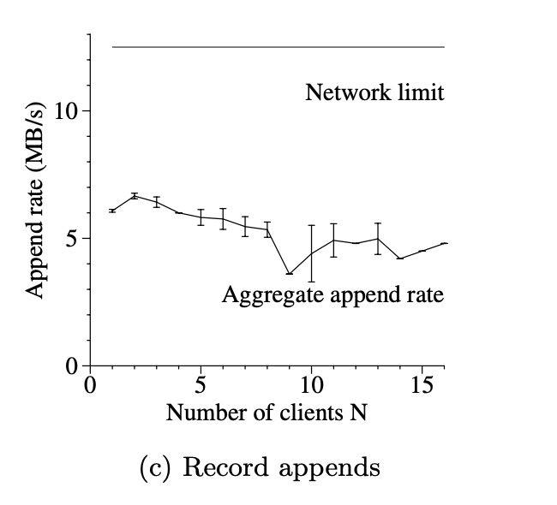
Evaluation
Microbenchmarks
Real production clusters
Metadata overhead
Read/Write throughput
Master load
Recovery time
Real workload characteristics
Plots taken from GFS paper [SOSP’03]

Slide 23
Impact of GFS
Inspired Append-only file systems
Ex: HDFS, Microsoft’s COSMOS
No support for byte-offset writes, only appends (cleaner)
SIGOPS Hall of Fame Award 2015
Most influential systems paper in last 10 years
Scale of today’s datacenter much larger
10,000-100,000 machines
Single master does not scale
COSMOS: Partitions namespace across multiple Masters
Tidbit: Recent GDPR policy invalidates append-only assumption

Slide 24
Thoughts?

Slide 25
Erasure Coding
GFS uses replication for fault tolerance
Storage overhead of 3x
Erasure Coding: Alternate technique for redundancy
Fault tolerance with lower storage overhead
Simple example: XOR-based Parity
In practice: (10,4) Reed-Solomon Codes
Data blocks
Parity

Slide 26
Recovery Cost
Key-challenge: Recovery cost
Re-constructing one block => read multiple blocks over network
Disk I/O, Network I/O, Compute overhead
Lot of work on reducing recovery cost
LRC Codes, Windows Azure Storage [ATC’12]
Hitchhiker [SIGCOMM’14]

Slide 27
Spanner [OSDI’12]
Geo-distributed storage system
Supports strong consistency guarantees
Implements Paxos across replicas for strong consistency
Implements Two phase commit across partitions to support transactions

Slide 28
TrueTime API
In GFS: Lease management is time-based
Clock skew across machines could cause issues!
Spanner [OSDI’12]
Uses TrueTime API for lease management
Implemented using GPS & Atomic clocks in Google clusters
Time returned not absolute, but interval
Truly Non-overlapping Paxos leaders

Slide 29
References
Ghemawat, Sanjay, Howard Gobioff, and Shun-Tak Leung. "The Google file system." (2003).
Sandberg, Russel, et al. "Design and implementation of the Sun network filesystem." Proceedings of the Summer USENIX conference. 1985.
Howard, John H., et al. "Scale and performance in a distributed file system." ACM Transactions on Computer Systems (TOCS) 6.1 (1988): 51-81.
Anderson, Thomas E., et al. "Serverless network file systems." ACM Transactions on Computer Systems (TOCS) 14.1 (1996): 41-79.
Lee, Edward K., and Chandramohan A. Thekkath. "Petal: Distributed virtual disks." ACM SIGPLAN Notices. Vol. 31. No. 9. ACM, 1996.
Thekkath, Chandramohan A., Timothy Mann, and Edward K. Lee. "Frangipani: A scalable distributed file system." SOSP. Vol. 97. 1997.

Slide 30
References
Stoica, Ion, et al. "Chord: A scalable peer-to-peer lookup service for internet applications." ACM SIGCOMM Computer Communication Review 31.4 (2001): 149-160.
Dabek, Frank, et al. "Wide-area cooperative storage with CFS." ACM SIGOPS Operating Systems Review. Vol. 35. No. 5. ACM, 2001.
Rhea, Sean C., et al. "Pond: The OceanStore Prototype." FAST. Vol. 3. 2003.
Huang, Cheng, et al. "Erasure coding in windows azure storage." Presented as part of the 2012 {USENIX} Annual Technical Conference ({USENIX}{ATC} 12). 2012.
Rashmi, K. V., et al. "A hitchhiker's guide to fast and efficient data reconstruction in erasure-coded data centers." ACM SIGCOMM Computer Communication Review. Vol. 44. No. 4. ACM, 2014.
Corbett, James C., et al. "Spanner: Google’s globally distributed database." ACM Transactions on Computer Systems (TOCS) 31.3 (2013): 8.

