Slide 1
Multiprocessors and Heterogeneous architectures
Hakim Weatherspoon
CS6410
Slides borrowed liberally from past presentations from Deniz Altinbuken, Ana Smith, Jonathan Chang

Slide 2
Overview
Systems for heterogeneous multiprocessor architectures
Disco (1997)
Smartly allocates shared-resources for virtual machines
Acknowledges NUMA (non-uniform memory access) architecture
Precursor to VMWare
Barrelfish (2009)
Uses replication to decouple resources for virtual machines via MPI
Explores hardware neutrality via system discovery
Takes advantage of inter-core communication

Slide 3
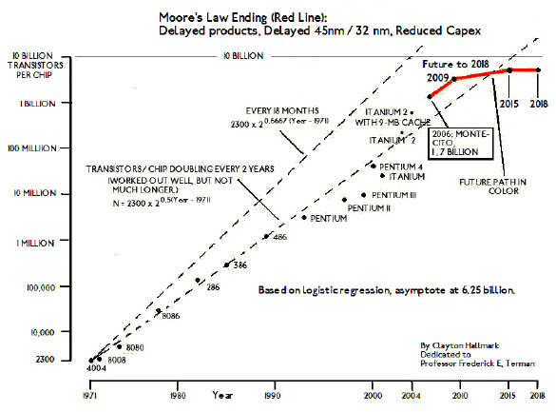
End of Moore’s Law?
Notes:
So the co-founder of Intel Gordon E. Moore introduced a law in 1965, stating that the number of transistors that can be placed inexpensively on an integrated circuit has doubled approximately every two years. But after a point the transistors became so dense that if the number of transistors continued to increase the chip would be hotter than a hot stove.
The first true multiprocessor D825 was introduced in 1962, so multiprocessors were already around when Moore’s Law started to degrade and to be able to continue with the same performance increase multiprocessors began to be produced thus introducing dual-core processors.

Slide 4
The Future

Slide 5
Processor Organizations
Single Instruction, Single Data Stream (SISD)
Single Instruction, Multiple Data Stream (SIMD)
Multiple Instruction, Single Data Stream (MISD)
Multiple Instruction, Multiple Data Stream (MIMD)
Uniprocessor
Vector Processor
Array Processor
Shared Memory
Distributed Memory
Symmetric Multiprocessor
Non-uniform Memory Access
Clusters
Notes:
So to have a look at the processor organizations in general, first there are single instruction single data stream processors that we call uniprocessors. These processors run a single instruction at a time on a single data. Then there is the single instruction multiple data stream processor which are mostly used for graphics/audio or video manipulation. They are used either to work on data stored as vectors or arrays. Then there is multiple instruction, single data stream processor organization which was not commercially introduced but used only for some research studies. Then at last we have the multiple instruction, multiple data stream processors. They either share their memory or have distributed memory. Clusters for example have distributed memories and work on multiple data with multiple instructions. On the other hand the multiprocessors share memory. The multiprocessors are either symmetric or have non-uniform access properties.

Slide 6
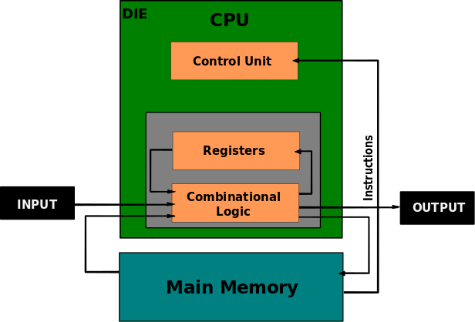
Evolution of Architecture (Uniprocessor)
Von Neumann Design (~1960)
# of Die = 1
# of Cores/Die = 1
Sharing=None
Caching=None
Frequency Scaling = True
Bottlenecks
Multiprogramming
Main memory access
Notes:
Picture from Wikipedia:
https://en.wikipedia.org/wiki/Central_processing_unit#/media/File:ABasicComputer.gif

Slide 7
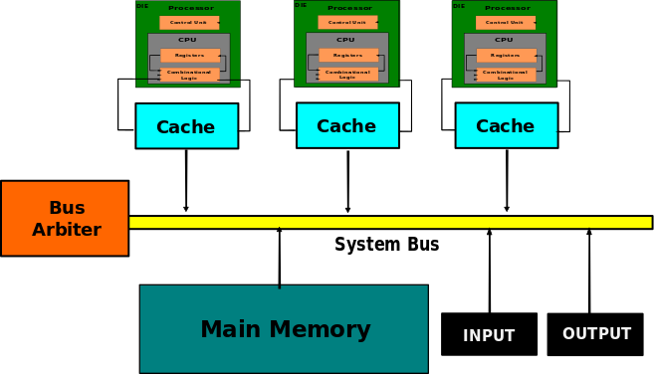
Evolution of Architecture (Multiprocessor)
Super computers (~1970)
# of Die = K
# of Cores/Die = 1
Sharing = 1 Bus
Caching = Level 1
Frequency Scaling = True
Bottlenecks:
Sharing required
One system bus
Cache reloading
Notes:
Picture from Wikipedia:
https://en.wikipedia.org/wiki/Symmetric_multiprocessing#/media/File:SMP_-_Symmetric_Multiprocessor_System.svg
http://www.computerhistory.org/timeline/1990/#169ebbe2ad45559efbc6eb357207433d
http://www.computerhistory.org/timeline/1964/#169ebbe2ad45559efbc6eb3572081363

Slide 8
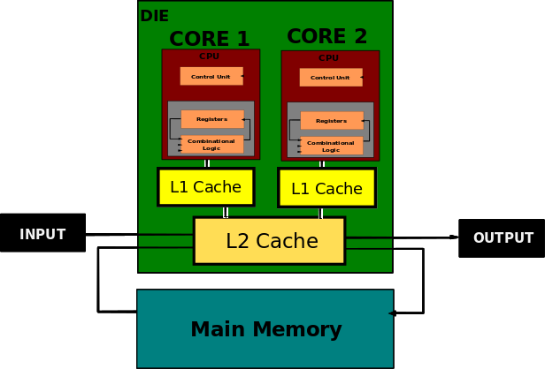
Evolution of Architecture (Multicore Processor)
IBM’s Power 4 (~2000s)
# of Die = 1
# of Cores/Die = M
Sharing = 1 Bus, L2 cache
Caching = Level 1 & 2
Frequency Scaling = False
Bottlenecks:
Shared bus & L2 caches
Cache-coherence
Notes:
Image adapted from Wikipedia:
https://en.wikipedia.org/wiki/Multi-core_processor#/media/File:Dual_Core_Generic.svg

Slide 9
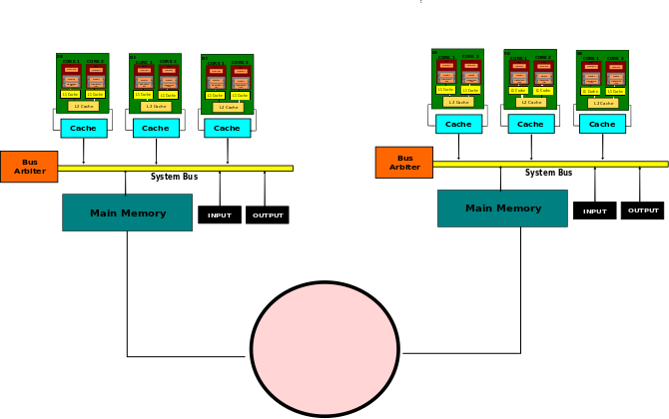
Evolution of Architecture (NUMA)
Non-uniform Memory Access
# of Die = K
# of Cores/Die = variable
Sharing = Local bus, local Memory
Caching: 2-4 levels
Frequency Scaling = False
Bottlenecks:
Locality: closer = faster
Processor diversity
Notes:
Images from Wikipedia:
https://en.wikipedia.org/wiki/File:NUMA.svg (right image)
https://en.wikipedia.org/wiki/ARM_big.LITTLE#/media/File:Global_Task_Scheduling.jpg (left image)

Slide 10
Challenges for Multiprocessor Systems
Stock OS’s (e.g. Unix) are not NUMA-aware
Assume uniform memory access
Requires major engineering effort to change this…
Synchronization is hard!
Even with NUMA architecture, sharing lots of data is expensive

Slide 11
Doesn’t some of this sound familiar?...
What about virtual machine monitors (aka hypervisors)?
VM monitors manage access to hardware
Present more conventional hardware layout to guest OS’s
Do VM monitors provide a satisfactory solution?
Notes:
Pause here to let the class answer

Slide 12
Doesn’t some of this sound familiar?...
What about virtual machine monitors (aka hypervisors)?
VM monitors manage access to hardware
Present more conventional hardware layout to guest OS’s
Do VM monitors provide a satisfactory solution?
High overhead (both speed and memory)
Communication is still an issue
Notes:
Speed overhead: virtualizing access to hardware resources slows down access to those resources
Memory overhead: running multiple copies of OS

Slide 13
Doesn’t some of this sound familiar?...
What about virtual machine monitors (aka hypervisors)?
VM monitors manage access to hardware
Present more conventional hardware layout to guest OS’s
Do VM monitors provide a satisfactory solution?
High overhead (both speed and memory)
Communication is still an issue
Proposed solution: Disco (1997)
Notes:
Speed overhead: virtualizing access to hardware resources slows down access to those resources
Memory overhead: running multiple copies of OS

Slide 14
Multiprocessors, Multi-core, Many-core
What are critical systems design considerations
Goal: Taking advantage of the resources in parallel
Scalability
Ability to support large number of processors
Flexibility
Supporting different architectures
Reliability and Fault Tolerance
Providing Cache Coherence
Performance
Minimizing Contention, Memory Latencies, Sharing Costs

Slide 15
Disco: About the Authors
Edouard Bugnion
Studied at Stanford
Currently at École polytechnique fédérale de Lausanne (EPFL)
Co-founder of VMware and Nuova Systems (now under Cisco)
Scott Devine
Co-founded VMWare, currently their principal engineer
Not the biology researcher
Cornell alum!
Mendel Rosenblum
Log-structured File System (LFS)
Another co-founder of VMWare

Slide 16
Disco: Goals
Develop a system that can scale to multiple processors…
...without requiring extensive modifications to existing OS’s
Hide NUMA
Minimize memory overhead
Facilitate communication between OS’s

Slide 17
Disco: Achieving Scalability
Additional layer of software that mediates resource access to, and manages communication between, multiple OS’s running on separate processors
OS
OS
OS
OS
...
Software
Disco
Multiprocessor
Processor
Processor
Processor
...
Processor
Hardware

Slide 18
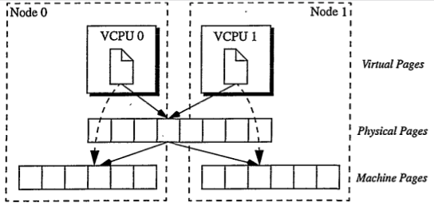
Disco: Hiding NUMA
Relocate frequently used pages closer to where they are used

Slide 19
Disco: Reducing Memory Overhead
Suppose we had to copy shared data (e.g. kernel code) for every VM
Lots of repeated data, and extra work to do the copies!
Solution: copy-on-write mechanism
Disco intercepts all disk reads
For data already loaded into machine memory, Disco just assigns mapping instead of copying

Slide 20
Disco: Facilitating Communication
VM’s share files with each other over NFS
What problems might arise from this?

Slide 21
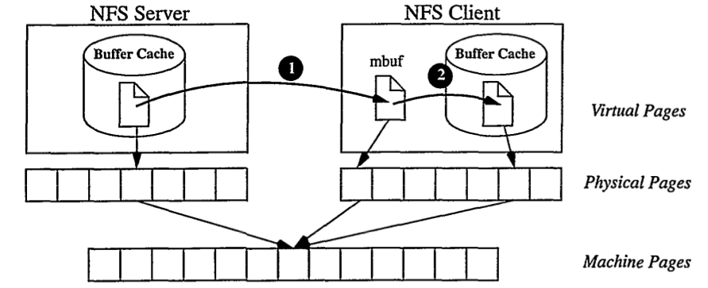
Disco: Facilitating Communication
VM’s share files with each other over NFS
What problems might arise from this?
Shared file appears in both client and server’s buffer!
Solution: copy-on-write, again!
Disco-managed network interface + global cache
Notes:
Regarding NFS buffer cache: NFS accumulates data into buffers before sending it. Disco’s solution produces an illusion of the file being in the client’s buffer by assigning a mapping to a shared page. That way the file doesn’t “really” need to be sent

Slide 22
Disco: Evaluation
Evaluation goals:
Does Disco achieve its stated goal of achieving scalability on multiprocessors?
Does it provide effective reduction in memory overhead?
Does it do all this without significantly impacting performance?
Evaluation methods: benchmarks on (simulated) IRIX (commodity OS) and SPLASHOS (custom-made specialized library OS)
Needed some changes to IRIX source code to make it compatible with Disco
Relocated IRIX kernel in memory, hand-patched hardware abstraction layer (HAL)
Is this cheating?
Notes:
Required changes to IRIX source code to relocate the kernel in memory
Authors also patched the hardware abstraction layer (HAL) to do the following:
Convert frequently used instructions to use non-trapping read/write calls (hand-patched!)
Pass hints to Disco to give it OS-level knowledge of resource allocation
Implement “remap” function that replaces NFS “bcopy” function

Slide 23
Disco: Evaluation Benchmarks
The following workloads were used for benchmarking:
Notes:
For those who are not familiar: raytracing is a technique in computer graphics that simulates the path of photons bouncing off surfaces

Slide 24
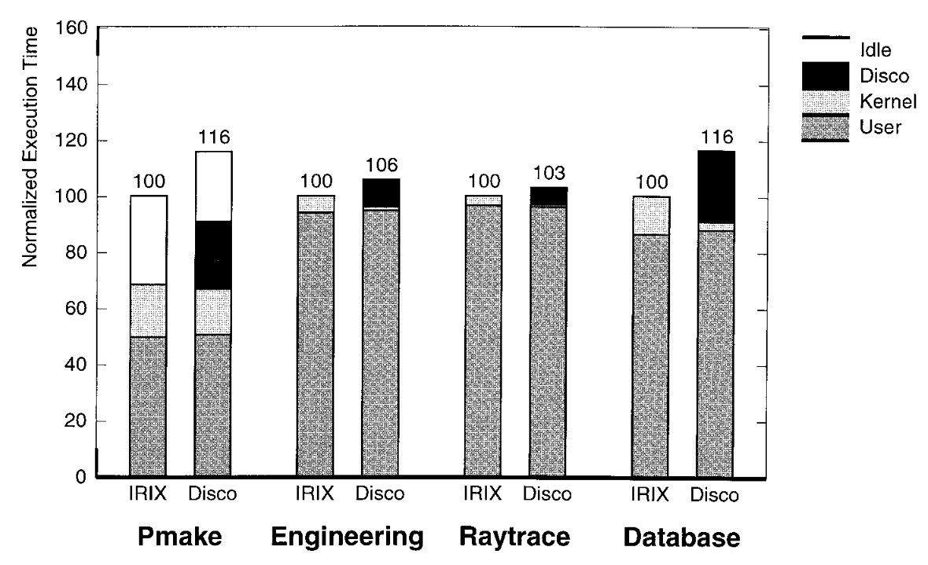
Disco: Impact on Performance
Methodology: run each of the 4 workloads on a uniprocessor system with and without Disco, measure difference in running time
What could account for the difference between workloads?
Notes:
Answer to question: pmake and database involve more file system usage

Slide 25
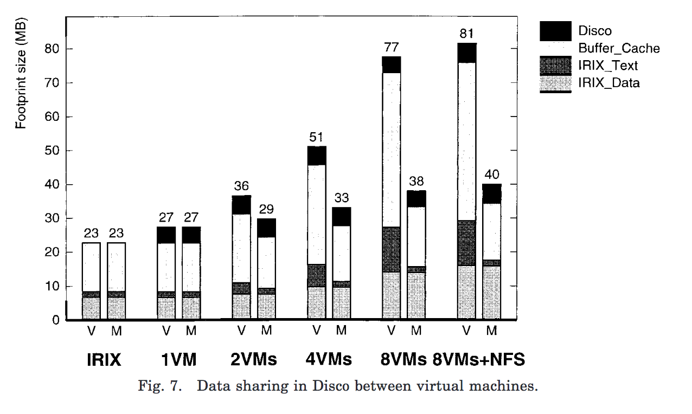
Disco: Measuring Memory Overheads
Methodology: run the pmake workload on stock IRIX and on Disco with varying number of VMs
Measurement: memory footprint in virtual memory (V) & actual machine memory (M)

Slide 26
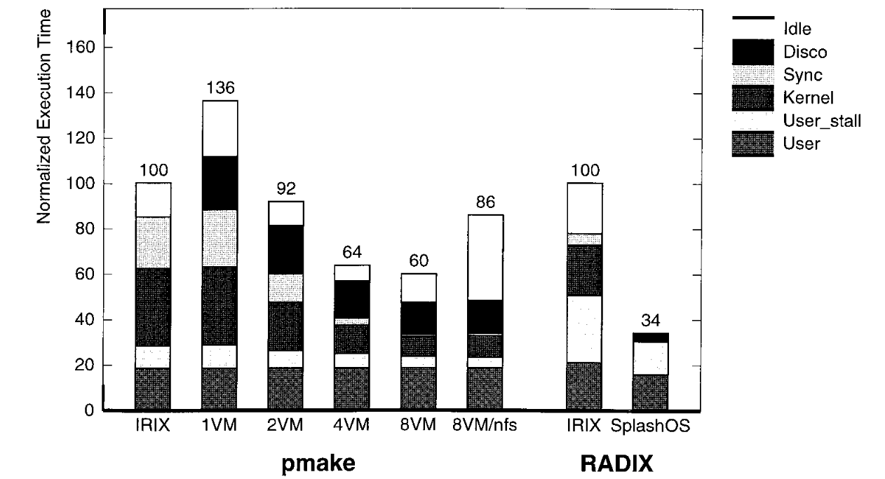
Disco: Does It Scale?
Methodology: run pmake on stock IRIX and on Disco with varying number of VM’s and measure execution time
Also compare radix sort performance on IRIX vs SPLASHOS

Slide 27
Disco: Takeaways
Virtual Machine Monitors are a feasible tool to achieve scalability on multiprocessor systems
Corollary: scalability does not require major changes
The disadvantages of virtual machine monitors are not intractable
Before Disco, overhead of VMs and resource sharing were big problems

Slide 28
Disco: Questions
Does Disco achieve its goal of not requiring major OS changes?
How does Disco compare to microkernels? Advantages/disadvantages?
What about to Xen / other virtual machine monitors?

Slide 29
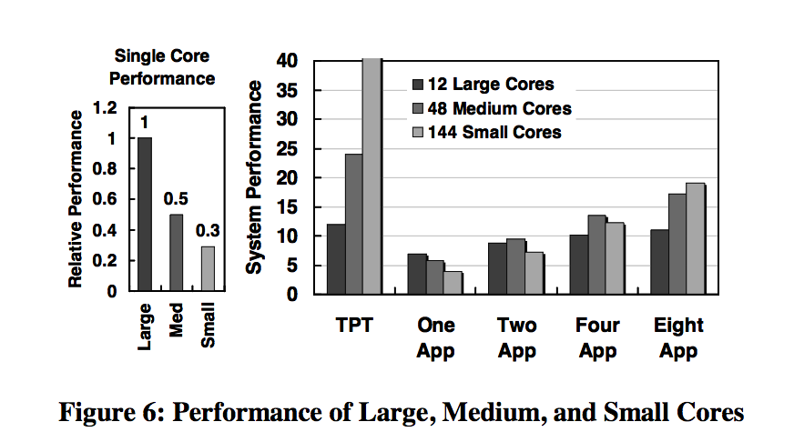
10 Years Later...
Multiprocessor → Multicore
Multicore → Many-core
Amdahl’s law limitations
Big.Little heterogeneous multi-processing
Notes:
Shekhar Borkar. 2007. Thousand core chips: a technology perspective. In Proceedings of the 44th annual Design Automation Conference (DAC '07). ACM, New York, NY, USA, 746-749. DOI=http://dx.doi.org/10.1145/1278480.1278667

Slide 30
From Disco to Barrelfish
Shared Goals | Disco (1997) | Barrelfish (2009)
Better VM Hypervisor | Make VMs scalable! | Make VMs scalable!
Better communication | VM to VM | Core to Core
Reduced overhead | Share redundant code | Use MPI to reduce wait
Fast memory access | Move memory closer | Distribute multiple copies
Notes:
Disco introduced a more efficient VM hypervisor by increasing the amount of shared information and reducing the overhead. Barrelfish seeks to re-work transport beneath abstraction.
Disco introduces the ability to communicate between VMs. Barrelfish heavily emphasizes inter-core communication
Disco: Share to reduce overhead. Barrelfish: Decouple to reduce waiting via message-passing

Slide 31
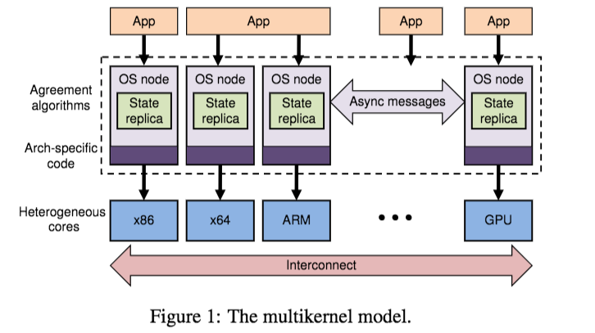
Barrelfish: Backdrop
“Computer hardware is diversifying and changing faster than system software”
12 years later, still working with heterogeneous commodity systems
Assertion: Sharing is bad; cloning is good.
Notes:
Message passing easier, cheaper than shared memory. Cache-coherence doesn’t solve everything.

Slide 32
About the Barrelfish Authors
Andrew Baumann
Currently at Microsoft Research
Better resource sharing (COSH)
Paul Barham
Currently at Google Research
Works on Tensorflow
“Xen and the art of virtualization” co-author
Pierre-Evariste Dagand
Formal verification systems
Domain specific languages
Tim Harris
Microsoft Research → Oracle Research → Amazon
“Xen and the art of virtualization” co-author
Notes:
Baumann, Andrew, Chris Hawblitzel, Kornilios Kourtis, Tim Harris, and Timothy Roscoe. "Cosh: Clear OS Data Sharing In An Incoherent World." In TRIOS. 2014.
Paul Barham, Boris Dragovic, Keir Fraser, Steven Hand, Tim Harris, Alex Ho, Rolf Neugebauer, Ian Pratt, and Andrew Warfield. 2003. Xen and the art of virtualization. SIGOPS Oper. Syst. Rev. 37, 5 (October 2003), 164-177. DOI=http://dx.doi.org/10.1145/1165389.945462

Slide 33
About the Barrelfish Authors
Rebecca Isaacs
Microsoft Research → Google →Twitter
Simon Peter
Assistant Professor, UT Austin
Timothy Roscoe
Swiss Federal Institute of Technology in Zurich
Adrian Schüpbach
Oracle Labs
Akhilesh Singhania
Oracle
Notes:
Baumann, Andrew, Chris Hawblitzel, Kornilios Kourtis, Tim Harris, and Timothy Roscoe. "Cosh: Clear OS Data Sharing In An Incoherent World." In TRIOS. 2014.
Paul Barham, Boris Dragovic, Keir Fraser, Steven Hand, Tim Harris, Alex Ho, Rolf Neugebauer, Ian Pratt, and Andrew Warfield. 2003. Xen and the art of virtualization. SIGOPS Oper. Syst. Rev. 37, 5 (October 2003), 164-177. DOI=http://dx.doi.org/10.1145/1165389.945462

Slide 34
Barrelfish: Goals
Design scalable memory management
Design VM Hypervisor for multicore systems
Handle heterogenous systems

Slide 35
Barrelfish: Goals → Implementation (Multikernel)
Memory Management: State replication instead of sharing
Multicore: Explicit inter-core communication
Heterogeneity: Hardware Neutrality
Notes:
Allows for batching, pipelining, and other optimizations
Enables split-phase communication (asynchronous)
Good for human analysis
Message-passing implementation may change
Device protocols might be conveniently adapted
Previous designs used a combination (including Disco)
Apply results from distributed systems literature
Reduce contention for resources and improve locality

Slide 36
Barrelfish: Implementation for Memory Management
Monitors & CPU drivers
User-level code performs virtual memory management (end-to-end)
CPU driver checks only that operations are correct (end-to-end)
Capability copying & retyping (abstraction)
Shared address spaces
Trade-off between replicated and shared hardware pages (Corey)
OS allowed to select spatio-temporal scheduling policy (end-to-end)
Notes:
About attempt to Generalize
(overly complex, but uniformity helpful)

Slide 37
Barrelfish: Implementation for Multicore
Cache-coherence costly, so supplement it with direct communication
Intercore instead of interprocess communication
Local shared cache-line
Notes:
https://users.cs.cf.ac.uk/Dave.Marshall/C/node33.html
Backwards compatible with threads, but uses Psyche-like process concepts
Mutually-trusting threads don’t need kernel intervention when switching context
User-level Remote Procedure Calls (URPC, transport agnostic) used for inter-core comm
Polling used with URPC before switching to monitor-wakeup

Slide 38
Barrelfish: Implementation for Heterogeneity
Monitors
Single-core, user-space processes
Runs the agreement protocol that synchronizes system state
CPU-driver
Authorization & process scheduling
Heavily customized for hardware/processors
Notes:
“Complex communication” relies on shared memory(!)
Contrasted with user-mode monitor (hardware agnostic)

Slide 39
Barrelfish: Implementation for Heterogeneity
Knowledge and policy engine
System knowledge based used to map hardware to first-order logic
Good for creating cache/topology aware networks
Experiences
CPU/monitor driver division → non-optimal performance, good engineering
Network stack insufficient
Notes:
Interesting idea, but is it stable?
Overall goal: show that message passing is viable

Slide 40
Barrelfish: Evaluation Goals
Memory management operations
Overhead of message-passing
CPU-intensive operations
I/O testing for async overhead

Slide 41
Barrelfish: Goals → Experiments
Memory management: TLB shootdown
Overhead: synchronous programs, polling & interrupts
CPU: CPU-bound applications
I/O: IP Loopback, Database, Web-server

Slide 42
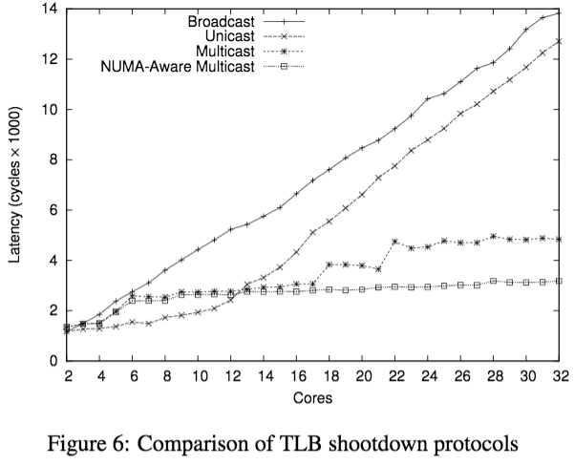
Barrelfish: Evaluation for Memory Management
Task: TLB shootdown
Difficulty: Requires global coordination
Result: NUMA-aware & plain multicast win
Question:
Is reliance on hardware knowledge problematic given the overhead of system discovery or hand-coding?
Notes:
Compute-bound results seemed fairly bad
I/O was okay, but not sound
Approach: NUMA-aware multicast
Idea: broadcast to highest latency nodes first
Requires system knowledge, overhead

Slide 43
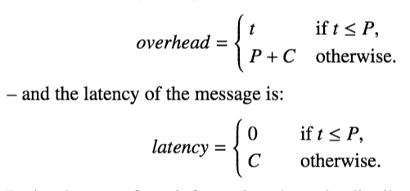
Barrelfish: Evaluation for Overhead
Task: Two-phase commit, polling & interrupts
Difficulty: Message-passing requires more polling and interrupts
Result: Current hardware is good enough
Question: TLB fills, cache pollution not included in costs. Fair?
Question: How might these results change with hardware? And application?

Slide 44
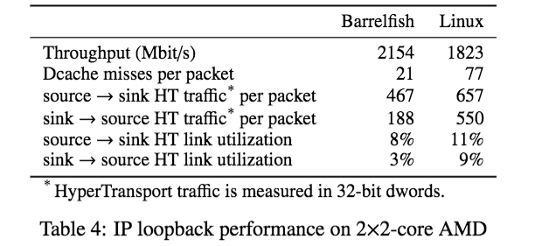
Barrelfish: Evaluation for Overhead
Task: IP Loopback Tests
Difficulty: Reading/writing sockets on local computer
Results: Barrelfish moderately outperforms Linux

Slide 45
Barrelfish: Evaluation for CPU
Task: Compute-bound (CPU heavy) workloads
Difficulty: Large shared-address spaces, parallel code
Result: Barrelfish not great, but comparable to Linux
Question:
Consistency > raw performance gains?
Notes:
Linux behavior more variable
Authors blame it on the user-level threads library, Linux’s in-kernel library
Thwarted by user-space threading library

Slide 46
Barrelfish: Evaluation for I/O
Task(s): Web-server and relational database setup
Difficulty: I/O traditional bottleneck
Approach: Message-passing/distributed systems
Result: Twice as many requests per second vs. lighttpd on Linux
Question: Does load pattern matter for comparison?
Question: Sufficient comparison for SQLite DB test?
Notes:
http://www.webtechster.com/trends/web-server/lighttpd.html

Slide 47
Barrelfish: Summary
Authors opinions
Building an operating from scratch is difficult
Barrelfish performs well given its relative underdevelopment
Still actively developed
http://www.barrelfish.org/download.html
Not quite VMWare though!
Message-passing elegant but perhaps not more efficient
Interesting use of system discovery
Evaluations
Very synthetic, no money-graph
Peppered with microbenchmarks, needs better macro-evaluation
TLB shootdown, I/O results better than compute-bound results
Notes:
What about more variable-sized, variable-scheduled payloads?

Slide 48
Barrelfish: Questions
Is message-passing a viable alternative to a shared-data approach?
What applications would this system be best for?
Were the evaluations thorough and realistic enough?
Notes:
In other words, are we going backwards with this approach? Why not leave good enough alone (Disco was pretty awesome)?
Compute bound applications are not friendly towards barrelfish… But what would be?
Mention microbenchmarks

Slide 49
Takeaways
Efficient VM monitor software critical
Rapidly changing computer architectures → the-floor-is-lava
Commodity and personal computing have increasing numbers of cores and processors
Improving VM performance possible if...
Resources are shared even more (Disco)
Resources are replicated and synced (Barrelfish)
Best of Disco
Don’t hide power: recognition of ccNUMA advantages
Get it right: Disco clearly beats out competitors
Best of Barrelfish
Reuse good ideas: distributed systems for many-core computers
Abstraction: System discovery

Slide 50
Thank You!

Slide 51
References
Baumann, Andrew, Paul Barham, Pierre-Evariste Dagand, Tim Harris, Rebecca Isaacs, Simon Peter, Timothy Roscoe, Adrian Schüpbach, and Akhilesh Singhania. "The multikernel: a new OS architecture for scalable multicore systems." In Proceedings of the ACM SIGOPS 22nd symposium on Operating systems principles, pp. 29-44. ACM, 2009.
Borkar, Shekhar. "Thousand core chips: a technology perspective." In Proceedings of the 44th annual Design Automation Conference, pp. 746-749. ACM, 2007.
Boyd-Wickizer, Silas, Haibo Chen, Rong Chen, Yandong Mao, M. Frans Kaashoek, Robert Morris, Aleksey Pesterev et al. "Corey: An Operating System for Many Cores." In OSDI, vol. 8, pp. 43-57. 2008.
Bugnion, Edouard, Scott Devine, Kinshuk Govil, and Mendel Rosenblum. "Disco: Running commodity operating systems on scalable multiprocessors." ACM Transactions on Computer Systems (TOCS) 15, no. 4 (1997): 412-447.

Slide 52
Perspective
Virtualization: creating a illusion of something
Virtualization is a principle approach in system design
OS is virtualizing CPU, memory, I/O …
VMM is virtualizing the whole architecture
What else? What next?

Slide 53
Next Time
Project: next step is the Survey Paper due next Friday
Read and write a review:
Required: Shielding Applications from an Untrusted Cloud with Haven. Andrew Baumann and Marcus Peinado and Galen Hunt. In the 11th USENIX Symposium on Operating Systems Design and Implementation (OSDI). Broomfield, CO, October 2014, pp. 267—283.
Optional: Logical Attestation: An Authorization Architecture For Trustworthy Computing. Emin Gun Sirer, Willem de Bruijn, Patrick Reynolds, Alan Shieh, Kevin Walsh, Dan Williams, and Fred B. Schneider. In Proceedings of the Symposium on Operating Systems Principles (SOSP), Cascais, Portugal, October 2011.

