Slide 1
Modern systems:
Extensible Kernels and Containers
Hakim Weatherspoon
CS6410

Slide 2
Motivation
Monolithic Kernels just aren't good enough?
  Conventional virtual memory isn't what userspace programs need (Appel + Li '91)
  Application-level control of caching gives 45% speedup (Cao et al '94)
  Application-specific VM increases performance (Krueger '93, Harty + Cheriton '92)
  Filesystems for databases (Stonebraker '81)
  And more...

Slide 3
Motivation
Lots of problems…

Slide 4
Motivation
Lots of problems…Lots of design opportunities!

Slide 5
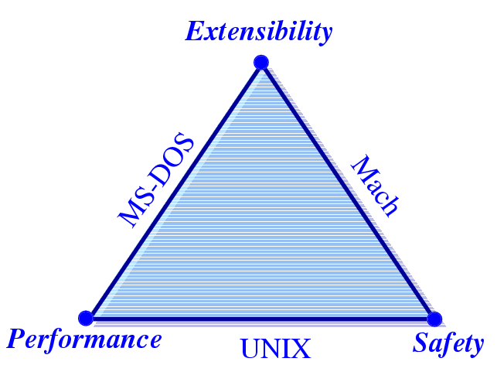
Motivation
Extensibility
Security
Performance
Can we have all 3
in a single OS?
From Stefan Savage’s SOSP 95 presentation
Notes:
Extensibility
Ability to use application specific knowledge
Security
Extensions should not compromise security. Applications should still be able to share resourses
Performance

Slide 6
Context for these papers
1990’s
  Researchers (mostly) were doing special purpose OS hacks
  Commercial market complaining that OS imposed big overheads on them
  OS research community began to ask what the best way to facilitate customization might be. In the spirit of the Flux OS toolkit…
2010’s
  containers: single-purpose appliances
  Unikernels: (“sealable”) single-address space
    Compile time specialized

Slide 7
Motivation
1988-1995: lots of innovation in OS development
  Mach 3, the first “true” microkernel
  SPIN, Exokernel, Nemesis, Scout, SPACE, Chorus, Vino,
  Amoeba, etc...
  And even more design papers

Slide 8
Motivation
Exploring new spaces
  Distributed computing
  Secure computing
  Extensible kernels (exokernel, unikernel)
  Virtual machines (exokernel)
  New languages (spin)
  New memory management (exokernel, unikernel)

Slide 9
Problems (examples coming-up)
Extensibility
  Abstractions overly general
  Apps cannot dictate management
  Implementations are fixed
Performance
  Crossing over into the kernel is expensive
  Generalizations and hiding information affect performance
Protection and Management offered with loss in Extensibility and Performance
Notes:
Microkernels (replaceable trusted servers, fault isolation)
- Process, address space, IPC
- same abstraction to all processes (even with trusted servers)
- is there a need to cross the protection boundary often?
Virtual Machines (multiple VMs on the same host OS)
- virtualization of hardware expensive
- virtualization can be counter-productive (apps LRU pager Vs VMM pager)

Slide 10
Exokernel
Dawson R. Engler, M. Frans Kaashoek and James O’Toole Jr.
Engler’s Master’s Thesis.
Follow-up publications on 1997 and 2002.
Kaashoek later worked on Corey.

Slide 11
Exokernels - Motivation
Existing Systems offer fixed high-level abstractions which is bad
  Hurt app performance (generalization – eg: LRU)
  Hide information (eg: page fault)
  Limit functionality (infrequent changes – cool ideas don’t make it through)

Slide 12
Motivation (cont.)
Separate protection from management, mgmt in user space
Apps should use domain specific knowledge to influence OS services
Small and simple kernel – adaptable and maintainable

Slide 13
Exokernel
Kernel only multiplexes hardware resources (Aegis)
Higher-level abstractions in Library OS (ExOS)
Secure binding, Visible resource revocation, Abort
Apps link with the LibOS of their choice
Notes:
Extensibility, Safety and Performance

Slide 14
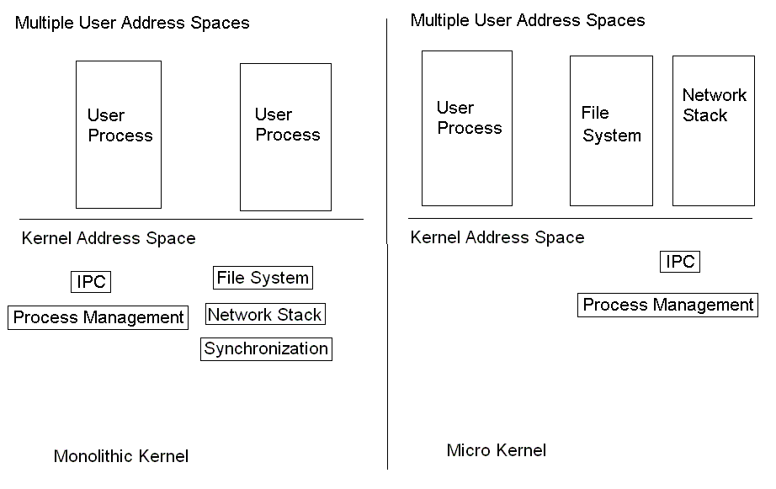
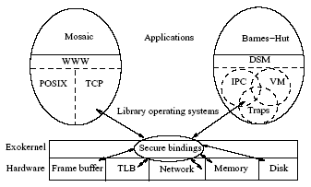
OS Component Layout
Exokernel

Slide 15
Exokernel main ideas
Kernel
  Resource sharing, not policies
Library Operating System
  Responsible for the abstractions
    IPC
    VM
    Scheduling
    Networking

Slide 16
Lib OS and the Exokernel
Lib OS (untrusted) can implement traditional OS abstractions (compatibility)
Efficient (Lib OS in user space)
Apps link with Lib OS of their choice
Kernel allows LibOS to manage resources, protects LibOss

Slide 17
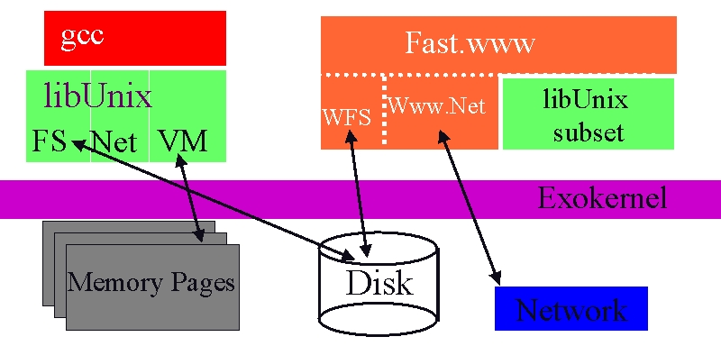
Exokernel Architecture
Exokernels. MIT CSAIL, 1998

Slide 18
Exokernel vs Microkenels vs VM
Exokernel defines only a low-level interface.
A microkernel also runs almost everything on user-level, but has fixed abstractions.
A VM emulates the whole machine, doesn’t provide direct access.

Slide 19
Design
Application-level resource management
Exports hardware resources
Multiplexes access between processes
Separates policy from management
  avoid resource management!

Slide 20
What problems do we solve?
High-level abstractions
  hurt application performance
  Hide information
  Limit functionality
Existing monolithic kernels
  Encourage stable (archaic) interfaces
  Difficult to extend with modern techniques

Slide 21
How do we solve them: Design
Secure bindings
Downloading code
Visible resource revocation
The abort protocol

Slide 22
How do we solve them: Design
Secure bindings
Downloading code
Visible resource revocation
The abort protocol

Slide 23
Secure bindings
Decouples authorization from use
Authorize once, at “bind time”
Use transferable “capabilities” to check access
Cache bindings in-kernel to decrease binding frequency
  Example: huge software-based TLB

Slide 24
How do we solve them: Design
Secure bindings
Downloading code
Visible resource revocation
The abort protocol

Slide 25
Downloading code
Userspace application produces kernel space code
Access checks at download time
Code is verified before being run, with JIT for speed

Slide 26
How do we solve them: Design
Secure bindings
Downloading code
Visible resource revocation
The abort protocol

Slide 27
Visible resource revocation
Revocation traditionally invisible (or transparent)
  Expensive: have to save entire state
Try visible instead!
  Save only the state you need
  Kernel gives you a few microseconds to do it

Slide 28
How do we solve them: Design
Secure bindings
Downloading code
Visible resource revocation
The abort protocol

Slide 29
Revocation: kernel asks process for resource
  “relinquish page 5 please”
  Process tracks state and returns resource
Abort: kernel demands resource
  “page 5 in 50 microseconds”
  Takes resource “by force”
  Invalidates credentials and bindings.
  Notifies library operating system

Slide 30
Exokernel
DEC MIPS
Aegis: actual exokernel
  Processor
  Physical memory
  TLB
  Exceptions, Interrupts
ExOS: library operating system
  Processes, IPC, Virtual Memory, Network protocols

Slide 31
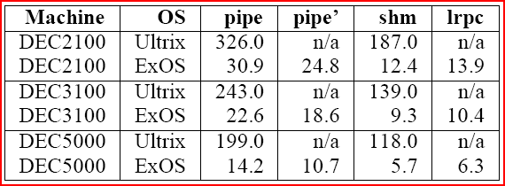
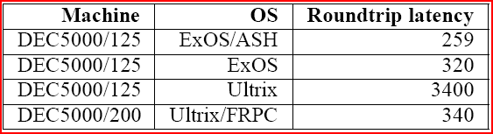
Microbenchmark results

Slide 32
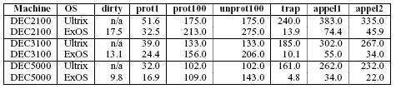
ExOS Virtual Memory
+ Fast Sys call.
- Half the time in look-up (vector).
Repeated access to Aegis STLB and ExOS PageTable
Notes:
Dirty – query if the page is dirty (user level)
Prot1 – change the protection of 1 page
100 – read [un]protect 100 pages
Trap – time to handle page-protection trap
Appel1 – access random protected page – prot (some other) + trap + unprot (faulting page)
Appel2 – prot100 + trap + unprot

Slide 33
Perspective
Extensible kernels are actually fast.
End-to-end arguments.
Efficient implementations.
Extensibility without loss of security or performance
  Exokernels
    Safely export machine resources
    Decouple protection from management

Slide 34
Containers
Grouping of processes
Provide isolation between groups
Containers cannot customize operating systems
Isn’t this similar to the problem exokernels tried to solve?
Container
Container
Container
MySQL
Web Server
MySQL
Web Server
Web Server
OS
Hypervisor
Notes:
Operating system may not be good for all groupings.

Slide 35
Unikernel: Library Operating Systems for the Cloud
Anil Madhavapeddy, Richard Mortier, Charalampos Rotsos, David Scott, Ralraj Singh,
ThomasGazagnaire, Steven Smith, Steven Hand, and Jon Crowcroft
University of Cambridge, University of Nottingham, Citrix Systems Ltd, OCamlPro SAS
In Proceedings of the 18th International Conference on Architectural Support for Programming Languages and Operating Systems pg. 461–472.
Unikernel slides from Shannon Joyner

Slide 36
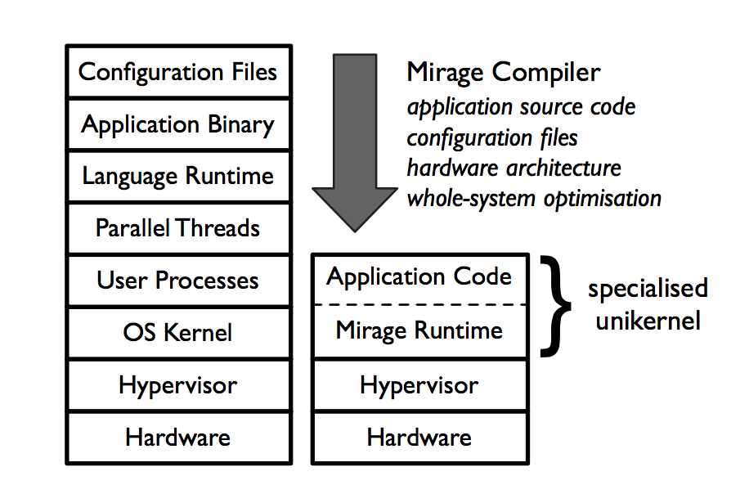
Unikernel = EXOKERNEL + CONTAINERs
Run one application per virtual machine
One process per application
Everything compiled into a VM image
Do not compile unused code
Unikernel, Figure 1

Slide 37
Unikernel
Run directly on top of standard hypervisor
Can run multiple unikernels on the same hypervisor
Unikernel
Unikernel
Unikernel
Application
Application
Application
OS
OS
OS
Hypervisor

Slide 38
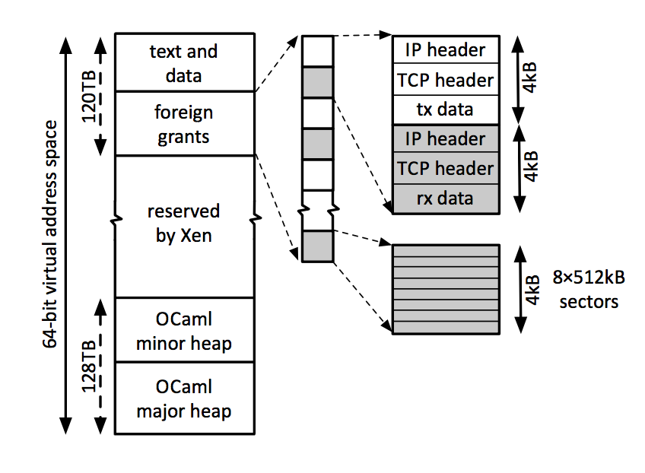
Mirage
Produces unikernels
Compiles OCaml code to Xen VM image
4 main components
  Text + Data segment
  Foreign Grants
  Minor Heap
  Major Heap
Unikernel, Figure 2
Notes:
Chose OCaml because of flexibility (implement imperative, functional, and OOP). Brevity. High performance. Xen is implemented in OCaml, so integration is easy.
PV Boot - Way to initialize VM with a single virtual CPU and multiple Xen event channels.

Slide 39
Text and Data
OCaml Runtime
PVBoot
  Initializes VM
Unikernel, Figure 2
Notes:
Initializes VM that application runs in

Slide 40
HEAP
Minor Heap
  Short lived values in VM
  Fast
Major Heap
  Long lived values
Unikernel, Figure 2

Slide 41
Foreign Grants
Used for VM communication
Write data to a grant table
Exchange table between VM address spaces
Unikernel, Figure 2

Slide 42
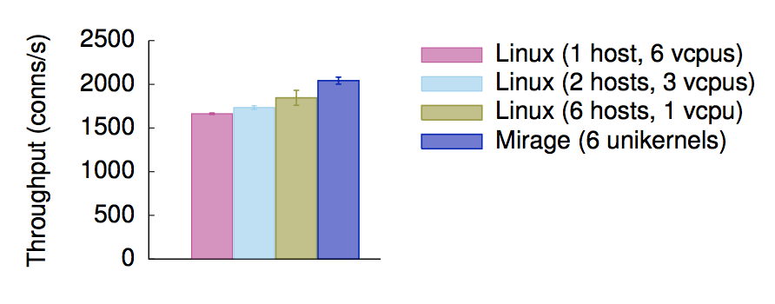
ApACHE BENCHMARK
Mirage unikernel improvements result in better performance than having multiple cores
Unikernel, Figure 2

Slide 43
Exokernel versus Unikernel
Exokernel
  All applications on same system
  Poor isolation
Unikernel
  Single application per system
  Better isolation

Slide 44
Next Time
Read and write review:
  The Origin of the VM/370 Time-Sharing System, R. J. Creasy, In IBM Journal of Research and Development, 25(5):483-490, September 1981.
  Xen and the Art of Virtualization, Paul Barham, Boris Dragovic, Keir Fraser, Steven Hand, Tim Harris, Alex Ho, Rolf Neugebauer, Ian Pratt, Andrew Warfield. 19th ACM symposium on Operating systems principles (SOSP), October 2003, page 164--177.

Slide 45
Next Time
MP1 part 2 due Friday
Project Survey Paper proposals due next week
Presentation schedule
Check website for updated schedule

