Slide 1
Distributed Systems:
Ordering and Consistency
October 11, 2018
A.F. Cooper

Slide 2

Context and Motivation
How can we synchronize an asynchronous distributed system?
How do we make global state consistent?
Snapshots / checkpoints
Example: Buying a ticket on Ticketmaster
Notes:
Today we’re going to talk about ordering and consistency in distributed systems.
This is the first talk in a series of lectures on distributed systems. So I’ll give a little general context and motivation.
If you have a single machine with one processor, synchronization of data structures within it. For example, events and threading we’ve already talked about. Multiprocessor or multiple machines / processes sending messages to each other, asynchronous, delays, any moment in time, how do you capture the state of your system?
Resources: https://fityourself.club/being-fit-isnt-hard-consistency-is-8199d6e92083

Slide 3
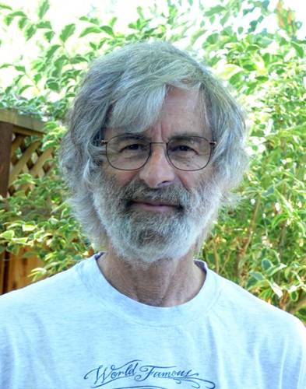
Leslie Lamport
MIT / Brandeis
Industrial researcher
“Father” of distributed computing
Paxos
“Time, Clocks, and the Ordering of Events in a Distributed System” (1978)
  Test of time award
  11,082 citations (Google Scholar)
Turing Award (2013) for LateX (notably, not for Paxos)
  Ken Birman was the ACM chair when Paxos paper submitted
Notes:
Leslie Lamport -- MIT BS CS, Brandeis MA/PhD Math
Paxos -- protocol for consistency, distributed computing
Notably did not win Turing award for this work, others have claims on this (including Ken Birman)
Submitted Paxos paper to ACM when Ken Birman was chair; almost got rejected / took years. Foundational work in distributed computing
Other fun facts I’ve learned while at Cornell: He’s a really odd guy, will leave conversations mid-sentence to think about a question. Years later, will come up to you at a conference and pick up right where he left off. Also, he’s an egotistical ass.
Resources: Last year’s presentation

Slide 4
Takeaways
What is time?
What does time mean in a distributed system?
In a distributed system, how do we order events such that we can get a consistent snapshot of the entire system state at a point in time?
  Happened before relation
  Logical clocks, physical clocks
  Partial and total ordering of events
Notes:
Today’s class will be a bit different than others. We won’t be looking at a system implementation, but instead some concepts, which are backed by proofs in the paper.
We will not be going through the proofs, and instead will discuss the intuition behind the ideas. Because I think it’d be a bit tedious to go through them step by step, so we’ll just focus on the concepts
The key concepts, at a glance -- in a distributed system, how do we order events such that we can get a consistent snapshot of the entire system state at a point in time
Some key words, which we’ll get into are the “happened before” relation, logical clocks, physical clocks, and partial and total orderings of events

Slide 5
Outline
Model of distributed system
Happened Before relation and Partial Ordering
Logical Clocks and The Clock Condition
Total Ordering
Mutual Exclusion
Anomalous Behavior
Physical Clocks to Remove Anomalous Behavior
Notes:
So now we’ll step through the paper -- here’s an outline of the things we’ll cover.
After we go through this, we’ll also talk a bit about snapshots and consistent cuts, drawbacks to Lamport’s work, and further work in the area since 1978.

Slide 6
Outline
Model of distributed system
Happened Before relation and Partial Ordering
Logical Clocks and The Clock Condition
Total Ordering
Mutual Exclusion
Anomalous Behavior
Physical Clocks to Remove Anomalous Behavior

Slide 7
Model of a Distributed System
Included:
Process: Set of events, a priori total ordering (sequence)
Event: Sending/receiving message
Distributed System: Collection of processes, spatially separated, communicate via messages
  How do you coordinate between isolated processes?
Not Included:
Global clock
Notes:
First, we need to define our model of a distributed system. The key components are the process, event, and then the overall system.
Process -- set of events, with an a priori total ordering (i.e. a sequence) to those events
The events themselves are sending and receiving of messages
So that the system overall is a collection of spatially separated processes, which communicate via sending / receiving messages
Key point, system is distributed if the message transmission delay is not negligible compared to the time between events in a single process.
This can apply to both systems with spatially separated computers, or one computer that is a multiprocessing system. But Lamport focuses on the several-separated computers case.
Resources: Lamport 558

Slide 8
Outline
Model of distributed system
Happened Before relation and Partial Ordering
Logical Clocks and The Clock Condition
Total Ordering
Mutual Exclusion
Anomalous Behavior
Physical Clocks to Remove Anomalous Behavior

Slide 9
Happened Before and Partial Ordering
Used to thinking about global clock time (a total order / timeline)
  I read a recipe, then I cook dinner (in that order)
Distributed systems
  Events in multiple places
    Everyone in class, each living in a tower
    Communicate via letter
      How do we know how letters ordered when sent?
  Events can be concurrent
  No global time-keeper
    We talk about time in terms of “causality”
      How can we decide we cooked dinner before reading a cookbook?
      No order unless one event “caused” another
      I cook dinner, I send a letter suggesting the cookbook I used, which “caused” another person to read the cookbook

Slide 10
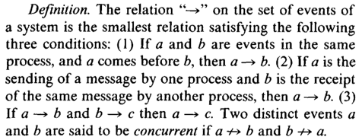
Happened Before and Partial Ordering
Notes:
In a distributed system, sometimes impossible to say that one of two event happened first.
The intuition people have when they say an event a happens before b is that a happened at an earlier time than b.
If the system uses physical time, then it needs to have real clocks. But there’s a problem here, because clocks are not perfectly accurate in trying to keep physical time.
So, happened before relation between two events is only a partial ordering of events in the system, though there is an a priori to all events in the system that is a total ordering.
But we’ll start with this idea of “happened before” and a partial ordering, and build on concepts until we get a total ordering. And since physical clocks are unreliable, we’ll remove them from consideration / we won’t use physical clocks. But we’ll get to that in a little bit. Let’s first describe precisely what “happened before” means.
Lamport defines this arrow operator as the happened before relation, and there are three conditions that must be satisfied
If a and b are events in the same process and a comes before b, then a happens before b
If a is the sending of a message by one process, b is the receipt of that message by another process, then a happens before b
Transitivity. If a happens before b, and b happens before c, then a happens before c
If neither a happens before b or b happens before a, then we can consider the two events concurrent (as long as they are distinct)
Also, we’ll be more specific and call it an irreflexive partial ordering, because a can’t happen before a.

Slide 11
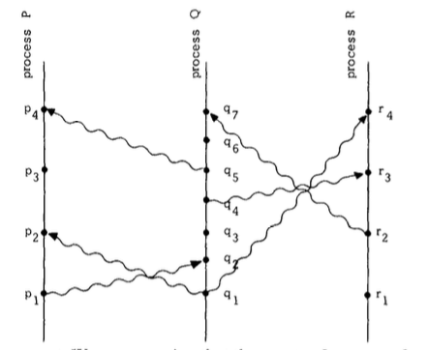
Happened Before and Partial Ordering
Another way to say “a happens before b” is to say that “a causally affects b”
Concurrent events do not causally affect each other
Notes:
It’s helpful to understand this using a “space-time diagram”.
The horizontal direction is space, the vertical is time. Later is higher.
The dots are events, and the wavy lines are messages.
A happens before b means we can go from a to b by moving up (forward in time) and across processes. So in this example, we go from p1 happens before r4.
Another way to say that a happens before b is to say that a causally affects b. Concurrent events do not causally affect each other.
Resources: Lamport, p. 559

Slide 12
Outline
Model of distributed system
Happened Before relation and Partial Ordering
Logical Clocks and The Clock Condition
Total Ordering
Mutual Exclusion
Anomalous Behavior
Physical Clocks to Remove Anomalous Behavior
Notes:
So now that we have defined the happened before relation, we can get to the part about not relying on real clock time. To do this, Lamport introduces the idea of a logical clock.

Slide 13
Logical Clocks and the Clock Condition
We need to assign a sort of “timestamp” to events to order them
We therefore need a clock (of some kind)
  Earlier example: What “time” did I eat dinner? What “time” did you read the cookbook?
A logical clock assigns a “timestamp” (a counter) to events

Slide 14
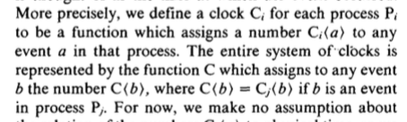
Logical Clocks and the Clock Condition
A counter, rather than a real timestamp
No relation to physical time (for now)
Notes:
We can think of a logical clock as a counter, rather than a real timestamp, with no relation to physical time for now.
We have a clock function, C, which takes an event and assigns a number to it (this is why a counter can be used). C represents the entire system of clocks, and each process has its own, so we can subscript C by the process id.
So Clock i of a is the number assigned to event a on process i.

Slide 15
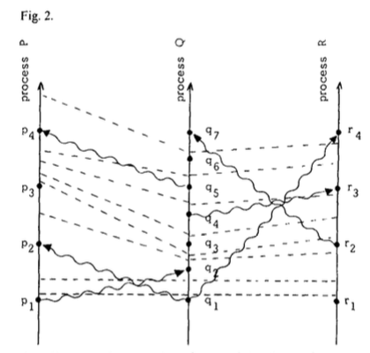
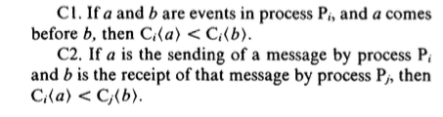
Logical Clocks and the Clock Condition
Notes:
More formally, Lamport defines the Clock Condition for logical clocks. If a and b are events in a process Pi, and a comes before b, then process i’s logical clock value for a is less than its logical clock value for b.
Secondly, if a is sending a message by process i and b is the receipt of that message by a process j, then the clock value of process i at a is less than the clock value of process j at b. That is to say, there is a FIFO-type ordering to sending/ receiving an event. A particular message cannot be received before it is sent.
We can add “ticks” to our previous spacetime diagram, as shown here with the dotted lines. Like-numbered subscripts across processes correspond to the same tick, which is why the lines look skewed.
Resources: Lamport, p. 560

Slide 16
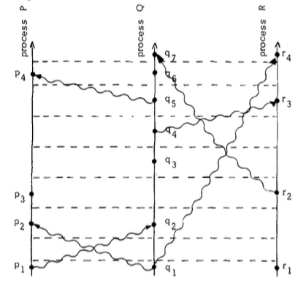
Logical Clocks and the Clock Condition
Notes:
We can flatten things out / project them to make it a bit clearer. The tick lines are straight, to make it clear that each tick is at the same relative point in time.
Resources: Lamport p. 560

Slide 17
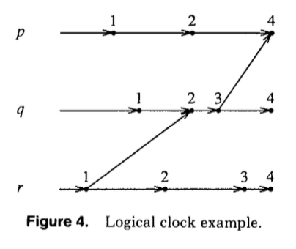
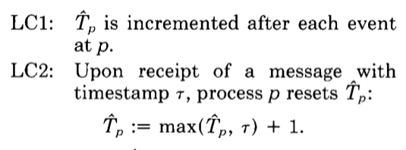
Logical Clocks and the Clock Condition
Notes:
Lamport then defines two conditions to guarantee that the clock condition is satisfied. I prefer Fred Schneider’s depiction of these conditions.
These are some images from Fred Schneider’s paper on state machines and fault tolerance. It’s a really nice representation of logical clocks, which Lamport doesn’t exactly provide. But the idea is the same. You have three processes, p q anr r. The numbers represent logical clock times, and the update rules indicate how we move time forward for a process as it receipts messages.
The timestamp is incremented after each event in the process, let’s say p.
Upon receipt of a message with a particular timestamp, the process p resets its timestamp by taking the max of its current timestamp and the value of the message’s timestamp and adding 1.
Resources: Fred’s paper, p. 305

Slide 18
Outline
Model of distributed system
Happened Before relation and Partial Ordering
Logical Clocks and The Clock Condition
Total Ordering
Mutual Exclusion
Anomalous Behavior
Physical Clocks to Remove Anomalous Behavior
Notes:
So now we’ve guaranteed a correct system for logical clocks and our partial ordering of events, using the happened before relation. Now let’s take the next step to get a total ordering on all of the events in the system.

Slide 19
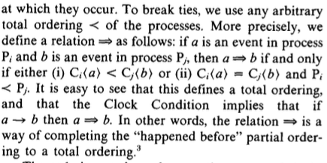
Total Ordering
Need a total order that everyone can agree on
  May not reflect “reality”
  I ate first or second, you read cookbook first or second, or concurrently
Order events by the time at which they occur
Break ties semi-arbitrarily (by process id -- establish a priority among processes)
Not unique; depends on system of clocks
Notes:
We move from a partial ordering to a total ordering by making the events fully comparable. We mark them by the time at which they occur, and break ties semi-arbitrarily. Lamport establishes this “less than” relation, which effectively establishes a priority among processes.
In the total order, happened before now means process i’s send clock value for event a is less than process j’s clock value for the receipt of that message (called b), or if the clock values are the same, then we just say that process i’s event happened first.

Slide 20
Outline
Model of distributed system
Happened Before relation and Partial Ordering
Logical Clocks and The Clock Condition
Total Ordering
Mutual Exclusion
Anomalous Behavior
Physical Clocks to Remove Anomalous Behavior
Notes:
So now we’ve guaranteed a correct system for logical clocks and our partial ordering of events, using the happened before relation. Now let’s take the next step to get a total ordering on all of the events in the system.

Slide 21
Mutual Exclusion
Single resource, many processes
Only one process can access resource at a time
  E.g., only one process can send to a printer at a time
Synchronize access
FIFO granting / releasing of access to resource
If every process granted the resource eventually releases it, then every request is eventually granted (we’ll come back to this “eventually”)
Notes:
At the high level, we can image a single resource that several processes want to access. We will need to synchronize access to avoid conflicts, and we want to grant requests in order.
There are three conditions we want to satisfy.
A process that has been granted the resource must release it before another process gets it
Different requests for the resource must be granted in the order in which they are made (FIFO)
If every process which is granted the resource eventually releases it, then every request is eventually granted (we’ll come back to this idea of “eventually” -- it’s a drawback in the paper)
We need a total ordering to satisfy this, so that we can properly synchronize resource use. A centralized scheduler isn’t sufficient unless there are additional assumptions.

Slide 22
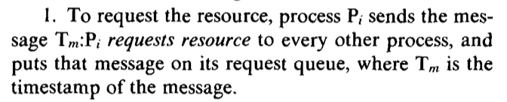
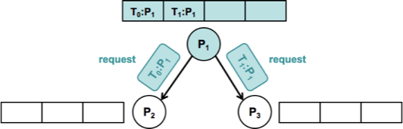
Mutual Exclusion
Notes:
So let’s step through this in detail. The images on the following slides are from last year’s presentation
At time 0 and time 1, process 1 requests the resource to every other process and puts that message on its request queue.
Resources: Last year’s presentation, Lamport p. 561

Slide 23
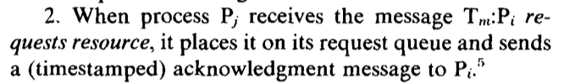
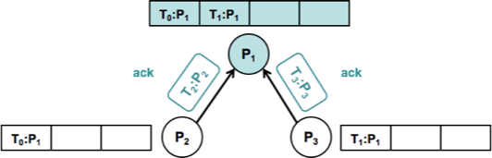
Mutual Exclusion
Notes:
The other processes put the requests on their request queues and send acknowledge messages back to the requesting process.
Resources: Last year’s presentation, Lamport p. 561

Slide 24
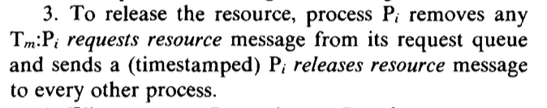
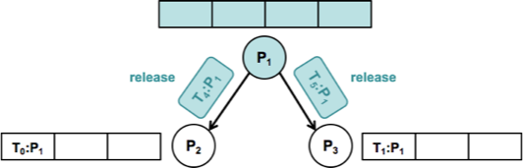
Mutual Exclusion
Notes:
To release the resource, the process dequeues the request messages from its queue and sends release messages to the other processes.
Resources: Last year’s presentation, Lamport p. 561

Slide 25
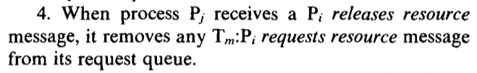
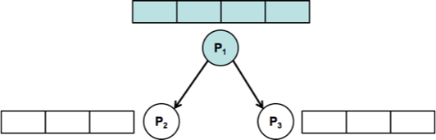
Mutual Exclusion
Notes:
The other processes remove the requests resource from their queues when they see the release message.
Resources: Last year’s presentation, Lamport p. 561

Slide 26
Mutual Exclusion
Distributed algorithm
  No centralized synchronization
State Machine specification
  Set of commands (C), set of states (S)
  Relation that executes on a command and a state, returns a new state
    Prior example:
      Commands: Request resource, release resource
      States: Queue of waiting request and release commands
Synchronization because of total order according to timestamps
Failure not considered
Notes:
Some key points are that this is a distributed algorithm, meaning that each process follows these rules independently. There is no centralized synchronizing process.
Lamport says this synchronization is specified in term sof a State Machine, where there is a set of commands and a set of states, and there is a relation defined where given a command and a state, and we execute the command with that state, another, new state is output. In the prior example, the commands are request and release resource, and thes tate is the queue of waiting request and release commands.
Each process independently simulates the execution of the State Machine. We get synchronization because all the processes order the commands according to their time stamps, which are a total order.
In this, a process must know all the commands issued by other processes.
A failure of a single process will make it impossible for any other process to execute the State Machine, halting the system. That is to say, this specification is not fault tolerant.
Lamport does not discuss what he calls “the problem of failure”, calling it out of scope for this paper. This is a drawback that we’ll return to later. He does note, though, that a user can tell that a system has crashed because it has waited too long for a response (hinting at the mechanism of timeouts, which Chandy proves the efficacy of in another paper)

Slide 27
Outline
Model of distributed system
Happened Before relation and Partial Ordering
Logical Clocks and The Clock Condition
Total Ordering
Mutual Exclusion
Anomalous Behavior
Physical Clocks to Remove Anomalous Behavior
Notes:
We’re not quite done. This total ordering can lead to some anomalous behavior, which we will now describe and figure out a way to deal with

Slide 28
Anomalous Behavior
Imagine a game of telephone
  Person A -- issues request on computer (A)
  Person A telephones person B (in another city)
  Person A tells Person B to issue a different request on computer (B)
Anomalous result
  Person B’s request can have a lower timestamp than A
  B can be ordered before A
  A preceded B, but the system has no way to know this
Precedence information is based on messages external to system
Notes:
Let’s image a game of telephone to describe anomalous behavior by example.
Let’s say there are to people, A and B, in different cities, each with their own computer. Person A can issue request A on their computer, call person B in a different city, and tell person B to issues request B on another computer.
The result is that request B can have a lower timestamp than A, leading to B being ordered before A even though A preceded it, in terms of real time.
The reason for this is that the precedence information is based on messages external to the system. We get wonky behavior in terms of consistency / ordering, relative to what the users of the system observe.

Slide 29
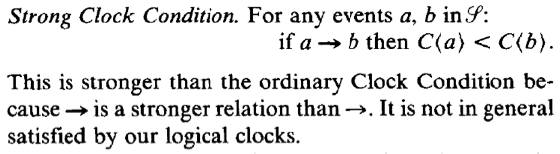
Strong Clock Condition
Notes:
Lamport defines the Strong Clock Condition to deal with this behavior, which considering a set S that is the set of all system events, and then introducing a new set which contains S and all other relevant external events, captured by this bolder arrow.
This set is a set of “real” events in physical spacetime. Lamport will now bring in physical clocks to help satisfy this conditoin, since in the real world physical clocks can run independently of one another and satisfy this Strong Clock Condition.
Resources: Lamport, p. 562

Slide 30
Outline
Model of distributed system
Happened Before relation and Partial Ordering
Logical Clocks and The Clock Condition
Total Ordering
Mutual Exclusion
Anomalous Behavior
Physical Clocks to Remove Anomalous Behavior
Notes:
So now we’ll look at physical clocks to remove anomalous behavior from our total ordering. We’ll bring physical time into our space-time picture from before.

Slide 31
Physical Clocks
Introduce physical time to our clocks
Needs to run at approximately correct rate
  Clocks can’t get too out-of-synch
We put bounds on how out-of-synch clocks relative to each other

Slide 32
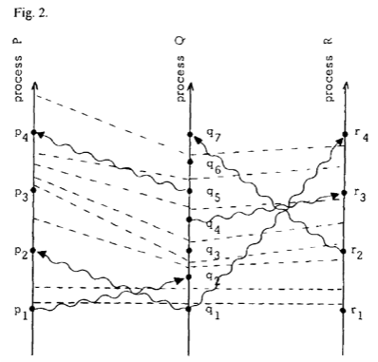
Physical Clocks
Notes:
Let’s look again at the un-flattened spacetime diagram. If we consider vertical distance to represent physical time, then the variation in height of a single tick line is less than epsilon.
We won’t go through the proof, because it is quite involved. But details are on on page 563 and the appendix.
Resources: Lamport, p. 559

Slide 33

Impact: Global State Intuition
Notes:
Group of photographers observing a panoramic, dynamic scene, such as sky filled with migrating birds.
Big, cannot be captured by one photo.
Photographers take several snapshots and stitch them together for overall scene.
Cannot be taken at precisely the same instant because of synch problems. Also, photographers should not disturb the process that is being photographed. Composite picture should be meaningful -- problem is to determine what meaningful is and how photographs should be taken.
Resources: https://picasageeks.com/tag/stitching-panoramas/

Slide 34
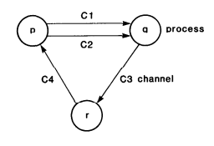
Global State Detection and Stable Properties
Must not affect underlying computation
Stable property detection
  Computation terminated
  System deadlocked
Consistent cuts
  Checkpoint / facilitating error recovery
Algorithm components
  Cooperation of processes
  Token passing
Notes:
Error handling - Chandy. Failure detection based on timeouts; assumes certain execution speeds / maximum delay for message transfer. Generally accepted that detecting failures impossible without using timeouts, they prove this formally.
Build on “state machine” concept that Lamport only briefly mentioned.
Model of a distributed system -- finite set of processes and finite set of channels. Labeled, directed graph in which vertices are processes, edges are channels.
State of channel is the sequence of messages sent along it, excluding messages received along the channel.
General idea, algorithm for process in distributed system to determine global state (global state detection). Superimposed on underlying computation -- must run concurrently but not alter it.
One example, stable property detection. Once a property becomes true, remains true after (persists). Such as computation has terminated, system has deadlocked.
Can be used for checkpointing / facilitating error recovery.
A little more detail:
Cooperation of other processes that must record their own local states and send recorded local states to process p.
All processes cannot record their local states at precisely the same instant unless have access to common clock. But assume processes do not share clocks or memory.
Instead, idea of passing a token. System contains one token that is passed from process to process.
If recorded global state shows no tokens in the system, because inconsistent state of channel; recorded before p sends a message along c and the state of p is recorded after p sends a message along c. E.g., bank money in transfer.
Resources: Chandy, Consistent Cuts, p. 66

Slide 35


Drawbacks -- “Eventually”
CAP
  Consistency
  Availability
  Partition Tolerance
COPS
  Clusters of Order-Preserving Services
  Don’t settle for eventual
  Causal+ consistency
  ALPS
    Availability
    (Low) Latency
    Partition Tolerance
    Scalability
Notes:
What does “eventually” mean -- eventually consistent.
CAP Theorem -- consistency, availability, partition tolerance. Impossible to create system that achieves all three. Modern web services embrace availability and partition tolerance.; “always on” -> low latency. Sacrifice consistency. (Partition tolerance -- system still functions even when partition between two network nodes.)
To get this, today’s systems often sacrifice consistency, exposing inconsistency to clients (Facebook example of liking photo) -- different parts of the world, lag between when you like a photo in one place, others see that “like” if in another location
COPS -- causal consistency and convergent conflict handling (Causal+).
Causal component of causal+ consistency ensures the data store respects the causal dependencies between operations. Implement key-value store that delivers this across wide area, is scalable.
Convergent conflict handling -- all conflicting puts to be handled in same manner at all replicas, using handler function, which must be associative and commutative so that replicas can handle conflicting writes in the order they receive them.
Resources:
Lamport, p. 561
https://commons.wikimedia.org/wiki/File:Facebook_like_thumb.png

Slide 36
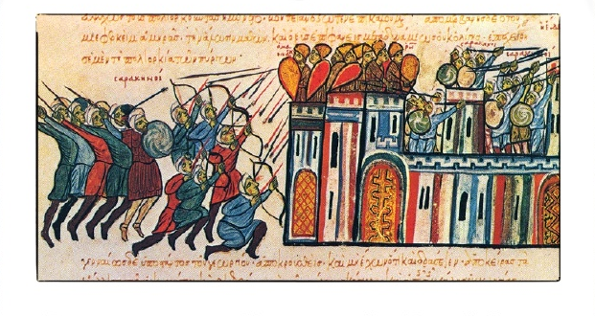
Drawbacks -- Handling Failures
Byzantine generals problem
How do reliable computer systems handle failing components?
  Particularly, components giving conflicting information
Majority voting
  “Commander” - input generator
  “Generals” - processors (loyal ones are non-faulty)
Notes:
Imagines Byzantine army camped with their troops around enemy city, communicating only via messenger. One or more may be traitors. How find an algorithm to ensure that loyal generals will reach agreement? Only works of ⅔ or more of generals are loyal. In other words, no fewer than 3m+1 generals can cope with m traitors.
Connect to distributed systems, no two processors can read a clock while its advancing, one may get old time, other new time. This can only be prevented by synchronizing reads with the advancing clock.
Could solve by majority voting:
all nonfaulty processors must use the same input value (so that produce same output).
If input unit nonfaulty, all nonfaulty processes use the value it provides as input.
The analogy -- where the commander is the unit generating the input and the lieutenants / generals are the processors, loyal means non-faulty.
Resources: https://www.slideshare.net/springerw/byzantine-generals

Slide 37
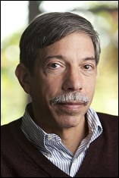
Drawbacks -- Handling Failures
Implementing fault-tolerant services using the State Machine Approach
Byzantine failure and fail-stop
Service only as tolerant as processor executing →
  Replicas (multiple servers that fail independently)
  Coordination between replicas
State machine
  State variables
  Commands
Fred Schneider
Notes:
Distributed software -- clients and services. Service comprises one or more servers, exports operations that clients invoke through requests. Resulting service can only be as tolerant as the processor executing the server.
If this level of fault tolerance not acceptable, then multiple servers that fail independently must be used (replicas).
State machine approach -- general method for implement fault-tolerant service by replicating servers and coordinating client interactions with server replicas.
State machine approach first described in Lamport, but not fully developed. For environments in which failures could not occur.
State variables, which encode state, and commands, which transform state.
1 ) Byzantine failures -- component can exhibit arbitrary and malicious behavior, perhaps involving collusion with other faulty components.
2) Fail-stop failures -- in response to failure, component changes to a state that permits other components to detect a failure has occurred and then stops.
Key to t fault-tolerant state machine is to ensure replica coordination (all replicas receive and process same sequence of requests) -- this has two requirements:
Agreement (every nonfaulty state machine replica receives every request)
Order (every nonfaulty state machine replica processes the requests it receives in same relative order)
Resources: http://www.cyber.umd.edu/events/symposium/keynotes2013

Slide 38
Drawbacks -- Every Process
Process must communicate with all other processes
Schneider deals with this
  Replica-generated identifier approach
    Next class
    Nutshell: Communication only between processors running the client and SM replicas

Slide 39
Drawbacks -- Implementation
Theory only
  Useful for reasoning about distributed systems
  But, gap between theory and practice
Modern distributed systems require more
  Physical time
  Network Time Protocol (NTP) syncing
Notes:
Common critique of Lamport -- doesn’t implement things. For example, Paxos is a foundational work in distributed computing, but paper is really out there and doesn’t actually implement the protocol. Turns out that it’s difficult to implement, and to implement well / efficiently
Useful for reasoning, but impractical for modern distributed systems. Gap between theory and practice of distributed systems; theory -- shun time, use “causality tracking” as abstraction to reason about concurrency.
Lamport drawbacks :
happened-before is defined based on passing of information rather than passing of time.
Not possible to query events in relation to physical time.
Assumes that all communications occur in the present system, no backchannels. Doesn’t extend well to today, loosely-coupled system of systems.
Practical systems -- use physical time, leverage physical clocks using NTP,
Perfect clock synchronization infeasible. Best effort due to difficulty of clock synchronization. Uncertainty intervals associated with physical time / timestamps.
PT Drawbacks:
When uncertainty intervals overlap, PT cannot order events.
Several kinks, such as leap seconds and non-monotonic updates to POSIX time, which can cause timestamps to go backwards.
A lot of other work has grown out of this foundational piece on logical clocks and time. Going to step through a few of them to wrap up.

Slide 40
Other Types of Clocks
1988: Vector clocks (DynamoDB)
2012: TrueTime (Spanner)
2014: Hybrid Logical Clocks (CockroachDB)
2018: Sync NIC clocks (Huygens)
Notes:
Vector clocks: Vectorized version of logical clock -- vector at each node which tracks knowledge this node has about logical clocks of other nodes. LC finds one consistent snapshot, VC finds all possible consistent snapshots. Example, DyamoDB. Version vectors for causality tracking of updates to the replicas.
Drawbacks: Useful for debugging, but huge space requirement.
TrueTime: Google Spanner. Tight clock synch due to GPS clocks and atomic clocks.
Drawbacks:
requires special hardware and custom-built tight clock synch protocol, which is impractical for for many systems (e.g. leased nodes from cloud providers).
If used for ordering events that respect causality, e hb f, then tt.e < tt.f; Spanner delays event f when necessary; reduces concurrency, prohibitive under loose clock synchronization
Logical physical clocks, or hybrid logical clocks (HLC): Idea to combine best of both.
Maintains a VC at each node, but also has knowledge about physical time, which it uses to trim entries from the VC / reduce the overhead of causality tracking.
Enables easy identification of consistent snapshots in distributed systems. Other applications -- message logging in distributed systems, Byzantine fault-tolerance protocols. They reimplement Spanner as an opensource DB using HLC (CockroachDB).
Observe it to be highly resilient, space requirement is bounded. Performant and space efficient.
Huygens: SysLunch paper. It’s Dutch -- ask Robbert how to actually pronounce it.
CockroachDB Drawbacks -- uncertainty about clocks can cause performance degradation with read requests having to be retried.
NTP synchronization / physical time can only achieve millisecond accuracy. What if want to get nanosecond resolution? On the order of 10-100s nanoseconds. Special hardware to combat network delays.
Instead, exploiting a natural network effect for scalable, fine-grained clock synchronization. Software clock synchronization that uses synchronization network. Use machine learning technique (specifically Support Vector Machine) classifier to help estimate one-way propagation times, get ns resolution.
New algorithm, achieves clock synch to 10s ns at scale, works with current generation network interface cards (NICs) in data centers.
Accurately sync NIC clocks, obtain globally accurate timestamps for data, protocol messages, other transactions between different servers.

Slide 41
Referenced Works
Leslie Lamport. Time, Clocks, and the Ordering of Events in a Distributed System. Communications of the ACM, Volume 21, Number 7, 1978.
K. Mani Chandy and Leslie Lamport. Distributed Snapshots: Determining Global States of Distributed Systems. ACM Transactions on Computer Systems, Volume 3, Number 1, 1985.
K. Mani Chandy and Jayadev Misra. How Processes Learning. ACM, 1985.
Leslie Lamport, et. al. The Byzantine Generals Problem. ACM Transactions on Programming Languages and Systems, Volume 4, Number 3, 1982.
Fred B. Schneider. Implementing Fault-Tolerant Services Using the State Machine Approach: A Tutorial. ACM Computing Surveys, Volume 22, Number 4, 1990.
Sandeep S. Kulkarni, et. al. Logical Physical Clocks. M. Principles of Distributed Systems, 2014
Wyatt Lloyd, et. al. Don’t Settle for Eventual: Scalable Causal Consistency for Wide-Area Storage with COPS. SOSP, 2011.
Yilong Geng, et. al. Exploiting a Natural Network Effect for Scalable Fine-grained Clock Synchronization. Proceedings of the 15th USENIX Symposium on Networked Systems Design and Implementation, 2018.

Slide 42
Questions?
How can we conceive of synchronization in modern, heterogeneous data centers?
How can we achieve synchronization using commodity hardware
What does “consistency” even mean as we move toward real-time computing?

