Slide 1
Bitcoin and Blockchains
Hakim Weatherspoon
[slide liberally taken from Kevin Seqniqi, Ittay Eyal, Emin Gun Sirer, Robbert van Renesse]
CS6410

Slide 2
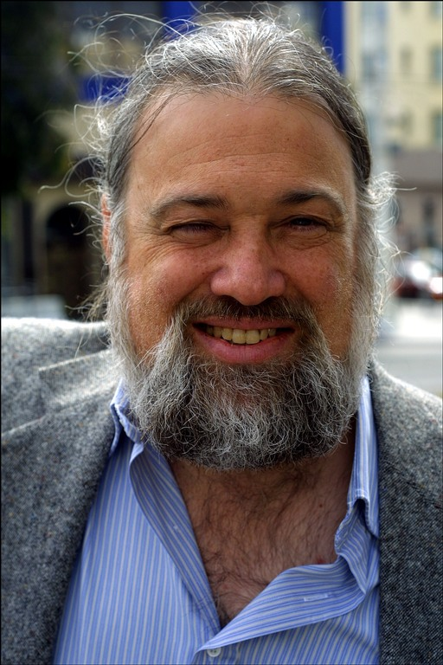
A Brave New World - The Vision of David Chaum
David Chaum
PhD CS/Business Adm from Berkeley 1982
Founded International Association for Cryptologic Research (IACR) same year
Known for eCash, mix nets, voting systems…

Slide 3
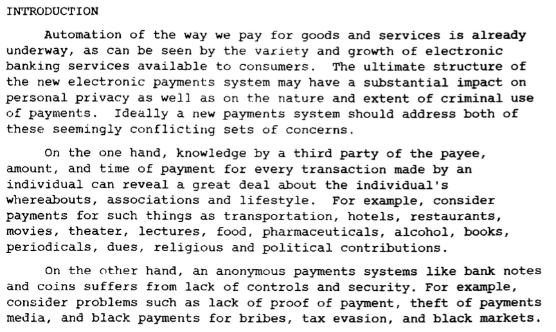
A Brave New World - The Vision of David Chaum [1983]
http://www.hit.bme.hu/~buttyan/courses/BMEVIHIM219/2009/Chaum.BlindSigForPayment.1982.PDF

Slide 4
A Brave New World - The Vision of David Chaum [1983]

Slide 5
A Brave New World - The Vision of David Chaum [1983]
Basically ...
Electronic payment systems suffer from loss of privacy and cumbersome trust on single entities.
Privacy protection, however, encounters issues of security and safety of data.

Slide 6
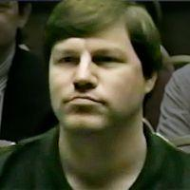
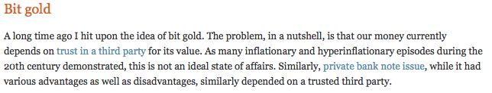
Nick Szabo [1998]

Slide 7

Nick Szabo [1998]

Slide 8
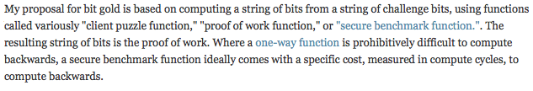
Nick Szabo [1998]
http://unenumerated.blogspot.com/2005/12/bit-gold.html

Slide 9
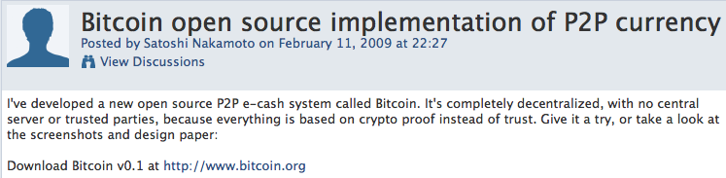
Satoshi Nakamoto and the Anon Post [2008]

Slide 10

Satoshi Nakamoto and the Anon Post [2008]

Slide 11
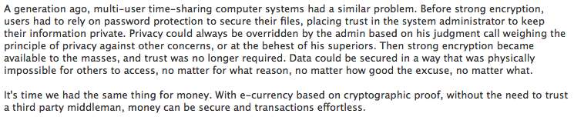
Satoshi Nakamoto and the Anon Post [2008]

Slide 12
Goals
An electronic payment system:
Guarantees safety of transactions, protects against double spends, gives full freedom to owners.
Yet no central trusted authority, no reliance on quorum since identities are not known.

Slide 13

A Replicated Ledger of Transactions
Ledger
give 10 bitcoins to Jane
give 3 bitcoins to Judy
give 10 bitcoins to Joe
Judy
(owns 15
bitcoin)
Jane
Joe (owns 1 bitcoin)
Notes:
Unstructured peer-to-peer network
Propagation by gossip
Talk about how transaction security prohibits theft.
Say we’re not going to deal with txns anymore.

Slide 14
Bitcoin Blockchain
Permissionless, open membership
Proof-of-Work
There are thousands of Bitcoin miners
  they use ASIC hardware to compute SHA256 hashes
  use about more energy than the country of Denmark
Overall rate is a few transactions per second

Slide 15

The Blockchain
nonce
Ledger
$$t$$
HASH( ) < target
“cryptopuzzle”
Notes:
Purpose: Batching transactions for efficiency!

Slide 16


Cryptographic One-Way Hash Function
hash(X) = Y
Given X it is easy to compute Y (the digest)
Given Y it is computationally infeasible to find
- unless you already know X, of course
In some sense, Y identifies X
Examples: MD5, SHA-256, SHA-3
HASH( ) < target
Note: unlike an ordinary hash function where you typically have fewer buckets than objects and thus multiple objects per bucket, with
cryptographic hash functions you typically have many more “virtual buckets” than objects, and at most one object in a bucket

Slide 17
The Blockchain: Proof-of-work / Mining
nonce
HASH( ) < target
SHA256(SHA256(PrevHash||Tx||Tx||…||Nonce)) < {0}^{k} {0,1}*
Mining: Find Nonce that when hashed with block of transactions results in k leading 0’s.
Block Identifier: Hash of block identifies the block
Each hash identifies the entire prefix of the ledger

Slide 18
The Blockchain
Notes:
Purpose: Batching transactions for efficiency!

Slide 19
The Blockchain
Notes:
Purpose: Batching transactions for efficiency!

Slide 20
The Blockchain
Exponentially distributed, with
constant mean interval
target automatically adjusted every 2016 blocks so that mean interval is 10 minutes

Slide 21
Incentives for Mining
Prize:
  “Minting”
  Transaction Fees
Wins proportional to computation power
Notes:
Mining total: 21 million at 2140

Slide 22
Forks
Two blocks “mined” at approximately the same time by two different miners

Slide 23
Fork Resolution
Longest chain wins
Transactions on short chain are reverted

Slide 24
Fork Resolution
A transaction is confirmed when
it is buried “deep enough”
(typically 6 blocks – i.e., one hour)
Notes:
There is no DECIDE step as in classical consensus
Making it difficult enough for attacker to out-run.

Slide 25

Security Threat!
$$t$$

Slide 26
Security Threat!
$$t$$
Threat: attacker outruns good miners

Slide 27
Security Threat!
$$t$$
20%
Threat: attacker outruns good miners
➔ Security Assumption: good miners own >.5 of the total compute power
[blockchain.info, April 2015]

Slide 28
Bitcoin: Network
1. New transactions are broadcast to all nodes.
2. Each node collects new transactions into a block.
3. Each node works on finding a difficult proof-of-work for its block.
4. When a node finds a proof-of-work, it broadcasts the block to all nodes.
5. Nodes accept the block only if all transactions in it are valid and not already spent.
6. Nodes express their acceptance of the block by working on creating the next block in the chain, using the hash of the accepted block as the previous hash.
Nodes always consider the longest chain to be the correct one and will keep working on extending it.
Notes:
The steps to run the network are as follows:
New transactions are broadcast to all nodes.
Each node collects new transactions into a block.
Each node works on finding a difficult proof-of-work for its block.
When a node finds a proof-of-work, it broadcasts the block to all nodes.
Nodes accept the block only if all transactions in it are valid and not already spent.
Nodes express their acceptance of the block by working on creating the next block in the chain, using the hash of the accepted block as the previous hash.

Slide 29
Bitcoin: Network
N1
N6
N2
TX1 = [Alice → Bob]
TX2 = [Alice → Carol]
N5
N3
N4
Notes:
The steps to run the network are as follows:
New transactions are broadcast to all nodes.
Each node collects new transactions into a block.
Each node works on finding a difficult proof-of-work for its block.
When a node finds a proof-of-work, it broadcasts the block to all nodes.
Nodes accept the block only if all transactions in it are valid and not already spent.
Nodes express their acceptance of the block by working on creating the next block in the chain, using the hash of the accepted block as the previous hash.

Slide 30
Bitcoin
N1
N6
N2
N5
N3
N4

Slide 31
Bitcoin
TX1
N1
TX2
N6
N2
TX2
TX1
N5
N3
TX1
N4
TX2

Slide 32
Bitcoin
TX1
N1
TX2
N6
N2
TX2
Paxos /PBFT-like
Voting/conensus
TX1
N5
N3
TX1
N4
TX2

Slide 33
Bitcoin
TX1
N1
TX2
N6
N2
TX2
Who are you?
Paxos /PBFT-like
Voting/conensus
TX1
N5
N3
TX1
N4
TX2

Slide 34
Bitcoin
Evil
Here’s what I know
New
?
Good
Here’s what I know

Slide 35
Bitcoin
TX1
N1
TX2
N6
N2
TX2
TX1
N5
N3
TX1
N4
TX2

Slide 36
Bitcoin
TX1
N1
TX2
N6
N2
TX2
TX1
N5
N3
TX1
N4
TX2

Slide 37
Bitcoin
SHA256(SHA256(TX || Nonce)) < {0}^{k} {0,1}*

Slide 38
Bitcoin
TX1
N1
TX2
N6
N2
TX2
Found it!
TX1
N5
N3
TX1
N4
TX2

Slide 39
Bitcoin
TX1
N1
TX2
N6
N2
TX2
Found it!
TX1
N5
N3
TX1
N4
TX2

Slide 40
Bitcoin
TX2
N1
TX2
N6
N2
TX2
TX2
N5
N3
TX2
N4
TX2

Slide 41
Bitcoin
TX1
N1
TX2
N6
N2
TX2
TX2
N5
N3
TX2
N4
TX2

Slide 42
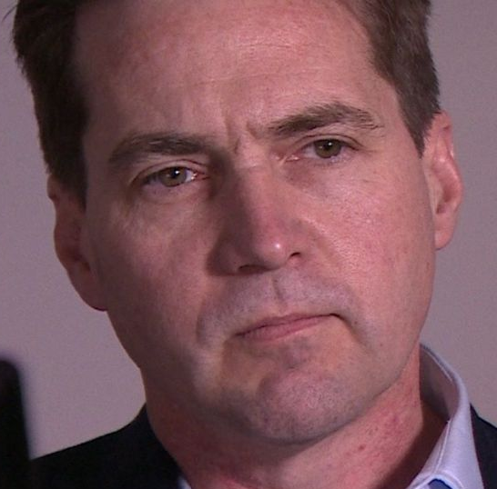
Bitcoin
N1
TX1
TX2
N6
TX2
N5
I’m confused
N4
TX2

Slide 43
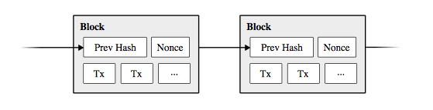
Bitcoin

Slide 44
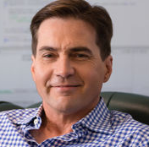
Bitcoin
N1
TX1
B2
B3
...
Loses!
I’m no longer confused
N4
TX2
B2
B3
...
Wins!

Slide 45
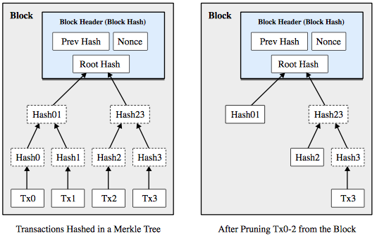
Bitcoin

Slide 46
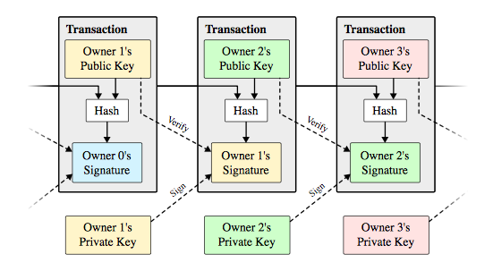
Bitcoin

Slide 47
Bitcoin
UTXO

Slide 48
Bitcoin
TX2
N1
TX2
N6
N2
TX2
TX2
N5
N3
TX2
N4
TX2
Thanks for the coins!

Slide 49
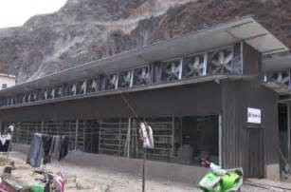
Bitcoin
Many more subtle details, but core mechanism is computational race.
Results:
  Breakthrough consensus mechanism in the permissionless setting
    Everybody agrees on what is on the blockchain
    Always available for reading and appending
    Fair
    Tamperproof (can’t change or truncate blockchain)
    No Single Administrative Domain
    Open membership
Challenges:
  Electrical usage of a medium-sized country.
  Very slow confirmation times.
  3 tx/second.
Power Consumption…

Slide 50
Bitcoin
Two years ago, when gave talk in December 2016, 1 BTC == $1100
Today at $7,291
Crypto market cap high of $180B last week, today $126B
21 million total possible Bitcoins. As supplies dwindle, price skyrockets.

Slide 51
Bitcoin: Tradeoffs
 | Permissionless | Permissioned
Approach | Competitive | Cooperative
Basic technique | Proof-of-Resource | Byzantine Consensus
Trust requirements | Crypto (+ peers…) | Peers (+ crypto…)
Membership | Open | Closed
Energy-efficiency | Often terrible | Excellent
Transaction rate | At best hundreds / sec | Many thousands per second
Txn latency | As high as many minutes | Less than a second
10

Slide 52
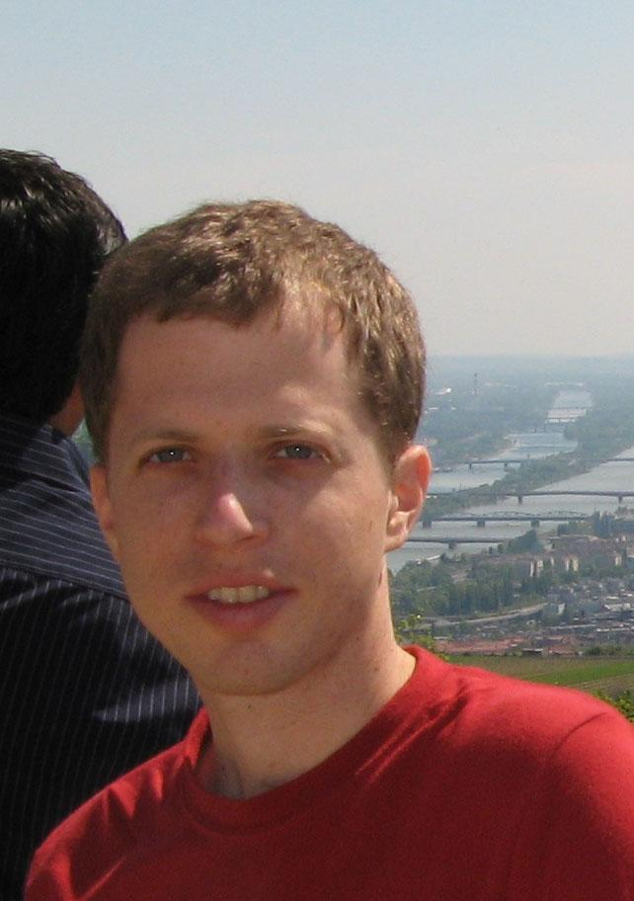
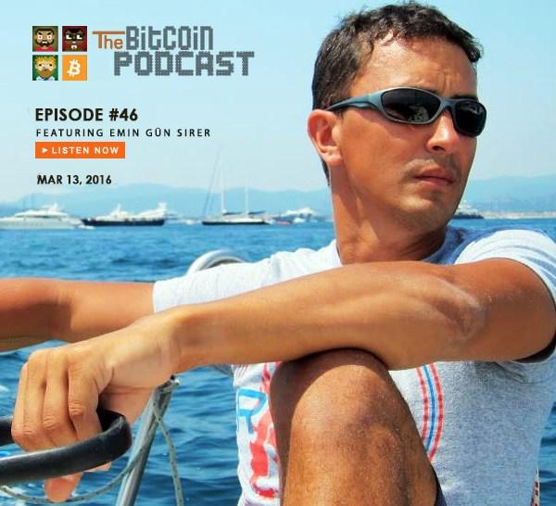
Majority is Not Enough: Bitcoin Mining is Vulnerable
Ittay Eyal
Postdoc @ Cornell, faculty @ Technion
Major contributor to Bitcoin community
Emin Gun Sirer
Also major contributor to the Bitcoin community

Slide 53
N1
TX1
B2
B3
49%
Rest of Network
TX2
B2
B3
51%

Slide 54
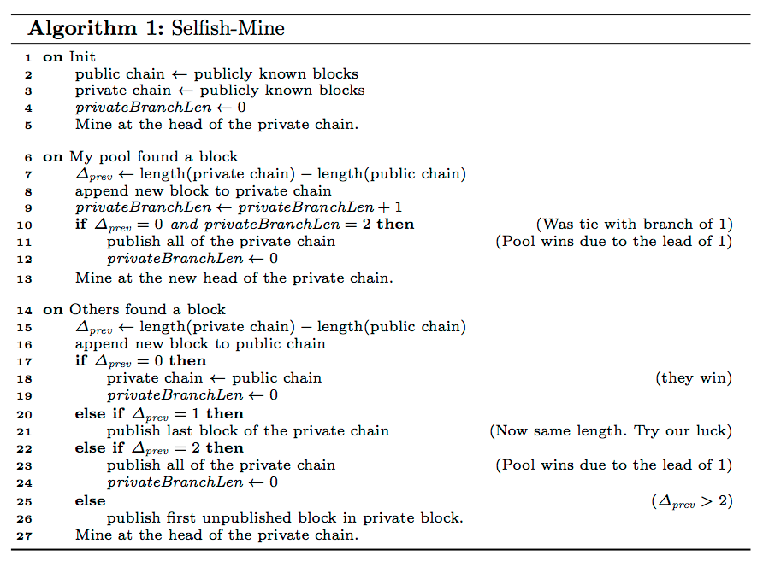
Majority is Not Enough: Bitcoin Mining is Vulnerable

Slide 55
Majority is Not Enough: Bitcoin Mining is Vulnerable
N1
...
RON

Slide 56
Majority is Not Enough: Bitcoin Mining is Vulnerable
N1
...
RON

Slide 57
Majority is Not Enough: Bitcoin Mining is Vulnerable
N1
...
RON

Slide 58
Majority is Not Enough: Bitcoin Mining is Vulnerable
N1
...
RON

Slide 59
Majority is Not Enough: Bitcoin Mining is Vulnerable
N1
...
RON

Slide 60
Majority is Not Enough: Bitcoin Mining is Vulnerable
N1
...
RON

Slide 61
Majority is Not Enough: Bitcoin Mining is Vulnerable
N1
...
RON

Slide 62
Majority is Not Enough: Bitcoin Mining is Vulnerable
N1
...
RON

Slide 63
Majority is Not Enough: Bitcoin Mining is Vulnerable
N1
...
RON

Slide 64
Majority is Not Enough: Bitcoin Mining is Vulnerable
N1
...
RON

Slide 65
Perspective
Exciting application possibilities
Interesting research problems in distributed systems and practical cryptography
Bitcoin “works”, but is extremely inefficient
 | Permissionless | Permissioned
Approach | Competitive | Cooperative
Basic technique | Proof-of-Resource | Byzantine Consensus
Trust requirements | Crypto (+ peers…) | Peers (+ crypto…)
Membership | Open | Closed (but stay tuned)
Energy-efficiency | Often terrible | Excellent
Transaction rate | At best hundreds / sec | Many thousands per second
Txn latency | As high as many minutes | Less than a second
31

Slide 66
Next Time
Read and write review for Thursday, September 6:
  Required The Design and Implementation of a Log-Structured File System, Mendel Rosenblum and Ousterhout. Proceedings of the thirteenth ACM symposium on Operating systems principles, October 1991, pages 1--15.On the duality of operating system structures, H. C. Lauer and R. M. Needham. ACM SIGOPS Operating Systems Review Volume 12, Issue 2 (April 1979), pages 3--19.
  Optional: A Fast File System for UNIX. Marshall K. McKusick, William N. Joy, Samuel J. Leffler, Robert S. Fabry. ACM TOCS 2(3), Aug 1984, pages 181--197.

Slide 67
Next Time
Read and write review:
MP1.a – due next Monday, September 10
Project Proposal due next Tuesday, September 11
  talk to me and other faculty and email and talk to me
Check website for updated schedule

