Slide 1
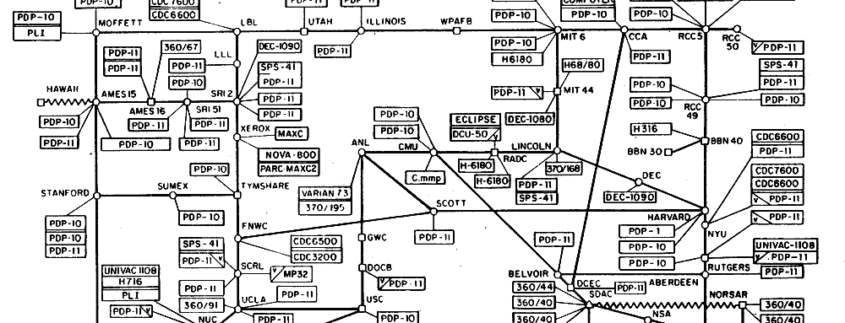
software defined networking
CS 6410 Fall 2017
Eric Campbell and Rolph Recto
Notes:
picture: ARPANET map, 1977
First to implement TCP
CS 6410 facts:
required papers: 35
Optional papers: 15
suggested:75

Slide 2
software defined networking

Slide 3
software defined networking
(OpenFlow, originally)
Notes:
the term “SDN” was originally coined to describe OpenFlow

Slide 4
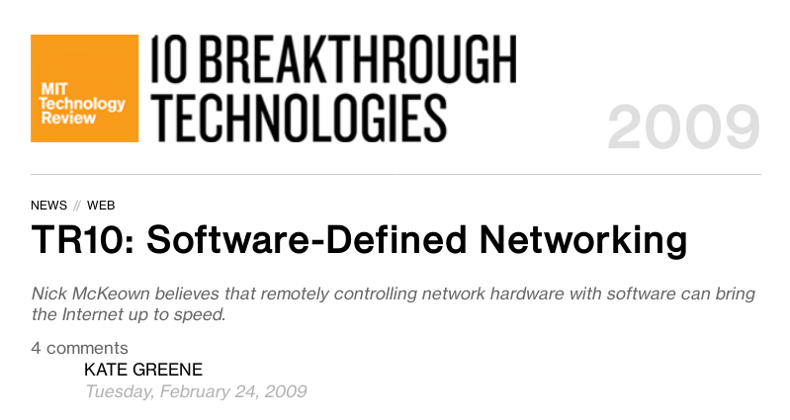
Notes:
“SDN” originally coined in an MIT Tech Review article describing OpenFlow

Slide 5
“Stanford computer scientist Nick McKeown and colleagues developed a standard called OpenFlow that essentially opens up the Internet to researchers, allowing them to define data flows using software–a sort of ‘software-defined networking.’ Installing a small piece of OpenFlow firmware (software embedded in hardware) gives engineers access to flow tables, rules that tell switches and routers how to direct network traffic.”

Slide 6
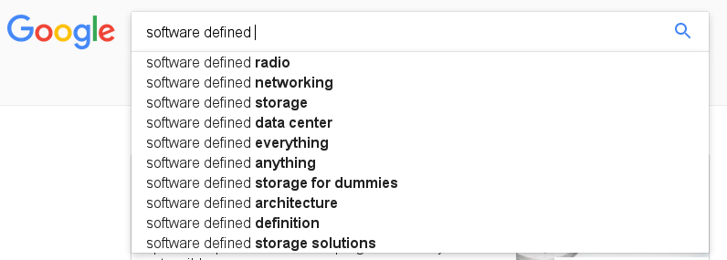
Notes:
The name has caught on to other fields….

Slide 7
control plane
routing
isolation
traffic engineering
data plane
packet forwarding
packet scheduling
Notes:
Networking devices have two parts for two different operations:
Control plane - computes forwarding behavior of the switch
Data plane - executes the forwarding behavior computed by the control plane

Slide 8
traditional networking
Notes:
Control plane and data plane were in the same device
Control plane ran distributed protocols
No standard protocol for communication between control plane and data plane

Slide 9
SDN
Notes:
Control plane is separated from the data plane
Can be a server, have arbitrary amounts of compute power!
Control plane is logically centralized, can have “global view” of network
Distributed protocols become graph algorithms
Rules on switches are just a “cache” for functions on packets defined by controller

Slide 10
software defined networking
(programmable)
Notes:
however, the term SDN has come to encompass a wider trend in research and industry to make networking more “programmable”
under this definition a broad array of research (including research that predates OpenFlow) can be described as SDN
Add: software defined datacenter, software defined cloud, etc.

Slide 11
Active Networks
Separating the Data and Control Planes
OpenFlow
SDN Today
Notes:
Active networks - shove untrusted programs in your packet
Separate data and control planes - network operator is running the program (monitoring) instead of random user in the endhost
“Network interoperability is achieved at a higher level of abstraction – instead of standardizing the computation performed on every packet, we standardize the computational model, i.e., the instruction set and resources available to capsule programs.”
Tennenhouse and Wetherall, p.6
re: the end-to-end argument: “While locating computation within the network may appear to contradict this guideline, we note that the argument pertains to the placement of functionality – it does not suggest that the choice of functions that are appropriately located within the network cannot be application-specific. If anything, active networks allow this guideline to be followed more carefully, by allowing applications to selectively determine the partitioning of functionality between the end points and intermediaries.” p. 12
“We are applying a programming language perspective to networks and their protocols. In place of protocol “stacks”, we anticipate the development of protocol components that can be tailored and composed to perform application-specific functions. These protocol components will leverage the tools of the modern programming trade – encapsulation, polymorphism and inheritance. Within our own research group, we are setting out to create a “Smalltalk of networking” and are interested not just in the “language” itself but also in the class hierarchy, etc. that will develop around it” p. 12
On network ossification: “Today, after a concept is prototyped its large scale deployment takes about 8 years. The process involves standardization, incorporation into vendor hardware platforms, user procurement and installation. The present backlog within the IETF includes multicast, authentication and mobility extensions, RSVP and IPv6.”

Slide 12
Tennenhouse &
Wetherall
Smart Packets
NetScript
ANTS
1995
2000
2005
2010
2015
Notes:
Tennenhouse and Wetherall: one of the first papers to describe active networks, distinguished between capsules and programmable switches
Language-based approach to networking
“We are applying a programming language perspective to networks and their protocols. In place of protocol “stacks”, we anticipate the development of protocol components that can be tailored and composed to perform application-specific functions. These protocol components will leverage the tools of the modern programming trade – encapsulation, polymorphism and inheritance. Within our own research group, we are setting out to create a “Smalltalk of networking” and are interested not just in the “language” itself but also in the class hierarchy, etc. that will develop around it” p. 12
ANTS
Dynamically deploy new network protocols
Addressed network ossification
“Capsules” contain info on what custom protocols; there is a “metaprotocol” to load new protocol programs dynamically if switch receives capsule of unknown protocol
Smart Packets: capsule approach, ran C-like code on a VM, used certificates for security (?)
E.g. push switch information back into packet
NetScript: programmable switch model, used DSL to defined packet headers and configure “graph” of computational nodes that ran C or Java
Authors admitted it was slow: 25 Mb/s, blamed Java

Slide 13
use pulls
technology pushes
network ossification
desire for unified middlebox interface
Notes:
Network ossification - hard to introduce new protocols
(e.g IPv6)
Desire for unified middlebox interface:
vendor-specific APIs for firewalls, proxies, etc

Slide 14
use pulls
technology pushes
lower compute costs
advances in
programming languages
DARPA Active Networks
Notes:
Lower compute costs: networking devices can compute more, can we do more interesting things there?
Advances in programming languages: rise of virtual machine languages like Java allow for portable and sandboxed execution
DARPA Active Networks programs:
DARPA gave a lot of grant money in the 90s to develop active networks

Slide 15
programmable switches
Notes:
Dynamically load programs into a switch
NetScript, ANTS (kinda - though it’s called “capsules” it looks like a hybrid system, where protos are loaded in band)

Slide 16
sniff.java

Slide 17
with sniff.java installed, switch maintains table of packet counts by source IP
srcIP | count

Slide 18
srcIP | count
10.0.0.1 | 1
...

Slide 19
srcIP | count
10.0.0.1 | 1
10.0.0.2 | 1
...

Slide 20
capsules
Notes:
Capsules: packets contain tiny programs to be executed by switches
Tennenhouse and Wetherall: “every message is a program”
e.g. Smart Packets

Slide 21
packet contains instructions to push switch info at every hop
Tiny Packet Programs
Jeyakumar et al, 2014
In-Band Network Telemetry
Kim et al, 2016
...
Notes:
Define control and data plane here
Make diagram more network-y so we have a better idea of why the distributed routing algorithm is not good

Slide 22
switch ID | egress time
2 | 1510765743
...
Notes:
Define control and data plane here
Make diagram more network-y so we have a better idea of why the distributed routing algorithm is not good

Slide 23
switch ID | egress time
3 | 1510765745
2 | 1510765743
...
Notes:
Define control and data plane here
Make diagram more network-y so we have a better idea of why the distributed routing algorithm is not good

Slide 24
whither active networks?
Notes:
DISCUSSION HERE

Slide 25
whither active networks?
performance and security concerns
no “killer app”
no practical deployment plan
“The misconception that packets would necessarily carry Java code written by end users made it possible to dismiss active network research as too far removed from real networks and inherently unsafe.”
“The Road to SDN,” Feamster et al 2014

Slide 26
whither active networks?
performance and security concerns
no “killer app”
no practical deployment plan
“The misconception that packets would necessarily carry Java code written by end users made it possible to dismiss active network research as too far removed from real networks and inherently unsafe.”
“The Road to SDN,” Feamster et al 2014

Slide 27
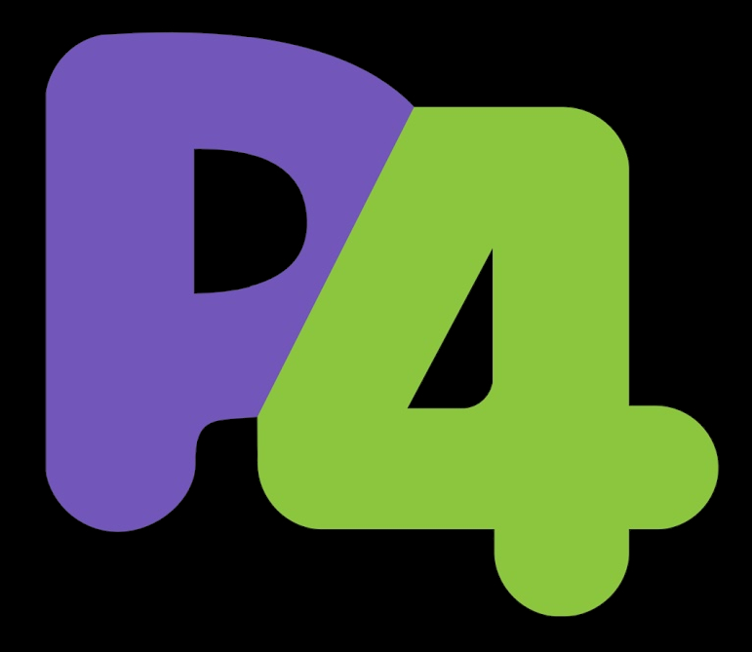
Tennenhouse &
Wetherall
Whippersnapper
P4FPGA
Smart Packets
SIGCOMM 2014
In-Band Network Telemetry
NetScript
ANTS
Tiny Packet Programs
1995
2000
2005
2010
2015
Notes:
Revival of active networks
P4, a language for programming dataplanes
Spawned new work on active networks
Barefoot Networks is developing it, creating chip to run arbitrary P4 programs at line rate

Slide 28
Active Networks
Separating the Data and Control Planes
OpenFlow
SDN Today

Slide 29
PCE
4D
SoftRouter
Tempest
Ethane
ForCES protocol
RCP
IRSCP
1995
2000
2005
2010
2015

Slide 30
PCE
4D
SoftRouter
Tempest
Ethane
ForCES protocol
RCP
IRSCP
1995
2000
2005
2010
2015

Slide 31
use pulls
technology pushes
burgeoning network speeds
insufficient network reliability
specialized services (VPNs)
Notes:
Network ossification - you can’t change the network without Cisco’s help

Slide 32
use pulls
technology pushes
open interface between control and data planes
logically centralized control

Slide 33
Open Shortest Path First (OSPF)
1μs
...
Notes:
First check all links! I.e. assign costs

Slide 34
OSPF
20μs
1μs
2μs
3μs
1μs
2μs
1μs
10μs
5μs
Notes:
First check all links! I.e. assign costs

Slide 35
OSPF
...
20μs
1μs
2μs
3μs
1μs
2μs
1μs
10μs
...
5μs
Notes:
First check all links! I.e. assign costs

Slide 36
OSPF
...
...
...
20μs
1μs
...
2μs
3μs
1μs
2μs
1μs
10μs
5μs
Notes:
First check all links! I.e. assign costs

Slide 37
SoftRouter
Network Entity (NE)
Control Element (CE)
ForCES
Forwarding
Entity (FE)
Notes:
Shortest path?
SECURITY POLICIES

Slide 38
SoftRouter
Notes:
Google syncs its datacenters can have a logical controller running and maintaining each datacenter and then only need to logically program the datacenter-to-datacenter protocols.

Slide 39
SoftRouter
Network Entity (NE)
Control Element (CE)
20μs
1μs
2μs
3μs
1μs
Forwarding
Entity (FE)
2μs
1μs
10μs
5μs
Notes:
SoftRouter / Software defined network
SDN is just this, but better OpenFlow is analogous to Forces and POX & other network operating systems are analogous to SoftRouter.

Slide 40
Shortest Path Routing
20μs
1μs
2μs
3μs
A
B
1μs
2μs
1μs
10μs
5μs
Notes:
SoftRouter / Software defined network
SDN is just this, but better OpenFlow is analogous to Forces and POX & other network operating systems are analogous to SoftRouter.

Slide 41
whither SoftRouter (and others)?
vendors didn’t adopt ForCES (and others)
not general enough
no practical deployment plan
Notes:
Vendors didnt support Open APIs like ForCES, because it would allow new vendors to enter the marketplace. Oracle wanted to keep its near-monopoly
Only allowed decisions based on IPv4 headers. Couldn’t program at the L2 level, couldn’t behave like a firewall, etc
Without vendor adoption and a general model for programming forwarding entities, most atte like ForCES/SoftRouter failed.

Slide 42
Active Networks
Separating the Data and Control Planes
OpenFlow
SDN Today
Notes:
Why OpenFlow is important:
Can program a wide variety of networking devices as abstract switches; SoftRouter can only program routers (IPv4 matching only)
Basically the OpenFlow API is better (more abstract and flexible)
Three-tiered architecture (logical control, state management, dataplane) as opposed to SoftRouter’s two layers (data and control plane)

Slide 43
OpenFlow
Ethane
NOX
1995
2000
2005
2010
2015
Notes:
Ethane: precursor to OpenFlow
Installed in Stanford CS dept to manage user access policies (e.g. faculty have access to these machines)
NOX
First OpenFlow controller
“Network Operating System”
OpenFlow

Slide 44
OpenFlow: enabling innovation in campus networks
Nick McKeown, Tom Anderson, Hari Balakrishnan,
Guru Parulkar, Larry Peterson,
Jennifer Rexford, Scott Shenker, Jonathan Turner
SIGCOMM 2008
Notes:
Describe where OpenFlow comes from, Stanford CS dept
One of the first successful SDN standards
ie. it was adopted by industry
OpenFlow and NOX papers published at SIGCOMM 2008
(OpenFlow paper cited over 6000 times, NOX paper cited over 1500 times)

Slide 45
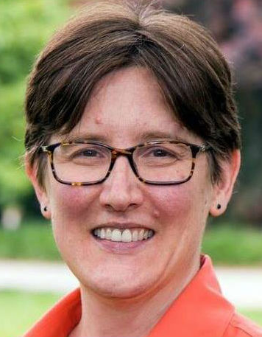
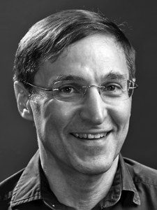
Nick McKeown
Stanford
Jennifer Rexford
Princeton
Scott Shenker
Berkeley
Notes:
Scott Shenker
We read his epidemic algorithms paper
Jennifer Rexford
Chair of SIGCOMM 2003-2007
Nick McKeown
Cofounder of Nicira Networks and Barefoot Networks

Slide 46
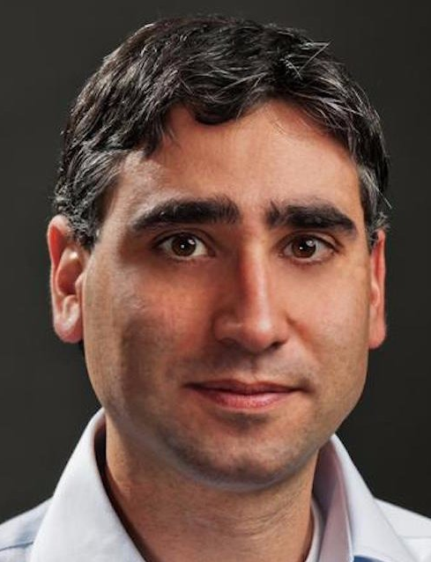
Nick McKeown
Stanford
Jennifer Rexford
Princeton
Scott Shenker
Berkeley
Martín Casado
Stanford
Notes:
Martin Casado
Grad student under Nick McKeown and Scott Shenker
Cofounder of Nicira Networks
Partner at Andreesen-Horowitz, left Nicira after it was acquired by VMWare

Slide 47
use pulls
technology pushes
networking research
market factors
datacenter networks
Notes:
Networking research
Prompted by large-scale infrastructure for networking research
E.g. Clean Slate Program headed by Nick McKeown
Global Environment for Network Innovations (GENI)
Need for virtualization in campus networks
Market factors
Chip designers (e.g. Broadcom) were opening APIs for switch chipsets
This opened up market for companies making switches
Datacenter networks
Complicated, required engagement with vendors

Slide 48
use pulls
technology pushes
backwards compatible
general packet processing
(more fields to match on)
Notes:
Backwards compatible: OF was designed to work with existing network devices
Usu devices just needed a firmware update to support OpenFlow
General packet processing:
Can match on ethernet frame fields, IP headers, TCP/UDP ports
Cf. with SoftRouter, only match on IP headers

Slide 49
OpenFlow
protocol
flow
table
fields | counter | action
srcIp=10.0.0.*, ipProto=TCP | 10 | pt = 2
dstPort=80 | 0 | drop
Notes:
OpenFlow protocol: describes communication between controller and switch
E.g. packet_in, packet_out, flow_mod
Flow table: generalized data plane functionality
Contains rules for matching on packet headers (ethernet frame, IP headers, TCP/UDP ports)
Rules have priorities, counters on how many times it was invoked, actions 2

Slide 50
learning switch
1
3
2
Notes:
Usu hardcoded in switches, trivially implemented in OpenFlow
Describe how a learning switch works NOT with openflow THEN with openflow

Slide 51
controller maintains hash table of MAC to port number mappings
MAC | port
1
3
2
Notes:
Define control and data plane here
Make diagram more network-y so we have a better idea of why the distributed routing algorithm is not good

Slide 52
MAC | port
src: spongebob
dst: patrick
msg: I’M READY
...
1
3
2

Slide 53
MAC | port
...
packet_in
1
3
2

Slide 54
MAC | port
spongebob | 1
...
packet_in
1
3
2
Notes:
Define control and data plane here
Make diagram more network-y so we have a better idea of why the distributed routing algorithm is not good

Slide 55
MAC | port
spongebob | 1
packet_out
...
1
3
2
Notes:
Define control and data plane here
Make diagram more network-y so we have a better idea of why the distributed routing algorithm is not good

Slide 56
MAC | port
spongebob | 1
1
3
...
2
...
Notes:
Define control and data plane here
Make diagram more network-y so we have a better idea of why the distributed routing algorithm is not good

Slide 57
install rule: forward packets for spongebob to port 1
MAC | port
spongebob | 1
flow_mod
1
3
2
Notes:
Define control and data plane here
Make diagram more network-y so we have a better idea of why the distributed routing algorithm is not good

Slide 58
MAC | port
spongebob | 1
src: patrick
dst: spongebob
msg: i’m patrick
1
3
2
...
Notes:
Define control and data plane here
Make diagram more network-y so we have a better idea of why the distributed routing algorithm is not good

Slide 59
no flooding required!
MAC | port
spongebob | 1
...
1
3
2
Notes:
Once a switch
Variations:
Install rules that match on (source, destination) MAC pairs instead of just destination MAC so that Patrick’s port will be learned (it will be sent to controller)
Patrick’s first packet will be sent to controller and then to spongebob, but every subsequent packet will be sent directly to Spongebob

Slide 60
firewall
1
3
2
Notes:
Add example here for dropping traffic

Slide 61
install rule: drop packets destined for squidward
flow_mod
1
3
2
Notes:
Add example here for dropping traffic

Slide 62
src: spongebob
dst: squidward
msg: hello
...
1
3
2
Notes:
Add example here for dropping traffic

Slide 63
Active Networks
Separating the Data and Control Planes
OpenFlow/SDN
SDN Today

Slide 64
Abstractions for Network Update
Frenetic
NetKAT
Propane
1995
2000
2005
2010
2015
Notes:
Frenetic: OpenFlow controller
Abstractions for Network Update:
How to update switch rules consistently
NetKAT:
DSL on top of Frenetic to describe forwarding behavior of network
Propane: DSL for BGP configurations
Complement to SDN; supports inter-domain configuration (while SDN focuses on intra-domain network config)

Slide 65
Abstractions for Network Update
Frenetic
NetKAT
Propane
1995
2000
2005
2010
2015

Slide 66
NetKAT
Forwarding Policy (F)
if sw==A then
(if pt==1 then pt=2 elif pt==2 then pt=1)
elif sw==B then
(if pt==1 then p=2 elif pt=2 then pt=1)
else drop
Network Behavior
run(F;T)
Topology (T)
if sw==A and pt==2 then (sw=B; pt=1)
elif sw==B and pt==1 then (sw=A; pt=2)
else drop
A
B
H1
1
2
1
2
H2
Notes:
Programs compile to forwarding rules
Also discuss how NetKAT is its own language for stating assertions re: network properties

Slide 67
NetKAT
Intuition: These are functions from packets to sets of packets
Forwarding Policy (F)
if sw==A then
(if pt==1 then pt=2 elif pt==2 then pt=1)
elif sw==B then
(if pt==1 then p=2 elif pt=2 then pt=1)
else drop
Network Behavior
run(F;T)
Topology (T)
if sw==A and pt==2 then (sw=B; pt=1)
elif sw==B and pt==1 then (sw=A; pt=2)
else drop
A
B
H1
1
2
1
2
H2
Notes:
Programs compile to forwarding rules
Also discuss how NetKAT is its own language for stating assertions re: network properties

Slide 68
Want to show:
SSH packets sent from H1 get to H2
Invariant true when
P1 is equivalent to P2.
P1
if typ==SSH and @h1
then run(F;T);
eventually(@h2)
P2
if typ==SSH and @h1
then run(F;T)
let @h1 be sw==A and pt==1
let @h2 be sw==B and pt==2
A
B
H1
1
2
1
2
H2
Notes:
Programs compile to forwarding rules
Also discuss how NetKAT is its own language for stating assertions re: network properties

Slide 69
Want to show:
SSH packets sent from H1 get to H2
Invariant true when
P1 is equivalent to P2.
P1
if typ==SSH and @h1
then run(F;T);
eventually(@h2)
P2
if typ==SSH and @h1
then run(F;T)
SSH packets from H1
A
B
H1
1
2
1
2
H2
Notes:
Programs compile to forwarding rules
Also discuss how NetKAT is its own language for stating assertions re: network properties

Slide 70
Want to show:
SSH packets sent from H1 get to H2
Invariant true when
P1 is equivalent to P2.
P1
if typ==SSH and @h1
then run(F;T);
eventually(@h2)
P2
if typ==SSH and @h1
then run(F;T)
“run” the network
A
B
H1
1
2
1
2
H2
Notes:
Programs compile to forwarding rules
Also discuss how NetKAT is its own language for stating assertions re: network properties

Slide 71
Want to show:
SSH packets sent from H1 get to H2
Invariant true when
P1 is equivalent to P2.
P1
if typ==SSH and @h1
then run(F;T);
eventually(@h2)
P2
if typ==SSH and @h1
then run(F;T)
packets received by H2
A
B
H1
1
2
1
2
H2
Notes:
Programs compile to forwarding rules
Also discuss how NetKAT is its own language for stating assertions re: network properties

Slide 72
NetKAT
A
if sw == A then: if port == 1 then port := 2 elif port == 2 then port := 3 else drop
elif sw == B then: if port==1 drop else port := 1
elif sw == C if port == 1 then port :=3 elif port == 3 then port :=2 elif port == 2 drop;
1
2
3
C
1
3
2
3
2
1
B
Notes:
Programs compile to forwarding rules
Also discuss how NetKAT is its own language for stating assertions re: network properties

Slide 73
NetKAT
A
if sw == A then: if port == 2 then alert_ctrl else port := 3
if sw == B then: if port == 1 then drop elif port == 2 then port := 3 elif port == 3 then port := 2
if sw == C if port == 1 then alert_ctrl elif port == 2 then port := 1 elif port == 3 then port := 2
1
2
3
C
1
3
2
3
2
1
B

Slide 74
whither SDN?
Notes:
Nicira Networks founded by Scott Shenker, Nick McKeown and Martin Casado
SDN startup
Sold to VMWare for $1 billion

Slide 75
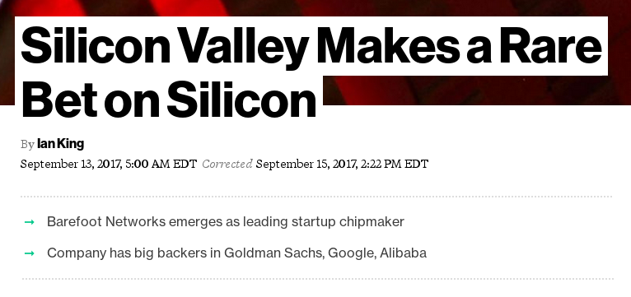
whither SDN?
Notes:
Barefoot Networks - co-founded by Nick McKeown (OpenFlow!)
$155 million in VC funding
Developing P4-programmable chip

Slide 76
questions?

Slide 77
thanks!

