Slide 1
Dynamo
Amazon’s Highly Available Key-value Store
SOSP ’07

Slide 2

Authors
Giuseppe DeCandia, Deniz Hastorun, Madan Jampani, Gunavardhan Kakulapati, Avinash Lakshman, Alex Pilchin, Swaminathan Sivasubramanian, Peter Vosshall and Werner Vogels
Werner Vogels
Cornell → Amazon

Slide 3
Motivation
A key-value storage system that provide an “always-on” experience at massive scale.

Slide 4
Motivation
A key-value storage system that provide an “always-on” experience at massive scale.
“Over 3 million checkouts in a single day” and “hundreds of thousands of concurrently active sessions.”
Reliability can be a problem: “data center being destroyed by tornados”.
Notes:
Reliability: components fail continuously

Slide 5
Motivation
A key-value storage system that provide an “always-on” experience at massive scale.
Service Level Agreements (SLA): e.g. 99.9th percentile of delay < 300ms
ALL customers have a good experience
Always writeable!

Slide 6
Consequence of “always writeable”
Always writeable ⇒ no master! Decentralization; peer-to-peer.
Always writeable + failures ⇒ conflicts
CAP theorem: A and P

Slide 7
Amazon’s solution
Sacrifice consistency!

Slide 8
System design: Overview
Partitioning
Replication
Sloppy quorum
Versioning
Interface
Handling permanent failures
Membership and Failure Detection

Slide 9
System design: Overview
Partitioning
Replication
Sloppy quorum
Versioning
Interface
Handling permanent failures
Membership and Failure Detection

Slide 10
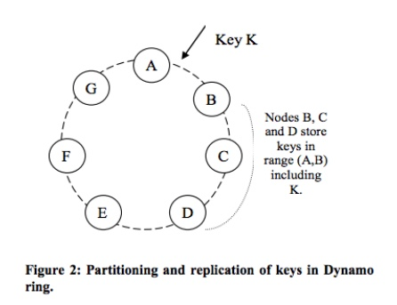
System design: Partitioning
Consistent hashing
The output range of the hash function is a fixed circular space
Each node in the system is assigned a random position
Lookup: find the first node with a position larger than the item’s position
Node join/leave only affects its immediate neighbors

Slide 11
System design: Partitioning
Consistent hashing
Advantages:
Naturally somewhat balanced
Decentralized (both lookup and join/leave)

Slide 12
System design: Partitioning
Consistent hashing
Problems:
Not really balanced -- random position assignment leads to non-uniform data and load distribution
Solution: use virtual nodes

Slide 13
System design: Partitioning
Virtual nodes
Nodes gets several, smaller key ranges instead of a big one
A
G
B
F
C
E
D

Slide 14
System design: Partitioning
Benefits
Incremental scalability
Load balance
A
G
B
F
C
E
D

Slide 15
System design: Partitioning
Up to now, we just redefined Chord

Slide 16
System design: Overview
Partitioning
Replication
Sloppy quorum
Versioning
Interface
Handling permanent failures
Membership and Failure Detection

Slide 17
System design: Replication
Coordinator node
Replicas at N - 1 successors
N: # of replicas
Preference list
List of nodes that is responsible for storing a particular key
Contains more than N nodes to account for node failures

Slide 18
System design: Replication
Storage system built on top of Chord
Like Cooperative File System(CFS)

Slide 19
System design: Overview
Partitioning
Replication
Sloppy quorum
Versioning
Interface
Handling permanent failures
Membership and Failure Detection

Slide 20
System design: Sloppy quorum
Temporary failure handling
Goals:
Do not block waiting for unreachable nodes
Put should always succeed
Get should have high probability of seeing most recent put(s)
CAP

Slide 21
System design: Sloppy quorum
Quorum: R + W > N
N - first N reachable nodes in the preference list
R - minimum # of responses for get
W - minimum # of responses for put
Never wait for all N, but R and W will overlap
“Sloppy” quorum means R/W overlap is not guaranteed

Slide 22
Conflict!
Example: N=3, R=2, W=2 Shopping cart, empty “” preference list n1, n2, n3, n4 client1 wants to add item X _ get() from n1, n2 yields “” _ n1 and n2 fail _ put(“X”) goes to n3, n4 n1, n2 revive client2 wants to add item Y _ get() from n1, n2 yields “” _ put(“Y”) to n1, n2 client3 wants to display cart _ get() from n1, n3 yields two values! _ “X” and “Y” _ neither supersedes the other -- conflict!

Slide 23
Eventual consistency
Accept writes at any replica
Allow divergent replica
Allow reads to see stale or conflicting data
Resolve multiple versions when failures go away(gossip!)

Slide 24
Conflict resolution
When?
During reads
Always writeable: cannot reject updates
Who?
Clients
Application can decide the best suited method

Slide 25
System design: Overview
Partitioning
Replication
Sloppy quorum
Versioning
Interface
Handling permanent failures
Membership and Failure Detection

Slide 26
System design: Versioning
Eventual consistency ⇒ conflicting versions
Version number? No; it forces total ordering (Lamport clock)
Vector clock

Slide 27
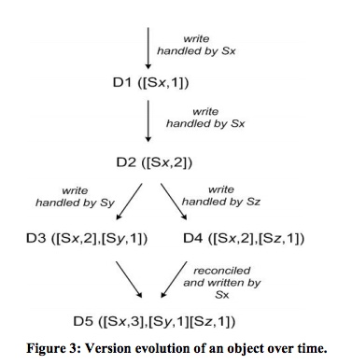
System design: Versioning
Vector clock: version number per key per node.
List of [node, counter] pairs

Slide 28
System design: Overview
Partitioning
Replication
Sloppy quorum
Versioning
Interface
Handling permanent failures
Membership and Failure Detection

Slide 29
System design: Interface
All objects are immutable
Get(key)
may return multiple versions
Put(key, context, object)
Creates a new version of key

Slide 30
System design: Overview
Partitioning
Replication
Sloppy quorum
Versioning
Interface
Handling permanent failures
Membership and Failure Detection

Slide 31
System design: Handling permanent failures
Detect inconsistencies between replicas
Synchronization

Slide 32
System design: Handling permanent failures
Anti-entropy replica synchronization protocol
Merkle trees
A hash tree where leaves are hashes of the values of individual keys; nodes are hashes of their children
Minimize the amount of data that needs to be transferred for synchronization
H_{ABCD}
Hash(H_{AB}+H_{CD})
H_{AB}
Hash(H_{A}+H_{B})
H_{CD}
Hash(H_{C}+H_{D})
H_{A}
Hash(A)
H_{B}
Hash(B)
H_{C}
Hash(C)
H_{D}
Hash(D)

Slide 33
System design: Overview
Partitioning
Replication
Sloppy quorum
Versioning
Interface
Handling permanent failures
Membership and Failure Detection

Slide 34
System design: Membership and Failure Detection
Gossip-based protocol propagates membership changes
External discovery of seed nodes to prevent logical partitions
Temporary failures can be detected through timeout

Slide 35
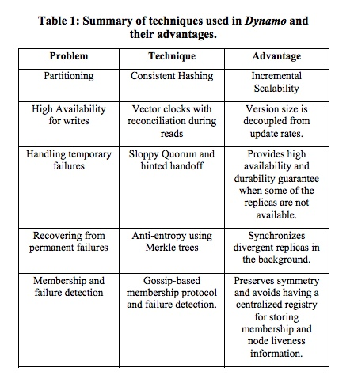
System design: Summary

Slide 36
Evaluation?
No real evaluation; only experiences

Slide 37
Experiences: Flexible N, R, W and impacts
They claim “the main advantage of Dynamo” is flexible N, R, W
What do you get by varying them?
(3-2-2) : default; reasonable R/W performance, durability, consistency
(3-3-1) : fast W, slow R, not very durable
(3-1-3) : fast R, slow W, durable

Slide 38
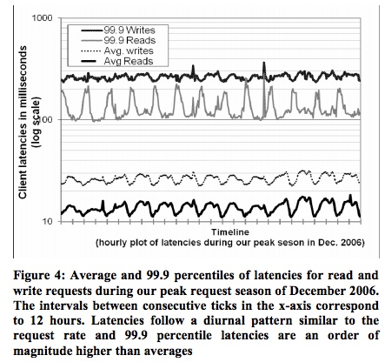
Experiences: Latency
99.9th percentile latency: ~200ms
Avg latency: ~20ms
“Always-on” experience!

Slide 39
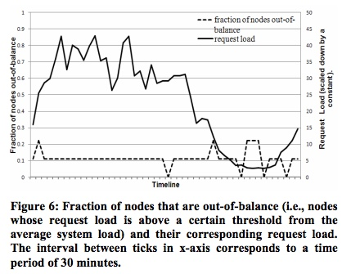
Experiences: Load balancing
Out-of-balance: 15% away from average load
High loads: many popular keys; load is evenly distributed; fewer out-of-balance nodes
Low loads: fewer popular keys; more out-of-balance nodes

Slide 40
Conclusion
Eventual consistency
Always writeable despite failures
Allow conflicting writes, client merges

Slide 41
Questions?

