Slide 1
DHT Routing Geometries and Chord
Dietrich Geisler

Slide 2
Initial Attempts
  Freenet, Gnutella, BitTorrent, Napster
  File-sharing services that take advantage of networks
  Two major approaches for file delivery system
    Central indexing which searches for data – vulnerable to failure
    Querying machines for file – inefficient and potentially incorrect

Slide 3
Problem
  How do we store and access distributed data?

Slide 4
Peer-to-Peer Systems
  Distributed system for managing data
  No central controller
  No notion of hierarchy among member nodes

Slide 5
Distributed Hash Tables
  Structure of a hash table – (key, value) pairs
  Member nodes contain local keys and values
  Nodes have information for retrieving ‘neighbor’ nodes in the form of keys
  Only a subset of all references are stored on a given node

Slide 6
Introduction to Chord
  Chord consists of a DHT protocol and program
  Nodes are placed on a ring structure
  Each node acts independently

Slide 7
Chord Goals
  Load Balancing
  Decentralization
  Scalability
  Flexible Naming
  Availability

Slide 8
Outline of Chord
  Key assignment
  Linking nodes
    Finger tables
  Adding/Removing nodes
  Optimizations
    Concurrency
    Load Balancing

Slide 9
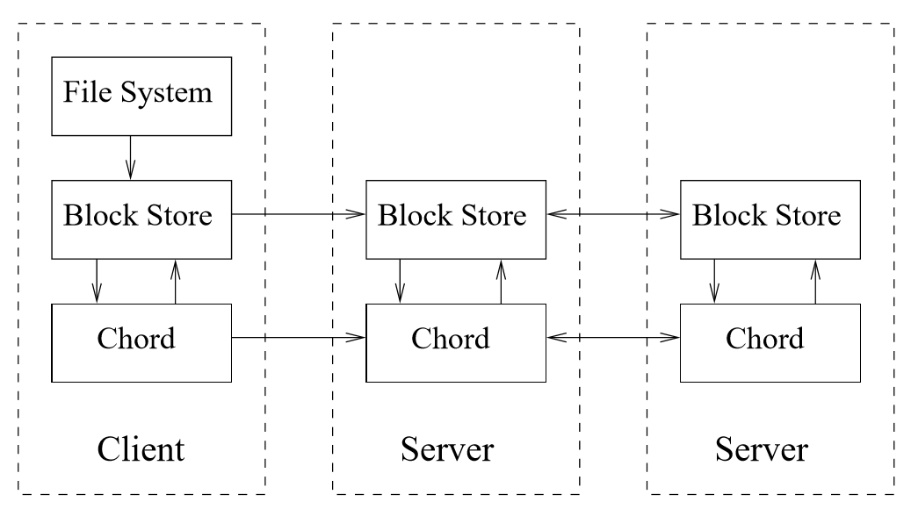
Chord Structure
From Chord: A Scalable Peer-to-peer Lookup Service for Internet Applications

Slide 10
Ring of Nodes
0
15
1
14
2
m = 4, 2^{m} = 16
13
3
12
4
11
5
10
6
9
7
8

Slide 11

Key Assignment in Chord
14
2
m = 4, 2^{m} = 16
Successor(14)
10
6

Slide 12
Key Assignment in Chord
14
2
m = 4, 2^{m} = 16
10
6

Slide 13
Key Assignment in Chord
1
14
2
m = 4, 2^{m} = 16
13
1
v₀
6
v₁
12
v₂
12
13
v₃
6
10
6

Slide 14
Key Assignment in Chord
1
14
2
m = 4, 2^{m} = 16
13
1
v₀
6
v₁
12
v₂
12
13
v₃
6
10
6

Slide 15
Key Assignment in Chord
1
14
2
m = 4, 2^{m} = 16
13
1
v₀
6
v₁
12
v₂
12
13
v₃
12
Which keys do we need to update?
6
10
6

Slide 16
Key Assignment in Chord
1
14
2
m = 4, 2^{m} = 16
13
1
v₀
6
v₁
12
v₂
12
13
v₃
6
10
6

Slide 17
Key Assignment in Chord
1
14
2
m = 4, 2^{m} = 16
13
1
v₀
6
v₁
12
v₂
12
13
v₃
Which keys do we need to update?
6
10
6

Slide 18
Key Assignment in Chord
1
14
m = 4, 2^{m} = 16
13
1
v₀
6
v₁
12
v₂
12
13
v₃
6
10
6

Slide 19
Properties of Consistent Hashing
  For any set of N nodes and K keys, with high probability,
  Each node is responsible for at most (1 + ε)K=N keys
    ε = O(logN)
  When an (N +1)st node joins or leaves the network, responsibility for O(K=N) keys changes hands (and only to or from the joining or leaving node)

Slide 20
Naïve Linking
14
2
m = 4, 2^{m} = 16
Successor(14)
Successor(2)
6
10
6

Slide 21
Naïve Linking
0
14
2
m = 4, 2^{m} = 16
13
3
12
How do we get the item with identifier 13 from node 0 using only successor nodes?
10
6
9

Slide 22
Naïve Linking
0
14
2
m = 4, 2^{m} = 16
13
3
12
10
6
9

Slide 23
Finger Tables
  Maintain a list of nodes at intervals of the ring
  Provide good coverage while minimizing space
  Tables where ith entry of the node n is the successor of
  (n + 2^{i-1}) mod 2^{m}

Slide 24
Naïve Linking
0
14
2
m = 4, 2^{m} = 16
Finger Table for node 0
i | ident. | node
1 | 1 | 2
2 | 2 | 2
3 | 4 | 6
4 | 8 | 9
3
12
10
6
9

Slide 25
Naïve Linking
0
14
2
m = 4, 2^{m} = 16
Finger Table for node 0
13
i | ident. | node
1 | 1 | 2
2 | 2 | 2
3 | 4 | 6
4 | 8 | 9
3
12
How do we get the item with identifier 13 from node 0?
(We don’t have a notion of predecessor yet!)
10
6
9

Slide 26
Naïve Linking
0
14
2
m = 4, 2^{m} = 16
Finger Table for node 0
13
i | ident. | node
1 | 1 | 2
2 | 2 | 2
3 | 4 | 6
4 | 8 | 9
3
12
10
6
9

Slide 27
Node Joins
  Preserve ability to locate a given key
    Each node’s successor must be correctly maintained
    For every k∈ Keys, successor(k) is responsible for k
  To help with this, each node will maintain a predecessor node in addition to the nodes stored in the finger table

Slide 28
Node Join Requirements
  Initialize the predecessor and ﬁngers of node n
  Update the ﬁngers and predecessors of existing nodes to reﬂect the addition of n
  Notify the higher layer software so that it can transfer state (e.g. values) associated with keys that node n is now responsible for.

Slide 29
Node Join Requirements
  Initialize the predecessor and ﬁngers of node n
  O(log N)
  Update the ﬁngers and predecessors of existing nodes to reﬂect the addition of n
  O(log N)
  Notify the higher layer software so that it can transfer state (e.g. values) associated with keys that node n is now responsible for.
  O(1)

Slide 30
Node Join
0
14
2
m = 4, 2^{m} = 16
Finger Table for node 0
i | ident. | node
1 | 1 | 4
2 | 2 | 4
3 | 4 | 4
4 | 8 | 8
12
4
Which nodes have to update their tables?
10
6
8

Slide 31
Node Join
0
14
2
m = 4, 2^{m} = 16
Finger Table for node 0
i | ident. | node
1 | 1 | 2
2 | 2 | 2
3 | 4 | 4
4 | 8 | 8
12
4
10
6
8

Slide 32
Node Join
0
14
2
m = 4, 2^{m} = 16
Finger Table for node 0
i | ident. | node
1 | 1 | 2
2 | 2 | 2
3 | 4 | 4
4 | 8 | 8
12
4
Which nodes have to update their tables?
10
6
8

Slide 33
Node Join
0
14
2
m = 4, 2^{m} = 16
Finger Table for node 0
i | ident. | node
1 | 1 | 2
2 | 2 | 2
3 | 4 | 4
4 | 8 | 10
12
4
10
6
8

Slide 34
What can go wrong?
  We have a protocol that can reach any node from a given node in O(log N) steps with high probability
  Nodes can join and leave while maintaining our tables
  So what problems do we still need to address?

Slide 35
Concurrency and Failures
  It is necessary to handle concurrent joins and failures
  It cannot be assumed the operations described will be able to handle these conditions
  In particular, we want to maintain finger tables to be as accurate as possible to minimize searching cost

Slide 36
Stabilization
  A node informs neighboring nodes of its existence
  Iterative runs of stabilize will eventually result in a system with fully correct tables
  If N nodes are added to a system with N initial nodes concurrently, lookups will take O(log N) time with high probability

Slide 37
Fault Tolerance
  To handle faults, each node must maintain an additional list of replacement successors of size r
  As r increases, fault tolerance clearly increases, but memory costs increase linearly
  In particular, r = O(log N) allows for recovery with high probability if each node fails with probability ½

Slide 38
Virtual Nodes
  The load balancing of this system can be improved
  How about we allow each member to house multiple ‘nodes’?

Slide 39
Virtual Nodes
0
1
14
2
m = 4, 2^{m} = 16
13
12
4
5
10
6
9
8

Slide 40
Virtual Nodes
0
1
14
2
m = 4, 2^{m} = 16
13
12
4
5
10
6
9
8

Slide 41
Virtual Nodes
0
1
14
2
m = 4, 2^{m} = 16
Finger Table for node 0
13
i | ident. | node
1 | 1 | 1
2 | 2 | 2
3 | 4 | 4
4 | 8 | 8
12
4
5
10
6
9
8

Slide 42
Virtual Nodes
  Virtual nodes allow for improved load balancing
  The probability that a given node contains no keys is
  (1-1/N)^{N} ≈ e⁻¹ ≈ 0.368
  With M < N virtual nodes, this probability is reduced to
  1-(1-(1-1/N)^{N})^{M} ≈ 1-(1- 0.368)^{M} ≈ 1-(0.632)^{M}

Slide 43
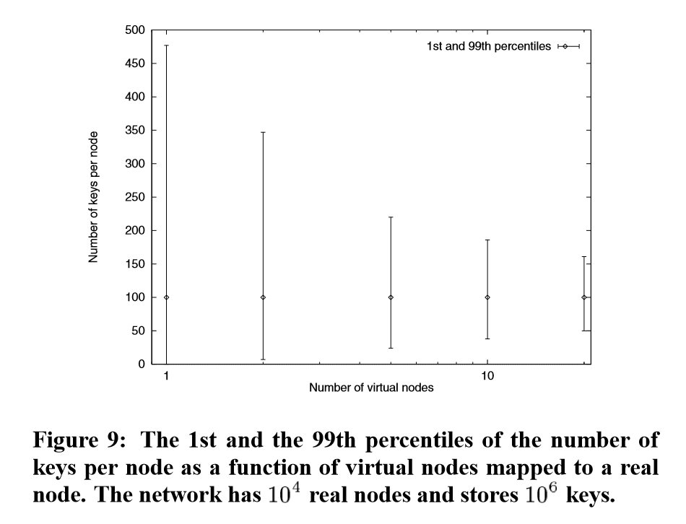
Results

Slide 44
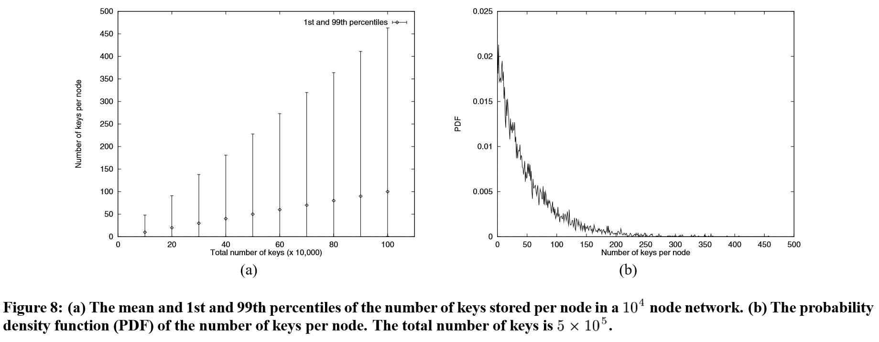
Results

Slide 45
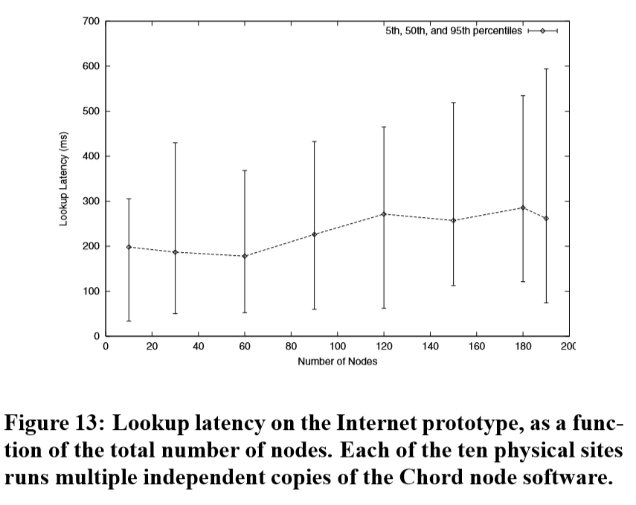
Results

Slide 46
Chord Goals
  How well did Chord achieve its goals?
    Load Balancing
    Decentralization
    Scalability
    Flexible Naming
    Availability
  What are the problems with this protocol?

Slide 47
Distributed Hash Tables (Recall)
  Structure of a hash table – (key, value) pairs
  Member nodes contain local keys and values
  Nodes have information for retrieving ‘neighbor’ nodes in the form of keys
  Only a subset of all references are stored on a given node

Slide 48
Geometry (and why it matters)
  How can we compare a variety of DHT algorithms?

Slide 49
Geometry (and why it matters)
  How can we compare a variety of DHT algorithms?
  The structure of how they connect and search for nodes within the system seems like a good place to start
  The geometry of a DHT refers loosely to the connections between nodes in the DHT structure

Slide 50
Outline of DHT Geometries
  Notable Geometries
  Theoretical Speed and Resilience Comparison
  Experimental Results

Slide 51
Notable Geometries
  Tree
  Hypercube
  Butterfly
  Ring (Chord!)
  XOR
  Hybrid

Slide 52
Tree Geometry
Origin Node
Distance = 1
Distance = 2
Distance = 3

Slide 53
Hypercube Geometry
Origin Node
Distance = 1
Distance = 2
Distance = 3

Slide 54
Butterfly Geometry
  Stages for each bit of the identifier
  O(log n) jumps for each stage
  Fast, but very little flexibility

Slide 55
Ring Geometry
Origin Node
Distance = 1

Slide 56
XOR Geometry (Tree, but fault-tolerant)
Origin Node
Distance = 1
Distance = 2
Distance = 3

Slide 57
Hybrid Geometry
  Allows combining the strengths of different geometries
  Can be implemented by computing the distance between two nodes multiple ways
  More space intensive than a single geometry and search complexity can be subtle

Slide 58

Geometry Summary
Hyper
Cube
Butter
fly
Tree
Ring
XOR
Neighbor selection (Speed)
Route selection (Resilience)
~

Slide 59
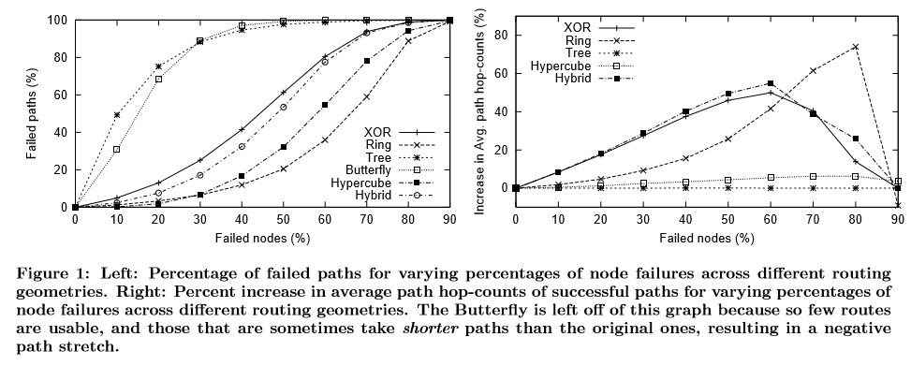
Results

Slide 60
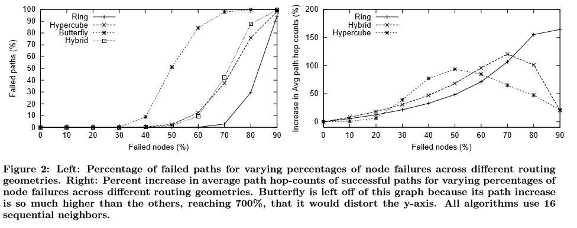
Results

Slide 61
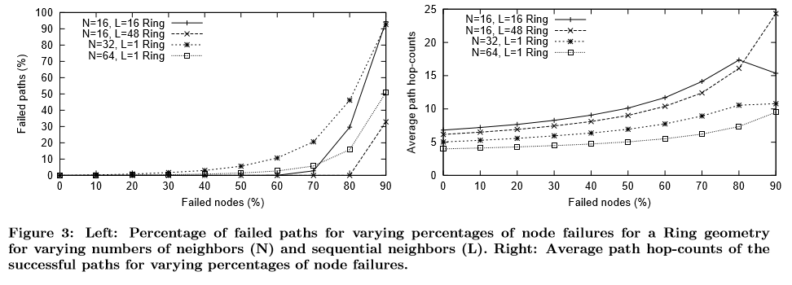
Fault-Tolerance

Slide 62
NOTE
  At this point, I think I’ll be out of time; I can add slides on PNS/PRS, Convergence, or the Discussion section if you think they’re relevant

Slide 63
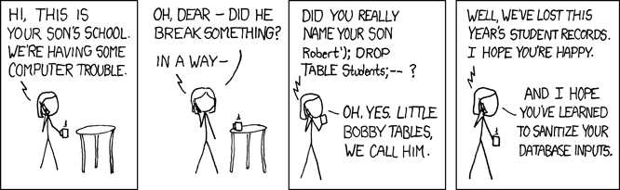
Questions
https://xkcd.com/327/

