Slide 1
Distributed Systems: Paxos
Burcu Canakci & Matt Burke

Slide 2
Outline
Consensus
The Part-Time Parliament
Single-Decree Paxos
Liveness
Multi-Decree Paxos
Paxos Variants
Conclusion

Slide 3
Outline
Consensus
The Part-Time Parliament
Single-Decree Paxos
Liveness
Multi-Decree Paxos
Paxos Variants
Conclusion

Slide 4
What is consensus?
Where do we want to go to eat lunch?

Slide 5
What is consensus?
I personally don’t care.
Indifferent.
I’m good with anywhere.

Slide 6
What is consensus?
Where do we want to go to eat lunch?

Slide 7
What is consensus?
I’d like Thai food.
I’m feeling Korean food.
I also want Thai food.

Slide 8
What is consensus?
OK, let’s get Thai food.
OK, let’s get Thai food.
OK, let’s get Thai food.

Slide 9
What is consensus?
Consensus is the problem of getting a set of processors to agree on some value.

Slide 10
What is consensus?
OK, let’s get Thai food.
OK, let’s get Thai food.
OK, let’s get Thai food.

Slide 11
What is consensus?
More formally, consensus is the problem of satisfying the following properties:
Validity
Agreement
Integrity
Termination
Notes:
Not to be confused with previous properties that we’ve seen with the same names (such as Agreement from SMR)

Slide 12
What is consensus?
More formally, consensus is the problem of satisfying the following properties:
Validity
If all processes that propose a value propose v, then all correct deciding processes eventually decide v
Agreement
Integrity
Termination
Notes:
Discussion question: in the lunch example, what is the meaning of validity?
Answer: If all of the proposals for where to eat are the same place, then all people eventually agree to eat at the proposed place.

Slide 13
What is consensus?
Validity: If all processes that propose a value propose v, then all correct deciding processes eventually decide v
I’d like Thai food.
Thai food.
I also want Thai food.

Slide 14
What is consensus?
More formally, consensus is the problem of satisfying the following properties:
Validity
If all processes that propose a value propose v, then all correct deciding processes eventually decide v
Agreement
If a correct deciding process decides v, then all correct deciding processes eventually decide v
Integrity
Termination
Notes:
Discussion question: in the lunch example, what is the meaning of agreement?
Answer: If a person in the groups makes a final decision to go to a place to eat, then all people in the group eventually agree to eat there as well.

Slide 15
What is consensus?
Agreement: If a correct deciding process decides v, then all correct deciding processes eventually decide v
I’d like Thai food.
OK, let’s get Thai food.
I’m feeling Korean food.
OK, let’s get Thai food.
I also want Thai food.
OK, let’s get Thai food.

Slide 16
What is consensus?
More formally, consensus is the problem of satisfying the following properties:
Validity
If all processes that propose a value propose v, then all correct deciding processes eventually decide v
Agreement
If a correct deciding process decides v, then all correct deciding processes eventually decide v
Integrity
Every correct deciding process decides at most one value, and if it decides v, then some process must have proposed v
Termination
Notes:
Discussion question: in the lunch example, what is the meaning of integrity?
Answer: There is no pre-determined place at which everyone will agree to eat. It must be possible (for sake of variety!) that a proposal can be made.

Slide 17
What is consensus?
Integrity: Every correct deciding process decides at most one value, and if it decides v, then some process must have proposed v
I’d like Thai food.
I’m feeling Korean food.
I also want Thai food.

Slide 18
What is consensus?
More formally, consensus is the problem of satisfying the following properties:
Validity
If all processes that propose a value propose v, then all correct deciding processes eventually decide v
Agreement
If a correct deciding process decides v, then all correct deciding processes eventually decide v
Integrity
Every correct deciding process decides at most one value, and if it decides v, then some process must have proposed v
Termination
Every correct learning process eventually learns some decided value
Notes:
Discussion question: in the lunch example, what is the meaning of termination?
Answer: They eventually get eat lunch!

Slide 19
What is consensus?
Agreement: If a correct deciding process decides v, then all correct deciding processes eventually decide v
Termination: Every correct learning process eventually learns some decided value
I’d like Thai food.
OK, let’s get Thai food.
I’m feeling Korean food.
OK, let’s get Thai food.
I also want Thai food.
OK, let’s get Thai food.

Slide 20
Assumption about our model
Asynchronous, but reliable, network

Slide 21
Assumption about our model
Asynchronous, but reliable, network
Every message is eventually delivered, but can be delayed arbitrarily long

Slide 22
Assumption about our model
Asynchronous, but reliable, network
Every message is eventually delivered, but can be delayed arbitrarily long
Processes can take arbitrarily long to transition between states

Slide 23
Assumption about our model
Asynchronous, but reliable, network
Every message is eventually delivered, but can be delayed arbitrarily long
Processes can take arbitrarily long to transition between states
Processes can only fail by crashing

Slide 24
Assumption about our model
Asynchronous, but reliable, network
Every message is eventually delivered, but can be delayed arbitrarily long
Processes can take arbitrarily long to transition between states
Processes can only fail by crashing
No indication of failure; simply stops responding to messages

Slide 25
Assumption about our model
Asynchronous, but reliable, network
Every message is eventually delivered, but can be delayed arbitrarily long
Processes can take arbitrarily long to transition between states
Processes can only fail by crashing
No indication of failure; simply stops responding to messages
Failed processes cannot arbitrarily transition or send arbitrary messages

Slide 26
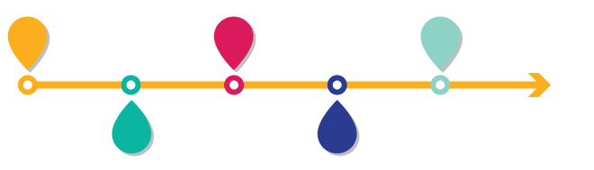
Timeline
Time, Clocks and Ordering
State Machine Replication
Paxos Published
1978
1984
1989

Slide 27
Timeline
Time, Clocks and Ordering
State Machine Replication
Paxos Published
Paxos Published In Journal
1978
1984
1989
1998

Slide 28
Timeline
Time, Clocks and Ordering
State Machine Replication
Paxos Published
Paxos Published In Journal
Paxos Made Simple
1978
1984
1989
1998
2001

Slide 29
Timeline
Time, Clocks and Ordering
State Machine Replication
Paxos Published
Paxos Published In Journal
Paxos Made Simple
1978
1984
1989
1998
2001
Paxos Made Moderately Complex
2015

Slide 30
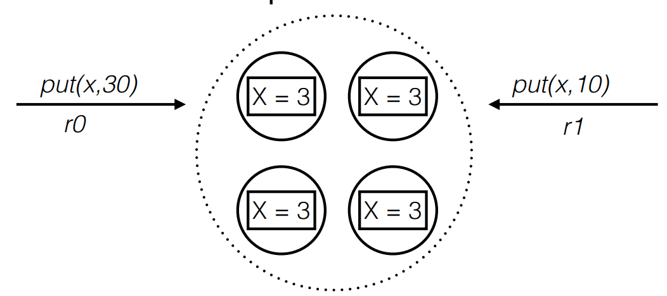
Recall the Consensus Problem in the State Machine Approach

Slide 31
Outline
Consensus
The Part-Time Parliament
Single-Decree Paxos
Liveness
Multi-Decree Paxos
Paxos Variants
Conclusion

Slide 32
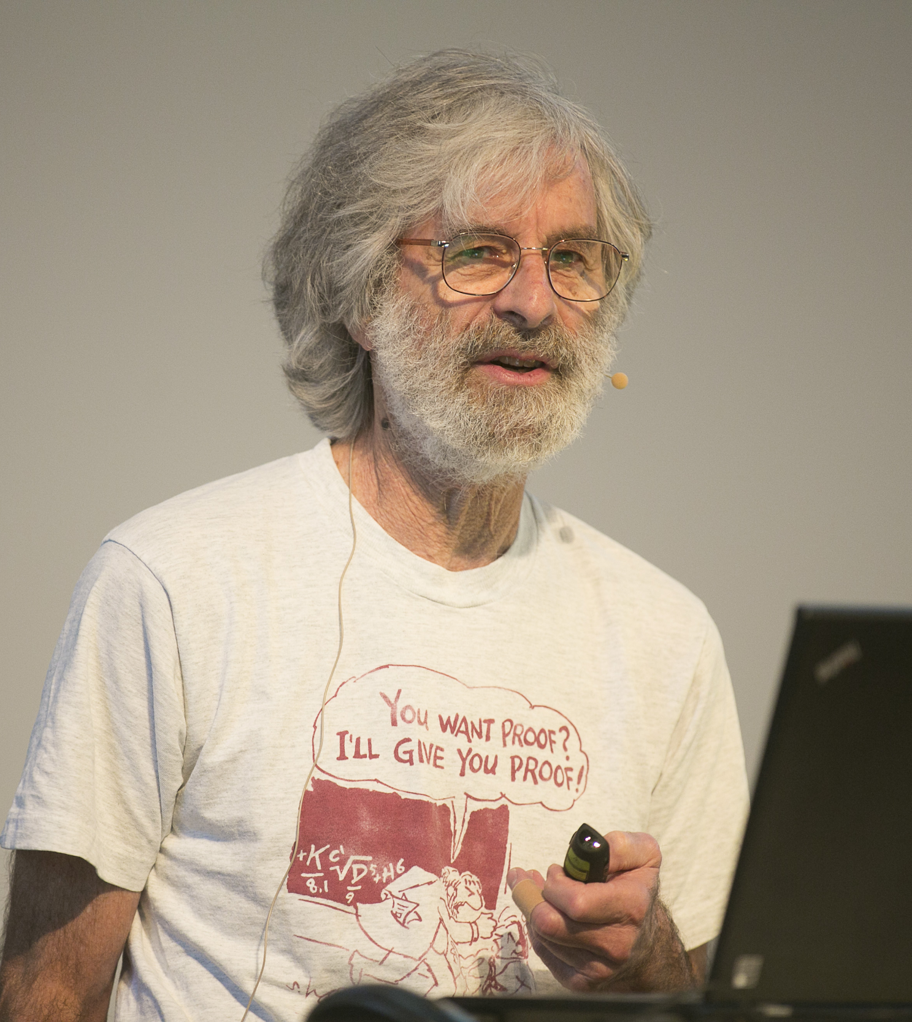
The Part-Time Parliament
The Part-Time Parliament (1998)
Recent archaeological discoveries on the island of Paxos reveal that the parliament functioned despite the peripatetic propensity of its part-time legislators. The legislators maintained consistent copies of the parliamentary record, despite their frequent forays from the chamber and the forgetfulness of their messengers. The Paxon parliament’s protocol provides a new way of implementing the state machine approach to the design of distributed systems.
Leslie Lamport

Slide 33

The Part-Time Parliament

Slide 34
The Part-Time Parliament
The Part-Time Parliament (1998)
Recent archaeological discoveries on the island of Paxos reveal that the parliament functioned despite the peripatetic propensity of its part-time legislators. The legislators maintained consistent copies of the parliamentary record, despite their frequent forays from the chamber and the forgetfulness of their messengers. The Paxon parliament’s protocol provides a new way of implementing the state machine approach to the design of distributed systems.
Paxos Made Simple (2001)
The Paxos algorithm, when presented in plain English, is very simple.
Leslie Lamport

Slide 35


Paxos Made Moderately Complex
Paxos Made Moderately Complex (2015)
This article explains the full reconfigurable multidecree Paxos (or multi-Paxos) protocol. Paxos is by no means a simple protocol, even though it is based on relatively simple invariants. We provide pseudocode and explain it guided by invariants.
Robbert Van Renesse
Deniz Altinbuken

Slide 36
Outline
Consensus
The Part-Time Parliament
Single-Decree Paxos
Liveness
Multi-Decree Paxos
Paxos Variants
Conclusion

Slide 37
Roles in Protocol
Validity
If all processes that propose a value propose v, then all correct deciding processes eventually decide v
Agreement
If a correct deciding process decides v, then all correct deciding processes eventually decide v
Integrity
Every correct deciding process decides at most one value, and if it decides v, then some process must have proposed v
Termination
Every correct learning process eventually learns some decided value
Notes:
Discussion question: in the lunch example, what is the meaning of termination?
Answer: They eventually get eat lunch!

Slide 38
Roles in Protocol
Proposers
Validity
If all processes that propose a value propose v, then all correct deciding processes eventually decide v
Agreement
If a correct deciding process decides v, then all correct deciding processes eventually decide v
Integrity
Every correct deciding process decides at most one value, and if it decides v, then some process must have proposed v
Termination
Every correct learning process eventually learns some decided value
Acceptors
Learners
Notes:
Discussion question: in the lunch example, what is the meaning of termination?
Answer: They eventually get eat lunch!

Slide 39
Constructing a Protocol
Proposer
Do nothing
Acceptor
Let v_{decided} = v₀ and send decide(v₀) to learners

Slide 40
Constructing a Protocol
Integrity: Every correct deciding process decides at most one value, and if it decides v, then some process must have proposed v
decide(v₀)
Notes:
Simple example: acceptor always decides some value v_0. Easy!
Discussion question: why doesn’t this solve consensus?
Answer: It violates the triviality property! v₀ was not proposed.

Slide 41
Constructing a Protocol
Proposer
When have value v to propose
Send propose(v) to acceptors
Acceptor
On receive propose(v)
If not yet decided, let v_{decided} = v and send decide(v) to learners

Slide 42

Constructing a Protocol
Termination: Every correct learning process eventually learns some decided value
???
propose(v)
propose(v)
propose(v)
Notes:
Simple example: a single acceptor is proposed the same value from all proposers. In order to satisfy validity, the acceptor must decide this proposed value.
Trivial protocol: acceptor decides the first value that it receives from a proposer and then informs learner.
Discussion question: does the protocol satisfy all of the properties? Are we done?
Answer: No, consider the case that the acceptor fails before informing the learner. In general, if the protocol is always broken with a single fault, it’s not very interesting.

Slide 43
Constructing a Protocol
Proposer
When have value v to propose
Send propose(v) to acceptors
Acceptor
On receive propose(v)
If not yet decided, let v_{decided} = v
When majority of correct acceptors have decided v
Send decide(v) to learners

Slide 44
Constructing a Protocol
propose(v)
decide(v)
propose(v)
decide(v)
propose(v)
Notes:
None of the consensus properties say anything about correct or incorrect proposers. It’s OK to either decide an incorrect proposers’ value or to decide some other value.
If a learner is incorrect, we don’t need to make it learn the decided value. Only care about correct learners.
Acceptors are the tricky ones that fail, since they are doing the work of deciding. To tolerate acceptor failures, we need to have multiple acceptors.
Consider a value decided only when a majority of acceptors have decided the value.

Slide 45
Constructing a Protocol
Agreement: If a correct deciding process decides v, then all correct deciding processes eventually decide v
propose(v)
v
???
propose(v’)
v’
propose(v’’)
v’’
Notes:
OK, but we’re forgetting about one of the properties (Agreement: If a correct deciding process decides v, then all correct deciding processes eventually decide v). What happens if different acceptors accept different values? On the one hand, the acceptors need to decide the first values that are proposed to satisfy validity. But on the other hand, acceptors might decide different values from different proposers.
There is no majority of correct acceptors that have decided the same value.

Slide 46
Constructing a Protocol
Ballot number: unique natural number associated with each proposal made by any proposer
v’,1
0
prepare(0)
1
promise(0)
propose(v,0)
decide(v’)
v’,1
0
1
decide(v’)
decide(v’)
propose(v’,1)
promise(1)
prepare(1)
v’,1
0
1
Notes:
Solution: proposers cooperate with acceptors with a preparatory round of communication.
Associate with each proposal a unique ballot number. Before making a proposal, a proposer must extract a promise from a majority of acceptors to not accept proposals below the current ballot number.
Acceptors only decide proposals that they have not promised to not accept.

Slide 47
Constructing a Protocol
Proposer
When have value v to propose
Send prepare(b) to acceptors, where b is the highest ballot number not yet used that is known to the proposer
When have majority of acceptors’ promises for proposal b
Send propose(v,b) to acceptors
Acceptor
On receive prepare(b)
If b > b_{promised}, let b_{promised} = b and respond with promise(b)
On receive propose(v,b)
If b = b_{promised}, let v_{decided} = v
When majority of correct acceptors have decided v
Send decide(v) to learners

Slide 48
Constructing a Protocol
Integrity: Every correct deciding process decides at most one value, and if it decides v, then some process must have proposed v
v,0
v’,1
v,1
prepare(0)
0
promise(0)
propose(v,0)
decide(v’)
decide(v)
v,0
v’
0
v
v,1
v’,1
decide(v’)
decide(v)
decide(v’)
decide(v)
propose(v’,1)
promise(1)
prepare(1)
v,0
0
v,1
v’,1
Notes:
This modification opens

Slide 49
Constructing a Protocol
Proposer
When have value v to propose
Send prepare(b) to acceptors, where b is the highest ballot number not yet used that is known to the proposer
When have majority of acceptors’ promises for proposal b
Send propose(v,b) to acceptors, where v is the value of the highest accepted proposal, or any value if no proposal accepted
Acceptor
On receive prepare(b)
If b > b_{promised}, let b_{promised} = b and respond with promise(b, v_{decided})
On receive propose(v,b)
If b = b_{promised}, let v_{decided} = v
When majority of correct acceptors have decided v
Send decide(v) to learners

Slide 50
Constructing a Protocol Paxos
Proposer
When have value v to propose
Send prepare(b) to acceptors, where b is the highest ballot number not yet used that is known to the proposer
When have majority of acceptors’ promises for proposal b
Send propose(v,b) to acceptors, where v is the value of the highest accepted proposal, or any value if no proposal accepted
Acceptor
On receive prepare(b)
If b > b_{promised}, let b_{promised} = b and respond with promise(b, v_{decided})
On receive propose(v,b)
If b = b_{promised}, let v_{decided} = v
When majority of correct acceptors have decided v
Send decide(v) to learners

Slide 51
Outline
Consensus
The Part-Time Parliament
Single-Decree Paxos
Liveness
Multi-Decree Paxos
Paxos Variants
Conclusion

Slide 52
Liveness
Something good eventually happens
Progress is made
An action is always eventually executed

Slide 53
Liveness
Something good eventually happens
Progress is made
An action is always eventually executed
In consensus
Termination
Every correct learning process eventually learns some decided value

Slide 54
Liveness
Something good eventually happens
Progress is made
An action is always eventually executed
In consensus
Termination
Every correct learning process eventually learns some decided value
Does Paxos guarantee liveness?

Slide 55
Scenario
prepare(0)
Notes:
Solution: proposers cooperate with acceptors with a preparatory round of communication.
Associate with each proposal a unique ballot number. Before making a proposal, a proposer must extract a promise from a majority of acceptors to not accept proposals below the current ballot number.
Acceptors only decide proposals that they have not promised to not accept.

Slide 56
Scenario
promise(0)
0
0
0
Notes:
Solution: proposers cooperate with acceptors with a preparatory round of communication.
Associate with each proposal a unique ballot number. Before making a proposal, a proposer must extract a promise from a majority of acceptors to not accept proposals below the current ballot number.
Acceptors only decide proposals that they have not promised to not accept.

Slide 57
Scenario
0
0
prepare(1)
0
Notes:
Solution: proposers cooperate with acceptors with a preparatory round of communication.
Associate with each proposal a unique ballot number. Before making a proposal, a proposer must extract a promise from a majority of acceptors to not accept proposals below the current ballot number.
Acceptors only decide proposals that they have not promised to not accept.

Slide 58
Scenario
1
1
promise(1)
1
Notes:
Solution: proposers cooperate with acceptors with a preparatory round of communication.
Associate with each proposal a unique ballot number. Before making a proposal, a proposer must extract a promise from a majority of acceptors to not accept proposals below the current ballot number.
Acceptors only decide proposals that they have not promised to not accept.

Slide 59
Scenario
propose(v, 0)
1
1
1
Notes:
Solution: proposers cooperate with acceptors with a preparatory round of communication.
Associate with each proposal a unique ballot number. Before making a proposal, a proposer must extract a promise from a majority of acceptors to not accept proposals below the current ballot number.
Acceptors only decide proposals that they have not promised to not accept.

Slide 60
Scenario
prepare(3)
3
3
3
Notes:
Solution: proposers cooperate with acceptors with a preparatory round of communication.
Associate with each proposal a unique ballot number. Before making a proposal, a proposer must extract a promise from a majority of acceptors to not accept proposals below the current ballot number.
Acceptors only decide proposals that they have not promised to not accept.

Slide 61
Scenario
promise(3)
3
3
._.
3
Notes:
Solution: proposers cooperate with acceptors with a preparatory round of communication.
Associate with each proposal a unique ballot number. Before making a proposal, a proposer must extract a promise from a majority of acceptors to not accept proposals below the current ballot number.
Acceptors only decide proposals that they have not promised to not accept.

Slide 62
Scenario
3
3
._.
propose(v’, 1)
3
Notes:
Solution: proposers cooperate with acceptors with a preparatory round of communication.
Associate with each proposal a unique ballot number. Before making a proposal, a proposer must extract a promise from a majority of acceptors to not accept proposals below the current ballot number.
Acceptors only decide proposals that they have not promised to not accept.

Slide 63
Scenario
3
3
-_-
prepare(4)
3
Notes:
Solution: proposers cooperate with acceptors with a preparatory round of communication.
Associate with each proposal a unique ballot number. Before making a proposal, a proposer must extract a promise from a majority of acceptors to not accept proposals below the current ballot number.
Acceptors only decide proposals that they have not promised to not accept.

Slide 64

Scenario
4
4
promise(4)
4
Notes:
Solution: proposers cooperate with acceptors with a preparatory round of communication.
Associate with each proposal a unique ballot number. Before making a proposal, a proposer must extract a promise from a majority of acceptors to not accept proposals below the current ballot number.
Acceptors only decide proposals that they have not promised to not accept.

Slide 65
Outline
Consensus
The Part-Time Parliament
Single-Decree Paxos
Liveness
Multi-Decree Paxos
Paxos Variants
Conclusion

Slide 66
Consider Input Ordering in SMR

Slide 67
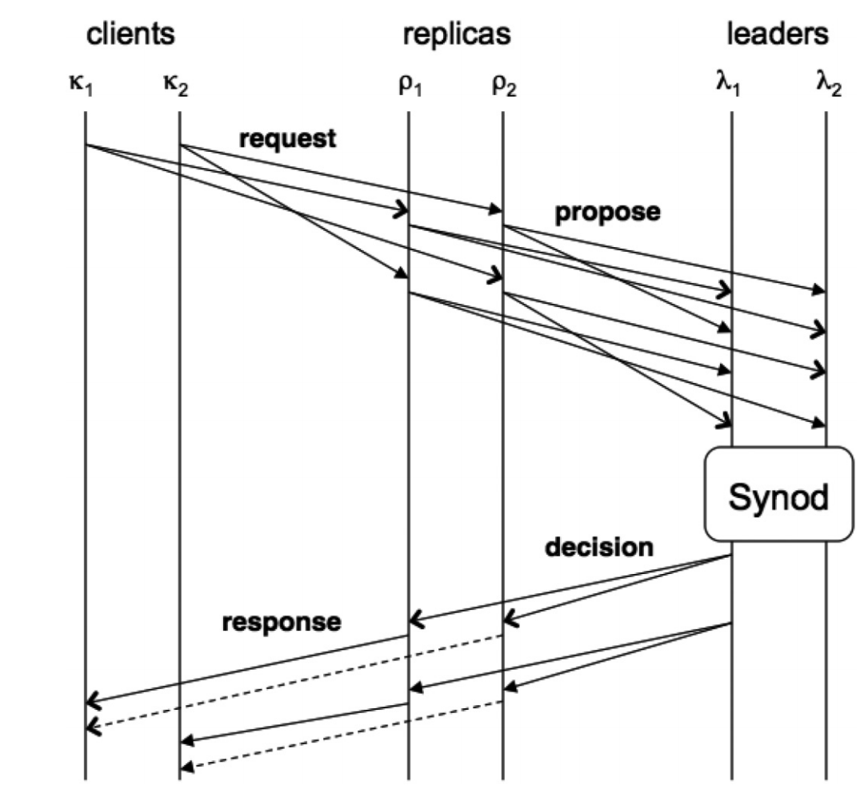
Paxos Made Moderately Complex
Notes:
Clients broadcasts new command to all replicas
Replicas
maintain application state
receive requests from clients
ask leaders to serialize requests
apply serialized requests to state
respond to clients
Leaders
receive requests from replicas
serialize requests
respond to replicas

Slide 68
Paxos Made Moderately Complex
Proposers

Slide 69
Paxos Made Moderately Complex
Proposers
Learners
Notes:
Clients broadcasts new command to all replicas
Replicas
maintain application state
receive requests from clients
ask leaders to serialize requests
apply serialized requests to state
respond to clients
Leaders
receive requests from replicas
serialize requests
respond to replicas

Slide 70
Paxos Made Moderately Complex
Proposers
Learners
Somewhere here
Acceptors
Notes:
Clients broadcasts new command to all replicas
Replicas
maintain application state
receive requests from clients
ask leaders to serialize requests
apply serialized requests to state
respond to clients
Leaders
receive requests from replicas
serialize requests
respond to replicas

Slide 71

Paxos Made Moderately Complex
Proposers
Learners
Somewhere here
Acceptors
Notes:
Clients broadcasts new command to all replicas
Replicas
maintain application state
receive requests from clients
ask leaders to serialize requests
apply serialized requests to state
respond to clients
Leaders
receive requests from replicas
serialize requests
respond to replicas

Slide 72
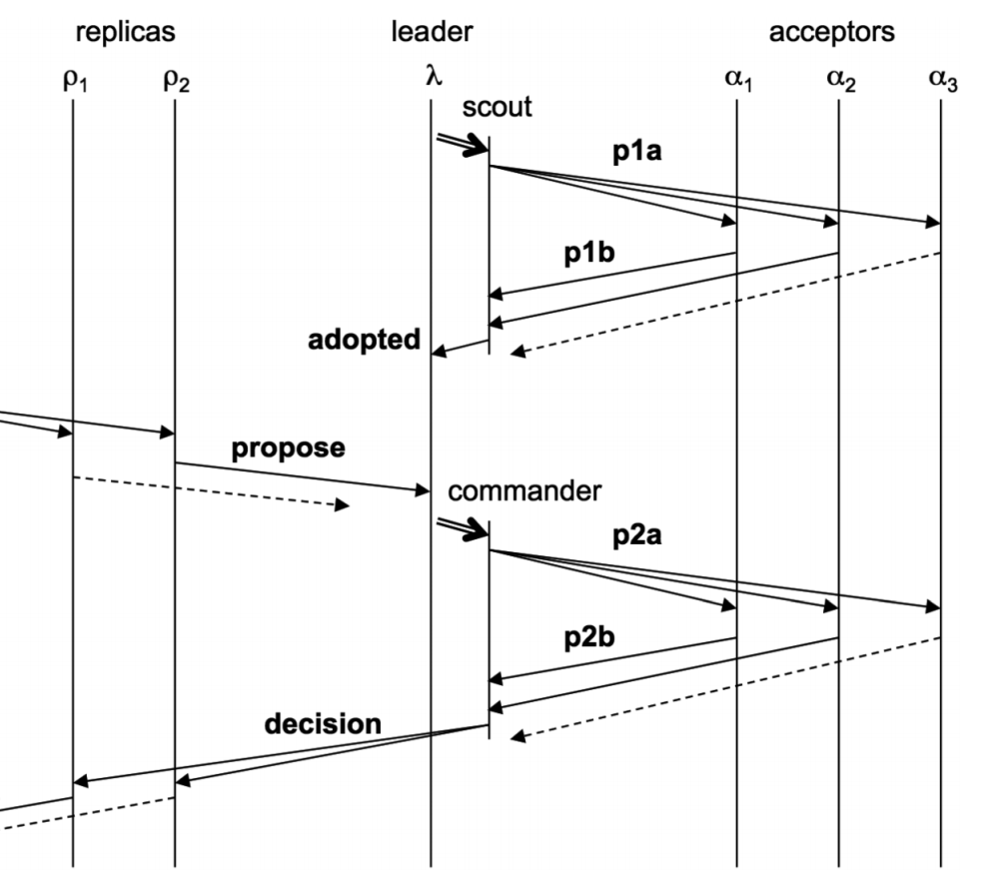
Paxos Made Moderately Complex
Notes:
Scouts
are spawned at most once for a ballot b
send prepare reqs for a ballot b
receive responses containing acceptors’ current ballot number and accepted values
return the accepted values if majority responds to the prepare request
Commanders
are spawned once per slot in a ballot b
send accept requests for <b, s, c>
receive response messages containing acceptors’ current ballot number
return the decision to all replicas if majority accepts the proposal

Slide 73
Paxos Made Moderately Complex
Prepare
Notes:
Scouts
are spawned at most once for a ballot b
send prepare reqs for a ballot b
receive responses containing acceptors’ current ballot number and accepted values
return the accepted values if majority responds to the prepare request
Commanders
are spawned once per slot in a ballot b
send accept requests for <b, s, c>
receive response messages containing acceptors’ current ballot number
return the decision to all replicas if majority accepts the proposal

Slide 74
Paxos Made Moderately Complex
Prepare
Promise
Notes:
Scouts
are spawned at most once for a ballot b
send prepare reqs for a ballot b
receive responses containing acceptors’ current ballot number and accepted values
return the accepted values if majority responds to the prepare request
Commanders
are spawned once per slot in a ballot b
send accept requests for <b, s, c>
receive response messages containing acceptors’ current ballot number
return the decision to all replicas if majority accepts the proposal

Slide 75
Paxos Made Moderately Complex
Prepare
Promise
Propose
Notes:
Scouts
are spawned at most once for a ballot b
send prepare reqs for a ballot b
receive responses containing acceptors’ current ballot number and accepted values
return the accepted values if majority responds to the prepare request
Commanders
are spawned once per slot in a ballot b
send accept requests for <b, s, c>
receive response messages containing acceptors’ current ballot number
return the decision to all replicas if majority accepts the proposal

Slide 76
Paxos Made Moderately Complex
Prepare
Promise
Propose
Notes:
Scouts
are spawned at most once for a ballot b
send prepare reqs for a ballot b
receive responses containing acceptors’ current ballot number and accepted values
return the accepted values if majority responds to the prepare request
Commanders
are spawned once per slot in a ballot b
send accept requests for <b, s, c>
receive response messages containing acceptors’ current ballot number
return the decision to all replicas if majority accepts the proposal

Slide 77
Paxos Made Moderately Complex
Prepare
can both be preempted by a higher ballot number being reported
Promise
Propose
Notes:
Scouts
are spawned at most once for a ballot b
send prepare reqs for a ballot b
receive responses containing acceptors’ current ballot number and accepted values
return the accepted values if majority responds to the prepare request
Commanders
are spawned once per slot in a ballot b
send accept requests for <b, s, c>
receive response messages containing acceptors’ current ballot number
return the decision to all replicas if majority accepts the proposal

Slide 78
Outline
Consensus
The Part-Time Parliament
Single-Decree Paxos
Liveness
Multi-Decree Paxos
Paxos Variants
Conclusion

Slide 79
Paxos Variants
Fast Paxos
Generalized Paxos
Disk Paxos
Cheap Paxos
Vertical Paxos
Egalitarian Paxos
Mencius
Stoppable Paxos

Slide 80

Paxos in Real Systems
Chubby
Google Spanner
Megastore
OpenReplica
Bing
WANDisco
XtreemFS
Doozerd
Ceph
Clustrix
Neo4j

Slide 81
Outline
Consensus
The Part-Time Parliament
Single-Decree Paxos
Liveness
Multi-Decree Paxos
Paxos Variants
Conclusion

Slide 82
Conclusion
Paxos is a protocol for solving the consensus problem in an asynchronous distributed environment with processors that can fail by crashing
A replicated state machine can be built by maintaining a distributed command log where the command at each position in the log is decided by solving consensus
Correctly and efficiently implementing a replicated state machine using Paxos is notoriously difficult

