Slide 1
Distributed Systems: Group Communication
Julia Proft and Utkarsh Mall

Slide 2
The Process Group Approach
to Reliable Distributed Computing
Communications of the ACM, Dec. 1993
Ken Birman, Cornell University
By naming our system ‘The Isis Toolkit’ we wanted to evoke this very old image of something that picks up the pieces and restores a computing system to life.
Reviews a decade of research on the Isis system.
Notes:
Isis “glues the system together.”

Slide 3
Timeline
Year | Event | Contributor(s)
1978 | Time, Clocks, and the Ordering of Events in a Distributed System | Lamport
1982 | Byzantine Generals Problem | Lamport, Shostak, and Pease
1983 | Impossibility of Distributed Fault Tolerant Consensus | Fischer, Lynch, and Patterson
1983 | Virtual Synchrony and the Isis Toolkit | Birman et al.
1984 | State Machine Replication | Lamport, Schneider
1985 | Distributed Process Groups (V System) | Cheriton, Deering, and Zwaenepoel
1987- 1993 | Bulk of development on the Isis Toolkit | Birman et al.

Slide 4
Motivation
Problem: the construction of reliable distributed software.
Issues of reliability have been left to the application programmers, who are “largely unable to respond to the challenge”; solutions to the problems are “probably beyond the ability of a typical distributed applications programmer.”
Solution: programming with distributed groups of cooperating programs, implemented in the computing environment itself or the operating system.
“The only practical approach”!

Slide 5
Process Groups
Anonymous groups
Application publishes data to a topic
Other processes subscribe to this topic
Properties needed for automatic, reliable operation:
Ability to address group
Atomic message delivery
Ordered message delivery
Access to history of group
Explicit groups
Direct cooperation between members
Share responsibility for responding to requests
Membership changes published to the group

Slide 6
Example: the Robot Operating System (ROS)
ROS Master
Register
Register
Camera Node
Publish
/image_data topic
Subscribe
Image Processing Node
Input
Publish
/gestures topic

Slide 7
Advantages
Fault tolerance
Transparent adaptation to failure and recovery
State machine replication
Consistency
Ordered and atomic message delivery
Consistent view of group membership
Ease of development
Need not worry about communication protocol
Leave fault tolerance and consistency to the OS

Slide 8
Problems
Unreliable communication
Membership changes
Delivery ordering
State transfer
Failure atomicity

Slide 9
Unreliable communication
UDP: packets lost, duplicated, delivered out of order
RPC: sender cannot distinguish reason for failure
TCP: broken channels result in inconsistent behavior
How to recover consistently from message loss?

Slide 10
Membership changes
Group membership changes do not happen instantaneously
How to make sure messages reach the latest group members?

Slide 11
Delivery ordering
Messages need to be ordered by causality
How to deliver in causal ordering?
Notes:
Context record on each message

Slide 12
State transfer
Processes joining group must get latest state
How to handle inconsistencies from concurrent messages?
Notes:
Might need to change the diagram

Slide 13
Failure atomicity
Need to achieve all-or-nothing message delivery
How to handle mid-transmission failures?
Notes:
Protocol needs exactly once delivery

Slide 14
Close Synchrony
A synchronous execution model.
Multicasts to a process group are delivered to all members
Send and delivery events occur as a single, instantaneous event

Slide 15
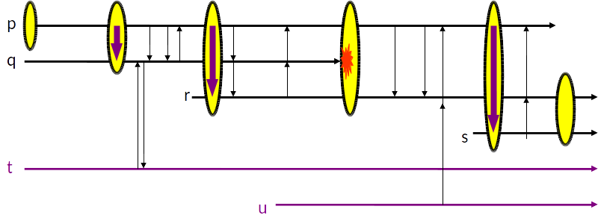
Close Synchrony
Execution runs in genuine lockstep.
Notes:
Processes receive/multicast membership changes in the same relative order

Slide 16
Close Synchrony
Unreliable Communication
Membership changes
Delivery Ordering
State Transfer
Failure Atomicity
Multicast is always reliable
Consistent membership at any logical instant
Concurrent multicasts are distinct events
Happens instantaneously
Multicast is a single logical event

Slide 17
Problems with Close Synchrony
In the real world, events are not instantaneous!
Expensive: execution runs in genuine lockstep!
Impossible to achieve in presence of failures (why?)
What do we do?
Notes:
Speed of system same as the slowest member

Slide 18
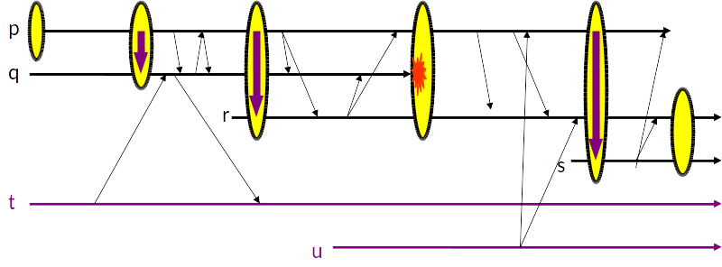
Virtual Synchrony
Asynchronous Close Synchrony
Synchronization needed only for events sensitive to ordering

Slide 19
Virtual Synchrony
Group Membership Service
Replicated service within the process group itself
Membership change needs to be done synchronously
Group Communication Service
Uses Lamport’s happened before relationship
CBcast (Causal Broadcast) or ABcast (Atomic Broadcast)
Multicasts are going to be a total event ordering equivalent to some close synchrony execution
Notes:
How is VS with abcast different from CS?

Slide 20
Vector Clocks
Array of clocks, indexed by processes in the process group
Protocol:
VT(p_{i}) = clock maintained by process p_{i}
VT(p_{i}) initialized to zero
For each send(m) at p_{i}, VT(p_{i})[i]+=1 and VT(m) = VT(p_{i})
If p_{j} delivers a message, received from p_{i}:
For k in 1..n: VT(p_{j})[k] = max(VT(m)[k],VT(p_{i})[k])
Ordering
VT₁ ≤ VT₂ iff ∀i, VT₁[i] ≤ VT₂[i]
VT₁ < VT₂ iff VT₁ ≤ VT₂ and ∃i, VT₁[i] < VT₂[i]
Notes:
Why use vc instead of lamport clock

Slide 21
CBcast
Uses vector clocks to detect causality
Delivery of received messages delayed until “happened before” messages are delivered
Protocol:
p_{j} on receiving message m from p_{i}, delays delivery until
VT(m)[k] = VT(p_{j})[k]+1 if k=i
VT(m)[k] ≤ VT(p_{j})[k] otherwise
When m is delivered follow vector clock protocol
Delayed messages stored in CBcast delay queue
Concurrent messages delivered out of order
Fast because asynchronous
Notes:
Implementation details

Slide 22
ABcast
Stronger ordering guarantee than CBcast
Total message ordering within a group
Messages can only be delivered if, no prior ABcast is undelivered
Slow
Protocol:
A process p_{i} holding token CBcasts message
If p_{i} is not holding the token
CBcast but mark undeliverable
Token holder delivers and CBcasts a set-order
Other follow the set-order
Notes:
Implementation details

Slide 23
Virtual Synchrony
Unreliable Communication
Membership changes
Delivery Ordering
State Transfer
Failure Atomicity
Group communication service
Group membership service
ABcast, CBcast
Group membership service
Group communication service, group membership service

Slide 24
Isis
An implementation of virtual synchrony
Used by
New York/Swiss stock exchange
French air traffic control system (PHIDIAS)
Also provides
monitoring facilities: site failures, triggers
Automated recovery
Styles of group
Notes:
Write applications

Slide 25
Discussion Questions
How is virtual synchrony with ABcast different from close synchrony?

Slide 26
Takeaways
Close synchrony with process groups provides:
Ease of development
Consistency
Fault tolerance
Virtual synchrony:
Faster asynchronous system

Slide 27
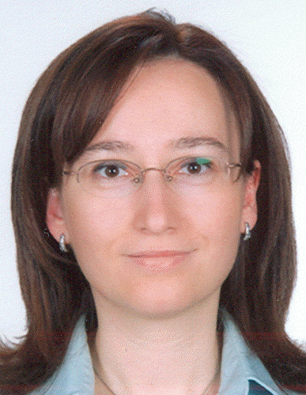
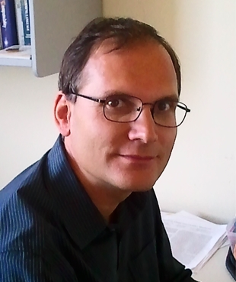
Bimodal Multicast (1999)
Ken Birman
PhD Berkeley ‘81
→ Cornell University
Mark Hayden
PhD Cornell ‘98
→ Compaq Research
→ North Fork Networks
→ Lefthand Networks
→ Ventura Networks
Öznur Özkasap
PhD Ege ‘00
→ Koç University
Spent two years (and completed dissertation) at Cornell
Zhen Xiao
PhD Cornell ‘01
→ AT&T Research
→ IBM Research
→ Peking University
Mihai Budiu
PhD CMU ‘03
→ Microsoft Research
→ Barefoot Networks
→ VMware Research
Spent a year at Cornell
Yaron Minsky
PhD Cornell ‘02
→ Jane Street
Fun fact: introduced Jane Street to OCaml

Slide 28
Motivation
Virtual synchrony
Costly protocol
Unstable under stress
Not scalable
Best effort reliability protocols
Scalable
Starts re-multicasting under low levels of noise
No membership check
No end-to-end guarantee
Multicast with stable throughput
e.g. Streaming Media, teleconferencing

Slide 29
Design
Two step protocol
Optimistic Dissemination Protocol
Unreliable Multicast like IP multicast
Two-Phase Anti-Entropy Protocol
Random gossip
Unicast lost messages
Cheaper than re-multicasting
Notes:
Read about ip mutlicast

Slide 30
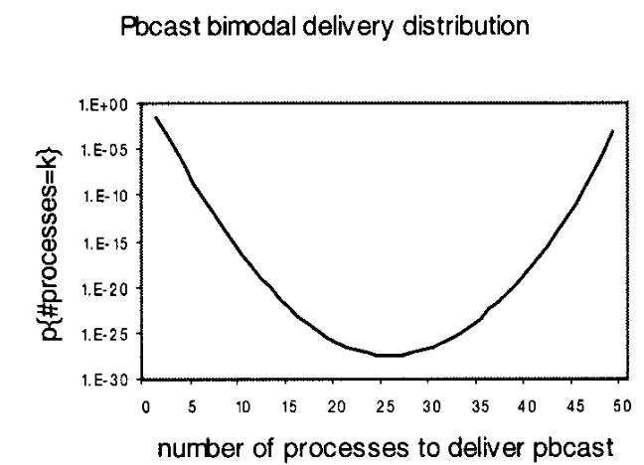
Advantages
PBcast (Probabilistic Broadcast)
Atomicity (Almost all or almost none)
Scalability
Throughput Stability
Notes:
Add bimodal diagram

Slide 31
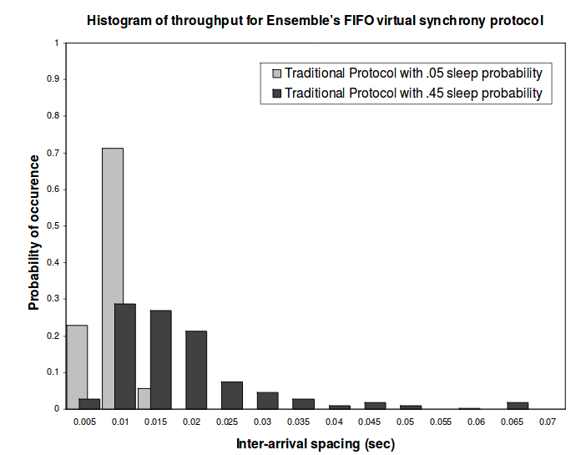
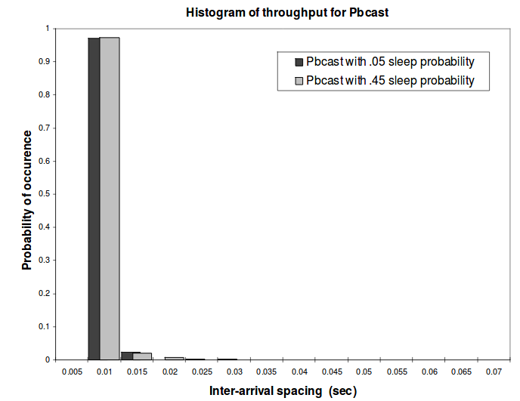
Performance

Slide 32
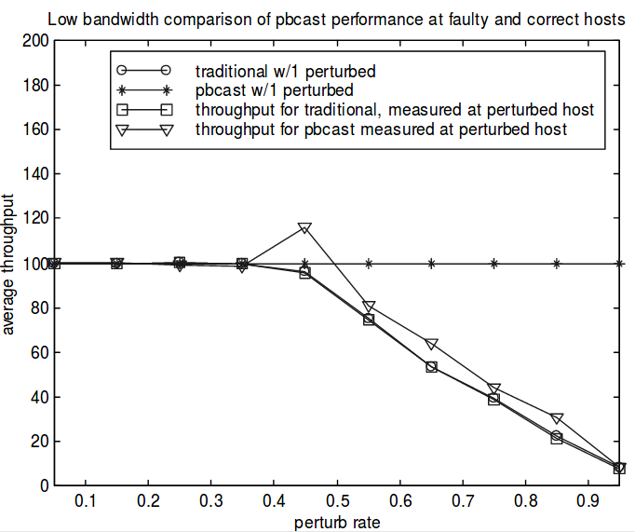
Performance

Slide 33
Discussion Questions
How to use bimodal multicast, if applications require strong reliability?

Slide 34
Takeaways
Bimodal Multicast
Stable throughput
Scalability at cost of “weaker” reliability
Predictable reliability
Predictable load

Slide 35
CAP Conjecture
Consistency
Client receives the latest the version of state
Availability
Client request always gets a response
Partition Tolerance
Can tolerate network partition
C
A
P
Enforced Consistency
Eventual Consistency
In presence of partition, choose a trade-off between Consistency and Availability.

Slide 36
Acknowledgments
Many slides/diagrams borrowed from Scott P., CS 6410 Fall 2011
Some diagrams borrowed from Ken Birman, CS 614 Fall 2006
Vector Clock, CBcast and ABcast borrowed from Birman, Schiper, Stephenson, Lightweight causal and atomic group multicast, 1991

