Slide 1
Cornell CS 6410, 10/5/2017
Today’s Theme:
Consistency in a Distributed System
Papers:
Time, Clocks, and the Ordering of Events in a Distributed System, Leslie Lamport, Communications of ACM,Volume 27 Issue 7, July 1978.
Distributed Snapshots: Determining Global States of Distributed Systems, K.Mani Chandy, Leslie Lamport. ACM Transactions on Computer Systems (TOCS), Volume 3 Issue 1, Feb. 1985.

Slide 2
Why should we care about this theme?
How can we make a consistent global state of an asynchronous system?
  What even is our synchronous protocol?
  Who today is asking/using these questions?
How can we coordinate in a distributed system?
  If an (airline) reservation database system is replicated and distributed and people can purchase tickets locally, how can we order the purchasing of tickets (e.g. two people want to buy a seat, but only one seat is left)?

Slide 3
Why should we care about these papers?
Why to care about the set
Time, Clocks, and the Ordering of Events in a Distributed System, Leslie Lamport, Communications of ACM,Volume 27 Issue 7, July 1978.
Distributed Snapshots: Determining Global States of Distributed Systems, K.Mani Chandy, Leslie Lamport. ACM Transactions on Computer Systems (TOCS), Volume 3 Issue 1, Feb. 1985.
5414?

Slide 4
Initial thoughts?

Slide 5
Today’s Goals
Time, Clocks, and the Ordering of Events in a Distributed System, Leslie Lamport, Communications of ACM,Volume 27 Issue 7, July 1978.
  Understand:
    The “happened before” relation
    How to establish partial/total order and what to do with it
    Physical, logical, local/global clocks
Distributed Snapshots: Determining Global States of Distributed Systems, K.Mani Chandy, Leslie Lamport. ACM Transactions on Computer Systems (TOCS), Volume 3 Issue 1, Feb. 1985.
  Understand:
    Global Snapshot
    Consistent Cut
    How Global Snapshot helps in finding a Consistent Cut

Slide 6
Time, Clocks, and the Ordering of
Events in a Distributed System
Leslie Lamport
Massachusetts Computer Associates, Inc.
Communications of the ACM - July 1978
Notes:
Introduce the point of the paper and why it mattered and the time and matters to us now -- make people care
State of the art then
Provide context for why they should understand it, not just how.
And if you don’t think it’s cool, say why you don’t think it’s cool -- ‘what is the teachable moment here’

Slide 7
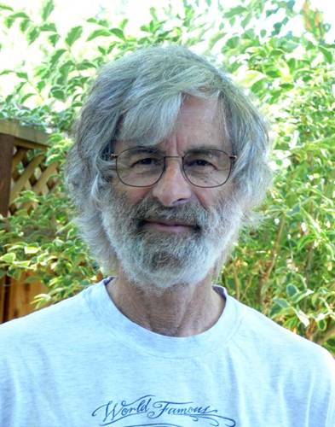
Leslie Lamport
BS in Math from MIT, 1960
MA, Ph.D. in Math from Brandeis, 1972
Research in industry
  Massachusetts Computer Associates (1970-77)
  SRI International (1977-85)
  DEC/Compaq (1985-2001)
  Microsoft Research (2001-)
2000 PODC Influential Paper award for Time, Clocks, and the Ordering of Events
2013 Turing Award Winner and initial developer of LaTeX

Slide 8
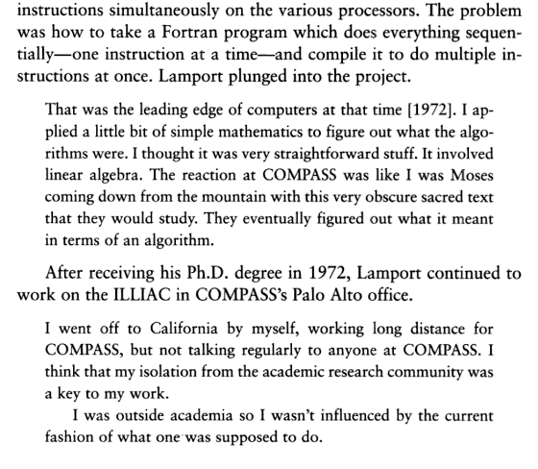

Author: Leslie Lamport
Massachusetts Computer Associates, Inc. → COMPASS
Out of their Minds: The Lives and Discoveries of 15 Great Computer Scientists
By Dennis Shasha, Cathy Lazere
pg. 125
Notes:
Massachusetts Computer Associates, also known as COMPASS, was a software company based in Wakefield, Massachusetts from approximately 1961 to 1987, focusing primarily on programming language design and implementation, especially source-to-source transformation.^{[1]} It was acquired in the late 1960s by Applied Data Research.
Many well-known computer scientist were employed by, or consulted for, COMPASS at some point in their careers, including Michael J. Fischer, Stephen Warshall, Robert W. Floyd, and Leslie Lamport.^{[2]} Some of the systems they worked on include AMBIT/G^{[3]} and IVTRAN, a Fortran compiler for the ILLIAC IV.^{[4]}
Leslie Lamport wrote his influential "Time, Clocks" paper while he was at COMPASS.^{[5][2]}
The original vectorizing compiler for the ILLIAC IV was written at COMPASS^{[6]} with contributions by Lamport, who worked there part-time.^{[7]}
Robert Floyd's Treesort algorithm was published while Floyd was at COMPASS.^{[8]}
Corporate history[edit]
Applied Data Research (ADR) bought Massachusetts Computer Associates in the late 1960s.^{[9]} ADR was sold to Ameritech in 1986 and then by Ameritech to the (unrelated) Computer Associates of New York.^{[10]}

Slide 9
Outline
Partial Ordering of Events
Logical Clocks
Total Ordering of Events
Anomalous Behaviour
Physical Clocks

Slide 10
Definitions and Perspectives
A process as a set of events with an a priori total ordering -- a sequencing.
System as a collection of processes, each process as a sequence of events
sending/receiving a message as an event in a process

Slide 11
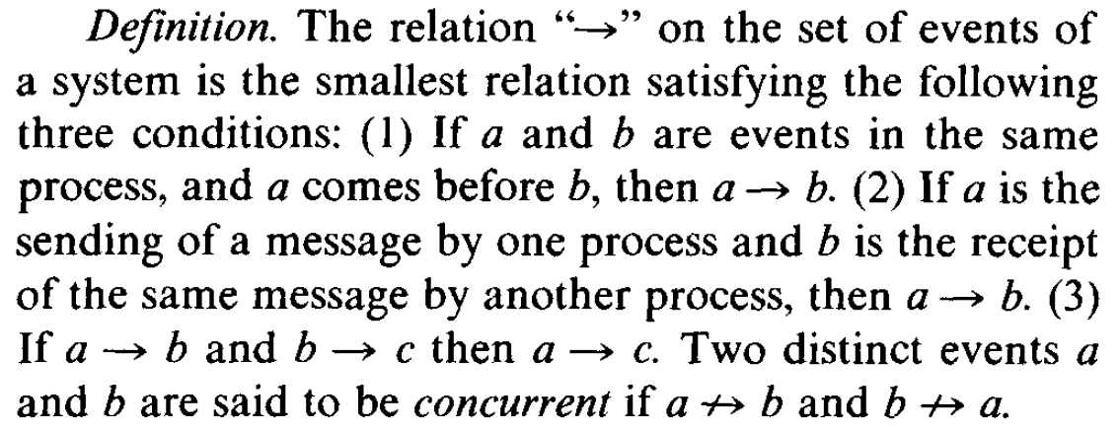
“Happened before” relation, “ → ”
(Lamport 559)

Slide 12

a ? a
a a
“an irreflexive partial ordering on the set of all events in the system”

Slide 13
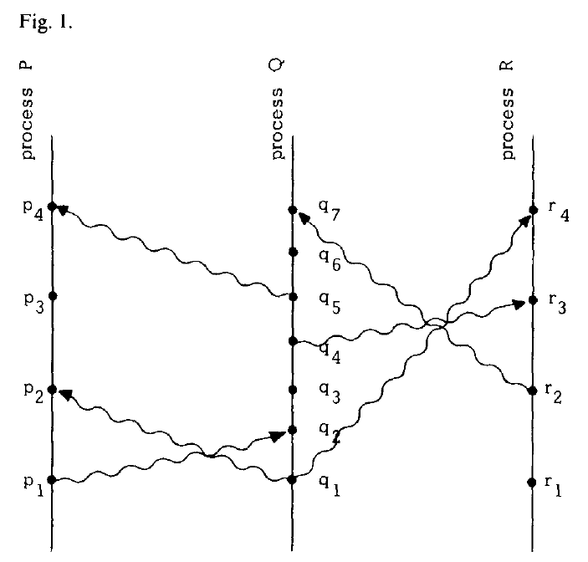
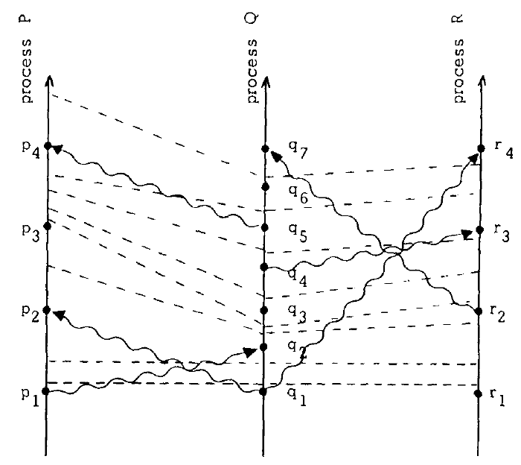
Space-time diagrams
Notes:
Space-time diagrams
Horizontal dir is space, vertical dir is time. Later time is higher than earlier time.
Dots as events, vertical lines as processes, wavy lines as messages.
A → b as meaning that one can go from a to b in the diagram by moving forward in time along process and message lines, e.g. p1 → r4

Slide 14
I.e., what can we say from a → b?
a → b means a can causally affect b
Concurrency?
Two events are concurrent if neither can causally affect the other.
Notes:
For example, events p3 and q4 of Figure 1 are concurrent. Even though we have drawn the diagram to imply that q3 occurs at an earlier physical time than p3, process P cannot know what process Q did at q3 until it receives the message at p4 (Before event p4, P could at most know what Q was *planning* to do at q3)
We should be able to determine if a system performed correctly by knowing only those events which *did* occur, without knowing which events *could have* occurred.

Slide 15
Outline
Partial Ordering of Events
Logical Clocks
Total Ordering of Events
Anomalous Behaviour
Physical Clocks

Slide 16
Logical Clocks
How might we begin thinking about clocks?
“We begin with an abstract point of view in which a clock is just a way of assigning a number to an event, where the number is thought of as the time at which the event occurred” (Lampson 559)
a clock C_{i}, for each process P_{i}, as a function assigning a number C_{i}(a) to any event a in P_{i}
system of clocks as a function C assigning to any event b the number C(b) such that C(b) =C_{j}(b) if b is an event in P_{j}
yet relating numbers C_{i}(a) to physical time, instead regarding C_{i} as logical clocks
  Use of counters rather than use of an ‘actual timing mechanism’

Slide 17
Correctness?
Physical timing of events order of events
If an event a happens before another event b, a should happen at an earlier time than b
  Time??
    Clock Condition
      “For any events a, b: if a → b then C(a) < C(b)
    Why can we not assume the converse as well?
Notes:
Converse of clock cond would imply that any two concurrent events must occur at the same time

Slide 18
“Happened before” relation, “ → ”
(Lamport 559)

Slide 19
Correctness
Clock Condition
  “For any events a, b: if a → b then C(a) < C(b)”
2 conditions to satisfy the Clock Condition:
  1. If a and b are events in a process P_{i}, and a comes before b, then C_{i}(a) < C_{i}(b)
    There must be a tick line between any two events on a process line
  2. If a is the sending of a message by process P_{i} and b is the receipt of that message by process P_{j}, then C_{i}(a) < C_{j}(b)
    Every message line must cross a tick line
...Tick lines?

Slide 20
Space-time diagrams
Notes:
Space-time diagrams
Horizontal dir is space, vertical dir is time. Later time is higher than earlier time.
Dots as events, vertical lines as processes, wavy lines as messages.
A → b as meaning that one can go from a to b in the diagram by moving forward in time along process and message lines, e.g. p1 → r4

Slide 21
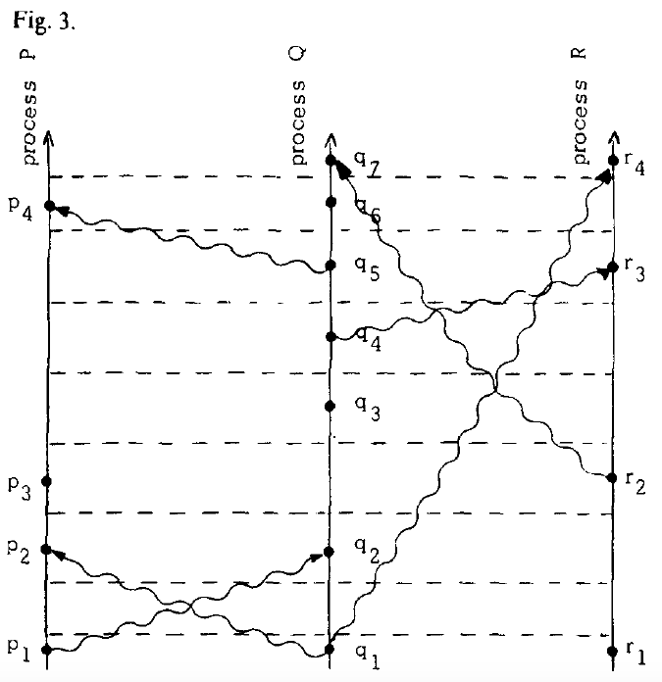
Space-time diagrams

Slide 22
Problem with Partial Order
A single resource
Processes must synchronize to avoid conflicts
Requests must be granted in order

Slide 23
Problem with Partial Order
A single resource
Processes must synchronize to avoid conflicts
Requests must be granted in order
Partial order is not helpful in solving this problem as partial order cannot resolve concurrent requests
Total ordering required…..

Slide 24
Outline
Partial Ordering of Events
Logical Clocks
Total Ordering of Events
Anomalous Behaviour
Physical Clocks

Slide 25
Total Ordering of Events
• Total ordering eliminates concurrency
• Identify message with event sending it
Notes:
Ask: any issues with total ordering?
Student comment - “However, since this total order is defined somewhat
arbitrarily and may not agree with the view of time from a user, the paper then
shows that under certain conditions of the network topology and message delay,
we can guarantee synchronization of clocks in all the participants up to a
controlled error factor.”

Slide 26
Distributed Mutual Exclusion
Every node i has a request queue q_{i}
keeps requests sorted by logical timestamps (total ordering enforced by including process id in the timestamps)
To request critical section:
1)send timestamped REQUEST(T_{m}:P_{i}) to all other nodes
2)put (T_{m}:P_{i}) in its own queue
On receiving a request (T_{m}:P_{i}):
1)send timestamped REPLY to the requesting Node i
2)put REQUEST (T_{m}:P_{i}) in the queue

Slide 27
Distributed Mutual Exclusion
Process i enters critical section if:
1)(T_{m}:P_{i}) is at top of its own queue, and
2)process i received a message (any message) with timestamp larger than (T_{m}:P_{i}) from all other nodes.
To release critical section:
1)Process i removes its request from its own queue and sends a timestamped RELEASE message to all other nodes.
2)On receiving a release message from i, i’s request is removed from the local request queue.

Slide 28
Distributed Mutual Exclusion
Process i enters critical section if:
1)(T_{m}:P_{i}) is at top of its own queue, and
2)process i received a message (any message) with timestamp larger than (T_{m}:P_{i}) from all other nodes. Why is this condition required?
To release critical section:
1)Process i removes its request from its own queue and sends a timestamped RELEASE message to all other nodes.
2)On receiving a release message from i, i’s request is removed from the local request queue.

Slide 29
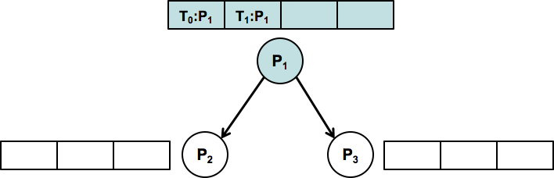
Total Ordering of Events
Step 1: P_{i} sends request resource
P_{i} sends request T_{m}:P_{i} to P_{j}
P_{i} puts request T_{m}:P_{i} on its request queue

Slide 30
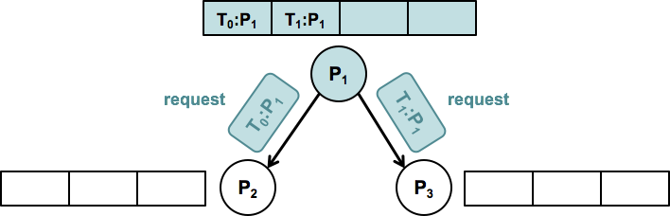
Total Ordering of Events
Step 1: P_{i} sends request resource
P_{i} sends request T_{m}:P_{i} to P_{j}
P_{i} puts request T_{m}:P_{i} on its request queue

Slide 31
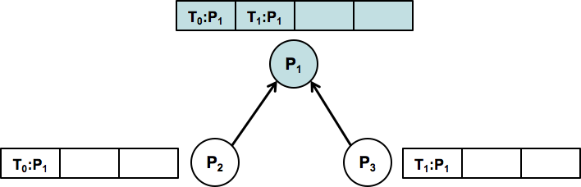
Total Ordering of Events
Step 2: P_{j} adds message
P_{j} puts request T_{m}:P_{i} on its request queue
P_{j} sends acknowledgement T_{m}:P_{j} to P_{i}

Slide 32
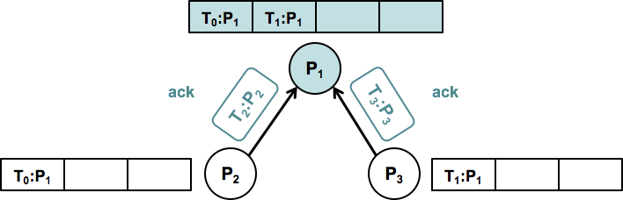
Total Ordering of Events
Step 2: P_{j} adds message
P_{j} puts request T_{m}:P_{i} on its request queue
P_{j} sends acknowledgement T_{m}:P_{j} to P_{i}

Slide 33
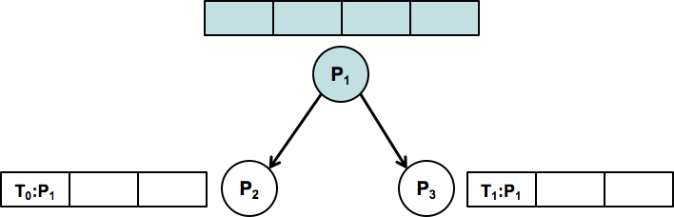
Total Ordering of Events
Step 3: P_{i} sends release resource
P_{i} removes request T_{m}:P_{i} from request queue
P_{i} sends release T_{m}:P_{i} to each P_{j}

Slide 34
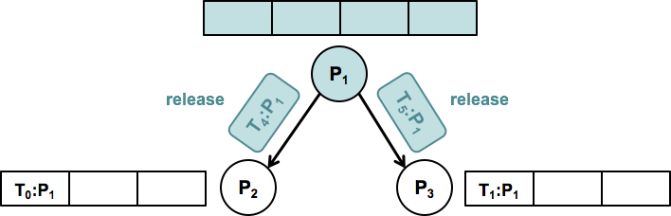
Total Ordering of Events
Step 3: P_{i} sends release resource
P_{i} removes request T_{m}:P_{i} from request queue
P_{i} sends release T_{m}:P_{i} to each P_{j}

Slide 35
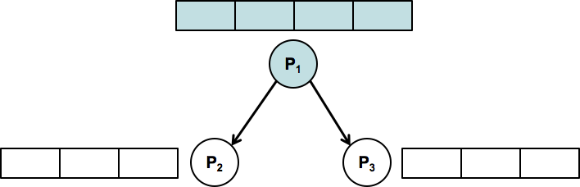
Total Ordering of Events
Step 4: P_{j} removes message
P_{j} receives release T_{m}:P_{i} from P_{i}
P_{j} removes request T_{m}:P_{i} from request queue

Slide 36
Message Complexity?

Slide 37
Message Complexity?
•3(n – 1) messages per critical section invocation
•Requests are granted in the increasing order of timestamps

Slide 38
Message Complexity?
•3(n – 1) messages per critical section invocation
•Requests are granted in the increasing order of timestamps
Ricart Agarwala – 2(n -1) , also doesn’t require FIFO assumption
Roucairol – Carvalho - (0 , 2(n – 1) ] based on request pattern

Slide 39
Outline
Partial Ordering of Events
Logical Clocks
Total Ordering of Events
Anomalous Behaviour
Physical Clocks

Slide 40

Anomalous Behavior

Slide 41
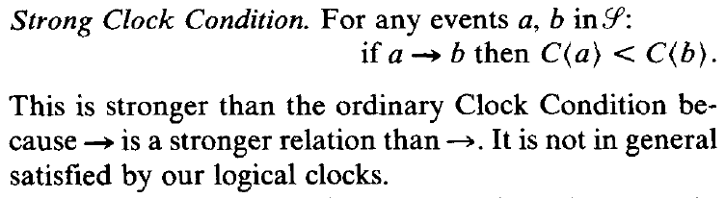
Strong Clock Condition
Now what?

Slide 42
Outline
Partial Ordering of Events
Logical Clocks
Total Ordering of Events
Anomalous Behaviour
Physical Clocks

Slide 43
Physical Clocks
“One of the mysteries of the universe is that it is possible to construct a system of physical clocks which, running quite independently of one another, will satisfy the Strong Clock Condition” (Lamport 562)

Slide 44
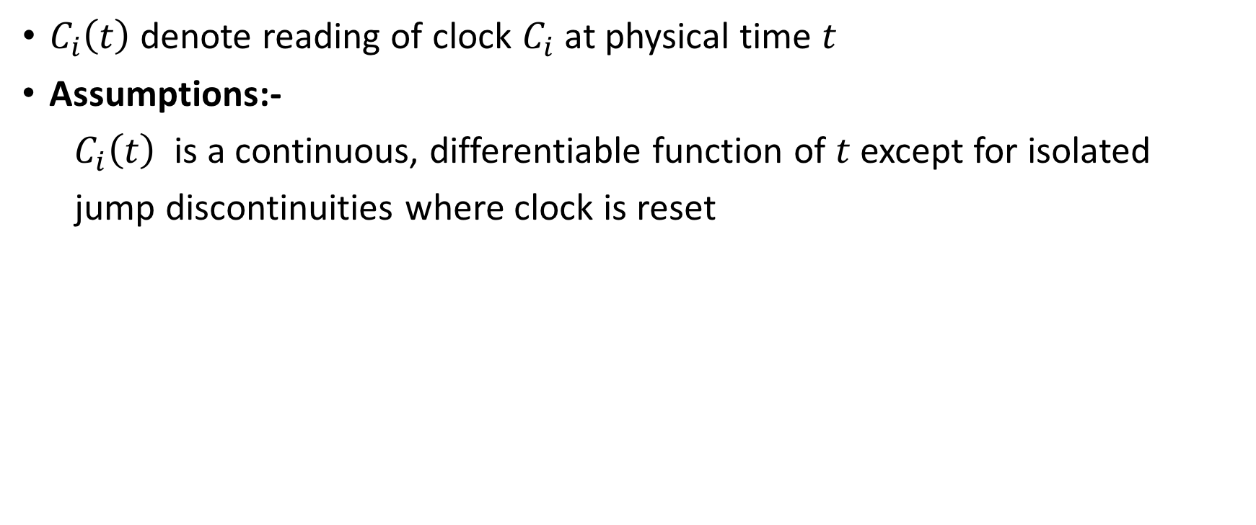
Physical Clocks

Slide 45
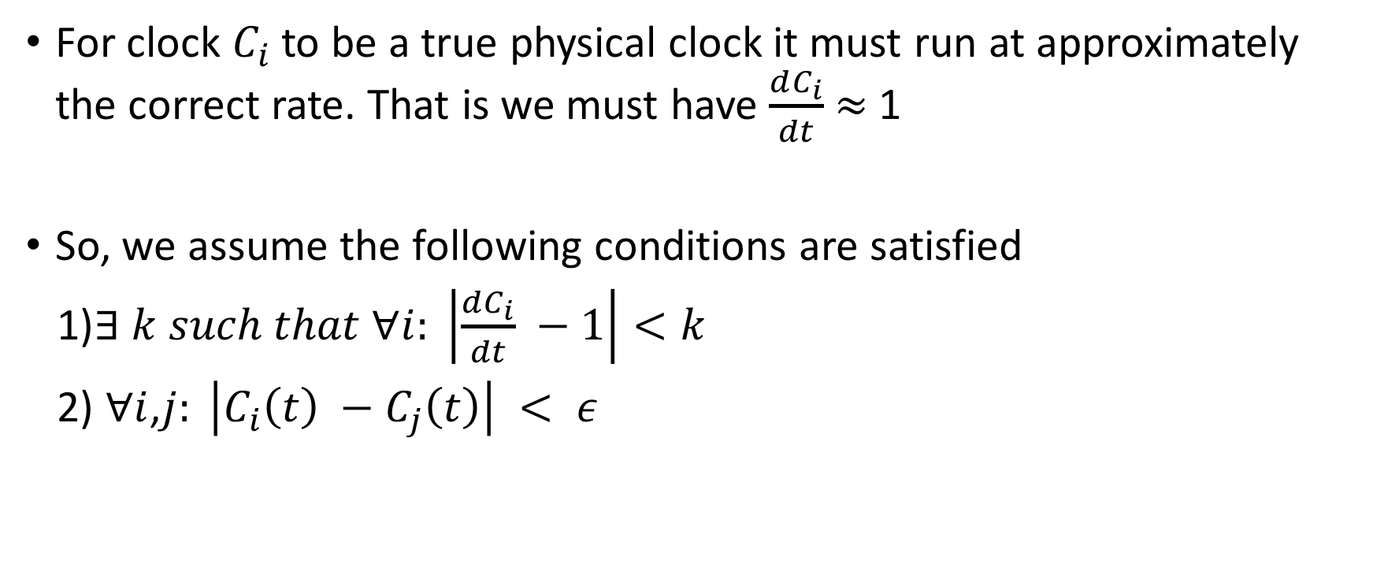
Physical Clocks

Slide 46
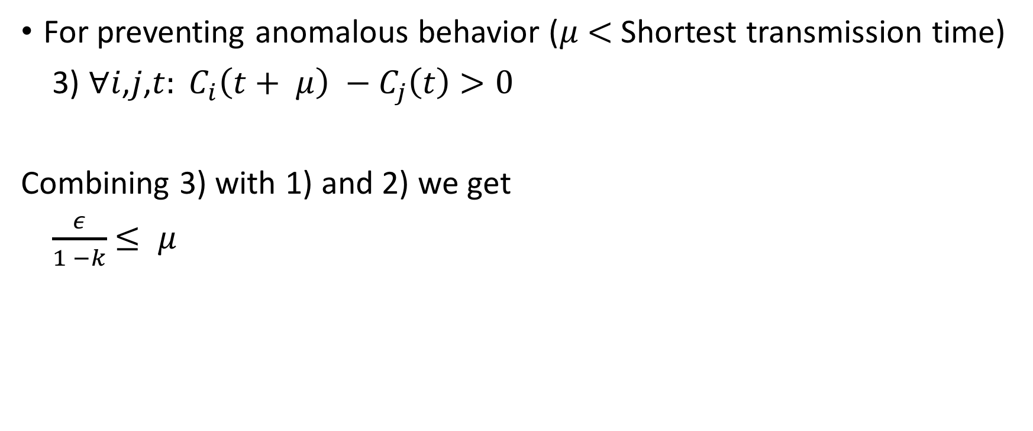
Physical Clocks

Slide 47
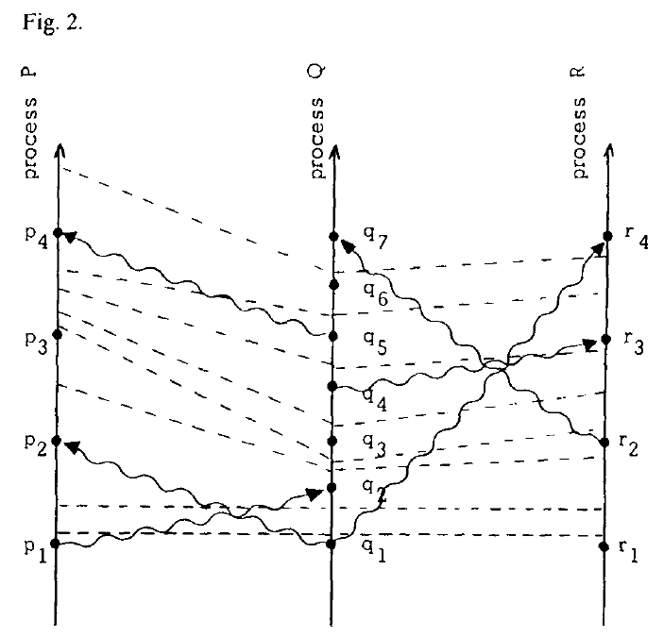
Notes:
If we consider vertical distance in Figure 2 to represent
physical time, then PC2 states that the variation in height
of a single tick line is less than E.

Slide 48
Summary
Partial Ordering of Events
Logical Clocks
Total Ordering of Events
Anomalous Behaviour
Physical Clocks

Slide 49

Distributed Snapshots: Determining Global States of Distributed Systems
Ph.D from MIT in Electrical Engineering
Was in University of Texas at Austin, CS Department from 1970 – 89
Simon Ramo Professor at CalTech
Member of National Academy of Engineering
IEEE Koji Kobayashi Award(1987)
A.A. Michelson Award(1985)
K. Mani Chandy
BS in Math from MIT, 1960
MA, PhD in Math from Brandeis, 1972
Research in industry
  Massachusetts Computer Associates (1970-77)
  SRI International (1977-85)
  DEC/Compaq (1985-2001)
  Microsoft Research (2001-)
2000 PODC Influential Paper award for Time, Clocks, and the Ordering of Events
2013 Turing Award Winner and initial developer of LaTeX
Leslie Lamport

Slide 50
What is a Snapshot?
Just a collection of local states of processes and channels!

Slide 51
Why do we need Snapshots?

Slide 52
Why do we need Snapshots?
Garbage collection :- Removing objects that do not have any references
Deadlocks:- Detecting deadlocks in distributed system
Checkpointing:- Helps in rolling back in case of failure

Slide 53
Challenges in recording Global State
Processes do not share clocks or memory (or) there is no universal clock.
So, no way to ensure that all nodes record state at exactly the same time…

Slide 54
Challenges in recording Global State
Processes do not share clocks or memory (or) there is no universal clock.
So, no way to ensure that all nodes record state at exactly the same time.
Global snapshot is all about finding a consistent cut!
  so what is a consistent cut?

Slide 55
Consistent Cut
Consistent Cut: a cut that obeys causality
A cut C is a consistent cut if and only if:
  for (each pair of events e, f in the system)
  Such that event e is in the cut C, and if f → e (f happens-before e)
    Then: Event f is also in the cut C

Slide 56
Example of (In)Consistent Cut
A B C D E
P1
Time
E F G
P2
H I J
P3
Consistent Cut
Inconsistent Cut
G → D, but only D is in cut

Slide 57
Solution: Chandy-Lamport’s Algorithm
Send a marker along all channels immediately after recording state
Upon receipt of a marker along channel c:
  Record process state if not already recorded
  Record state of c as all messages received between recording process state and receiving marker
Eventually markers will reach all processes, so all state will be recorded

Slide 58
Example
A B C D E
P1
Time
E F G
P2
H I J
P3
Instruction or Step
Message

Slide 59
P1 is Initiator:
Record local state S1,
Send out markers
Turn on recording on channels C₂₁, C₃₁
A B C D E
P1
Time
E F G
P2
H I J
P3

Slide 60
S1, Record C₂₁, C₃₁
A B C D E
P1
Time
E F G
P2
H I J
P3
First Marker!
Record own state as S3
Mark C₁₃ state as empty
Turn on recording on other incoming C₂₃
Send out Markers

Slide 61
S1, Record C₂₁, C₃₁
A B C D E
P1
Time
E F G
P2
H I J
P3
S3
C₁₃ = < >
Record C₂₃

Slide 62
Duplicate Marker!
State of channel C₃₁ = < >
S1, Record C₂₁, C₃₁
A B C D E
P1
Time
E F G
P2
H I J
P3
S3
C₁₃ = < >
Record C₂₃

Slide 63
S1, Record C₂₁, C₃₁
C₃₁ = < >
A B C D E
P1
Time
E F G
P2
H I J
P3
First Marker!
Record own state as S2
Mark C₃₂ state as empty
Turn on recording on C₁₂
Send out Markers
S3
C₁₃ = < >
Record C₂₃

Slide 64
S1, Record C₂₁, C₃₁
C₃₁ = < >
A B C D E
P1
Time
E F G
P2
H I J
P3
S2
C₃₂ = < >
Record C₁₂
S3
C₁₃ = < >
Record C₂₃

Slide 65
S1, Record C₂₁, C₃₁
C₃₁ = < >
A B C D E
P1
Time
E F G
P2
H I J
P3
S2
C₃₂ = < >
Record C₁₂
Duplicate!
C₁₂ = < >
S3
C₁₃ = < >
Record C₂₃

Slide 66
Duplicate!
C₂₁ = <message G→D >
S1, Record C₂₁, C₃₁
C₃₁ = < >
A B C D E
P1
Time
E F G
P2
H I J
P3
S2
C₃₂ = < >
Record C₁₂
C₁₂ = < >
S3
C₁₃ = < >
Record C₂₃

Slide 67
Algorithm has Terminated
C₂₁ = <message G→D >
S1
C₃₁ = < >
A B C D E
P1
Time
E F G
P2
H I J
P3
S2
C₃₂ = < >
C₁₂ = < >
S3
C₁₃ = < >
C₂₃ = < >

Slide 68
C₂₁ = <message G→D >
S1, Record C₂₁, C₃₁
C₃₁ = < >
A B C D E
P1
Time
E F G
P2
H I J
P3
S2
C₃₂ = < >
Record C₁₂
C₁₂ = < >
S3
C₁₃ = < >
Record C₂₃
Duplicate!
C₂₃ = < >

Slide 69
Collect the Global Snapshot Pieces
C₂₁ = <message G→D >
S1
C₃₁ = < >
A B C D E
P1
Time
E F G
P2
H I J
P3
S2 C₃₂ = < >
C₁₂ = < >
S3 C₁₃ = < >
C₂₃ = < >

Slide 70
Consistent Cut Obtained
C₂₁ = <message G→D >
S1
C₃₁ = < >
A B C D E
P1
Time
E F G
P2
H I J
P3
S2
C₃₂ = < >
C₁₂ = < >
S3
C₁₃ = < >
Consistent Cut captured by our Global Snapshot Example
C₂₃ = < >

Slide 71
Summary
Global Snapshot definition
Uses of collecting a Global Snapshot
Consistent Cuts
Chandy-Lamport’s Algorithm

Slide 72
Parting Thoughts & Questions: Ours
What does Lamport bring from the first paper into the second?
Why might we want to cover these papers before MapReduce?
What assumptions have been made?
  FIFO - “The assumption that all messages sent from process Pi to Pj are received in the same order as they are sent is also too strong.”
Notes:
“However, they assume that the messages sent from P1 to P2 are received in the same order by P2, which is an unrealistic assumption.”

Slide 73
Parting Thoughts & Questions: Yours
“The idea is very novel in the time when it published as distributed systems were not so much relevant in those days.”
  “I want to highlight [the first paper’s] elegance. We often take for granted that computing problems didn't come logically into the minds of our predecessors.”
“The paper also didn’t consider the scenario of process and message delivery failure.”
  “unreasonable assumptions about reliability, such as nodes cannot fail and messages cannot be dropped and must have predictable delay.”
“The ideas presented were quite complex...This paper presented the formalisms needed quite well and established a clear language.”
“The biggest weakness of this paper is that the system cannot inherently capture non-computational events such as phone calls, and also that there's no sense of the physical feasibility of this synchronization approach. How does propogation delay affect the synchronization scheme? How fault-tolerant is the system?”
Notes:
“However, this paper remained largely theoretical and so did not provide empirical evidence supporting the claims. In particular, this paper did not give immediate support for why a user may want to use or implement the systems described.” -- mutual exclusion example in the paper, plus a reason one may have to read the optional paper….

Slide 74
Parting Thoughts & Questions: Yours, Cont’d
“The strong point of this paper is a novel algorithm to guarantee synchronization of distributed system that does not rely on a central authority to perform the synchronization. A total ordering of events can be obtained even when only a partial ordering is available from the space-time diagram. However, in order to achieve this result, all processes must be aware of every other processes messages, which assume that all processes are not anomalous. This is an assumption that can be easily violated by a rogue process. The next logical step for this work is to be resilient to rogue processes which could be purposefully providing incorrect timestamps, or even collaborate to fool the synchronization algorithm.”
Notes:
“However, this paper remained largely theoretical and so did not provide empirical evidence supporting the claims. In particular, this paper did not give immediate support for why a user may want to use or implement the systems described.” -- mutual exclusion example in the paper, plus a reason one may have to read the optional paper….

Slide 75
A Nice Review to Consider Together :)
“Lamport's paper on Time, Clocks and Ordering in a distributed system does an excellent job of defining a problem in distributed systems and proposing several solutions along with their requirements and drawbacks. It also omits a number of details for the sake of brevity and readability; it is outside of my expertise to be able to identify if any/all of these details are essential to his argument. For example, he omits details on ensuring eventual message delivery and message delivery order. Obviously TCP can be used to ensure order between any two processes, but it's not clear to me what algorithm Lamport would use do ensure eventual delivery; is it simply timeout based along with a known assumption of max delivery time? I assume it is since he says elsewhere that failures and fault-tolerance are not considered in this paper; but since he omits this small detail it's hard for me to know for sure. This is a minor point to pick as most of the paper is very clear, especially thanks to his decision to omit agonizingly small details. However, there are a few places where he introduces details for reasons that are unclear to me; he mentions 'unpredictable message delay', denotes a symbol for it and then never mentions it again. It seems like a waste and a bit confusing since it gave me the feeling that that measurement was meaningful and necessary for some part of the proof, even though it was not. Overall, the paper's structure is clear, addresses practical issues in distributed systems with a very practical theoretical approach (e.g. considering the fidelity of modern clocks in his error calculations) and is not overly burdened with complex proofs (but does provide them where necessary as footnotes and in the appendix.)
N.B. I don't have anywhere near the experience reading theoretical papers, so it's very likely that I'm missing some critical angles of assessment and/or giving him some free passes (e.g. I don't expect much more than a motivating example on how one might actually build or use a system that a theoretical paper describes)”

Slide 76
Further Reading Suggested by Prof. Alvisi
Dijkstra’s Take on Chandy-Lamport:
https://www.cs.utexas.edu/users/EWD/transcriptions/EWD08xx/EWD864.html

Slide 77
Acknowledgements
Time, Clocks, and the Ordering of Events in a Distributed System, Leslie Lamport, Communications of ACM,Volume 27 Issue 7, July 1978.
Distributed Snapshots: Determining Global States of Distributed Systems, K.Mani Chandy, Leslie Lamport. ACM Transactions on Computer Systems (TOCS), Volume 3 Issue 1, Feb. 1985.
Previous years’ slides
CS4410 Lecture Slides
Professor Hakim Weatherspoon and Professor Lorenzo Alvisi for presentation advice
THANK YOU

