Slide 1
MapReduce &
Resilient Distributed Datasets
Yiqing Hua, Mengqi(Mandy) Xia

Slide 2
Outline
MapReduce:
Motivation
Examples
The Design and How it Works
Performance
Resilient Distributed Datasets (RDD)
Motivation
Design
Evaluation
Comparison

Slide 3
MapReduce: Simplified Data Processing on Large Clusters

Slide 4
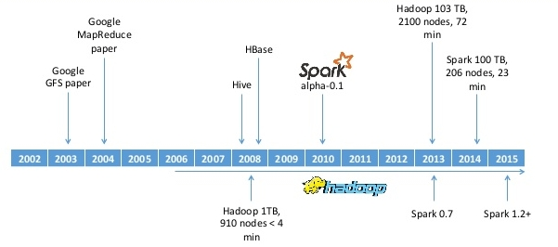
Timeline
RDD paper
https://image.slidesharecdn.com/adioshadoopholasparkt3chfestdhiguero-150213043715-conversion-gate01/95/adios-hadoop-hola-spark-t3chfest-2015-9-638.jpg?cb=1423802358
Notes:
In 2006 Hadoop is born
The most popular MR system is Hadoop, an open-source project under development by Yahoo! and the Apache Software Foundation
Spark was initially started by Matei Zaharia at UC Berkeley's AMPLab in 2009, and open sourced in 2010
AMPLAB is a University of California, Berkeley lab focused on Big data analytics. The name stands for the Algorithms, Machines and People Lab

Slide 5
MapReduce: Simplified Data Processing on Large Clusters
OSDI 2004
22,495 citations
Jeffrey Dean -- Google Senior Fellow in the Systems and Infrastructure Group
Sanjay Ghemawat -- Google Fellow in the Systems Infrastructure Group
ACM Prize in Computing (2012) 2012 ACM-Infosys Foundation Award
“When Jeff has trouble sleeping, he Mapreduces sheep.”
Cornell Alumni
Notes:
Operating Systems Design and Implementation
Jeff, Google Brain, a system for large-scale artificial neural networks. TensorFlow, an open-source machine-learning software library.

Slide 6
Motivation
The need to process large data distributed across hundreds or thousands of machines in order to finish in a reasonable amount of time.
In 2003, Google published the Google File System Paper.
People want to take advantage of GFS and hide the issues of parallelization, fault-tolerance, data distribution and load balancing from the user.
Notes:
While the Google File System serves as a solid basis for managing data, it does not prescribe applications to follow certain patterns or architectures. On the one hand, this freedom underlines the flexibility of GFS, on the other hand, it raises the question how applications can make efficient use of both, GFS and a cluster infrastructure
batch data processing can be implemented on top of GFS and a cluster system
MapReduce has been inspired by the idea of higher order functions, in particular the functions map (also referred to as fold) and reduce. These functions are an integral part of functional programming languages such as Lisp or Haskell, but are also commonly provided by non purelyfunctional languages such as Python

Slide 7
What is MapReduce?
Notes:
ETL is short for extract, transform, load, three database functions that are combined into one tool to pull data out of one database and place it into another database.
Powerful tools. MR systems are fundamentally powerful tools for ETL-style applications and for complex analytics. Additionally, they are popular for “quick and dirty” analyses and for users with limited budgets. On the other hand, if the application is query-intensive, whether semistructured or rigidly structured, then a DBMS is probably the better choice.

Slide 8
What is MapReduce?
MapReduce is a software framework for easily writing applications which process vast amounts of data (multi-terabyte data-sets) in-parallel on large clusters (thousands of nodes) of commodity hardware in a reliable, fault-tolerant manner.
https://hadoop.apache.org
MR is more like an extract-transform-load (ETL) system than a DBMS, as it quickly loads and processes large amounts of data in an ad hoc manner. As such, it complements DBMS technology rather than competes with it.
MapReduce and Parallel DBMSs: Friends or Foes?
Michael Stonebraker et al.
Notes:
ETL is short for extract, transform, load, three database functions that are combined into one tool to pull data out of one database and place it into another database.
Powerful tools. MR systems are fundamentally powerful tools for ETL-style applications and for complex analytics. Additionally, they are popular for “quick and dirty” analyses and for users with limited budgets. On the other hand, if the application is query-intensive, whether semistructured or rigidly structured, then a DBMS is probably the better choice.

Slide 9
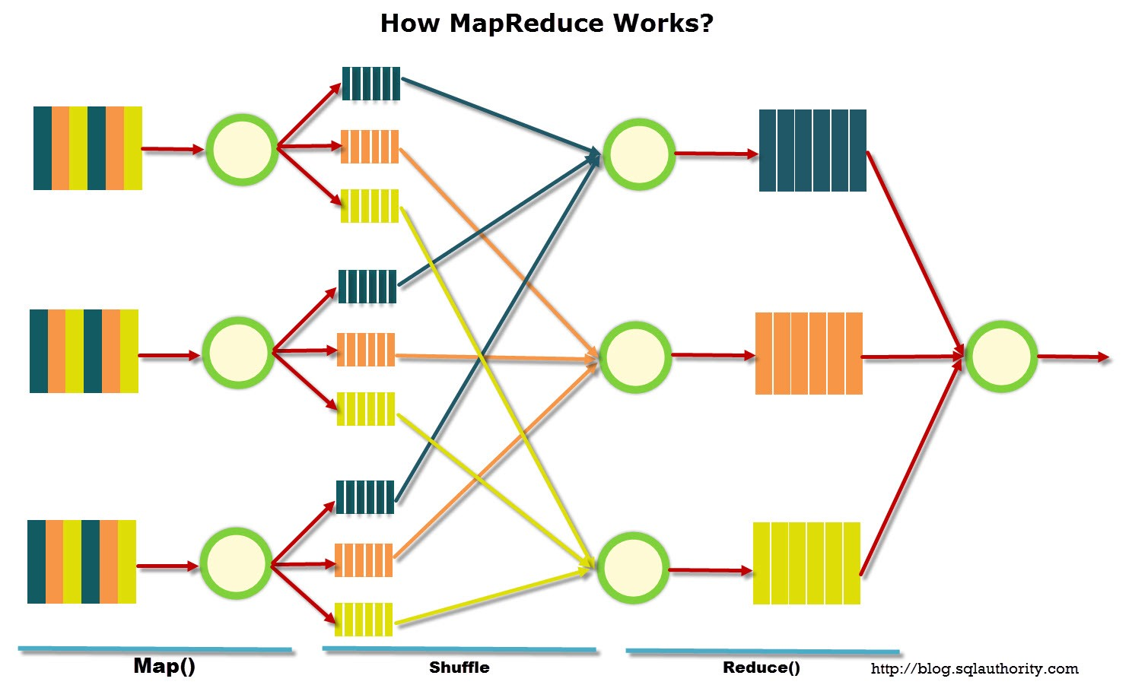
What is MapReduce?
Notes:
The MapReduce algorithm contains two important tasks, namely Map and Reduce. Map is a function written by the user that takes a key/value pair as input and yields a list of key/value pairs as result. digest raw data and generate (potentially very large quantities of) unaggregated intermediate results. Reduce is the second function implemented by the user. It takes a key and a list of values as input and generates a list of values as result. The primary role of reduce is thus to aggregate data. The input keys and values are drawn from a different domain than the output keys and values. For example, as we will see in the following word count example, input key is document name, value is document contents but output keys are words and values are counts. The intermediate keys and values are from the same domain as the output keys and values.
Provided these functions, the infrastructure not only transparently provides for all necessary communication between cluster nodes, it also automatically distributes and load-balances the processing among the machines, this will be further explained when Yiqing talks about the design of the system.

Slide 10
Example: Word Count of the Complete Work of Shakespeare
BERNARDO Who's there?
FRANCISCO Nay, answer me: stand, and unfold yourself.
BERNARDO Long live the king!
FRANCISCO Bernardo?
BERNARDO He.
FRANCISCO You come most carefully upon your hour.
BERNARDO 'Tis now struck twelve; get thee to bed, Francisco.
…...

Slide 11
Step 1: define the “mapper”
map(String key, String value): // key: document name // value: document contents for each word w in document: EmitIntermediate (w, “1”);
map(“Hamlet”, “Tis now strook twelve…”)
{“tis”: “1”}
{“now”: “1”}
{“strook”: “1”}
…

Slide 12
Step 2: Shuffling
The shuffling step aggregates all results with the same key together into a single list. (Provided by the framework)
{“tis”: [“1”,“1”,“1”...]}
{“now”: [“1”,“1”,“1”]}
{“strook”: [“1”,“1”]}
{“the”: [“1”,“1”,“1”...]}
{“twelve”: [“1”,“1”]}
{“romeo”: [“1”,“1”,“1”...]}
{“juliet”: [“1”,“1”,“1”...]}
…
{“tis”: “1”}
{“now”: “1”}
{“strook”: “1”}
{“the”: “1”}
{“twelve”: “1”}
{“romeo”: “1”}
{“the”: “1”}
…

Slide 13
Step 3: Define the Reducer
Aggregates all the results together.
reduce(String key, Iterator values): // key: a word // values: a list of counts sum = 0 for each v in values: result += ParseInt(v) Emit (AsString(result))
reduce(“tis”, [“1”,“1”,“1”,“1”,“1”])
{“tis”: “5”}
reduce(“the”, [“1”,“1”,“1”,“1”,“1”,“1”,“1”...])
{“the”: “23590”}
reduce(“strook”, [“1”,“1”])
{“strook”: “2”}
...

Slide 14
The Design and How it Works

Slide 15
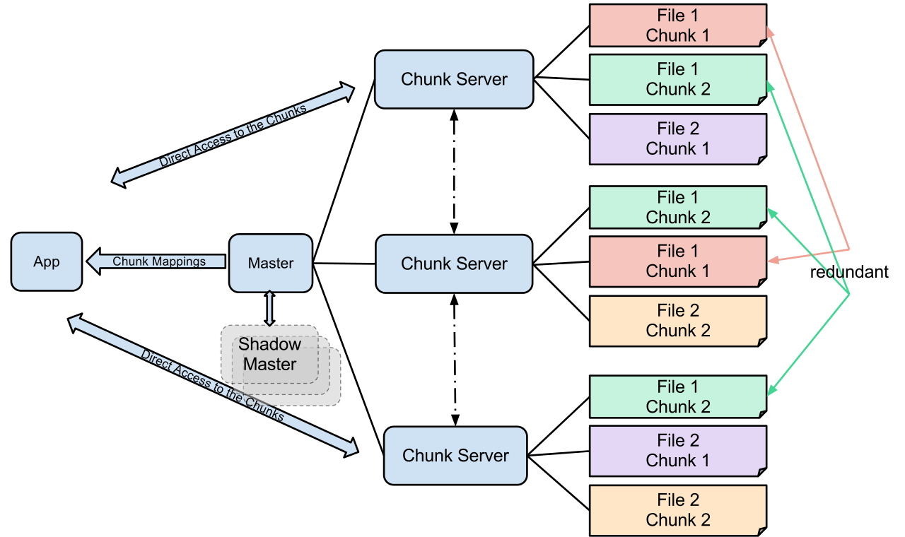
Google File System
User-level process running on Linux commodity machines
Consist of Master Server and Chunk Server
Files broken into chunks, 3x redundancy
Data transfer between client and chunk server

Slide 16
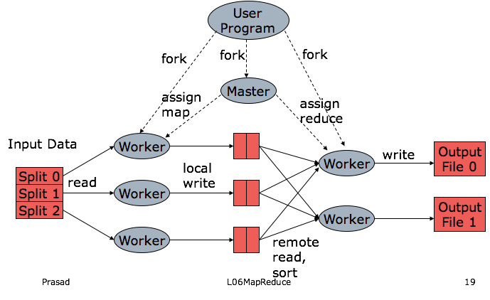
Infrastructure

Slide 17
Fault Tolerance -- Worker
Periodically Pinged by Master
NO response = failed worker => task reassigned
Re-execute incomplete failed task
Re-execute failed task
Notify reducers working on this task

Slide 18
Fault Tolerance -- Master
Master writes periodic checkpoints → New master can start from it
Master failure doesn’t occur often → Aborts the job and leave the choice to client

Slide 19
Fault Tolerance -- Semantics
Atomic Commits of Outputs Ensures
→ Same Result with Sequential Execution of Deterministic Programs
→ Any Reduce Task will have the Same Result with a non-Deterministic Program with Sequential Execution with a Certain Order (But not necessarily the same one for all the reduce tasks)

Slide 20
Locality
Implementation Environment:
Storage: disks attached to machines
File System: GFS
Locality == efficiency
Master node can schedule jobs to machines that have the data
Or as close as possible to the data

Slide 21
Task Granularity
How many map tasks and
how many reduce tasks?
The more the better → improves dynamic load balancing, speeds up recovery
Master nodes has a memory limit to keep the states
Also you probably don’t want tons of output files

Slide 22
Stragglers
The machine running the last few tasks that takes forever

Slide 23
Stragglers
Backup execute the remaining jobs elsewhere
The machine running the last few tasks that takes forever

Slide 24
Refinements
Partitioning Function
Ordering Guarantees
Combiner Function
Input and Output Types
Side-effects
Skipping Bad Records
Local Execution
Status Information
Counters

Slide 25
Refinements
Basically with this you can define your own fancier mapper
Like mapping hostname
Partitioning Function
Ordering Guarantees
Combiner Function
Input and Output Types
Side-effects
Skipping Bad Records
Local Execution
Status Information
Counters

Slide 26
Refinements
Intermediate results are sorted in key order:
Efficient random lookup
If you want it sorted
Partitioning Function
Ordering Guarantees
Combiner Function
Input and Output Types
Side-effects
Skipping Bad Records
Local Execution
Status Information
Counters

Slide 27
Refinements
Partitioning Function
Ordering Guarantees
Combiner Function
Input and Output Types
Side-effects
Skipping Bad Records
Local Execution
Status Information
Counters
Partial merge of the data before sending to the network:
In the case of word count, it can be more efficient

Slide 28
Refinements
Partitioning Function
Ordering Guarantees
Combiner Function
Input and Output Types
Side-effects
Skipping Bad Records
Local Execution
Status Information
Counters
Supports self defined input output type, as long as you provide a reader interface

Slide 29
Refinements
Partitioning Function
Ordering Guarantees
Combiner Function
Input and Output Types
Side-effects
Skipping Bad Records
Local Execution
Status Information
Counters
If you want to have auxiliary files, make the writes atomic and idempotent

Slide 30
Refinements
Partitioning Function
Ordering Guarantees
Combiner Function
Input and Output Types
Side-effects
Skipping Bad Records
Local Execution
Status Information
Counters
In this mode, if multiple failures happen on one record, it will be skipped in next attempt

Slide 31
Refinements
Partitioning Function
Ordering Guarantees
Combiner Function
Input and Output Types
Side-effects
Skipping Bad Records
Local Execution
Status Information
Counters
Basically allows you debug your mapper and reducer locally

Slide 32
Refinements
Partitioning Function
Ordering Guarantees
Combiner Function
Input and Output Types
Side-effects
Skipping Bad Records
Local Execution
Status Information
Counters
Informs the user of running status

Slide 33
Refinements
Partitioning Function
Ordering Guarantees
Combiner Function
Input and Output Types
Side-effects
Skipping Bad Records
Local Execution
Status Information
Counters
Mostly used for sanity checking.
Some counters are computed automatically.

Slide 34
Implementation Environment
Machines: dual-processor running Linux, 2-4 GB memory
Commodity Networking Hardware: 100 MB/s or 1 GB/s, averaging less
Cluster: hundreds or thousands of machines → Common Machine Failure
Storage: disks attached to machines
File System: GFS
Users submit jobs(consists of tasks) to scheduler, scheduler schedules to machines within a cluster.

Slide 35
Performance
Using 1,800 machines
Grep: 150 sec through 10^10 100-byte records
Sort: 891 sec of 10^10 100-byte records

Slide 36
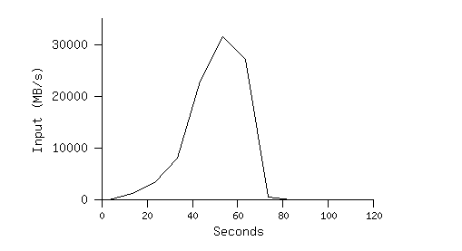
MR_GREP
Locality helps:
1800 machines read 1 TB of data at peak of ~31 GB/s
Without this, rack switches would limit to 10 GB/s
Startup overhead is significant for short jobs

Slide 37
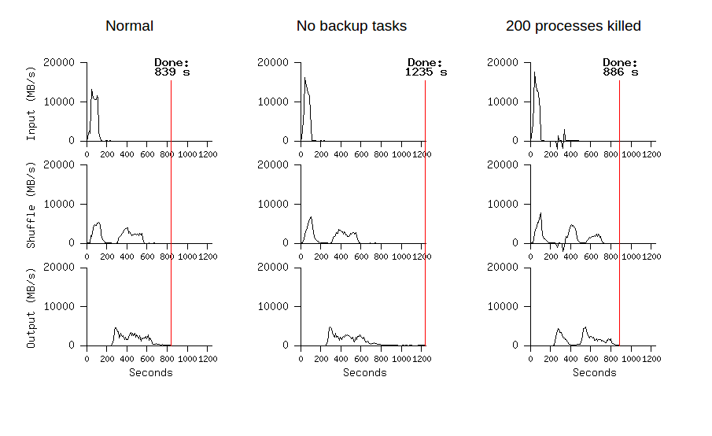
MR_SORT
Backup helps
Fault Tolerance Works

Slide 38
What is MapReduce?
MapReduce is a software framework for easily writing applications which process vast amounts of data (multi-terabyte data-sets) in-parallel on large clusters (thousands of nodes) of commodity hardware in a reliable, fault-tolerant manner.
https://hadoop.apache.org
MR is more like an extract-transform-load (ETL) system than a DBMS, as it quickly loads and processes large amounts of data in an ad hoc manner. As such, it complements DBMS technology rather than competes with it.
MapReduce and Parallel DBMSs: Friends or Foes?
Michael Stonebraker et al.
Notes:
ETL is short for extract, transform, load, three database functions that are combined into one tool to pull data out of one database and place it into another database.
Powerful tools. MR systems are fundamentally powerful tools for ETL-style applications and for complex analytics. Additionally, they are popular for “quick and dirty” analyses and for users with limited budgets. On the other hand, if the application is query-intensive, whether semistructured or rigidly structured, then a DBMS is probably the better choice.

Slide 39
Limitations
MapReduce greatly simplified “big data” analysis on large, unreliable clusters
But as soon as it got popular, users wanted more:
More complex, multi-stage applications (e.g. iterative machine learning & graph processing)
More interactive ad-hoc queries
These tasks require reusing data between jobs.

Slide 40
Limitations
Iterative algorithms and interactive data queries both require one thing that MapReduce lacks:
Efficient data sharing primitives
MapReduce shares data across jobs by writing to stable storage.
This is SLOW because of replication and disk I/O, but necessary for fault tolerance.
Notes:
Write to hdfs and replicate to different machines to start on next stage, Overhead between stages limited by network bandwidth

Slide 41
Motivation for a new system
Memory is much faster than disk
Goal: keep data in memory and share between jobs.
Challenge: a distributed memory abstraction that is fault tolerant and efficient
Notes:
Datasharing between jobs using MapReduce requires copying large amounts of data over the cluster network, whose bandwidth is far low than RAM

Slide 42
Resilient Distributed Datasets:
A Fault-Tolerant Abstraction for In-Memory Cluster Computing

Slide 43
Resilient Distributed Datasets: A Fault-Tolerant Abstraction for In-Memory Cluster Computing
NSDI 2012
2345 citations
Matei Zaharia, Assistant Professor, Stanford CS
Mosharaf Chowdhury, Assistant Professor, UMich EECS
Tathagata Das, Software Engineer, Databricks
Ankur Dave, PhD, UCB
Justin Ma, Software Engineer, Google
Awarded Best Paper!
Murphy McCauley, PhD, UCB
Michael J. Franklin, Professor, UCB CS
Scott Shenker, Professor, UCB CS
Ion Stoica, Professor, UCB CS
Notes:
AMPLAB is a University of California, Berkeley lab focused on Big data analytics. The name stands for the Algorithms, Machines and People Lab
Matei also co-founder and Chief Technologist of Databricks, the big data company commercializing Apache Spark

Slide 44
Resilient Distributed Datasets
Restricted form of distributed shared memory
Immutable, partitioned collections of records
Can only be built through coarse-grained deterministic operations
i.e. Transformations (map, filter, join,…)
Efficient fault recovery using lineage
Lineage: transformations used to build a data set
Recompute lost partitions on failure using the logged functions
Almost no cost if nothing fails
Notes:
A fine grained update would be an update to one record in a database whereas coarse grained operations are operations applied to all elements in a data set at once, for example map, reduce, flatMap, join. Spark's model takes advantage of this because once it saves a graph of transformations, it can use that to recompute as long as the original data is still there. With fine grained updates basically if you update each record out of billions separately you have to save the information to compute each update, whereas with coarse grained you can save one function that updates a billion records. Clearly though this comes at the cost of not being as flexible as a fine grained model.
Only need to log one function instead of the real data, so if nothing fails, there is almost no cost

Slide 45
Spark Programming Interface
Provides:
Resilient Distributed Datasets (RDDs)
Operations on RDDs: transformations (build new RDDs), actions (compute and output results)
Control of each RDD’s
Partitioning (layout across nodes)
Persistence (storage in RAM, on disk, etc)
Notes:
Open source, use Scala programming language. Persistent in memory or checkpoint to disk

Slide 46
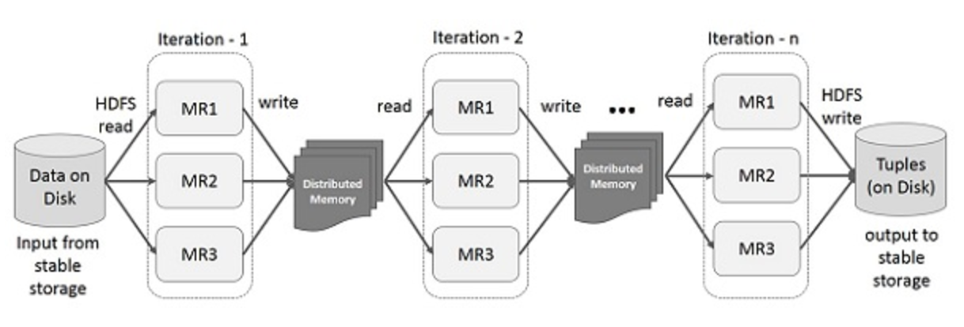
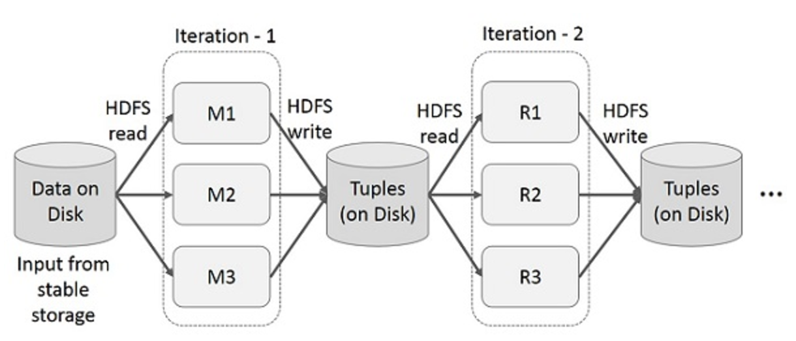
Iterative Operations
on MapReduce
on Spark RDD
Notes:
Hadoop file system, go to disk, read from disk , replicated

Slide 47
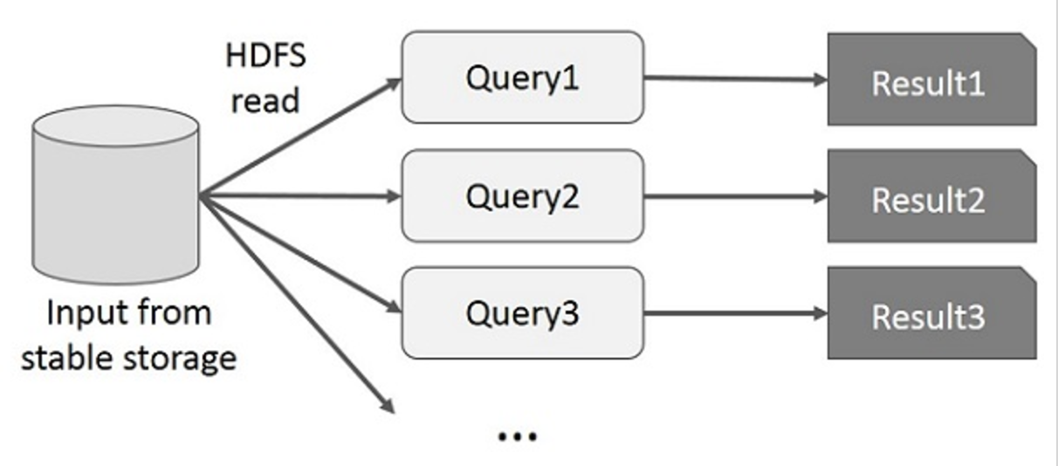
Interactive Operations
on MapReduce
on Spark RDD
Notes:
Each query needs disk I/O which also suffers from overhead

Slide 48
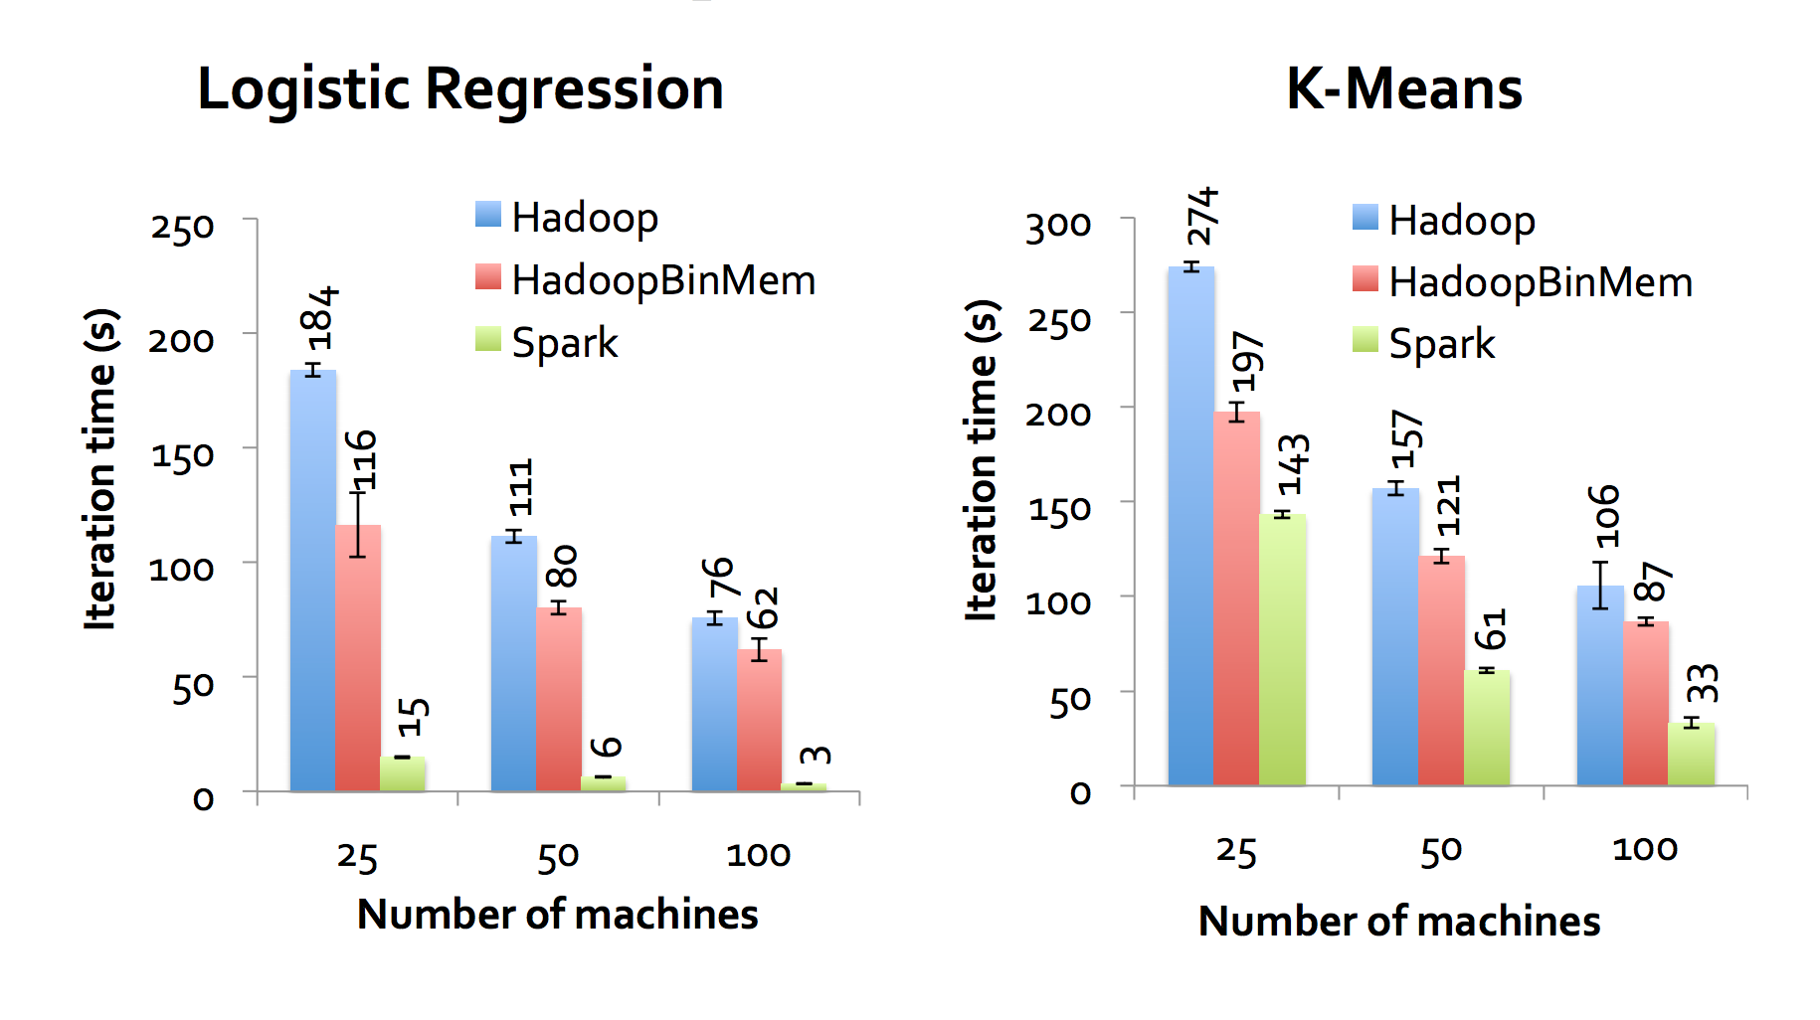
Evaluation
Spark outperforms Hadoop by up to 20x in iterative machine learning and graph applications.
Notes:
Hadoopbinmem is a hadoop deployment that converts the input data into a low-overhead binary format in the first iteration to elimiate text parsing in later ones, and stores it in an in-momery HDFS instance

Slide 49
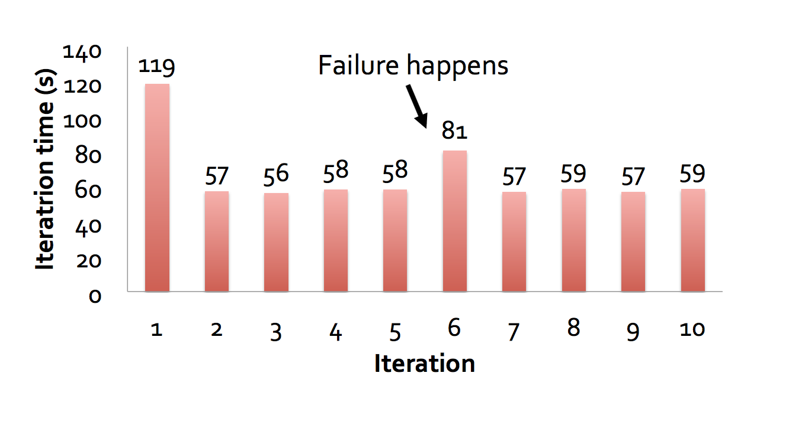
Evaluation
When nodes fail, Spark can recover quickly by rebuilding only the lost RDD partitions.
Notes:
Evaluated the cost of reconstructing RDD partitions using lineage after a node failure in the k-means application. Running times for 10 iterations of k-means on a 75-node cluster in normal operating scenario, with one where a node fails at the start of the 6th iteration.

Slide 50
Limitations
RDDs are best suited for batch applications that apply the same operation to all elements of a dataset. RDDs are not suitable for applications that make asynchronous fine-grained updates to shared state.
Spark loads a process into memory and keeps it for the sake of caching. If the data is too big to fit entirely into the memory, then there could be major performance degradations.

Slide 51
MapReduce vs Spark

Slide 52
Conclusions
MapReduce
A simple and powerful interface that enables automatic parallelization and distribution of large-scale computations.
Achieves high performance on large clusters of commodity PCs.
Implemented based on Google’s infrastructure. (highly engineered accordingly)
The frequent disk I/O and data replication limits its usage in iterative algorithm and interactive data queries.
2. Spark RDD
A Fault-Tolerant Abstraction for In-Memory Cluster Computing
Recovers data using lineage instead of replication
performs much better on iterative computations and interactive data queries.
Large memory consumption is the main bottleneck.

Slide 53
Reference
“Take a close look at MapReduce”, Xuanhua Shi
“MapReduce: Simplified Data Processing on Large Clusters”, Jeffery Dean and Sanjay Ghemawat
“Resilient Distributed Datasets: A Fault-Tolerant Abstraction for In Memory Cluster Computing”, Matei Zaharia et al.

