Slide 1
Cloud Scale Storage Systems
Yunhao Zhang
& Matthew Gharrity

Slide 2
Two Beautiful Papers
Google File System
SIGOPS Hall of Fame!
pioneer of large-scale storage system
Spanner
OSDI’12 Best Paper Award!
Big Table got SIGOPS Hall of Fame!
pioneer of globally consistent database

Slide 3
Topics in Distributed Systems
GFS
Fault Tolerance
Consistency
Performance & Fairness
Spanner
Clock (synchronous v.s. asynchronous)
Geo-replication (Paxos)
Concurrency Control

Slide 4
Google File System
Rethinking Distributed File System Tailored for the Workload

Slide 5
Authors
Sanjay Ghemawat
Howard Gobioff
Shun-tak Leung
Cornell->MIT->Google
R.I.P.
UW->DEC->Google

Slide 6
Evolution of Storage System (~2003)
P2P routing/DistributedHashTables (Chord, CAN, etc.)
P2P storage (Pond, Antiquity)
data stored by decentralized strangers
cloud storage
centralized data center network at Google
Question: Why using centralized data centers?

Slide 7
Evolution of Storage System (~2003)
benefits of data center
centralized control, one administrative domain
seemingly infinite resources
high network bandwidth
availability
building data center with commodity machines is easy

Slide 8
Roadmap
Traditional File System Design
Motivations of GFS
Architecture Overview
Discussion
Evaluation
Design Lessons

Slide 9
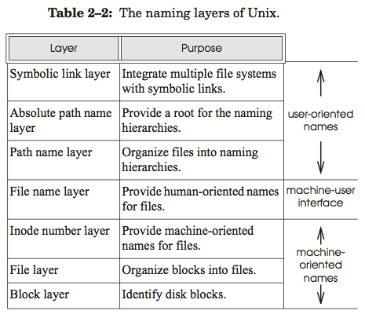
Recall UNIX File System Layers
high level functionalities
filenames and directories
machine-oriented file id
disk blocks
Table borrowed from “Principles of Computer System Design” by J.H. Saltzer
Notes:
Although GFS looks very different to UNIX file system, they share some design philosophy.

Slide 10
Recall UNIX File System Layers
Question: How GFS move from traditional file system design?
In GFS, what layers disappear?
What layers are managed by the master?
What are managed by the chunkserver?
Table borrowed from “Principles of Computer System Design” by J.H. Saltzer
Notes:
Although GFS looks very different to UNIX file system, they share some design philosophy.
Think about how GFS move from traditional UNIX FS design.

Slide 11
Recall NFS
distributed file system
assume same access pattern of UNIX FS (transparent)
no replication: any machine can be client or server
stateless: no lock
cache: files cache for 3 sec, directories cache for 30 sec
problems
inconsistency may happen
append can’t always work
assume clocks are synchronized
no reference counter

Slide 12
Roadmap
Traditional File System Design
Motivations of GFS
Architecture Overview
Discussion
Evaluation
Design Lessons

Slide 13
Different Assumptions
inexpensive commodity hardware
failures are norm rather than exception
large file size (multi-GB, 2003)
large sequential read/write & small random read
concurrent append
codesigning applications with file system

Slide 14
A Lot of Questions Marks on My Head
inexpensive commodity hardware (why?)
failures are norm rather than exception (why?)
large file size (multi-GB, 2003) (why?)
large sequential read/write & small random read (why?)
concurrent append (why?)
codesigning applications with file system (why?)

Slide 15
So, why?
inexpensive commodity hardware (why?)
cheap! (poor)
have they abandoned commodity hardware? why?
failures are norm rather than exception (why?)
too many machines!
large file size (multi-GB, 2003) (why?)
too much data!
large sequential read/write & small random read (why?)
throughput-oriented v.s. latency-oriented
concurrent append (why?)
producer/consumer model
codesigning applications with file system (why?)
customized fail model, better performance, etc.

Slide 16
Roadmap
Traditional File System Design
Motivations of GFS
Architecture Overview
Discussion
Evaluation
Design Lessons

Slide 17
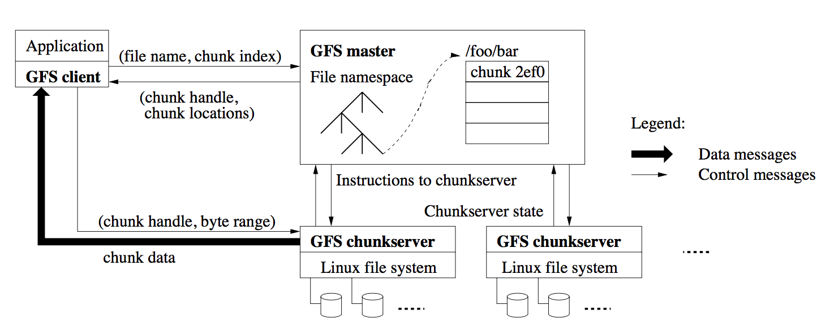
Moving to Distributed Design
Notes:
Relationship between the two figures

Slide 18
Architecture Overview
GFS Cluster (server/client)
single master + multiple chunkservers
Chunkserver
fixed sized chunks (64MB)
each chunk has a globally unique 64bit chunk handle
Master
maintains file system metadata
namespace
access control information
mapping from files to chunks
current locations of chunks
Question: what to be made persistent in operation log? Why?

Slide 19
Architecture Overview
Discussion Question: Why using Linux file system? Recall Stonebraker’s argument.
Notes:
keep in mind and leave to discussion

Slide 20
Roadmap
Traditional File System Design
Motivations of GFS
Architecture Overview
Discussion
Evaluation
Design Lessons

Slide 21
Major Trade-offs in Distributed Systems
Fault Tolerance
Consistency
Performance
Fairness
Notes:
What lessons can we learn from these aspects of distributed system

Slide 22
Recall Assumptions
inexpensive commodity hardware
failures are norm rather than exception
large file size (multi-GB, 2003)
large sequential read/write & small random read
concurrent append
codesigning applications with file system

Slide 23
What is Fault Tolerance?
fault tolerance is the art to keep breathing while dying
before we start, some terminologies
error, fault, failure
why not error tolerance or failure tolerance?
crash failure v.s. fail-stop
which one is more common?
Notes:
distinguishing error, fault and failure
shadow master is a cold backup

Slide 24
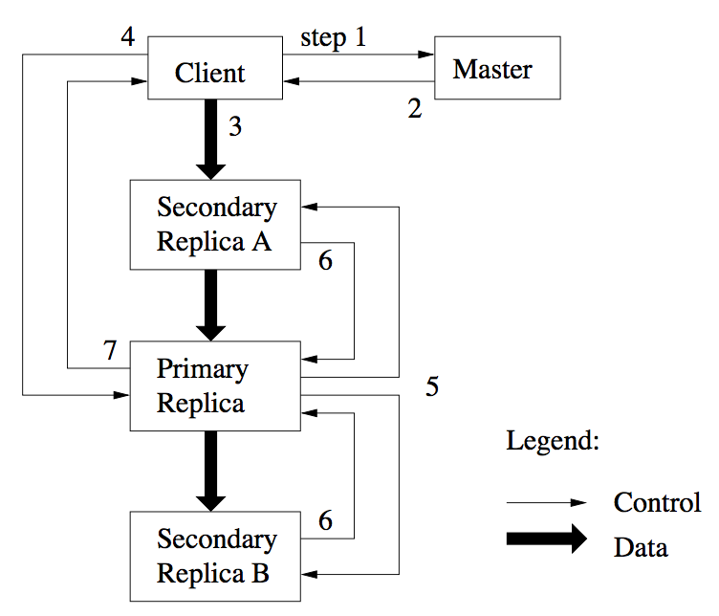
Fault Tolerance: Keep Breathing While Dying
GFS design practice
primary / backup
hot backup v.s. cold backup

Slide 25
Fault Tolerance: Keep Breathing While Dying
GFS design practice
primary / backup
hot backup v.s. cold backup
two common strategies:
logging
master operation log
replication
shadow master
3 replica of data
Question: what’s the difference?

Slide 26
My Own Understanding
logging
atomicity + durability
on persistent storage (potentially slow)
little space overhead (with checkpoints)
asynchronous logging: good practice!
replication
availability + durability
in memory (fast)
double / triple space needed
Question: How can (shadow) masters be inconsistent?
Notes:
Answer: batching. recall the two styles of workload: batch & single short job

Slide 27
Major Trade-offs in Distributed Systems
Fault Tolerance
logging + replication
Consistency
Performance
Fairness
Notes:
What lessons can we learn from these aspects of distributed system

Slide 28
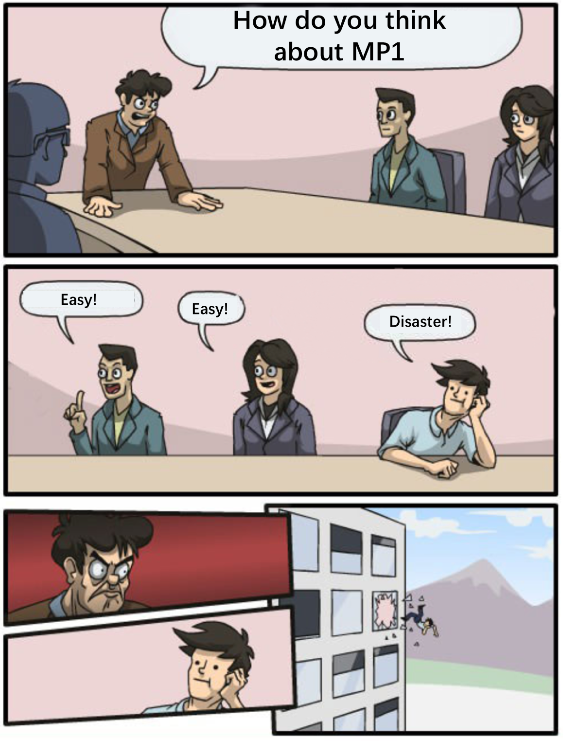
What is Inconsistency?
inconsistency!
client is angry!

Slide 29
How can we save the young man’s life?
Question: What is consistency? What cause inconsistency?

Slide 30
How can we save the young man’s life?
Question: What is consistency? What cause inconsistency?
Consistency model defines rules for the apparent order and visibility of updates (mutation), and it is a continuum with tradeoffs.
-- Todd Lipcon

Slide 31
Causes of Inconsistency
1. MP1 is easy
2. MP1 is disaster
1. MP1 is disaster
2. MP1 is easy
Replica1
Replica1
1. MP1 is disaster
2. MP1 is easy
1. MP1 is disaster
2. MP1 is easy
(not arrived)
Replica2
Replica2
Order
Visibility

Slide 32
Avoid Inconsistency in GFS
inexpensive commodity hardware
failures are norm rather than exception
large file size (multi-GB, 2003)
large sequential read/write & small random read
concurrent append
codesigning applications with file system

Slide 33
Mutation → Consistency Problem
mutations in GFS
write
record append
consistency model
defined (atomic)
consistent
optimistic mechanism v.s. pessimistic mechanism (why?)
Notes:
defined -> entirety
consistent -> same to all client
optimistic: even allow junks in the middle of a file

Slide 34
Mechanisms for Consistent Write & Append
Order: lease to primary and primary decides the order
Visibility: version number eliminates stale replicas
Integrity: checksum
Consistency model defines rules for the apparent order and visibility of updates (mutation), and it is a continuum with tradeoffs. -- Todd Lipcon

Slide 35
However, clients cache chunk locations!
Recall NFS
Question: What’s the consequence? And why?
Notes:
Performance!

Slide 36
Major Trade-offs in Distributed Systems
Fault Tolerance
logging + replication
Consistency
mutation order + visibility == lifesaver!
Performance
Fairness
Notes:
What lessons can we learn from these aspects of distributed system

Slide 37
Recall Assumptions
inexpensive commodity hardware
failures are norm rather than exception
large file size (multi-GB, 2003)
large sequential read/write & small random read
concurrent append
codesigning applications with file system

Slide 38
Performance & Fairness
principle: avoid bottle-neck! (recall Amdahl’s Law)
Notes:
what is serialized?

Slide 39
Performance & Fairness
principle: avoid bottle-neck! (recall Amdahl’s Law)
minimize the involvement of master
client cache metadata
lease authorize the primary chunkserver to decide operation order
namespace management allows concurrent mutations in same directory

Slide 40
Performance & Fairness
principle: avoid bottle-neck! (recall Amdahl’s Law)
minimize the involvement of master
chunkserver may also be bottle-neck
split data-flow and control-flow
pipelining in data-flow
data balancing and re-balancing
operation balancing by indication of recent creation

Slide 41
Performance & Fairness
principle: avoid bottle-neck! (recall Amdahl’s Law)
minimize the involvement of master
chunkserver may also be bottle-neck
time-consuming operations
make garbage collection in background

Slide 42
Conclude Design Lessons
Fault Tolerance
logging + replication
Consistency
mutation order + visibility == lifesaver!
Performance
locality!
work split enables more concurrency
fairness work split maximize resource utilization
Fairness
balance data & balance operation
Notes:
What lessons can we learn from these aspects of distributed system

Slide 43
Roadmap
Traditional File System Design
Motivations of GFS
Architecture Overview
Discussion
Evaluation
Design Lessons

Slide 44
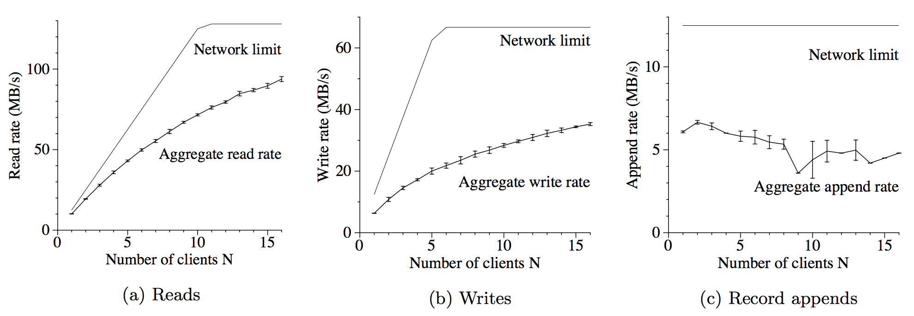
Throughput
Notes:
standard deviation of record append

Slide 45
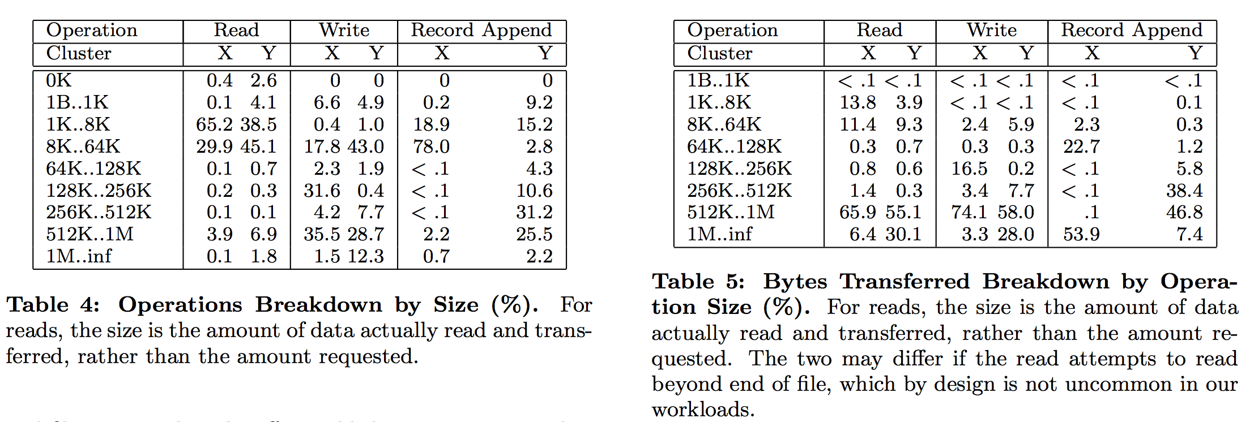
Breakdown

Slide 46
Roadmap
Traditional File System Design
Motivations of GFS
Architecture Overview
Discussion
Evaluation
Design Lessons

Slide 47
Discussion
Open Questions:
What if a chunk server is still overloaded?
Why using Linux file system? Recall Stonebraker’s argument.
What are pros/cons of a single master in this system? How can single master be a problem?
Are industry papers useful to the rest of us? Details?
Notes:
keep in mind and leave to discussion

Slide 48
Spanner
Combining consistency and performance in a globally-distributed database

Slide 49
Authors
James C. Corbett, Jeffrey Dean, Michael Epstein, Andrew Fikes, Christopher Frost, JJ Furman, Sanjay Ghemawat, Andrey Gubarev, Christopher Heiser, Peter Hochschild, Wilson Hsieh, Sebastian Kanthak, Eugene Kogan, Hongyi Li, Alexander Lloyd, Sergey Melnik, David Mwaura, David Nagle, Sean Quinlan, Rajesh Rao, Lindsay Rolig, Yasushi Saito, Michal Szymaniak, Christopher Taylor, Ruth Wang, Dale Woodford

Slide 50
Background
Bigtable
Another database designed by Google
Fast, but not strongly consistent
Limited support for transactions
Megastore
Another database designed by Google
Strong consistency, but poor write throughput
Can we get the best of both?

Slide 52
What does Spanner do?
Key-value store with SQL
Transactions
Globally distributed (why?)
Externally consistent (why?)
Fault-tolerant
Claim to fame
“It is the first system to distribute data at global scale and support externally-consistent distributed transactions.”

Slide 53
What does Spanner do?
Key-value store with SQL
Familiar database interface for clients
Transactions
Perform several updates atomically
Globally distributed
Can scale up to “millions of machines” across continents
Protection from wide-area disasters
Externally consistent
Clients see a single sequential transaction ordering
This ordering reflects the order of the transactions in real time
Fault-tolerant
Data is replicated across Paxos state machines

Slide 54
Why we want external consistency
Transaction T₁ deposits $200 into a bank account
Transaction T₂ withdraws $150
If the bank observes a negative balance at any point, the customer incurs a penalty
In this case, we want that no database read sees the effects of T₂ before it sees the effects of T₁
Example taken from the documentation for Cloud Spanner

Slide 55
TrueTime API
Basic idea
Transactions are ordered by timestamps that correspond to real time
In order to maintain consistency across replicas, a Spanner node artificially delays certain operations until it is sure that a particular time has passed on all nodes

Slide 56
TrueTime API
Previously, distributed systems could not rely on synchronized clock guarantees
Sending time across the network is tricky
Google gets around this by using atomic clocks (referred to as “Armageddon masters”) and GPS clocks
“As a community, we should no longer depend on loosely synchronized clocks and weak time APIs in designing distributed algorithms.”

Slide 57
TrueTime API
Key benefits
Paxos leader leases can be made long-lived and disjoint
No contention--good for performance!
External consistency can be enforced
Two-phase locking can also enforce external consistency, but even read-only transactions must acquire locks. On the other hand, Spanner maintains multiple versions of key-value mapping, and uses TrueTime to allow read-only transactions and snapshot reads to commit without locks. This makes performance practical.

Slide 58
Locality
Data is sharded using key prefixes
(userID, albumID, photoID) -> photo.jpg
The data for a particular user is likely to be stored together

Slide 59
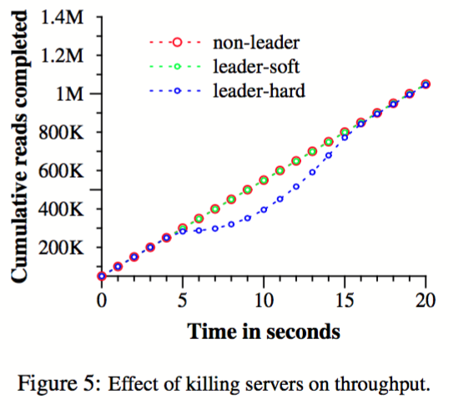
Evaluation

Slide 60
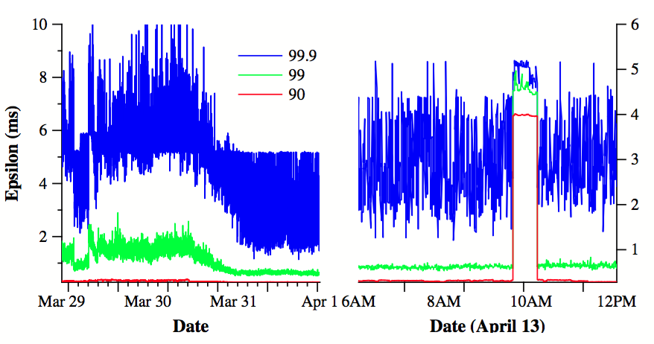
Evaluation

Slide 61
Closing Remarks
Assumptions guide design
E.g., GFS is optimized for large sequential reads
E.g., Spanner is built for applications that need strong consistency
Fast, consistent, global replication of data is possible
Just need careful design (and maybe atomic clocks!)

Slide 62
Closing Remarks
“In a production environment we cannot overstate the strength of a design that is straight-forward to implement and to maintain”
-- Finding a needle in Haystack: Facebook’s photo storage

