Slide 1
Concurrency, threads, and events
Hakim Weatherspoon
CS6410

Slide 2

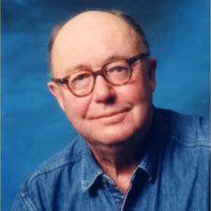
On the Duality of Operating System Structure
Hugh C. Lauer
  Adjunct Prof., Worcester Polytechnic Institute
  Xerox, Apollo Computer, Mitsubishi Electronic Research Lab, etc.
  Founded a number of businesses:
    Real-Time Visualization unit of
    Mitsubishi Electric Research Labs (MERL)
Roger M. Needham
  Prof., Cambridge University
  Microsoft Research, Cambridge Lab
  Kerberose, Needham-Schroeder security protocol, and key exchange systems

Slide 3
Message vs Procedure oriented system
(i.e. Events vs Threads)
Are they really the same thing?
Lauer and Needham show
  1) two models are duals
    Mapping exists from one model to other
  2) dual programs are logically identical
    Textually similar
  3) dual programs have identical performance
    Measured in exec time, compute overhead, and queue/wait times
Notes:
“UNIX is basically a simple operating system, but you have to be a genius to understand the simplicity.” – Dennis Ritchie

Slide 4
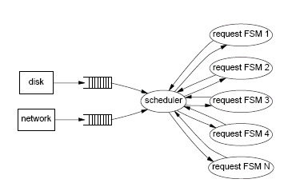
Message-oriented system (Event)
Small, static # of process
Explicit messaging
Limited data sharing in memory
Identification of address space or context with processes

Slide 5
Message-oriented system
Characteristics
  Queuing for congested resource
  Data structure passed by reference
  (no concurrent access)
  Peripheral devices treated as processes
  Priority of process statically determined
  No global naming scheme is useful

Slide 6
Message-oriented system
Calls:
  SendMessage, AwaitReply
  SendReply
  WaitForMessage
Characteristics
  Synchronization via message queues
  No sharing of data structures/address space
  Number of processes static
Notes:
“UNIX is basically a simple operating system, but you have to be a genius to understand the simplicity.” – Dennis Ritchie

Slide 7
Message-oriented system
Canonical model
  begin
  Do forever
    WaitForMessages
    case port
    port 1: …;
    port 2: …; SendReply; …;
    end case
    end loop
  end

Slide 8
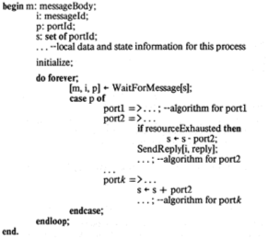
Message-oriented system
Notes:
“UNIX is basically a simple operating system, but you have to be a genius to understand the simplicity.” – Dennis Ritchie

Slide 9
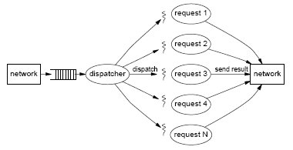
Procedure-Oriented System (Thread)
Large # of small processes
Rapidly changing # of processes
Communication using direct sharing and interlocking of data
Identification of context of execution with function being executed

Slide 10
Process-oriented system
Characteristics
  Synchronization and congestion control associates with waiting for locks
  Data is shared directly and lock lasts for short period of time
  Control of peripheral devices are in form of manipulating locks
  Priority is dynamically determined by the execution context
  Global naming and context is important

Slide 11
Process-oriented system
Calls:
  Fork, Join (process)
  Wait, Signal (condition variables)
Characteristics
  Synchronization via locks/monitors
  Share global address space/data structures
  Process (thread) creation very dynamic and low-overhead
Notes:
“UNIX is basically a simple operating system, but you have to be a genius to understand the simplicity.” – Dennis Ritchie

Slide 12
Process-oriented system
Canonical model
  Monitor
  -- global data and state info for the process
  proc1: ENTRY procedure
  proc2: ENTRY procedure returns
  begin
  If resourceExhausted then WAIT; …;
  RETURN result; …;
  end
  proc L: ENTRY procedure
  begin
  …; SIGNAL; …
  end;
  endloop;
  initialize;
  end

Slide 13
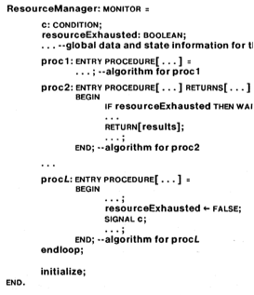
Process-oriented system
Notes:
“UNIX is basically a simple operating system, but you have to be a genius to understand the simplicity.” – Dennis Ritchie

Slide 14
Dual Mapping
Event | Thread
Processes: CreateProcess | Monitors: NEW/START
Message channel | External procedure id
Message port | Entry procedure id
Send msg (immediate); AwaitReply | Simple procedure call
Send msg (delayed); AwaitReply | FORK; … JOIN
Send reply | Return from procedure
Main loop of std resource manager, wait for message stmt, case stmt | Monitor lock, ENTRY attribute
Arms of case statement | ENTRY proc declaration
Selective waiting | Condition vars, WAIT, SIGNAL
Notes:
Can map one model to the other

Slide 15
Preservation of Performance
Performance characteristics
  Same execution time
  Same computational overhead
  Same queuing and waiting times
Do you believe they are the same?
What is the controversy?
Notes:
“UNIX is basically a simple operating system, but you have to be a genius to understand the simplicity.” – Dennis Ritchie

Slide 16
SEDA: An Architecture for Well-Conditioned, Scalable Internet Services (Welsh, 2001)
20 to 30 years later, still controversy!
Analyzes threads vs event-based systems, finds problems with both
Suggests trade-off: stage-driven architecture
Evaluated for two applications
  Easy to program and performs well

Slide 17
SEDA: An Architecture for Well-Conditioned, Scalable Internet Services (Welsh, 2001)
Matt Welsh
  Cornell undergraduate Alum (Worked on U-Net)
  PhD from Berkeley (Worked on Ninja clustering)
  Prof. at Harvard (Worked on sensor networks)
  Currently at Google
David Culler
  Faculty at UC Berkeley
Eric Brewer
  Faculty at UC Berkeley (currently on leave at Google)

Slide 18
What is a thread?
A traditional “process” is an address space and a thread of control.
Now add multiple thread of controls
  Share address space
  Individual program counters and stacks
Same as multiple processes sharing an address space.

Slide 19
Thread Switching
To switch from thread T1 to T2:
  Thread T1 saves its registers (including pc) on its stack
  Scheduler remembers T1’s stack pointer
  Scheduler restores T2’ stack pointer
  T2 restores its registers
  T2 resumes

Slide 20
Thread Scheduler
Maintains the stack pointer of each thread
Decides what thread to run next
  E.g., based on priority or resource usage
Decides when to pre-empt a running thread
  E.g., based on a timer
Needs to deal with multiple cores
  Didn’t use to be the case
“fork” creates a new thread

Slide 21
Synchronization Primitives
Semaphores
  P(S): block if semaphore is “taken”
  V(S): release semaphore
Monitors:
  Only one thread active in a module at a time
  Threads can block waiting for some condition using the WAIT primitive
  Threads need to signal using NOTIFY or BROADCAST

Slide 22
Uses of threads
To exploit CPU parallelism
  Run two threads at once in the same program
To exploit I/O parallelism
  Run I/O while computing, or do multiple I/O
  I/O may be “remote procedure call”
For program structuring
  E.g., timers

Slide 23
Common Problems
Priority Inversion
  High priority thread waits for low priority thread
  Solution: temporarily push priority up (rejected??)
Deadlock
  X waits for Y, Y waits for X
Incorrect Synchronization
  Forgetting to release a lock
Failed “fork”
Tuning
  E.g. timer values in different environment

Slide 24
What is an Event?
An object queued for some module
Operations:
  create_event_queue(handler) → EQ
  enqueue_event(EQ, event-object)
    Invokes, eventually, handler(event-object)
Handler is not allowed to block
  Blocking could cause entire system to block
  But page faults, garbage collection, …

Slide 25
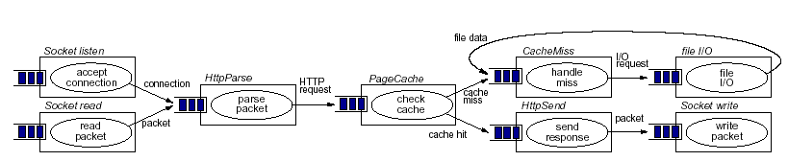
Example Event System
(Also common in telecommunications industry, where it’s called “workflow programming”)

Slide 26
Event Scheduler
Decides which event queue to handle next.
  Based on priority, CPU usage, etc.
Never pre-empts event handlers!
  No need for stack / event handler
May need to deal with multiple CPUs

Slide 27
Synchronization?
Handlers cannot block → no synchronization
Handlers should not share memory
  At least not in parallel
All communication through events

Slide 28
Uses of Events
CPU parallelism
  Different handlers on different CPUs
I/O concurrency
  Completion of I/O signaled by event
  Other activities can happen in parallel
Program structuring
  Not so great…
  But can use multiple programming languages!

Slide 29
Common Problems
Priority inversion, deadlock, etc. much the same with events
Stack ripping

Slide 30
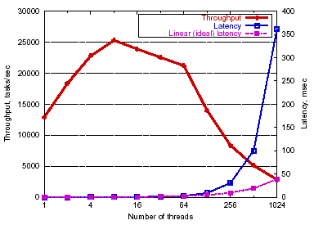
Threaded Server Throughput

Slide 31
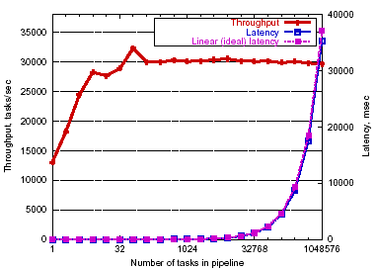
Event-driven Server Throughput

Slide 32
Threads vs. Events
Events-based systems use fewer resources
  Better performance (particularly scalability)
Event-based systems harder to program
  Have to avoid blocking at all cost
  Block-structured programming doesn’t work
  How to do exception handling?
In both cases, tuning is difficult

Slide 33
SEDA
Mixture of models of threads and events
Events, queues, and “pools of event handling threads”.
Pools can be dynamically adjusted as need arises.

Slide 34
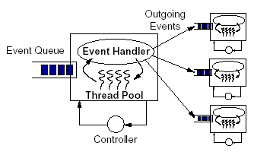
SEDA Stage

Slide 35
Best of both worlds
Ease of programming of threads
  Or even better
Performance of events
  Or even better
Did we achieve Lauer and Needham’s vision with SEDA?

Slide 36
Next Time
Read and write review:
MP1 – due next Friday
  Let us know how you are doing; if need help
Presentations
  Sign up to present
Project Proposal due tomorrow
  Also, talk to faculty and email and talk to me
Check website for updated schedule
Notes:
Lab 0 – graded

Slide 37
Next Time
Read and write review:
  Required: Mach: A new kernel foundation for UNIX development, Mike Accetta, Robert Baron, William Bolosky, David Golub, Richard Rashid, Avadis Tevanian, and Michael Young. Proceedings of the USENIX Summer Conference, Atlanta, GA, 1986, pages 93—112.
  Optional: The Performance of µ-Kernel-based Systems, Hermann Härtig, Michael Hohmuth, Jochen Liedtke, Jean Wolter, and Sebastian Schönberg. 16th ACM Symposium on Operating Systems Principles (SOSP), Oct 1997, pages 66—77.

