Slide 1
Bitcoin & Blockchains
Kevin Sekniqi

Slide 2
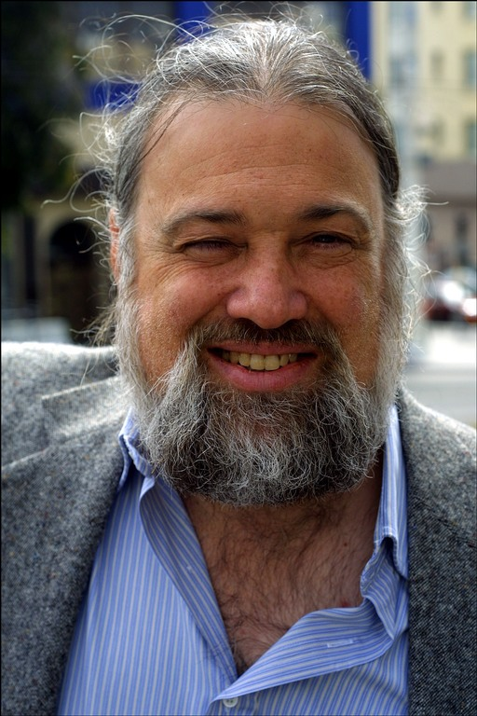
A Brave New World - The Vision of David Chaum
David Chaum
PhD CS/Business Adm from Berkeley 1982
Founded IACR same year
eCash, mix nets, voting systems …

Slide 3
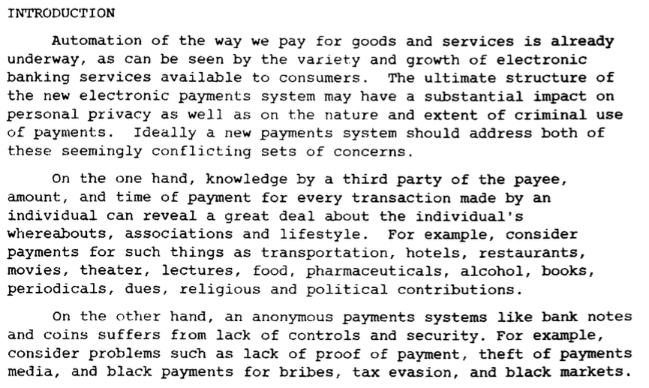
A Brave New World - The Vision of David Chaum [1983]
http://www.hit.bme.hu/~buttyan/courses/BMEVIHIM219/2009/Chaum.BlindSigForPayment.1982.PDF

Slide 4
A Brave New World - The Vision of David Chaum [1983]

Slide 5
A Brave New World - The Vision of David Chaum [1983]
Basically ...
Electronic payment systems suffer from loss of privacy and cumbersome trust on single entities.
Privacy protection, however, encounters issues of security and safety of data.

Slide 6
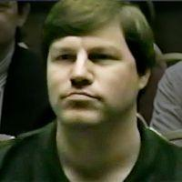
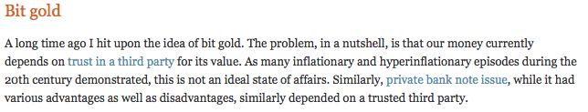
Nick Szabo [1998]

Slide 7

Nick Szabo [1998]

Slide 8
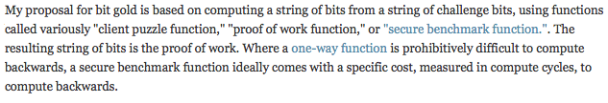
Nick Szabo [1998]
http://unenumerated.blogspot.com/2005/12/bit-gold.html

Slide 9
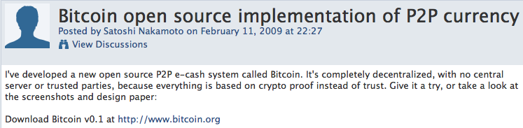
Satoshi Nakamoto and the Anon Post [2008]

Slide 10

Satoshi Nakamoto and the Anon Post [2008]

Slide 11
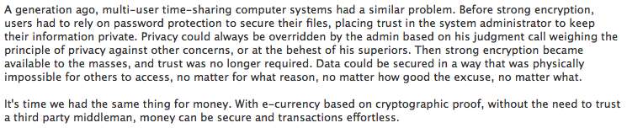
Satoshi Nakamoto and the Anon Post [2008]

Slide 12
Goals
An electronic payment system:
Guarantees safety of transactions, protects against double spends, gives full freedom to owners.
Yet no central trusted authority, no reliance on quorum since identities are not known.

Slide 13
Bitcoin
N1
N6
N2
TX1 = [Alice → Bob]
TX2 = [Alice → Carol]
N5
N3
N4

Slide 14
Bitcoin
N1
N6
N2
N5
N3
N4

Slide 15
Bitcoin
TX1
N1
TX2
N6
N2
TX2
TX1
N5
N3
TX1
N4
TX2

Slide 16
Bitcoin
TX1
N1
TX2
N6
N2
TX2
PBFT
TX1
N5
N3
TX1
N4
TX2

Slide 17
Bitcoin
TX1
N1
TX2
N6
N2
TX2
Who are you?
PBFT
TX1
N5
N3
TX1
N4
TX2

Slide 18
Bitcoin
Evil
Here’s what I know
New
?
Good
Here’s what I know

Slide 19
Bitcoin
TX1
N1
TX2
N6
N2
TX2
TX1
N5
N3
TX1
N4
TX2

Slide 20
Bitcoin
TX1
N1
TX2
N6
N2
TX2
TX1
N5
N3
TX1
N4
TX2

Slide 21
Bitcoin
SHA256(SHA256(TX || Nonce)) < {0}^{k} {0,1}*

Slide 22
Bitcoin
TX1
N1
TX2
N6
N2
TX2
Found it!
TX1
N5
N3
TX1
N4
TX2

Slide 23
Bitcoin
TX1
N1
TX2
N6
N2
TX2
Found it!
TX1
N5
N3
TX1
N4
TX2

Slide 24
Bitcoin
TX2
N1
TX2
N6
N2
TX2
TX2
N5
N3
TX2
N4
TX2

Slide 25
Bitcoin
TX1
N1
TX2
N6
N2
TX2
TX2
N5
N3
TX2
N4
TX2

Slide 26
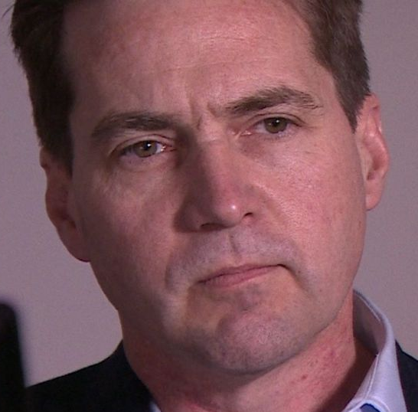
Bitcoin
N1
TX1
TX2
N6
TX2
N5
I’m confused
N4
TX2

Slide 27
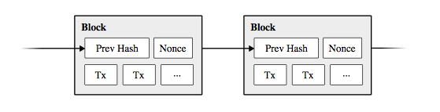
Bitcoin

Slide 28
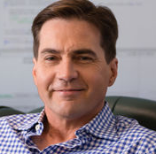
Bitcoin
N1
TX1
B2
B3
...
Loses!
I’m no longer confused
N4
TX2
B2
B3
...
Wins!

Slide 29
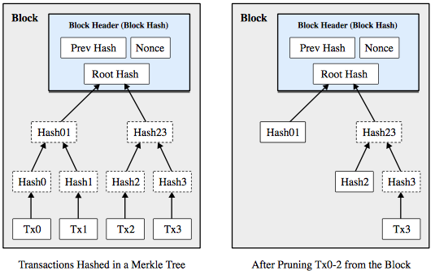
Bitcoin

Slide 30
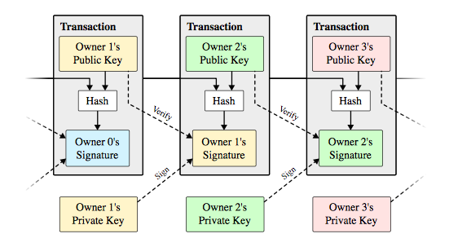
Bitcoin

Slide 31
Bitcoin
UTXO

Slide 32
Bitcoin
TX2
N1
TX2
N6
N2
TX2
TX2
N5
N3
TX2
N4
TX2
Thanks for the coins!

Slide 33
Bitcoin
Many more subtle details, but core mechanism is computational race.
Results:
  Breakthrough consensus mechanism in the permissionless setting
Challenges:
  Electrical usage of a medium-sized country.
  Very slow confirmation times.
  3 tx/second.

Slide 34
Bitcoin
Last year, when I gave this talk in December, 1 BTC == $1100
Today at $4000
Crypto market cap high of $180B last week, today $130B
21 million total possible Bitcoins. As supplies dwindle, price skyrockets.

Slide 35
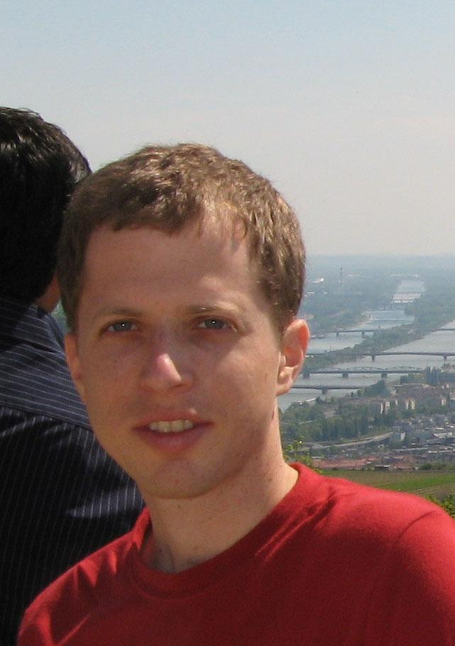
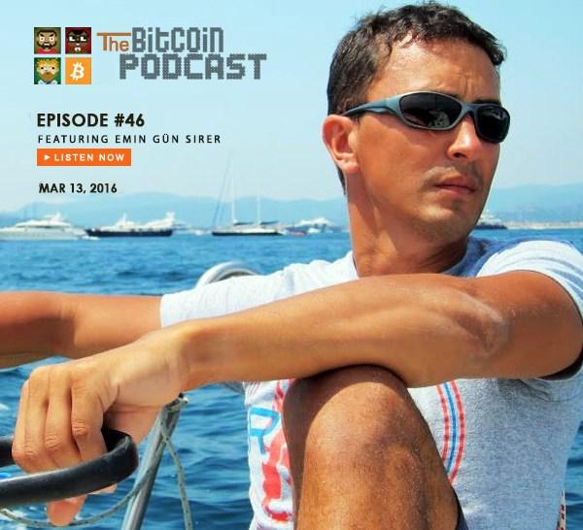
Majority is Not Enough: Bitcoin Mining is Vulnerable
Ittay Eyal
Postdoc @ Cornell, faculty @ Technion
Major contributor to Bitcoin community
Emin Gun Sirer
Also major contributor to the Bitcoin community

Slide 36
N1
TX1
B2
B3
49%
Rest of Network
TX2
B2
B3
51%

Slide 37
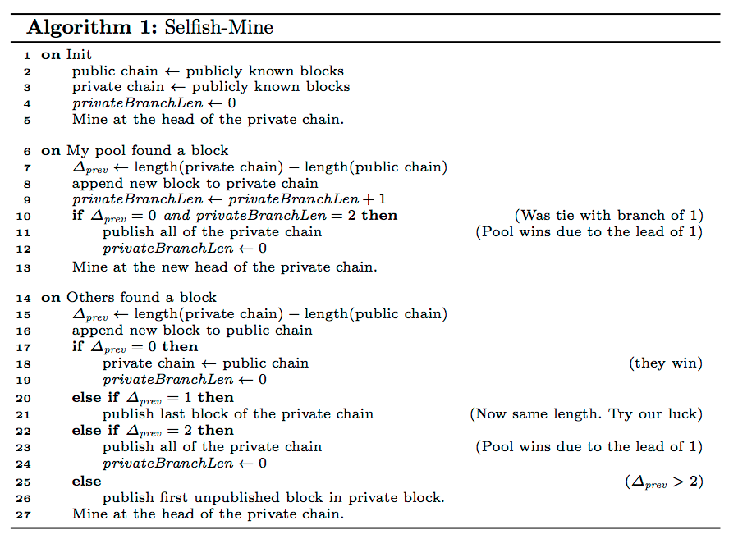
Majority is Not Enough: Bitcoin Mining is Vulnerable

Slide 38
Majority is Not Enough: Bitcoin Mining is Vulnerable
N1
...
RON

Slide 39
Majority is Not Enough: Bitcoin Mining is Vulnerable
N1
...
RON

Slide 40
Majority is Not Enough: Bitcoin Mining is Vulnerable
N1
...
RON

Slide 41
Majority is Not Enough: Bitcoin Mining is Vulnerable
N1
...
RON

Slide 42
Majority is Not Enough: Bitcoin Mining is Vulnerable
N1
...
RON

Slide 43
Majority is Not Enough: Bitcoin Mining is Vulnerable
N1
...
RON

Slide 44
Majority is Not Enough: Bitcoin Mining is Vulnerable
N1
...
RON

Slide 45
Majority is Not Enough: Bitcoin Mining is Vulnerable
N1
...
RON

Slide 46
Majority is Not Enough: Bitcoin Mining is Vulnerable
N1
...
RON

Slide 47
Majority is Not Enough: Bitcoin Mining is Vulnerable
N1
...
RON

