Slide 1
Bitcoin & Blockchains
Kevin Sekniqi

Slide 2
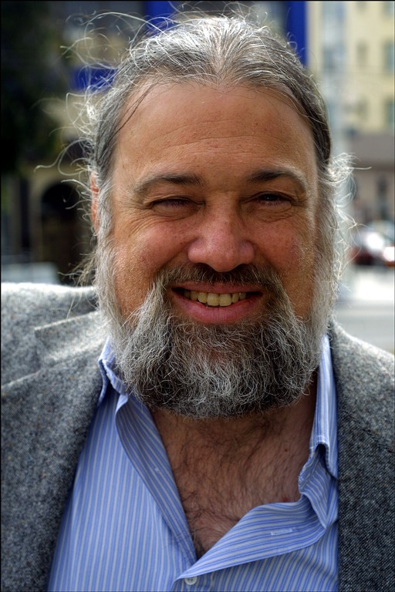
A Brave New World - The Vision of David Chaum
David Chaum
PhD CS/Business Adm from Berkeley 1982 Founded IACR same year
eCash, mix nets, voting systems …

Slide 3
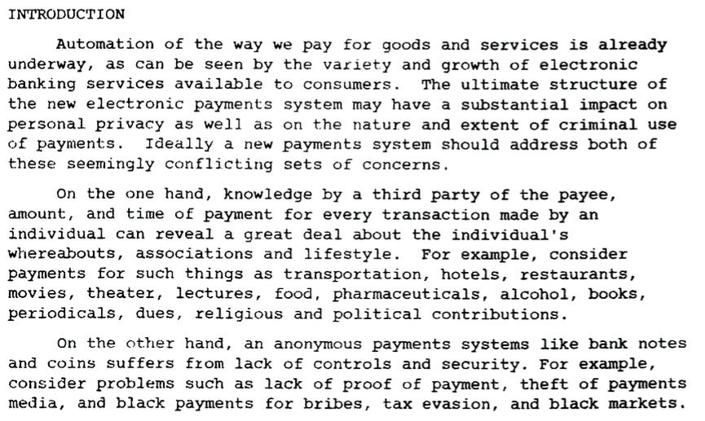
A Brave New World - The Vision of David Chaum [1983]
http://www.hit.bme.hu/~buttyan/courses/BMEVIHIM219/2009/Chaum.BlindSigForPayment.1982.PDF

Slide 4
A Brave New World - The Vision of David Chaum [1983]

Slide 5
A Brave New World - The Vision of David Chaum [1983]
Basically ...
Electronic payment systems suffer from loss of privacy and cumbersome trust on single entities.
Privacy protection, however, encounters issues of security and safety of data.

Slide 6
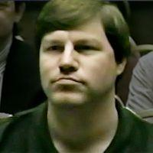
Nick Szabo [1998]

Slide 7
Nick Szabo [1998]

Slide 8
Nick Szabo [1998]
http://unenumerated.blogspot.com/2005/12/bit-gold.html

Slide 9
Satoshi Nakamoto and the Anon Post [2008]

Slide 10
Satoshi Nakamoto and the Anon Post [2008]

Slide 11
Satoshi Nakamoto and the Anon Post [2008]

Slide 13
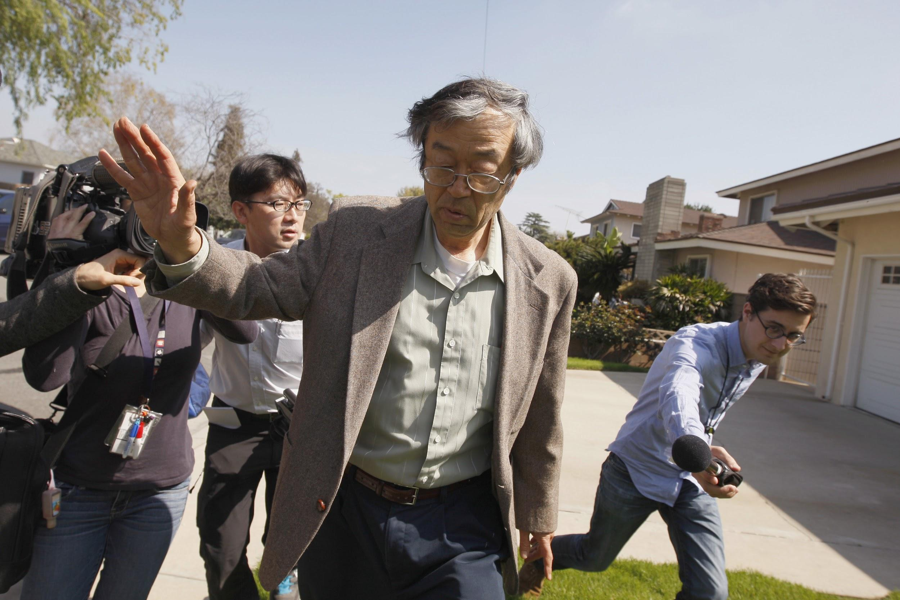
The Search For Satoshi Nakamoto

Slide 14
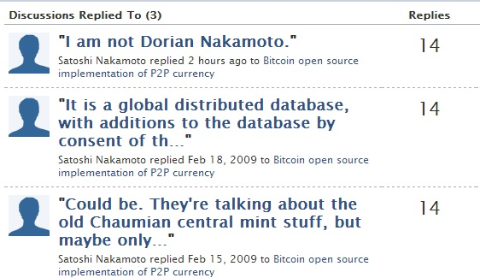
The Search For Satoshi Nakamoto

Slide 15
Goals
An electronic payment system:
Guarantees safety of transactions, protects against double spends, gives full freedom to owners.
Yet no central trusted authority, no reliance on quorum since identities are not known.

Slide 16
Bitcoin
N1
N6
N2
TX1 = [Alice → Bob]
TX2 = [Alice → Carol]
N5
N3
N4

Slide 17
Bitcoin
N1
N6
N2
N5
N3
N4

Slide 18
Bitcoin
TX1
N1
TX2
N6
N2
TX2
TX1
N5
N3
TX1
N4
TX2

Slide 19
Bitcoin
TX1
N1
TX2
N6
N2
TX2
PBFT
TX1
N5
N3
TX1
N4
TX2

Slide 20
Bitcoin
TX1
N1
TX2
N6
N2
TX2
Who are you?
PBFT
TX1
N5
N3
TX1
N4
TX2

Slide 21
Bitcoin
Evil
Here’s what I know
New
?
Good
Here’s what I know

Slide 22
Homebrewed Bitcoin
PBFT / Classical consensus
Plain gossip?

Slide 23
Bitcoin
TX1
N1
TX2
N6
N2
TX2
TX1
N5
N3
TX1
N4
TX2

Slide 24
Bitcoin
TX1
N1
TX2
N6
N2
TX2
TX1
N5
N3
TX1
N4
TX2

Slide 25
Bitcoin
SHA256(SHA256(TX || Nonce)) < {0}^{k} {0,1}*

Slide 26
Bitcoin
TX1
N1
TX2
N6
N2
TX2
Found it!
TX1
N5
N3
TX1
N4
TX2

Slide 27
Bitcoin
TX1
N1
TX2
N6
N2
TX2
Found it!
TX1
N5
N3
TX1
N4
TX2

Slide 28
Bitcoin
TX2
N1
TX2
N6
N2
TX2
TX2
N5
N3
TX2
N4
TX2

Slide 29
Bitcoin
TX1
N1
TX2
N6
N2
TX2
TX2
N5
N3
TX2
N4
TX2

Slide 30
Bitcoin
N1
TX1
TX2
N6
TX2
N5
I’m confused
N4
TX2

Slide 31
Bitcoin

Slide 32
Bitcoin
N1
TX1
B2
B3
...
Loses!
I’m no longer confused
N4
TX2
B2
B3
...
Wins!

Slide 33
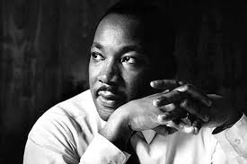
Bitcoin
The arc of the moral universe is long, but it bends towards justice.

Slide 34
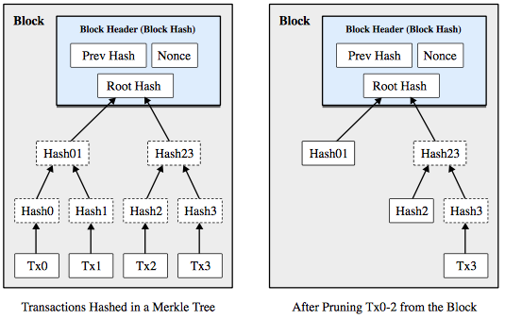
Bitcoin

Slide 35
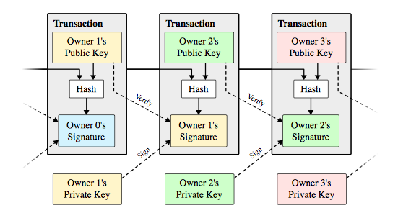
Bitcoin

Slide 36
Bitcoin
UTXO

Slide 37
Bitcoin
TX2
N1
TX2
N6
N2
TX2
TX2
N5
N3
TX2
N4
TX2
Thanks for the coins!

Slide 38
Bitcoin
Many more subtle details, but core mechanism is computational race.
Results:
Breakthrough consensus mechanism in the permissionless setting
Challenges:
Electrical usage of a small country.
Very slow confirmation times.
7 tx/second.

Slide 39
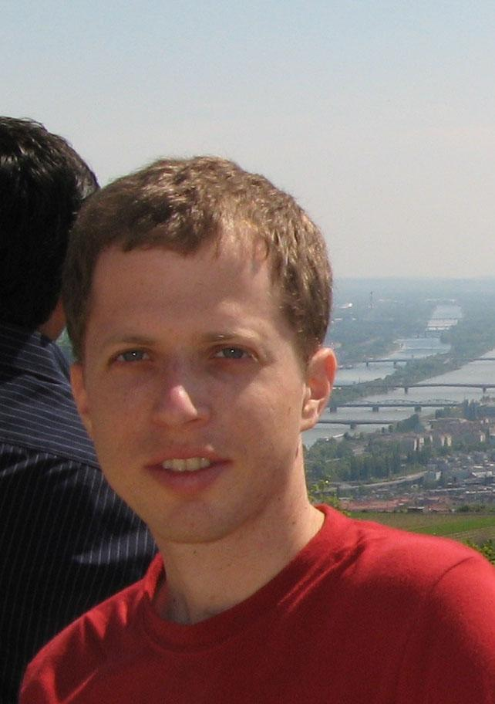
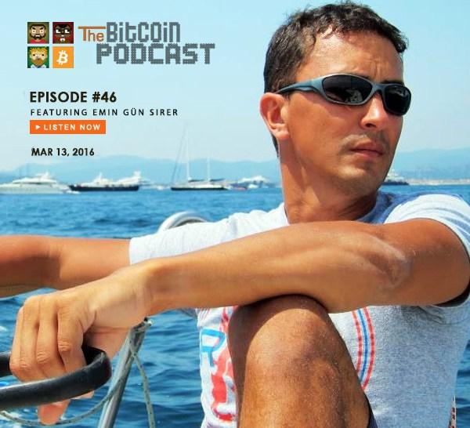
Majority is Not Enough: Bitcoin Mining is Vulnerable
Ittay Eyal
Postdoc @ Cornell, faculty @ Technion in 2017
Major contributor to Bitcoin community
Emin Gun Sirer
Has sick sunglasses and owns a sick boat
Tells me what to do

Slide 40
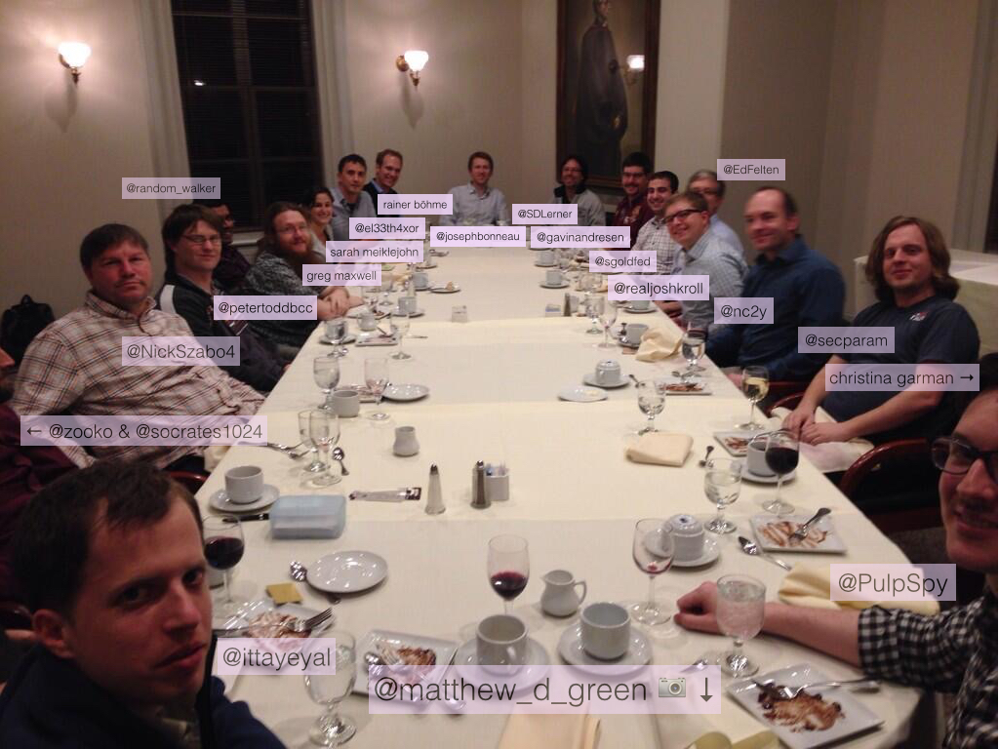
Majority is Not Enough: Bitcoin Mining is Vulnerable

Slide 41
N1
TX1
B2
B3
49%
Rest of Network
TX2
B2
B3
51%

Slide 42
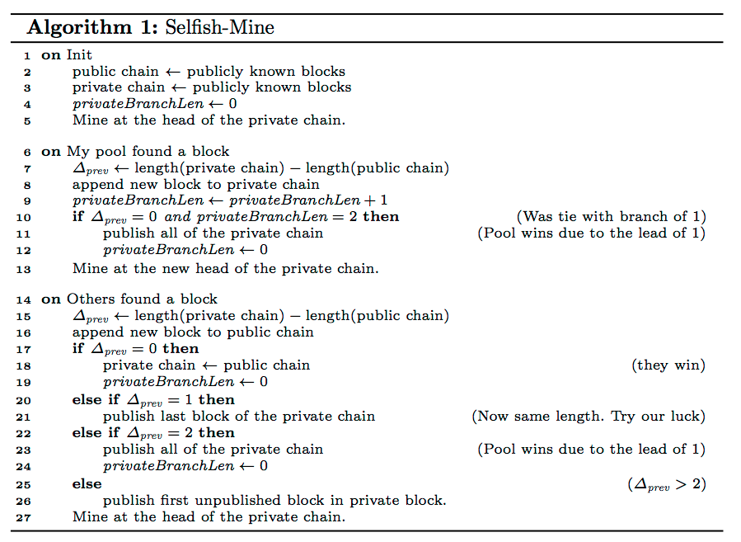
Majority is Not Enough: Bitcoin Mining is Vulnerable

Slide 43
Majority is Not Enough: Bitcoin Mining is Vulnerable
N1
...
RON

Slide 44
Majority is Not Enough: Bitcoin Mining is Vulnerable
N1
...
RON

Slide 45
Majority is Not Enough: Bitcoin Mining is Vulnerable
N1
...
RON

Slide 46
Majority is Not Enough: Bitcoin Mining is Vulnerable
N1
...
RON

Slide 47
Majority is Not Enough: Bitcoin Mining is Vulnerable
N1
...
RON

Slide 48
Majority is Not Enough: Bitcoin Mining is Vulnerable
N1
...
RON

Slide 49
Majority is Not Enough: Bitcoin Mining is Vulnerable
N1
...
RON

Slide 50
Majority is Not Enough: Bitcoin Mining is Vulnerable
N1
...
RON

Slide 51
Majority is Not Enough: Bitcoin Mining is Vulnerable
N1
...
RON

Slide 52
Majority is Not Enough: Bitcoin Mining is Vulnerable
N1
...
RON

