Slide 1
High Performance Networking
U-Net and FaRM

Slide 2
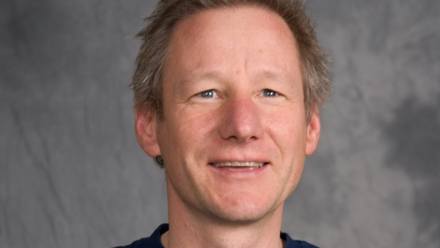
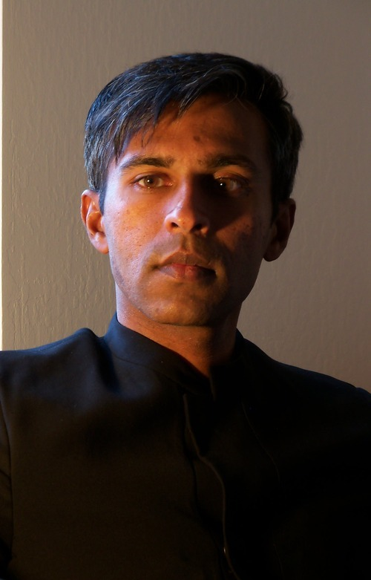
U-Net (1995)
Thorsten von Eicken
Ph.D Berkeley, Prof Cornell, now CTO at RightScale
Anindya Basu
Ph.D Cornell
Vineet Buch
MS Cornell, now at Google
Werner Vogels
Cornell, Amazon
Notes:
Rightscale -cloud computing

Slide 3
Motivation

Slide 4
The Traditional Network
A message explicitly managed by the kernel
Traverse network “stack”

Slide 5
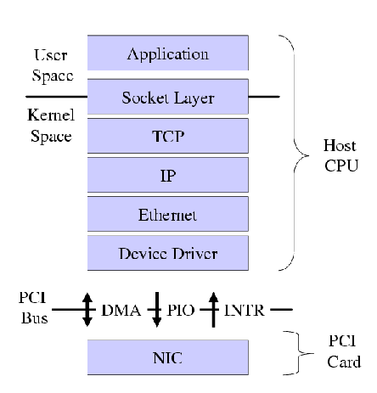
The Traditional Network
Send
Application buffer -> Socket Buffer
Attach headers
Move to Network Interface Card (NIC)
Receive
Same story
NIC buffer -> Socket Buffer
Parse Headers
Socket Buffer -> Application Buffer
Context Switch
Notes:
TCP transport layer (how to transport, header)
IP Packet layer (address layer)
Process listening on sockets, when it recieves activity operates on sockets aka context switch (expensive)

Slide 6
Costs
Processing Cost
Transmission Cost
Notes:
Cost (time)
Processing - CPU
Transmission -Network

Slide 7
Transmission cost vs Processing cost
Network layers in a kernel are not a problem if transmission cost dominate!
Large messages
For example, video streaming
Transmission cost >> Processing cost
More often than not, messages are small
Processing cost >> Transmission cost
Layers increasing latency, decrease bandwidth

Slide 8
What are the problems with traditional networking?

Slide 9
What are the problems with this model?
Messages go through Kernel
More processing
Applications have to interface with Kernel
Multiple copies of same message
Unnecessary replication
Low Flexibility
Protocol processing inside Kernel means no new interfaces
As a result, poor performance and flexibility!

Slide 10
Goals, Takeaways, and Secret Sauce

Slide 11
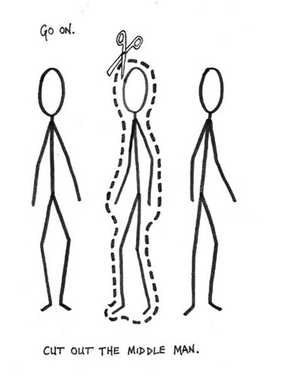

Slide 12
U-Net Goals
Put network processing at user level
Sort of like an Exokernel
This bypasses the Kernel (the middleman)
Decrease number of copies
Holy Grail: Zero Copy Networking
No copying in network activity
High protocol flexibility
U-Net should be able to implement existing protocols for legacy reasons
As a result, high performance and flexibility!

Slide 13
U-Net Takeaways
Putting networking at user level increases performance
Both Latency and Bandwidth
Networking analogy of exokernel

Slide 14
U-Net Secret Sauce
Create sockets at the user level
Called endpoints in U-Net
Let Network Interface Card (NIC) handle networking instead of CPU

Slide 15
Related Work
Mach3 (Exokernel)
User level implementation of TCP/IP
Not done for performance -no choice
Parallel computing/HPC community
Required specialized hardware and software (e.g. no TCP)
Custom Machines = Expensive
Still holds today

Slide 16
Inner Workings

Slide 17
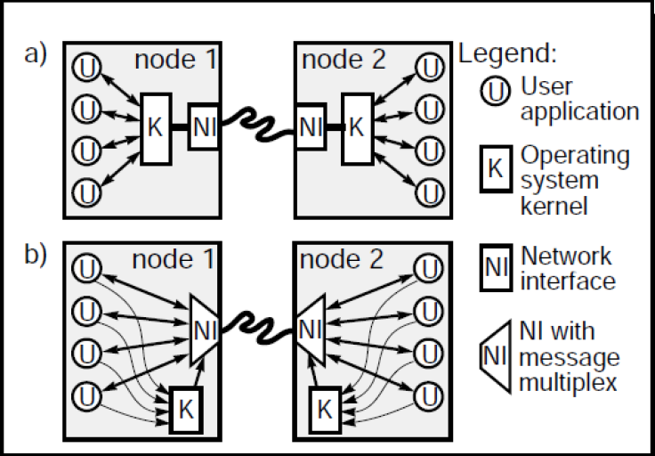
The traditional network. Kernel as a middleman
U-Net. Direct access to network interface

Slide 18
A Simplified View of U-Net
Look in Queue
DMA to Memory
U-Net Traffic (send)
NIC
Message Queue
Memory

Slide 19
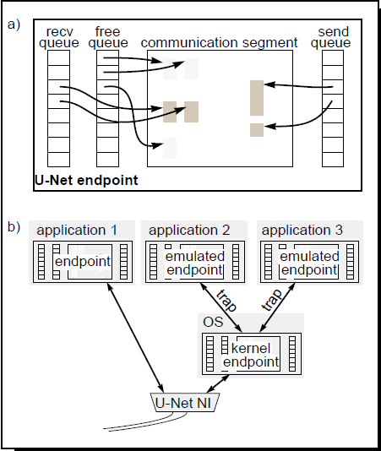
U-Net Design
Endpoints are a handle into the network
Sort of like socket
Communication Segments,
Sections of memory holding message contents
Message Queues hold descriptors of messages
Hold pointers, not data

Slide 20
U-Net Design
User accessing U-Net create endpoint, queues, alloc memory

Slide 21
U-Net Design
To send, user puts message in communication segment
A descriptor (pointer) gets put into send queue
Looking in send queue, NIC grabs descriptor
Using a DMA, NIC retrieves message from communication segment and sends it out to receive endpoint

Slide 22
U-Net Design
Descriptor put onto receive queue
To receive, user looks in free queue for empty communication segment
Message then written into empty communication segment by NIC

Slide 23
NIC handles everything else!

Slide 24
Zero Copy and “True” Zero Copy
In the literature, a zero copy is one that does not use any excess memory
I.e. Is not copied to a buffer first
Zero Copies in traditional networking isn’t “true”
Buffering MUST occur between kernel and application
Communication buffer (kernel) to application buffer
U-Net attempts to support true zero copying
Authors note need for specialized hardware

Slide 25
Performance Numbers

Slide 26
Performance
Two measures of “Performance”: Latency and Bandwidth
Latency: Delay in messages
Bandwidth: bits/sec
Highway analogy

Slide 27
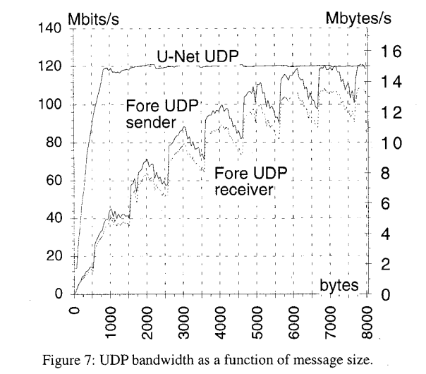

Slide 28
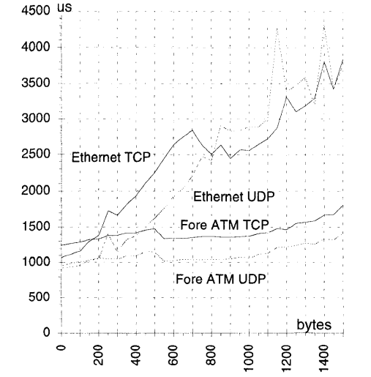

Slide 29
Food for Thought: Trade-offs
What are some trade-offs associated with switching from OS level to application level networking?
Why is OS level networking far more popular?
Notes:
Dev Time, Security, Multiplexing

Slide 30
Food for Thought: Trade-offs
Development time vs performance
Application development requires re-implementation of key features
Why is OS level networking far more popular?
Same reason exokernels/microkernels aren’t successful!
Standard interface makes life easy for developer
Security
Without kernel, more things to worry about
Multiplexing
How to efficiently share network?

Slide 31
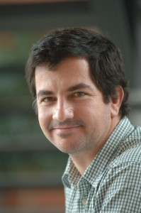
FaRM (2014)
Aleksandar Dragojevic (Ph.D EPFL)
Dushyanth Narayanan (Ph.D Carnegie Mellon)
Orion Hodson (Ph.D University College London)
Miguel Castro (Ph.D MIT)

Slide 32
FaRM
Relatively modern Distributed Computing Platform
Uses Remote Direct Memory Accesses (RDMA) for performance

Slide 33
RDMA

Slide 35
RDMA: A History
U-Net (1995)
Virtual Interface Architecture (VIA) (1997)
U-Net interface + Remote DMA service
RDMA (2001-2002)
Succeeds where prior work didn’t
Widely adopted kernel-bypass networking
Standard “interface” (known as verbs)
Not a real interface, verbs define legal operations
Notes:
Sprite OS: Global Shared Memory

Slide 36
RDMA over Infiniband
Infiniband networks = HPC Networks
RDMA traditionally used in Infiniband Networks
Infiniband has a number of vendors, including Intel, Qlogic, and Mellanox
Used extensively in HPC machines (Supercomputers)
Expensive, requires specialized hardware (physical network and NIC)
100Gb/s standard

Slide 37
RDMA over Ethernet/TCP
RoCE: RDMA done over Ethernet instead of Infiniband
(RDMA over Converged Ethernet)
Still requires specialized hardware
Cheaper because need only specialized NICs
40Gb/s (and maybe 60Gb/s)
RoCE seems to scale worse
iWARP
RDMA over TCP
Once again, cheaper; only needs specialized NICs
Big arguments over which technology preferable

Slide 38
RDMA Today
Widely used in Data Centers, HPC, Storage Systems, Medical Imaging, etc
RoCE seems to be the most popular.
Azure offers RDMA over Infiniband as well
Supported natively in (newer) Linux, some Windows, and OSX
Bandwidth growing… 1Tb/s in the future!

Slide 39
How RDMA Works
RDMA traffic sent directly to NIC without interrupting CPU
A remote memory region registers with the NIC first
NIC records virtual to physical page mappings.
When NIC receives RDMA request, it performs a Direct Memory Access into memory and returns the data to client.
Kernel bypass on both sides of traffic
Notes:
Memory access over the network, two machines
Kernel bypass on both sides
Machine 1 -> NIC 1 <-> NIC 2 <- Machine 2

Slide 40
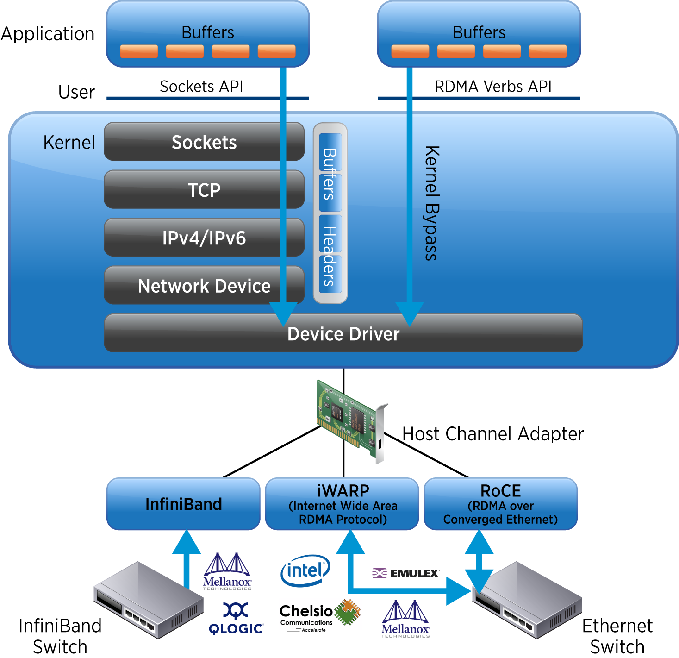

Slide 41
A Simplified View of RDMA
NIC
NIC
Machine 1
Machine 2

Slide 42
Goals and Secret Sauce

Slide 43
FaRM Goals
If one has control over all machines, why worry about networking?
Just write to memory directly between machines
Not an original idea (Sprite OS, Global Shared Memory, etc)
Streamline memory management
The user should not worry about machine-level memory management

Slide 44
FaRM Secret Sauce
Use RDMA. Leads to massive performance gains in terms of latency
Use a Shared Memory Address Space
Treat cluster memory as a shared resource
Memory management is far easier
Powerful Abstraction!

Slide 45
FaRM Design
FaRM is a distributed supports two main communication primitives
One-sided RDMA reads
RDMA message passing between nodes

Slide 46
FaRM Design
Shared address space
Memory of all machines in the cluster exposed as shared memory
This is powerful!
Requires some management
Reads from this shared address space are done via one-sided RDMA reads
1
2
3
4
5
6
7
8

Slide 47
FaRM Implementation
This shared memory abstraction must be maintained internally
A machine associated with a piece of shared memory goes down
Despite this, shared memory must still be consistent
Map shared memory to machines via ring
Replication to guarantee fault-tolerance
Membership determined using Zookeeper
Analogy
DHT but where keys are memory addresses

Slide 48
Performance Numbers

Slide 49
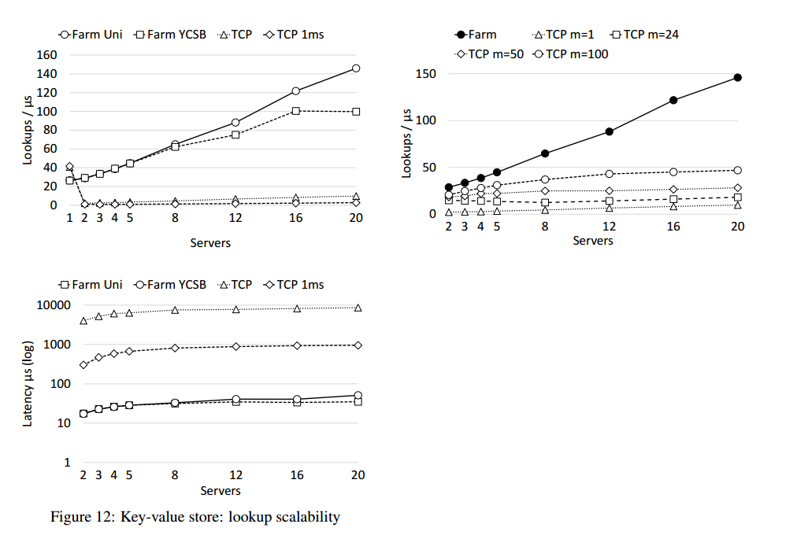

Slide 50
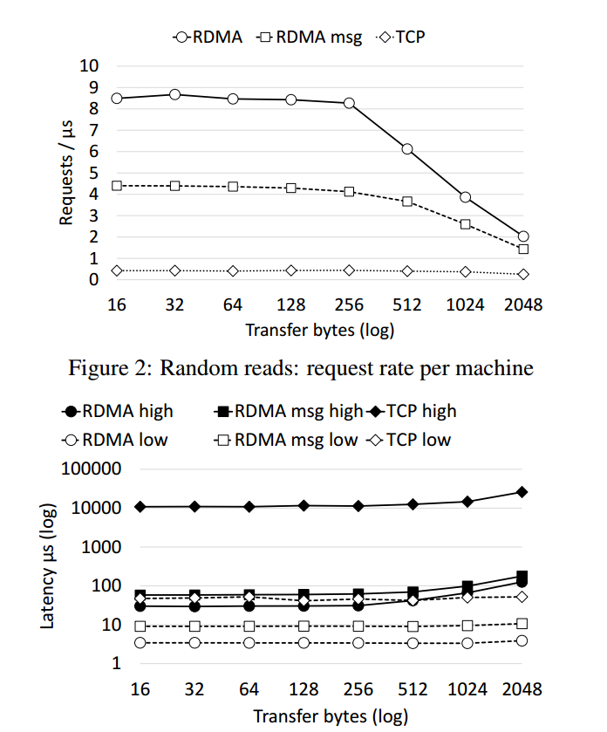

Slide 51
Food for Thought
RMDA improved upon a good idea by providing a standard interface
Is there any analogous thing in the exokernel case?
FaRM’s shared memory abstraction is convenient
What are the trade-offs with this approach?

