Slide 1
P2P: Storage

Slide 2
Overall outline
(Relatively) chronological overview of P2P areas:
  What is P2P?
  Filesharing → structured networks → storage → the cloud
Dynamo
  Design considerations
  Challenges and design techniques
  Evaluation, takeaways, and discussion
Cassandra
  Vs Dynamo
  Notable design choices
Notes:
Give background because this is the last class on P2P we’re doing
“As a review”
Sequence of areas where the P2P design pattern was applied in research, from the beginning of interest in P2P to the cloud environment where Dynamo picks up
Cassandra: mention some interesting design choices and do a bit of comparison to Dynamo

Slide 3
Background: P2P
Formal definition?
Symmetric division of responsibility and functionality
Client-server: Nodes both request and provide service
Each node enjoys conglomerate service provided by peers
Can offer better load distribution, fault-tolerance, scalability...
On a fast rise in the early 2000’s
Notes:
I tried looking around but couldn’t find a formal definition. This is the definition that I have, if Hakim wants to interject here…
In relation to the server/client setup …
What this means for the individual node as a client is that…
Why is P2P worth mentioning? Because a correct use of P2P’s symmetry property can…
Now I will discuss how interest in P2P evolved since it sparked in the early 2000s

Slide 4
Background:P2P filesharing & unstructured networks
Napster (1999)
Gnutella (2000)
FreeNet (2000)
Key challenges:
  Decentralize content search and routing
Notes:
The main application of P2P in the early 2000’s was in filesharing systems, including …
The key challenges is using symmetric P2P design to decentralize the content search and search/route on any topology

Slide 5
Background: P2P structured networks
CAN (2001)
Chord (2001)
Pastry (2001)
Tapestry (2001)
More systematic+formal
Key challenges:
  Routing latency
  Churn-resistance
  Scalability
Notes:
Then came structured P2P networks with routing geometries is defined with various complex tradeoffs
Original 4 systems
We have reviewed some of these systems, so we know that the main challenges in this area was

Slide 6
Background: P2P Storage
CAN (2001)
Chord (2001) → DHash++ (2004)
Pastry (2001) → PAST (2001)
Tapestry (2001) → Pond (2003)
Chord/Pastry → Bamboo (2004)
Key challenges:
  Distrusting peers
  High churn rate
  Low bandwidth connections
Notes:
Storage systems were built on these routing geometries
The main challenges facing these … distrusting peers and with high expected churn rate

Slide 7
Background: P2P on the Cloud
In contrast:
  Single administrative domain
  Low churn (only due to permanent failure)
  High bandwidth connections
Notes:
This new environment created new space for research …. Which is where Dynamo picks up

Slide 8

Dynamo:Amazon’s Highly Available Key-value Store
SOSP 2007: Giuseppe DeCandia, Deniz Hastorun, Madan Jampani, Gunavardhan Kakulapati, Avinash Lakshman, Alex Pilchin, Swaminathan Sivasubramanian, Peter Vosshall and Werner Vogels
Best seller lists, shopping carts, etc.
Also proprietary service@AWS
Werner Vogels: Cornell → Amazon
Notes:
Also offered as a proprietary service

Slide 9
Interface
Put (key, context, object) → Success/Fail
Success of (set of values, context)/Fail ← Get (key)

Slide 10
Dynamo’s design considerations
Strict performance requirements, tailored closely to the cloud environment
Very high write availability
  CAP
  No isolation, single-key updates
99.9th percentile SLA system
Regional power outages are tolerable → Symmetry of function
Incremental scalability
  Explicit node joins
  Low churn rate assumed
Notes:
Why worth mentioning?
Uncommon at the time
Reflect the cloud environment discussed
Later design choices greatly depend on assumptions made here
No writes should fail or delay from consistency management
no transactions
SLA = Service Level Agreement, Setting an upper bound on latency
Incremental scalability means minimal tolerance to one node manually added at a time

Slide 11
List of challenges:
Incremental scalability and load balance
Flexible durability
High write availability
Handling temporary failure
Handling permanent failure
Membership protocol and failure detection
Notes:
Generally follows the paper’s table 1 … added non-trivial decisions like flexible durability as well

Slide 12
List of challenges:
Incremental scalability and load balance
  Adding one node at a time
  Uniform node-key distribution
  Node heterogeneity
Flexible durability
High write availability
Handling temporary failure
Handling permanent failure
Membership protocol and failure detection
Notes:
Minimizing disruption when adding one node at a time
Maintaining a uniform node-key distribution
Addressing node heterogeneity

Slide 13
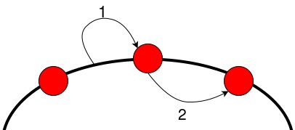
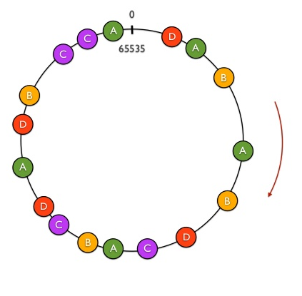
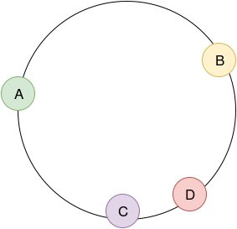
Incremental scalability and load balance
Consistent Hashing
Virtual nodes (as seen in Chord):
Node gets several, smaller key ranges instead of one big one

Slide 14
Incremental scalability and load balance
Consistent Hashing
Virtual nodes (as seen in Chord):
Node gets several, smaller key ranges instead of one big one
Benefits:
  More uniform key-node distribution
  Node join and leaves requires only neighbor nodes
  Variable number of virtual nodes per physical node

Slide 15
List of challenges:
Incremental scalability and load balance
Flexible durability
  Latency vs durability
High write availability
Handling temporary failure
Handling permanent failure
Membership protocol and failure detection

Slide 16
Flexible Durability
Key preference list
N - # of healthy nodes coordinator references
W - min # of responses for put
R - min # of responses for get
R, W, N tradeoffs
  W↑ ⇒ Consistency↑, latency↑
  R↑ ⇒ Consistency↑, latency↑
  N↑ ⇒ Durability↑, load on coord↑
  R + W > N : Read-your-writes
Notes:
R+W > N : if assuming no inaccessibility, guaranteed read-your-writes

Slide 17
Flexible Durability
Key preference list
N - # of healthy nodes coordinator references
W - min # of responses for put
R - min # of responses for get
R, W, N tradeoffs
Benefits:
  Tunable consistency, latency, and fault-tolerance
  Fastest possible latency out of the N healthy replicas every time
  Allows hinted handoff
Notes:
R+W > N : if assuming no inaccessibility, guaranteed read-your-writes

Slide 18
List of challenges:
Incremental scalability and load balance
Flexible durability
High write availability
  Writes cannot fail or delay because of consistency management
Handling temporary failure
Handling permanent failure
Membership protocol and failure detection
Notes:
The key idea is that Dynamo aggressively accepts all writes that it receives

Slide 19
Achieving High Write Availability
Weak consistency
  Small W → outdated objects lying around
  Small R → outdated objects reads
Update by itself is meaningful and should preserve
Accept all updates, even on outdated copies
Updates on outdated copies ⇒ DAG object was-before relation
Given two copies, should be able to tell:
  Was-before relation → Subsume
  Independent → preserve both
But single version number forces total ordering (Lamport clock)

Slide 20
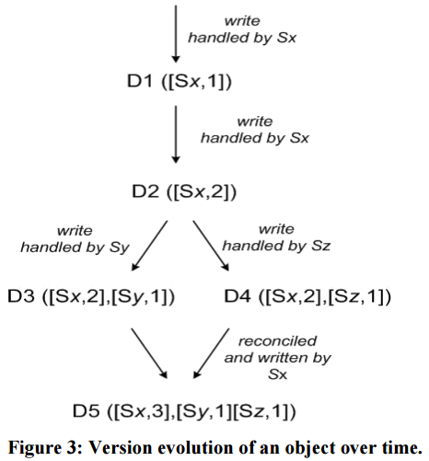
Hiding Concurrency
(1)
(2)
(3)
(3)
Write handled by Sz
(4)

Slide 21
Achieving High Write Availability
Weak consistency
  Small W → outdated objects lying around
  Small R → outdated objects reads
Update by itself is meaningful and should preserve
Accept all updates, even on outdated copies
Updates on outdated copies ⇒ DAG object was-before relation
Given two copies, should be able to tell:
  Was-before relation → Subsume
  Independent → preserve both
But single version number forces total ordering (Lamport clock)
Vector clock: version number per key per machine, preserves concurrence

Slide 22
Showing Concurrency
Write handled by Sz
[Sz,2] )

Slide 23
Achieving High Write Availability
No write fail or delay because of consistency management
Immutable objects + vector clock as version
Automatic subsumption reconciliation
Client resolves unknown relation through context

Slide 24
Achieving High Write Availability
No write fail or delay because of consistency management
Immutable objects + vector clock as version
Automatic subsumption reconciliation
Client resolves unknown relation through context
Read (k) = {D3, D4}, Opaque_context(D3(vector), D4(vector))
/* Client reconciles D3 and D4 into D5 */
Write (k, Opaque_context(D3(vector), D4(vector), D5)
Dynamo creates a vector clock that subsumes clocks in context

Slide 25
Achieving High Write Availability
No write fail or delay because of consistency management
Immutable objects + vector clock as version
Automatic subsumption reconciliation
Client resolves unknown relation through context
Benefits:
  Aggressively accept all updates
Problem:
  Client-side reconciliation
  Reconciliation not always possible
  Must read after each write to chain a sequence of updates

Slide 26
List of challenges:
Incremental scalability and load balance
Flexible durability
High write availability
Handling temporary failure
  Writes cannot fail or delay because of temporary inaccessibility
Handling permanent failure
Membership protocol and failure detection

Slide 27
Handling Temporary Failures
No write fail or delay because of temporary inaccessibility
Assume node will be accessible again soon
coordinator walks off the N-preference list
References node N+a on list to reach W responses
N+a keeps passes object back to the hinted node at first opportunity
Benefits:
  Aggressively accept all updates

Slide 28
List of challenges:
Incremental scalability and load balance
Flexible durability
High write availability
Handling temporary failure
Handling permanent failure
  Maintain eventual consistency with permanent failure
Membership protocol and failure detection

Slide 29
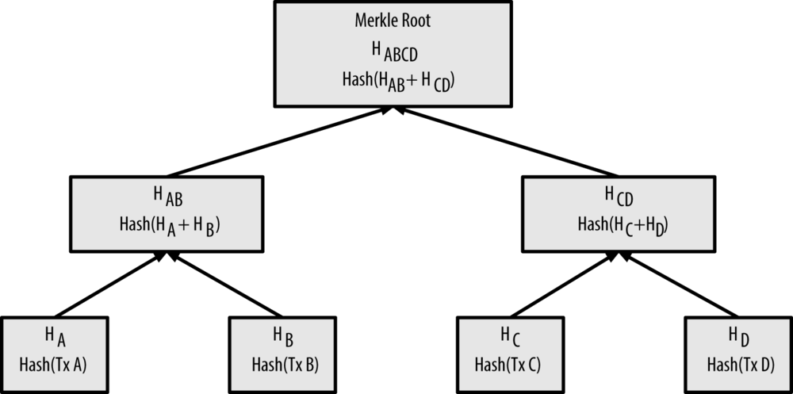
Permanent failures in Dynamo
Use anti-entropy between replicas
Merkle Trees
Speeds up subsumption

Slide 30
List of challenges:
Incremental scalability and load balance
Flexible durability
High write availability
Handling temporary failure
Handling permanent failure
Membership protocol and failure detection

Slide 31
Membership and failure detection in Dynamo
Anti-entropy to reconcile membership (eventually consistent view)
Constant time lookup
Explicit node join and removal
Seed nodes to avoid logical network partitions
Temporary inaccessibility detected through timeouts and handled locally

Slide 32
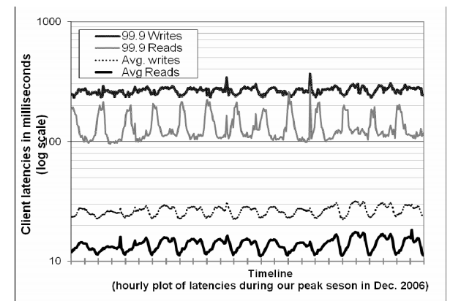
Evaluation
1 low variance in read and write latencies
2 Writes directly to memory, cache reads
3 Shows skewed distribution of latency
1
2
3

Slide 33
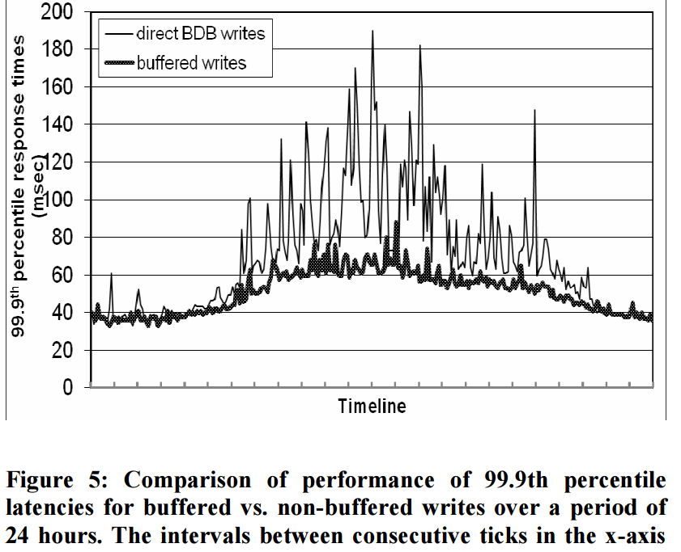
Evaluation
- Lowers write latency
- smoothes 99.9th percentile extremes
- At a durability cost

Slide 34
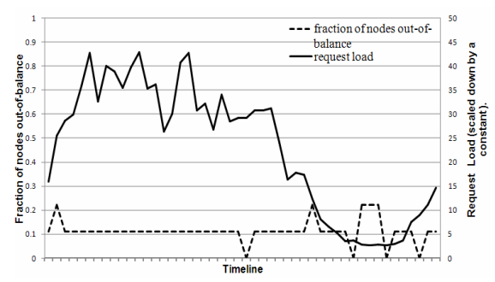
Evaluation
- lower loads:
Fewer popular keys
- In higher loads:
Many popular keys roughly equally among the nodes, most node don’t deviate more than 15%
Imbalance = 15% away from average node load

Slide 35
Takeaways
User gets knobs to balance durability, latency, and consistency
P2P techniques can be used in the cloud environment to produce highly-available services
Instead resolving consistency for all clients at a universally higher latency, let each client resolve their own consistency individually
∃ Industry services that require the update to always preserve

Slide 36

Cassandra - A Decentralized Structured Storage System
Avinash Lakshman, Prashant Malik
Avinash from Dynamo team
Used in multiple internals in FB, including inbox search

Slide 37
Interface / Data Model
Borrows from BigTable
Rows are keys
Columns are common key attributes
Column families and super columns

Slide 38
In Relation to Dynamo
Implement very similar systems
“A write operation in Dynamo also requires a read to be performed for managing the vector timestamps … limiting [when] handling a very high write throughput.”
Instead of virtual nodes, moves tokens
  “Makes the design and implementation very tractable … deterministic choices about load balancing”
Consistency option between quorum or single-machine and anti-entropy
Automate bootstraping through ZooKeeper

Slide 39
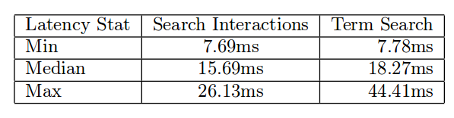
Results

Slide 40
Thank you for listening!

