Slide 1
P2P: Distributed Hash Tables
Chord + Routing Geometries
Nirvan Tyagi
CS 6410 Fall16

Slide 2

Peer-to-peer (P2P)

Slide 3
Peer-to-peer (P2P)
Decentralized!
Hard to coordinate with peers joining and leaving

Slide 4



Peer-to-peer (P2P)
Napster (1999)

Slide 5
Peer-to-peer (P2P)
Napster (1999)

Slide 6
Peer-to-peer (P2P)
Napster (1999)
Problem - Centralized index server

Slide 7



Peer-to-peer (P2P)
Napster (1999)
Problem - Centralized index server
Solution - Distributed hash table

Slide 8
Distributed Hash Tables (DHT)
Hash table
k₀
v₀
k₁
v₁
k₂
v₂
k₃
v₃
k₄
v₄
k₅
v₅

Slide 9
Distributed Hash Tables (DHT)
Hash table
k₀
v₀
k₁
v₁
k₀
v₀
k₂
v₂
k₁
v₁
k₃
v₃
k₄
v₄
k₄
v₄
k₅
v₅
k₅
v₅
k₂
v₂
k₃
v₃

Slide 10
Distributed Hash Tables (DHT)
Desirable Properties
Decentralization
Load-balancing
Scalability
Availability
k₀
v₀
k₁
v₁
k₄
v₄
k₅
v₅
k₂
v₂
k₃
v₃

Slide 11
Outline
Chord
Specific DHT protocol for P2P systems
Simple, efficient
DHT Routing Geometry
Effect of different DHT protocols on desirable system properties

Slide 12
Chord
A scalable P2P lookup service for internet applications
Ion Stoica, Robert Morris, David Karger
Frans Kaashoek, Hari Balakrishnan

Slide 13
Chord - Overview
How to assign keys to peers?
Hash table
k₀
v₀
k₁
v₁
k₀
v₀
k₂
v₂
k₁
v₁
k₃
v₃
k₄
v₄
k₄
v₄
k₅
v₅
k₅
v₅
k₂
v₂
k₃
v₃

Slide 14
Chord - Overview
Hash table
k₀
v₀
k₁
v₁
k₂
v₂
k₃
v₃
k₄
v₄
k₅
v₅

Slide 15
Chord - Overview
k₅
k₄
Hash table
k₀
v₀
k₁
v₁
k₀
k₂
v₂
k₃
v₃
k₁
k₄
v₄
k₃
k₅
v₅
k₂

Slide 16
Chord - Overview
k₅
k₀
v₀
k₄
k₁
v₁
Hash table
k₄
v₄
k₅
v₅
k₀
v₀
k₁
v₁
k₀
k₂
v₂
k₃
v₃
k₁
k₄
v₄
k₃
k₅
v₅
k₂
v₂
k₃
v₃
k₂

Slide 17
Chord - Overview
2^{m}-1
0
1
Identifier ring
over hash space 2^{m}
2^{m-1}

Slide 18
Chord - Overview
2^{m}-1
0
1
= node
Identifier ring
over hash space 2^{m}
= key
node id = hash( node )
key id = hash( key )
2^{m-1}

Slide 19
Chord - Overview
2^{m}-1
0
1
= node
Identifier ring
over hash space 2^{m}
= key
node id = hash( node )
key id = hash( key )
successor(id)
finger table for node at id i
finger
node id
1
succ(i)
2
succ(i + 2)
2^{m-1}
j
succ(i + 2 ^{j - 1} )

Slide 20
Chord - Overview
0
= node
Identifier ring
= key
12
4
8

Slide 21
Chord - Overview
0
= node
Identifier ring
= key
12
4
8

Slide 22
Chord - Overview
0
= node
Identifier ring
= key
12
4
finger
node id
1
succ(i)
2
succ(i + 2)
3
succ(i + 2²)
4
succ(i + 2³)
8

Slide 23
Chord - Overview
0
= node
Identifier ring
= key
12
4
finger
node id
1
succ(4)
2
succ(4 + 2)
3
succ(4 + 2²)
4
succ(4 + 2³)
8

Slide 24
Chord - Overview
0
= node
Identifier ring
= key
12
4
finger
node id
1
5
2
8
3
8
4
1
8

Slide 25
Chord - Lookup
find_successor(id):
p = find_predecessor(id)
return p.successor
find_predecessor(id):
n = self
while id not between (n, n.successor]:
n = n.closest_preceding_finger(id)
return n
0
Identifier ring
finger
node id
1
5
2
8
12
4
3
8
4
1
finger
node id
1
11
8
2
11
3
1
4
1

Slide 26
Chord - Lookup
find_successor(id):
p = find_predecessor(id)
return p.successor
find_predecessor(id):
n = self
while id not between (n, n.successor]:
n = n.closest_preceding_finger(id)
return n
0
Identifier ring
finger
node id
1
5
2
8
12
4
3
8
4
1
lookup(10)
finger
node id
1
11
8
2
11
3
1
4
1

Slide 27
Chord - Lookup
find_successor(id):
p = find_predecessor(id)
return p.successor
find_predecessor(id):
n = self
while id not between (n, n.successor]:
n = n.closest_preceding_finger(id)
return n
0
Identifier ring
finger
node id
1
5
2
8
12
4
3
8
4
1
lookup(10)
follow finger 3 to node id 8
finger
node id
1
11
8
2
11
3
1
4
1

Slide 28
Chord - Lookup
find_successor(id):
p = find_predecessor(id)
return p.successor
find_predecessor(id):
n = self
while id not between (n, n.successor]:
n = n.closest_preceding_finger(id)
return n
0
Identifier ring
finger
node id
1
5
2
8
12
4
3
8
4
1
lookup(10)
follow finger 3 to node id 8
node id 8 identifies as predecessor of id 10
finger
node id
1
11
8
2
11
3
1
4
1

Slide 29
Chord - Lookup
find_successor(id):
p = find_predecessor(id)
return p.successor
find_predecessor(id):
n = self
while id not between (n, n.successor]:
n = n.closest_preceding_finger(id)
return n
0
Identifier ring
finger
node id
1
5
2
8
12
4
3
8
4
1
lookup(10)
follow finger 3 to node id 8
node id 8 identifies as predecessor of id 10
complete lookup at successor of node id 8
finger
node id
1
11
8
2
11
3
1
4
1

Slide 30
Chord - Lookup
find_successor(id):
p = find_predecessor(id)
return p.successor
find_predecessor(id):
n = self
while id not between (n, n.successor]:
n = n.closest_preceding_finger(id)
return n
0
Identifier ring
finger
node id
Hops?
Each finger lookup halves distance to key
O(log N)
1
5
2
8
12
4
3
8
4
1
lookup(10)
follow finger 3 to node id 8
node id 8 identifies as predecessor of id 10
complete lookup at successor of node id 8
finger
node id
1
11
8
2
11
3
1
4
1

Slide 31
Chord - Joins + Stabilization
join():
self.predecessor = null
self.successor = find_successor(self)
stabilize():
p = self.successor.predecessor
if p between (self, self.successor):
self.successor = p
self.successor.notify(self)
notify(n):
if self.predecessor == null ||
n between (self.predecessor, self):
self.predecessor = n
0
Identifier ring
12
4
8

Slide 32
Chord - Joins + Stabilization
join():
self.predecessor = null
self.successor = find_successor(self)
stabilize():
p = self.successor.predecessor
if p between (self, self.successor):
self.successor = p
self.successor.notify(self)
notify(n):
if self.predecessor == null ||
n between (self.predecessor, self):
self.predecessor = n
0
Identifier ring
12
4
predecessor = 4
successor = 8
predecessor = 5
successor = 11
8

Slide 33
Chord - Joins + Stabilization
join():
self.predecessor = null
self.successor = find_successor(self)
stabilize():
p = self.successor.predecessor
if p between (self, self.successor):
self.successor = p
self.successor.notify(self)
notify(n):
if self.predecessor == null ||
n between (self.predecessor, self):
self.predecessor = n
0
Identifier ring
12
4
predecessor = 4
successor = 8
join(), self = 6
predecessor = 5
successor = 11
predecessor = null
successor = 8
8

Slide 34
Chord - Joins + Stabilization
join():
self.predecessor = null
self.successor = find_successor(self)
stabilize():
p = self.successor.predecessor
if p between (self, self.successor):
self.successor = p
self.successor.notify(self)
notify(n):
if self.predecessor == null ||
n between (self.predecessor, self):
self.predecessor = n
0
Identifier ring
12
4
predecessor = 4
successor = 8
stabilize()
predecessor = 5 6
successor = 11
predecessor = null
successor = 8
8

Slide 35
Chord - Joins + Stabilization
join():
self.predecessor = null
self.successor = find_successor(self)
stabilize():
p = self.successor.predecessor
if p between (self, self.successor):
self.successor = p
self.successor.notify(self)
notify(n):
if self.predecessor == null ||
n between (self.predecessor, self):
self.predecessor = n
0
Identifier ring
12
4
predecessor = 4
successor = 8 6
stabilize()
predecessor = 5 6
successor = 11
predecessor = null 5
successor = 8
8

Slide 36
Chord - Joins + Stabilization
join():
self.predecessor = null
self.successor = find_successor(self)
stabilize():
p = self.successor.predecessor
if p between (self, self.successor):
self.successor = p
self.successor.notify(self)
notify(n):
if self.predecessor == null ||
n between (self.predecessor, self):
self.predecessor = n
0
Identifier ring
12
4
predecessor = 4
successor = 6
Outcomes of incomplete stabilization:
Lookup unaffected
Fingers out-dated, successors correct -> lookup slow but correct
Successors in lookup region still stabilizing -> lookup fails
predecessor = 5
successor = 8
predecessor = 6
successor = 11
8

Slide 37
Chord - Failure + Replication
0
Identifier ring
Maintain list of k successors
Keys replicated on all k successors
12
4
predecessor = [4, 1]
successor = [6, 8]
predecessor = [5, 4]
successor = [8, 11]
predecessor = [6, 5]
successor = [11, 1]
8

Slide 38
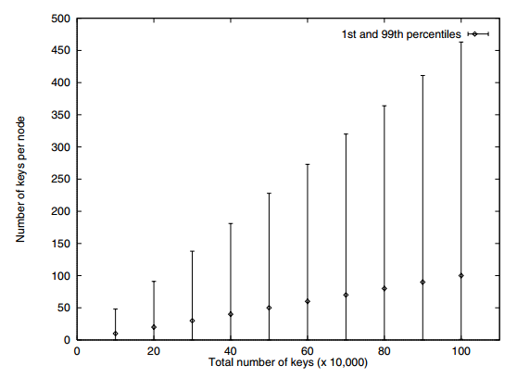
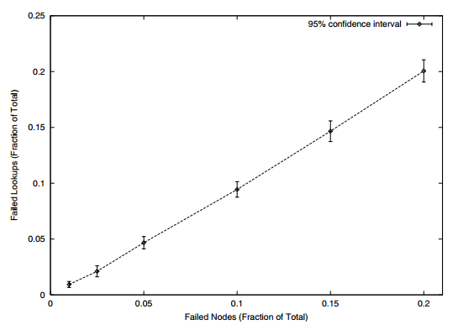
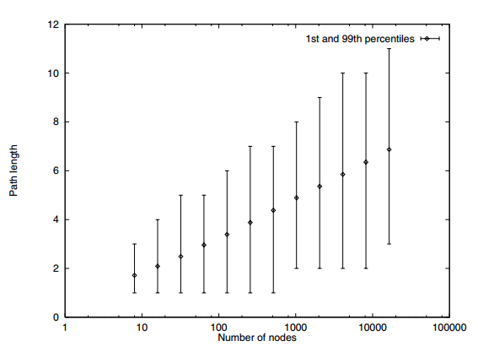
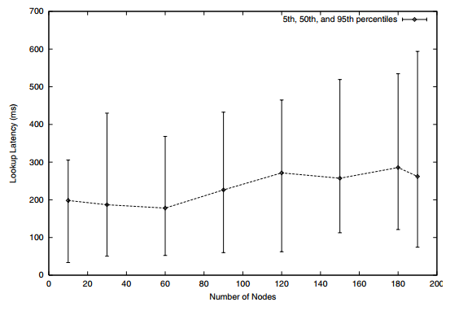
Load balance
Failure resilience
Lookup path length
Lookup latency

Slide 39
Load balance
Failure resilience
Lookup path length
Lookup latency

Slide 40
Load balance
Failure resilience
Lookup path length
Lookup latency

Slide 41
Load balance
Failure resilience
Thoughts on Chord performance?
Lookup path length
Lookup latency

Slide 42
Load balance
Failure resilience
Lookup path length
Lookup latency

Slide 43
Improvements to Chord routing and failure resilience in future works Pastry + Bamboo
Load balance
Failure resilience
Lookup path length
Lookup latency

Slide 44
The Impact of DHT Routing Geometry on Resilience and Proximity
K. Gummadi, R. Gummadi, S. Gribble
S. Ratnasamy, S. Shenker, I. Stoica

Slide 45
DHT Routing Geometries
Ring (Chord)
Tree (Tapestry, PRR)
Hypercube (CAN)
Butterfly (Viceroy)
XOR (Kademlia)
Hybrid (Pastry, Bamboo)

Slide 46
Proximity + Resilience
Proximity - Pick routes through “physically nearby” peers, reducing latency
Resilience - Continue to route requests despite network churn and failure

Slide 47
Proximity + Resilience
Flexibility
Proximity - Pick routes through “physically nearby” peers, reducing latency
Resilience - Continue to route requests despite network churn and failure
Neighbor selection - options in selecting which peers to keep in routing table
Route selection - options in selecting where to route to given a destination

Slide 48
Proximity + Resilience
Flexibility
Proximity - Pick routes through “physically nearby” peers, reducing latency
Resilience - Continue to route requests despite network churn and failure
Neighbor selection - options in selecting which peers to keep in routing table
Route selection - options in selecting where to route to given a destination
Flexibility in neighbor selection -> good proximity
Flexibility in route selection -> good resilience

Slide 49
DHT Routing Geometries
Ring (Chord)
Tree (Tapestry, PRR)
Hypercube (CAN)
Butterfly (Viceroy)
XOR (Kademlia)
Hybrid (Pastry, Bamboo)

Slide 50
DHT Routing Geometries - Tree
XXX
0XX
00X
000
001
010
011
100
101
110
111

Slide 51
DHT Routing Geometries - Tree
Neighbor selection - one neighbor for each prefix in opposite subtree
XXX
0XX
00X
000
001
010
011
100
101
110
111

Slide 52
DHT Routing Geometries - Tree
Neighbor selection - one neighbor for each prefix in opposite subtree
XXX
0XX
00X
000
001
010
011
100
101
110
111

Slide 53
DHT Routing Geometries - Tree
Neighbor selection - one neighbor for each prefix in opposite subtree
XXX
Route selection - route to neighbor in subtree of destination
0XX
00X
000
001
010
011
100
101
110
111

Slide 54
DHT Routing Geometries - Tree
Neighbor selection - one neighbor for each prefix in opposite subtree
XXX
Route selection - route to neighbor in subtree of destination
0XX
00X
000
001
010
011
100
101
110
111

Slide 55
DHT Routing Geometries - Tree
Neighbor selection - one neighbor for each prefix in opposite subtree
XXX
Route selection - route to neighbor in subtree of destination
0XX
00X
Good flexibility in neighbor selection
Poor flexibility in route selection
000
001
010
011
100
101
110
111

Slide 56
DHT Routing Geometries - Hypercube
110
111
100
101
011
010
000
001

Slide 57
DHT Routing Geometries - Hypercube
Neighbor selection - neighbor differs in the bit of one dimension
110
111
100
101
011
010
000
001

Slide 58
DHT Routing Geometries - Hypercube
Neighbor selection - neighbor differs in the bit of one dimension
110
111
100
101
011
010
000
001

Slide 59
DHT Routing Geometries - Hypercube
Neighbor selection - neighbor differs in the bit of one dimension
110
111
Route selection - route to destination by correcting any differing bit
100
101
011
010
000
001

Slide 60
DHT Routing Geometries - Hypercube
Neighbor selection - neighbor differs in the bit of one dimension
110
111
Route selection - route to destination by correcting any differing bit
100
101
011
010
000
001

Slide 61
DHT Routing Geometries - Hypercube
Neighbor selection - neighbor differs in the bit of one dimension
110
111
Route selection - route to destination by correcting any differing bit
100
101
Poor flexibility in neighbor selection
Good flexibility in route selection
011
010
000
001

Slide 62
DHT Routing Geometries - Ring
000
111
001
110
010
101
011
100

Slide 63
DHT Routing Geometries - Ring
000
Neighbor selection - one neighbor in each finger interval
111
001
110
010
101
011
100

Slide 64
DHT Routing Geometries - Ring
000
Neighbor selection - one neighbor in each finger interval
111
001
110
010
101
011
100

Slide 65
DHT Routing Geometries - Ring
000
Neighbor selection - one neighbor in each finger interval
111
001
Route selection - route to destination by making progress along ring
110
010
101
011
100

Slide 66
DHT Routing Geometries - Ring
000
Neighbor selection - one neighbor in each finger interval
111
001
Route selection - route to destination by making progress along ring
110
010
101
011
100

Slide 67
DHT Routing Geometries - Ring
000
Neighbor selection - one neighbor in each finger interval
111
001
Route selection - route to destination by making progress along ring
110
010
Good flexibility in neighbor selection
Good flexibility in route selection
101
011
100

Slide 68

DHT Routing Geometries - Summary
Tree
Hypercube
Ring
Neighbor selection
(Proximity)
Route selection
(Resilience)

