Slide 1
Gossip Protocols
CS 6410
Eugene Bagdasaryan
Notes:
Even though this paper started a new area that is called gossip protocols, authors use all the words: “epidemic”, “rumor”: except gossip

Slide 2

Gossip Protocols
CS 6410
Eugene Bagdasaryan
Notes:
Even though this paper started a new area that is called gossip protocols, authors use all the words: “epidemic”, “rumor”: except gossip

Slide 3
What was covered before?
Paxos
Byzantine Generals
Impossibility consensus
What are these ideas aimed for?
What is the difference with the current paper?

Slide 4
What was covered before?
Paxos
Byzantine Generals
Impossibility consensus
What are these ideas aimed for?
Data consistency, fault-tolerance
What is the difference with the current paper?
“Eventual” consistency, scalability, fault-tolerance

Slide 5
CAP theorem
CAP = Consistency, Availability, Partition tolerance
Previous papers focused on Consistency and Partition Tolerance
  Paxos sometimes is unavailable for writes, but would remain consistent
This paper wants to provide Availability, Partition Tolerance, and “relaxed” form of consistency
Notes:
Paxos provides CP because the system is always consistent, even in a partition, but a reachable replica may deny service without agreement of the others. (Actually Paxos provides availability even in a partition if the server the request hits is part of a majority quorum. The requests that hit a minority island are the ones that get rejected.)

Slide 6
EPIDEMIC ALGORITHM FOR REPLICATED DATABASE MAINTENANCE
Xerox Palo Alto Research Center 1987

Slide 7






Authors
Alan Demers
Cornell Univ.
Dan Greene
Palo Alto
Research Center
Carl Hauser
Washington State
Univ.
Wesley Irish
Coyote Hill Consulting LLC
John Larson
Howard Sturgis
Dan Swinehart
Scott Shenker
EECS Berkley
Doug Terry
Samsung Research
America
Notes:
Demers – professor here. Teaches Databases. Worked on Clearinghouse and Bayou (system for mobile computing)
Shenker - postdoc at Cornell University -> Xerox PARC -> International Computer Science Institute at Berkeley; highest cited 106k top 5 among CS. Promotes SDN, author of OpenFlow, paper on Spark, DHT (Distributed Hash Table) and Content Addressable Network
Doug Terry - Principal Researcher at Microsoft Research Silicon Valley (12 years) -> ‎Distinguished Research Engineer and Vice President ‎Samsung Research America, author of Bayou
Wesley – PARC-> Director of Networking Systems at Stanford -> VP of Operations at Topix -> VP at iControl Networks -> Traffic Watch Pilot -> Certified Flight Instructor. Technology Consultant
Carl Hauser - Advanced Programming Languages at WSU
Dan Greene – still at PARC
**Herbert Simon holds the highest index with 289k citations – worked at CMU, has Nobel Prize

Slide 8
Real applications
Uber uses SWIM for real-time platform
Apache Cassandra internode communication
Docker’s multi-host networking
Cloud providers multi node networking (Heroku)
Serf by Hashicorp
Notes:
https://www.consul.io/docs/internals/architecture.html
Scalable Weakly-consistent, Infection-style Process Group Membership Protocol.
https://www.infoq.com/news/2015/03/uber-realtime-market-platform

Slide 9
Context
Xerox wanted to run replicated database on hundred or thousand sites
Each update is injected at a single site and must be propagated to all other sites
A packet from a machine in Japan to one in Europe may traverse as many as 14 gateways and 7 phone lines
Notes:
When theory meets practice
Xerox Grapevine and clearinghouse

Slide 10
Problem
High network traffic to send update over the large set of nodes
Time to propagate update to all nodes is significant
Notes:
In early 1986, many of the network observed performance problems could be traced to traffic created in trying to achieve consistency on these highly replicated domains.
For a domain stored at 300 sites, 90,000 mail messages might he introduced each night.

Slide 11
Problem
High network traffic to send update over the large set of nodes
Time to propagate update to all nodes is significant
” For a domain stored at 300 sites, 90,000 mail messages might he introduced each night”.
Notes:
In early 1986, many of the network observed performance problems could be traced to traffic created in trying to achieve consistency on these highly replicated domains.
For a domain stored at 300 sites, 90,000 mail messages might he introduced each night.

Slide 12
Basic idea
Max Planck Institute für Dynamics and Self-organization
Notes:
Flight map. Eventually every system need to be aware about situation, but what is most import to have availability for this system. Flight control should know first local data
Virus spreading actually has the same map. In Russia people compared the spread of virus 40 years ago when not many people travelled everyday to know, the flu virus spread in 2 weeks instead of 3 month.

Slide 13
Objective
Design algorithms that scale gracefully
Every replica receives every update eventually

Slide 14
Objective
Design algorithms that scale gracefully
Every replica receives every update eventually
“Replace complex deterministic algorithms for replicated database consistency with simple randomized algorithms that require few guarantees from the underlying communication system.“

Slide 15
Why epidemic? Why gossip?
Highly available
Fault-tolerant
Overhead is tunable
Fast
Scalable
Epidemic spreads eventually to everyone
Notes:
No need for single source of information
Spreads well locally

Slide 16

Types of nodes
infective – node that holds an update it is willing to share
susceptible – node that has not yet received an update
removed – node that has received an update but is no longer willing to share
$$s+i+r=1$$

Slide 17
Types of communication
Direct mail
Anti-entropy
Rumor mongering

Slide 18
DIRECT MAIL
attempts to notify all other sites of an update soon after it occurs.
Social network case – infected accounts sends private message to his whole contact list with malicious link
Notes:
Wasn’t taken from epidemic theory, but I guess currently exists an analogue

Slide 19
DIRECT MAIL
© Ki Suh Lee

Slide 20
DIRECT MAIL
May not know this node
© Ki Suh Lee

Slide 21
DIRECT MAIL
Messages may be dropped
© Ki Suh Lee

Slide 22
DIRECT MAIL
Pros:
Fast
Cons:
not reliable
heavy load on network

Slide 23

ANTI-ENTROPY
Every site regularly chooses another site at random and by exchanging database contents with it resolves any differences between the two
Real life case – meet sometimes with old friends and tell all the fun stories about you and your friends.
Notes:
whispering

Slide 24
ANTI-ENTROPY
© Ki Suh Lee

Slide 25
ANTI-ENTROPY
© Ki Suh Lee

Slide 26
ANTI-ENTROPY
© Ki Suh Lee

Slide 27
ANTI-ENTROPY
© Ki Suh Lee

Slide 28
ANTI-ENTROPY
© Ki Suh Lee

Slide 29
ANTI-ENTROPY
© Ki Suh Lee

Slide 30
ANTI-ENTROPY
© Ki Suh Lee

Slide 31
ANTI-ENTROPY
© Ki Suh Lee

Slide 32
ANTI-ENTROPY
© Ki Suh Lee

Slide 33
ANTI-ENTROPY
© Ki Suh Lee

Slide 34
Anti-entropy
Pros
  Complete sync of all info
Cons
  Very expensive to run
Optimizations:
  Checksums
  Recent Update Lists
  Inverted Index by timestamp
Notes:
checksums – recent updates

Slide 35
Push vs Pull
Push
Pull
A
B
A
B
Has Y, Z
Missing X
Has X, Z
Missing Y
Has X, Y, Z
Has X, Y, Z
+x +y +z
+x -y +z
Retransmit (x)
Packet (y)
Packet (x)

Slide 36
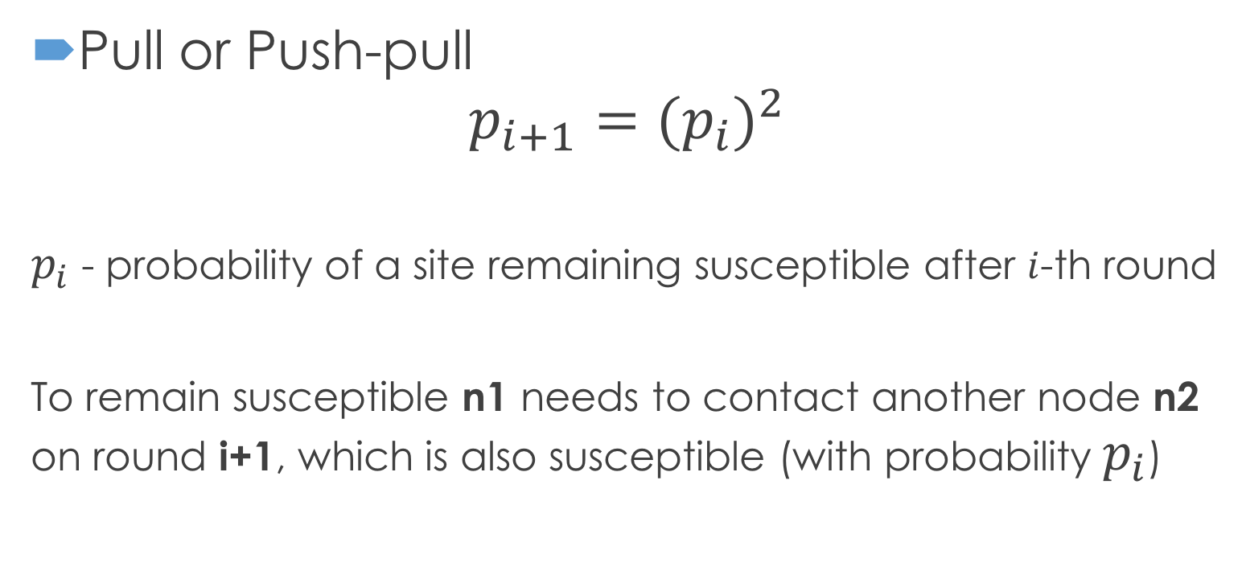
Push vs Pull
n3
n4
n1
n2
n5
Pull or Push-pull
$$p_{i+1}={(p_{i})}^{2}$$
$p_{i}$ - probability of a site remaining susceptible after $i$-th round
To remain susceptible n1 needs to contact another node n2 on round i+1, which is also susceptible (with probability $p_{i}$)

Slide 37
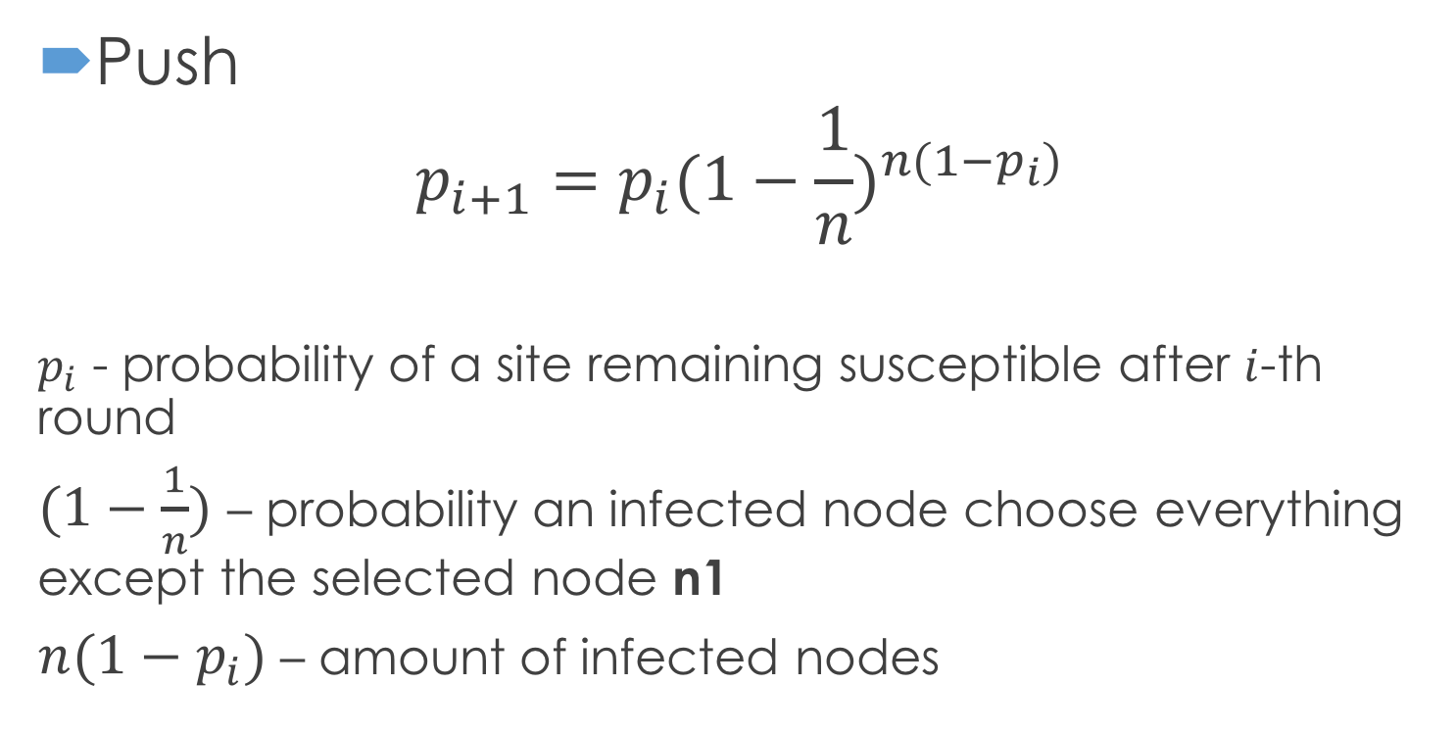
Push vs Pull
n3
n4
n1
n2
n5
Push
$$p_{i+1}=p_{i}{(1−\frac{1}{n})}^{n(1−p_{i})}$$
$p_{i}$ - probability of a site remaining susceptible after $i$-th round
$(1−\frac{1}{n})$ – probability an infected node choose everything except the selected node n1
$n(1−p_{i})$ – amount of infected nodes

Slide 38

Push vs Pull
Pull or Push-pull
$$p_{i+1}={(p_{i})}^{2}$$
Push
$$p_{i+1}=p_{i}{(1−\frac{1}{n})}^{n(1−p_{i})}≈p_{i}e^{−1}$$
Pull converges to 0 much faster.

Slide 39

Rumor mongering
Share an update, while it is hot. When everyone knows about it stop spreading.
News case – newspapers write more articles on trending topics spreading information.

Slide 40
RUMOR MONGERING
© Ki Suh Lee

Slide 41
RUMOR MONGERING
© Ki Suh Lee

Slide 42
RUMOR MONGERING
© Ki Suh Lee

Slide 43
RUMOR MONGERING
© Ki Suh Lee

Slide 44
RUMOR MONGERING
Pros
  Less traffic, than Direct mail
  Fast
Cons
  Some sites could miss the information
Can be improved by Complex Epidemics

Slide 45
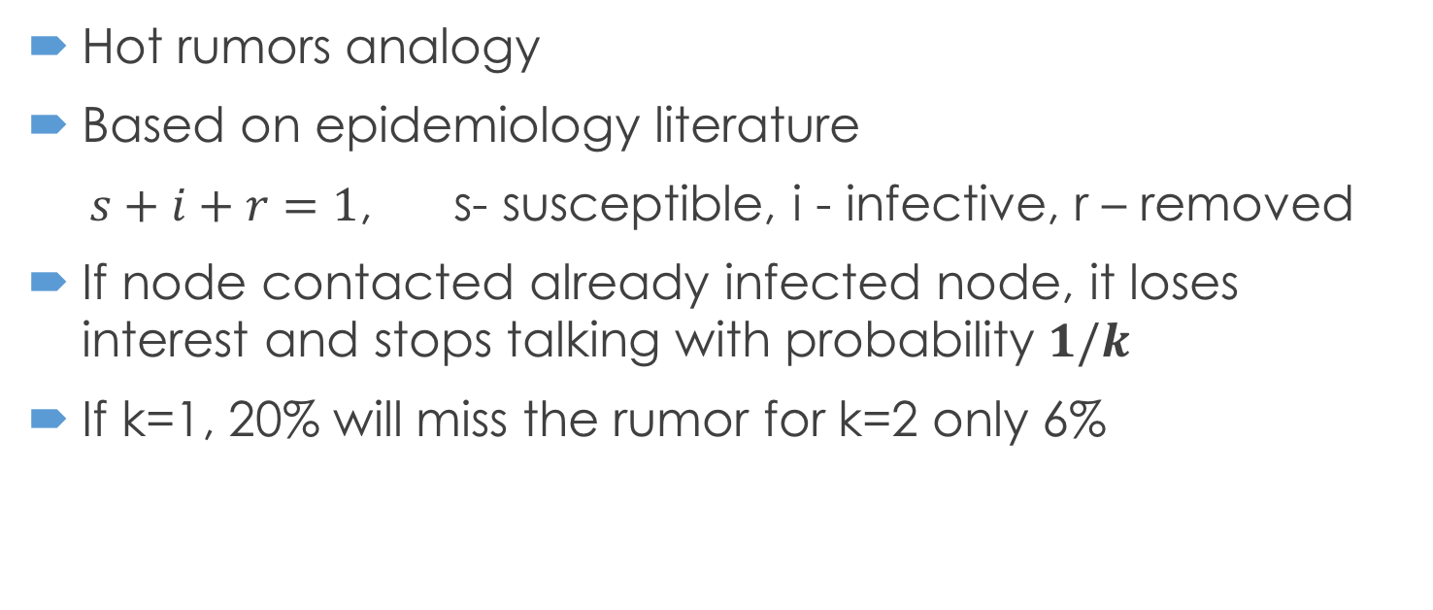

Complex epidemics
Hot rumors analogy
Based on epidemiology literature
$s+i+r=1$, s- susceptible, i - infective, r – removed
If node contacted already infected node, it loses interest and stops talking with probability $1/k$
If k=1, 20% will miss the rumor for k=2 only 6%
$$s=e^{−(k+1)(1−s)}$$

Slide 46
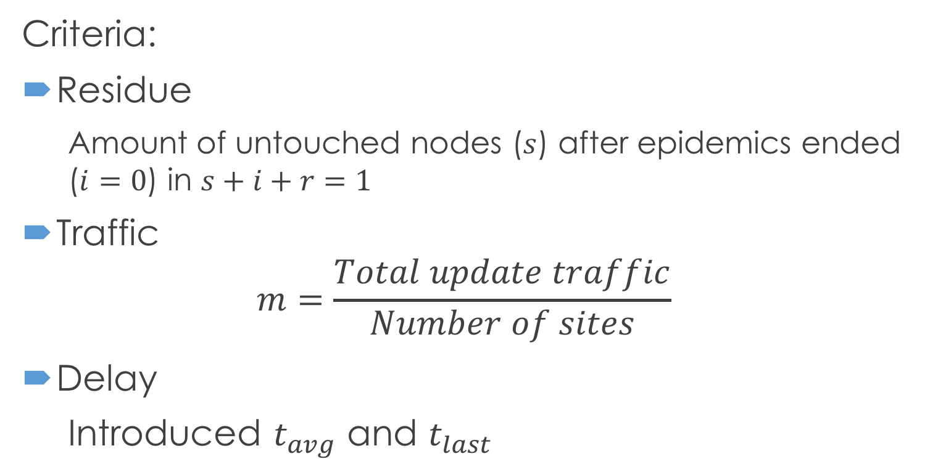
Complex epidemics
Criteria:
Residue
  Amount of untouched nodes ($s$) after epidemics ended ($i=0$) in $s+i+r=1$
Traffic
$$m=\frac{Total update traffic}{Number of sites}$$
Delay
Introduced $t_{avg}$ and $t_{last}$

Slide 47
Variations
Blind vs. Feedback
Counter vs. Coin
Push vs. Pull
Minimization
Connection Limit
Hunting

Slide 48
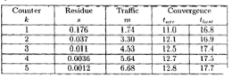
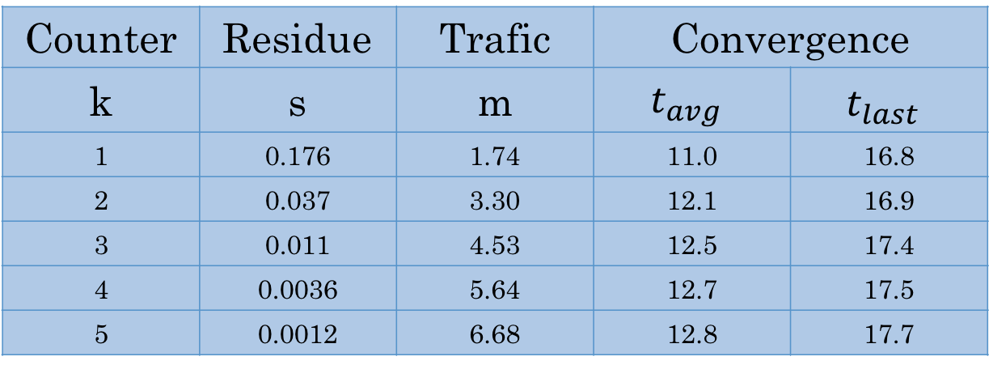
Table 1. Push, Feedback & Counters
Counter | Residue | Trafic | Convergence
k | s | m | $$t_{avg}$$ | $$t_{last}$$
1 | 0.176 | 1.74 | 11.0 | 16.8
2 | 0.037 | 3.30 | 12.1 | 16.9
3 | 0.011 | 4.53 | 12.5 | 17.4
4 | 0.0036 | 5.64 | 12.7 | 17.5
5 | 0.0012 | 6.68 | 12.8 | 17.7
Table 2. Push, Blind & Coin
1 | 0.960 | 0.04 | 19 | 38
2 | 0.205 | 1.59 | 17 | 33
3 | 0.060 | 2.82 | 15 | 32
4 | 0.021 | 3.91 | 14.1 | 32
5 | 0.008 | 4.95 | 13.8 | 32
Table 3. Pull, Feedback & Counters
1 | 0.031 | 2.7 | 9.97 | 17.63
2 | 0.00058 | 4.49 | 10.07 | 15.39
3 | 0.000004 | 6.09 | 10.08 | 14.00
© Ki Suh Lee

Slide 49
Deletion
Death Certificates
  Dormant DC
    Too long to distribute
    Can be lost
  Anti-entropy with Dormant DC
    Activate DC on sync with another node, if this node doesn’t have it
  Rumor mongering with Dormant DC
    Parallel to normal data distribution through rumor mongering

Slide 50
Spatial Distributions
Different weights on connections between nodes
Can reduce traffic on critical links
Favor nearby neighbors
Trade off between convergence time and average traffic per link

Slide 51
Perspective/Questions?
Perspective
Fast, eventually consistent protocol
Low traffic in the system
Potential problems:
Weird topology can decrease performance
Byzantine Failures

Slide 52
Astrolabe: a robust and scalable technology for distributed system monitoring, management, and data mining
Robbert van Renesse, Kenneth P. Birman, and Werner Vogels
Notes:
Another paper: Navigating in the Storm: Using Astrolabe to Adaptively Configure Web Services and Their Clients

Slide 53
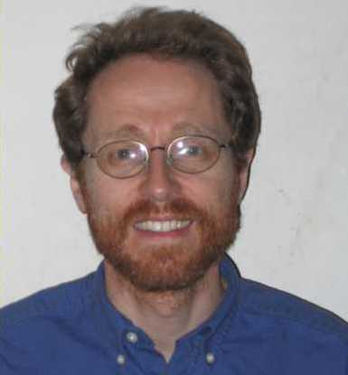
Authors
Ken Birman
Cornell Univ.
Robbert van Renesse
Cornell Univ.
Werner Vogels
Amazon.com CTO
Notes:
Ken Birman – author of Vsync, Derecho graduate from Berkeley
Robbert van Renesse - Vrije Universiteit (Amsterdam) in September 1989, under the supervision of Andy Tanenbaum
Vogels – Vrije Universiteit in Amsterdam, INESC Portugal, 10 years researcher at Cornell
was at Cornell end of 90-s and they worked together
http://www.allthingsdistributed.com/
Build evolvable systems
Expect the unexpected
Primitives not frameworks
Automation is key
APIs are forever

Slide 54
Context
Rise of Web Services and computer-to-computer systems in 2000-s
Availability and scalability of the system matters more than consistency
Applications require fast data mining

Slide 55
Objective
Build a system that
Supports scaling
Fault-tolerant
Has an eventual consistency
Guarantees security
Can be controlled through SQL syntax

Slide 56
Overview
Design principles
  Scalability through hierarchy
  Flexibility through mobile code
  Robustness through a randomized p2p protocol
  Security through certificates
Now used in Amazon.com

Slide 57
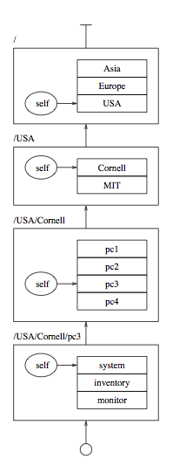
ZONE AND MIB
Zone name: path of zone identifiers from the root
Management Information Base(MIB): attribute list containing the information associated with the zone
  Each agent has a local copy of the root MIB, the MIBs of each child of the root
  Each agent maintains MIB list of child zones

Slide 58
GOSSIP PROTOCOL
Epidemic p2p protocol to propagate information
Each zone elects a set of representative agents to gossip on behalf of that zone.
  An agent may represent more than one zone
Each agent periodically gossips
  Picks one of the child zones at random,
  Picks a random agent from child’s list
  Sends attributes of all the child zones up to root level.
Gossip spreads quickly, O(log n)
For scalability, robustness, and rapid dissemination of updates, eventual consistency is adopted.

Slide 59
EVENTUAL CONSISTENCY
Probabilistic consistency
Given an aggregate attribute X that depends on some other attribute Y
  When an update u is made to Y, either u itself, or an update to Y made after u, is eventually reflected in X
  With probability 1

Slide 60
ASTROLABE IS A FLEXIBLE MONITORING OVERLAY
Name | Time | Load | Weblogic? | SMTP? | Word Version
swift | 2011 | 2.0 | 0 | 1 | 6.2
falcon | 1971 | 1.5 | 1 | 0 | 4.1
cardinal | 2004 | 4.5 | 1 | 0 | 6.0
Name | Time | Load | Weblogic? | SMTP? | Word Version
swift | 2271 | 1.8 | 0 | 1 | 6.2
falcon | 1971 | 1.5 | 1 | 0 | 4.1
cardinal | 2004 | 4.5 | 1 | 0 | 6.0
swift.cs.cornell.edu
Periodically, pull data from monitored systems
Name
Name
Time
Time
Load
Load
Weblogic?
Weblogic?
SMTP?
SMTP?
Word Version
Word Version
swift
swift
2003
2003
.67
.67
0
0
1
1
6.2
6.2
falcon
falcon
1976
1976
2.7
2.7
1
1
0
0
4.1
4.1
cardinal
cardinal
2201
2231
3.5
1.7
1
1
1
1
6.0
6.0
cardinal.cs.cornell.edu
From Ken’s slide http://www.cs.cornell.edu/courses/cs614/2006fa/Slides/Epidemics.ppt

Slide 61
STATE MERGE: CORE OF ASTROLABE EPIDEMIC
Name | Time | Load | Weblogic? | SMTP? | Word Version
swift | 2011 | 2.0 | 0 | 1 | 6.2
falcon | 1971 | 1.5 | 1 | 0 | 4.1
cardinal | 2004 | 4.5 | 1 | 0 | 6.0
swift.cs.cornell.edu
Name
Time
Load
Weblogic?
SMTP?
Word Version
swift
2003
.67
0
1
6.2
falcon
1976
2.7
1
0
4.1
cardinal
2201
3.5
1
1
6.0
cardinal.cs.cornell.edu
From Ken’s slide http://www.cs.cornell.edu/courses/cs614/2006fa/Slides/Epidemics.ppt

Slide 62
STATE MERGE: CORE OF ASTROLABE EPIDEMIC
Name | Time | Load | Weblogic? | SMTP? | Word Version
swift | 2011 | 2.0 | 0 | 1 | 6.2
falcon | 1971 | 1.5 | 1 | 0 | 4.1
cardinal | 2004 | 4.5 | 1 | 0 | 6.0
swift.cs.cornell.edu
swift | 2011 | 2.0
cardinal | 2201 | 3.5
Name
Time
Load
Weblogic?
SMTP?
Word Version
swift
2003
.67
0
1
6.2
falcon
1976
2.7
1
0
4.1
cardinal
2201
3.5
1
1
6.0
cardinal.cs.cornell.edu
From Ken’s slide http://www.cs.cornell.edu/courses/cs614/2006fa/Slides/Epidemics.ppt

Slide 63
STATE MERGE: CORE OF ASTROLABE EPIDEMIC
Name | Time | Load | Weblogic? | SMTP? | Word Version
swift | 2011 | 2.0 | 0 | 1 | 6.2
falcon | 1971 | 1.5 | 1 | 0 | 4.1
cardinal | 2201 | 3.5 | 1 | 0 | 6.0
swift.cs.cornell.edu
Name
Time
Load
Weblogic?
SMTP?
Word Version
swift
2011
2.0
0
1
6.2
falcon
1976
2.7
1
0
4.1
cardinal
2201
3.5
1
1
6.0
cardinal.cs.cornell.edu
From Ken’s slide http://www.cs.cornell.edu/courses/cs614/2006fa/Slides/Epidemics.ppt

Slide 64
SCALING UP… AND UP…
We don’t want every system to “see” all others (cost would be huge)
Instead, structure into “zones”. You only see data from your neighbors…
Name | Time | Load | Weblogic? | SMTP? | Word Version
swift | 2011 | 2.0 | 0 | 1 | 6.2
falcon | 1976 | 2.7 | 1 | 0 | 4.1
cardinal | 2201 | 3.5 | 1 | 1 | 6.0
Name | Time | Load | Weblogic? | SMTP? | Word Version
swift | 2011 | 2.0 | 0 | 1 | 6.2
falcon | 1976 | 2.7 | 1 | 0 | 4.1
cardinal | 2201 | 3.5 | 1 | 1 | 6.0
Name | Time | Load | Weblogic? | SMTP? | Word Version
swift | 2011 | 2.0 | 0 | 1 | 6.2
falcon | 1976 | 2.7 | 1 | 0 | 4.1
cardinal | 2201 | 3.5 | 1 | 1 | 6.0
Name | Time | Load | Weblogic? | SMTP? | Word Version
swift | 2011 | 2.0 | 0 | 1 | 6.2
falcon | 1976 | 2.7 | 1 | 0 | 4.1
cardinal | 2201 | 3.5 | 1 | 1 | 6.0
Name | Time | Load | Weblogic? | SMTP? | Word Version
swift | 2011 | 2.0 | 0 | 1 | 6.2
falcon | 1976 | 2.7 | 1 | 0 | 4.1
cardinal | 2201 | 3.5 | 1 | 1 | 6.0
Name | Time | Load | Weblogic? | SMTP? | Word Version
swift | 2011 | 2.0 | 0 | 1 | 6.2
falcon | 1976 | 2.7 | 1 | 0 | 4.1
cardinal | 2201 | 3.5 | 1 | 1 | 6.0
Name | Time | Load | Weblogic? | SMTP? | Word Version
swift | 2011 | 2.0 | 0 | 1 | 6.2
falcon | 1976 | 2.7 | 1 | 0 | 4.1
cardinal | 2201 | 3.5 | 1 | 1 | 6.0
cardinal.cs.cornell.edu
From Ken’s slide http://www.cs.cornell.edu/courses/cs614/2006fa/Slides/Epidemics.ppt

Slide 65
A FORM OF DATA MINING CONTINUOUSLY SUMMARIZES REMOTE INFORMATION
Dynamically changing query output is visible system-wide
SQL query “summarizes” data
Name | Avg Load | WL contact | SMTP contact
SF | 2.6 | 123.45.61.3 | 123.45.61.17
NJ | 1.8 | 127.16.77.6 | 127.16.77.11
Paris | 3.1 | 14.66.71.8 | 14.66.71.12
Name | Load | Weblogic? | SMTP? | Word Version | …
swift | 2.0 | 0 | 1 | 6.2
falcon | 1.5 | 1 | 0 | 4.1
cardinal | 4.5 | 1 | 0 | 6.0
Name | Load | Weblogic? | SMTP? | Word Version | …
gazelle | 1.7 | 0 | 0 | 4.5
zebra | 3.2 | 0 | 1 | 6.2
gnu | .5 | 1 | 0 | 6.2
San Francisco
New Jersey
From Ken’s slide http://www.cs.cornell.edu/courses/cs614/2006fa/Slides/Epidemics.ppt

Slide 66
(1) QUERY GOES OUT… (2) COMPUTE LOCALLY… (3) RESULTS FLOW TO TOP LEVEL OF THE HIERARCHY
Name | Avg Load | WL contact | SMTP contact
SF | 2.6 | 123.45.61.3 | 123.45.61.17
NJ | 1.8 | 127.16.77.6 | 127.16.77.11
Paris | 3.1 | 14.66.71.8 | 14.66.71.12
1
1
3
3
Name | Load | Weblogic? | SMTP? | Word Version | …
swift | 2.0 | 0 | 1 | 6.2
falcon | 1.5 | 1 | 0 | 4.1
cardinal | 4.5 | 1 | 0 | 6.0
Name | Load | Weblogic? | SMTP? | Word Version | …
gazelle | 1.7 | 0 | 0 | 4.5
zebra | 3.2 | 0 | 1 | 6.2
gnu | .5 | 1 | 0 | 6.2
2
2
San Francisco
New Jersey
From Ken’s slide http://www.cs.cornell.edu/courses/cs614/2006fa/Slides/Epidemics.ppt

Slide 67
HIERARCHY IS VIRTUAL… DATA IS REPLICATED
Yellow leaf node “sees” its neighbors and the domains on the path to the root.
Name | Avg Load | WL contact | SMTP contact
SF | 2.6 | 123.45.61.3 | 123.45.61.17
NJ | 1.8 | 127.16.77.6 | 127.16.77.11
Paris | 3.1 | 14.66.71.8 | 14.66.71.12
Name | Load | Weblogic? | SMTP? | Word Version | …
swift | 2.0 | 0 | 1 | 6.2
falcon | 1.5 | 1 | 0 | 4.1
cardinal | 4.5 | 1 | 0 | 6.0
Name | Load | Weblogic? | SMTP? | Word Version | …
gazelle | 1.7 | 0 | 0 | 4.5
zebra | 3.2 | 0 | 1 | 6.2
gnu | .5 | 1 | 0 | 6.2
San Francisco
New Jersey
From Ken’s slide http://www.cs.cornell.edu/courses/cs614/2006fa/Slides/Epidemics.ppt

Slide 68
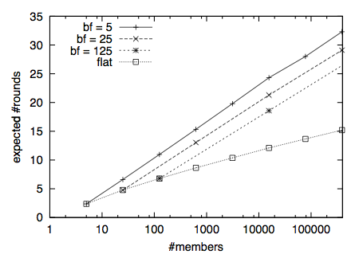
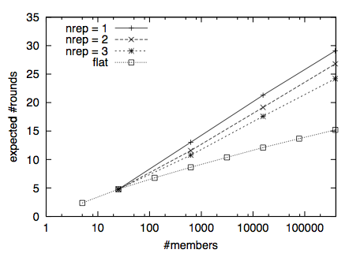
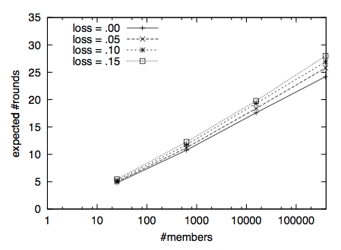
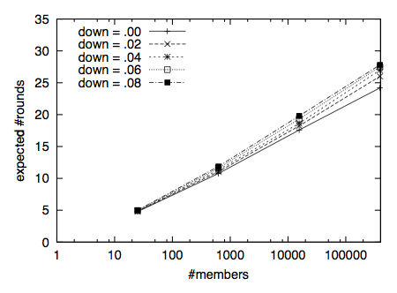
Average # of rounds necessary to infect all nodes

Slide 69
CONCLUSION
Tree-based gossip protocol
Robust and scalable
Eventual Consistency

Slide 70
Thank you

